Slide 1
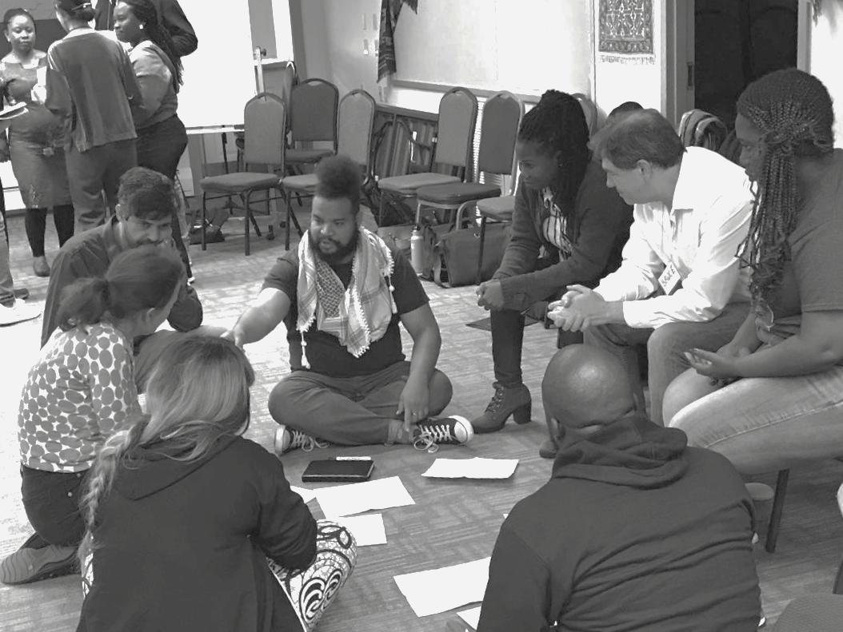

Applying Restorative Practices in
Higher Education
2023
January 12th
Center for Restorative Practices
Amherst College x WIHEA: RJ in HE Seminar Series

Slide 2
Session Agenda
Founding the Center for Restorative Practices | Allen
2. Working with Athletics | Yaqui
3. Utilizing Student Labor | Ji
4. Circle Programming & Circle Training | Fabio
5. Harm Repair | Susie
6. Questions and Answers
All
2023 Amherst College ODEI Center for Restorative Practices

Slide 3
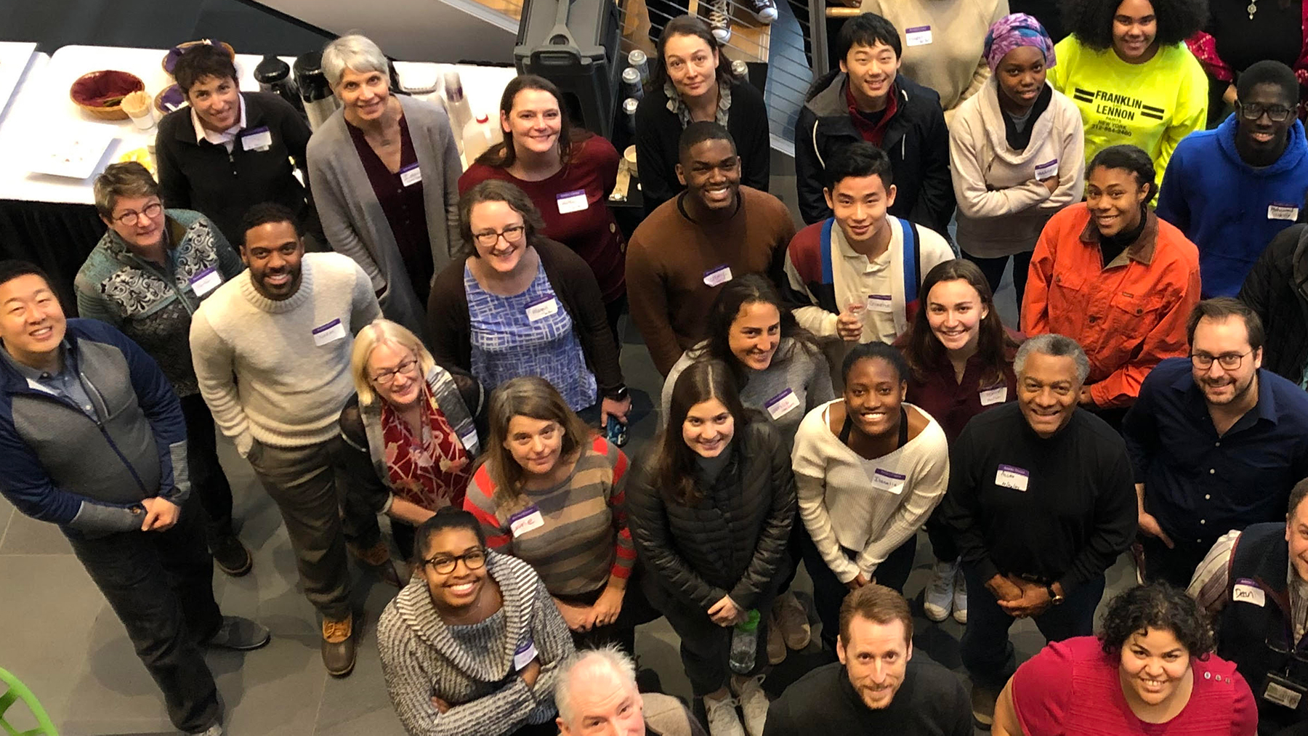
Our Start: The Center for Restorative Practices

Slide 4
FOUNDING A CENTER
Institutional Ingredients
Student Activism
History, Aspirations, Mission
Students as Catalysts for Change
Administrative Buy-in & Support
Students as drivers of the work
(Non)Linear progress
Outcomes
Sustainability
Work in Progress, Adaptability
Becoming a Restorative Community
2023 Amherst College ODEI Center for Restorative Practices

Slide 5
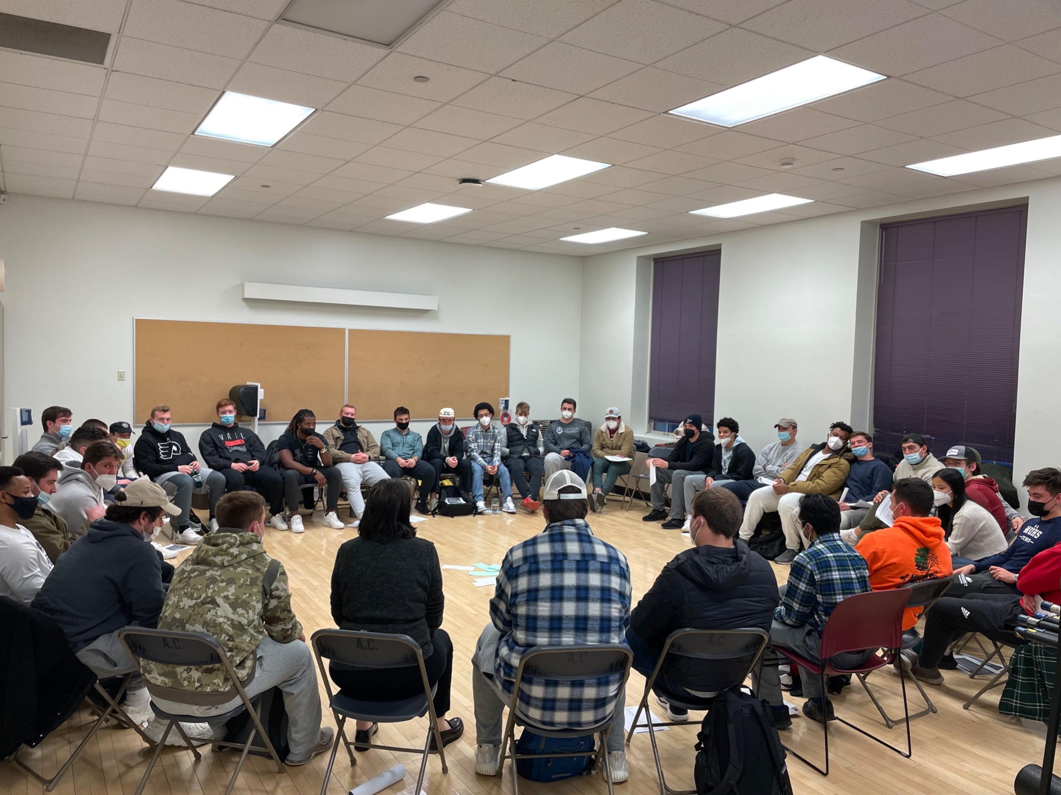
2. Circle Work With Athletics On Campus
2023 Amherst College ODEI Center for Restorative Practices

Slide 6
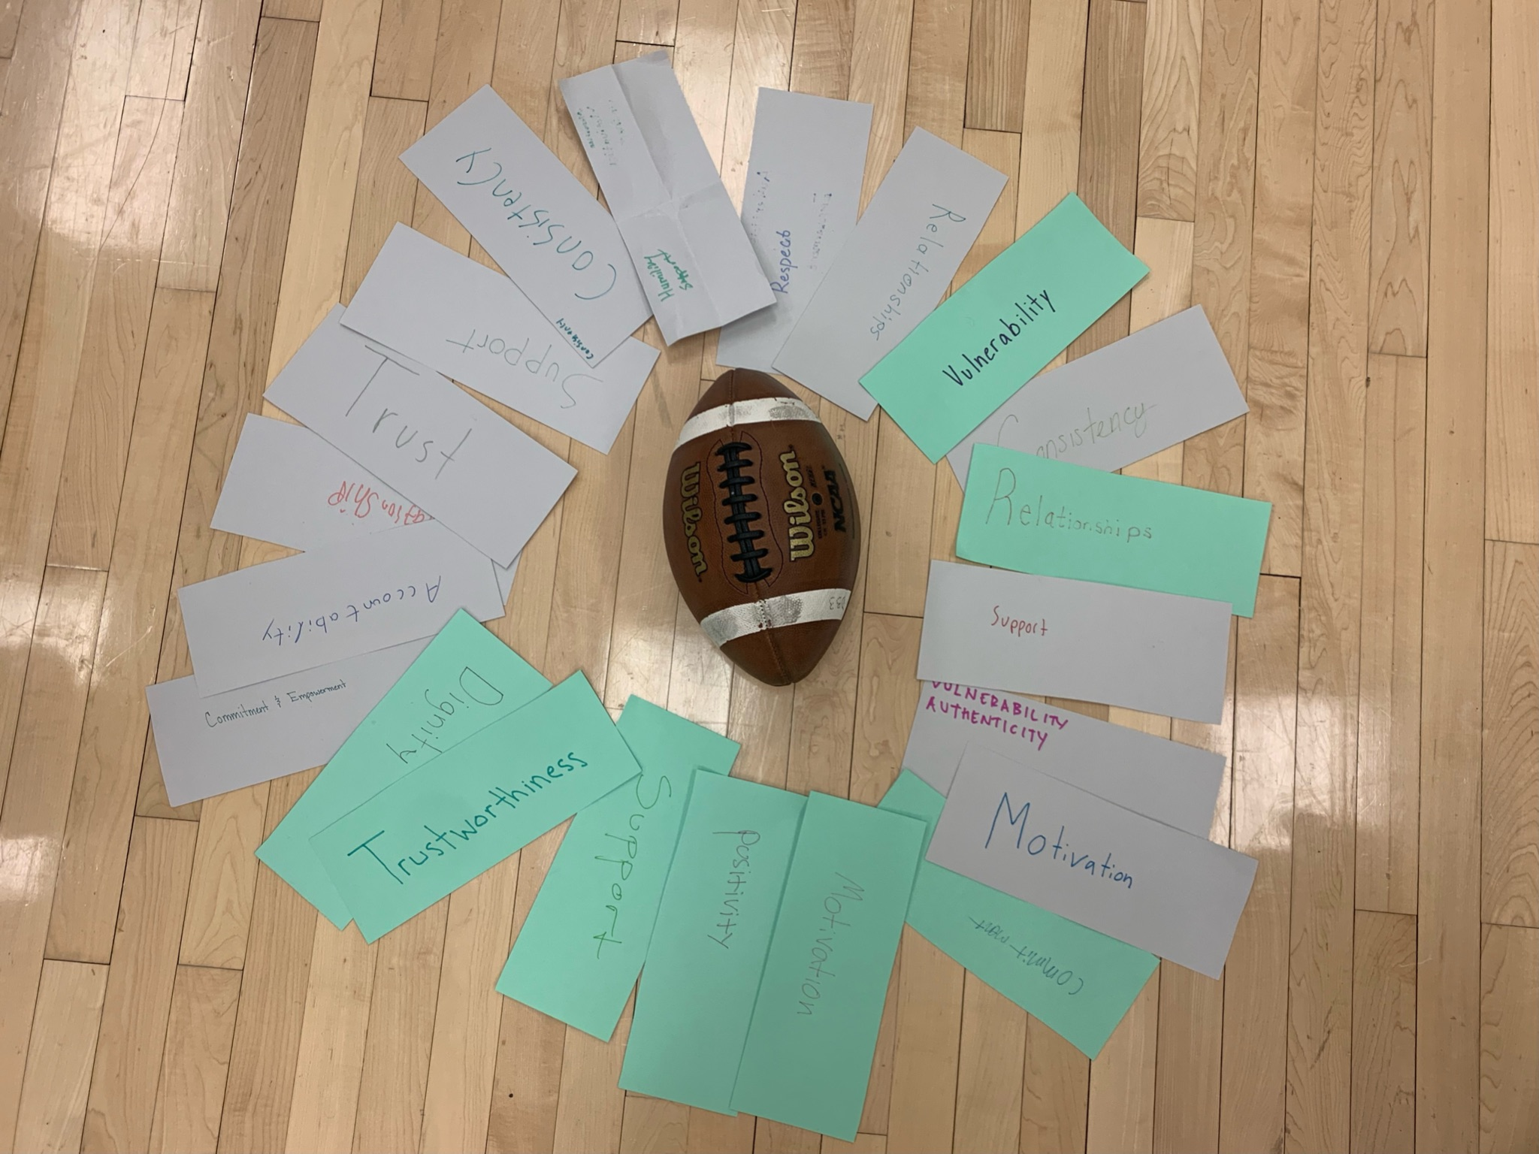
Circle Work With Athletics On Campus
4-Part Circle Curriculum
Storytelling
Team Values
Authenticity and Vulnerability
Celebration
2023 Amherst College ODEI Center for Restorative Practices

Slide 7
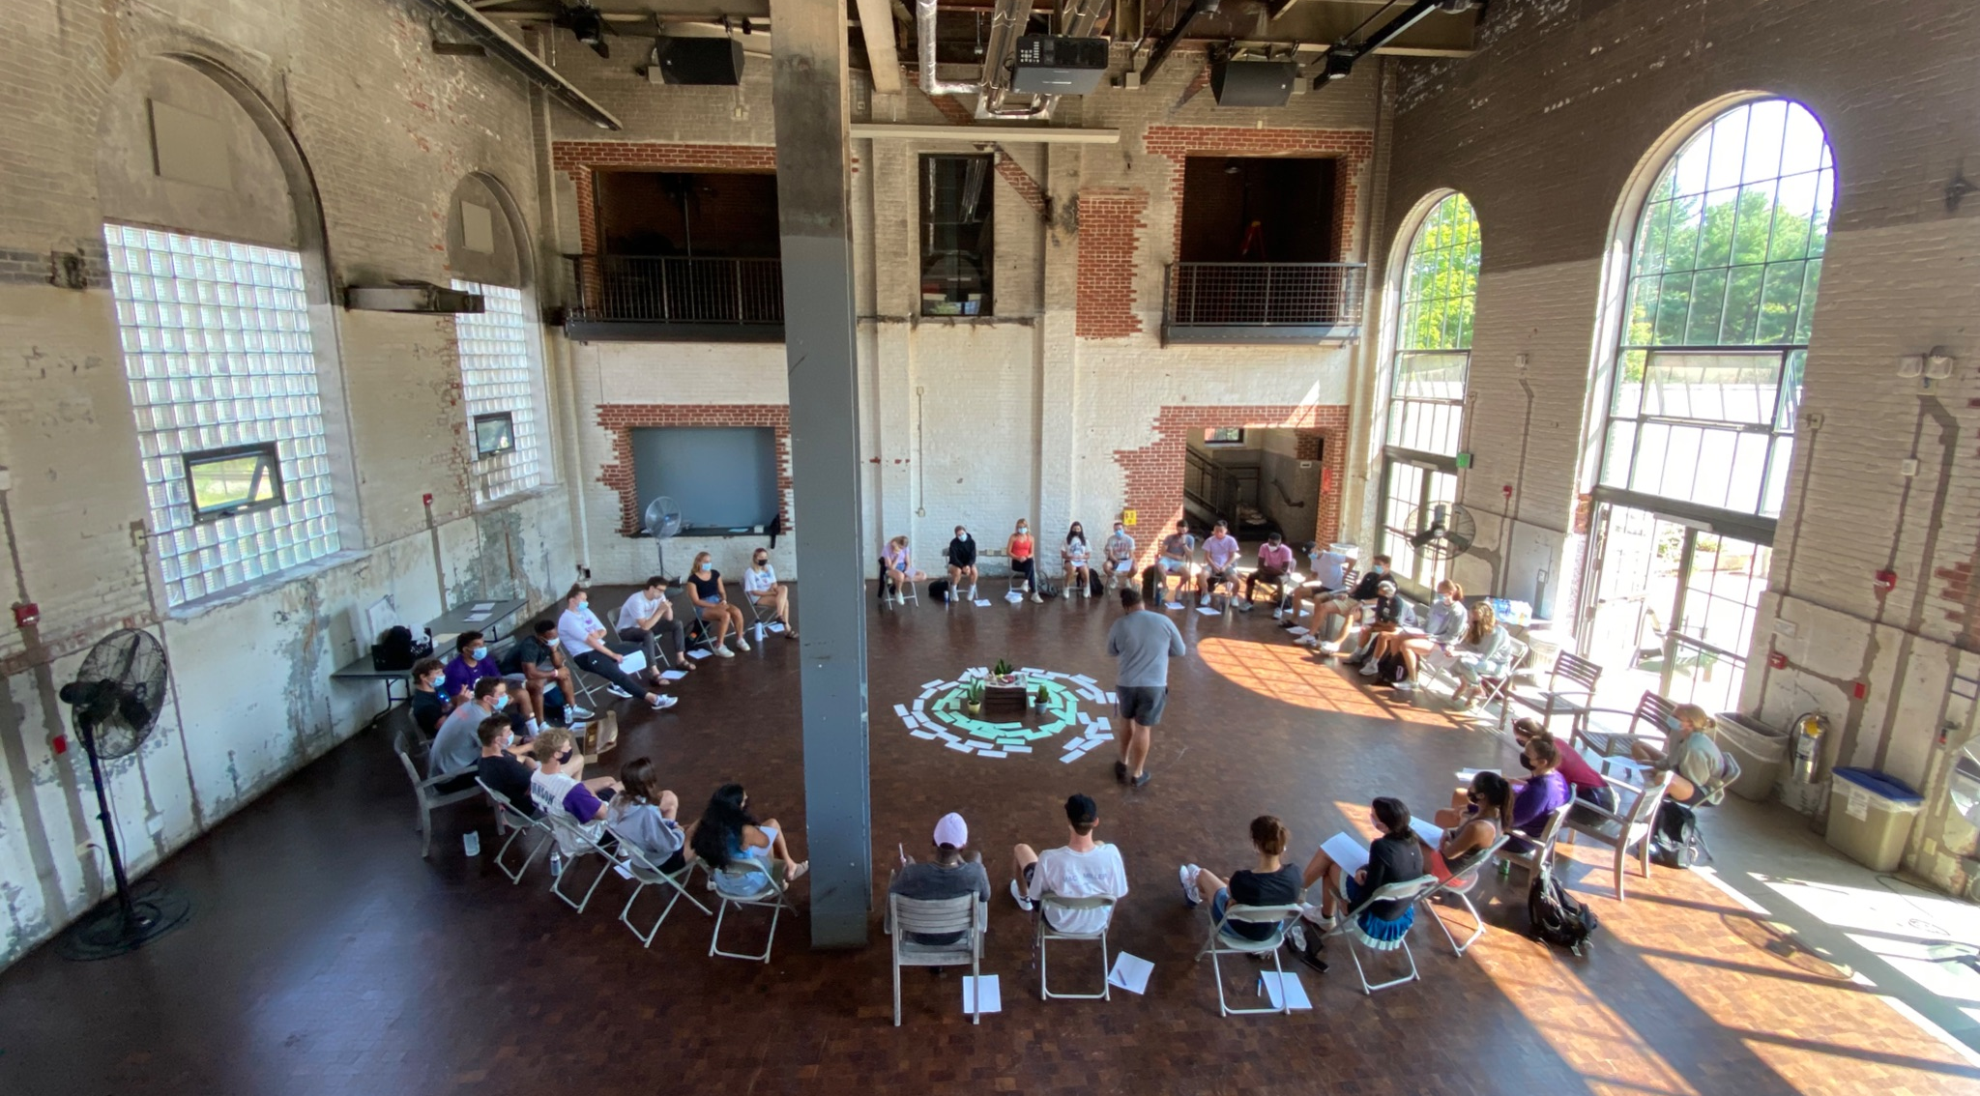
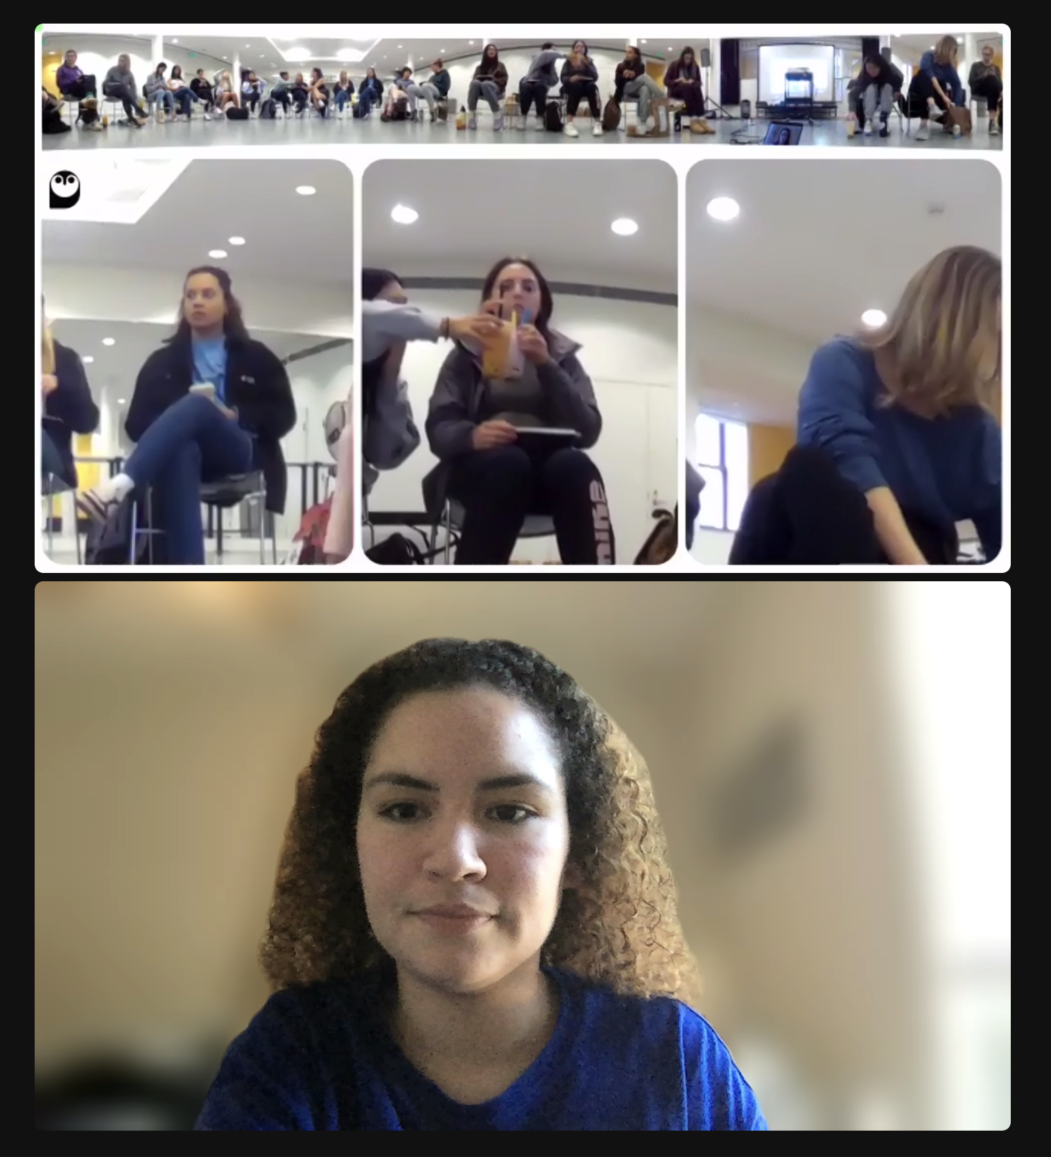
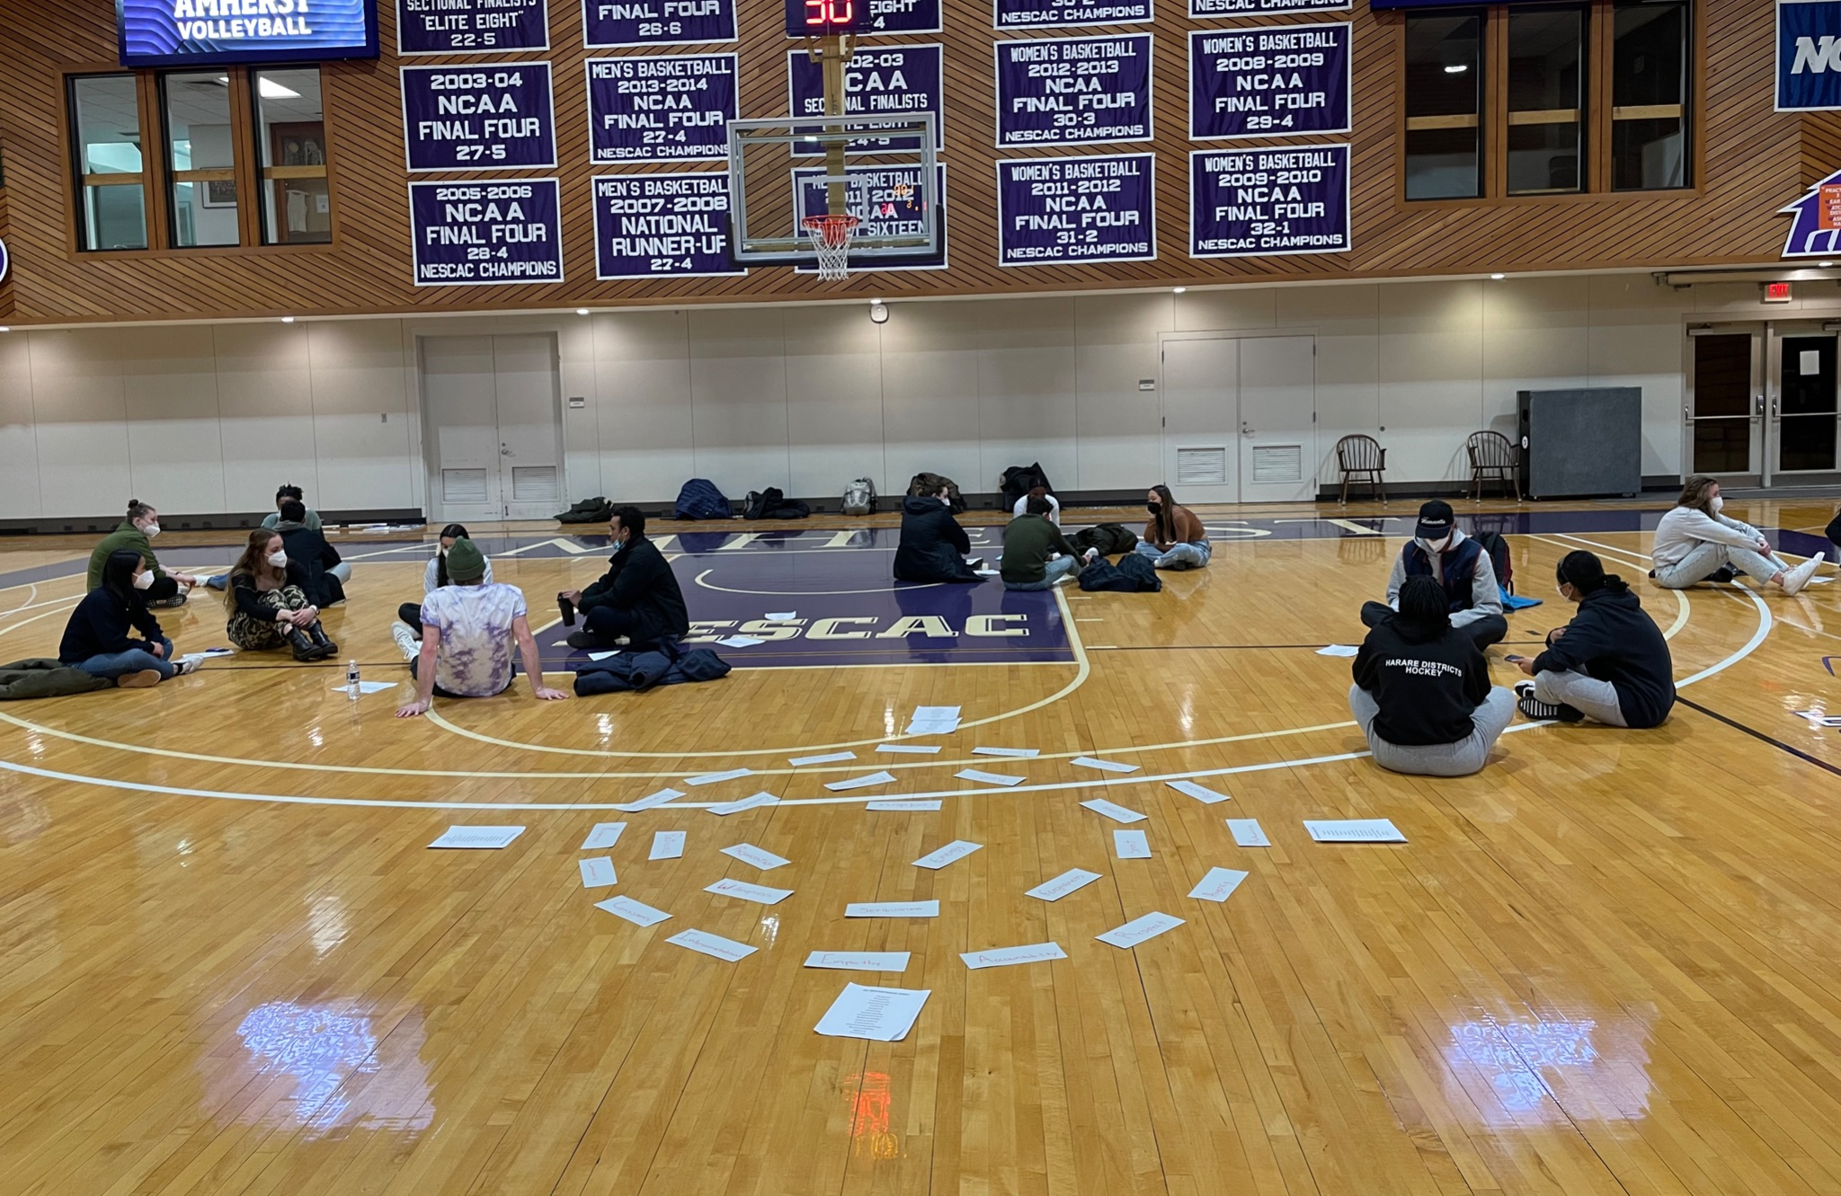
Circle Work With Athletics On Campus
2023 Amherst College ODEI Center for Restorative Practices

Slide 8






3. Working with Student Workers:
Restorative Supervision
2023 Amherst College ODEI Center for Restorative Practices

Slide 9
WORKING WITH STUDENT WORKERS
01
02
03
PROJECT MANAGEMENT
INTERPERSONAL FACTORS
COMMUNICATION
Clear directions and deadlines
Opportunities to ask for help
Fair distribution of tasks
Clear professional and personal expectations and boundaries
Emphasis on interpersonal connection
Motivation and contribution
Honest communication
Lowering formality barriers
Modeling respectful and timely communication
2023 Amherst College ODEI Center for Restorative Practices
Notes:
Project Management
Sometimes projects have clear parameters, and I like organizing an email in a lab manual format with necessary resources, deadlines, and step-by-step instructions
When courses are in session and students are on campus, student interns are required to work in-person in our office for 2 of their 5 required hours. This ensures that I am available to answer questions as they come up while completing tasks, as well as making sure I can check in with each student.
Many of the tasks do not require constant supervision, so some of their 5 hours may be used to do weekly recurring tasks or other work that can be completed virtually and at any time.
I try to give each student 1 recurring task such as scheduling instagram posts or updating our linktree and website, and 1 more involved project that requires more critical thinking and provides learning opportunities.
Communication
As of now, I oversee most of the office’s interactions with student interns.
I’ve asked the students what form of communication they prefer, and most prefer text for time-sensitive communications and emails for longer messages
Formality can be a barrier to communication
Interpersonal/Motivational Factors
I try to be as clear as possible about how each small or large task contributes to the larger goals of the center, so that students know how exactly they are contributing and what impact their work has.
I’ve found that student workers can lose motivation easily when it feels like the work they do gets submitted and disappears into thin air.
I usually reach out to all the interns about projects, and see who is interested. I also like to encourage them to use these projects as opportunities to learn or practice new skills whether that’s excel formulas, automation, or digital media creation.

Slide 10
4 THINGS TO KEEP IN MIND
TIME
COMPENSATION
Academics over all else
Organization limits on student work
5/week, 2 of 5 in person
Compensation for student labor is an example of dedicating resources to this work: Money? Credits? Training/Courses Away?
HIRING
SKILLSET
Workload of advertising, onboarding, interviewing
Hiring criteria
Skills that are necessary vs helpful
Areas I could use help in?
2023 Amherst College ODEI Center for Restorative Practices
Notes:
Time
As of now we have 5 students interns, who are paid through our parent office to work up to 10 hours per week per person. We have one international student who is limited to 20 hours per week across all campus jobs, including the internship through our office.
This is important because students’ #1 priority is and should be academics. Our office has been trying to plan around midterm and final exams to accommodate both student and faculty in terms of participation in programming and work hours.
We ask that interns work an average of 5 hours per week, fluctuations are expected as students have varying academic workloads. We just ask that students keep track of their average hours and communicate honestly about any upcoming concerns about meeting their hours.
Interns are paid the college’s standard hourly rate for non-academic student workers in non-hazardous positions, slightly higher than Massachusetts state minimum wage
Compensation for student labor has been highlighted as a necessary step for institutionalized change
It is an explicit declaration of material support on behalf of the college to DEI initiatives
Provides students the opportunity to pursue jobs they are interested in without taking time away from other paid opportunities
Hiring
I chose to take responsibility for the hiring process because I knew I’d spend the most time working directly with students
I selected candidates based on our office’s goals for the year and what sort of manpower/skills would be necessary or helpful in achieving those goals.
For example, we had one candidate who was passionate about research, and another that had skills in data analysis. Our center agreed earlier in the year that we wanted to focus on quantitative assessment and analysis of our work, which led me to hire the students with excel/computer science skills

Slide 11
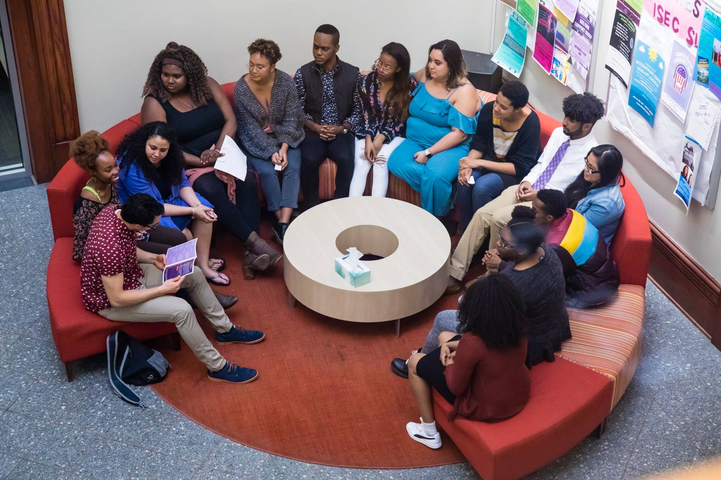
4. Restorative Circle Programming and Training

Slide 12
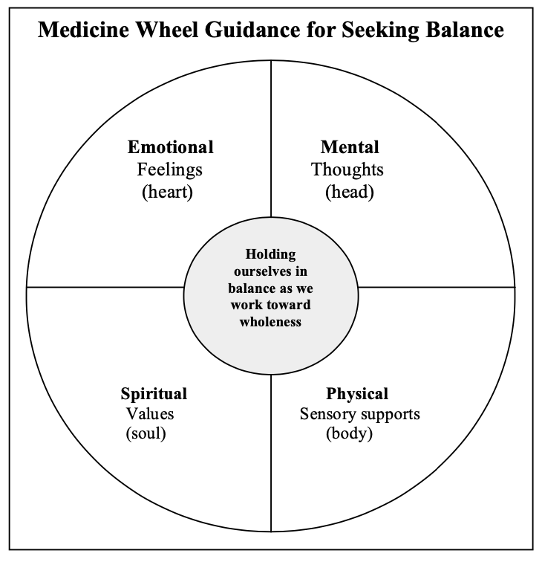
Our Circle Practice at Amherst is Grounded in the Tradition of the Medicine Wheel
Used by generations of various Native American Tribes, the medicine wheel is a visual representation of the cosmological belief that wholeness, or harmony is found in the balance of Head, Heart, Body, and Soul.
2023 Amherst College ODEI Center for Restorative Practices

Slide 13

Our “Hanger Model” Supports This Circle Practice at Amherst
What?
So What?
Now What?
2023 Amherst College ODEI Center for Restorative Practices

Slide 14

Different “Garments” Placed on our Hanger
Community Building
Reading Circle
Reflective Circle
Check In - If how you’re feeling was a color, what would it be and why?
Reflective Round #1 - Share a time in your life when you felt seen, respected, and appreciated for the gifts you brought.
Reflective Round #2 - What are some qualities you look for in supportive communities?
Reflective Round #3 - What is a gift you would like to give to the members of this circle community?
Resonance - Based on what you've heard so far, what is resonating with you?
Next Steps - What from our circle conversation do you want to take with you?
Check In - How are you coming into the circle today on a scale of 0-5? Why?
Reflective Round #1 - What are some of the things that came up for you while reading the assigned chapter?
Reflective Round #2 - What had real meaning for you from the reading, and why?
Reflective Round #3 - What more needs to be said, that hasn't been said already?
Resonance - Based on what you've heard so far, what is resonating with you?
Next Steps - What questions still feel unanswered?
Check In - If how you’re feeling was a landscape, what would it look like and why?
Reflective Round #1 - What is something you accomplished this semester that you are proud of?
Reflective Round #2 - What was a challenge you encountered this semester and a source of strength that got you through it?
Reflective Round #3 - What is something you learned this semester that you want to take with you into next year?
Resonance - Based on what you've heard so far, what is resonating with you?
Next Steps - How do we want to remember what we've shared today?
2023 Amherst College ODEI Center for Restorative Practices

Slide 15
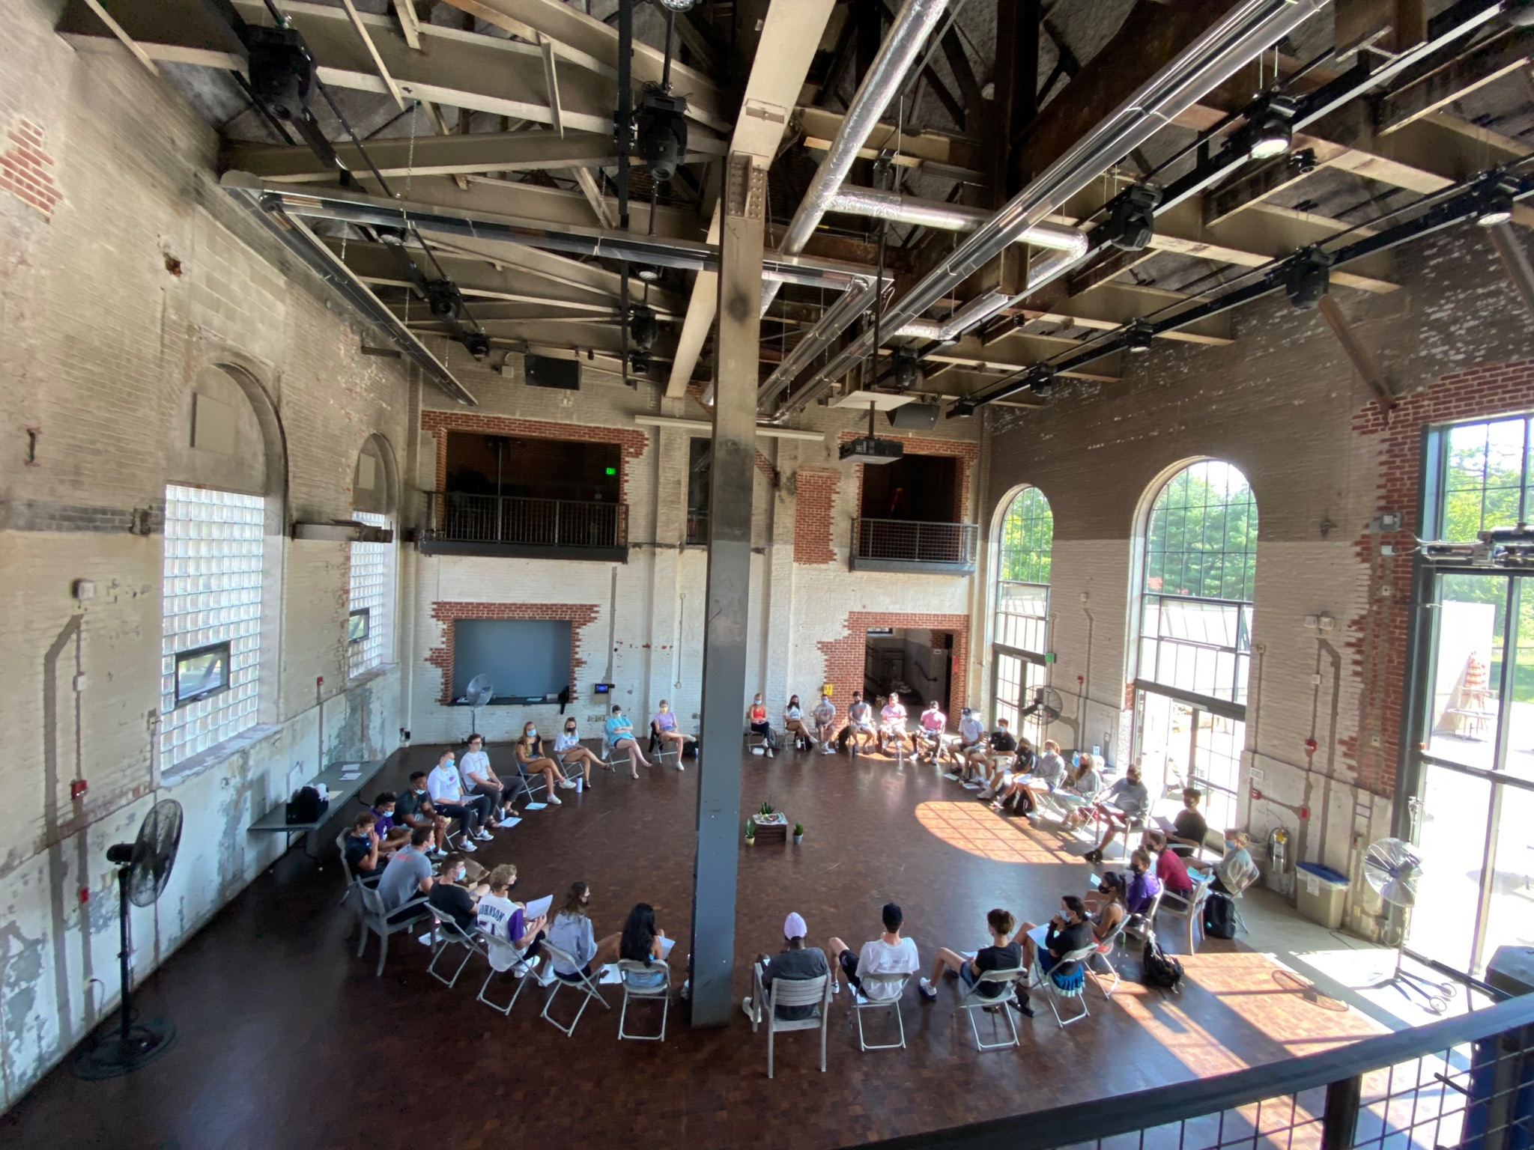
Circle Programming for Students, Staff, Faculty, Alumni, and Campus Partners
Proactive Circle Programing
Community Building Circles
STORYTELLING CIRCLES
HOPES & DREAMS - VISIONING CIRCLE
ACADEMIC CIRCLE - PRE & POST KNOWLEDGE SHARING
DISCUSSING DIFFICULT TOPICS WITH MULTIPLE OPINIONS
CO-CREATING EXPECTATIONS
CELEBRATION CIRCLE
2023 Amherst College ODEI Center for Restorative Practices

Slide 16
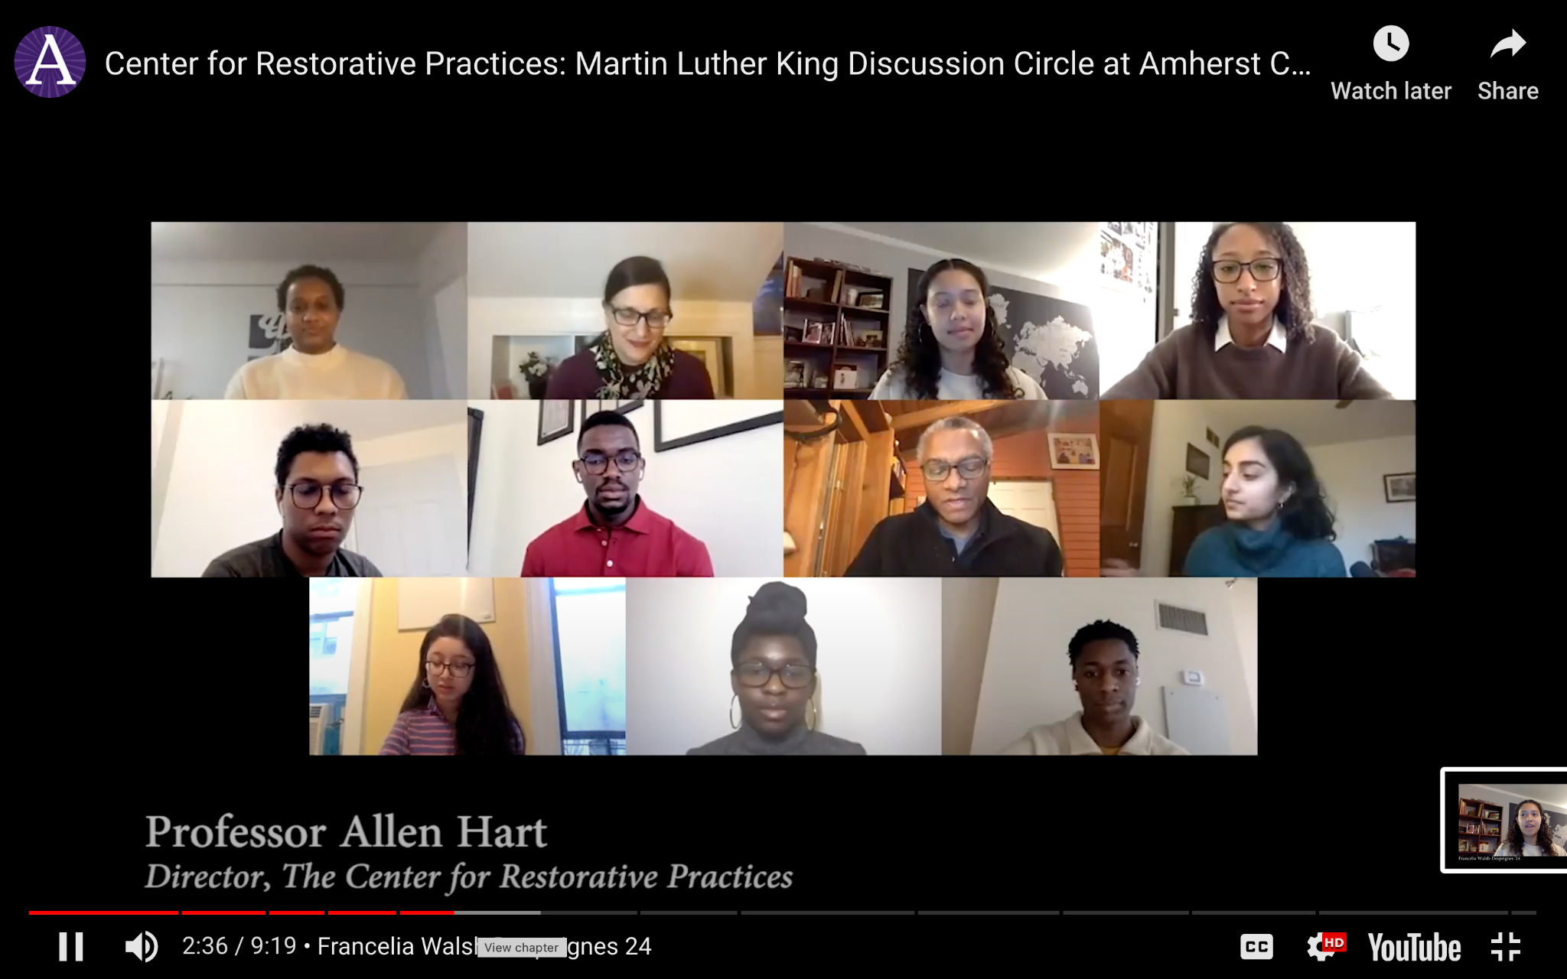
Circle Programming for Students, Staff, Faculty, Alumni, and Campus Partners
Proactive Circle Programing
Community Building Circles
Identity Based Circles
First Year and New Student Orientation Circles (Mammoth Circles)
Restorative Impact Circles
Themed Circles in Collaboration with Other Departments
Self-Care & Wellbeing Circles
Virtual / In-Person / Hybrid Options
2023 Amherst College ODEI Center for Restorative Practices

Slide 17
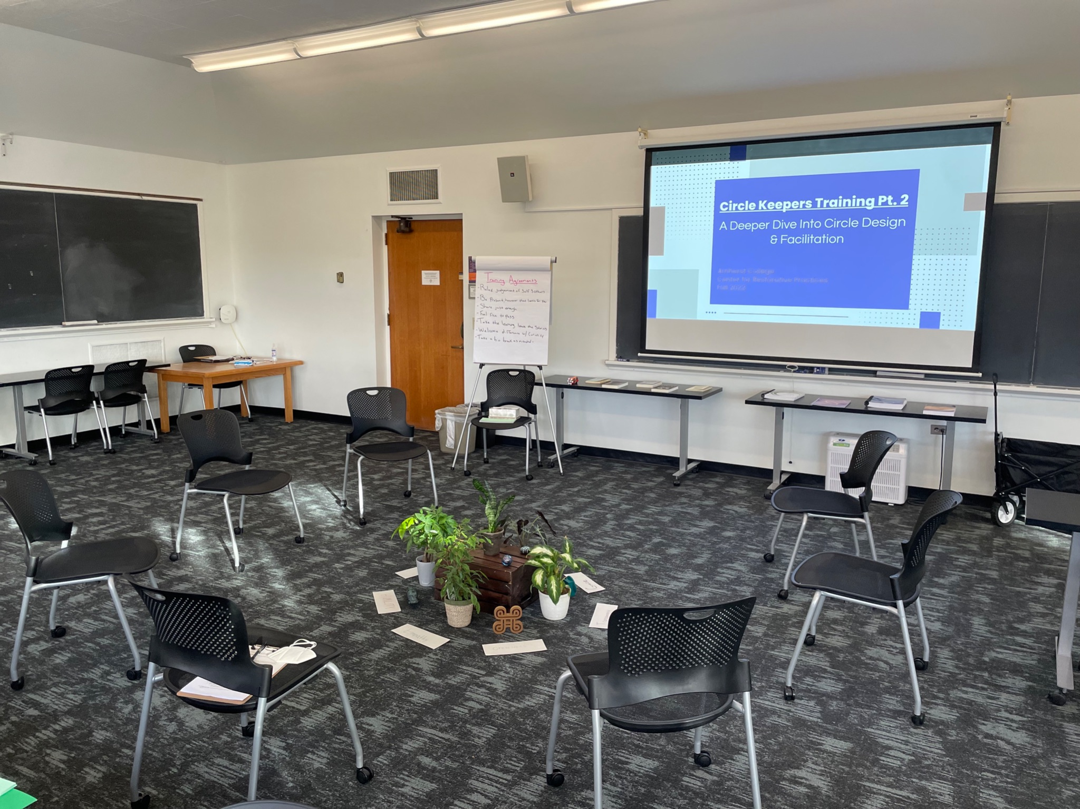
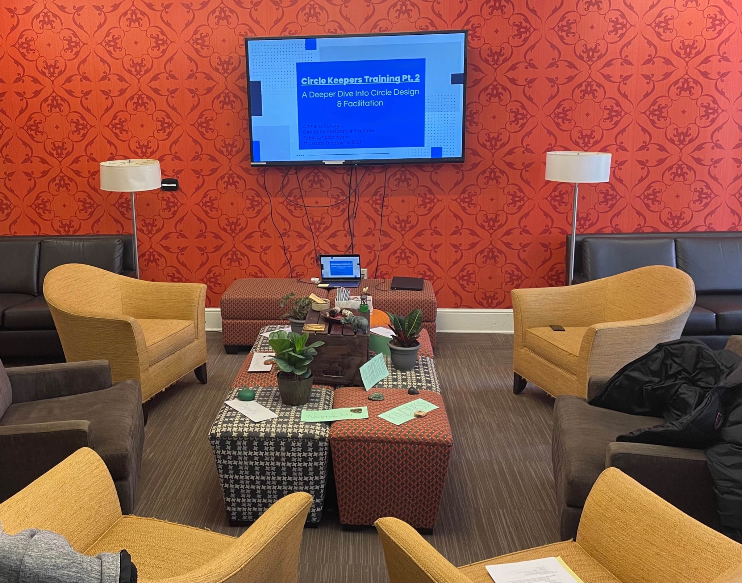
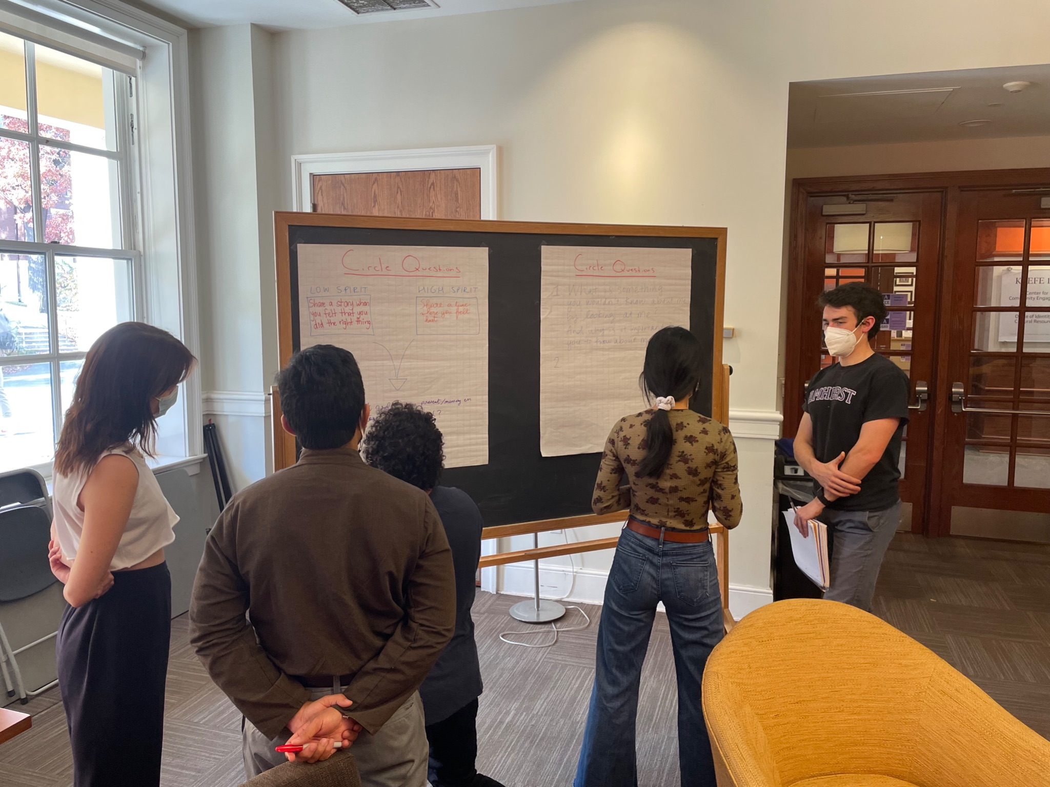
Circle Keeper Training for Student, Staff, Faculty, Alumni & Campus Partners
3-Part Experiential Circle Training Consisting of the Following:
Session #1 "Introduction to Circle & Circle Keepering"
Session #2 "A Deeper Dive into Circle Design & Facilitation"
  Resources Include: Circle Scripts, Design Templates, Circle Videos, Readings & RP Manuals
Circle Project
  Planning & Facilitating a Tier 1 Circle
Session #3 "Reflecting on Our Circle Work"
Post Training Support
2023 Amherst College ODEI Center for Restorative Practices

Slide 18
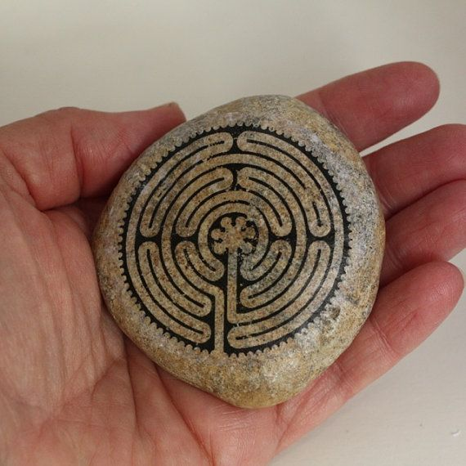
5. Restorative Harm Repair

Slide 19

Harm Repair with Students, Staff, Faculty and Alumni
Theory
Practice
Trainings/Workshops
Consultations On and Off Campus
Presentations at Conferences
1:1 Multipartial Mediation
Small Group Conferencing
Reparative Circles
Department-wide Restorative Programming Implementation
2023 Amherst College ODEI Center for Restorative Practices

Slide 20
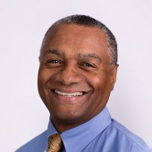



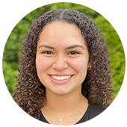
Questions & Answers
crp@amherst.edu
https://www.amherst.edu/offices/restorative-practices
@crpamherst
linktr.ee/centerforrestorativepractices
Please keep this slide for attribution
2023 Amherst College ODEI Center for Restorative Practices

