Slide 1


Compartmental Modelling
Dr Mike Chappell
M.J.Chappell@warwick.ac.uk
Structural Identifiability Analysis

Slide 2
What are compartmental models?
Consist of finite number of compartments
homogeneous, well-mixed, lumped subsystems
kinetically the same
Exchange with each other and environment
Inter-compartment transfers represent flow of material
Rate of change of quantity of material in each compartment described by first order ODE
principle of mass balance
AMR Summer School: Structural Identifiability Analysis

Slide 3
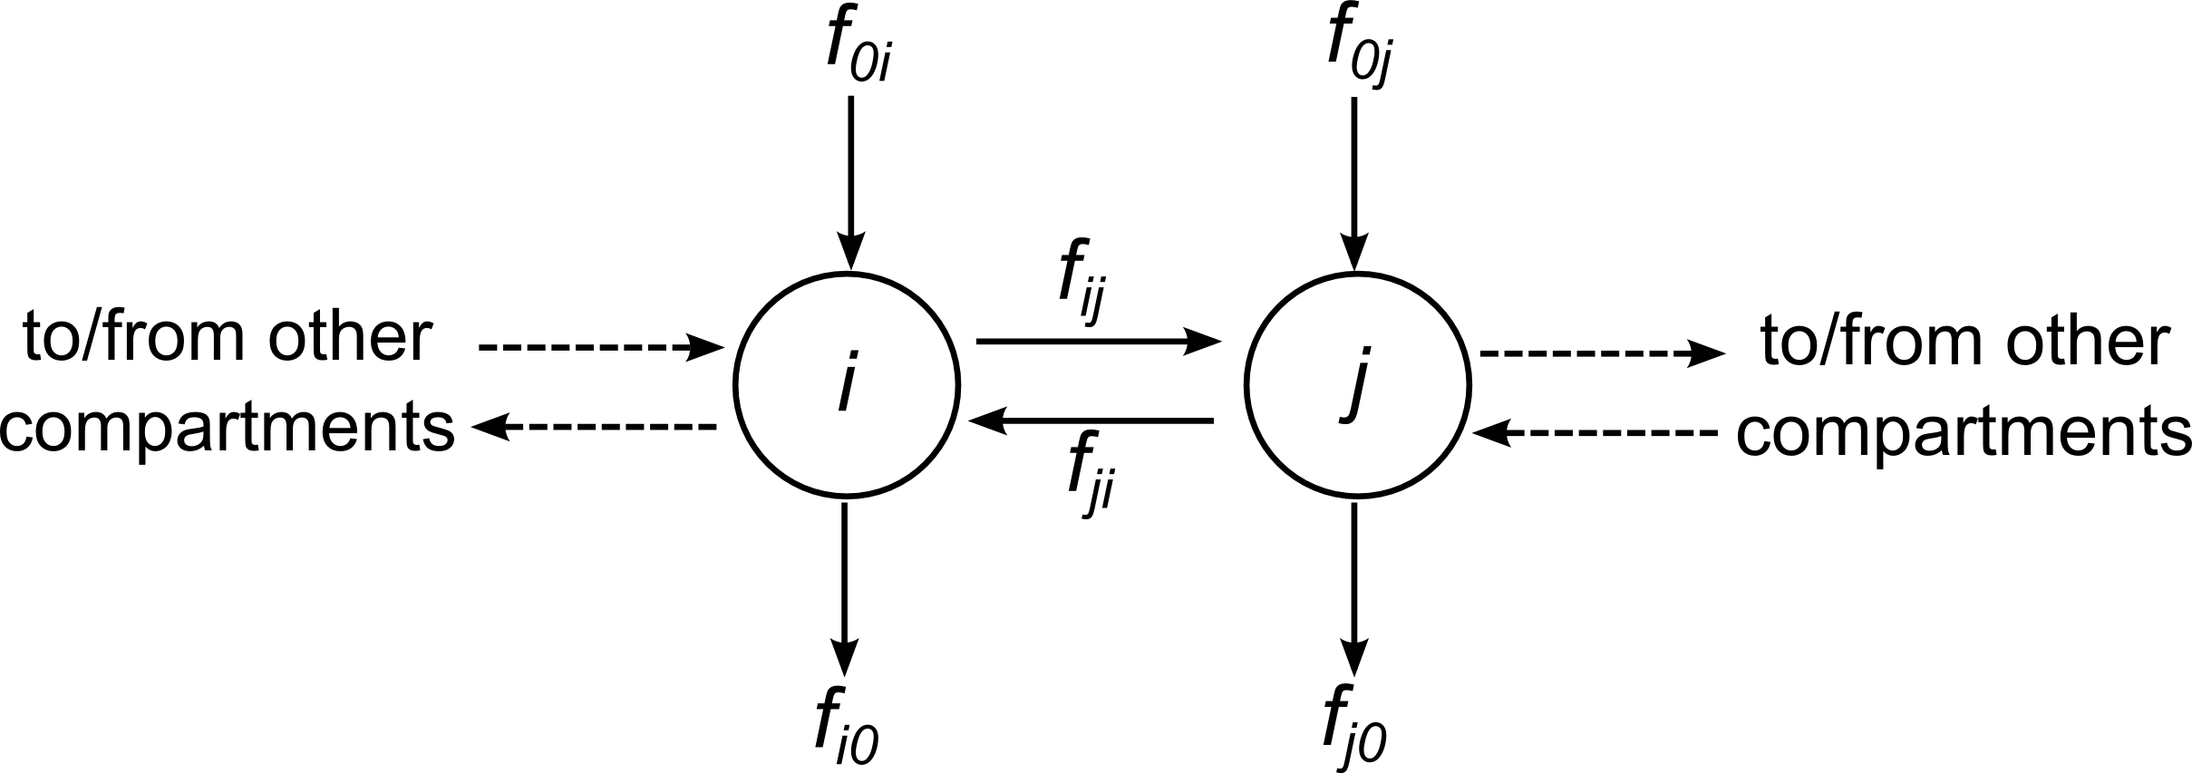
General form of system equations
where q_{i} denotes quantity in compartment i
f_{ij} denotes the flow rate coefficient from i to j
compartment 0 is external environment
AMR Summer School: Structural Identifiability Analysis

Slide 4
Areas of application of compartmental models
Used extensively in:
Pharmacokinetics and Anaesthesia (drug kinetics)
Biomedicine/Biomedical Control (Tumour Targeting)
Chemical Reaction Systems (Enzyme Chains, Nuclear Reactors)
Also:
Electrical Engineering (Lumped systems of transmission lines, filters, ladder networks)
Ecosystems (Ecological Models)
Neural Computing (Neural Nets)
Process Industries (Black Box Models)
AMR Summer School: Structural Identifiability Analysis

Slide 5
Linear (time-invariant) compartmental models
Flow rates, F_{ij} = f_{ij} q_{i}
directly proportional to amount of material in donor compartment, q_{i} (mathematically: f_{ij} = k_{ij})
does not depend on any other amounts
System equations:
where inflow rate f_{0i} has been written as an input/control function u_{i}(t) – external source of material
AMR Summer School: Structural Identifiability Analysis

Slide 6
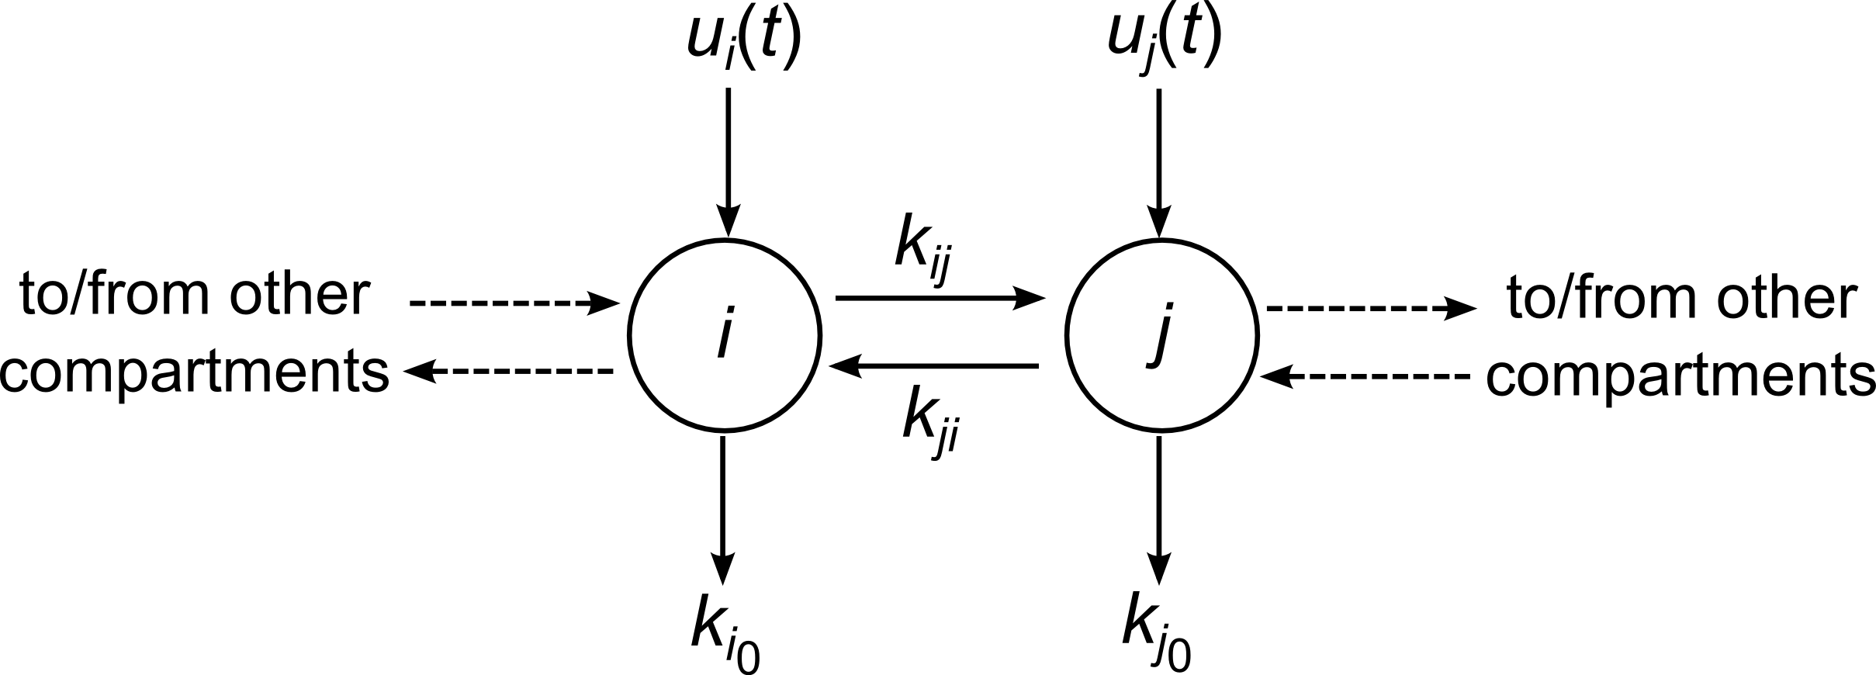
General form of system equations
Perhaps an oversimplification, but does provide (in general) good description of responses of many systems when small perturbation (ie: input) is made to system previously in steady state
AMR Summer School: Structural Identifiability Analysis

Slide 7
Common forms of input for pharmacokinetic models
Mathematical Term
u_{i}(t)
D_{i} δ(t) – impulsive input of size D_{i} at time t = 0
k_{0i} – constant input of size k_{0i} per unit of time
– repeated . impulsive inputs of size D_{ij} at times t_{j}
Pharmacokinetic Term
input or intervention
bolus injection of dose D_{i} .
constant infusion of drug, rate k_{0i} per unit of time
repeated bolus injections of dose D_{ij} at times t_{j}
AMR Summer School: Structural Identifiability Analysis

Slide 8
Rules for compartmental models
General rules
amounts can’t be negative (positive system), q_{i} ≥ 0
flows can’t be negative, f_{ij}(q)q_{i} ≥ 0
State space form:
can be written in form q´ = F(q)q + I
F(q) is compartmental matrix and satisfies
sum of terms down column i equals elimination from compartment i
diagonal terms are outflows from respective compartments – so not positive
off diagonal terms are inflows so not negative
AMR Summer School: Structural Identifiability Analysis

Slide 9
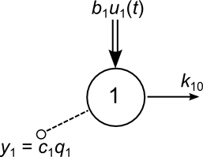
Example: One compartment model
Examples:
radioactive substance (decay)
systemic blood & perfused tissue
System equations
with observation
(c₁ is observation gain)
AMR Summer School: Structural Identifiability Analysis

Slide 10
Example: One compartment model
System equations
Taking Laplace transforms and rearranging
the transfer function relating input to output
AMR Summer School: Structural Identifiability Analysis

Slide 11
Example: One compartment model
Transfer function:
Impulsive input, u₁(t) = D₁δ(t)
Constant input, u₁(t) = k₀₁
AMR Summer School: Structural Identifiability Analysis

Slide 12
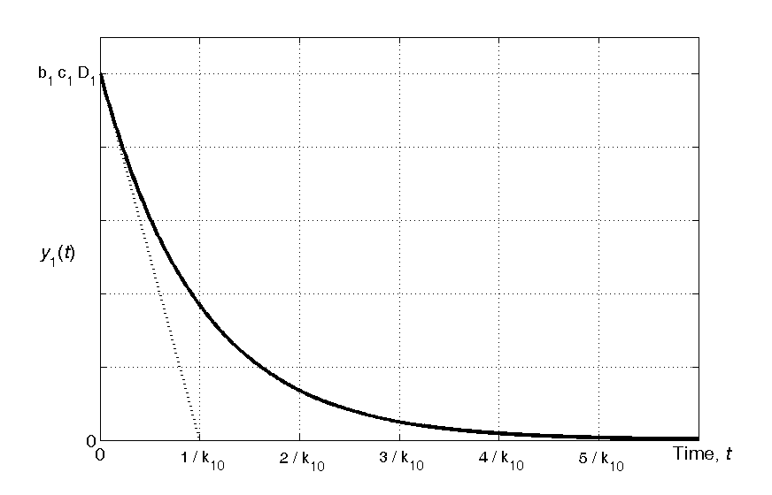
Example: One compartment model
Observed impulse response of one compartment model
AMR Summer School: Structural Identifiability Analysis

Slide 13
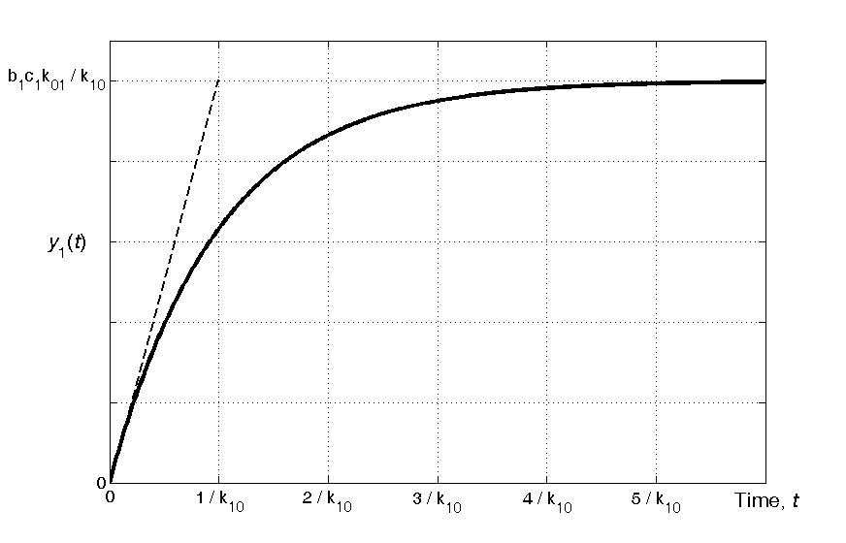
Example: One compartment model
Observed step (constant infusion) response of one compartment model
AMR Summer School: Structural Identifiability Analysis

Slide 14
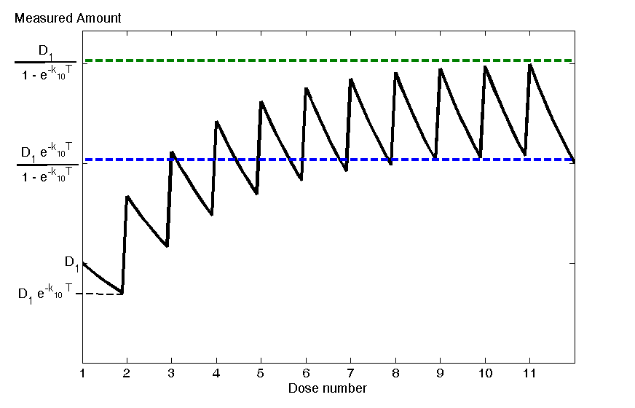
Example: One compartment model
Observed response of one compartment model with repeated bolus injections of size D₁ repeated at regular intervals of T
AMR Summer School: Structural Identifiability Analysis

Slide 15
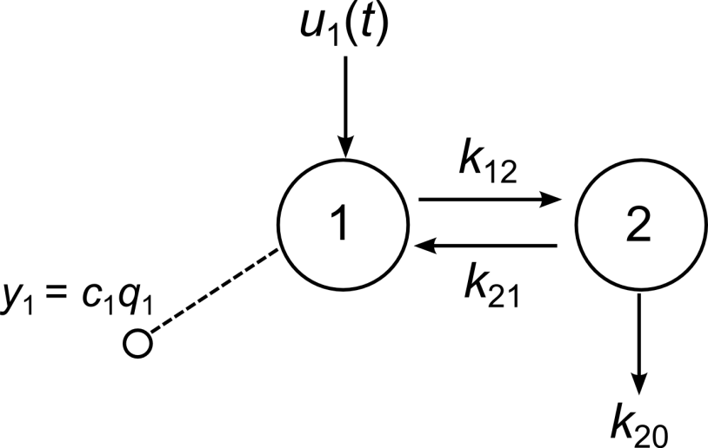
Exercise: Two compartment model
System equations
?????
with observation
?????
(c₁ is observation gain)
AMR Summer School: Structural Identifiability Analysis

Slide 16
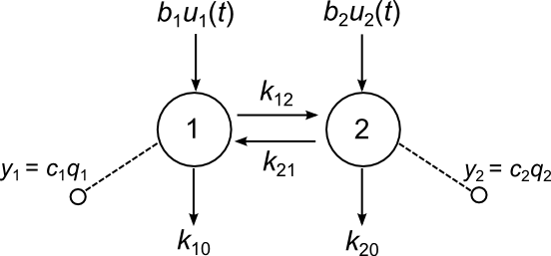
Example: Two compartment model
System equations
with observation
(c_{i} are observation gains)
AMR Summer School: Structural Identifiability Analysis

Slide 17
Example: Two compartment model
System equations
These can be rewritten in vector-matrix state-space form:
for matrices A, B and C; and so the Transfer Function is given by C (sI – A)⁻¹ B
AMR Summer School: Structural Identifiability Analysis

Slide 18
Example: Two compartment model
System equations
Note:
So a_{ij} = k_{ji} (i ≠ j) – off diagonal terms
Diagonal terms:
AMR Summer School: Structural Identifiability Analysis

Slide 19
Example: Two compartment model
Impulsive input
Suppose u₁(t) = D₁δ(t) (and u₂(t) = 0)
Constant infusion
Suppose u₁(t) = k₀₁ (and u₂(t) = 0)
AMR Summer School: Structural Identifiability Analysis

Slide 20
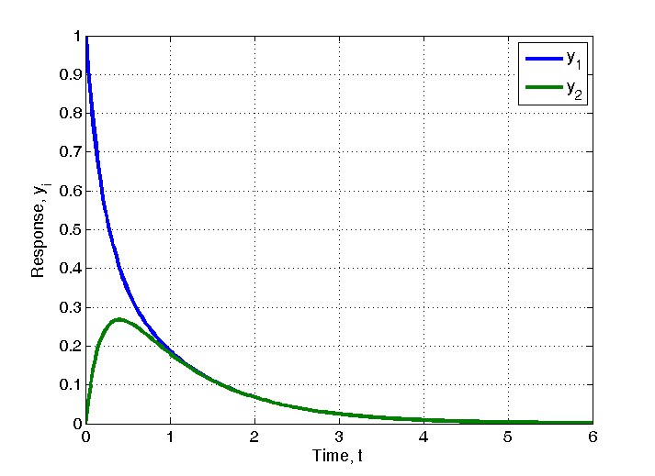
Example: Two compartment model
Observed response of two compartment model with impulsive input to compartment 1 (impulse response)
AMR Summer School: Structural Identifiability Analysis

Slide 21
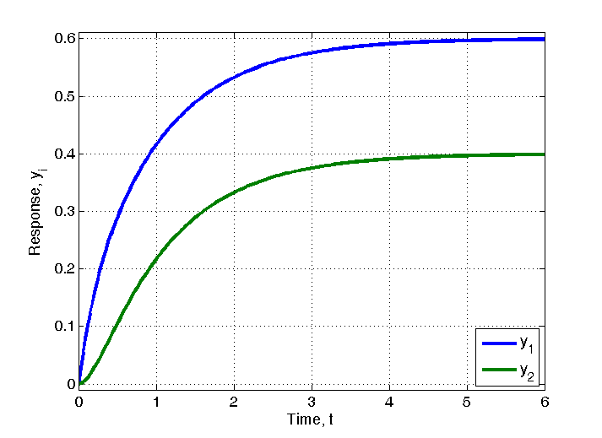
Example: Two compartment model
Observed response of two compartment model with constant input to compartment 1 (step response)
AMR Summer School: Structural Identifiability Analysis

Slide 22
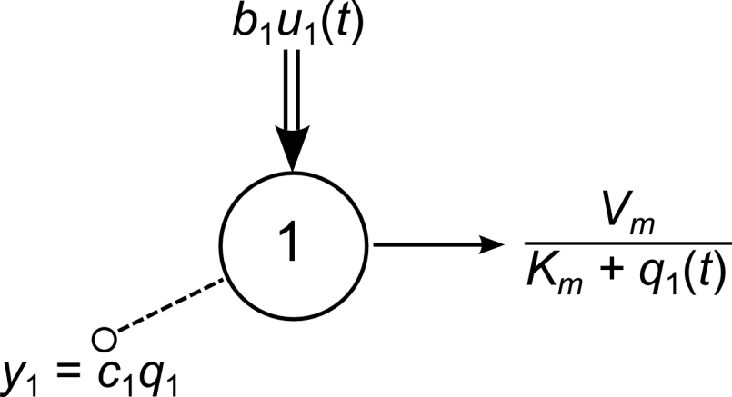
Example: One compartment nonlinear model
System equation
Note: Elimination (Michaelis-Menten) saturates
Impulsive input: u₁(t) = D₁δ(t), treat as q₁(0⁺) = D₁
No explicit analytical solution for q₁(t)
AMR Summer School: Structural Identifiability Analysis

Slide 23
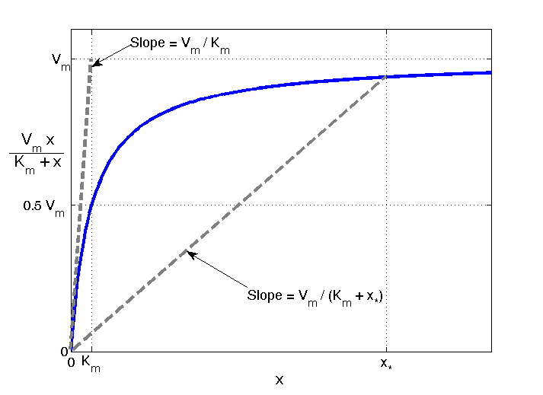
Michaelis-Menten saturation curve
AMR Summer School: Structural Identifiability Analysis

Slide 24
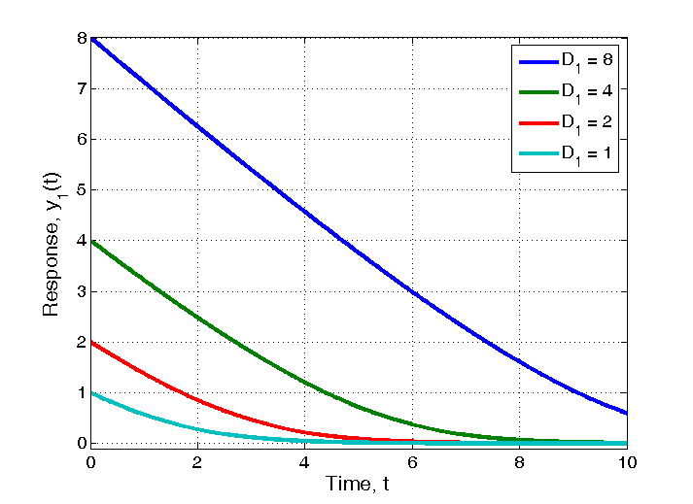
Input response under nonlinear elimination
Impulse response of one compartment nonlinear model with varying input (K_{m} = V_{m} = b₁ = c₁ = 1)
AMR Summer School: Structural Identifiability Analysis

Slide 25
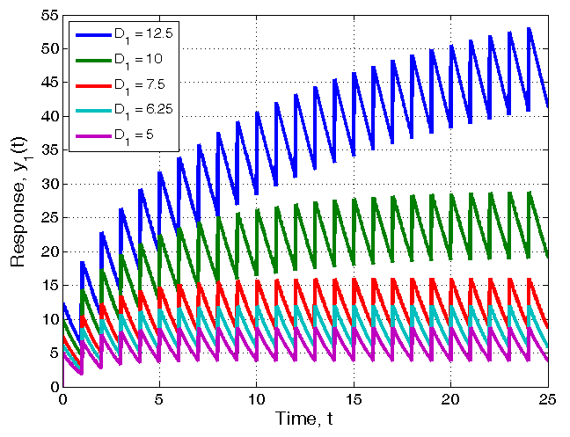
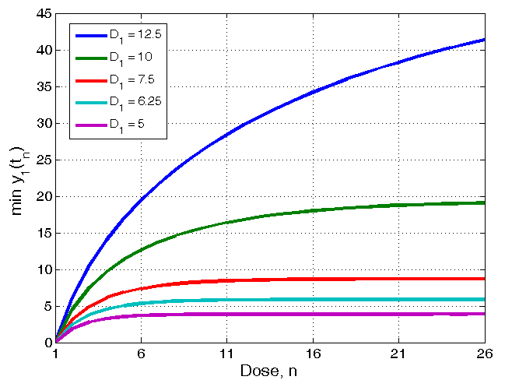
Repeated impulsive inputs under nonlinear elimination
Response to repeated impulsive inputs at regular intervals of 1 time unit with varying input (K_{m} = 12, V_{m} = 15, b₁ = c₁ = 1)
(adapted from K. Godfrey. Compartmental Models and their Applications, 1983)
AMR Summer School: Structural Identifiability Analysis

Slide 26
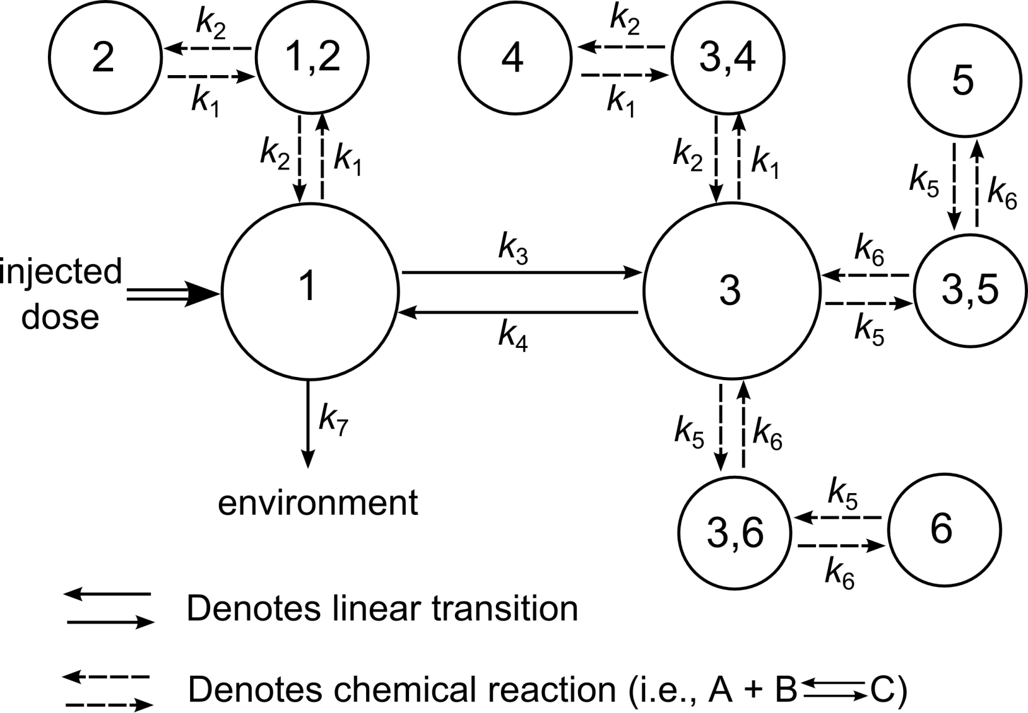
Model for Tumour Targeting
AMR Summer School: Structural Identifiability Analysis

Slide 27
Other important considerations
Identifiability of unknown system parameters
Given postulated system model, values for some of parameters (eg rate constants) may not be known
Identifiability is a theoretical analysis of whether these parameters may be uniquely determined from perfect input/output data
Linear systems – relatively straightforward
Nonlinear systems – fewer methods, complex
Parameter estimation (the real situation)
AMR Summer School: Structural Identifiability Analysis

Slide 28
Other important considerations
Parameter estimation (the real situation)
It may be necessary/instructive to actually calculate estimates for unknown parameter values for postulated model from real data (actual measurements/observations)
Generally performed using computer packages which employ linear/nonlinear regression techniques
Practical problems for Pharmacokinetic Models:
Few Data Points (eg blood samples)
Inaccuracy of Measurement – method of collection (eg urine samples)
Measurement Noise
AMR Summer School: Structural Identifiability Analysis

Slide 29
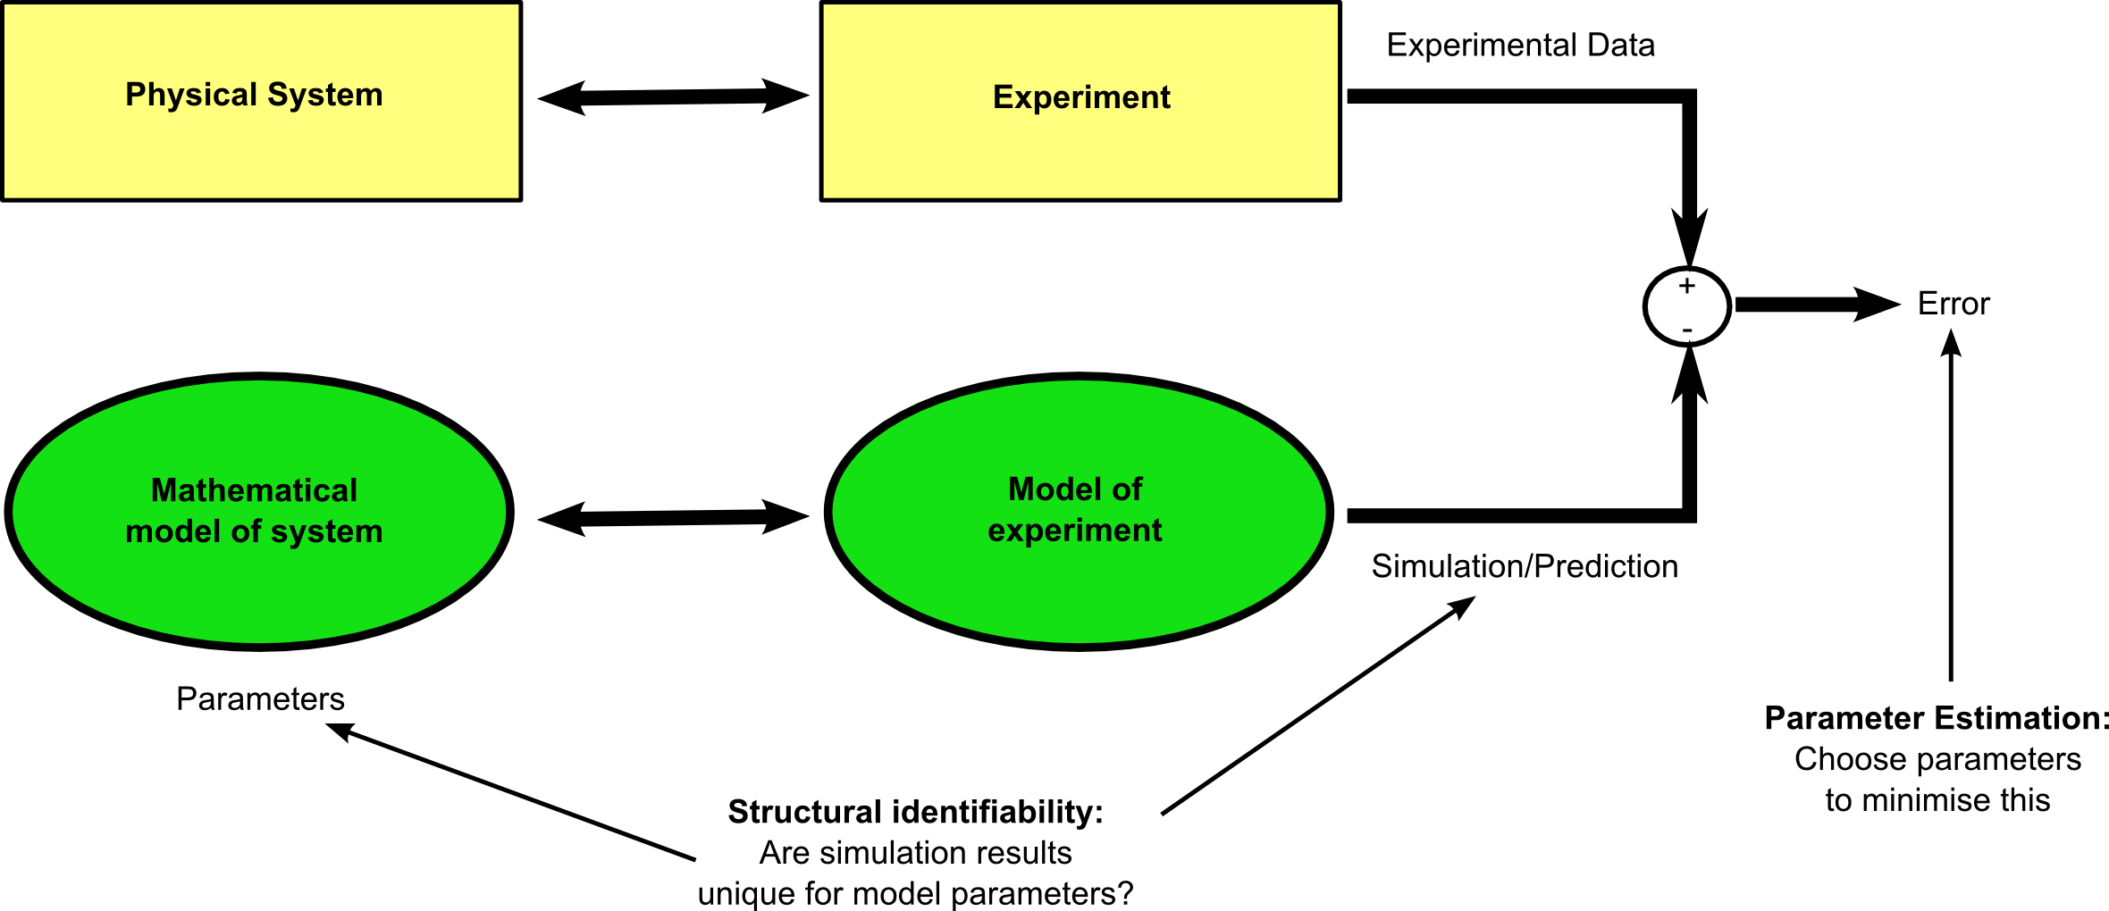
AMR Summer School: Structural Identifiability Analysis

