Slide 1

University of Warwick: AMR Summer School 4th-6th July, 2016 Structural Identifiability Analysis Dr Mike Chappell, School of Engineering, University of Warwick. Laplace Transforms
DR. MIKE CHAPPELL
OFFICE: D216 - Email: M.J.Chappell@warwick.ac.uk

Slide 2
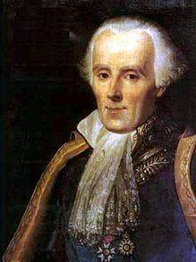
Pierre-Simon LAPLACE
1749-1827
2

Slide 3
LAPLACE TRANSFORMS
For a piecewise continuous function f (t), t≥0
the Laplace Transform is defined as:
Often denoted by
An integral transform: transforms
Note: The transform only exists when the improper integral (*) exists (i.e. is finite)
(*)
LAPLACE TRANSFORM
3

Slide 4
Examples
What is the Laplace transform of ( k constant, t≥0)
By definition:
(Note: exists for s>0)
LAPLACE TRANSFORM - EXAMPLE
4

Slide 5
Examples
(2) What is the Laplace transform of (t≥0)
By definition:
(Note: exists for s>a)
Only a function of s
LAPLACE TRANSFORM - EXAMPLE
5

Slide 6
Laplace Transform pairs
If then by taking inverses we can, knowing F(s),
obtain f (t)
and give a Laplace Transform pair
Both satisfy linearity conditions:
For inverses:
The Laplace transform pairs for the most common cases are given in Tables (in the textbook and more importantly in your Data Books)
( k constant)
( α constant)
LAPLACE TRANSFORM PAIRS
6

Slide 7
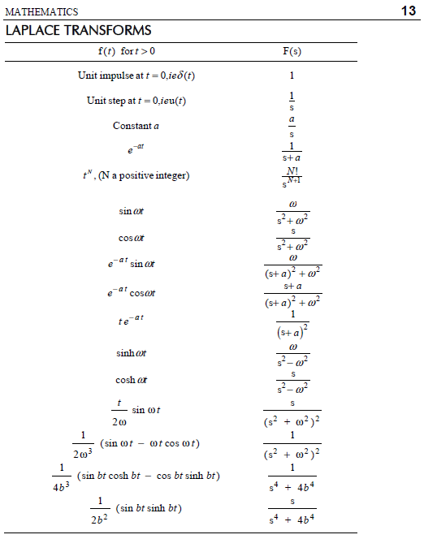
LAPLACE TRANSFORM PAIRS
7

Slide 8
Examples:
Find the Laplace Transforms of:
(1) Note:
Tables give Laplace transform of e^{at} :
So a=2
(2)
Tables give Laplace transform sinωt :
Here ω=3
LAPLACE TRANSFROM - EXAMPLE
8

Slide 9
Examples:
(3) From Tables:
So a=5, ω=3
(4)
By linearity:
Solving from Tables:
LAPLACE TRANSFORM - EXAMPLE
9

Slide 10
Examples:
Find the Inverse Laplace transforms of:
(1) from Tables:
So a=5
(2) from Tables:
So N=2
INVERSE LAPLACE TRANSFORM - EXAMPLE
10

Slide 11
Examples:
(3)
By Linearity
from Tables:
Hence
INVERSE LAPLACE TRANSFORM - EXAMPLE
11

Slide 12
Note:
You may need to use partial fractions; i.e. find
By partial fractions:
Let compare coeffs.
So
From tables:
INVERSE LAPLACE TRANSFORM - EXAMPLE
12

Slide 13
Note:
You may also need to use completing the square
i.e. find
Completing square gives:
From tables:
(Denominator will not factorise)
INVERSE LAPLACE TRANSFORM - EXAMPLE
13

Slide 14
Laplace Transform of Derivatives
Consider y(t) such that , what is ?
By definition
Use parts
So
So , similarly
LAPLACE TRANSFORM OF DERIVATIVES
14

Slide 15
Example:
If find given
Note: DIFFERENTIAL EQUATION BECOMES ALGEBRAIC
If . Take Laplace transforms, then (*) gives:
and taking the inverse Laplace transform to give y(t) yields:
No arbitrary constants, Immediate solution including i.c’.s
(*)
LAPLACE TRANSFORM OF DERIVATIVES - EXAMPLE
15

Slide 16
Solution for initial value problems
Solving linear ODEs with given initial conditions algebraically
Examples:
(1)
Take Laplace transforms on both sides of the equation:
Rearranging gives:
Taking inverse Laplace transforms gives:
SOLUTION OF INITIAL VALUE PROBLEMS
16

Slide 17
Examples:
(2)
Take Laplace transforms on both sides of the equation:
Using partial fractions
SOLUTION OF INITIAL VALUE PROBLEMS
17

Slide 18
Examples:
(2) (cont)
Using partial fractions:
i.e.
So
Taking inverse Laplace transforms gives:
SOLUTION OF INITIAL VALUE PROBLEMS
18

Slide 19
INTRODUCTION TO SYSTEMS THEORY
Consider system equation (1)
with observation/measurement (2)
Assume all initial conditions are zero (i.e. y(0)=y’(0)=0)
Take Laplace Transforms of (1) and (2) to give:
(3)
(4)
From (3)
Substitute for X(s) in (4) to give:
OR
The Transfer Function
(relates input to output)
INTRODUTION TO SYSTEMS THEORY
19

Slide 20
In block diagram form
Set to give the Fourier transform
INTRODUTION TO SYSTEMS THEORY OF FREQUENCY RESPONSE IN ES18
20

Slide 21
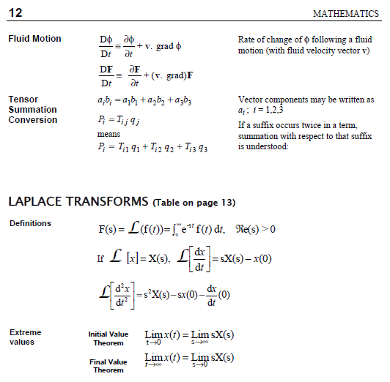
21

