Slide 1
AMR modelling and data analysis
Andrew Mead
Applied Statistics Group
NERC Environmental Microbiology and Human Health

Slide 2
Data
Samples from 13 sites on 4 occasions
Log Class 1 integron prevalence measured
Locations of 46 WWTPs relative to sampling sites
Only those upstream within a 10km radius
River distance from WWTP to sampling site
Classification of type for each WWTP
Population served by each WWTP
Percentage land cover data (LCM2007) around each sampling site (2km radius)
Rainfall data (period prior to sampling)

Slide 3
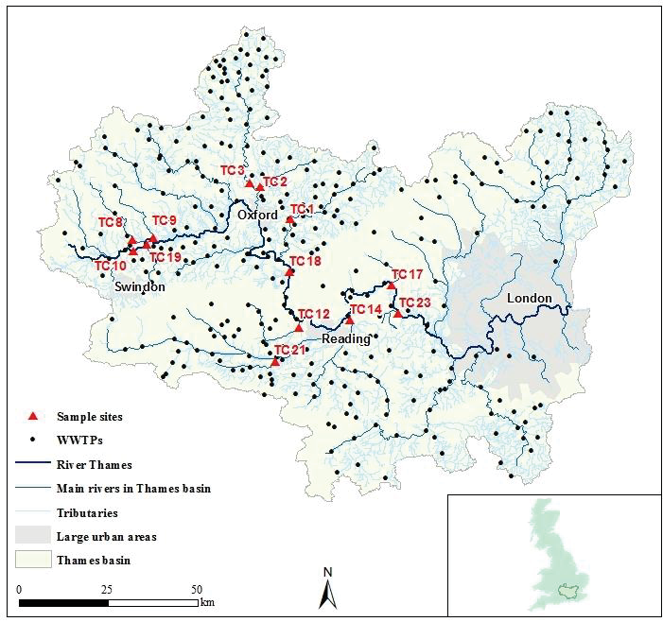
Sampling sites and WWTPs

Slide 4
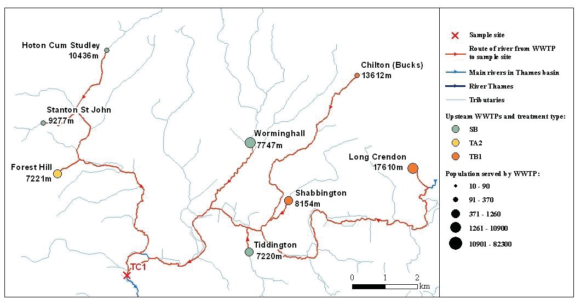
WTTP river distance and type

Slide 5
WWTP Data
Site Number | Distance (D) | Treatment type (t) | Population size (P)
1 | 10436 | 1 | 370
1 | 9277 | 1 | 300
1 | 7221 | 2 | 500
1 | 7747 | 1 | 3340
1 | 7220 | 1 | 720
1 | 8154 | 3 | 430
1 | 13612 | 3 | 250
1 | 17610 | 3 | 2250
2 | 13076 | 1 | 580
2 | 2602 | 1 | 4180
3 | 18212 | 1 | 331
3 | 9450 | 4 | 320
3 | 8064 | 1 | 570
4 | 12738 | 5 | 16500
4 | 9699 | 5 | 10900
5 | 9294 | 2 | 82300
6 | 17420 | 6 | 31300
6 | 13019 | 3 | 870
6 | 13148 | 1 | 4070
6 | 6981 | 1 | 2220
6 | 1035 | 1 | 6000
6 | 14489 | 1 | 920
6 | 27068 | 1 | 2530
7 | 10045 | 1 | 4010
7 | 3667 | 1 | 170
7 | 6547 | 3 | 1710
Site Number | Distance (D) | Treatment type (t) | Population size (P)
8 | 446 | 4 | 740
8 | 6611 | 1 | 1260
8 | 5753 | 1 | 500
8 | 5340 | 1 | 790
8 | 12014 | 2 | 39860
8 | 16844 | 1 | 220
9 | 13972 | 1 | 50
9 | 10526 | 1 | 620
9 | 9017 | 3 | 4080
9 | 10523 | 1 | 10
9 | 13144 | 1 | 332
9 | 7594 | 1 | 10
9 | 4865 | 1 | 40
9 | 9622 | 1 | 60
10 | 5892 | 1 | 5140
10 | 2953 | 2 | 65900
11 | 8667 | 1 | 900
12 | 7395 | 1 | 130
12 | 14248 | 1 | 90
12 | 13194 | 4 | 4140
13 | 0 | 0 | 0

Slide 6
LCM2007 land cover types
LCM2 007 class | LCM2007 class number | Broad Habitat sub-class
Broadleaved woodland | 1 | Deciduous
 |  | Recent (<10yrs)
 |  | Mixed
 |  | Scrub
‘Coniferous Woodland’ | 2 | Conifer
 |  | Larch
 |  | Recent (<10yrs)
 |  | Evergreen
 |  | Felled
‘Arable and Horticulture’ | 3 | Arable bare
 |  | Arable Unknown
 |  | Unknown non-cereal
 |  | Orchard
 |  | Arable barley
 |  | Arable wheat
 |  | Arable stubble
Improved Grassland’ | 4 | Improved grassland
 |  | Ley
 |  | Hay
Rough Grassland | 5 | Rough / unmanaged grassland
‘Neutral Grassland’ | 6 | Neutral
‘Calcareous Grassland’ | 7 | Calcareous
Acid Grassland | 8 | Acid
 |  | Bracken
‘Fen, Marsh and Swamp’ | 9 | Fen / swamp
Heather | 10 | Heather & dwarf shrub
 |  | Burnt heather
 |  | Gorse
 |  | Dry heath
Heather grassland | 11 | Heather grass
LCM2 007 class | LCM2007 class number | Broad Habitat sub-class
‘Bog’ | 12 | Bog
 |  | Blanket bog
 |  | Bog (Grass dom.)
 |  | Bog (Heather dom.)
‘Montane Habitats’ | 13 | Montane habitats
Inland Rock’ | 14 | Inland rock
 |  | Despoiled land
Salt water | 15 | Water sea
 |  | Water estuary
Freshwater | 16 | Water flooded
 |  | Water lake
 |  | Water River
‘Supra-littoral Rock’ | 17 | Supra littoral rocks
‘Supra-littoral Sediment’ | 18 | Sand dune
 |  | Sand dune with shrubs
 |  | Shingle
 |  | Shingle vegetated
‘Littoral Rock’ | 19 | Littoral rock
 |  | Littoral rock / algae
Littoral sediment | 20 | Littoral mud
 |  | Littoral mud / algae
 |  | Littoral sand
Saltmarsh | 21 | Saltmarsh
 |  | Saltmarsh grazing
Urban | 22 | Bare
 |  | Urban
 |  | Urban industrial
Suburban | 23 | Urban suburban
S

Slide 7
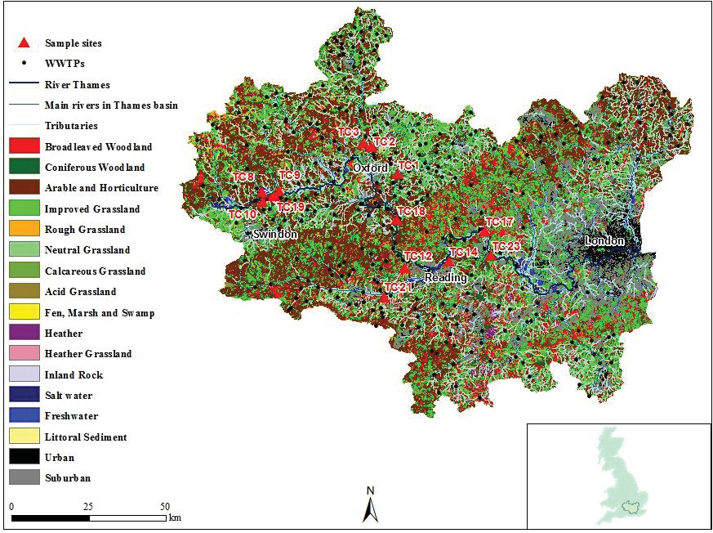
Land Cover (LCM2007)

Slide 8
Land cover percentages
 | LCM2007 classes
Site | 1 | 2 | 3 | 4 | 5 | 6 | 7 | 8 | 11 | 14 | 16 | 22 | 23
TC1 | 1.55 | 0.00 | 44.74 | 36.46 | 1.73 | 7.38 | 0.40 | 0.00 | 0.00 | 1.53 | 0.00 | 0.40 | 6.21
TC2 | 0.56 | 0.00 | 60.69 | 25.96 | 3.08 | 1.93 | 0.00 | 0.00 | 0.00 | 0.00 | 0.00 | 0.00 | 7.78
TC3 | 3.62 | 0.00 | 33.96 | 46.91 | 3.50 | 3.52 | 0.00 | 0.00 | 0.00 | 0.00 | 0.95 | 0.06 | 7.48
TC8 | 2.92 | 0.00 | 51.14 | 38.91 | 4.58 | 0.00 | 0.00 | 0.00 | 0.00 | 0.18 | 0.60 | 0.18 | 0.50
TC9 | 0.64 | 0.00 | 61.73 | 32.09 | 0.84 | 3.80 | 0.00 | 0.00 | 0.00 | 0.00 | 0.90 | 0.00 | 0.02
TC10 | 2.53 | 0.00 | 46.75 | 27.67 | 4.02 | 0.00 | 0.00 | 0.00 | 0.00 | 0.90 | 8.85 | 0.40 | 8.89
TC12 | 16.49 | 1.37 | 35.73 | 34.57 | 8.67 | 0.97 | 0.00 | 0.00 | 0.00 | 0.00 | 0.00 | 0.00 | 2.19
TC14 | 4.38 | 0.00 | 35.19 | 22.66 | 1.51 | 3.86 | 0.00 | 0.00 | 0.06 | 0.52 | 3.92 | 0.74 | 27.17
TC17 | 3.05 | 0.20 | 16.79 | 41.98 | 1.83 | 3.50 | 0.06 | 0.58 | 0.26 | 0.00 | 6.39 | 2.73 | 22.64
TC18 | 2.65 | 0.00 | 42.35 | 22.20 | 2.13 | 0.00 | 0.00 | 0.00 | 0.00 | 0.00 | 2.67 | 2.69 | 25.32
TC19 | 2.97 | 0.00 | 64.47 | 13.77 | 3.07 | 12.14 | 0.00 | 0.00 | 0.00 | 2.25 | 0.00 | 1.34 | 0.00
TC21 | 9.32 | 0.24 | 62.29 | 12.74 | 5.12 | 5.68 | 0.00 | 0.00 | 0.00 | 1.11 | 2.03 | 0.00 | 1.57
TC23 | 3.04 | 1.05 | 18.02 | 32.05 | 6.23 | 0.00 | 0.00 | 0.00 | 0.20 | 7.08 | 16.15 | 1.67 | 14.50

Slide 9
Response data (Model 1)
Site number | Log Mean Integron Prevalence
1 | -0.280349328
2 | -0.750782021
3 | -1.225923478
4 | -0.49321998
5 | 0.173932181
6 | -0.777090005
7 | -1.118970796
8 | -0.898046724
9 | -0.61677328
10 | -0.20203761
11 | -1.483509042
12 | -0.509392897
13 | -1.682019008

Slide 10
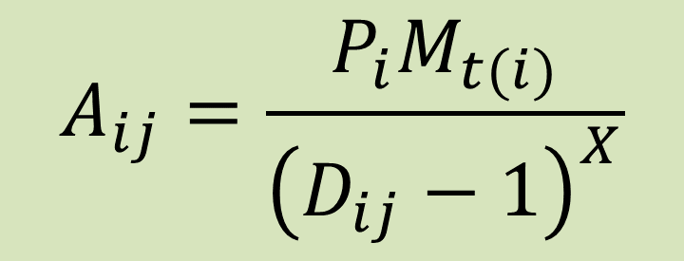
Model 1 – WWTP effects only
Semi-mechanistic approach
Assumption 1: effect (A) of each WWTP (i) depends on size, type and distance from sampling site (j)
Size measured by population equivalent (P)
7 types of WWTP defined (M_{t}, t = 1…7)
Only 6 observed in catchment
Effect decays with distance (D) following a power law (X)
$$A_{ij}=\frac{P_{i}M_{t(i)}}{{\left(D_{ij}−1\right)}^{X}}$$

Slide 11
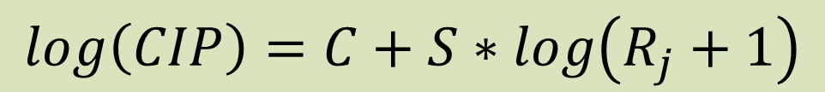
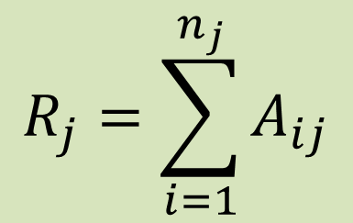
Model 1 – WWTP effects only
Assumption 2: total impact (R) of WWTPs at a sampling site (j) is sum of impacts of each individual WWTP
n_{j} WTTPs associated with each sampling site
Class 1 integron prevalence (CIP) log-transformed to cope with variance heterogeneity
Linear regression of CIP against log-transformed total impact of WWTPs
$$R_{j}=\sum_{i=1}^{n_{j}}{A_{ij}}$$
$$log\left(CIP\right)=C+S∗log\left(R_{j}+1\right)$$

Slide 12
Model 1 – WWTP effects only
Model fitted using general non-linear regression
Newton-Raphson algorithm to minimise squared differences between model and observations
10 parameters to estimate (7 WWTP types, distance decay (X), intercept (C = indigenous level), slope (S = rate of increase with increasing WWTP impact)
WWTP type parameters are relative
So constrain one (for type with maximum response) to estimate others
Parameters then give reduction for other WWTP types

Slide 13
Model construction
model [function=SS]
rcycle [maxcycle=50] param=loading[1...6],Power,Intercept,Slope;\
initial=0.124,0.247,1,0.912,0.272,0,0.388,-1.74448,0.236019;\
upper=6(1),1,0,1; lower=2(0),1,3(0),0,-10,0;\
step=2(0.01),0,4(0.01),0.1,0.01
expr [val=(Loadings[1...6] = loading[1...6]*Treatments[1...6])] \
expr[1]
expr [val=(all_loadings = vsum(Loadings))] expr[2]
expr [val=(cont=(all_loadings*Population_size)/((Distance+1)**Power))]\
expr[3]
expr [val=(resp$[1...13] =\
Intercept+Slope*log(sum(cont*(Site_Number.eq.1...13))+1))] expr[4]
expr [val=(SS = sum((Log_Mean_Integron_Prevalence - resp)**2))] expr[5]
fitnonlinear [pr=mo,su,es,mon; calc=expr[]; selinear=yes]

Slide 14
Fitted parameters
Parameter | Value
WTTP type (M_{t}) parameters
1 – Secondary biological (SB) | 0.1239
2 – Tertiary activated sludge 2 (TA2) | 0.2471
3 – Tertiary biological 1 (TB1) | (fixed) 1.0000
4 – Secondary activated sludge (SA) | 0.9115
5 – Tertiary biological 2 (TB2) | 0.2722
6 – Tertiary activated sludge 1 (TA1) | 0.0100
Regression parameters
S (rate of increase of integron prevalence) | 0.5426
X (decay of impact with distance) | 0.3875
C (indigenous level of antibiotic resistance in soils) | -1.7440

Slide 15
Model checking
0.5
Fitted model provides predictions of log mean integron prevalence for each sample location
Simple linear regression of observed values (4 different seasons) against predictions
Adjusted R² = 0.495
0.0
-0.5
Actual log integron prevalence
-1.0
-1.5
-2.0
0.0
0.5
1.0
1.5
2.0
2.5
Predicted log integron prevalence

Slide 16
Response and explanatory data (Model 2)
Site | Log R | Log Integron prevalence | Season | Rainfall day before | Log Rainfall
TC1 | 1.969833968 | -0.572518394 | 1 | 0.51 | 0.178977
TC2 | 2.524137944 | -0.95493767 | 1 | 0.51 | 0.178977
TC8 | 0 | -1.470952226 | 1 | 0.51 | 0.178977
TC9 | 1.98799373 | -0.527623748 | 1 | 0.51 | 0.178977
TC10 | 1.437844986 | -0.80859654 | 1 | 0.51 | 0.178977
TC12 | 1.09615238 | -1.190013086 | 1 | 0.51 | 0.178977
TC14 | 2.302748075 | -0.751812868 | 1 | 0.51 | 0.178977
TC17 | 2.771169249 | -0.470545575 | 1 | 0.51 | 0.178977
TC18 | 2.017142179 | -1.549012174 | 1 | 0.51 | 0.178977
TC19 | 1.861053654 | -1.26122087 | 1 | 0.51 | 0.178977
TC21 | 2.0949495 | -0.58136756 | 1 | 0.51 | 0.178977
TC23 | 2.880226649 | -0.356534217 | 1 | 0.51 | 0.178977
TC1 | 1.969833968 | -0.562604167 | 2 | 0 | 0
TC2 | 2.524137944 | -0.779308327 | 2 | 0 | 0
TC3 | 0.63555794 | -1.412938056 | 2 | 0 | 0
TC8 | 0 | -1.838857454 | 2 | 0 | 0
TC9 | 1.98799373 | -0.693043606 | 2 | 0 | 0
TC10 | 1.437844986 | -0.630632858 | 2 | 0 | 0
TC12 | 1.09615238 | -0.955437261 | 2 | 0 | 0
TC14 | 2.302748075 | -1.038630757 | 2 | 0 | 0
TC17 | 2.771169249 | 0.067769947 | 2 | 0 | 0
TC18 | 2.017142179 | -0.892125487 | 2 | 0 | 0
TC19 | 1.861053654 | -1.011995807 | 2 | 0 | 0
TC21 | 2.0949495 | -1.211796024 | 2 | 0 | 0
TC23 | 2.880226649 | -0.855788485 | 2 | 0 | 0
TC1 | 1.969833968 | 0.101738363 | 3 | 2.8 | 0.579784
TC2 | 2.524137944 | -1.189564972 | 3 | 2.8 | 0.579784
TC3 | 0.63555794 | -1.71560132 | 3 | 2.8 | 0.579784
TC8 | 0 | -1.892593092 | 3 | 2.8 | 0.579784
Site | Log R | Log Integron prevalence | Season | Rainfall day before | Log Rainfall
TC9 | 1.98799373 | -0.346925794 | 3 | 2.8 | 0.579784
TC10 | 1.437844986 | -0.545645316 | 3 | 2.8 | 0.579784
TC12 | 1.09615238 | -1.684321248 | 3 | 2.8 | 0.579784
TC14 | 2.302748075 | -1.664827194 | 3 | 2.8 | 0.579784
TC17 | 2.771169249 | 0.205933323 | 3 | 2.8 | 0.579784
TC18 | 2.017142179 | -0.698709612 | 3 | 2.8 | 0.579784
TC21 | 2.0949495 | -0.416222489 | 3 | 2.8 | 0.579784
TC23 | 2.880226649 | 0.124667471 | 3 | 2.8 | 0.579784
TC1 | 1.969833968 | -0.534328969 | 4 | 3.81 | 0.682145
TC2 | 2.524137944 | -0.785014844 | 4 | 3.81 | 0.682145
TC3 | 0.63555794 | -1.390948706 | 4 | 3.81 | 0.682145
TC8 | 0 | -1.656084655 | 4 | 3.81 | 0.682145
TC9 | 1.98799373 | -0.539850237 | 4 | 3.81 | 0.682145
TC10 | 1.437844986 | -1.445037953 | 4 | 3.81 | 0.682145
TC12 | 1.09615238 | -1.379829514 | 4 | 3.81 | 0.682145
TC14 | 2.302748075 | -0.002351016 | 4 | 3.81 | 0.682145
TC17 | 2.771169249 | 0.455796504 | 4 | 3.81 | 0.682145
TC18 | 2.017142179 | -0.506216161 | 4 | 3.81 | 0.682145
TC21 | 2.0949495 | -0.585740068 | 4 | 3.81 | 0.682145
TC23 | 2.880226649 | -0.221763146 | 4 | 3.81 | 0.682145

Slide 17
Model 2 – WWTP plus land-cover and rainfall
Multiple linear regression of log(CIP)
WWTP impacts using calculated log(R_{j}) values for each sample site using fitted Model 1
Land-cover percentages for range of major classes
Log-transformed values (Normalised values)
Allow different effects of land-cover classes indifferent seasons
Regression with groups
Rainfall on day prior to sampling
Including combinations of rainfall values with land-cover percentages
All-subsets and stepwise regression approaches used to find “best” model
8 land-cover variables included, plus interactions with rainfall and season

Slide 18
Fitted parameter values
Parameter | Coefficient | Standard error | t-Value | Significance level
Constant | -0.778 | 0.305 | -2.55 | 0.018
R(Total impact of WWTPs) | 0.3207 | 0.0723 | 4.43 | <0.001
Coniferous woodland | 1.748 | 0.711 | 2.46 | 0.022
Rough grassland | -1.272 | 0.416 | -3.05 | 0.006
Neutral grassland | -0.478 | 0.190 | -2.51 | 0.020
Acid grassland | 8.29 | 3.36 | 2.47 | 0.022
Heather grassland | -7.77 | 5.76 | -1.35 | 0.191
Inland rock | 1.476 | 0.461 | 3.21 | 0.004
Urban | -1.771 | 0.503 | -3.52 | 0.002
Suburban | 0.160 | 0.159 | 1.01 | 0.326
Coniferous woodland.rainfall | -1.41 | 1.15 | -1.22 | 0.234
Neutral grassland.rainfall | 0.994 | 0.386 | 2.58 | 0.017
Acid grassland.season 2 | 5.24 | 3.99 | 1.31 | 0.203
Acid grassland.season 3 | 7.91 | 4.33 | 1.83 | 0.081
Acid grassland.season 4 | -8.64 | 4.53 | -1.91 | 0.069
Heather grassland.season 2 | -11.38 | 6.55 | -1.74 | 0.097
Heather grassland.season 3 | -18.70 | 7.60 | -2.46 | 0.022
Heather grassland.season 4 | 13.37 | 7.84 | 1.71 | 0.102
Inland rock.season 2 | -0.321 | 0.514 | -0.62 | 0.539
Inland rock.season 3 | 1.607 | 0.599 | 2.68 | 0.014
Inland rock.season 4 | -1.538 | 0.614 | -2.50 | 0.020
Urban.season 2 | 1.174 | 0.684 | 1.72 | 0.100
Urban.season 3 | 3.370 | 0.810 | 4.16 | <0.001
Urban.season 4 | 2.323 | 0.846 | 2.75 | 0.012
Suburban.season 2 | 0.046 | 0.178 | 0.26 | 0.798
Suburban.season 3 | -0.822 | 0.217 | -3.79 | 0.001
Suburban.season 4 | -0.218 | 0.235 | -0.93 | 0.365

Slide 19
Model checking
Predict log integron prevalence based on the fitted model
Simple linear regression of observed on predicted demonstrates quality of fit
Adjusted R² = 0.829
0.5
0.0
-0.5
actual log integron prevalence
-1.0
-1.5
-2.0
-2.0
-1.5
-1.0
-0.5
0.0
0.5
Predicted log integron prevalence

Slide 20
Model 3 – water quality parameters
Separate multiple linear regression analysis of log(CIP)
Range of water quality parameters included
All-subsets and stepwise regression approaches used to find “best” model
Strong correlations between water quality parameters (collinearity)
11 water quality parameters included
Model fit not as good as for Model 2 (71.4% variance accounted for compared with 82.9%)
Potential to extend Model 2 by including water quality parameters
Providing additional explanatory power
Or use water quality parameters to parameterise effects of land cover?

Slide 21
Metagenomic data – new project
More complex data sets with multiple response variables
Consider individually, or summarise patterns using multivariate approaches
Principal Component Analysis, Correspondence Analysis, Hierarchical Cluster Analysis
Identify groups of samples with similar profiles
Identify genes contributing to differences
Canonical Variate Analysis, Canonical Correspondence Analysis
allow a more direct association of relative gene abundance patterns to environmental (water quality) parameters
Identify groups of genes that provide basis for combining information for model development
Also consider measures of diversity, and functional groups

Slide 22
New modelling approaches
Use “Low Flows 2000 – Water Quality Extension” (LF2000-WQX) to better quantify effect of river distance from WWTPs to sampling sites
Allows assessment of between-season variation
Allows incorporation of variability/uncertainty due to structure of river system
General non-linear multiple regression
Impacts of WWTPs (using LF2000-WQX)
Extend using subsets of landscape/environmental variables
Links between land-cover and water quality variables??
Models for individual genes
Models for combined responses for groups of “similar” genes
From multivariate analyses, functional groups, …
Models for other summaries of genes, e.g. diversity measures
Identify where there are common parameters across models – extend/combine using multivariate regression?

Slide 23
Validation and Prediction
Validation of fitted models
Using a cross-validation approach
Re-fit models to data for a subset of sampling points and compare predictions and observations at omitted sampling points
Repeat for multiple omitted subsets
Prediction and mitigation
Predict risk of ARGs across the whole river system
Explore impacts of different mitigation strategies

