Slide 1
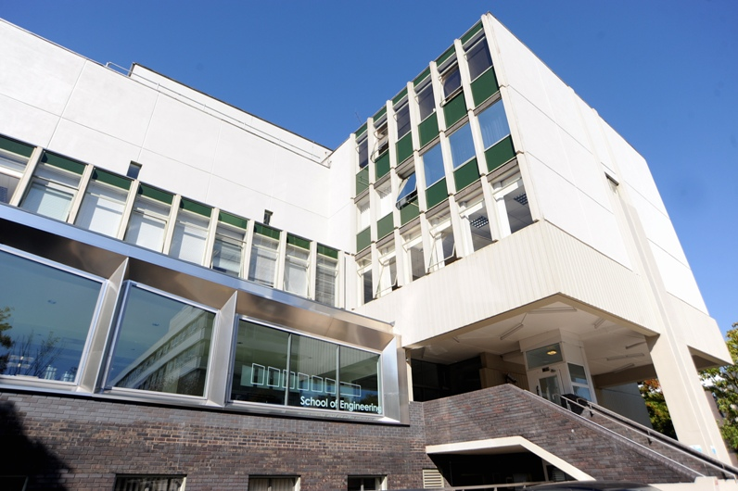
Disease Diagnostics Data Analysis
Dr James A. Covington
Bio-Medical Sensors Laboratory
School of Engineering

Slide 2
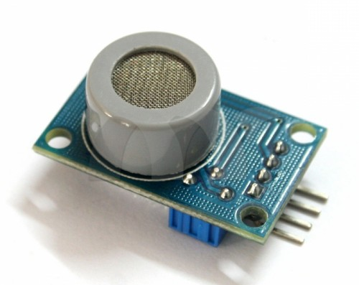

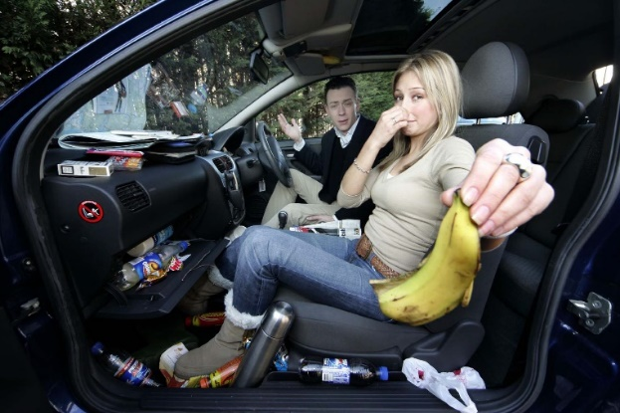
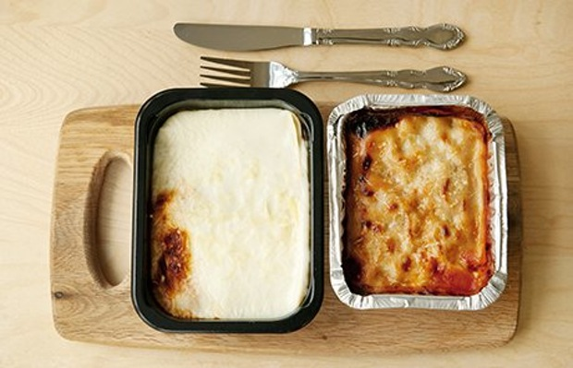
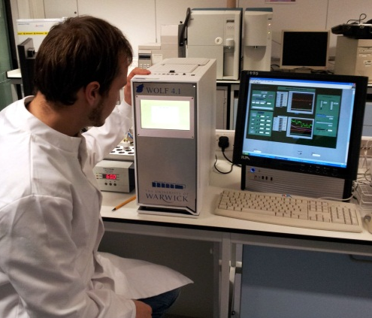
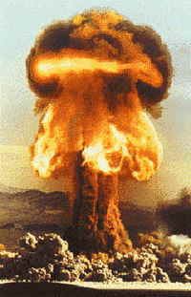
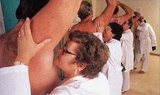
Sensors@Warwick

Slide 3

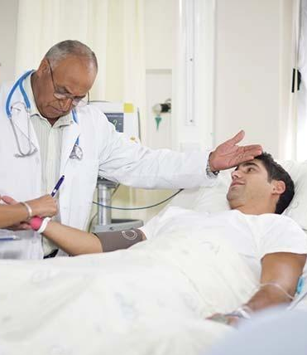
Motivation…
Point of care
Rapid
Patient acceptable
Low-cost
Simple
Hospitals/Home
Developing countries

Slide 4
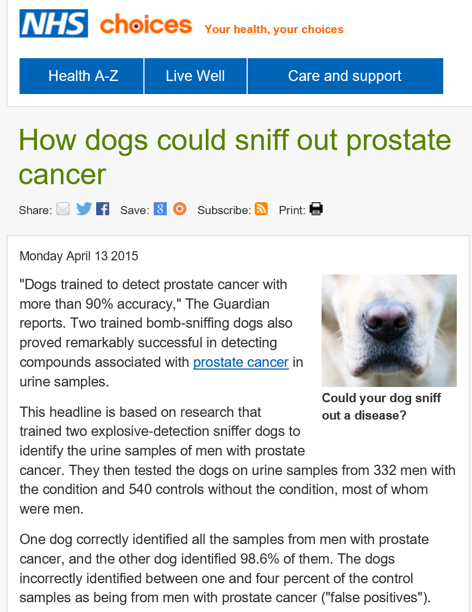
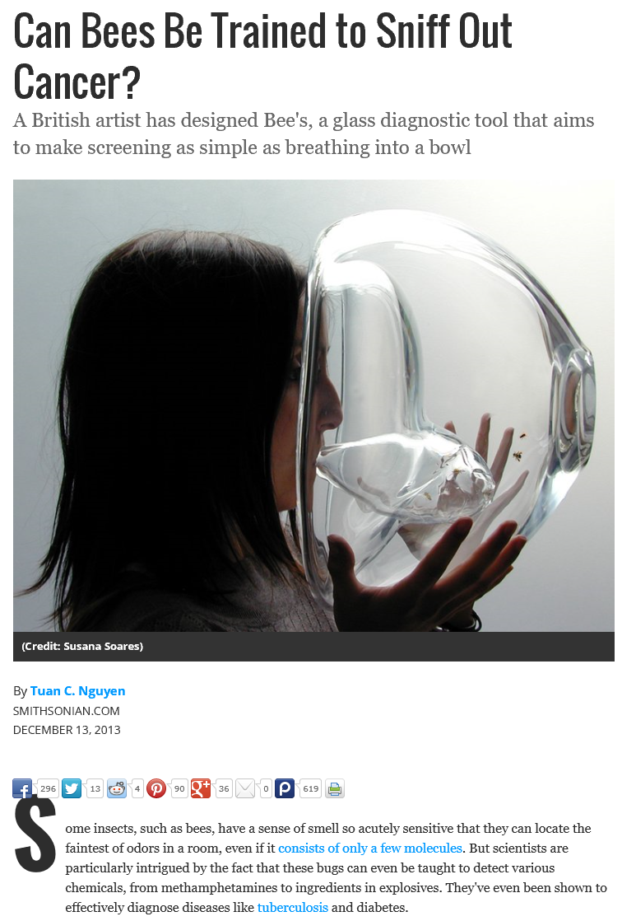
The Biological Solution

Slide 5
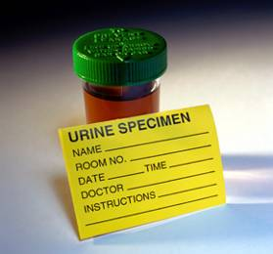
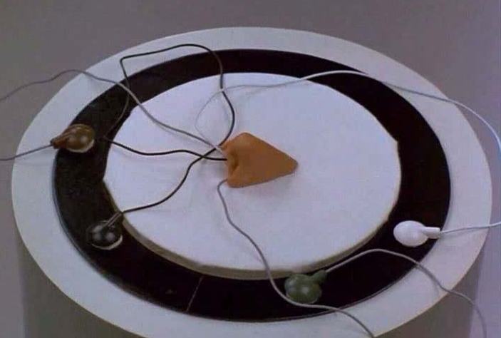
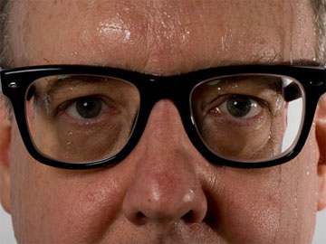
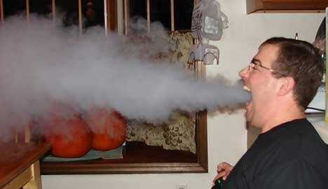

Slide 6

Artificial Olfaction
Invented at Warwick in the early 1980s replicate the human nose
Non-invasive, real-time
Immediate sample introduction
Portable/small form factor
Can be used away from the lab
Easy to use/understand
No specialised services (gas lines etc.).
Dr George Dodd

Slide 7
Electronic Nose Operation
Array of sensors with different broad sensitivity e.g. Alcohols
Operate by measuring change in resistance/capacitance/frequency
e⁻
e⁻
e⁻
e⁻
e⁻
e⁻
e⁻
e⁻
e⁻
e⁻
e⁻
e⁻
e⁻
e⁻
e⁻
e⁻
e⁻
e⁻

Slide 8

Electronic Nose for Medicine
Example Sensor Response
ΔR_{max} / R_{b}
Sample in
Sample out
Response
ΔR_{max}
Time
sensor
array
time
Many sensors within the electronic nose respond to different odours within the sample. These responses are then processed
The air from around an area of interest is sampled

Slide 9
Understanding your problem…
Disease Diagnostics Data Analysis

Slide 10
What is the medical question?
Is there any difference
between these two?
Which one is the same as the standard?

Slide 11
Nature of the test…

Slide 12
What are the issues?
Who took the sample?
How did they take the sample?
When did they take the sample?
How old is the sample?
Did they take it in a different room?
When did the person last eat?
Do they have perfume on?
When was the room last cleaned?
Understand how your sample is collected

Slide 13
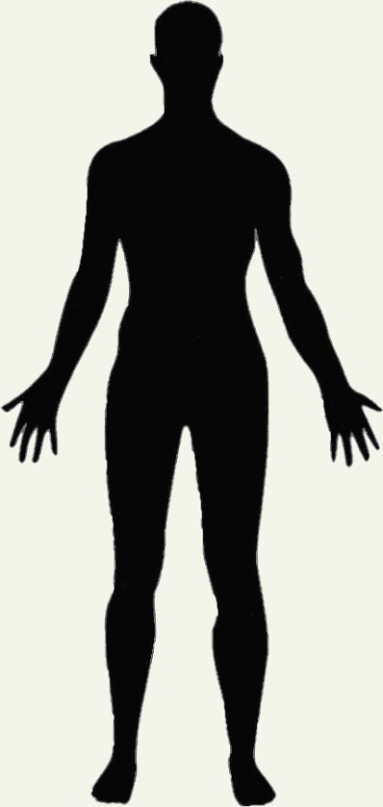
University Hospital Coventry & Warwickshire
Brain Cancer/Schizophrenia
Diseases investigated…
  Bile acid malabsorption
  Bladder/prostate Cancer
  Clostridium difficile
  Coeliac's disease
  Colorectal Cancer
  Crohns disease /Ulcerative colitis
  Diabetes
  Hepatic encephalopathy
  Irritable bowel syndrome
  Liver disease
  Obesity
  Pelvic radiation
  Pre-term labour
  Tuberculosis
Lung diseases
Metabolic diseases
Eye infections
Ear/Nose/Throat
Liver disease
Gastrointestinal
diseases
Bacterial infections
i.e. MRSA & C-Diff
Wound infections
Application of ‘Smell Technology’

Slide 14
Understanding your Machine…
Electronic noses in Medicine

Slide 15
Important Test Conditions

Slide 16
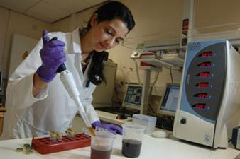
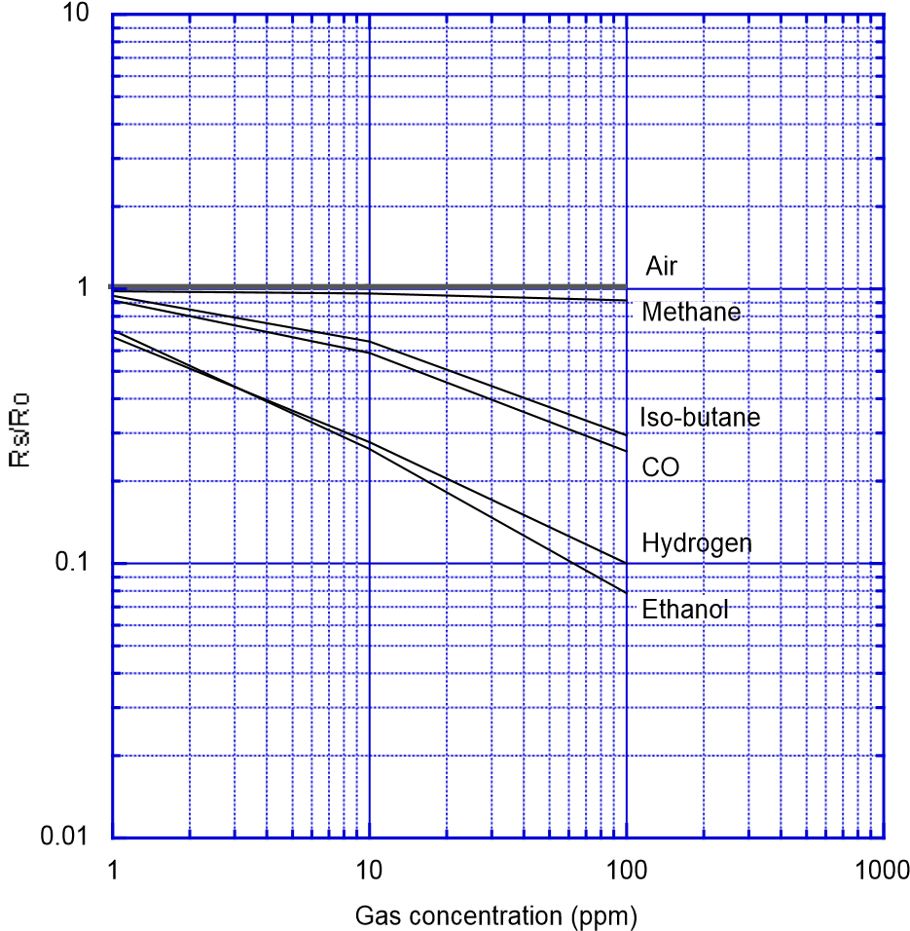
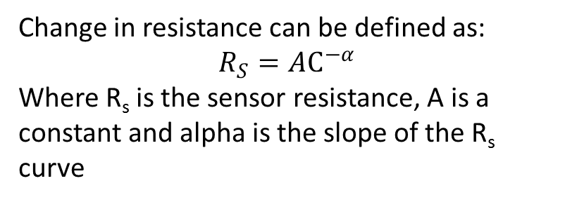
Traditional Electronic Nose
Array of discrete Sensors
Most employ metal-oxides
Non-linear response with gas concentration
Change in resistance can be defined as:
$$R_{S}=AC^{−α}$$
Where R_{s} is the sensor resistance, A is a constant and alpha is the slope of the R_{s} curve

Slide 17
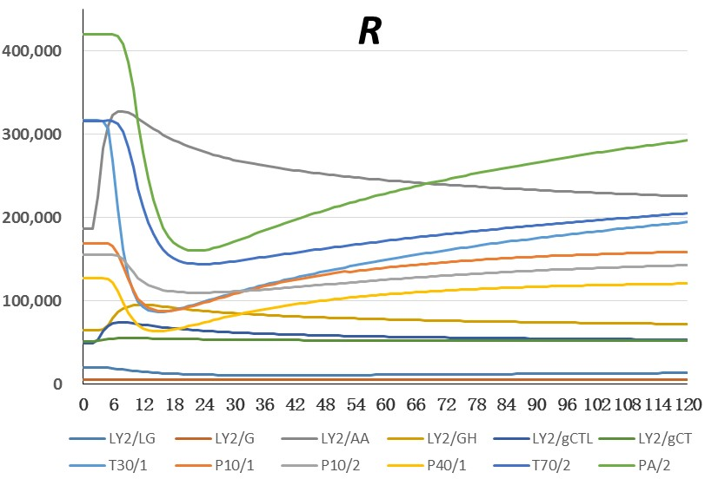
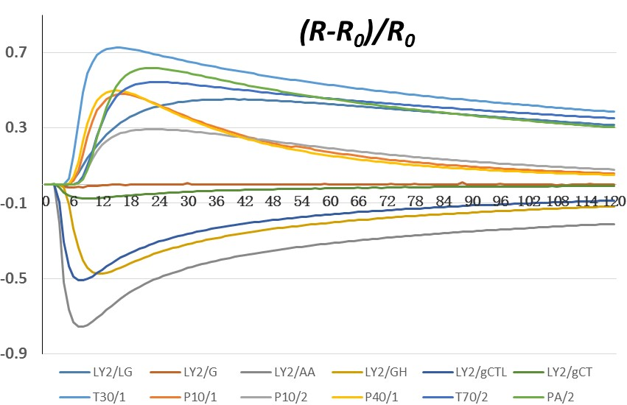
Typical Sensor Responses
Generates around 1000 data points per sensor
Feature reduction is required

Slide 18
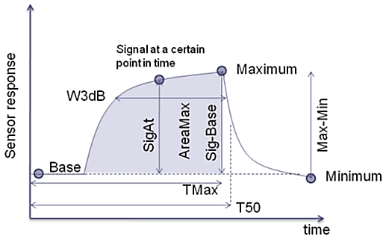
Potential Features…

Slide 19
And also…
And anything else you can think of…

Slide 20
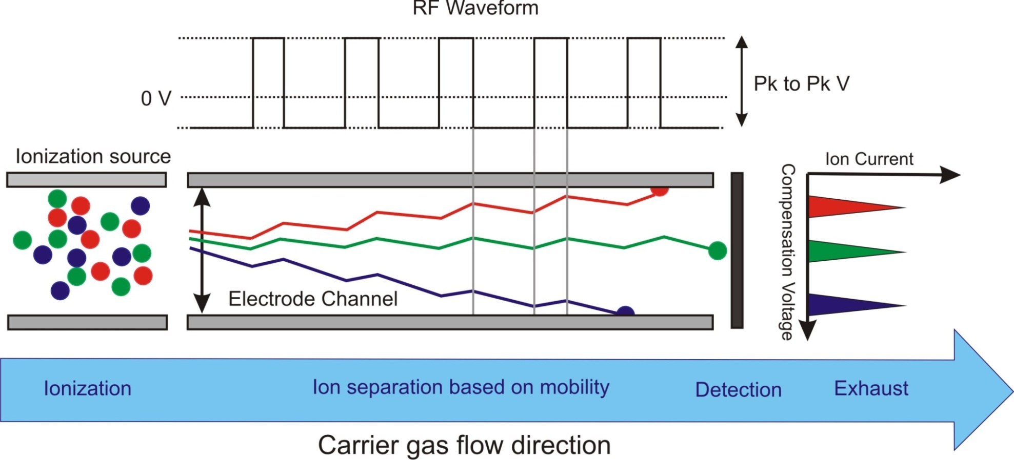
Ion Mobility Spectrometry - FAIMS
Used in chemical warfare detection
Applications for military or home security

Slide 21
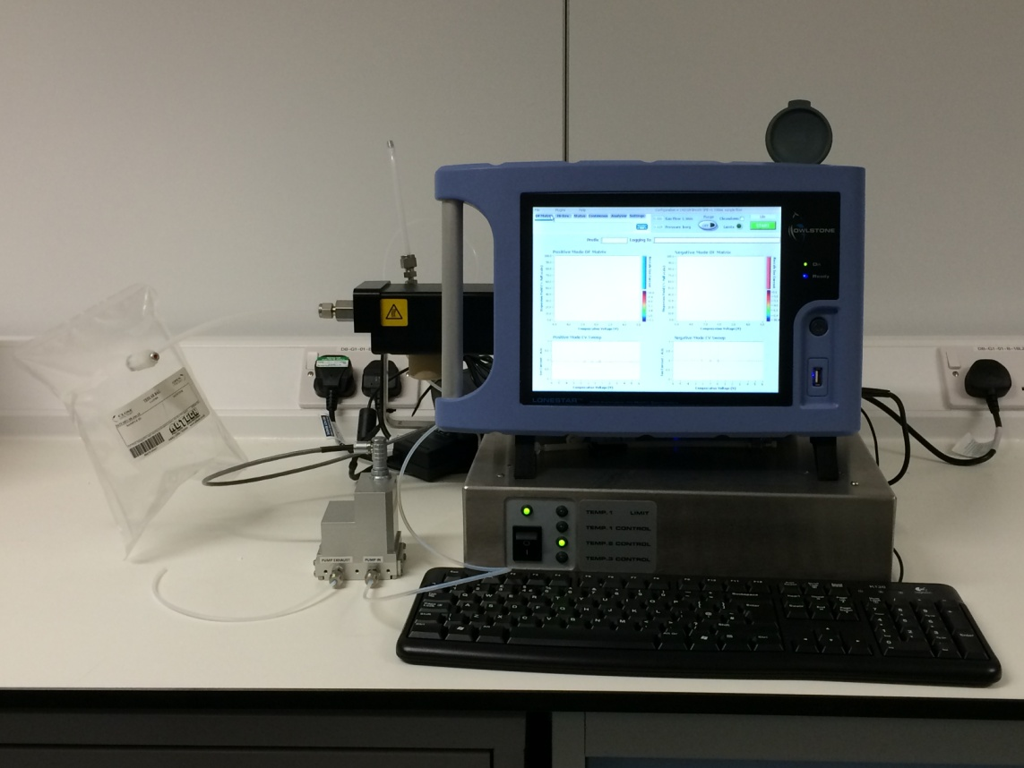
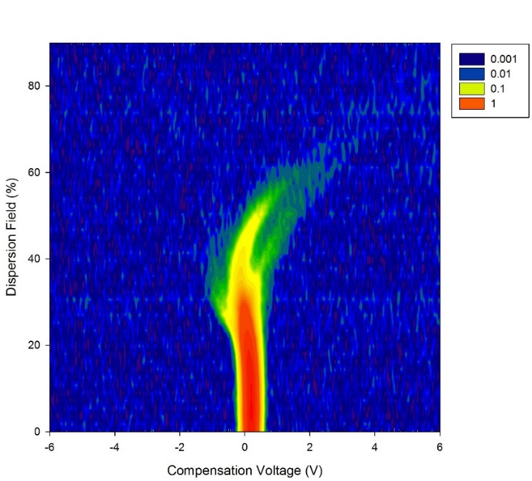
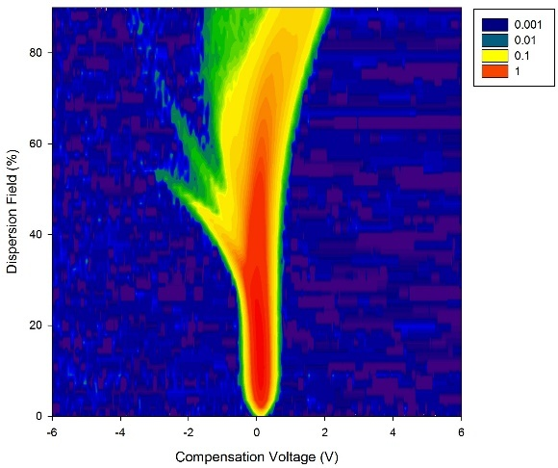
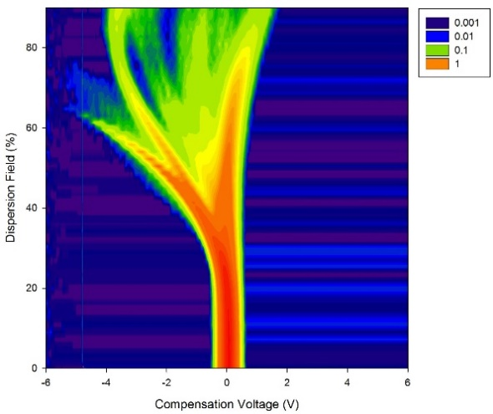
Sample Collection…
FAIMS creates datasets of 52,254 data points for one scan
Usually three full scans are taken
Feature reduction is critical…
Urine
Breath
Stool

Slide 22
Wavelet transformation
Discrete
Wavelet transform
Raw Data
Data in 1D
Andrea S. Martinez-Vernon 2016

Slide 23
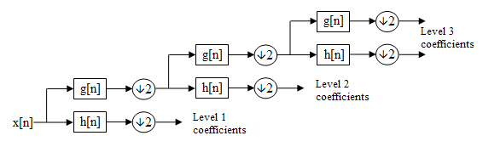

Wavelet transform
At each level in the above diagram the signal is decomposed into low and high frequencies.
Due to the decomposition process the input signal must be a multiple of 2^{n} where is the number of levels.

Slide 24
Feature heat-map Coeliac Disease
1 in 100 in the UK are affected, with many undiagnosed
Urine samples used, 20 CD patients and 27 controls
Heat map of different features
Clear differences in the dataset

Slide 25
Understanding your Data processing…
Disease Diagnostics Data Analysis

Slide 26
Multivariate data processing techniques

Slide 27
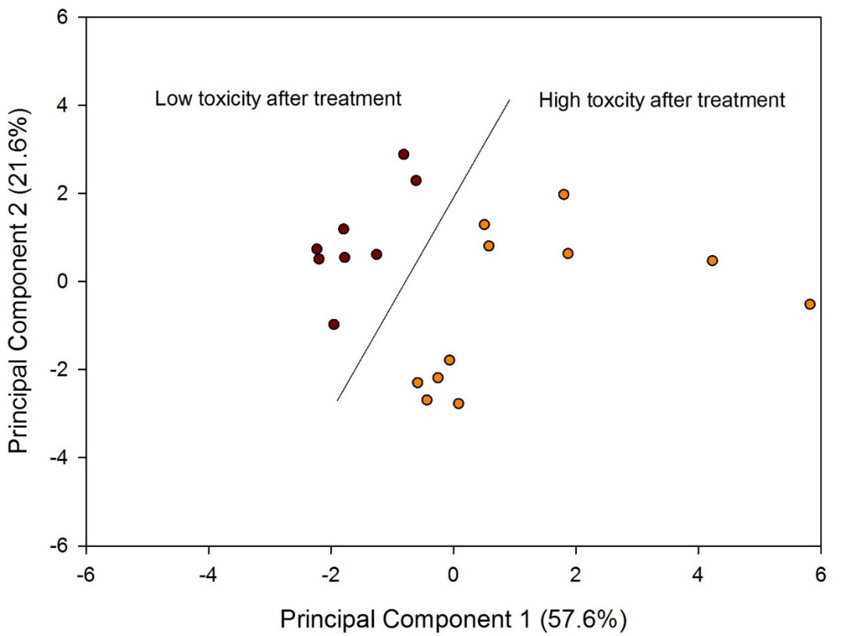
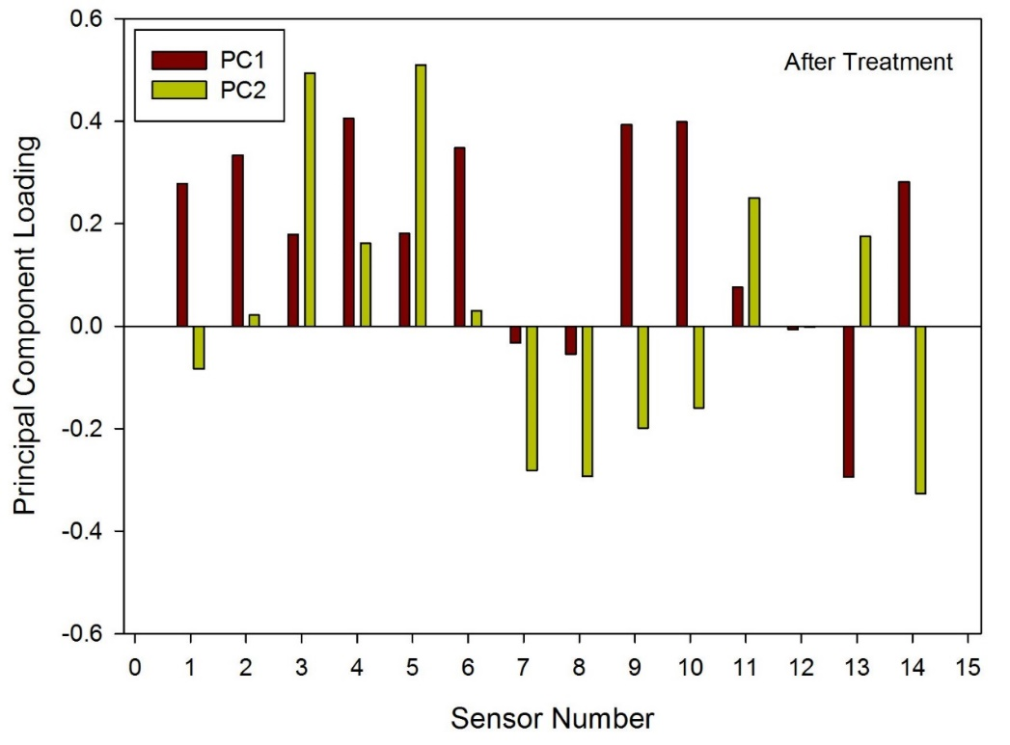
Unsupervised - PCA example
In PCA, we are interested to find the directions (components) that maximize the variance in our dataset
Linear separation

Slide 28
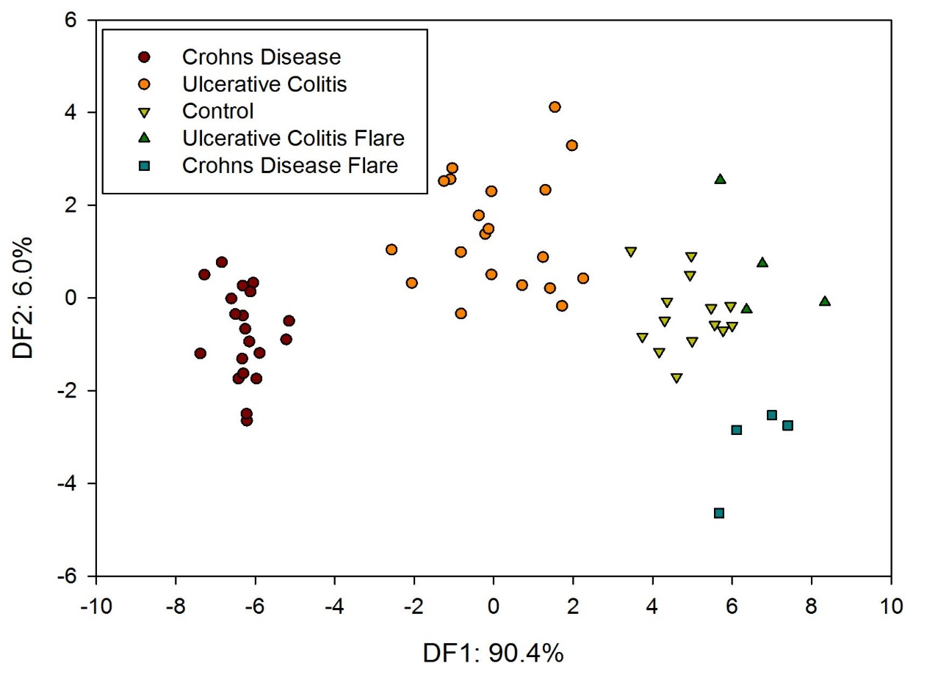
Supervised - LDA example
LDA determines a suitable subspace to distinguish between patterns that belong to different classes

Slide 29
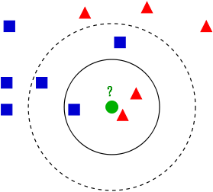
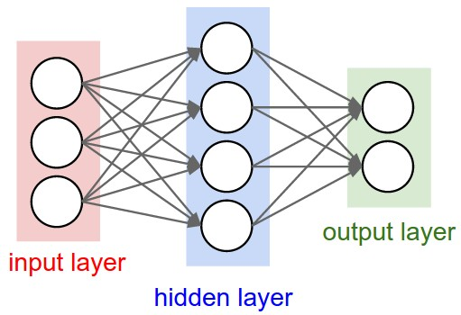
Classifiers - Traditional
K-NN
Two common are k-Nearest Neighbour and neural networks (with various learning methods)
Multi-output solution

Slide 30
Medical binary classifiers
Single-output solution…many options…
  Support vector machine: Samples are assigned into a new feature space to maximise the difference between the two groups
  Random Forrest: Creates a series of decision trees which vote together to create a classification
  Sparse logistic regression: Fits a model to the data and then uses this model to predict unknown samples (non-linear)
But also…
  Neural network
  Gaussian processes

Slide 31
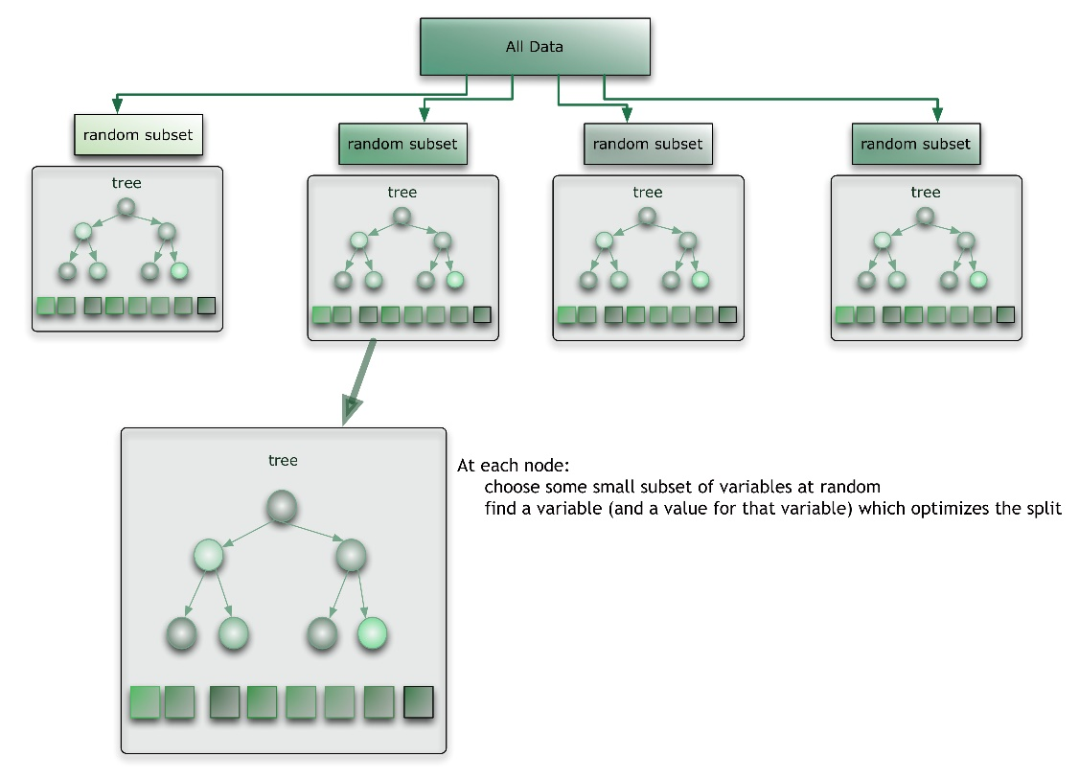
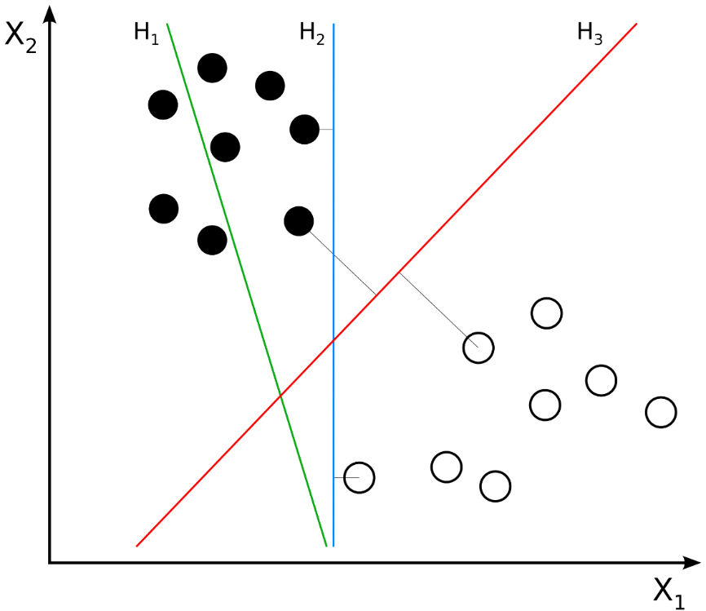
Medical binary classifiers II
Support vector machines
Random forest

Slide 32
FAIMS Medical Data
Remove “zero” values (padding)
Wilcoxon rank-sum test for (with cross-validation) in turn
It is a non-parametric statistical hypothesis test used when comparing two related samples, matched samples, or repeated measurements on a single sample to assess whether their population mean ranks differ (i.e. it is a paired difference test).
Then keep only the features with the lowest p-value
Normally n=2 is sufficient

Slide 33
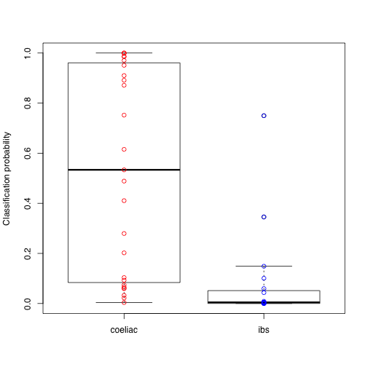
Coeliac's from urine
Box whisker plot of probabilities
Boxes show interquartile range
Data created by Sparse Logistic regression
Sensitivity/Specificity of 85%

Slide 34
What does you medic want you to give them?
Electronic noses in Medicine

Slide 35
Sensitivity and Specificity
Sensitivity: measures the proportion of positives that are correctly identified
Specificity measures the proportion of negatives that are correctly identified
  True positive: Sick people correctly identified as sick
  False positive: Healthy people incorrectly identified as sick
  True negative: Healthy people correctly identified as healthy
  False negative: Sick people incorrectly identified as healthy

Slide 36
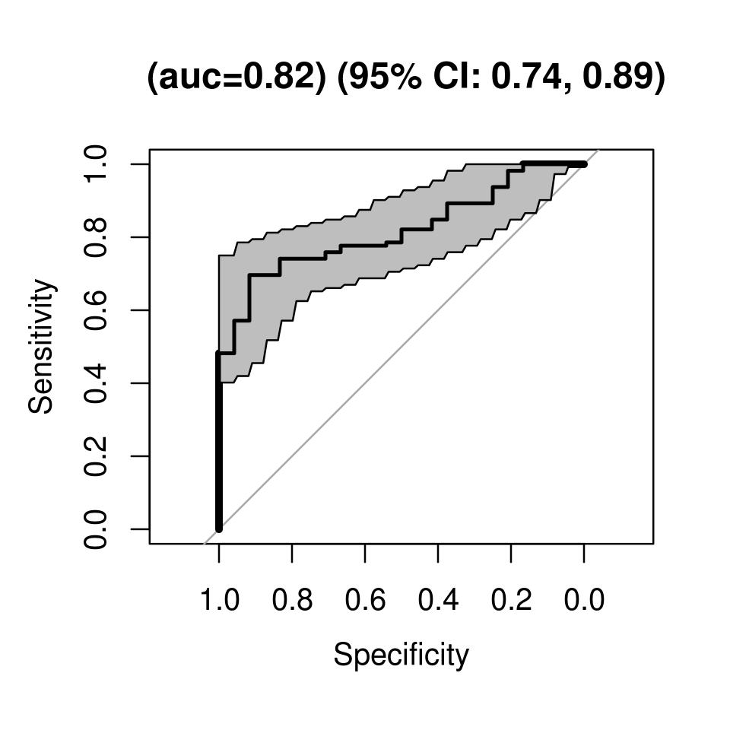
IBD in Breath
Graphical plot that illustrates the performance of a binary classifier system as its discrimination threshold is varied.
Plots the positive rate (sensitivity) against the false positive rate (specificity) at various threshold settings.
76 IBD patients / 22 Controls
Random Forrest Classifier
Sensitivity: 74%
Specificity: 75%

Slide 37
C.Diff from Stool
213 stool samples
  All suspected of C.diff
71 confirmed cases
10 fold cross-validation
AUC = 0.93 (95% CI: 0.85,1)
Sensitivity: 92%
Specificity: 86%

Slide 38
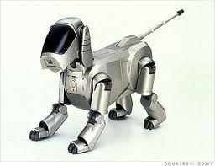
Conclusions…
Electronic noses have been around for more than 20 years
Developed at Warwick, there have been a range of classification approaches applied to them
Critical understanding of the medical problem is needed before processing data
Multiple methods applied to classification – with mixed results
Future maybe a machine in every GP and/or home

