Slide 1
Modelling clinical data
Dr Julie V Robotham
Modelling and Economics Lead - AMR & HCAI
Dept. of Statistics, Modelling and Economics / AMRS & HCAI Programme

Slide 2
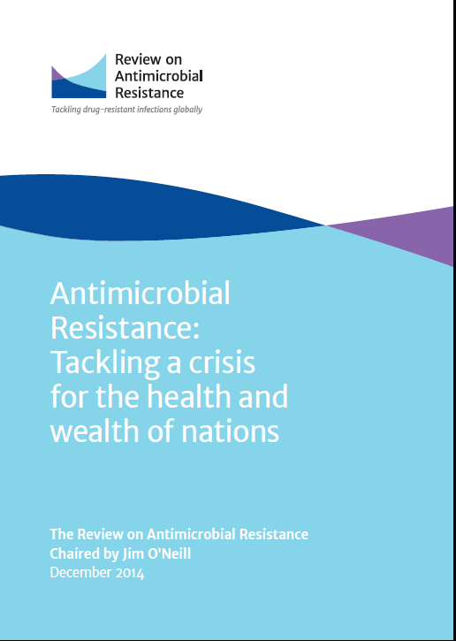
Antimicrobial Resistant (AMR) Organisms
AMR arises through inappropriate antibiotic use and spreads through poor infection control (e.g. poor hand-hygiene, management of invasive devices such as urinary or vascular catheters, skin and wound care).
It comprises a third of the annual 100,000 HCAI and 5000 deaths.
AMR is recognised as a growing threat - the Chief Medical Officer’s report, 2011, recommended for it to be placed on the national risk register.
Responding to mounting international concern, in July 2014 David Cameron commissioned a review on AMR.
Economist Jim O’Neill, Chairman of the Review on AMR, said:
"Drug-resistant infections already kill hundreds of thousands a year globally, and by 2050 that figure could be more than 10 million. The economic cost will also be significant, with the world economy being hit by up to $100 trillion by 2050 if we do not take action.”

Slide 3
UK 5-Year AMR Strategy 7 Key Areas for Future Action
Improving infection prevention and control practices
Optimising prescribing (through antimicrobial stewardship)
Improving professional education, training and public engagement
Developing new drugs, treatments and diagnostics
Better access to and use of surveillance data
Better identification and prioritization of AMR research needs
Strengthened international Collaboration

Slide 4
Models
Mathematical models provide an efficient way of assessing many control methods
Represent a simplification of the real world
Allow exploration of hypotheses, and can generate hypotheses
Help understand patterns in epidemiological data
Allow incorporation of all available evidence with synthesis of many sources
Show clearly what is still unknown about a system
So show us where more information is needed
Include sensitivity analysis to explore uncertainty of data inputs and model structure
Are transparent and reproducible

Slide 5
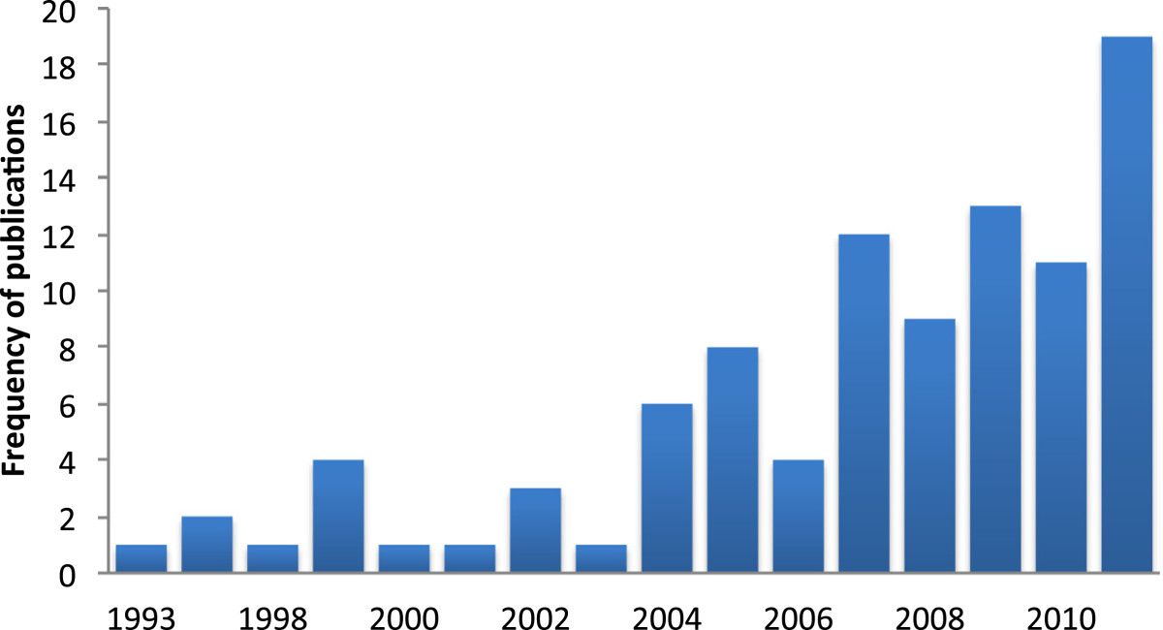
Modelling HCAI & AMR
Mathematical models are increasingly being used to obtain a deeper understanding of epidemiological patterns in hospital infections and to guide hospital infection control policy decisions.
Modelling publications over time (1993–2011).
Number of studies identified on modelling of HCAI and antimicrobial resistance spread in a nosocomial setting according to year of publication.
van Kleef et al. BMC Infectious Diseases 2013 13:294

Slide 6
Parameter estimation
Data collection / collation
Development of models
Understanding dynamics
Estimation of burden
Intervention evaluation
Informing policy

Slide 7
Parameter estimation
Data collection / collation
Development of models
Understanding dynamics
Estimation of burden
Intervention evaluation
Informing policy

Slide 8
Data: Microbiology
Routinely-generated laboratory data – laboratories across the country when they test samples, will conduct susceptibility testing
Mandatory surveillance programmes (Trust data)
Bacteraemia due to MRSA, MSSA, E. coli
C. difficile infection
Surgical site infection (SSI)
GRASP (Gonococcal Resistance to Antimicrobials Surveillance Programme)
Enhanced Tuberculosis Surveillance System

Slide 9
What the Data Doesn’t Tell us
Device related?
Nosocomial?
Co-morbidities?
Underlying Infections?
Clinical outcomes?
Procedures?
Speciality?
Antibiotic Treatment?
Transmission?
Notes:
What are the characteristics of a disease? Where are the critical control points

Slide 10
Data: Clinical
Hospital Episode statistics (HES)
HES is a data warehouse containing details of all admissions, outpatient appointments and A&E attendances at NHS hospitals in England.
Death registrations (ONS)
National Renal & Joint registries
Patient Reported Outcome Measures (NHS)
Paediatric Intensive Care Audit Network
Intensive Care National Audit & Research Centre
Clinical Practice Research Datalink

Slide 11
Data: Antimicrobial Use
In response to the threat posed by antimicrobial resistance Public Health England has developed a national programme, the
English Surveillance Programme for
Antimicrobial Utilization and Resistance (ESPAUR)
To bring together the elements of antimicrobial utilization and resistance surveillance in both primary and secondary care settings, alongside the development of quality measures and methods to monitor unintended outcomes of antimicrobial stewardship and both public and professional behaviour interventions.
Ashiru-Oredope D, Hopkins S; English Surveillance Programme for Antimicrobial Utilization an Resistance Oversight Group.
J Antimicrob Chemother. 2013 Nov;68(11):2421-3

Slide 12
ESPAUR
Worked with the NHS Business Service Authority and private information technology organisations to collect and collate…
…comprehensive antibiotic consumption data from community (general practice, dental practice, prisons, out-of-hours, walk-in centres, and other community locations) and hospital (acute, mental health, specialist and community) settings…
…to build a comprehensive picture of antibiotic prescribing trends across England.

Slide 13
ESPAUR
Total antibiotic consumption (DDD/1000 inhabitants/day) in England has increased by 6.5% (2011 – 2014)
Antibiotic prescriptions in primary care (number dispensed, adjusted for age and sex) has declined for the last two years and is now lower than the similar measure in 2011
Prescribing to hospital inpatients increased significantly by 11.7% and to hospital outpatients by 8.5% between 2011 and 2014
ESPAUR Reports 2014 & 2015:
https://www.gov.uk/government/publications/english-surveillance-programme-antimicrobial-utilisation-and-resistance-espaur-report

Slide 14
Data Linkage
Linkage of disparate but complementary data sets provides a much more comprehensive picture
Requires patient-level record linkage
Deterministic linkage (e.g. NHS number)
Probabilistic linkage (multiple identifiers)
Highly robust information governance and secure IT systems essential to ensure patient confidentiality

Slide 15
Parameter estimation
Data collection / collation
Development of models
Understanding dynamics
Estimation of burden
Intervention evaluation
Informing policy

Slide 16
Can seasonality or nosocomial transmission explain trends in Escherichia coli bloodstream infection incidence across England?
There has been a sustained increase in E. coli blood stream infections (BSI) the burden of which is regionally varied.
The reason for this is unclear.
There is an emerging body of evidence to suggest that E. coli infection rates are seasonal, peaking in the summer months.
We examined a national mandatory surveillance dataset of E. coli BSI in England
to:
Identify patterns of seasonality in the hospital and community, and variation across regions.
Quantify the clinical impact of this seasonality.
Quantify the extent of clustering, i.e. transmission, within the hospital setting.

Slide 17
Can seasonality or nosocomial transmission explain trends in Escherichia coli bloodstream infection incidence across England?
Dataset
Mandatory reported details of every BSI with a blood specimen that tested positive for E.coli collected between July 2011 and December 2013 from all 167 NHS trusts, via a web-enabled surveillance system held by Public Health England.
Statistical Methods - Seasonality
Base model: generalized additive mixed-effects Poisson model, with a log link.
Reporting hospital included as a categorical variable (as a control for case mix).
Fixed linear polynomial by hospital interaction term controlled for varying rates of change (mainly increase) over time.
Seasonal model: cyclic effect (periodic penalized regression spine) fitted to the week of the year variable was added to base model
Model fit assessed using the Akaike Information Criterion.
Statistical Methods – Clustering of Hospital onset cases
Temporal clustering, indicating transmission, was determined by departures from independence of the model residuals.
The Box-Pierce portmanteau statistic was used to indicate dependence and quantify statistical significance taking a maximum four-week interval.

Slide 18
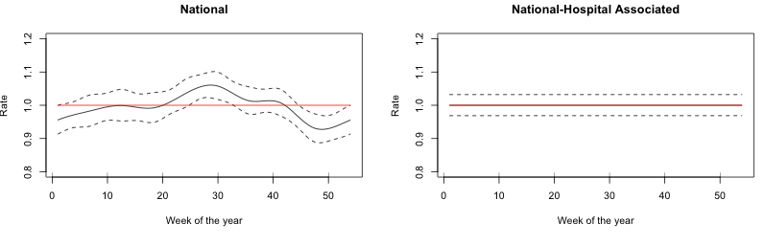
Can seasonality or nosocomial transmission explain trends in Escherichia coli bloodstream infection incidence across England?
E coli BSI : variation by region and place of onset²
Model with linear time trend and a cyclic cubic spine provided the best fit to the data.
- there is a relationship between week of the year and E. coli weekly counts when all other variables (linear increase over time and between hospital variance) are taken into account
Model with a linear time trend provided the best fit to the data i.e. without the cubic spline
- no evidence of seasonality
Deeny SR, van Kleef E, Bou-Antoun S, Hope RJ, Robotham JV. Seasonal changes in the incidence of Escherichia coli bloodstream infection: variation with region and place of onset. Clin Microbiol Infect. 2015

Slide 19
Can seasonality or nosocomial transmission explain trends in Escherichia coli bloodstream infection incidence across England?
E coli BSI : variation by region and place of onset²
Regional Cases
Seasonality improved model fit in the North to the greatest degree.
Clinical Impact
Extra 0.5 BSIs per hospital for the total summer period and 0.5 fewer BSIs per hospital each winter.
Clinical impact modest
Temporal dynamics
No evidence of clustering (correlation between weeks) in E.coli hospital-onset BSI cases in time.
No evidence of immediate onward transmission

Slide 20
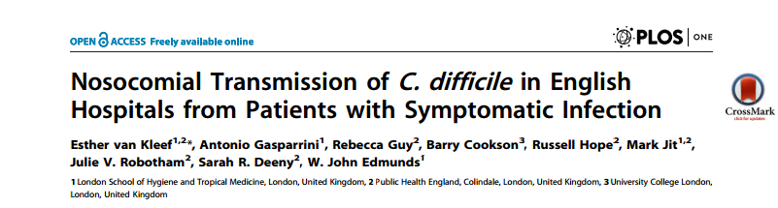
Mandatory surveillance data
C difficile: nosocomial transmission
Used a similar model to explore possible clustering (transmission between symptomatic in-patients) of Clostridium difficile infection cases.
Found a low, but statistically significant, correlation between successive weekly CDI case incidences (phi = 0.029, 95%CI: 0.009-0.049). This correlation was five times stronger in a subgroup analysis restricted to teaching hospitals (phi = 0.104, 95%CI: 0.048-0.159).

Slide 21
Parameter estimation
Data collection / collation
Development of models
Understanding dynamics
Estimation of burden
Intervention evaluation
Informing policy

Slide 22
There is a need to quantify health and economic burden of AMR
Given the importance of AMR in current and future health policy there is a need to quantify the health and economic impact of AMR bacterial infections in the English National Health Service.
Quantification of the economic burden can help provide incentives to encourage pharmaceutical companies to develop new antibiotics, and for patients and healthcare providers to use existing antibiotics sustainably
Allow health economic analyses that inform the allocation of resources to e.g. infection control programmes or stewardship interventions

Slide 23
Issues with estimating the economic impact/ burden of AMR bacteria
Quantifying the health and economic impacts of resistance represents a significant research challenge
Antibiotic resistance is not in itself a disease entity. It encompasses many types of infections & bacteria.
Require prevalence estimates, which are often not so easy to obtain as might be suspected. Definitions are often not clear cut - Which bugs? Which drugs?
For hospital impact it is primarily the outcomes of mortality and additional stay associated with these infections that are of interest.
A large part of the cost of an AMR HCAI can be represented by the economic value of bed-days released by preventing infection.
However, there are problems associated with the estimation of additional length of stay and attributable mortality.

Slide 24
Methodological challenges :
Additional length of stay due to infection
Taking MRSA as an example, studies report a 3-20 day increase in length of stay. Why the wide variation?
Confounders such as disease severity, type of infection.
Definition of cases and controls
Endogeneity bias and time dependency
Infections may increase the length of stay and increased length of stay increases the chance of infection.
Traditional approaches (e.g. logistic regression) ignore the timing of events.
A wide variation in estimates of additional length of stay results from how (and whether) timing of infection is accounted for.
Barnett et al [Value Health, 2011] demonstrated that estimates for MRSA were reduced by almost 10 days when timing of infection was included within the analysis.
Informative censoring
The most severely ill will have the highest chance of dying and the lowest chance of being discharged on a given day.
Such informative censoring can lead to very large biases if unaccounted for (e.g. in a standard survival analysis).
Notes:
I think that the burden of HCAI on our health systems is one that is universally acknowledged. However quantifying the true excess burden is more challenging. The most pressing and dominating cost as a result of a HCAI infection is increased length of stay. This causes distress and morbidity to the patient in addition to increasing a huge economic burden. However estimating this excess burden is challenging. There is a wide variation from studies.

Slide 25
Methodological challenges :
Additional length of stay due to infection
Taking MRSA as an example, studies report a 3-20 day increase in length of stay. Why the wide variation?
Failing to account for these issues can lead to large biases (usually large overestimates) in additional length of stay
Overvaluing the cost of bed days, and therefore the cost of infections, is dangerous as it can lead to exaggerated estimates of the value of prevention.
Very little data on additional bed days and excess mortality due to infections with AMR bacteria
Many studies suffer from flaws in their methodological design, leading to severely biased estimations of these key economic drivers.
Advances were made through the BURDEN project (http://www.eu-burden.info) which used alternative modelling and statistical techniques which account for the time dynamic nature of the process e.g. De Kraker et al (2011) PLoS Med
In the 31 participating countries:
5,503 excess deaths and 255,683 excess hospital days
total costs attributable to excess hospital stays: 44 million Euros
Notes:
I think that the burden of HCAI on our health systems is one that is universally acknowledged. However quantifying the true excess burden is more challenging. The most pressing and dominating cost as a result of a HCAI infection is increased length of stay. This causes distress and morbidity to the patient in addition to increasing a huge economic burden. However estimating this excess burden is challenging. There is a wide variation from studies.

Slide 26
Example of Data Linkage
Incidence, epidemiology and impact (mortality; LoS) of paediatric bacteraemia
Linking national surveillance data with national patient data
LabBase
Microbiology surveillance data
Positive blood cultures
Patients aged 1m-18y
(N=8,718)
HES
Hospital administrative in-patient data
Individual patient records
Patients aged 1m-18y
(N=1,834,300)
Linked PHE & HES data
Notes:
The LabBase2 data were probabilistically linked with HES data [25]. The technique assigned match weights to 1 or more potential matches for those records that could not be assigned “unequivocal matches,” and the record with the highest weight was accepted as a match.

Slide 27
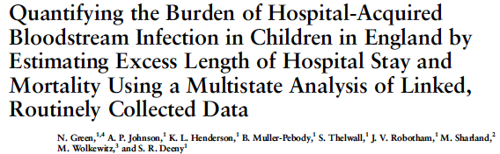
Multistate Model
Each patient enters the model at state 0
May move between states with defined daily probabilities
At each time-point, each patient occupies one of the states.
1. Infection.
LoS 2c
2a. In-hospital death.
0. Admission, No Infection.
2b. Discharge alive.

Slide 28
Extending methodology to look at attributable LoS and mortality associated with E coli bacteraemia and that attributable to resistance and that attributable to inappropriate prescribing
Multistate Model
After adjustment for time to hospital associated-BSI and co-morbidities:
Excess length of stay associated with all-cause HA-BSI was 1.6 days (95% CI, .2–3.0), although this duration varied by pathogen.
Patients with HA-BSI had a 3.6 (95% CI, 1.3–10.4) times higher hazard for in-hospital death than noninfected patients.

Slide 29
Parameter estimation
Data collection / collation
Development of models
Understanding dynamics
Estimation of burden
Intervention evaluation
Informing policy

Slide 30
Impact of changing hospital networks on the spread of hospital-associated pathogens
Patients not always treated in the same hospital
Transfers for specialist care, patient choices, etc.
Form hospital network
Hospital-associated pathogens can spread through this network
This network is not static over the years
We can measure how it changes
And how this affects the spread of HA-pathogens

Slide 31
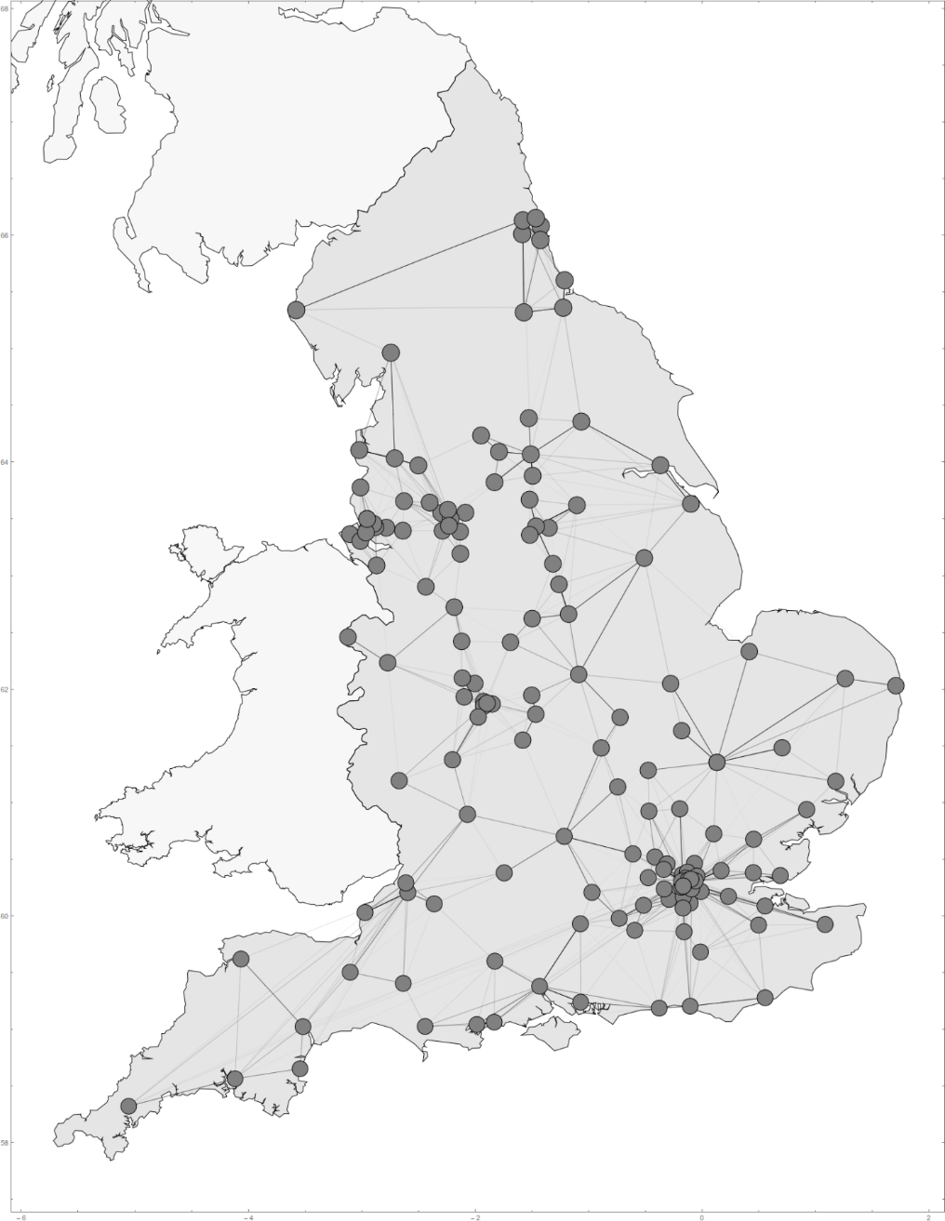
English hospital network
Each connection offers a chance for hospital-associated pathogens move between hospitals

Slide 32

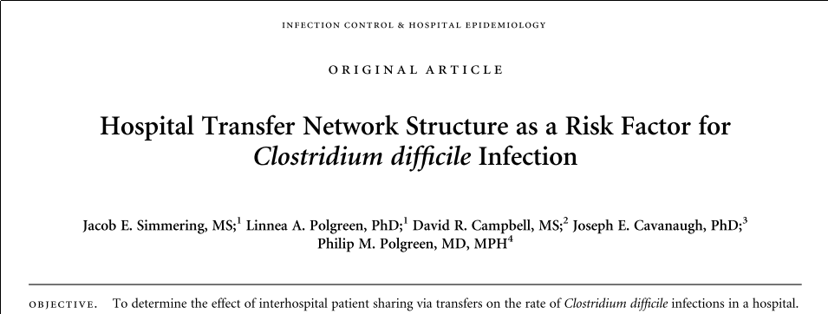

Effect on hospital-acquired pathogens

Slide 33
Incidence differed considerably between regions, reflecting the structure of patient movements between hospitals
Despite large differences in incidence, for any one hospital estimated imported CPE from other regions was a tiny proportion of all admitted CPE positive patients
Hospitals with small CPE problems in the same region pose a larger threat to each other than those regions with large problems, even if the incidence in the other regions is orders of magnitude higher
Donker T , Henderson KL , Hopkins KL, Dodgson AR, Thomas S, Crook DW, Peto TEA, Johnson AP, Woodford N, Walker AS, Robotham JV The relative importance of large problems far away vs. small problems closer to home: insights into limiting the spread of carbapenemase-producing Enterobacteriaceae (CPE) in England. Lancer Public Health In submission

Slide 34
Parameter estimation
Data collection / collation
Development of models
Understanding dynamics
Estimation of burden
Intervention evaluation
Informing policy

Slide 35
How to tackle the issue: control interventions
Tackling AMR and reducing the health and economic burden it causes is a high priority for the Department of Health
Many infection prevention and control strategies exist. However, there remains uncertainty over their efficacy.
results from trials are often contradictory
many methods employed at the same time – which component is having an effect
(if any? [Wyllie et al BMJ Open. 2011])
only a few have been rigorously assessed in clinical trials
effectiveness of strategies may differ between settings e.g. prevalence, specialty
it is not obvious how findings should be generalised between settings
inevitable costs and disruption
Evidence on effectiveness of interventions is growing, however studies evaluating cost-effectiveness are in short supply
Overall, there is little evidence to help decision makers allocate scarce resources

Slide 36

If I was a decision maker, what would I want to know?
Costs
Benefits

Slide 37
If I was a decision maker, what would I want to know?
Costs
Health Benefits

Slide 38
If I was a decision maker, what would I want to know?
Costs
QALY
Can compare against other healthcare decisions – that are also measured in cost per QALY

Slide 39
This is where modelling can help
Can use models when experiments are not possible
Can assess many more interventions than would be possible using randomised controlled trials
Investigation of mulitple scenarios possible (as many as you can think of )
By using a dynamic transmission model it is possible to capture the knock-on effects associated with infectious diseases -therefore can evaluate both costs and benefits of interventions accounting for the infectious nature of AMR organsims
Notes:
What are the characteristics of a disease? Where are the critical control points

Slide 40
Cost effectiveness analysis (CEA)
Costs are expressed in pounds
Benefits are expressed in “natural units,” e.g. deaths averted, symptom-free days experienced by a patient, life-years gained
Presented as a Cost Effectiveness Ratio
Cost per life-year (or other measure of benefit)
The analysis itself can compare different policies or interventions – and say which is ‘better’, but cannot tell you whether it is worth investing in. Now the valuation of the outcome is shifted to the decision maker.

Slide 41
Cost utility analysis (CUA)
Ideally, the benefit will be expressed in Quality Adjusted Life Years (QALYS) …
Provide a numerical score for different states of health
A year in full health = 1 QALY
Death = 0 QALYs
If a year of blindness = 0.5 QALYs, then gaining a year of life of 2 blind individuals is equivalent to gaining a year of life of 1 individual in full health.
Presented as a Cost Utility Ratio
- Cost per quality adjusted life year
It can be regarded as a subset of CEA.

Slide 42
Why QALYs as a measure of outcome?
Combine morbidity and mortality into a single measure
Makes it possible to summarize the effects of an intervention that affects both morbidity and mortality
Makes it possible to compare interventions with very different effect
Can compare across health areas
Can be valued in monetary terms (continues to be controversial!)

Slide 43
1.0
QALYs gained
Quality
of life valuation
u
Health profile with intervention
Health profile
without intervention
0
1
2
3
4
5
6
Time in years t

Slide 44
Theory of hospital associated AMR intervention evaluation
Interventions reduce transmission
Fewer infections
Reduced length of stay
Reduced mortality
More patients going on to accrue quality adjusted life years (QALYs) post-discharge
Greater health benefits (measured in QALYs)

Slide 45
As well as a gain in QALYs, successful interventions should also result in some cost savings, off setting the cost of the intervention
Interventions reduce transmission
Fewer infections
Reduced length of stay
Reduced mortality
More patients going on to accrue quality adjusted life years (QALYs) post-discharge
Greater health benefits (measured in QALYs)

Slide 46
As well as a gain in QALYs, successful interventions should also result in some cost savings, off setting the cost of the intervention
Interventions reduce transmission
Saving
Fewer infections
Reduced length of stay
Reduced mortality
Saving
More patients going on to accrue quality adjusted life years (QALYs) post-discharge
Greater health benefits (measured in QALYs)

Slide 47
Interventions reduce transmission
Cost
Saving
Fewer infections
Reduced length of stay
Reduced mortality
Saving
More patients going on to accrue quality adjusted life years (QALYs) post-discharge
Greater health benefits (measured in QALYs)

Slide 48
If total cost per QALY gained for a new strategy is less than ~ £30,000 a move to the new strategy is considered cost-effective
Interventions reduce transmission
Cost
Saving
Fewer infections
Reduced length of stay
Reduced mortality
Saving
More patients going on to accrue quality adjusted life years (QALYs) post-discharge
Greater health benefits (measured in QALYs)

Slide 49
Transmission dynamic modelling
An example: MRSA transmission and control - cost-effectiveness of alternative screening strategies
MRSA screening has been a widely debated topic over recent years, particularly:
Who to screen?
All patients? High risk patients? Patients admitted to certain specialties?
and how?
Wide selection of screening technologies

Slide 50
Aim
To use transmission dynamic models to assess the effectiveness and cost-effectiveness of MRSA screening and infection control strategies in hospital settings.

Slide 51
Transmission dynamic modelling
MRSA transmission and control: cost-effectiveness of alternative screening strategies
Effectiveness of interventions
Transmission
Movement patterns
Costs
Discharges / Deaths
Additional LoS and mortality
I
C
Transmission
Admissions
S
Ward
Discharges / Deaths
Compare outputs (infections, deaths, QALY gains, costs) under alternative intervention options and alternative scenarios and settings

Slide 52
Evaluating cost-effectiveness of screening and isolation in an ICU
Base Line “Do Nothing” approach - isolation of clinical cases only
Pre-emptive isolation
Of all admissions
Of high risk patients only
Screening (+ isolation of identified positives):
Conventional Culture
Chromogenic Agar
Polymerase Chain Reaction
Of all
Of high risk
Robotham JV et al. BMJ. 2011; 343: d5694.

Slide 53
How effective are each of the strategies?
Baseline
1 Isolate clinical cases only
--------------------------------------------------
2 Universal pre-emptive isolation
3 Pre-emptive isolation of high risk
4 Pre-emptive isolation of high risk
amended according to screen
--------------------------------------------------
5 Screening all CC (isolate +ves)
6 Screening all CA
7 Screen all CA (24hr & 48hr)
8 Screen all PCR
--------------------------------------------------
9 Screen high risk CC
10 Screen high risk CA
11 Screen high risk CA (24hr & 48hr)
Screen high risk PCR
Pre-emptive
Universal screening
Targeted screening

Slide 54
How much do they cost?
Baseline
1 Isolate clinical cases only
--------------------------------------------------
2 Universal pre-emptive isolation
3 Pre-emptive isolation of high risk
4 Pre-emptive isolation of high risk
amended according to screen
--------------------------------------------------
5 Screening all CC (isolate +ves)
6 Screening all CA
7 Screen all CA (24hr & 48hr)
8 Screen all PCR
--------------------------------------------------
9 Screen high risk CC
10 Screen high risk CA
11 Screen high risk CA (24hr & 48hr)
Screen high risk PCR
Pre-emptive
Universal screening
Targeted screening

Slide 55
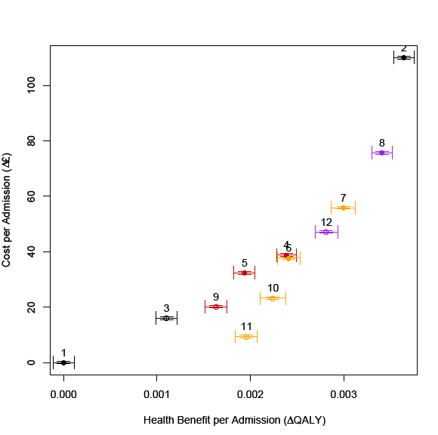
Putting costs and effects together: Cost-effectiveness results
isolate clinical cases only
preemptive isolation of all
preemptive isolation of high risk
preemptive isolation of high risk (amended following CC screen result)
Screen all admissions (+wkly screens) with CC (isolate known +ves)
Screen all with CA
Screen all with CA_early
Screen all with PCR
Screen high risk with CC
Screen high risk with CA
Screen high risk with CA_early
Screen high risk with PCR
Cost
Baseline Strategy/
Existing Practice
Effectiveness

Slide 56
Exclude dominated options
isolate clinical cases only
preemptive isolation of all
preemptive isolation of high risk
preemptive isolation of high risk (amended following CC screen result)
Screen all admissions (+wkly screens) with CC (isolate known +ves)
Screen all with CA
Screen all with CA_early
Screen all with PCR
Screen high risk with CC
Screen high risk with CA
Screen high risk with CA_early
Screen high risk with PCR

Slide 57
Exclude dominated options
isolate clinical cases only
preemptive isolation of all
preemptive isolation of high risk
preemptive isolation of high risk (amended following CC screen result)
Screen all admissions (+wkly screens) with CC (isolate known +ves)
Screen all with CA
Screen all with CA_early
Screen all with PCR
Screen high risk with CC
Screen high risk with CA
Screen high risk with CA_early
Screen high risk with PCR

Slide 58
Evaluate remaining options
Each of these strategies costs something
But we are getting more health benefits
Which strategy gives us the most health benefit
per £ spent ?

Slide 59
Evaluate remaining options
Each of these strategies costs something
But we are getting more health benefits
Which strategy gives us the most health benefit
per £ spent ?

Slide 60
Evaluate remaining options
Each of these strategies costs something
But we are getting more health benefits
Which strategy gives us the most health benefit
per £ spent ?
£5,000/ QALY

Slide 61
Evaluate remaining options
Each of these strategies costs something
But we are getting more health benefits
Which strategy gives us the most health benefit
per £ spent ?
£146,000/ QALY
£47,500 / QALY
£44,000/ QALY
£5,000/ QALY

Slide 62
Evaluate remaining options
Each of these strategies costs something
But we are getting more health benefits
Which strategy gives us the most health benefit
per £ spent ?
Which option is the most
cost-effective is dependent on how much you are
willing to spend per QALY
£146,000/ QALY
£47,500 / QALY
£44,000/ QALY
£5,000/ QALY

Slide 63
Evaluate remaining options
Which option is the most
cost-effective is dependent on how much you are
willing to spend per QALY
£146,000/ QALY
£47,500 / QALY
NHS threshold
If total cost per QALY gained for a new strategy is less than ~ £30,000
a move to the new strategy is considered cost-effective
£44,000/ QALY
£5,000/ QALY

Slide 64
Evaluate remaining options
Which option is the most
cost-effective is dependent on how much you are
willing to spend per QALY
£146,000/ QALY
£47,500 / QALY
NHS threshold
If total cost per QALY gained for a new strategy is less than ~ £30,000
a move to the new strategy is considered cost-effective
£44,000/ QALY
£5,000/ QALY

Slide 65
Evaluate remaining options
Which option is the most
cost-effective is dependent on how much you are
willing to spend per QALY
£146,000/ QALY
£47,500 / QALY
NHS threshold
If total cost per QALY gained for a new strategy is less than ~ £30,000
a move to the new strategy is considered cost-effective
£44,000/ QALY
£5,000/ QALY
Screening high risk patients combined with isolation

Slide 66
How to deal with decision uncertainty
“basic costing studies and economic evaluations of interventions to control infections or improve antimicrobial stewardship are needed”
Roberts & Cookson, NAO Report, 2009.
As a result there exists a lot of uncertainty in both sides of the decision: i.e. in both costs and health benefits
This needs to be accounted for in decision making
to highlight where more information is required
and to be open about how certain we are in our decision of the most cost-effective option

Slide 67
Including uncertainty
Cost
Baseline Strategy/
Existing Practice
Effectiveness

Slide 68
Including uncertainty
Cost
Baseline Strategy/
Existing Practice
Effectiveness

Slide 69
Including uncertainty
Cost
Baseline Strategy/
Existing Practice
Effectiveness

Slide 70
Including uncertainty
Cost
Baseline Strategy/
Existing Practice
Effectiveness

Slide 71
Multivariate results
Multivariate analysis results on a cost-effectivness plane.
Each dot represents the mean of 10,000 simulations run with a randomly chosen parameter set. The results of 1000 parameter sets for each strategy are plotted
= 120 million runs

Slide 72
Cost Effectiveness Acceptability Curve (CEAC)
Show the probability that a particular intervention will be cost effective for each value of willingness to pay for health benefits
Cost Effectiveness Acceptability Frontier (CEAF)
Show the scenario with the highest expected net monetary benefit for a given willingness to pay threshold
i.e. only the probability that the strategy with the highest net monetary benefit is cost-effective for a given WPT is shown.

Slide 73
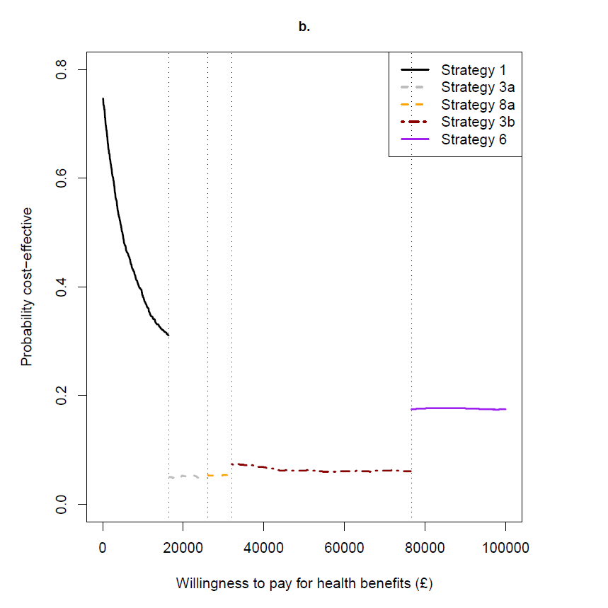
Cost-effectiveness acceptability frontier: Screening and isolation strategies
3
11
4
8
1 Isolate clinical cases only
--------------------------------------------------
2 Universal pre-emptive isolation
3 Pre-emptive isolation of high risk
4 Pre-emptive isolation of high risk
amended according to screen
--------------------------------------------------
5 Screening all CC (isolate +ves)
6 Screening all CA
7 Screen all CA (24hr & 48hr)
8 Screen all PCR
--------------------------------------------------
9 Screen high risk CC
10 Screen high risk CA
11 Screen high risk CA (24hr & 48hr)
12 Screen high risk PCR
Baseline
Pre-emptive
Universal screening
Targeted screening
Screening high risk patients combined with isolation

Slide 74
Using this model to inform decision-making
In 2010 the English Dept. of Health introduced universal MRSA screening of hospital admissions.
This policy had not been subject to a robust economic assessment, despite huge implications for resource use in the NHS, so the DH commissioned a national audit to review the policy post-implementation.
The National One Week Prevalence Audit of universal MRSA screening 2012¹ collected data to provide predictions of the effectiveness and cost-effectiveness of 6 screening strategies for each NHS Trust type:
1) no screening
2) all admissions (emergency and elective)
3) admissions to “high-risk” specialties only
4) checklist activated screening of all admissions
5) all admissions to “high-risk” specialties plus checklist activated screening of all other admissions
6) all admissions plus pre-emptive isolation of those known to be previously MRSA positive
1. Fuller C, Robotham J, Savage J, et al. PLoS One. 2013 Sep 12;8(9)

Slide 75
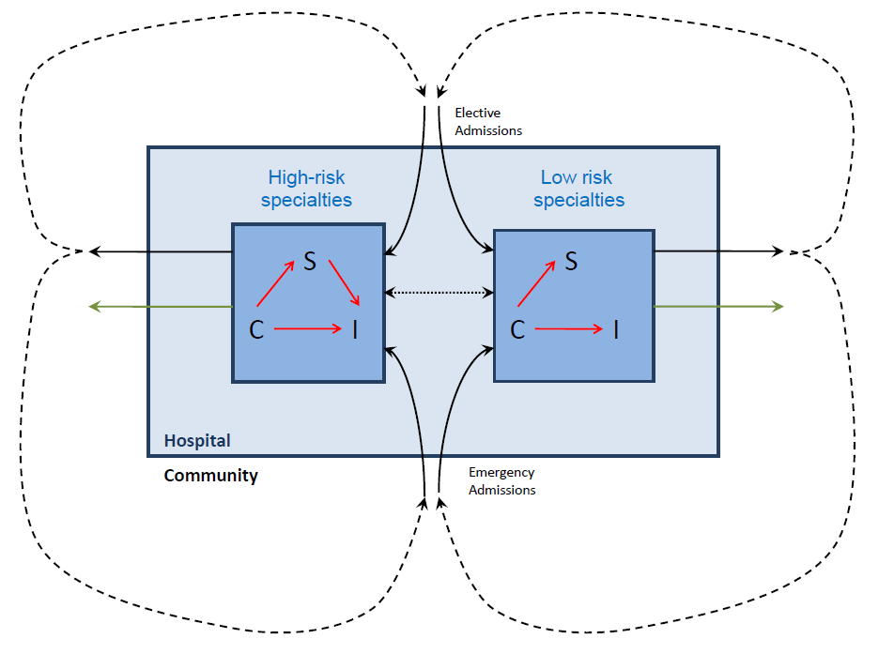
Model structure

Slide 76
Transmission dynamic modelling
MRSA transmission and control: cost-effectiveness of alternative screening strategies
Found universal MRSA screening highly unlikely to be cost-effective in any NHS hospital type, and that changing this policy to screening admissions to high-risk specialties could allow the NHS to save or re-invest up to £420M per year
Led to the DH publishing ‘Implementation of modified admission MRSA screening guidance for NHS (2014)’ recommending NHS hospitals should focus screening on high risk specialties and patients.
Robotham JV, Deeny Sr, Fuller C, et al. Lancet ID. Nov 2015.

Slide 77
Antimicrobial stewardship

Slide 78
Modelling the optimal level of antibiotic prescribing
Analysing individual-level prescribing in primary care to identify and quantify patterns of care and cost-causing consequences of both appropriate and inappropriate prescribing
Model-based evaluation estimating the health and cost outcomes associated with varying levels of inappropriate prescribing
How (and where) can reductions in prescribing be safely achieved?
How low can you go??

Slide 79
Key messages
AMR bacteria represent both a health and economic burden
Given this burden, and the ever increasing threat they pose, increased emphasis has been put on controlling their development and spread
Mathematical models can be used to
compare interventions using the best available evidence
rationally choose between intervention options
identify the optimal use of limited resources
For healthcare associated resistant organisms models tend to be: transmission dynamic, stochastic and individual-based
Additional length of stay due to infection is a dominant cost, but there are methodological difficulties in its estimation
Basic cost estimates and evaluations of interventions are lacking
Consideration of uncertainty in the decision is important
Models can allow quantification of key sources of uncertainty, helping to direct future research into areas where more information could ensure cost-effective decision making.

Slide 80
Acknowledgements
Sarah Deeny
Esther van Kleef
Nathan Green
Tjibbe Donker
Alan Johnson
Alber Jan van Hoek
Ben Cooper
Nick Graves
Sheldon Stone
Barry Cookson

