Slide 1

Warwick Youth Engagement Programmes

Slide 2
Inspiring Families
Christmas Lectures
Family Days
Science Gala

Slide 3
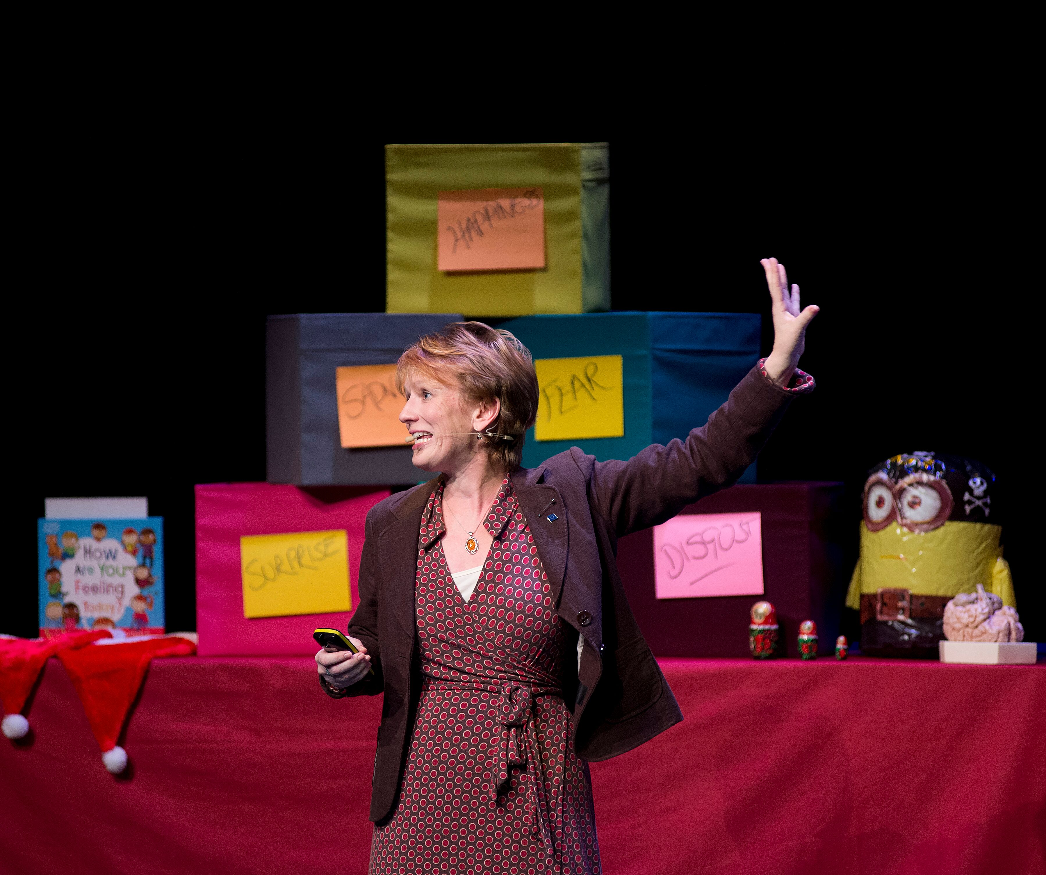
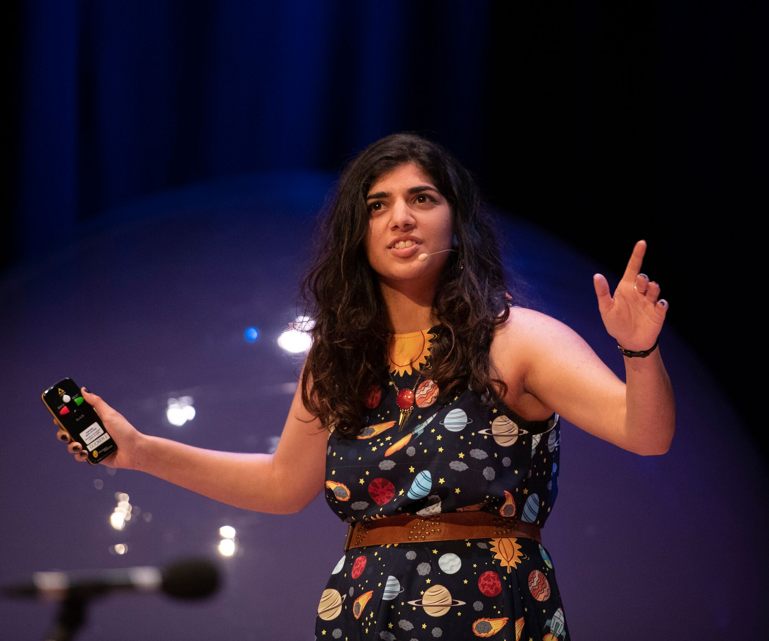
Christmas Lectures
Held annually, to evenings (typically held in consecutive weeks) of fun, interactive lectures involving exciting demos and audience participation. Typically 3 20 minute talks per evenings.
Organised by dept of Physics, but accepts speakers from any STEM subject
Audience is 8+, Family Groups, Kids Clubs e.g. Brownies/ school science clubs
Reach – typically sells out Butterworth Hall – 1.5k attendees at each show. £3.50 cost per ticket.
Objectives:
  Inspire kids
  Highlight that STEM can be fun
  Upskill presenters, and their supporting volunteers

Slide 4
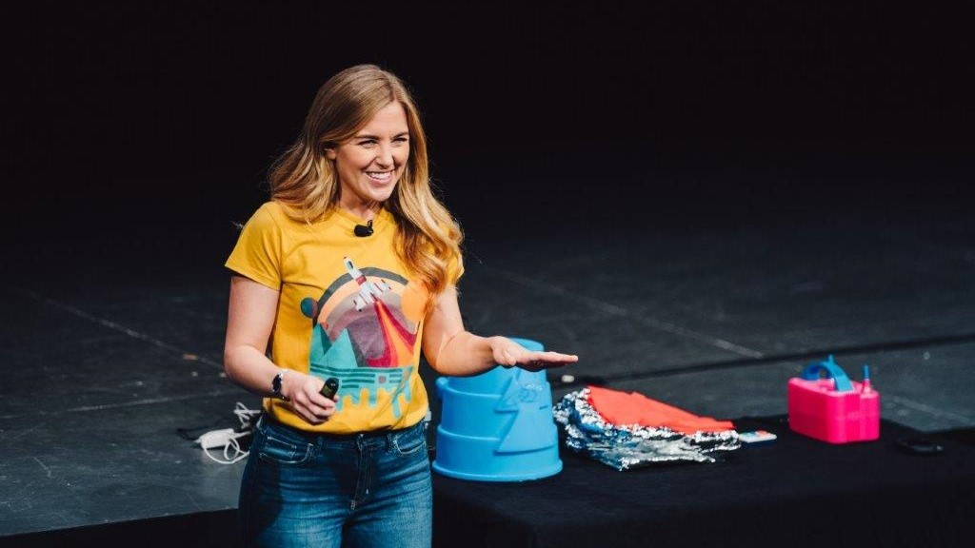
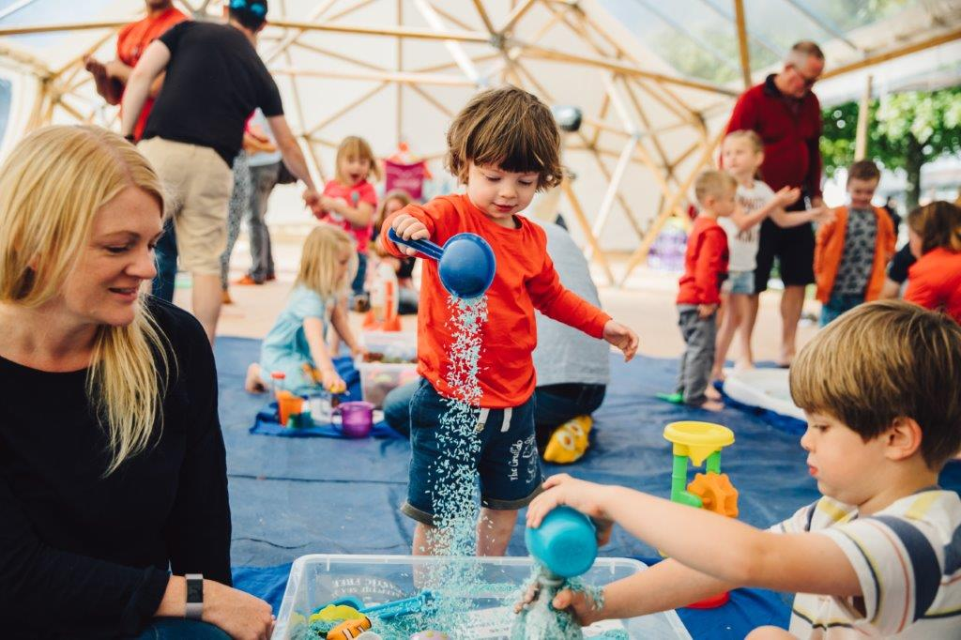
Family Days
Usually held in June and December –day of activities including talks, workshops, shows
Organised by Warwick Arts Centre, chance to promote their own activities, brings in external companies and academics to run workshops and drop in stands – WMG are especially involved, Warwick Sport also heavily involved. Creative Learning team run several of their own activities.
Audience is 1-16 year olds and their families – typically see many more under 11’s than teens visiting.
Reach – 3-5k visitors each event, June typically more popular than December
Objectives:
  Open up the Arts Centre/ Warwick Sport to new audiences
  Inform the public what WMG are working on/ Inspire the next generation of scientists

Slide 5
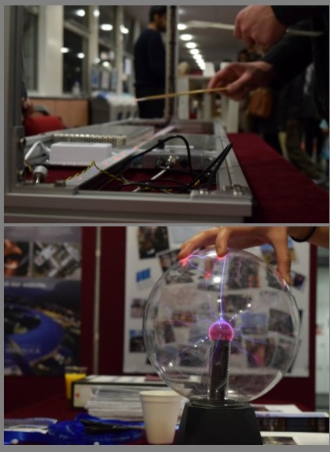
Science Gala
Held annually for one evening each January this event takes over the Science Concourse from 17:30-20:00 with dozens of stalls, workshops, talks, planetarium shows, and free food drink for attendees – all aimed at inspiring families about STEM and showing what STEM careers can involve.
Organised by Dept Physics but open to any STEM subject to participate in
Audience is 5-16 year olds and their families (typically more under 11’s than over)
Reach – Estimated 750 visitors
Objectives:
  Inspire young people to get involved with STEM
  Inform people about potential careers in STEM

Slide 6
Dept of Physics Programmes
Grenoble Visit
Annual 4 day trip to visit EPN Science Campus in Grenoble (in it’s 5th year)
Essay competition for girls in year 12 (16-17) on what was the legacy of pioneering female scientists
16 winners selected who are then invited on the trip, all expenses paid
School Physicist of the Year (no longer running)
Teachers could nominate their top physics student in y12 (16-17) to receive a prize from the university
Winners invited to Warwick for prize ceremony with their family. Opportunity to speak to families about what physics is and what jobs people who work in it can do.
Ogden trust provided funding and winners became eligible for their exclusive scholarship – means tested.

Slide 7
Working with Schools
Outreach/ Widening Participation Team programmes
STEM Up
Departmental Outreach
  Warwick Classics Network
  WMG
  School of Modern Languages
Student Societies
Nick Barker – Hollymount School

Slide 8
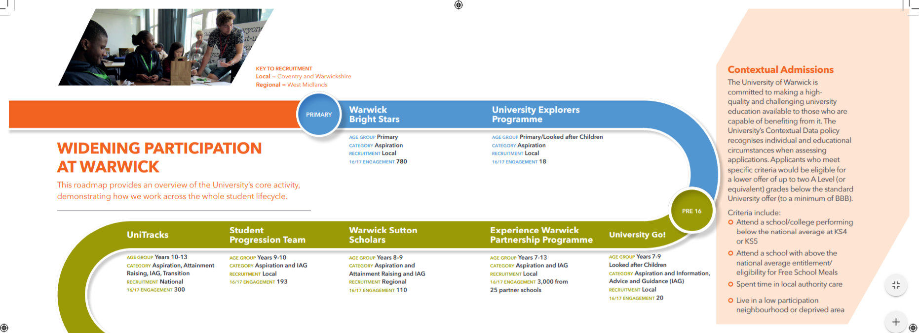
Age: 9-11
Age: 9-11
Age: 14-18
Age: 13-15
Age: 12-14
Age: 11-18
Age: 11-14

Slide 9
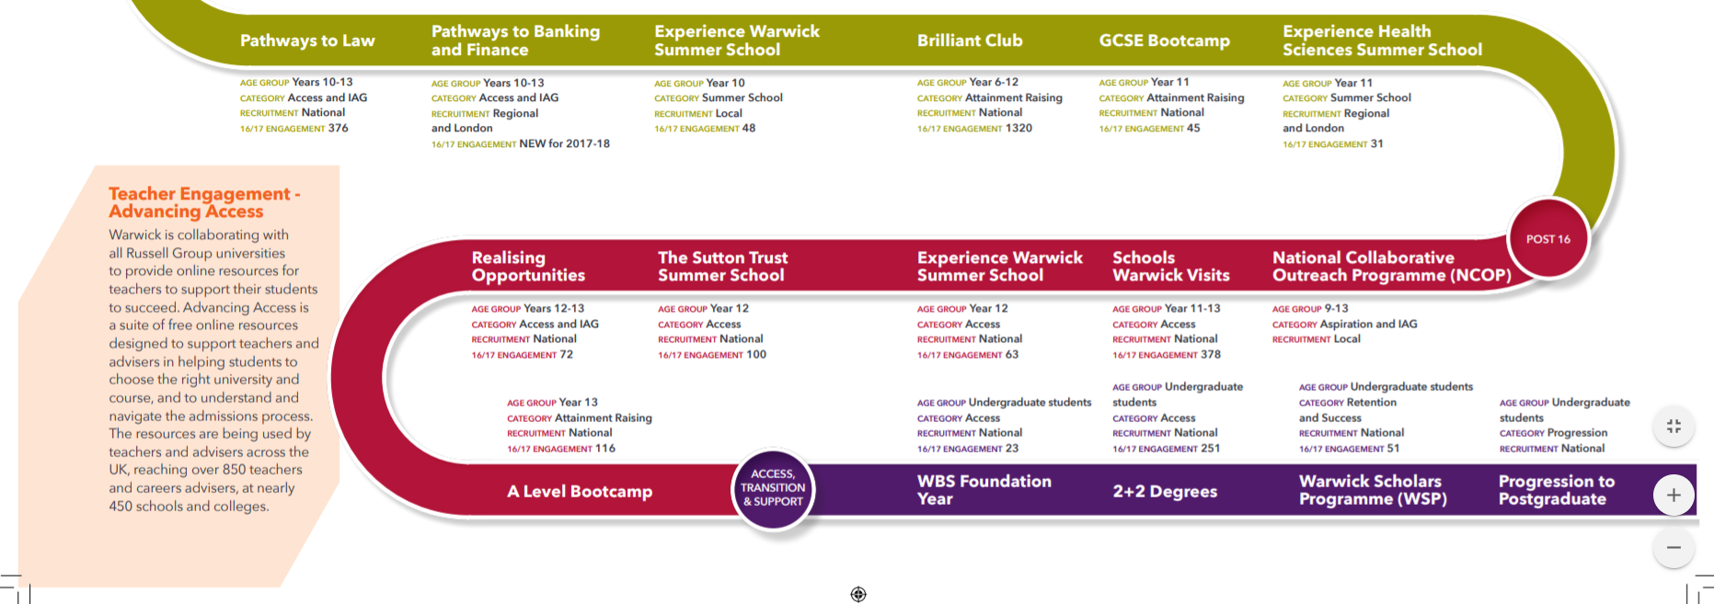
Age: 14-18
Age: 14-15
Age: 10-17
Age: 15-16
Age: 14-18
Age: 15-16
Age: 15-18
Age: 15-18
Age: 16-18
Age: 16-17
Age: 16-17
Age: 17-18
Age: 18+
Age: 18+
Age: 18+
Age: 18+
Visit: https://warwick.ac.uk/study/outreach/whatweoffer/primary-to-postgrad/

Slide 10
STEM Up programme
KS2, Y5&6 (9-11) | Bright Stars Campus visits Modules for y5/6 pupils over 3 week
KS3, Y7,8,9 (11-14) | STEM After School Clubs 10 weeks of After School Clubs, 8 academic sessions 2 careers sessions
KS4, Y10,11 (14-16) | Resource Boxes - Lesson plans and equipment for staff to run 1 hour sessions in school
KS5, Y12,13 (16-18) | Academic Tutoring - Matching our students with WP pupils to build confidence in their ability to succeed
Planned new programme (subject to securing funding) to work with 7 selected schools from the most deprived areas of the region and 1 community based centre (INTO University Coventry)
Activities programmed in from KS2 to KS5
Plan is to be able to longitudinally track the impact of dedicated programmes through pupils school lifecycle and assess the impact (thus the limited number of schools included)
Aim: “By growing aspirations and knowledge about STEM from current academics and students, we inspire our pupils to think about current careers that will take them forward in the real world.”

Slide 11
Warwick Classics Network
Ancient Drama Festival
  Runs annually, being expanded from a 1 day festival to 3 days for 2020, expecting 1,500 students (typically 11-13)
  Resources made available post festival (including full performance recording)for those who can’t attend/ schools to make use of in the classroom
Getting Classics into schools
  WCN working to bring classics to 45% of Warwickshire state secondary schools (11-16) by Sept 2020 (was just 15% prior to launch of WCN in July 2018)
  Have successfully introduced classics to several local WP schools, including Barr's Hill, President Kennedy, and Stoke Park
  The WCN has also been creating a suite of resources for teachers of classics and their students, including the #AskAnAcademic videos for students and teachers in which Warwick academics answer questions on specific topics sent in by schools.
Regularly partake in/ run public engagement and outreach sessions, such as
  Stands at Warwick Family Day/ Connecting Cultures/City of Culture Open Showcase at the FarGo Village
  Weekly Facebook live video sessions with Michael Scott
  Sutton Trust Summer school module
  Ancient Worlds Study Day for 1,000 school children (sessions for KS2/3 and 4/5 [9-18]) and members of the public – Featuring talks and workshops on ancient world, myths and story-telling from top authors such as Natalie Haynes, Emily Hauser, Caroline Lawrence, and Alexandra Sheppard + Warwick Academics. Supported by A. G. Leventis Foundation

Slide 12
WMG
CPD Courses for Teachers, run locally and through Computing at School Coventry Community, in partnership with Coventry University
In school and on campus sessions for pupils (KS2-5 [Ages 9-18]), including: A day in the life of a battery engineer, Illuminating engineering, Electric Vehicle Batter Builder, Royal Institution Engineering Masterclasses, Understanding supply chains, Creative programming and control: embroidery machines
Contribute a module to the Warwick Bright Stars Programme (Y5/6 [Ages 9-11], organised by the outreach team)
Free places at Engineering Society Conferences for y12/13 (Ages 16-18)students interested in engineering
Find out more: https://warwick.ac.uk/fac/sci/wmg/about/outreach/opportunities
Numbers engaged are not recorded

Slide 13
School of Modern Languages
Primary School Languages Day; 180 students aged 7 to 11
  One off event at St Paul’s Primary School in Leamington Spa in 2019, excellent feedback – likely to run again.
  Years 3 and 4 were introduced to Spanish Christmas traditions and Chinese New Year traditions. Years 5 and 6 explored different Christmas traditions in French-speaking countries around the world.
  Objective to show students how far they could ‘travel’ with knowledge of different cultures/languages and to promote the study of languages at a school where there is only one language teacher (French).
A-Level Teacher Day; 20 teachers
  Run once in 2019 – good feedback so hope to run this event again.
  20 teachers from 16 schools attended
  Objective to support teaching of texts at A-Level and facilitate a network for teachers. Also an opportunity for SMLC staff to find out more about the challenges facing MFL teachers and how to support them.
Languages Mentoring Scheme: (with Coventry) 480 students aged 12 to 14
  National mentoring scheme run by Language Horizons with funding from the Department for Education. http://mflmentoring.co.uk/language-horizons/
  Warwick and Coventry are the second ‘hub’ for this scheme in England after it ran in Sheffield last year.
  Student mentors from universities are sent into schools where languages are not compulsory at GCSE to improve the uptake of languages.
  The scheme aims for around 75% of the schools participating to meet widening participation criteria (high pupil premium).
  19 schools in the West Midlands are participating in the scheme this term. Two mentors will be sent to each school. Scheme aims to target approximately 480 students.

Slide 14
School of Modern Languages Continued
Glastonbury Goes Global: 72 students aged 12 to 13
  This event ran for the second time this year on campus on 26 November.
  The event open to schools that qualify for widening participation programmes; students in year 8 (aged 12-13) worked in teams of 6; in total 72 students attended from 8 schools.
  Students are asked to design a music festival in France, Germany, Italy, or Spain. They use their language skills to order materials to build a festival model, to interview local councils and a ‘celebrity’. At the end of the day various awards are handed out to the teams.
  The objective is to show students how they might use languages in the workplace. The event targets students early in year 8 because this is the year in most WP schools where students make GCSE option choices.
Language Centre Video Competition: estimate 40 students aged 15 to 18
  Ran for first time in 2019, plans to repeat (lots of interest shown from schools)
  Students in SMLC have made videos describing their experiences of learning Arabic, Chinese, Japanese, Portuguese or Russian.
  Pupils from local schools are invited to come and watch the videos and act as judges, voting for their favourite video. Last year approximately 20 students from local schools attended, most aged between 16 and 18.
  Objective is to promote the study of other languages not traditionally taught in schools and to give students a taster of what picking up a new language at university might involve.
  https://warwick.ac.uk/fac/arts/languagecentre/news/videocomp/event/

Slide 15
School of Modern Languages Continued
Other events in planning for 2020:
SMLC taster day: for students in year 12 studying a language to A-Level; we will run lectures and seminars to give a taste for what a languages degree involves. The event will be open to all but we will try to partner up students that qualify for widening participation programmes with some of our WP student ambassadors before the event and on the day. The day aims to showcase the cultural components and variety of a languages degree; the WP element of the day aims to make languages at university accessible. Anticipate between 50-100 students will attend.
Event for year 10 (14-15 year olds): hoping to run an event for year 10 in June to target students soon to make their A-Level subject choices. Anticipate 90 students will attend.
SMLC working to establishing a network for MFL teachers and students in Coventry/Leamington and north/east Birmingham where we are in touch with a few secondary schools. Languages are not being taught to A-Level in most local schools that qualify for WP programmes, in several schools there is only one student studying a language at A-Level. Plan to support such students by providing taster/revision sessions and/or putting them in touch with some of our student ambassadors via school or campus visits.
Contact Holly Langstaff further info - H.Langstaff.1@warwick.ac.uk

Slide 16


Student Societies
ChemSoc
Visit roughly 8 schools per term (terms 1 and 2 only)
Able to run sessions for primary – 6th form (8-18)
Repeat visits to: Grange Farm, Paddocks Primary, All Souls, Budbrook, Blue Coat. New schools on request
Also do visits to local PHABS – Children and adults with disabilities
Run a climate change conference for students. 1 or 2 schools invited to attend free (our students pay £2) – GRP sponsored
Helps build skills of students as well as giving back to community
Support department events e.g. Science Gala/Christmas Lectures
Inspire Society
Aims to tackle educational inequality and inspire change
Student volunteers deliver sessions to pupils in local schools, encouraging them to consider the possibilities of higher education, discussing barriers to entry and sharing our personal experiences with them.
2019/20 spoke to 3 schools, 25 pupils at each.
Typically speak to Y8-11 (Ages 12-16)
Launching a conference (Inspire+), one full day on campus, discussing topics such as university funding, opportunities and teaching. Attendees will get the opportunity to ask any university specific questions, before breaking off into self-identified groups and supported discussions led by our guest speakers.

Slide 17
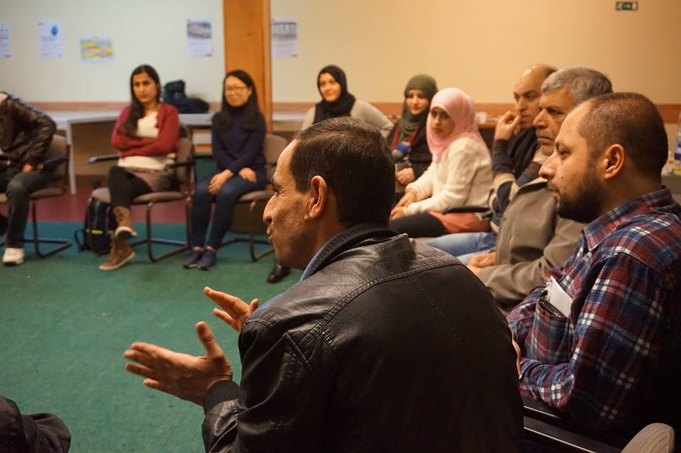
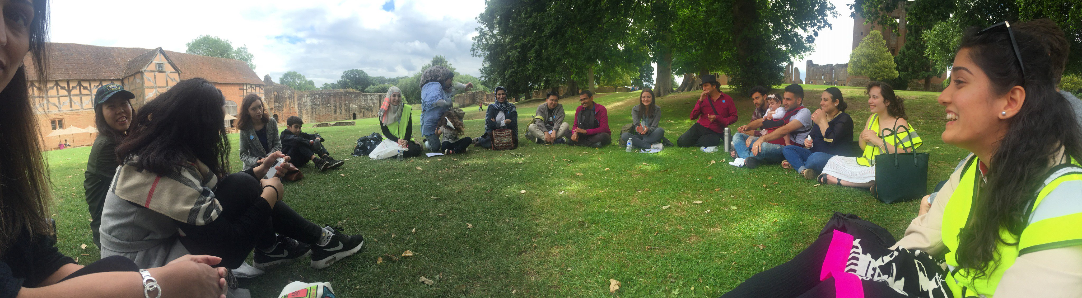
Student Societies
Warwick Chapter of STAR - Student Action for Refugees
Not all activity with children – fundraising and awareness raising of matters concerning Refugees and Asylum Seekers in Europe
Largest activity is Conversation Club - three times a week volunteers will travel up to Coventry City Centre to sit down with newly arrived Refugees that have been settled in the Coventry area. Aim to help with English skills. Ages can range from teenagers to participants in their 60's and 70's. Numbers not recorded, approx 30-40 participants per year.
Creating a Homework Club for refugee children to support where they may not have parents who are able to support them – will be set up in a local primary school.
Provides an opportunity for our students to make a meaningful contribution to Coventry and build bonds with participants.
Very active society - 100 active members, 350 people on their mailing list and 1000+ social media followers.

Slide 18
Student Societies
Mind Aware
Volunteer project delivering workshops on mental health and wellbeing to KS3 students (11-14)
Estimate 600 pupils a year, 25 sessions to classes of 30.
Develops student skills/ confidence in a classroom
Provides an opportunity to give back to pupils and address some of the wider shortcomings with mental health provision for young people.
Annual Conference on Research in Natural Sciences (ACORNS)
Researchers from WMG, Engineering, Physics, Chemistry (many students, via student societies) present their research to local A-Level students
Schools attending Finham Park; Coundon Court; Arden Academy and Solihull 6th Form College
Organised by students
250 attendees annually

Slide 19

Student Societies
Law Society
Law Trek
  Aim to inspire college students to think about higher education or their career prospects, particularly in the field of law.
  Debunk the myths that law is inaccessible to many or too daunting a career to consider.
  Done through school visits, CV workshops and practical advice given by students, many of whom study law or wish to convert to a career in the law following their degree.
Youth Inspire
  Aim to inspire children in schools to engage with current events and politics through school visits
  Visits consist of presentations and workshops, as well as dedicated seminars exploring different themes and issues
UNICEF On Campus
Schools Project
  Volunteers visit schools in Leamington, Kenilworth and Coventry to organise workshops focused towards primary school students (7-11)
  28 sessions across 6 schools in 18-19

Slide 20
Student Societies – Sport
Ladies’ Hockey
Volunteer coaching at Leamington Junior Hockey club
  2-3 students attend each Sunday morning
  Support over 200 children each week, with ages ranging from 6-14
Play in the Warwickshire Women’s Hockey league for ages 14+, so regularly play against local youths
Volleyball Club
Promote the sport to local youth by going out to local school PE sessions and after school clubs
This year:
  6 week after school club at Kenilwoth School and 6th form with 15 children
  2 weeks teaching PE at Stoke Park school Cov, 150 children
Ran a session with Warwick PGCE PE teachers on how to play/ teach volleyball to children – addressing an issue that it’s a widely under taught sport despite being on the national curriculum.
Ran an event at Family Day for 50 children and their families
Run a paid for junior volleyball club on Saturday mornings with 19 kids.
Men’s Cricket
Run a free, weekly after school cricket club for St Paul’s C of E Primary School
Several students volunteer as coaches for Complete Cricket to deliver coaching in the local area, especially at Leek Wootton and in Stratford.

Slide 21

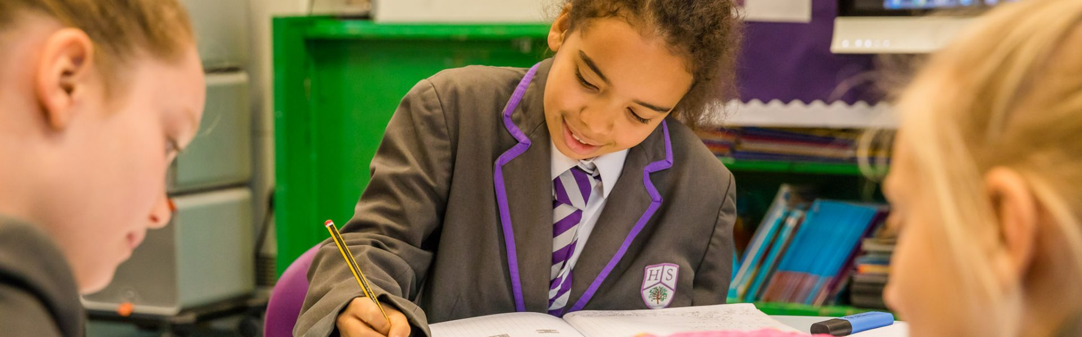
Nick Barker – Hollymount School
Based out of Worcester primary school - WR4, 86% are growing up in relative poverty. No one ever goes to university
Reporting back to the uni about what stops the kids getting out of this situation
450 pupils – supports them via assemblies, tutorials in maths and science, bringing in guest speakers.
Additionally doing assemblies for up to 2 other schools a week - usually back up in Coventry.
Resources are paid for by Chem dept – no other outreach work done by them.
Before this Nick spoke to 70-80,000 people in 11 years programmes run from the Chem Dept.

Slide 22
Into University

Slide 23
Into University Coventry
IntoUniversity Coventry opened in autumn 2018 in partnership with the University of Warwick
Programme of support provides children and young people from disadvantaged backgrounds with the help they need to achieve their potential… includes:
  Academic Support (e.g. homework support, tutoring, UCAS forms, Interview techniques)
  FOCUS Programme
    The school curriculum gives little sense of the university experience of concentrated, passionate learning in a specialist area. The FOCUS Programme offers young people learning experiences which aim to immerse them in a single topic or subject area. It includes: primary school workshops and FOCUS Weeks ; secondary school workshops and holiday FOCUS activities; Extending Horizons weekends away; and after-school Careers in FOCUS.
  Mentoring – students 10-17 paired with university student mentors
  Corporate Mentoring Scheme - Year 13 (17-18) students are paired with graduates in full-time employment
  Employability Support

Slide 24
Skills Development
Degree apprenticeships
Apprenticeships at Warwick

Slide 25
Degree Apprenticeships 18+
Warwick offers degree apprenticeships in
  BEng Applied Engineering
  BEng Civil and Infrastructure Engineering
  BEng Cyber Security Engineering
  BSc Digital Technology Solutions
  BEng Engineering with Dyson
  BSc Digital Healthcare Science
  PgDip Engineering Business Management
  MSc Senior Leadership Development
  BA Social Work
Apprenticeships team promotes degree apprenticeships (both as a general concept and those running at Warwick) to students in Y11-13 (16-18) through:
  Presenting at careers evenings
  Stands at skills fairs
  Presentations at UCAS conference
Future plans include:
  Dedicated pre-apprenticeship maths bridging programme – enabling non traditional learners, or those who haven’t achieved a high enough maths grade to benefit
  In discussion with Sutton Trust about the possibility of establishing Pathways into Apprenticeships programmes (Engineering and Digital)
Currently speaking <1,000 students a year – looking to grow this

Slide 26
Work Placements/ Apprenticeships at Warwick
Apprenticeship roles at Warwick
Accountancy / Taxation Professional L7
Advanced Carpentry and joinery L3
Business Administrator Level 2
Business Administrator Level 3
Chemical Engineering Technician L3
Children's & Young People's Early Years Educator Level 3
Children's and Young People's Workforce Level 2
CIPD - HR Support L3
CIPD - L&D L5
Early Years Educator Level 3
Electrical / Electronic Support Engineer Level 6
Engineering Technician Level 3
Horticultural Landscape Operative Level 2
Manufacturing Engineer Level 6
Marketing Apprenticeship
Marketing Level 2
Marketing Level 3
Propulsion Technician
Snr Leaders Masters Degree
Sports Turf Operative Level 2
Unspent apprenticeship levy pledge – we have recently pledged £280k to support apprenticeships in the West Midlands region.
T-levels – we will be trialling industrial placements for T-level students next year with a view to expanding this opportunity.
Ambitious Futures graduate scheme
Graduate schemes in finance and estates
WMG and the Nursery each take on a new apprenticeship cohort every year – sustained investment in these roles.
Warwick Arts Centre have managed to secure the full costs for apprentices as part of their social funding bid to develop the arts centre and have a number of apprentices currently working and roles out to advert which are all entry level.

Slide 27
Other activity
Warwick Arts Centre programmes
Warwick Volunteers
Royal Society Summer Exhibition
Warwick Sport
Slice of Science

Slide 28
Warwick Arts Centre Programmes
Resources and What’s on guides for teachers/ home educators
Work experience opportunities for year 10/11 pupils (14-16) (2 week long placements each year)
Youth Theatre Groups (Juniors, 8-11, Seniors 12-16) and Connections Company (14-19)
MI:Lab – Weekly workshops for young people to learn skills relating to digital arts
STAMP IT – free activities for young children (currently on hiatus)
Monthly concert series, with 1,000 free tickets for schools from Warwickshire, Coventry and Solihull. (100 per concert)
Free lunchtime concerts every Thursday – half term concerts child friendly

Slide 29
Warwick Volunteers Programmes
Fun with Numbers
Groups of volunteers lead weekly sessions in primary schools playing fun maths board games with children aged 4-11 years old aiming to:
Encourage pupils to have fun whilst learning
Improve numeracy skills
Increase levels of confidence and skills in maths.
Bake it Up!
Aims to improve the self-esteem of young people by allowing them to get creative in the kitchen and achieving something they can be proud of.
Volunteers run two after school clubs (1 primary 7-11, 1 secondary, 11-13), which enable participants to develop new skills, learn to work as a team and gain knowledge about various ingredients and foods.
Kidz Camp:
4 day residential trip for primary aged pupils receiving pupil premium/ free school meals. 30 pupils per year. Entirely planned and organised by student volunteers.
Right to Read programme:
As a Right to Read volunteer you will work with children one-to-one or in small groups at local primary or secondary schools aiming to:
  Improve their reading ability
  Increase levels of confidence and self esteem
  Inspire a love of reading for life
Student Tutoring
The Student Tutoring project places volunteers in a classroom in Primary, Secondary and SEN schools across Coventry, Leamington, Kenilworth and Warwick. Volunteers will take on a teaching assistant role and work alongside class teachers to provide support to pupils.

Slide 30
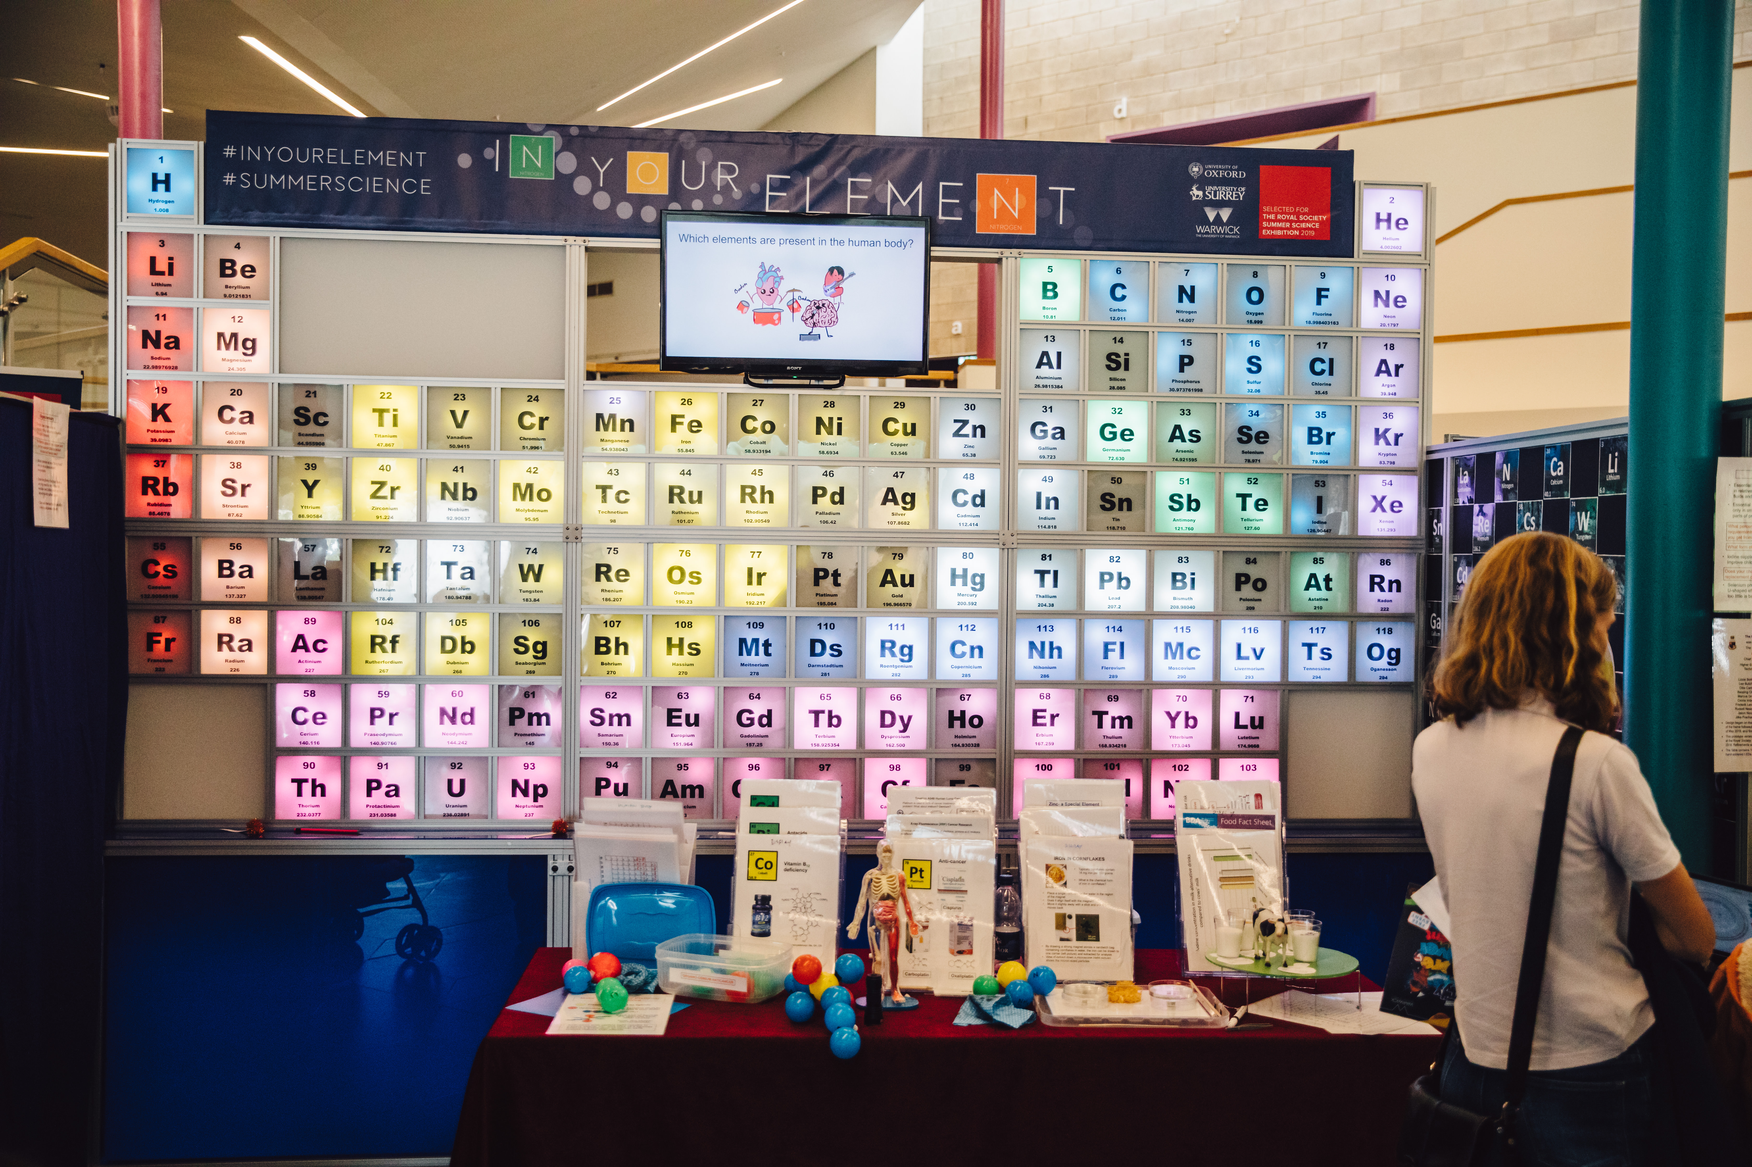
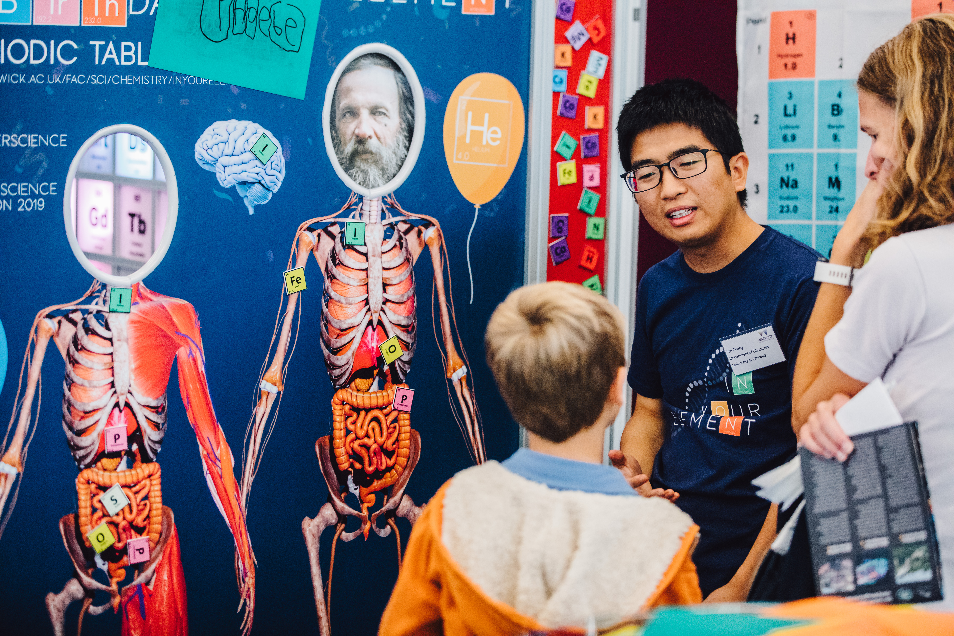
Royal Society Summer Science Exhibition
Annual event every summer held at the Royal Society in London
Universities/ research centres apply to have a stand as part of the showcase – very competitive call, training on producing a high quality stand also provided to all exhibitors, results in some very high quality stands.
During the week schools are invited to bring their students to visit the exhibition, one evening is reserved for adults to visit, and the last day is a public day for families to visit.
Each year over 14,000 members of the public, including 2,500 school students, visit the Summer Science Exhibition. Many more are reached through coverage on TV, in the media and online.
Warwick has run two exhibits in the last 10 years, Diamond Research Group and Dept of Chemistry (In your element – pictured right). QBP submitting for funding to apply in 2021.

Slide 31
Warwick Sport
Community Outreach Hubs for Football and Rugby Ian to confirm how many engaged with/ ages
  Warwick Lionesses; girls aged 12 - 16 football sessions
  FA Wildcats; girls aged 5-11 football sessions
Active Family Sessions, swimming, climbing, tennis and more, 3-16.
  150 members of the Saturday morning climbing club – open to 7+
Sponsor local events (e.g. Balsall Common 10km)
Race for Life at Warwick in 2020
Climbing birthday parties
Holiday camps – 5-16 year olds
Junior tennis club sessions – 3-4, 8-10, 11+

Slide 32
Slice of Science
Date | Event | Time | Event Location | Expected Audience | Expected Numbers
Thursday 6th March 2020 | Slice of Science Coffee Morning Foleshill Women’s Trust (FWT) Coffee Morning. Academic interactive session Activity run for the young people/children present. | 10am – 12pm | Foleshill, Coventry | Mums, Dads, Grandparents, Carers, aunties, community members | 20
Sunday 8th March 2020 | International Women’s Day Slice of Science Event Focus on Intergenerational science. Leading women in research showcase with interactive workshops/stalls. Afternoon tea | 1pm – 4pm | University of Warwick | Female family members, community members i.e. grandmas, cousins, aunties, mums, children. Not to exclude men though, all welcome. | 100
Wednesday 11th March 2020 | Slice of Science Schools Day Science taster day with a focus on Women in Science | 9:30am – 2:30pm | University of Warwick | School Students in Years 9 and 10 (13-15) | 120
Thursday 12th March or Friday 13th March 2020 | Slice of Science Cake Morning Nuneaton Treacle Tarts (WI) Academic talk and interactive session | tbc | Nuneaton Heritage Centre Avenue Road, Nuneaton CV11 4LU | WI members and relations | 20
Planned for British Science Week (6-15 March 2020)/ International Women’s Day, series of events on the theme of Relationships.
Objectives:
  1) To reach new audiences and communities not currently engaged in our work
  2) to help with promotion of PoS
  3) Provide opportunities for our female SEM researchers to promote their research more (and be ambassadors for more women to go in to Science careers) – Diversity and equality

