Slide 1


Slide 2
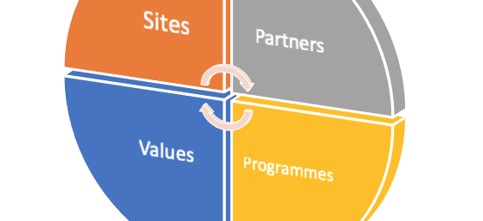

Internationalisation @ Warwick
Internationalisation at Warwick is a dynamic, ongoing, transformative process of enhancement. It enables us to address global challenges, articulate the local specificity of complex problems, transcend disciplinary, language and national borders through our curricular/co-curricular offering, research priorities, partnerships, campus and global presence. We recognise and value the vital contribution of international students to our global learning community and aspire for all Warwick students to develop intercultural competency and curiosity, able to operate and communicate effectively in global teams and environments.

Slide 3

International
C.12%
STUDENTS FROM EUROPE
700+ students undertake study abroad each year
C.60%
C.28%
STUDENTS FROM UK
STUDENTS FROM OVERSEAS
Student enrolment figures Oct 2020 (based on Country of Domicile 2020/21); HESA data 19/20
Notes:
Warwick is an international university with students and staff from a diverse international community. We have significant cohorts of students from China, India, Hong Kong and Malaysia as well as from the UAE, Singapore and Nigeria. In addition, you may also be interested to know that usually around 700 study abroad placements are undertaken by students to work or study with partners worldwide.

Slide 4
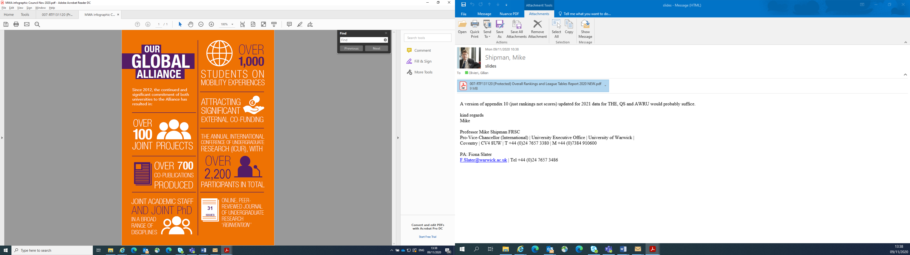



Strategic University Partners
Notes:
Eutopia
EUTOPIA is a challenge-led, student-centred, place-based inclusive alliance of entrepreneurial, change focused universities.
Our joint mission is to build a distinctive, daring and driven alliance of transformative and engaged institutions:
To produce challenge-driven research and teaching
To prepare empowered European graduate employment
To lead regional and international involvement
To support diversity, inclusivity and widening citizenship
The EUTOPIA alliance is committed to delivering open, innovative and inclusive higher education in Europe.
For students considering studying overseas the partnerships enable students to engage with the partners throughout the networks.

Slide 5


Slide 6

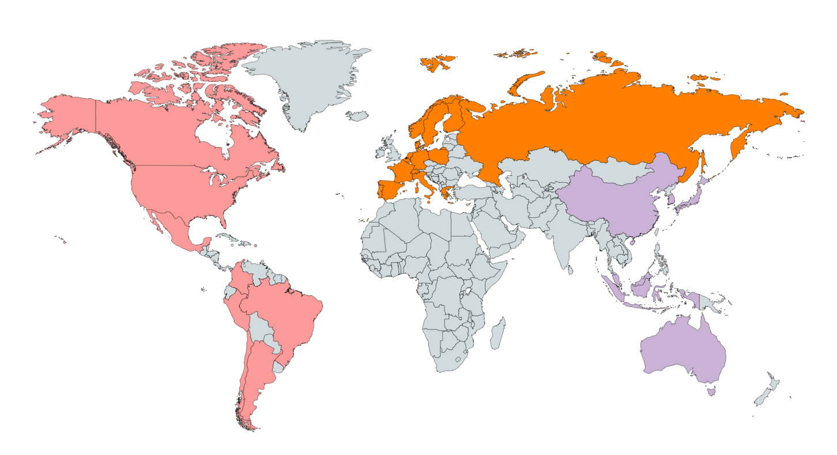

Study Abroad: Partners throughout the world.
https://warwick.ac.uk/services/studentopportunity/studentmobility/studyabroad/partnerinstitutions/
Opportunities (warwick.ac.uk)
Notes:
Full – year options or depending on your department. You may work for half a year and study for half a year.
Currently all Warwick intercalated opportunities are for one year.

Slide 7
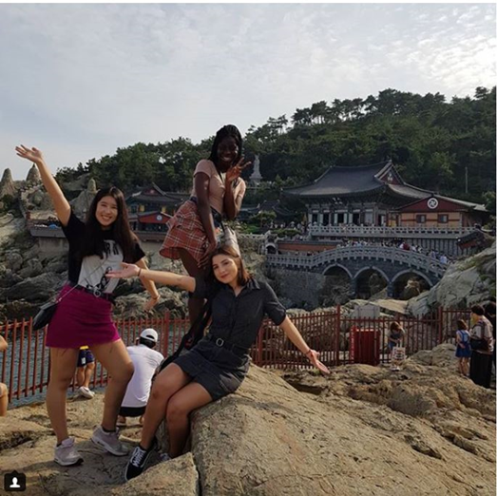


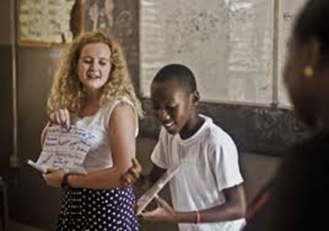

International opportunities to:
Study
Work
Volunteer
Research
IN PERSON or VIRTUAL
Opportunities can include:
DURING TERM-TIME
Department-led visit
Term abroad
Year abroad
Work placements
Warwick in Venice
OUTSIDE TERM-TIME
Summer Schools
Language Courses
Volunteer placements
Research show those who undertake international study or work experiences are:
9% more likely to gain a 2:1
24% less likely to be unemployed
9% more likely to be in a graduate job six months after graduation
5% higher earnings after six months of graduation
Funding support for students may include (confirmed on an annual basis):
Fully and partially funded short term mobility during summer vacation
Turing Scheme: work and study
warwick.ac.uk/studentmobility

Slide 8
Examples of activities Turing funding may be able to support:
International experiences lasting 4 weeks+ including:
Summer Schools
Summer volunteering programmes
Some full or part-year exchange programmes
What is the Turing Scheme?
Government funding to support students from UK universities to engage in international experiences.
Who can Turing Scheme funding support:
Students who meet one or more WP criteria are particularly supported by Turing Scheme funding.
Funding may have limitations (confirmed annually) and it should be considered as additional support rather than relied upon to finance study abroad.
Notes:
Slide 8
The Turing Scheme is a Government funded initiative to support students from UK universities to engage in international experiences.
Funding is dependent on allocation on an annual basis. As funding cannot be guaranteed it should be considered as additional support rather than relied upon to finance study abroad as the finance can vary on an annual basis. Students from a WP background are prioritised for any funding if awarded.
Examples of activities Turing funding may be able to support:
International experiences lasting 4 weeks+ including:
Summer Schools
Summer volunteering programmes
Some full or part-year exchange programmes

Slide 9


Slide 10


Warwick Intensive Study Programme
A flagship programme providing a wide range of cross-departmental undergraduate modules with a multi-focal and interdisciplinary approach.
Students study intensively alongside others from top international universities in the world, attending blended credit-bearing modules taught either face-to-face or in a hybrid format over 2-3-4 weeks.
When?
Term 3 into early summer
Cost
No additional fees
Where?
On Warwick campus and relevant European locations
Numbers
100+ students, attending up to two modules/projects
Notes:
A flagship programme developed under the Monash Warwick Alliance, providing a wide range of cross-departmental undergraduate modules with a multi-focal and interdisciplinary approach.
Students study intensively alongside others from top international universities in the world, attending blended credit-bearing modules taught either face-to-face or in a hybrid format over 2, 3 or 4 weeks.

Slide 11

TeamWork is a virtual international programme bringing together multi-disciplinary teams of up to 8 students from universities around the world to collaborate on a specific challenge provided by an organisation.
These organisations are based all around the world, and represent a range of different sectors – including global sustainability, business, technology, health, arts and culture. Types of project include marketing and social media, consultancy and innovation.
Bursary support and priority applications are provided for participants from under-represented demographic groups.
Virtual International Programme
Cost
No fees.
When?
Term 3
Numbers
675 places offered in 2022
Feedback
“TeamWork has been a highlight of my university experience”
Notes:
Now in its fifth year, TeamWork is an established international programme connecting teams of multi-disciplinary, multi-national students from Warwick and top global universities, who work together remotely to provide solutions to a project or challenge provided by an international organisation.
Students benefit from work experience in an international context, while developing their project management, communication, teamwork, innovation and intercultural skills – leading to enhanced graduate outcomes.
There are three streams to TeamWork:
Alliance - Warwick students working with students from Monash Australia and Monash Malaysia
Global - Warwick students working with students from Shanghai Jiao Tong University, Cornell University, Hong Kong University, University of Toronto and new for 2023, students from IIT Delhi.
EUTOPIA – Warwick students working with students from 6 of the EUTOPIA partner universities.
In 2022:
244 Warwick students were offered a place
31% of applicants were UK-domiciled; majority of departments represented
76 qualifying students who took part received a £400 bursary
431 partner university students from Australia, Malaysia, India, Canada, Hong Kong, Singapore, China, Belgium, Slovenia, Sweden, Spain, Ljubljana and France were offered a place on the programme.

Slide 12


Global Challenge programme
Students from across a range of subject areas team up virtually with their counterparts from Shanghai Jiao Tong University over three weeks to jointly research and present possible solutions to key global challenges, drawn from the UN Sustainable Development goals.
Projects are student-led, with guidance on research methodology and relevant sources provided by academic experts at SJTU and Warwick.
When?
Term 3
Cost
No additional fees
Where?
Online
Numbers
15 places

Slide 13

International Conference for Undergraduate Research (ICUR)
An annual, two-day academic conference that showcases the best in undergraduate research from around the world. Warwick students are joined by others from Monash and our many international partner institutions.
It provides the opportunity for undergraduate researchers to present their work from their own country and link with fellow presenters in joint sessions via video-conferencing technology.
When?
End of September
Cost
No additional fees
Where?
On campus
Numbers
550 student presenters annually
Notes:
ICUR is also recorded on students’ Higher Education Achievement Record (HEAR) and contributes towards the Warwick Award

Slide 14

Undergraduate Research Support Scheme (URSS)
Enables undergraduate students to carry out a summer research or public engagement project.
The scheme is open to any UG student at Warwick, in any year including first and final year students. Applicants can apply for a URSS bursary to undertake their research project, either in the UK or abroad, for between 6-10 weeks.
When?
Summer
Cost
Bursary up to £1500
Where?
UK or abroad
Numbers
Over 270 students

Slide 15

Warwick in Africa (Community)
A programme consisting of two core elements: a Student Volunteering programme and a Teacher Support programme - the main subject focus being Mathematics and English.
Voluntary opportunities for students also include fundraising and ambassador roles, in addition to provision devised to support the development of a broad range of skills.
When?
Year round but school placements during summer vacation period
Cost
The programme is philanthropically funded and will receive Turing funding in 2023 related to school placements.
Where?
Ghana, South Africa & Tanzania
Numbers
24 school placements in 2023
Unlimited opportunities to participate in community events and activities
Notes:
Warwick in Africa:
Supports and partners with 23 schools across Ghana, Tanzania and South Africa with the teaching of English and Maths through volunteering placements -alongside offering professional development opportunities for local teachers.
It is an University run and managed programme - places are fully funded, anyone can take part. You just need to reach a fundraising target of £1000 which we support you with.
ability to teach Maths or English up to UK A level standard
You don’t have to have taught before, but you should be confident that spending a summer teaching is something you would enjoy (placements are between 4 – 7 weeks)
Applications in November annually

Slide 16


Slide 17


Internationalisation at Home - the international and intercultural learning opportunities you can have at Warwick, without leaving campus.
What’s in it for me?
Make connections with people from all over the world
Get to know yourself and your culture in greater depth
Challenge yourself and develop your intercultural competence Develop your ability to work in multicultural teams
Enhance your CV and gain valuable interview material
Fun, friendship and global citizenship
How can I get involved?
Join our student intercultural training programme; become a member of our Global Connections Community; take part in our campus cultural celebrations through the Warwick Presents programme and so much more

Slide 18

Intercultural Training
Highly interactive and experiential programme aimed at helping students to better understand, communicate, and build effective relationships with those from different cultural backgrounds without resorting to stereotype.
Provides students with the opportunity to enhance skills that are highly sought after by employers.
2000
Students attended a workshop in one year
“This was incredible - honestly the best workshop I have ever attended”
- Student feedback

Slide 19
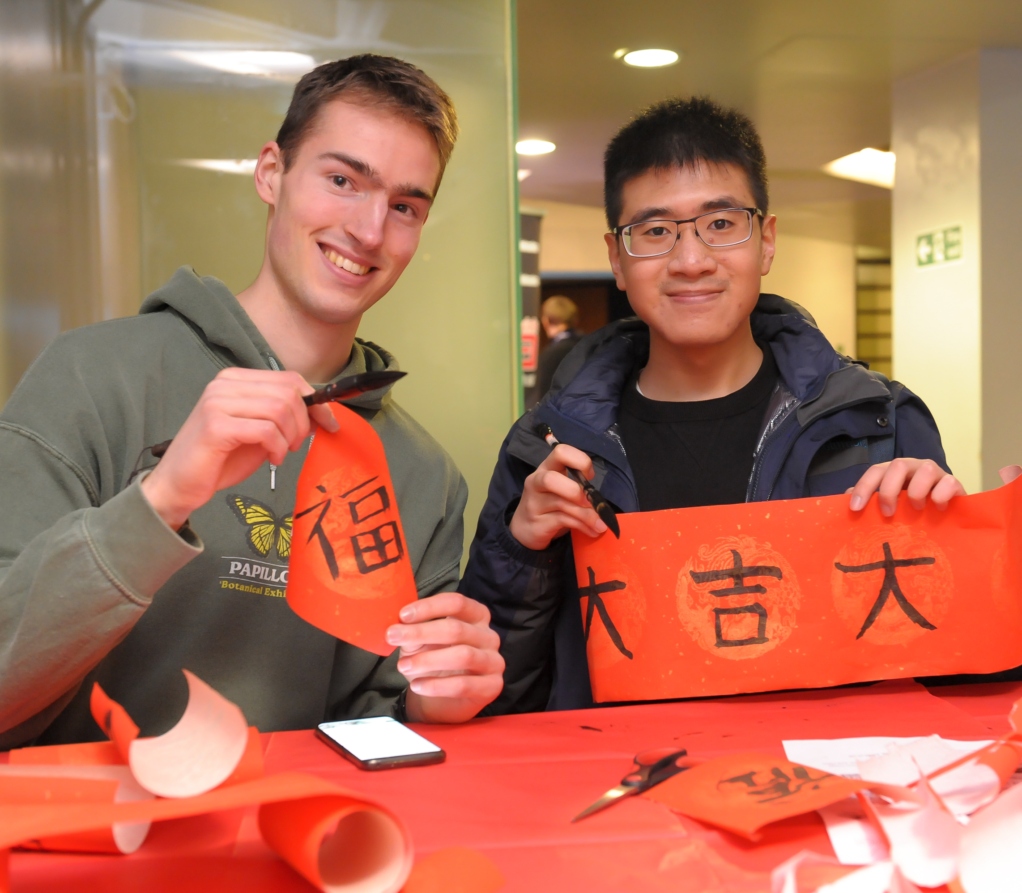
Global Connections
warwick.ac.uk/globalconnections
We welcome ALL students - home & international; undergrad & postgrad!
Meet friends and connect across cultures at our informal social and
cultural events.
Connect around shared interests in our friendly online space.
Regular social events

Slide 20

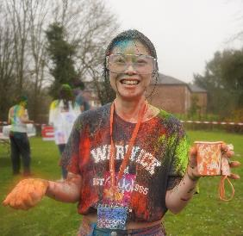
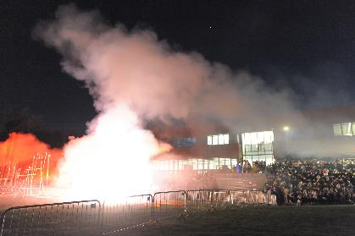
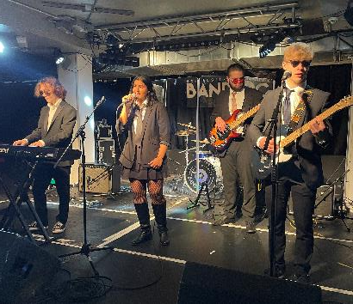
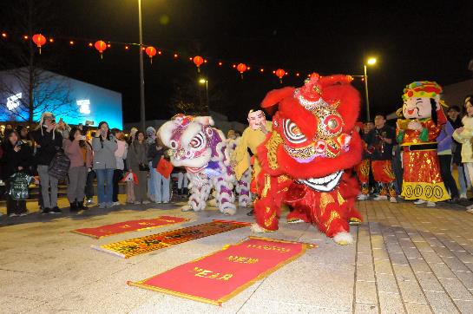


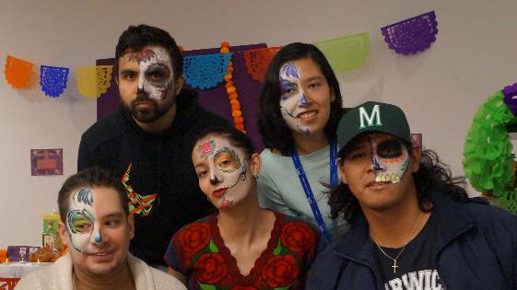
YOUR STUDENT EXPERIENCE
Life at Warwick beyond the classroom, from the start of Welcome Week through to the end of your degree.
COMPETITONS
EVENTS
GAMES
WORKSHOPS
FOOD
SCREENINGS
CELEBRATIONS
PERFORMANCE
warwick.ac.uk/warwickpresents
Notes:
Warwick Presents is about life at Warwick beyond the classroom, from the start of Welcome Week through to the end of your degree.

