Slide 1
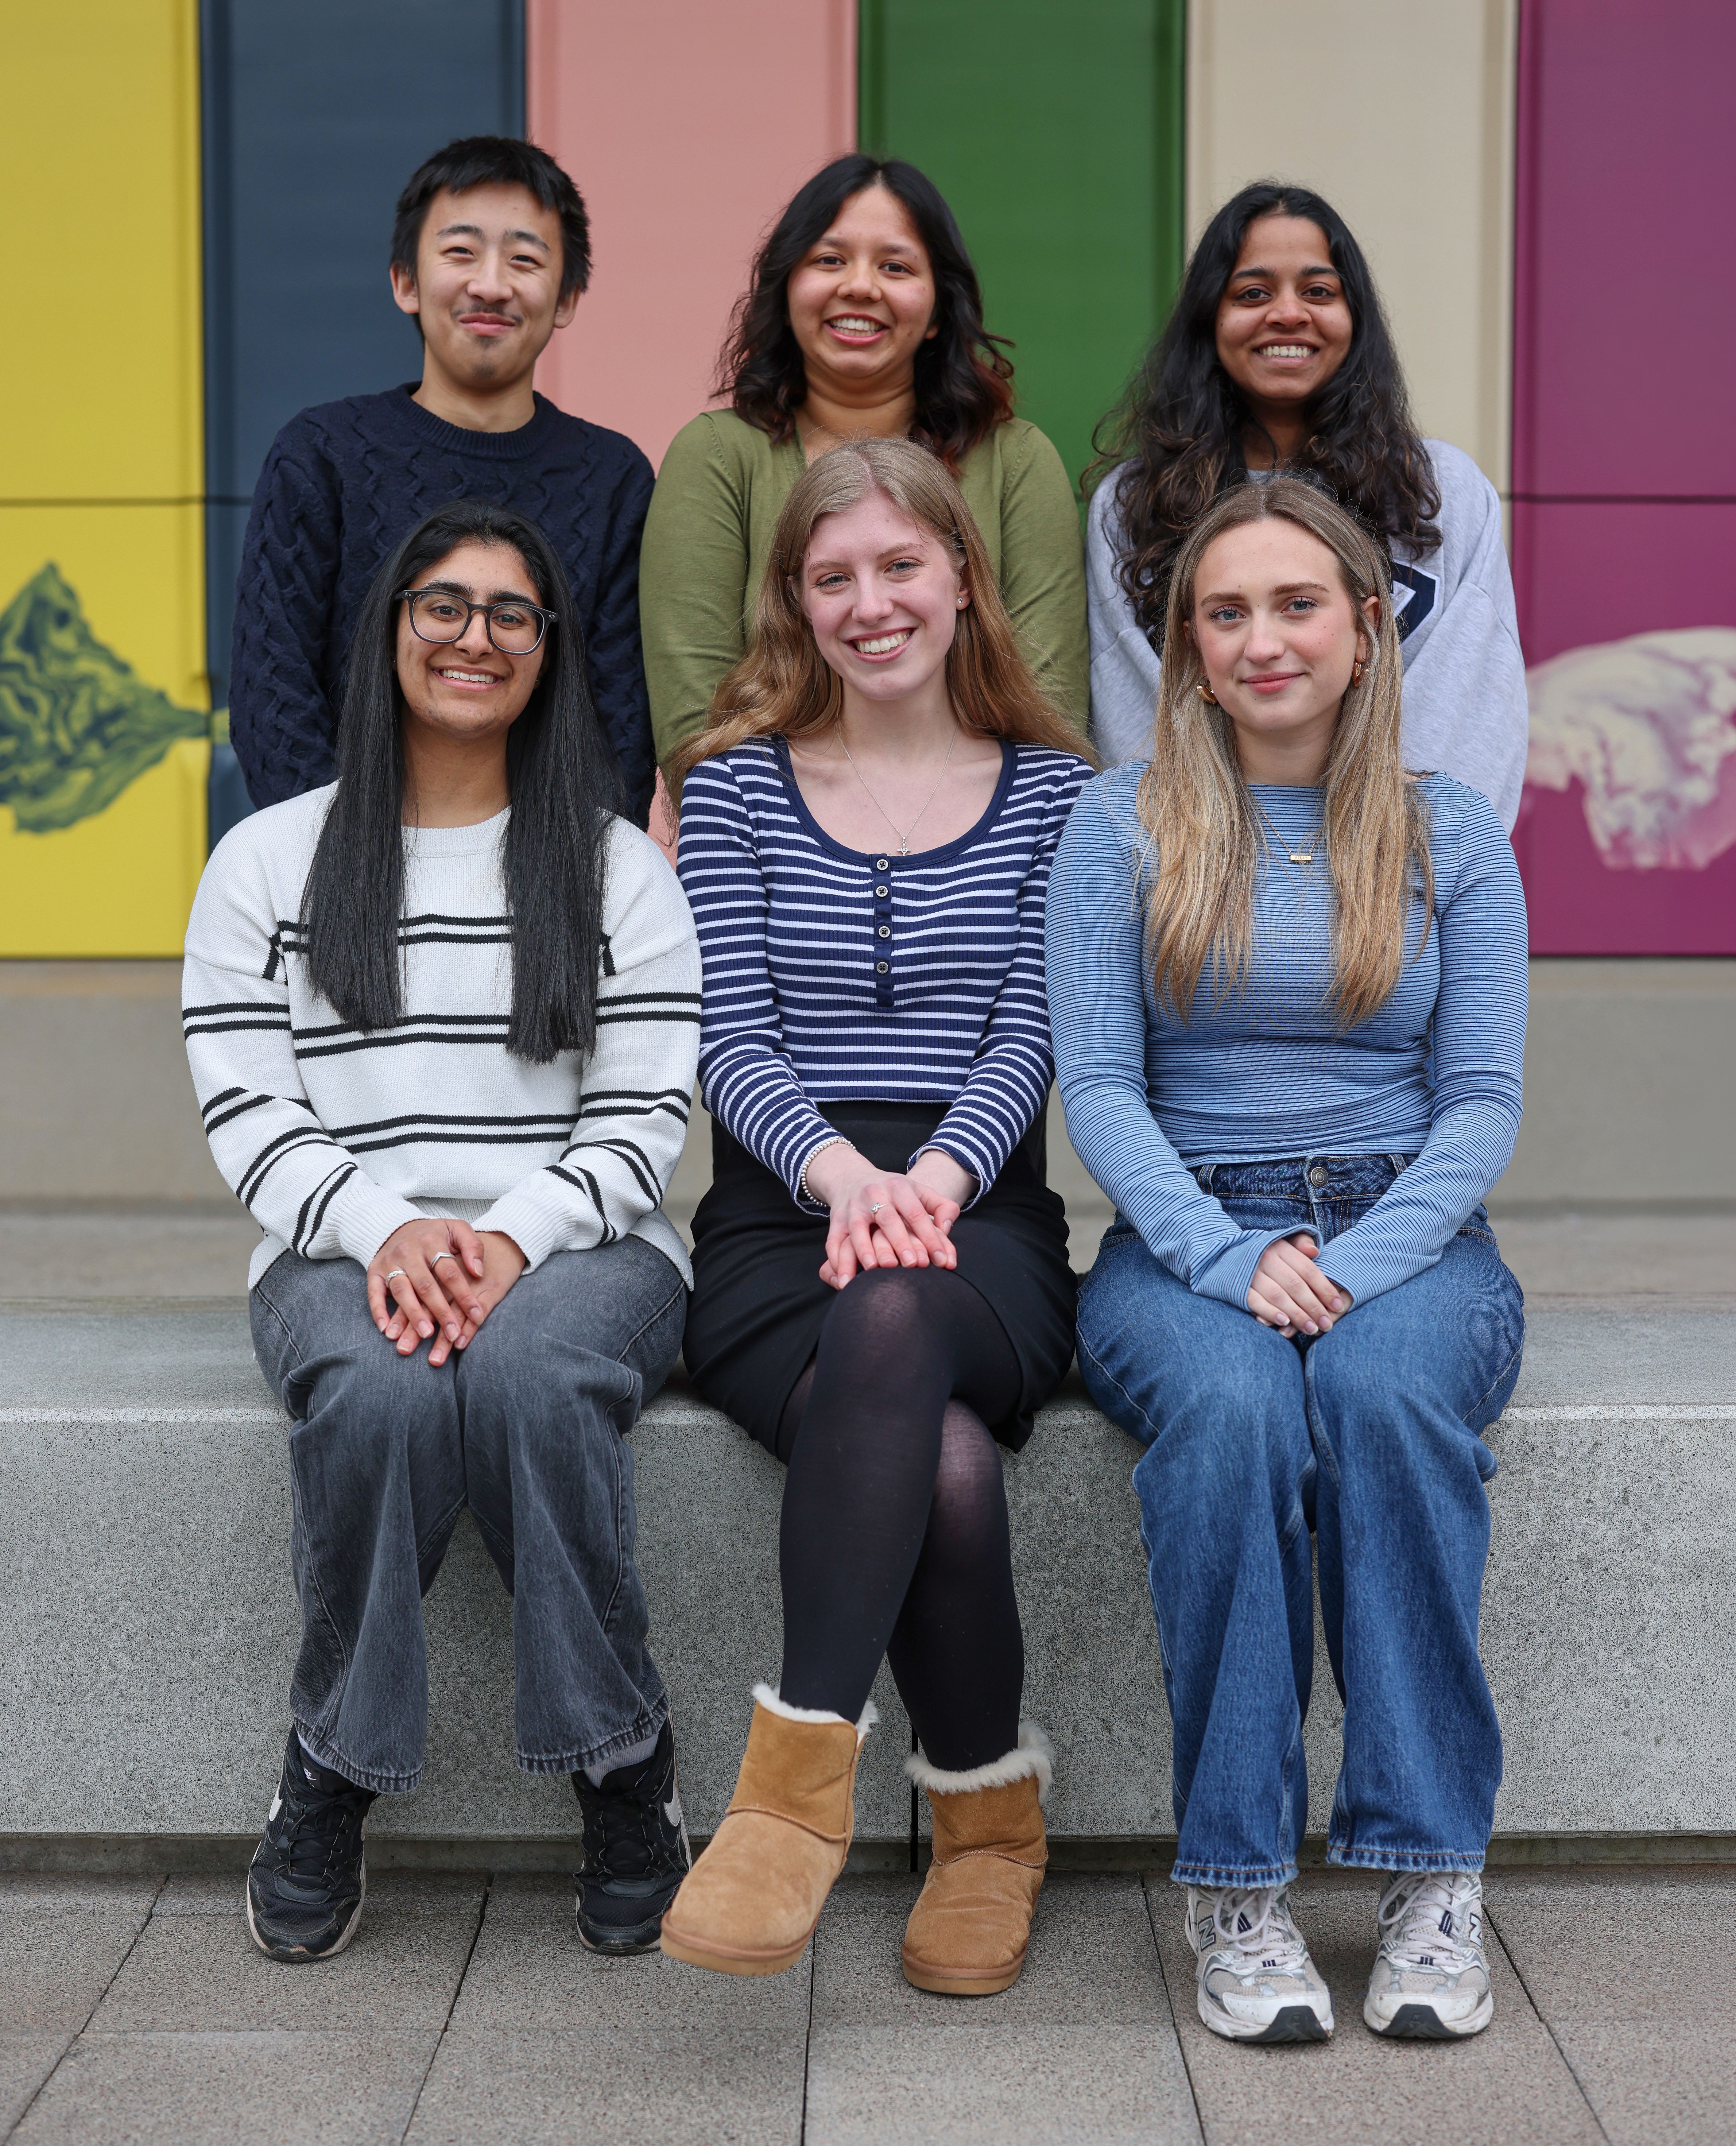

Welcome!
We are
Warwick Volunteers
Your 26-27 Student Executive
Notes:
I'm 'xx' and I am here today to give you all a quick introduction to what Warwick Volunteers is and why you should become a volunteer!

Slide 2
What is Warwick Volunteers?
We help students:
Build new skills
Meet a range of students across Warwick
Become Project Leaders, Session Leaders and Ambassadors
Follow their passions
Have a positive impact on local communities

Slide 3






Our community partners
Notes:
Warwick Volunteers brings together student volunteers and different community projects.

Slide 4









Student Led Projects
Refugees
Environment
Young people
Health
Schools
Food Poverty
Culture and Heritage
Older People

Slide 5
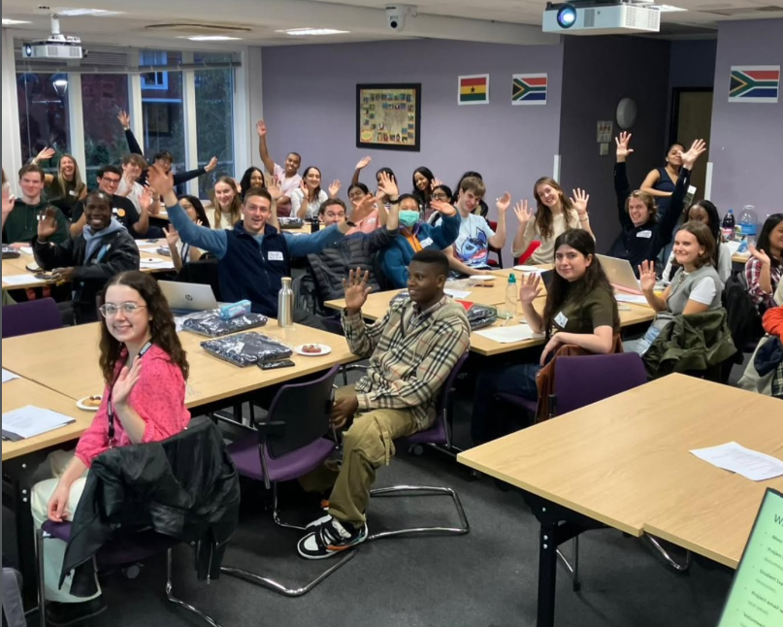
Opportunity to lead: Who Are The Student Leaders?
Friendly faces
60+ Student Leaders in total
They manage the project and log your hours for you
No one has to attend a project alone
Great student leadership and responsibility opportunity
Notes:
Student Leaders are the friendly faces organising our student-led projects
71 Student Leaders
They manage the project and log your hours for you
No one has to attend a project alone as student leaders will always be there
Great student leadership and responsibility opportunity

Slide 6
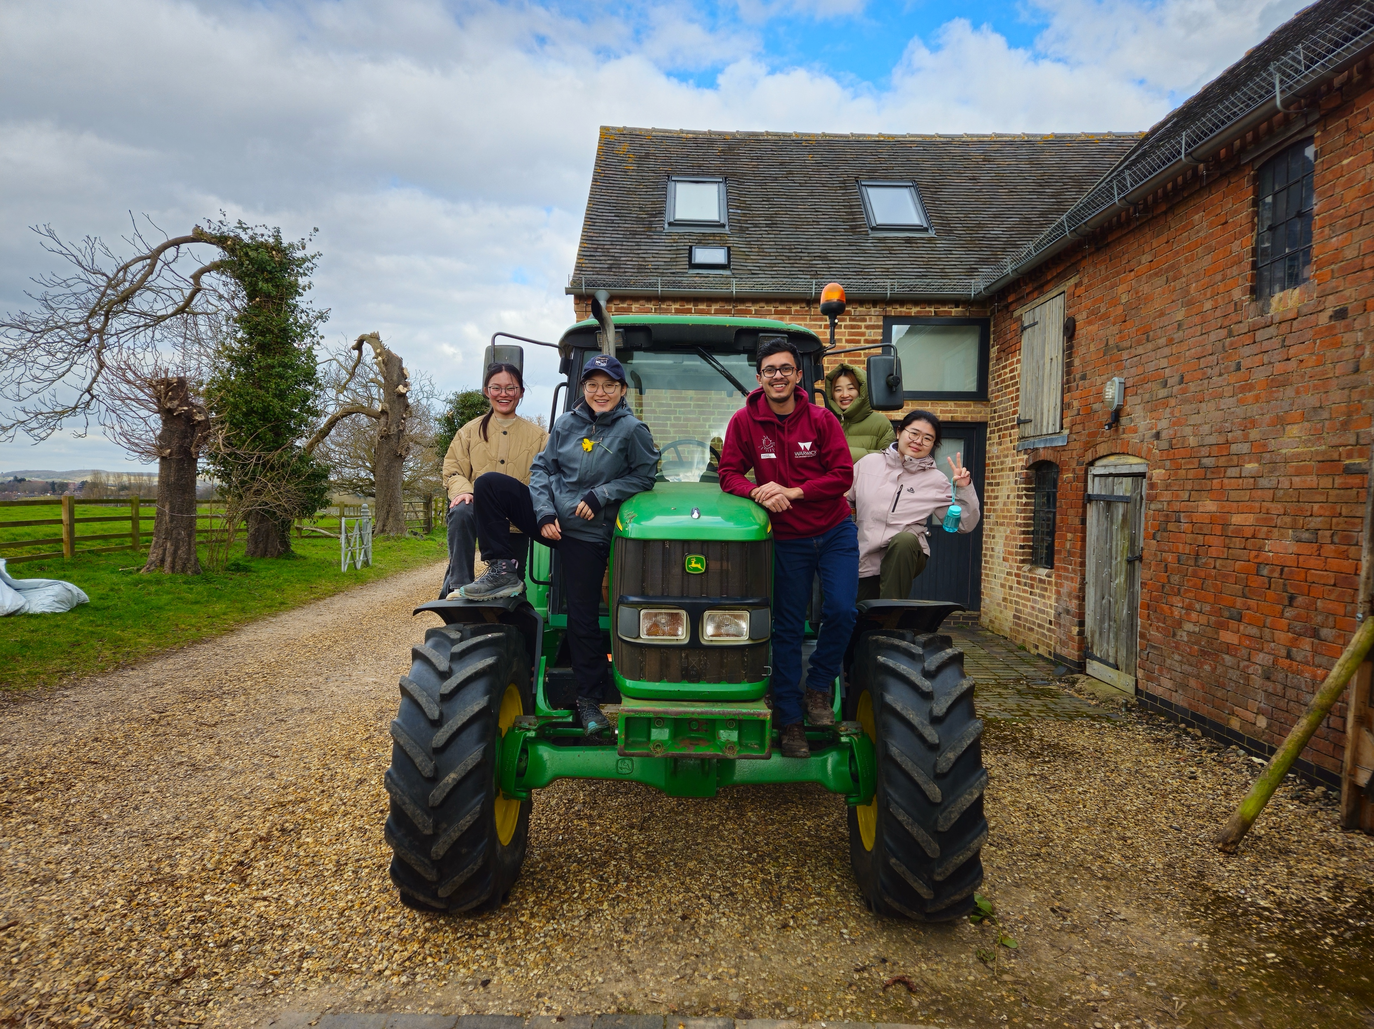
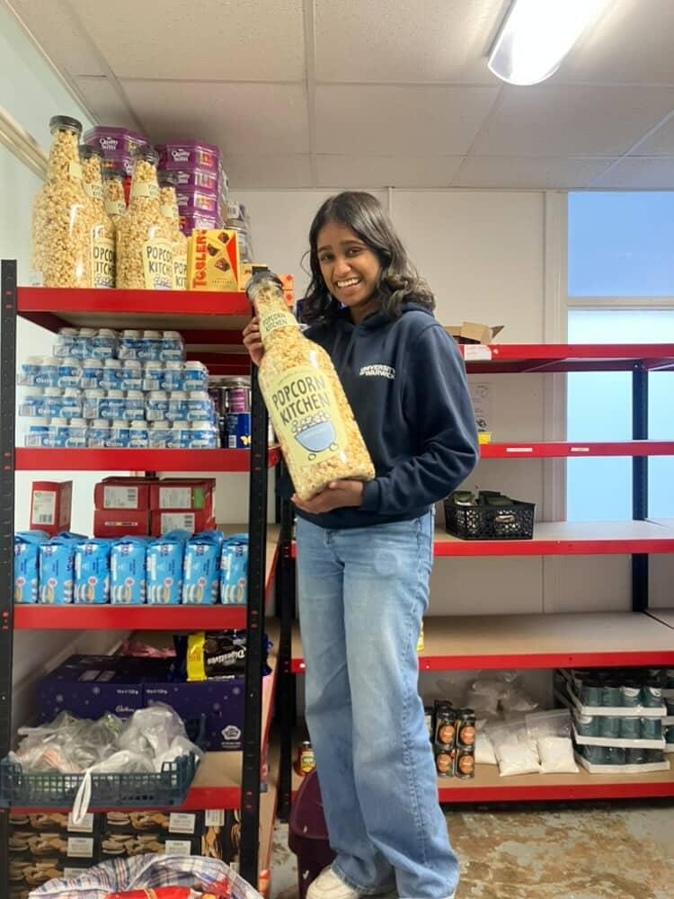
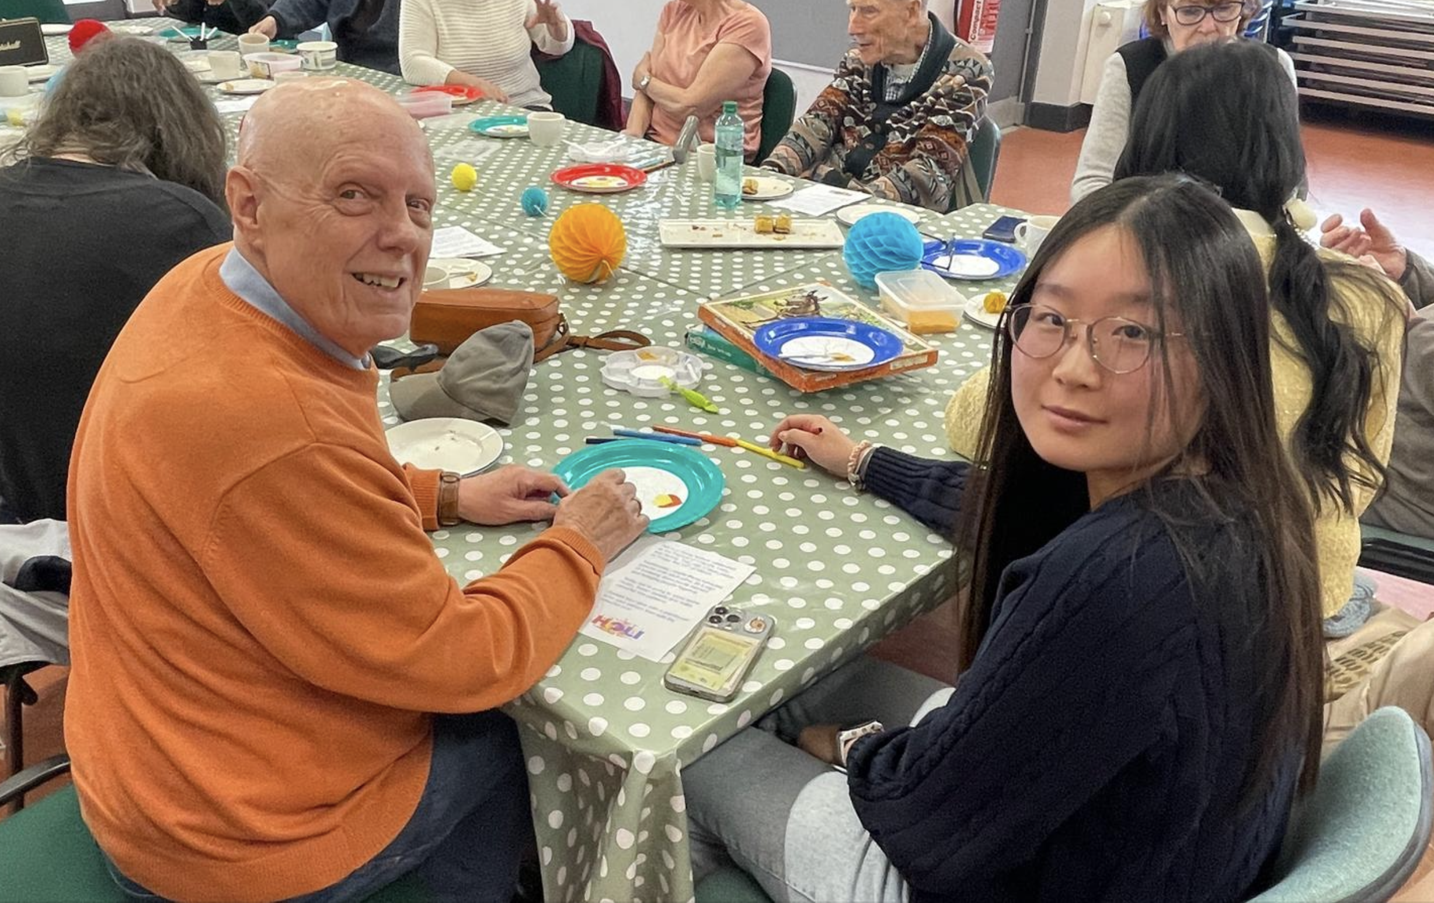
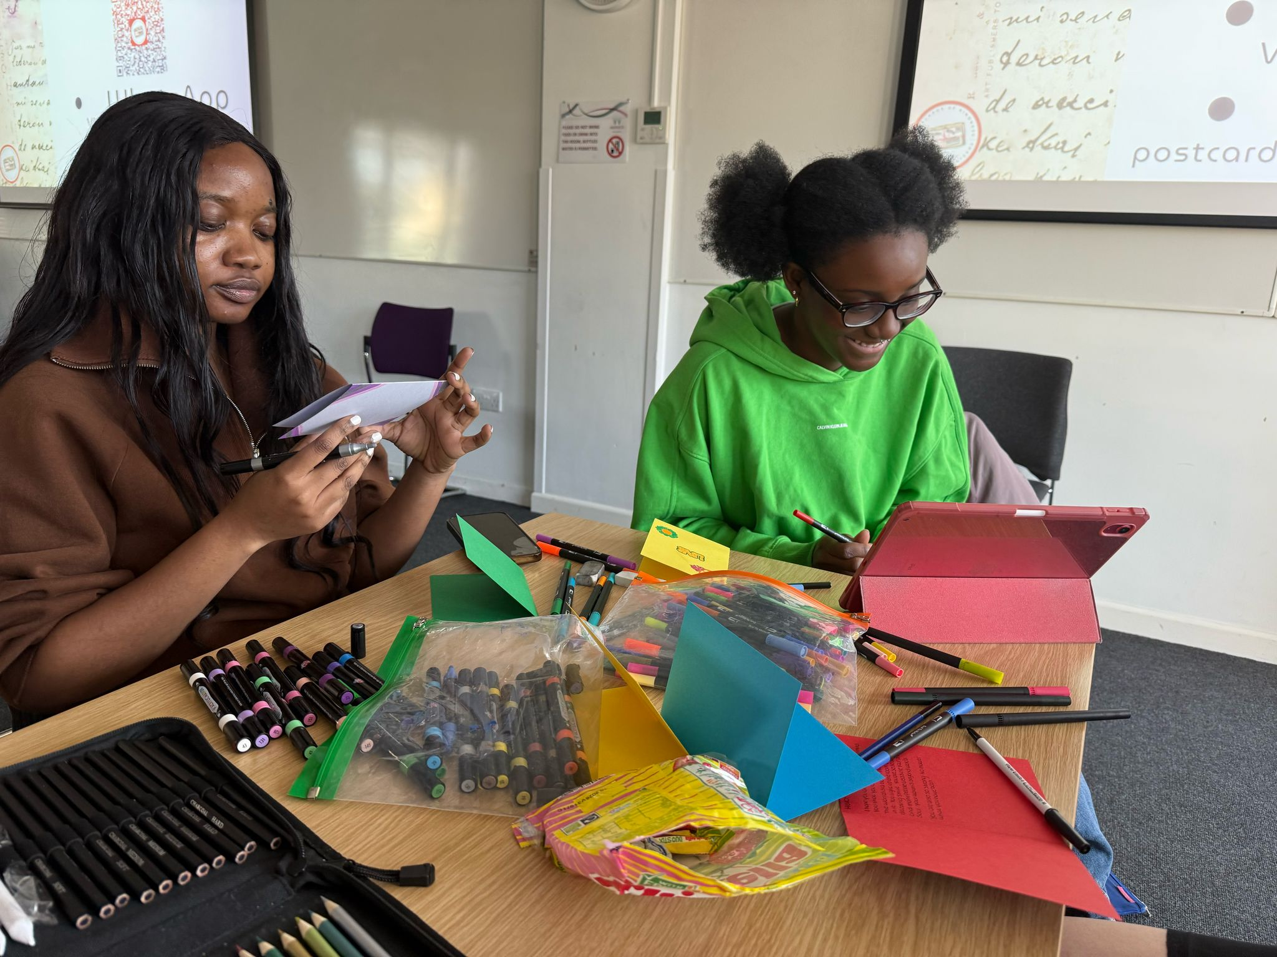
Notes:
Examples of projects

Slide 7
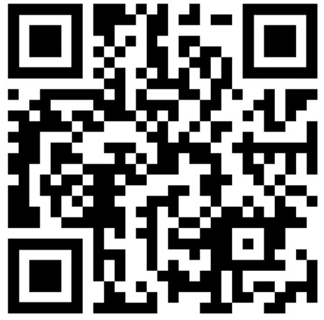
How to get involved
Register and set up a profile
Receive the regular newsletter with the latest news and updates
Updates when new opportunities are added
Browse opportunities and register interest online
Log hours online and get WV Perks!
Notes:
Plan for 2025-26
Ongoing
Volunteering Portal, WV Social Media and WV Newsletter – processes on the resources page.
Social media – WV has insta account, some individual projects have their own accounts – opportunity to collaborate on posts or share content with us to post through the main WV account.
WV Ambassadors – experienced volunteers who represent WV at events, run stalls, and deliver presentations to promote WV across the university (role renamed – previously know as WV Champions).
Arrivals Weekend and Welcome Week
WV will have a daily presence on the piazza and stalls at the Societies and Sports Fairs. Led by WV Ambassadors, exec, staff and student leaders. Opportunity for you to help during Welcome week join the WV Ambassadors team.
Initial focus on raising awareness of WV, signing up to the volunteering portal and registering interest in projects.
Weeks 1-3
WV will run drop-in sessions to support students to sign up with WV and find opportunities.
WV videos and information shared through departments and lecture shout outs.
We would like all projects to hold taster or information sessions within those first few weeks.
Even of your project doesn’t start sessions until later in the term/ year – find ways to keep volunteers engaged.
Get Creative
We would like you to get creative – other ways to recruit
Each project is unique with different needs adapt accordingly. Bring your own ideas.
New volunteers join all year round – how to engage and create a welcoming environment through that join later if applicable.
Key Tasks for Student Leaders
Review and update Project Profile on the Volunteering Portal
Plan and deliver volunteer taster sessions or volunteer information sessions within the first 3 weeks of term.
We will share guidance and resources

Slide 8
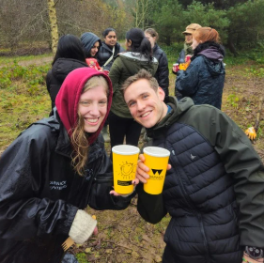
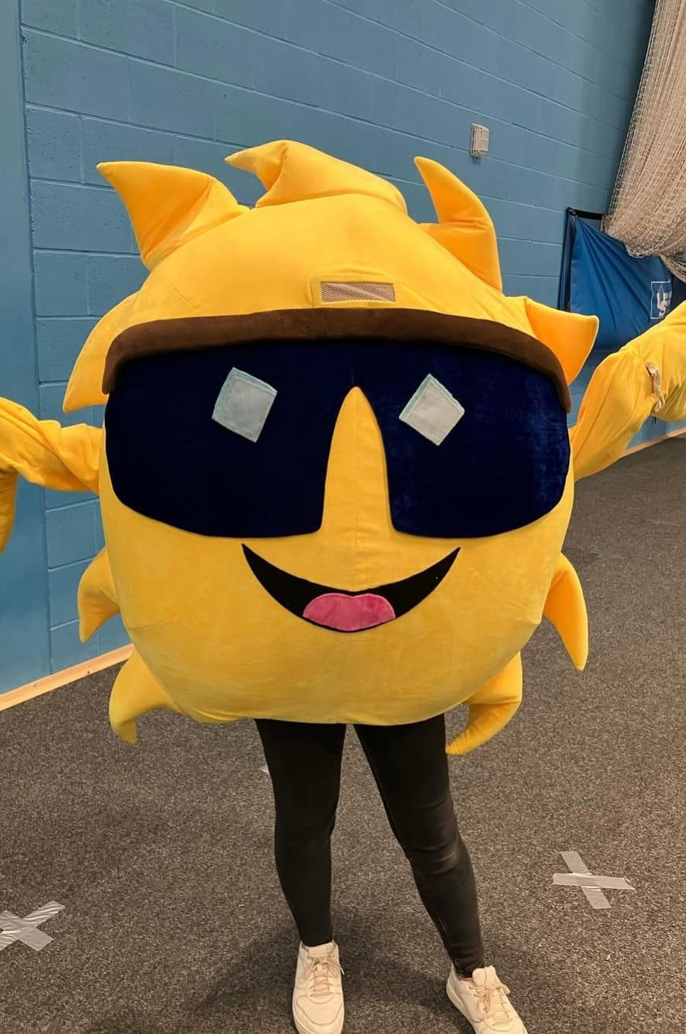
Benefits of volunteering
Meeting new people outside of your Warwick bubble
Gain skills and work experience for your CV
Improving your wellbeing
Accreditation for the HEAR and Warwick Award points
Making a difference
Notes:
Process for SL logging hours – demo
Incentives – 5 hours certificate, 10 hours coffee cup, 15 hours 7 day Sports Hub pass, 30 waterbottle,
Warwick Award - All Student Leaders are eligible for 20 core skill points under the 'WV Session Leader' Warwick Award-accredited activities category, but you must complete your reflection piece via Gradintel.com to receive the points.
You can also earn up to 20 core skills points for any additional volunteering with WV for projects outside your leadership role. Please ensure you log your hours on the portal and complete your reflection piece via Gradintel. The volunteering hours data is sent to the Warwick Award team at the end of each term and will be updated on Gradintel accordingly
Firs access to skill session
HEAR - 15+ hours
Skills sessions – first access to any skills sessions

Slide 9

And did we mention……
IT'S FREE!!!
Notes:
Process for SL logging hours – demo
Incentives – 5 hours certificate, 10 hours coffee cup, 15 hours 7 day Sports Hub pass, 30 waterbottle,
Warwick Award - All Student Leaders are eligible for 20 core skill points under the 'WV Session Leader' Warwick Award-accredited activities category, but you must complete your reflection piece via Gradintel.com to receive the points.
You can also earn up to 20 core skills points for any additional volunteering with WV for projects outside your leadership role. Please ensure you log your hours on the portal and complete your reflection piece via Gradintel. The volunteering hours data is sent to the Warwick Award team at the end of each term and will be updated on Gradintel accordingly
Firs access to skill session
HEAR - 15+ hours
Skills sessions – first access to any skills sessions

Slide 10
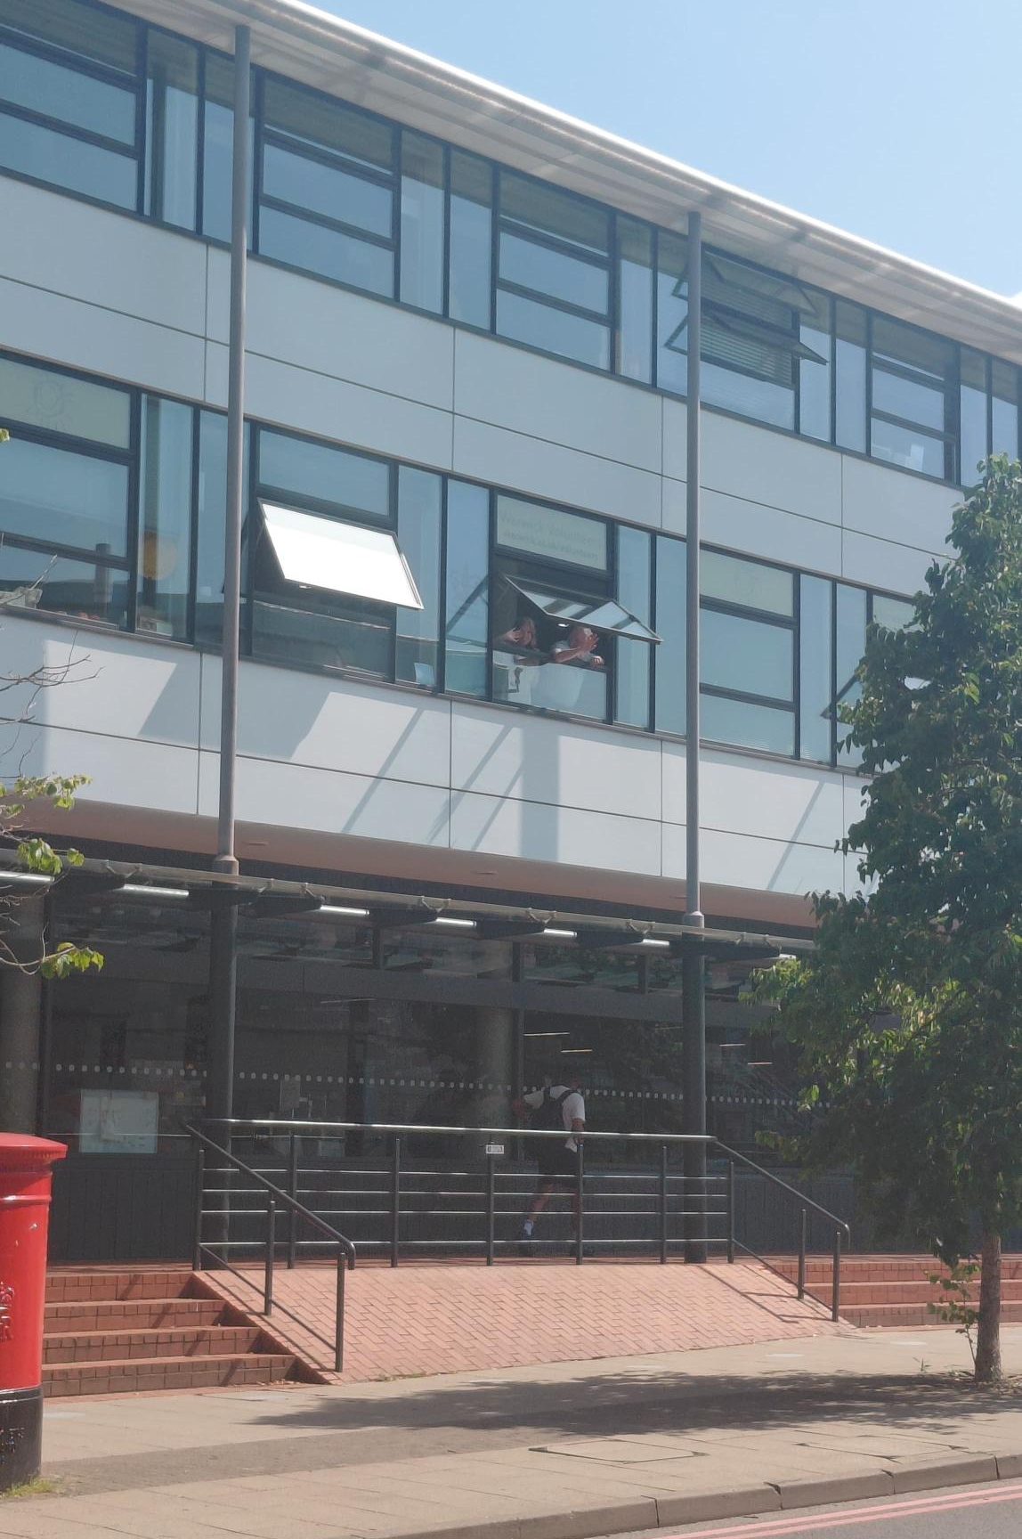

What’s Next?
Register with Warwick Volunteers and get regular updates as new projects become available
Come & see us: The Warwick Volunteer Office is in the Volunteering Hub, Students' Union HQ, just past The Green Room on level one.

Slide 11
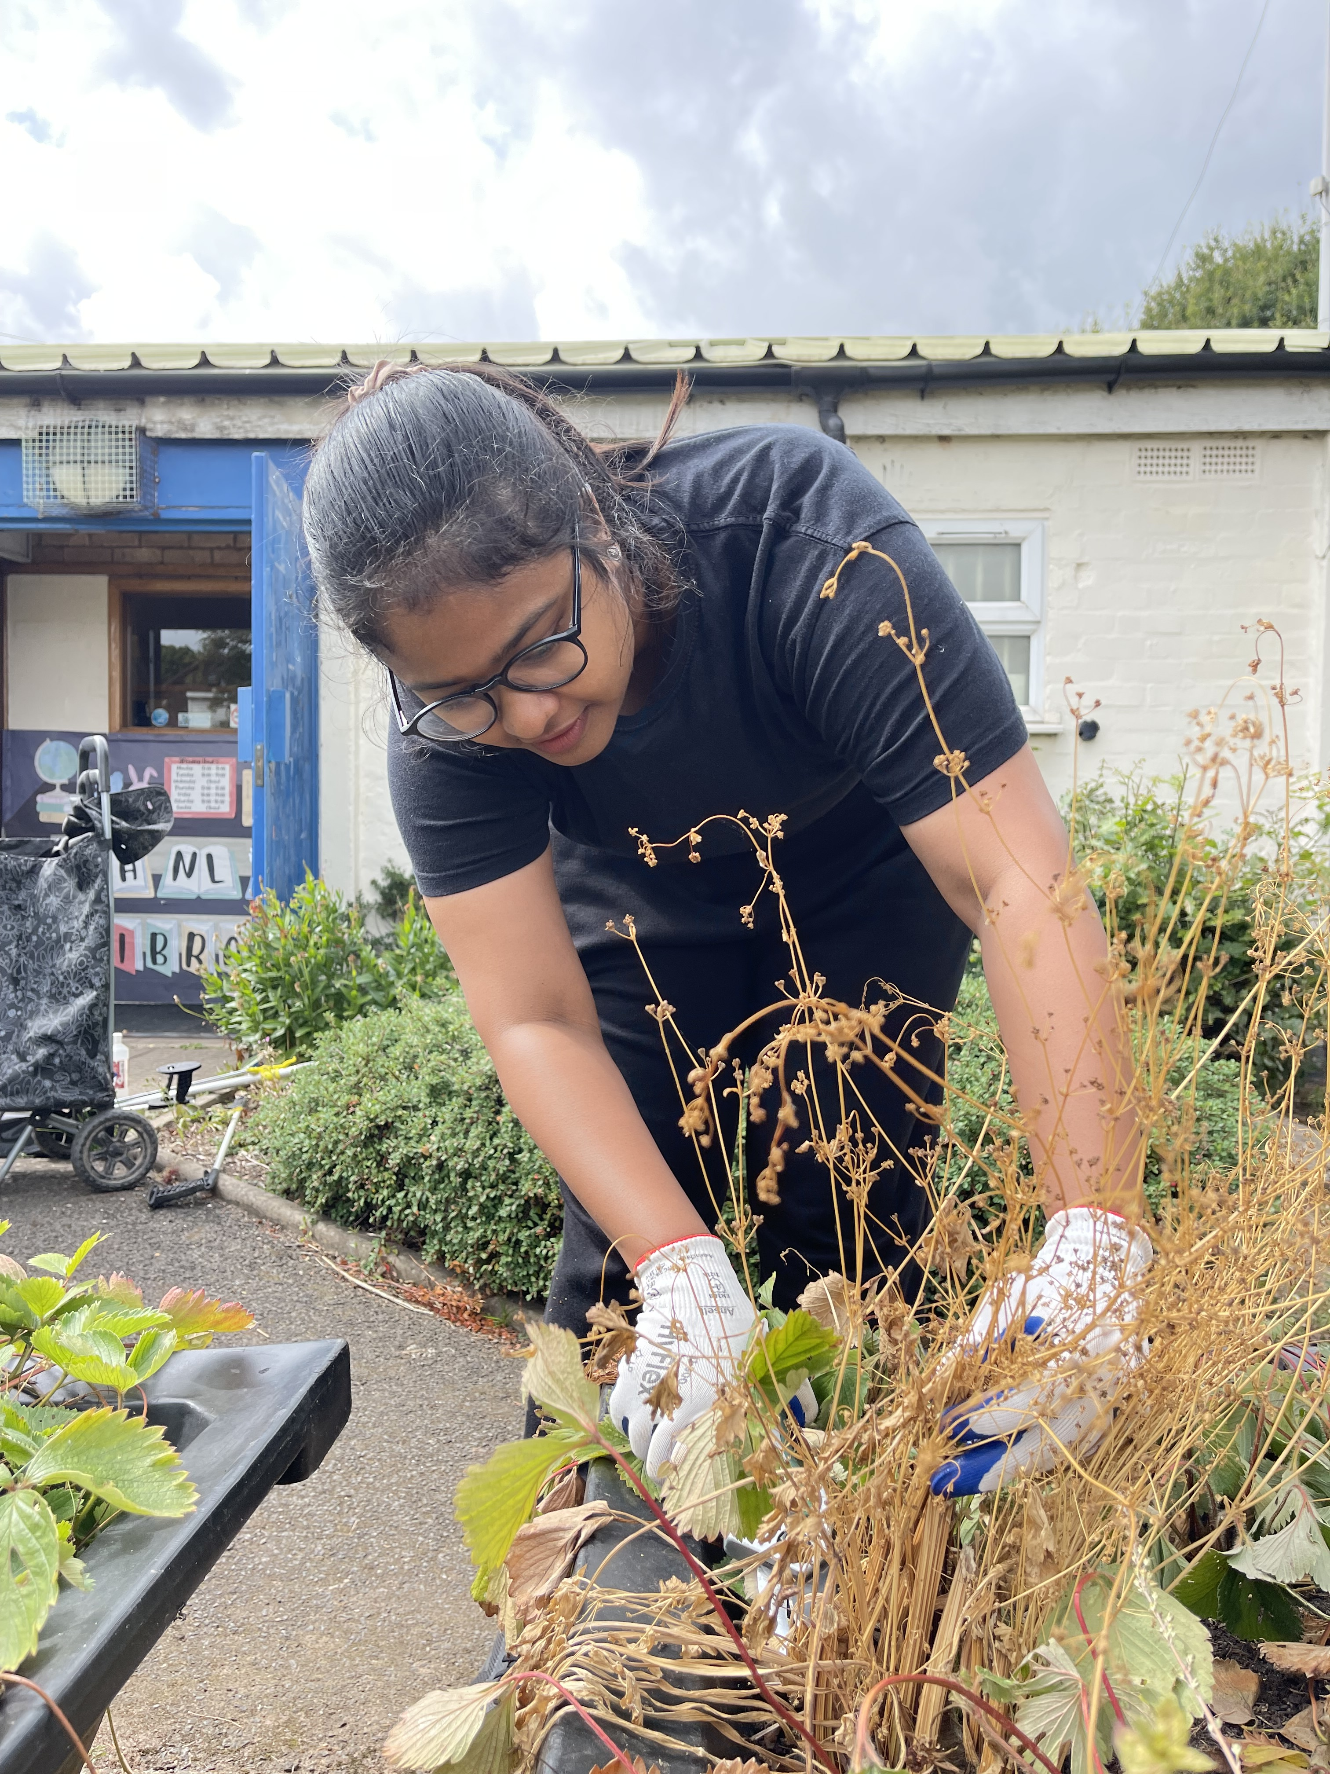

Questions?
@warwickvolunteers
Scan to Join!

