Slide 1
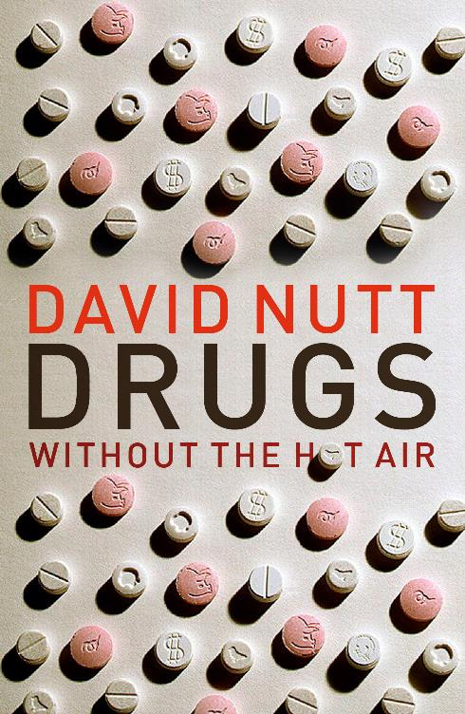
How the drug laws are the worse censorship of research since the Catholic church banned the telescope.
Warwick 2016
David Nutt FMedSci
Edmond J Safra Prof of Neuropsychopharmacology
Imperial College London
d.nutt@imperial.ac.uk
Chair – Drugscience.org.uk
profdavidnutt@twitter.com

Slide 2
Health warning!

Slide 3
Who am I ?
A psychiatrist with > 30 years experience
A researcher for about 30 years
into effects of drugs and the brain
Over 800 publications – many from Bristol University
Worked in USA and Australia – mostly in UK
A parent of 4 (post)teenage children
An (ex) government drugs advisor
9 years as chair of the technical (scientific) committee
1 year Chair of Council – then sacked by Home Sec Alan Johnson
Which is how most people know of me

Slide 4
Oct 30th 2009
Sacked…
…but not gagged
And now I know I was right!

Slide 5
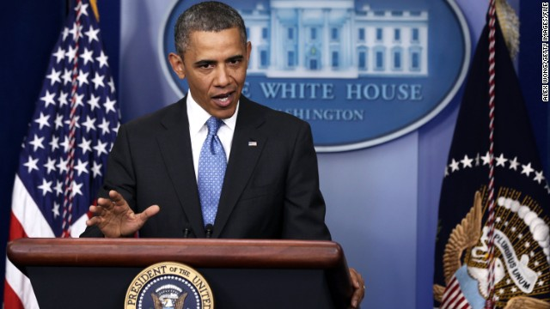
Obama now agrees with Nutt!
http://politicalticker.blogs.cnn.com/2014/01/19/obama-says-marijuana-no-more-dangerous-than-alcohol/

Slide 6
What is a drug? And who says?
The science of drugs

Slide 7
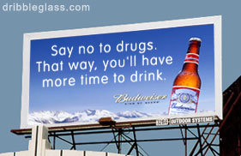
What the drinks industry wants us to think

Slide 8
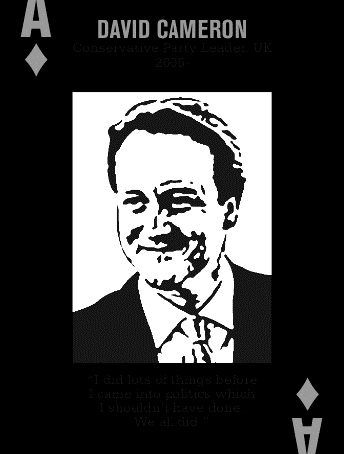
What is a drug? My definition
“something a politician once used but now regrets”
Jaqui Smith (ex Home secretary)
“I smoked cannabis but didn’t enjoy”
David Cameron
“I did things when young that I I shouldn’t have – we all did”
etc etc
Release

Slide 9
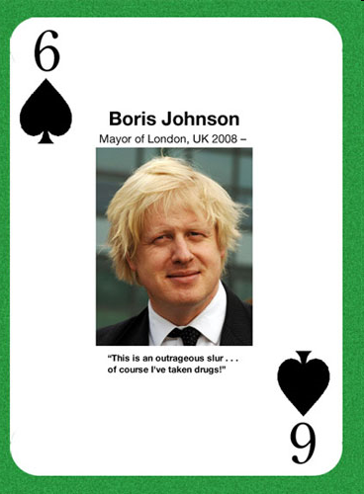
Some make a joke about it
This an outrageous slur – of course I have taken drugs!

Slide 10
What scientists say
a drug is
“a chemical which when taken produces physiological changes”
Which in relation to controlled drugs relates to pleasurable/desirable effects in the brain
Or damaging ones……..

Slide 11
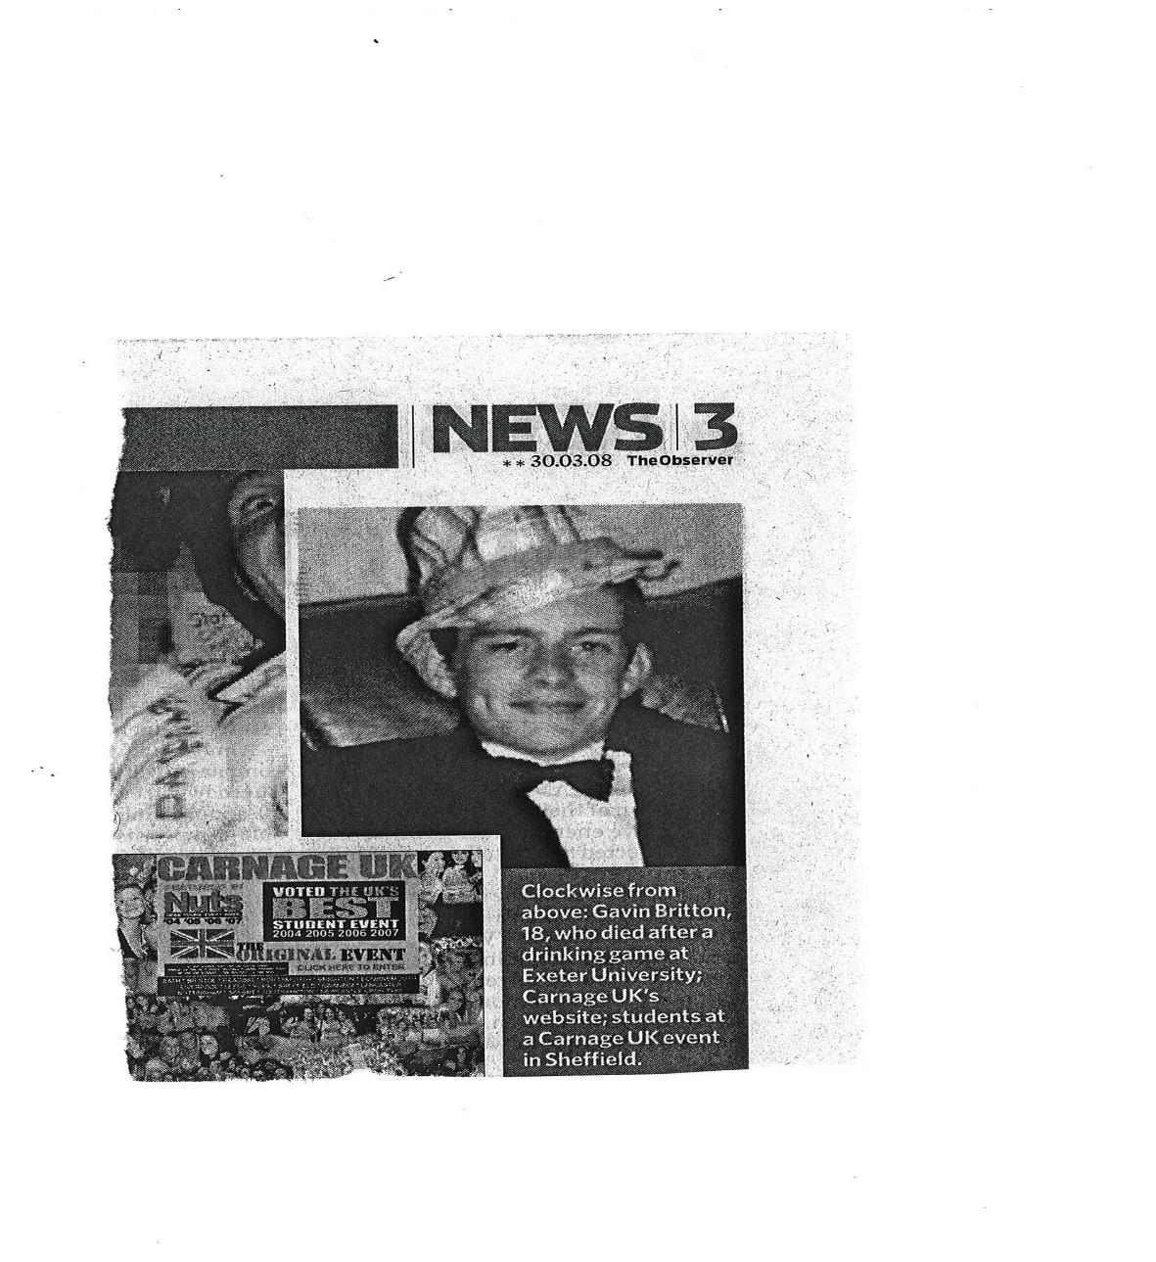
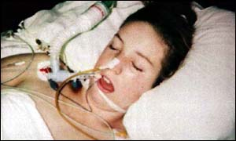
Deaths from drugs
SORTED
Gavin Britton Leah Betts
alcohol poisoning MDMA → water poisoning (drinking game after Exeter University golf match)

Slide 12
Drugs are controlled because …
They are harmful
They might be harmful
The media wants it
… as do the majority of politicians
… and some of the public

Slide 13
The present framework of UK drug regulation
MHRA medicines act
Recreational
khat
khat
alcohol
Tobacco
Psychoactive
Substances
caffeine
solvents
Home Office – Misuse of Drugs Act
Unregulated sales Food/commodities
Regulated sales Food/commodities

Slide 14
The present framework of UK drug regulation
MHRA medicines act
morphine, heroin
amphetamines benzodiazepines
ketamine
Recreational
khat
khat
alcohol
Tobacco
Psychoactive
Substances
caffeine
solvents
Home Office – Misuse of Drugs Act
Unregulated sales Food/commodities
Regulated sales Food/commodities

Slide 15
A quiz What killed Amy Winehouse?
Drug overdose
Alcohol overdose
Both of above

Slide 16
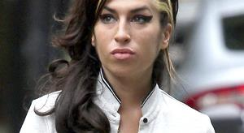
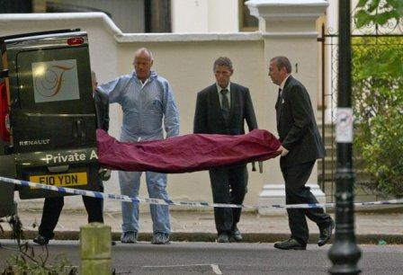
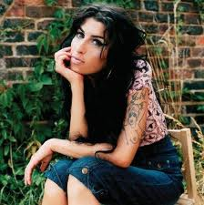
Which is why they keep quiet about Amy Winehouse's death from acute alcohol poisoning (3 per week in UK)
Blood alcohol 450mg/%
= 5.5 x legal driving limit
+ Imperial College student in 2013
Despite being in “recovery”

Slide 17
Drug related deaths in UK
Source: Smoking and drinking among adults, 2009. Office for National Statistics
Drug Misuse Declared: Findings from the 2010/11 British Crime Survey England and Wales. Home Office and Alcohol Fractions report
Estimates of the Prevalence of Opiate Use and/or Crack Cocaine Use, 2009/10: Sweep 6 report. The Centre for Drug Misuse Research

Slide 18
Other preventable deaths
Melanoma RTAs Suicide AIDS
>2000 > 2500 >6000 ~400
Source: Smoking and drinking among adults, 2009. Office for National Statistics
Drug Misuse Declared: Findings from the 2010/11 British Crime Survey England and Wales. Home Office and Alcohol Fractions report
Estimates of the Prevalence of Opiate Use and/or Crack Cocaine Use, 2009/10: Sweep 6 report. The Centre for Drug Misuse Research

Slide 19
Alcohol now the most common reason for death in men under 50
Male deaths from alcohol in UK
20%
http://www.nwph.net/nwpho/publications/alcoholattributablefractions.pdf

Slide 20
The 16 ways drugs can harm
Harms to users
Drug-specific mortality
Drug-related mortality
Drug-specific harms
Drug-related harms
Dependence
Drug-specific impairment of mental functioning
Drug-related impairment of mental functioning
Loss of tangibles
Loss of relationships
Harms to others
Injury
Crime
Economic cost
Impact on family life
International damage
Environmental damage
Decline in reputation of the community
ACMD report 2010

Slide 21
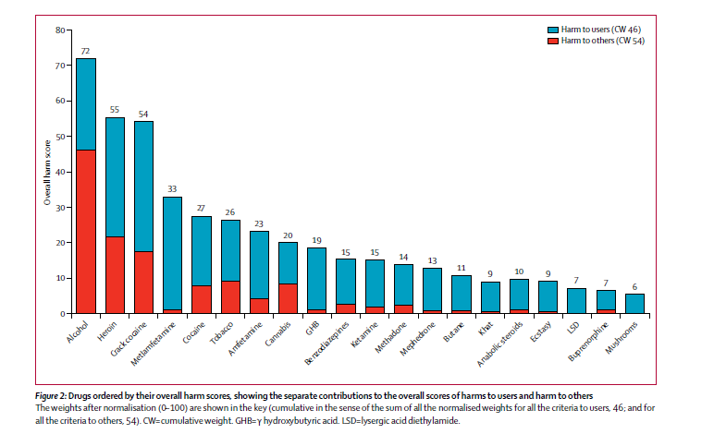
Comparative harms of 20 drugs
Alcohol
Tobacco
Cannabis
Nutt King & Phillips Lancet Nov 2010

Slide 22
No correlation of UK Drugs Act or the UN Conventions with ISCD results
linear r = 0.04

Slide 23
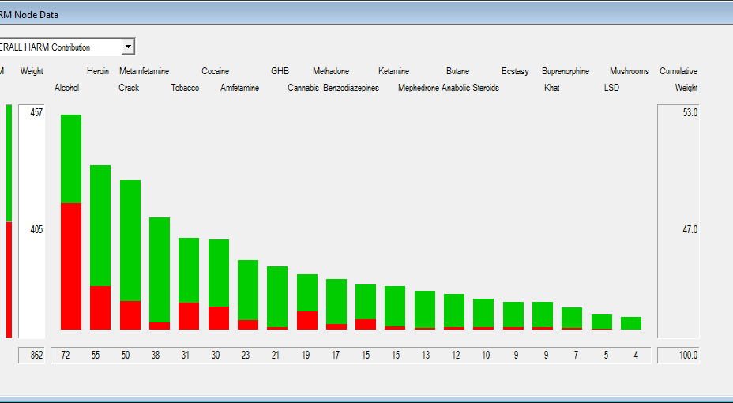
European expert ratings
van Amsterdam J, Nutt D, Phillips L, van den Brink W (2014) European rating of drug harms. J Psychopharmacol. 2015 Apr 28. pii: 0269881115581980

Slide 24
Hippocrates
Primum non nocere
= First do no harm
Key principle of medical ethics
Should not the same principle apply to the law politics and the media?

Slide 25
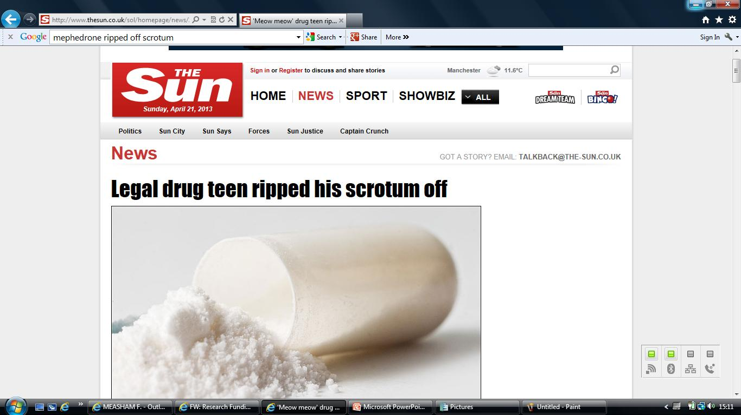
Media lies increase harms
Untrue claim re mephedrone m-CAT, miaow miaow

Slide 26
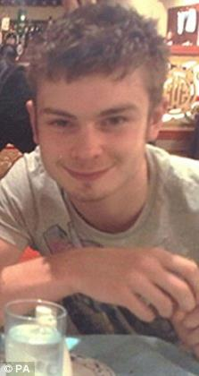
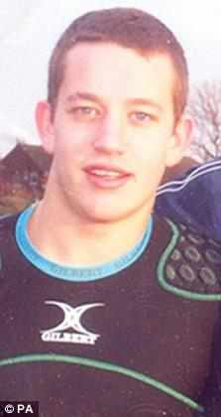
Police collusion The Scunthorpe two (17/03/10)
Two young men found dead
“Officers believe both lads had M-CAT (mephedrone)”
- they had also been drinking heavily until 2am
Nick's dad wept as he urged youngsters to avoid the drug… "I don't want him to be labelled a druggie because he wasn't. He was just on a night out with friends enjoying himself, a normal, caring, hard-working lad.“” (The Sun, 17/03/10)
In fact no mephedrone detected at post-mortem
Death due to alcohol + methadone
But regardless mephedrone was banned to appease the press

Slide 27
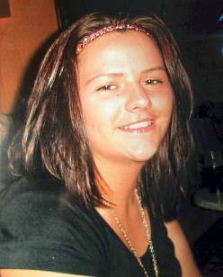
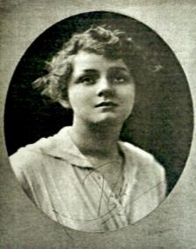
In fact nothing has changed in a century! How UK politicians recycle rhetoric
“… subject (?) to their [ACMD] advice we will take immediate action. We are determined to act to prevent this evil [mephedrone] hurting the young people of our country." (UK PM Gordon Brown, quoted by Reuters, 24/03/10)
“[there is a need]… to stamp out the evil [cocaine] now rapidly assuming huge dimensions, special legislation is imperatively needed” (Sir Edward Henry 1916, Metropolitan Police Commissioner, quoted in Spear 2002 p4.).
Stephanie Howard

Slide 28
Number of drug-related deaths where selected substances were mentioned on the death certificate, England and Wales
The remarkable impact of mephedrone to reduce stimulant deaths
Mephedrone: enters banned
John Corkery Hugh Claridge Barbara Loi Christine Goodair Fabrizio Schifano
National Programme on Substance Abuse Deaths (NPSAD) International Centre for Drug Policy (ICDP) St George’s, University of London, UK Drug-related deaths in the UK: January-December 2012 Annual Report 2013

Slide 29
Many banned drugs have potential as treatments
Cannabis – pain, sleep, spasticity, cancer, PTSD
Ecstasy (MDMA) – PTSD, Parkinson’s disease
Psilocybin – depression, OCD, cluster headaches
LSD – for terminal illnesses/ addiction
Mephedrone & Naphyrone – for treatment of depression and addiction
But current regulations make them almost impossible to research

Slide 30
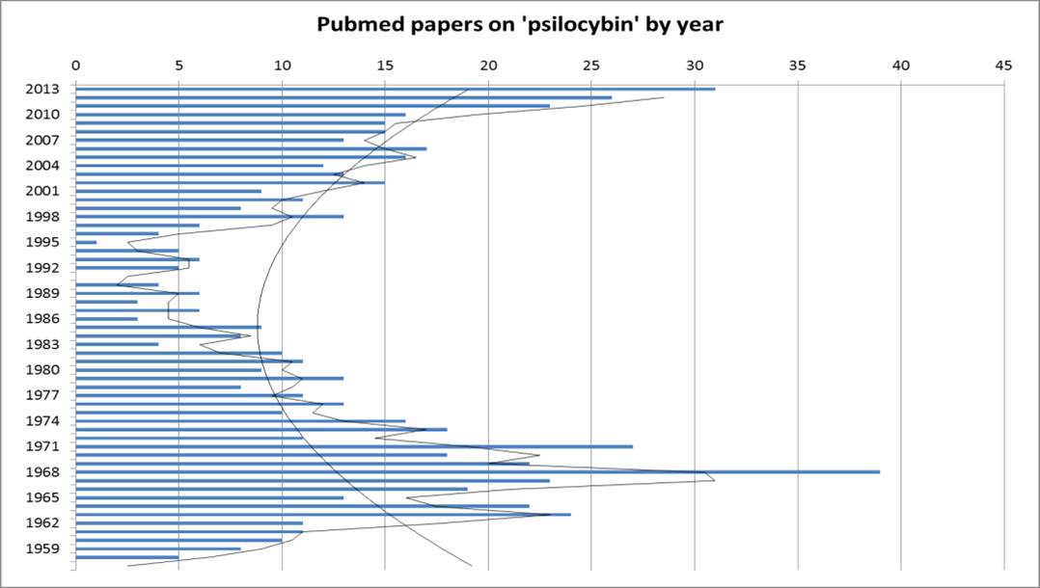
How illegality affects scientific outputs
Made illegal
Structure identified

Slide 31
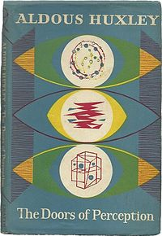
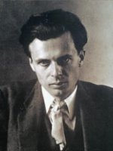
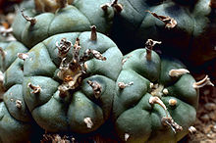
Psychedelics – changing the way we think
Peyote cactus
If the doors of perception were cleansed every
Thing would appear to man as it is, infinite.
For man has closed himself up, till he sees all
Things thro’ narrow chinks of his cavern.
William Blake, 1793

Slide 32
Clinical Interest in psychedelics (mostly LSD) in the 1950s and 1960s
Hundreds of psychiatrists worldwide
1000 clinical papers
40,000 patients
40 books
6 International conferences
Results were overwhelmingly positive, describing safe and effective treatments (Masters and Houston, 1971)

Slide 33
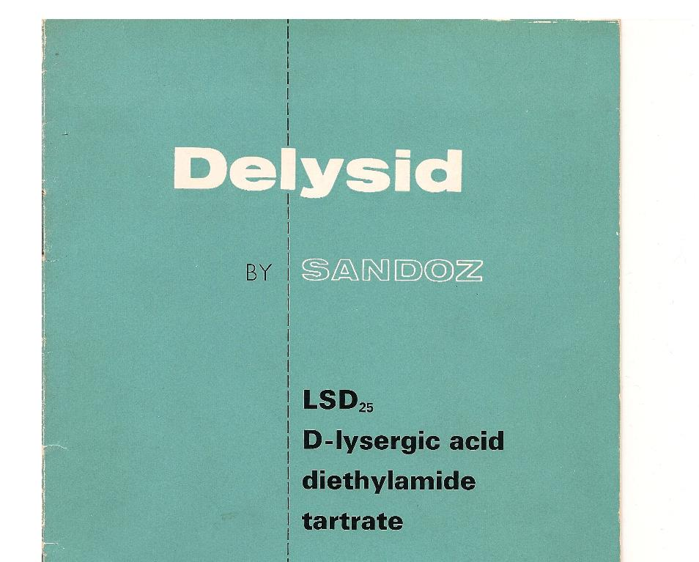
Would LSD have saved Amy?

Slide 34
LSD in alcoholism
Effect size >= all current therapies

Slide 35
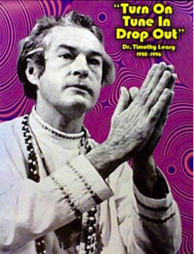
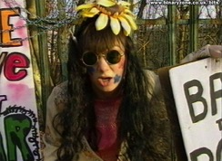
Why was LSD banned?
Because the CIA were worried about American youth refusing to fight in Vietnam – and cultural change (flower power)
Scare stories e.g. trying to fly

Slide 36
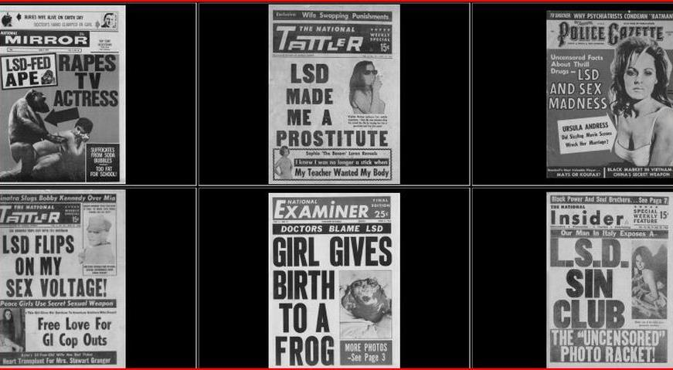
Even worse than the Sun over mephedrone !

Slide 37
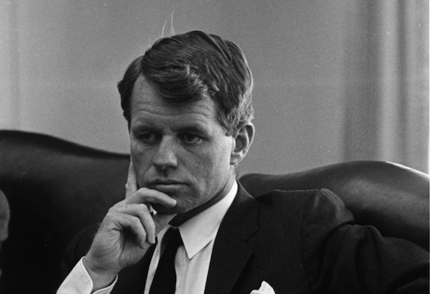
LSD and all other psychedelics banned in face of opposition from senators
“Why if the trials were worthwhile six months ago, why aren’t they worthwhile now? We keep going around and around… If I could get a flat answer about that I would be happy. Is there a misunderstanding about my question?
I think perhaps we have lost sight of the fact that LSD can be very, very helpful in our society if used properly.” (Senator Kennedy)
Q. Has there ever been a worst example of research censorship?
Never in medicine and only one other contender in science….

Slide 38
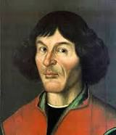
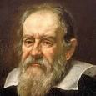
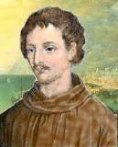
The banning of the telescope?
1616 The papal Congregation of the Index banned all books advocating the Copernican system of explaining the earth is NOT the centre of the universe
Not revoked until 1758
Galileo Galilei
1564-1642
Giordano Bruno
1548-1600
Nicolaus Copernicus
1473-1543

Slide 39
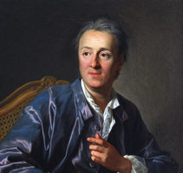
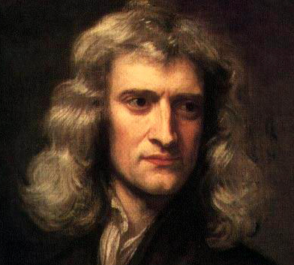
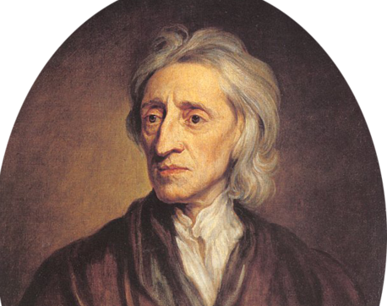
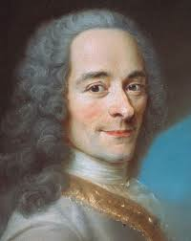
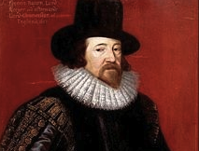
Pillars of the original Enlightenment
Newton
Locke
Voltaire
Prejudices are what fools use for reason
Diderot
Bacon

Slide 40
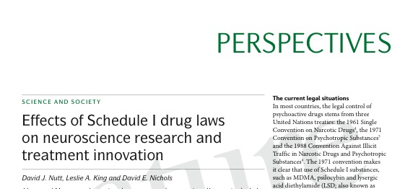
Read more about it
Nature Reviews Neuroscience June 2013
Or free in PLOS Biology
March 2015

Slide 41
And now it gets worse! Psychoactive Substances Bill will ban sale of ANY psychoactive substances now or ever to be!
Read critique on DrugScience.org.uk

Slide 42
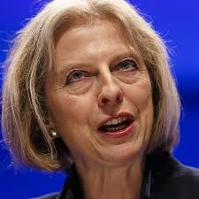
I will stop you having fun even if its harmless
Teresa May
As Home Secretary

Slide 43
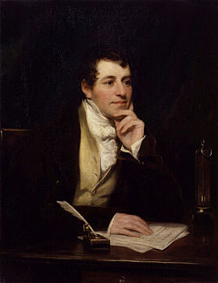
Nitrous Oxide – the new whipping boy
Sun newspaper hysteria over soccer players
“hippy crack” slang inferring as harmful as the most harmful form of cocaine
Discovered and used by Humphry Davy
In 200 years no deaths
Used by Colleridge, Southey for poetic inspiration
Millions of women for childbirth
And Prince Harry …..

Slide 44
To paraphrase Disraeli: "There are lies, damned lies and legal high statistics"
The judicious use of the MDAct1971 has in fact reduced “legal” legal high deaths to less than 5 per year

Slide 45
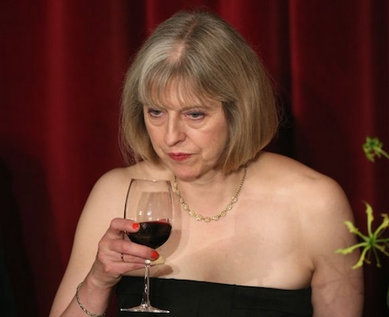
As the daughter of the Church what she really means
Thou shalt have no other drug but alcohol !
For ever and ever. Amen
Adapted from Commandment 2
Exodus 20

Slide 46
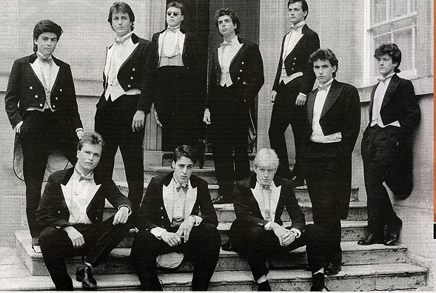
What the male Tories really mean
The proles are complaining we will ban N2O
Let them snort Coke!
Was good enough for us!
The Bullingdon Club – Oxford
Drug fueled drinking society

Slide 47
The worst law ever?
Immoral - as pushes people to use alcohol
Will increase harms and deaths via black market
Based on false premise (lies about harms)
Bans proven safe substances eg Nitrous
Anti-scientific – will block all advances in safer drugs as NO provision for new inventions
Maybe worst law affecting moral choice since ban of Roman Catholicism by Act of Supremacy in 1559?

Slide 48
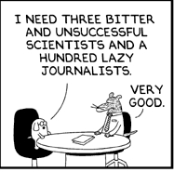
Scientists also need to be more honest
Dilbert

Slide 49
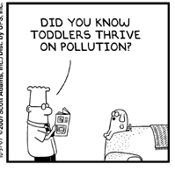
Dilbert

Slide 50
And ecstasy causes brain damage
And cannabis causes schizophrenia
And LSD causes insanity...
And legal highs are dangerous
Etc etc
Dilbert

Slide 51
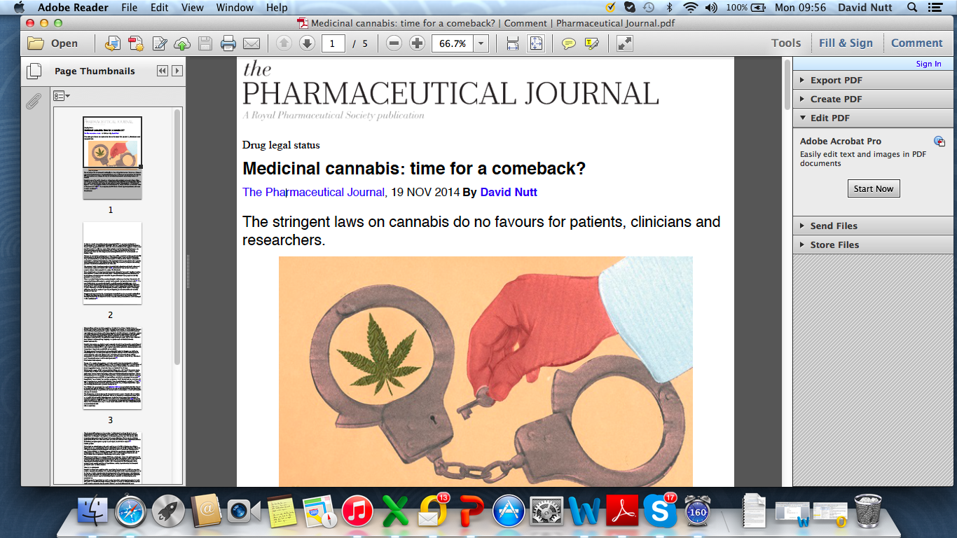
Fighting back - 1

Slide 52
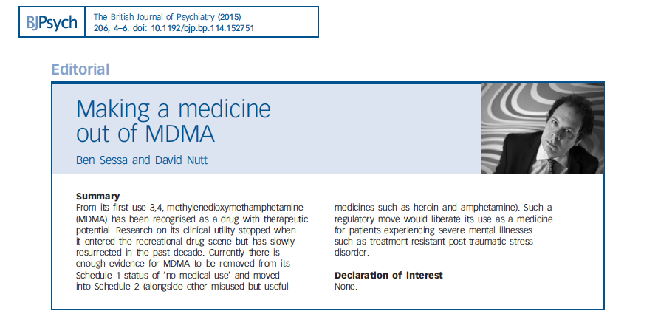
Fighting back - 2

Slide 53
Fighting back - 3
March 2015
UN Commission on Narcotic Drugs will vote to ban ketamine worldwide
– in face of opposition from the WHO!
- driven by China where ketamine widely abused
If 35 (of 56) countries support then ketamine will be banned
UK medics and vets leading efforts to stop this
madness

Slide 54
Fighting back - 4
First LSD brain imaging study ever –
- Results on April 13th
First psilocybin depression study
– see next slide
Alcosynth – to reduce alcohol harms
- compounds identified
- needs funding

Slide 55
Psilocybin efficacy in resistant depression

Slide 56
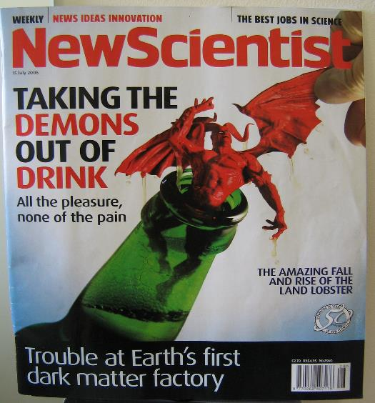
Putting neuroscience in charge?
A safer “synthetic” alcohol
- with antidote
New Scientist 2006
The Scientist Jan 2011
Science 2014
Could save 3million lives per year
Should this not be a global health challenge?

Slide 57
Should this not be the underpinning principle of our (drug) laws?
In a freedom-loving society no conduct by rational adults should be criminalised unless it is harmful to others
(after John Stuart Mill)

Slide 58
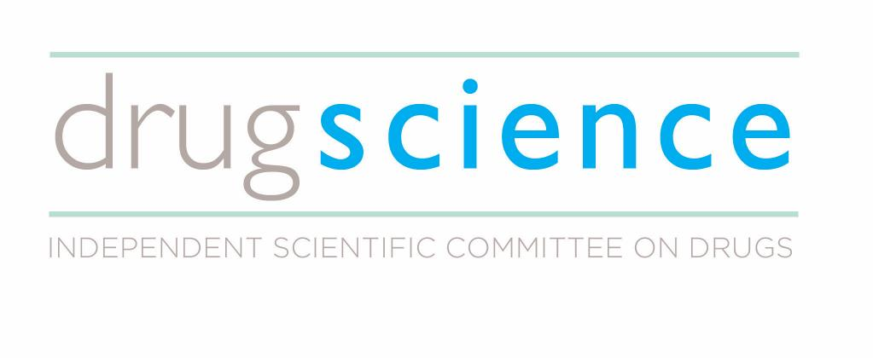
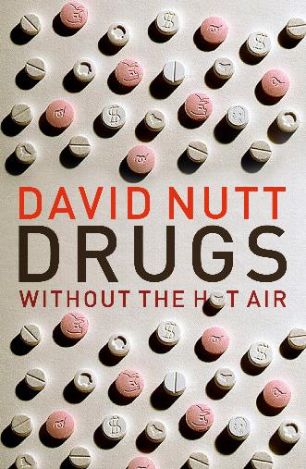
Support our work
Thanks and questions
Buy this book for your kids/parents
Donate: http://drugscience.org.uk/donate/donate/
Text INFO42 £5 to 70070 to donate.
Newsletter: http://drugscience.org.uk/newsletter/
Social media: Facebook: Drug Science, Twitter:@Drug_Science
All proceeds to DrugScience

