Slide 1
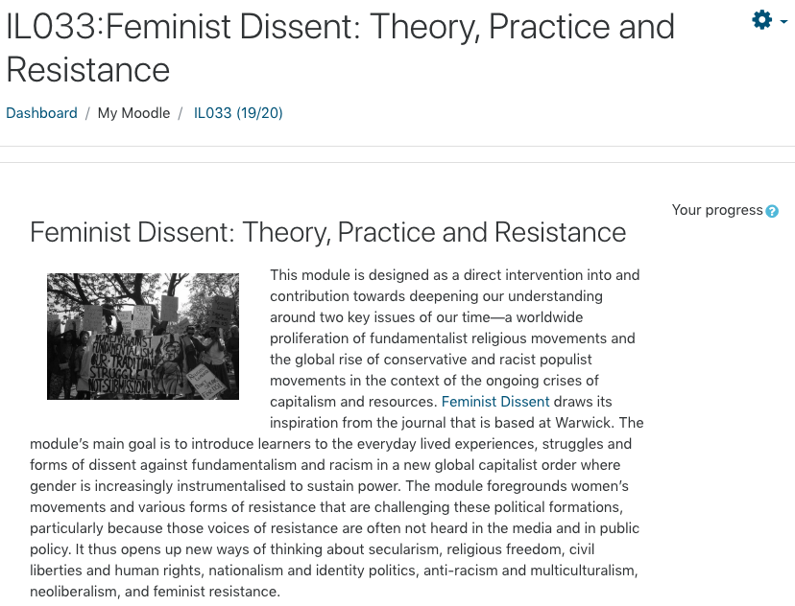

Transformative and Innovative Assessment Methods: Student Devised Assessment
Dr Roxanne Ellen Bibizadeh

Slide 2
Structure
Censorship and Society and Feminist Dissent: Theory, Practice and Resistance
Personal Experience Assessment
Student Feedback on Assessments at Warwick
Speed Dating: Find your perfect assessment match!
Transforming Assessments: An IATL Toolkit

Slide 3

Censorship and Society

Slide 4
Assessment
Formative Assessment: Group Abstract
Summative Assessment:
45% Presentation at Conference
45% Traditional Academic Essay / Edited Collection of Blogs / Vlog: Video Project
10% Critical Commentary reflecting on their experience of the conference / Creative Auto-Fiction
https://warwick.ac.uk/fac/cross_fac/iatl/study/ugmodules/censorship/assessment/
https://moodle.warwick.ac.uk/course/view.php?id=32632

Slide 5
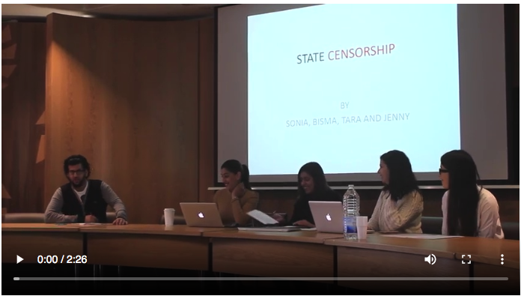
Student Conference Week 10

Slide 6
Purpose of the Student Conference
Agency and autonomy – designing presentation content and delivery
Transferrable skills: employability (organising and presenting)
Celebratory showcase of learning – peer learning
Team work – group presentation – marked individually

Slide 7
Conference Organisation
CONFERENCE
Publicity – create a poster/ front page for programme
Help design a programme
Conference chair for panels
Organise for the conference to be filmed and an edited video created to remember the event.
Can you think of anything else we need to consider?
Helpful experience for reflective critical commentary

Slide 8
Divide and Conquer: The importance of guidance
Groups should be no larger than 4, but can be a pair.
Everyone will contribute to the paper for each group - 10 minutes – which equates to around 4 pages of 12 point font double line spacing – which generally takes 8/10 minutes to read.

Slide 9
Each group needs to:
Create a question/theme/title for your panel presentation.
Formative (unweighted) Assessment: submit a group abstract week 7.
Consider the interesting connections or comparisons that may be drawn between your presentations.

Slide 10
Plan of action:
Pick your group and share contact details
Create a title/theme/question
Start to work on your abstract and decide how you plan to finish it
Decide if you want props – PowerPoint, video, photos etc…
Set a date for distributing your work and piecing it together – ie: the order of your presentation
Check out the marking scale and guide each other in ensuring your presentation meets the criteria for the mark you wish to acquire.
Perhaps arrange a coffee date to run through your presentation
Think about any questions that the class might ask
Present!

Slide 11
Abstract Help
Read through the programme for previous years and the mark scheme online.

Slide 12
Review your abstracts
Circulate the room and find someone you don’t normally speak to
Read each others abstracts
Offer some positive feedback
Consider:
What may be important to their presentation?
What would you include?
What arguments do they need to consider?
What research do you suggest they do?

Slide 13
Student Conference
How does your presentation engage with debates surrounding censorship? Does your presentation engage with any of the content we have covered? Can you draw any interesting connections?
Focus on analysing rather than explaining and describing.
Create a distinct and independent argument that stands alone.
Consider delivery – speak clearly, emphasise your argument, try to do more than just read from a script, get creative!
Consider the questions and answers you would like and correspond with your chair.
Consider connections – this can take the form of similarities and differences between your presentations or presentations delivered in other groups.
Support your argument with evidence – what scholarly references are you relying on and what makes your presentation unique, and important – what’s the point? Challenge what you read – avoid merely accepting what you read as the truth.
When referencing the work of others – ask yourself – how do you go beyond or further their argument – be careful in your presentation to find your voice and your argument – what makes your presentation new and original? What contribution are you making to your chosen topic?

Slide 14

Critical Commentary/ Creative Autofiction
Self-reflection
Critical thinking: Peer learning
Creativity
Freedom

Slide 15
Conference Critical Commentary
What did you learn from the experience? This can extend to what you learnt from others, from the experience of presenting, the physical and mental challenge it presented, including engaging in the problems or questions you were left with surrounding your topic and that of others.
Don’t just focus on the positive, what would you do differently? What difficulties did you encounter? How might you improve?
Reflect on the presentations of others, focusing on the content, what did you learn, were your ideas challenged, were you inspired to go in search of more knowledge on their topic?
Reflect on the questions you were asked, and your responses. Consider what you were not asked and what this might indicate, what did you wish you had said if you had more time, or what question would you have liked to receive from the audience and how would you respond?
What did you learn from chairing a panel? – Focus on critically engaging with the content of the presentations.
Remember don’t describe what you did, you need to be critical and analytical in the commentary.

Slide 16
Auto-Fiction
A term used in literary criticism to refer to a form of fictionalised autobiography.
Auto-Fiction combines two paradoxically contradictory styles, that of autobiographical writing and fiction.
The term was first used by Serge Doubrovsky in 1977, he initially defined it as “fiction of strictly real events”. There is, however, no single agreed definition of autofiction.
Autofiction gives the writer the power to write freely because it is unclear whether they are writing fiction or autobiography.

Slide 17
Mandanipour’s Censoring an Iranian Love Story: Three Typographical Layers
Bold text is used for the love story between two subversive young Iranians named Sara and Dara, this text, it is imagined is approved by the censor.
The interior plot is in bold and struck-through, because had it been included it would have made the story too political or sexually charged to be published.
Non-bolded story of a frustrated author also named Shahriar Mandanipour, who struggles against a fictive censoring bureaucrat named after Dostoevsky’s Porfiry Petrovich from Crime and Punishment. Porfiry Petrovich is a magistrate in charge of investigating murders, and although he only appears sparingly in Crime and Punishment, his presence is constantly felt. In Censoring an Iranian Love Story Petrovich is a censoring bureaucrat from Iran’s Ministry of Culture and Islamic Guidance.

Slide 18

Creative Activity: Censoring the Self Three Typographical Layers of Censorship
Bold font / colour font – what we feel able to say
Struck out/crossed out font – what we feel we cannot say
Non-bold – our internal monologue detailing the struggle over what we wish to say, and our personal conflict with censorship.

Slide 19
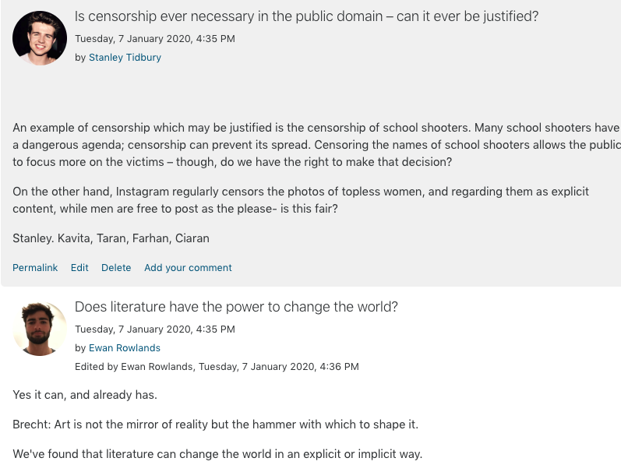
Blogging/Vlogging/Essay
Control their learning journey – choice of traditional assessment method or to blog/vlog
Technology enhanced education
Interdisciplinary thinking
Week 1 gloup blogging exercise in class
Weekly questions as a source of inspiration
Peer led learning

Slide 20
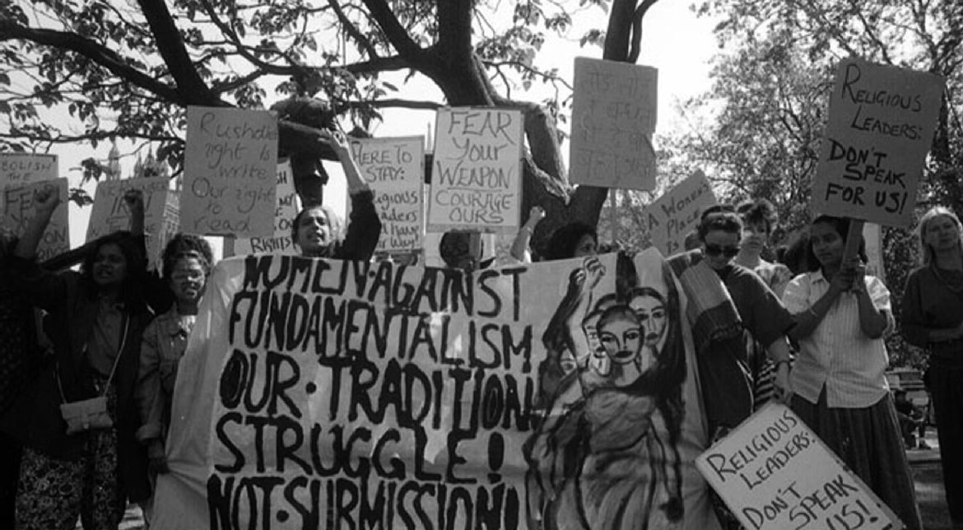
Feminist Dissent: Theory, Practice and Resistance

Slide 21
Feminist Dissent: Theory, Practice and Resistance
Design a campaign, conference or organisation to incite some form of change – 50%
Research Project – 50%
Externals: Optional Certificate Assignment
The external participants online are international, they include students from Australia, Pakistan and India, academics from Manitoba, Namibia, Cape Town, Dublin and Arkansas, activists from the UK, Malawi and Nigeria.

Slide 22
Design a campaign, conference or organisation to incite some form of change
Students will be encouraged to develop an innovative way of presenting this campaign, conference, or organisation, be it via a website, or portfolio
Submissions thus far have included: documentary, blogs, podcasts, websites, letters to policy makers, app designs, teaching resource packs, posters, conference reports, articles, art.

Slide 23
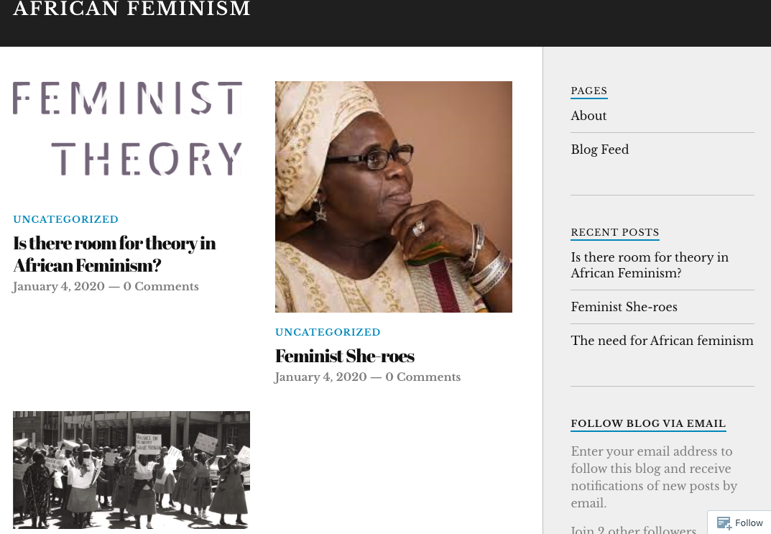

Slide 24
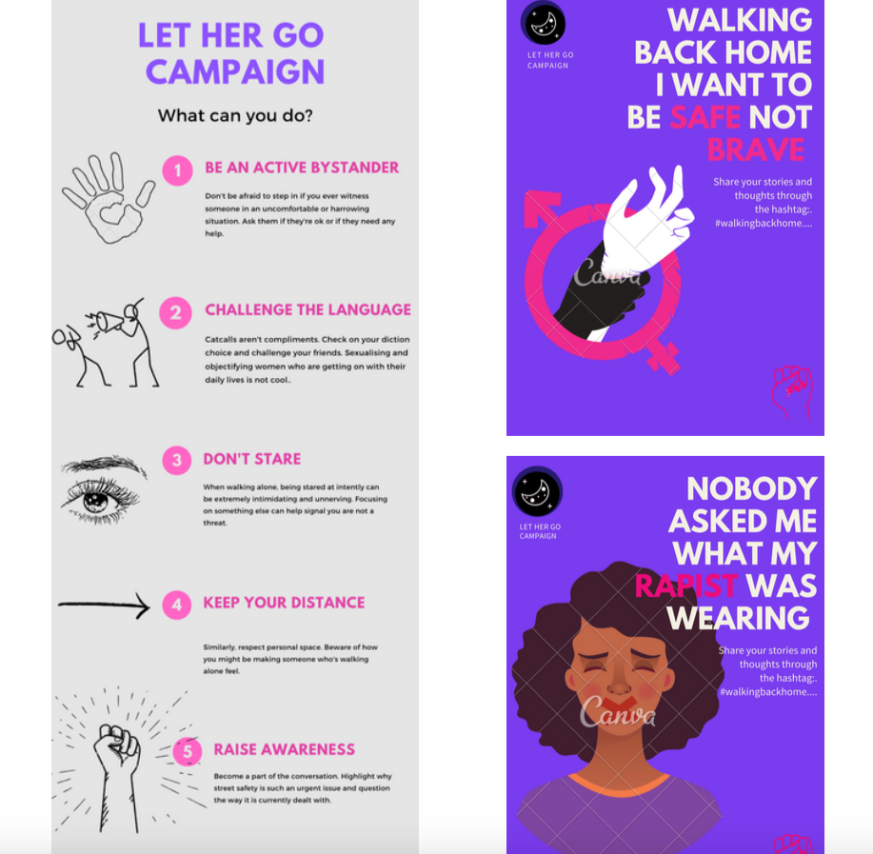

Slide 25


Slide 26
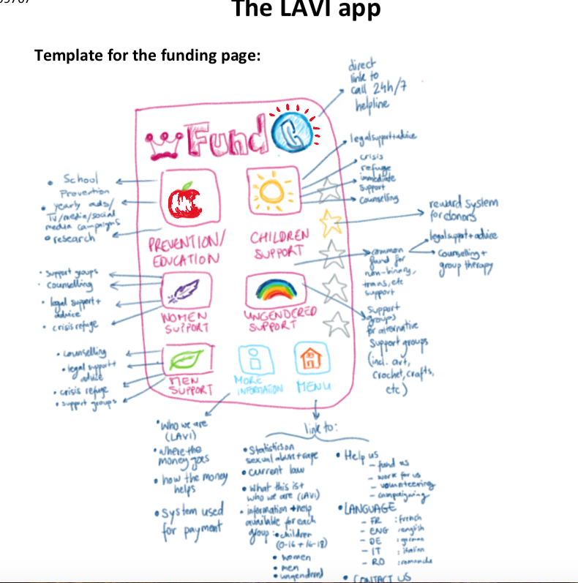

Slide 27
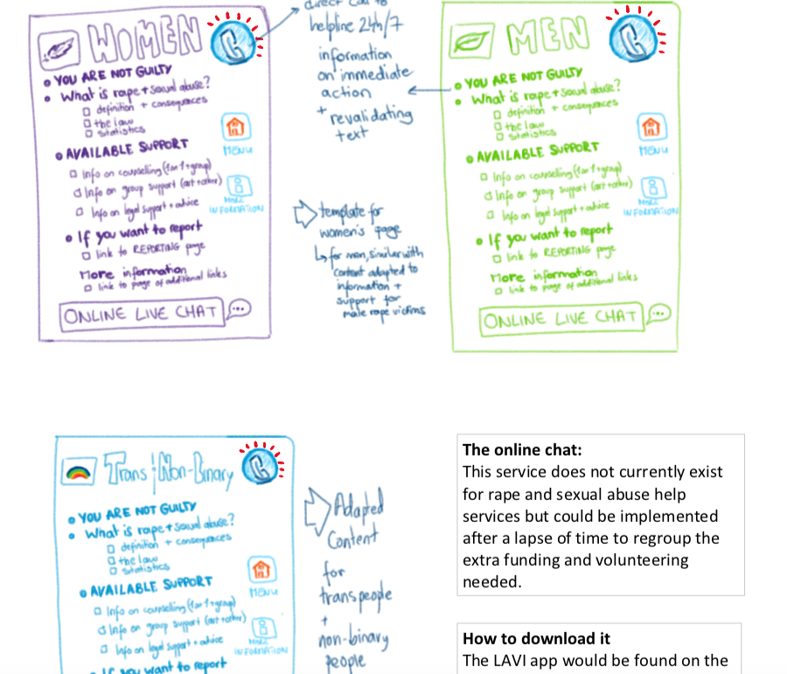

Slide 28


Slide 29
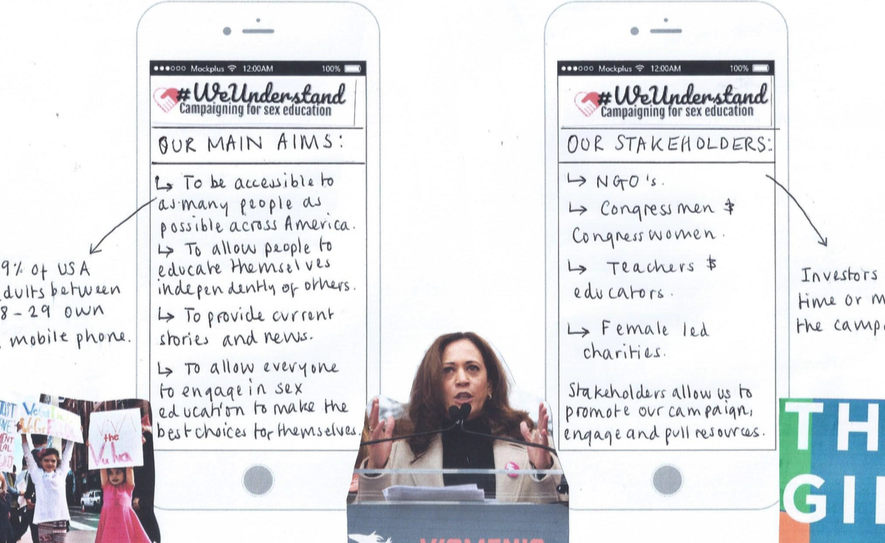

Slide 30
Research Project – 50%
This study should consist of original research, which could include (but is not be limited to): interviews, field visits. The research should be presented in the form of a paper, website, interactive blog, study, moodle page, journal, or commonplace book.

Slide 31
Public Pedagogic Intervention
Externals: Optional Certificate Assignment
Please tell us about your experience of this module in up to 500 words in order to earn a certificate

Slide 32
Challenges and Opportunities
Challenges
Anxiety surrounding presenting/public speaking
How to assess and feedback
Support and guidance
Opportunities
“Student as researcher” – modeled on academic conference
Improve presentation skills, team work – transferrable skills
Assessment specific mark schemes
Innovative submissions

Slide 33
ANY QUESTIONS?

Slide 34
Personal Experiences: Challenges and Opportunities
Type of assessment
Feeling/experience
Anecdote
Feedback
What can we learn from this?

Slide 35
Speed Dating: Share our Assessment Strategies
What is innovative and transformative about our assessment methods?
What assessment methods were particularly appealing?
Find your perfect match!

Slide 36
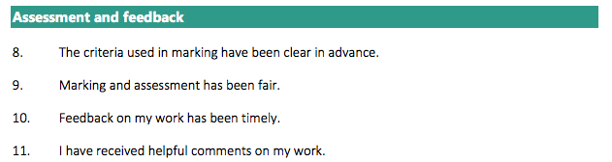
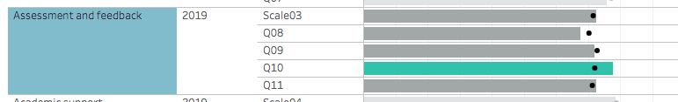
NSS 2019

Slide 37
Why do we need to transform assessment?
Improve student satisfaction – strong rationale and convincing evidence to create meaningful assessment
Improve graduate employability and transferable skills
Improve level of student engagement in learning throughout their degrees; encouraging them to be active participants in the learning process
Reduce attainment gaps; help the retention and progression of students from diverse backgrounds
Raise awareness among staff of the principles of good assessment and feedback
Encourage research-informed teaching
Position IATL as a leader in pedagogic change; encouraging wider pedagogic innovation

Slide 38
The Challenge:
How do we devise innovative, inclusive, and authentic assessment options?
How do you enhance student engagement through assessment?
How can we make students active agents in the productive use of feedback?

Slide 39
Our Aims:
Is the assessment fit for purpose? What is the purpose and relevance of the assessment – is the assessment meaningful?
Does the assessment have a positive impact on student experience?
Does the assessment support the development individual agency?
Does the assessment encourage autonomous learning?
Does the assessment encourage student responsibility for their learning journey?

Slide 40
How can we enhance the quality of assessment and feedback?
Students are empowered to co-design their assessments
Assessment criteria is clear, accessible and designed in partnership with students to ensure accessibility
Submission processes are reviewed frequently in partnership with students.
Students are active agents in the feedback process and feedback feeds forward in their learning journey
Opportunities for peer learning and self-reflection are embedded in the curriculum

Slide 41
Transforming Assessments
How do we devise innovative, inclusive, and authentic assessment options?
How do you enhance student engagement through assessment?
How can we make students active agents in the productive use of feedback?
What would our Collective IATL Assessment Toolkit include?

Slide 42
Thank you for participating ☺

