Slide 1
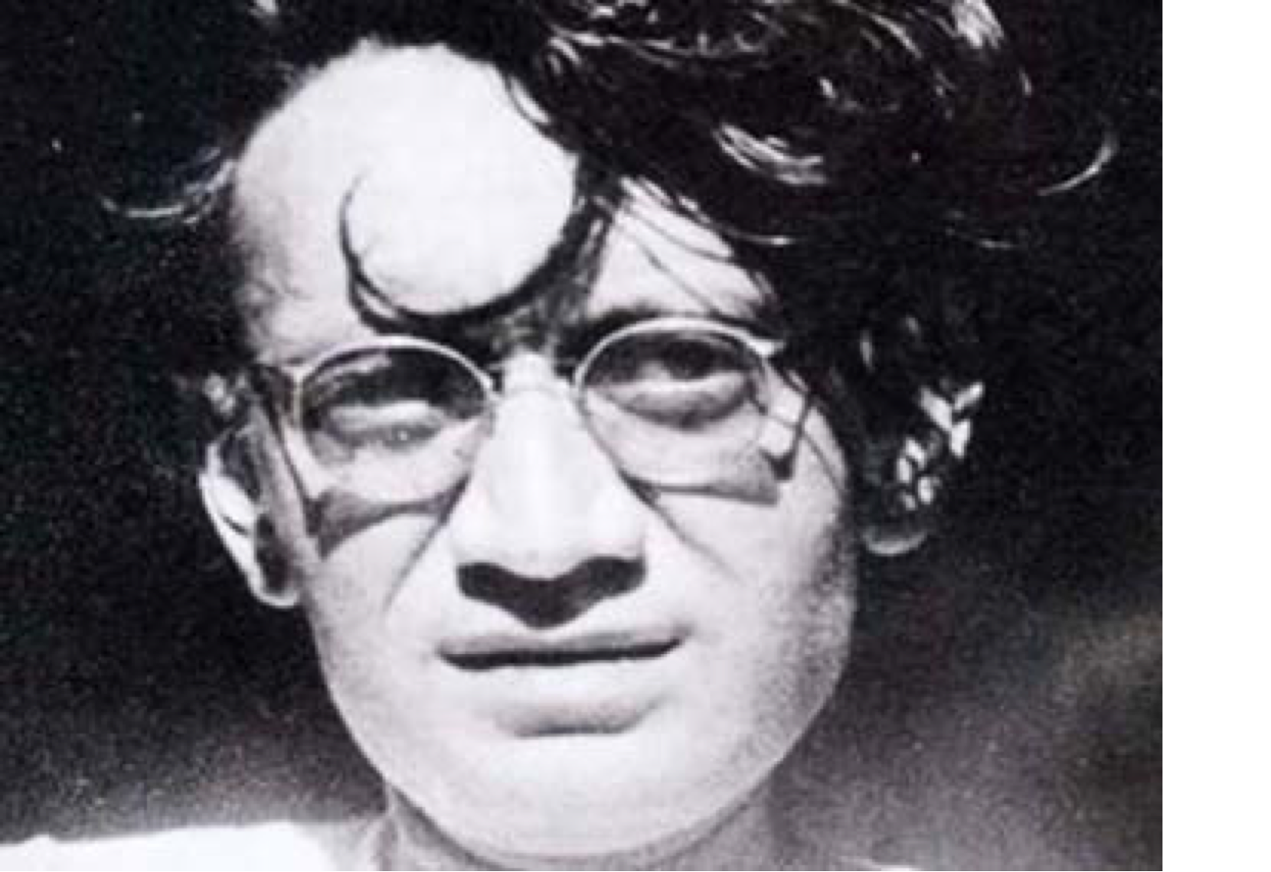
Week 9: Saadat Hasan Manto - Bitter Fruit (collection of stories)
Session Aims:
To examine why Manto’s stories were pursued in the courts and why they were considered obscene.

Slide 2
Saadat Hasan Manto
Saadat Hasan Manto was one of the greatest South Asian writers of his time whose stories present an unflinching depiction of the human condition.
He said that: “if you find my stories dirty, the society you are living in is dirty. With my stories, I expose only truth.”
The authorities however consistently pursued him in the courts arguing that his stories were in breach of the obscenity laws inherited from the British empire.

Slide 3
Different Titles
Colder Than Ice – Thanda Ghost – Cold Meat/ Cold Flesh
The Return – Khol Do – Open it / Open up
Odour – Bu - Smell
The Gift – Kali Shadwar – Black Trousers
Do these titles add anything to your reading of the stories?
Do these titles change your perception of the stories?

Slide 4
Obscene
The Gift and Odour were considered obscene by the state before Independence.
Colder than Ice and The Return were considered obscene by the state of Pakistan.
The Punjab government declared Colder than Ice obscene and harmful for public morality.
Manto was tried and convicted, but the judgement of the lower court was set aside in the appeal, only to be reconfirmed by a Lahore High Court Judge.
Discuss why he faced continual prosecution for his writing.

Slide 5
Obscene
Manto was also accused of disrespecting the dead by exposing their sexual sins instead of drawing a veil over their failings and saying something nice about them.
Manto’s writings were also considered so depraved that some felt no ‘lady of the house’ or young girls and children should be exposed to them.

Slide 6
Manto and the Law
How do you respond to the assertion that “the motive of intention in publishing the work does not prevent it from being obscene if the descriptions in it are in themselves obscene. […] It was wholly immaterial what the intention of the author in writing the story was”?
In the Judgement Muhammad Munir C.J. contended “while considering the question whether certain words or representations are obscene or not, one has to apply standards that are current to society in this country or anywhere else in the civilised world, there can be no doubt that a description of the acts preparatory to sexual intercourse, however graphic or lifelike that description may be, would be considered obscene.” Discuss this judgement.

Slide 7
Compare Manto’s trial with the trial of Lady Chatterley
“To deprave means to make morally bad, to pervert, to debase or corrupt morally. To corrupt means to render morally unsound or rotten, to destroy the moral purity or chastity, to pervert or ruin a good quality debase, to defile” R v Penguin Books Ltd [1961] Crim LR 176 at 177
The Pakistan Penal Code was inherited from colonial rule. Does it need to be rewritten?

Slide 8
Non-Fiction
What impression do you get of Manto and his experience of being prosecuted from his essay “A Day in Court”?
What were your impressions of Manto on Manto?
What do these two essays add to your understanding of his short stories?
What do the trials tell you about law?

Slide 9
Manto and his writing
Born in Samrala in Punjab in 1912, Manto, a Muslim, lived in Amritsar until 1936, when he moved to Bombay to write for films. In 1948, soon after India’s partition, he emigrated to Pakistan where he died in 1955. The author of more than 200 stories and dozens of essays and plays, he is best known for his partition stories in which he attempts to answer the following questions:
  Now that we were free, had subjection ceased to exist? Who would be our slaves? When we were colonial subjects, we could dream of freedom, but now that we were free, what would our dreams be? Were we even free?.... India was free. Pakistan was free.... But man was a slave in both countries, of prejudice, of religious fanaticism, of bestiality, of cruelty.

Slide 10
Reading Manto
As the quotation demonstrates, even as he problematizes Indian and Pakistani freedom, Manto subsumes the politics of gender under the mantle of a singular, masculinized discourse of post-Independence slavery in nationalism.
Some contend that Manto uses patriarchal nation-based politics as evidenced by his construction of the raped and silent woman-as-signifier of man’s enslavement to prejudice, religious fanaticism, bestiality, and cruelty.
For example, such scholars as Leslie Fleming and Khalid Hasan focus on the formal characteristics of Manto’s stories to praise him for his powerful, moving, and masterful portrait[s] expressing the human pain of partition, for writing with detachment and passion, deep irony and humanism about the communal holocaust, in short for creating great literature.

Slide 11
Criticisms of Manto
Some of his critics from amongst the Progressive Writers Movement denounce his work as obscene and cynical. However, even as the latter condemn Manto for being perversely preoccupied with the world of the socially wronged and sexually exploited woman, they fail to investigate the androcentrism underlying his construction of the sexually oppressed - and hence, according to Manto, silenced and virtually erased woman as a cultural signifier of the politico-social violations of partition in his overwhelmingly male narratives. As a stand-in for the political rape of the body of India and Pakistan, the raped woman is written into the patriarchal national narrative not to thematise her own suffering but merely to signify the horrors of partition.

Slide 12
Silencing Women?
Thus, in being constructed as the object of sexual violence, the female victim is assaulted not only as body but also, and perhaps more importantly, as subject, for, as Rajeswari Sunder Rajan notes in her study of gender and postcolonial culture:
  paradoxically, at the same time that she becomes an existential cypher the raped woman also turns into a symbolic cause. She becomes the representative of her social group, the very embodiment of its collective identity.... The woman’s newly recognized identity - which may be more properly described as her function in an economy of sexual propriety and property - becomes an emotional war-cry and the prelude to the virtual disappearance of the concerns of the woman herself.
Do you agree, is Manto guilty of silencing women?

Slide 13
Female Victims
As Manto says in another context in his essay Safed Jhut (White Lie),
  I am a man who . . . writes because he has something to say. What ever I see, the way and the angle I see it from, I present it to others in that very way and angle.
It is this way and angle of Manto’s seeing of woman’s essential vulnerability and silence that underlies what Lynn Higgins and Brenda Silver define generally as the ambivalence of male texts of female rape that elide the scene of violence. Yet such an elision also marks the subversive presence or gap that provides us a space to speak of women’s violation and subjectivity.
Additionally, while it is undeniable that women are raped, tortured, and murdered during communal conflict and war, to represent them only as the targets of physical violence is to deny them agency, roles of resistance, and their very voices.
Do you agree that it is problematic to depict women only as victims?

Slide 14
Colder than Ice
Manto’s much discussed story Colder than Ice is the retrospective death bed narrative of a Sikh man, Ishar Singh. As he lies dying of a fatal stab wound made by his jealous mistress Kalwant Kaur.
He recounts his role in the material, sexual, and human atrocities of partition: following eight days of looting Muslim shops and homes, he murders six male members of a Muslim family and abducts the sole female of the household; only after he rapes her does he realize that she is dead, a heap of cold flesh, a realization that leads to his impotence. And at the narrative’s end, having told his chilling tale, he is himself near death, colder than ice.
How did you interpret this story?

Slide 15
Manto on Colder than Ice
Now regarded as one of Manto’s technical masterpieces, Colder than Ice was, however, denounced for obscenity by many of his contemporaries, a charge which Manto answers thus:
  The story seemingly revolves around one aspect of sexual psychology, but, in fact, in it an extremely subtle message is given to man, that, even at the last limits of cruelty and violence, of barbarity and bestiality, he still does not lose his humanity! If Ishar Singh had completely lost his humanity, the touch of the dead woman would not have affected him so violently as to strip him of his manhood.
Does this story prove the argument that Manto depicts women only as victims?
How does he defend the story from the charge of obscenity?

Slide 16
Language of Power and Conquest
Colder than Ice critiques Manto’s masculinist fictive and interpretive stance in which he not only casts the dead woman as the bodily site upon which the cruelty, barbarity and bestiality of nationalist discourse is emulated but also positions her as the vehicle for Ishar Singh’s new-found and (ostensibly) praiseworthy humanity.
In this male narrative of the nation, the raped woman is denied a name, a voice, subjectivity, even life. Entrapped in this patriarchal story of partition, she is represented only as a permanently silent, sexualized body, a thing that Ishar Singh hides from Kalwant Kaur, a mouthful of luscious fruit that he - using the language of power and conquest decide[s] to trump right away, a dead body . . . a heap of cold flesh.
Do you agree, does Singh find humanity in the story?

Slide 17
Kalwant Kaur
Even Kalwant Kaur, cast as the dead woman’s sexual adversary, and a seemingly strong female character who is painfully alive at the narrative’s end, remains secondary to the male plot of partition politics.
The growth of Ishar Singh’s humanity, a symbol of a universal hope amidst the horrors of 1947, remains the crux of the story, whereas Kalwant Kaur supports his development both sexually and textually. Cast in sexually over determined imagery described by the (masculinist) narrator as a big woman with generous hips, fleshy thighs and unusually high breasts, a flirt and a coquette, a woman who boil[s] with passion like a kettle on high fire. Kalwant Kaur not only reenacts stereotypical male typologies of the Punjabi Sikh woman, but she is also depicted as the cause of Ishar Singh’s murderous appetite for the Muslim woman – “IsharSian, you gorge yourself on Kalwant Kaur everyday... How about a mouthful of this luscious fruit,” says Ishar Singh- and thus sets in motion his paradoxical ascent to humanity. In addition, her narrative function as impetus and audience for Ishar Singh’s confessional story – “Jani, what’s wrong she asks” thereby prompting his cathartic account – this further marks her as a rhetorical ploy in the male nationalist and cultural plot.
How do you read Kalwant Kaur and her role in the story?
Do you agree with this reading?

Slide 18
The Return
Similarly, Manto’s story The Return is a third person, male-focused account, this time of a Muslim man, Sirajuddin’s attempts to find his seventeen-year-old daughter, Sakina, from whom he has become separated following an attack on their Lahore-bound train. The eight men he recruits to cross the border into India after partition and find his daughter end up abducting and gang-raping her, as the chilling end of the narrative reveals.
Coming upon Sakina’s unconscious body, Sirajuddin thinks his prayers have been answered, but as the attendant doctor asks him to open up the window, the now semi-conscious Sakina groped for the cord which kept her shalwar tied round her waist. With painful slowness, she unfastened it, pulled the garment down and opened her thighs.

Slide 19
Sakina’s Rape
Generally, the story has been praised as one that plumbs the human pain of partition and explores with a remarkable combination of anger, sarcasm and tenderness the effects of the violence and dislocation of its victims, or criticized for its intention to shock the reader [through Sakina’s rape] rather than to generate sympathy for Sirajuddin and thus for its failure to provide a deeply felt, realistic, or universalized version of the Partition experience.

Slide 20
Sexualisation
The Return was analysed by Higgins and Silver’s challenge to listen to ... [those] who do not speak . . . [to] recuperate what has too often been left out: the physical violation of women.
However, like the dead woman in Colder than Ice, Sakina is positioned as a silent and absent presence in much of the narrative. She is cast as essentially vulnerable on the basis of her sexuality: Sirajuddin describes her as fair, very pretty.... About seventeen. Big eyes, black hair, a mole on the left cheek, thereby arousing her would-be rescuers’ desire for her body; while the Manto like narrator notes that it was obvious that she was ill-at-ease without her dupatta [veil], trying nervously to cover her breasts with her arms. Sexualized thus, her repeated rape signified at the narrative’s end for its shock value, Sakina too is reduced to a metaphor of the horrors of partition, her story of violation curtailed and exploited so that the story of the nation can be enunciated.
Do you think that Sakina is sexualised?
Is the violence inflicted upon her body merely a vehicle for Manto’s message?

Slide 21
Manto Explains
Even as he denounces the corruptions of the new nations of Pakistan and India, Manto thus remains complicit with patriarchal cultural as well as textual structures. As he ironically reveals in the metaphor of female undress that he adopts in an address to a college audience:
  I am not seditious. I do not want to stir up people’s ideas and feelings. If I take off the blouse of culture and society, then it is naked. I do not try to put clothes back on, because that is not my job.
Do you think it is justifiable to object to Manto’s use of the female body?

Slide 22
Female Subjectivity
Thus, while Manto uses the violence of rape to mark the crisis of the nationalisms of Pakistan and India, he thereby erases female subjectivity.
Do you think Manto erases female subjectivity?

Slide 23
Manto on Odour
“People object that the only thing new writers write about is sex. For myself, all I'll say is that the subject interests me. Why? Just because. Ascribe it to perversion. But if you're smart you'll be able to trace out its causes. That is, the age we live in. If you're still unaware of the times, please read my stories. If you can't stand my stories, the reason is that the times are insufferable. Whatever faults I have are those of the times.”

Slide 24
Manto and the figure of women
“But people have given this mentality the wrong name. Some call it progressive, some call it obscenity and some call it socialist. Some even say that these writers are obsessed with women. The truth of the matter is that men have been obsessed with women since Adam and Eve, and why not? What should men be obsessed with elephants or horses? A male pigeon coos when he sees a female pigeon, so why shouldn't a man write a ghazal or a story when a woman inspires him? Women are much more interesting, pretty, and intelligent than pigeons. That goes without saying.”

Slide 25
Discussion Questions Odour
How does Manto present the female body in this story?
Manto’s female characters are often on the margins of society, why might he have chosen to write about prostitutes and women who are financially struggling?
What might the smell be symbolic of?
Is Manto trying to debunk the romantic myth of idealised women?

Slide 26
Discussion Questions The Gift
Manto describes the sensitive relationship between a prostitute and a gigolo. What is the moral of this story?
What is your perception of Sultana?
How do you read their relationship?
What is your perception of Shanker?
What is Shanker’s role in the story?

Slide 27
Group Activity
Divide into four groups of four or five.
You have 4 minutes with each set of questions to note down your ideas.
Has your opinion changed? Can you add anything to your responses?

Slide 28

What is censorship?
Is censorship ever necessary in the public domain – can it ever be justified?

Slide 29
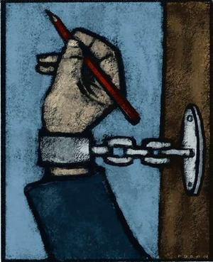
Do we have freedom of expression?
Can we ever obtain freedom of expression?

Slide 30

Is literature capable of damaging or corrupting us?
Who defines the moral values that govern society?

Slide 31
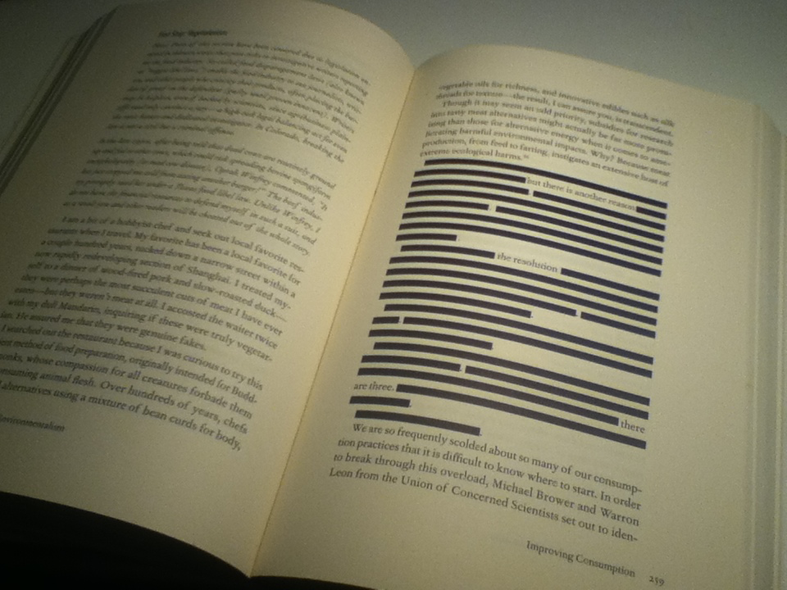
What is more effective in keeping the peace: blunt state censorship of “dangerous” texts, or safe interpretations of supposedly “respectable” ones?
Does literature have the power to change the world?

Slide 32
Assessments
http://www2.warwick.ac.uk/fac/cross_fac/iatl/activities/modules/ugmodules/censorship/assessment/
70% - Essay or Blog Posting - Term 3 Week 2 - Tuesday 3rd May 2016
20% - Presentation at a conference - the student conference will be held Tuesday 15th March 2016 (all day).
A group abstract of no more than 400 words must be submitted in class on Tuesday 23 February 2016 - Week 7.
10% - Reflective commentary on the conference and Guest Lecture - Due Thursday 24th March 2016

Slide 33
Step by Step Guide to Conference
Upload the transcript of your presentation (which includes your abstract at the top) to tabula - Tuesday 15th March 2016 12pm
You can also upload your PowerPoint if you have one.
Present your paper.
Remember to consider/prepare for how you might respond to any questions you are asked.
Try to draw connections between your individual presentations within the group.
Contribute to the question and answer session, try to ask at least one question.
Make notes of your experience after the event for your commentary.

Slide 34
Step by Step Guide to Conference Chairing
Read abstracts
Devise a question for each person presenting based on their abstract.
Introduce the presentation and their names before each presentation.
Make notes of possible comments/questions on each presentation.
Make an overall complimentary comment before asking if the audience has any questions once the presentation is complete.
Ask the first question if no one is forthcoming.
Make sure each presenter gets asked one question – you may need to be the one to ask that question!
Keep track of the time, do not allow it to overrun.

Slide 35
Guide to Reflective Commentary
Make notes during/after the day of your experience presenting, working in a group, and contributing to the organisation.
You can use personal pronouns but make sure you write critically.
Don’t be afraid to identify what you would like to improve or do differently.
Organise your ideas – don’t forget to use paragraphs.
Analyse don’t explain or describe.
Provide examples that are concise to substantiate your points.
Consider how you might create an overall thesis or showcase a discovery in a short introduction and conclusion.
Demonstrate the development of your ideas.

Slide 36
Guide to Edited Collection
Pick 5 blog posts, due to the limit on words for each post you have to be precise and concise in the presentation of your ideas and argument.
You can arrange a meeting to get feedback on all blog posts prior to submission.
Blogging helps to enable more interdisciplinary thinking which may result in a higher mark – because you are forced to cover a range of disciplines.
Remember you still need to provide evidence to support your points, this should be referenced using MLA.
Place the question above each blog post, you can create a original title for the whole submission.
When submitting the blog posts you still need to incorporate an introduction and conclusion which ties all posts together. This thesis needs to be threaded throughout each blog post.
Consider the overarching questions we discussed at the start of the module – perhaps one of these could serve as a frame.
Make sure you make an appointment to get feedback – email me!
Consider how you can show transdisciplinary thinking and research!

Slide 37
Guide to Academic Essay for IATL
Pick a question from one of the questions posed each week online.
You must then email me the question, the week this comes from, and a brief outline of your ideas, which I will respond to and provide some feedback. You must do this to ensure the question you pick and your approach is suitable.
You must provide examples to substantiate your points.
Create a clear argument/thesis which is developed throughout your essay.
Engage in the complexities of the question, don’t be afraid to identify what is unresolved or problematic.
Make sure you think transdisciplinary – you need to incorporate multiple disciplinary approaches to your question and evidence to support this thinking.
Writing critically and analytically, avoid explaining and describing.
Try to create an original and sophisticated argument that demonstrates an awareness of existing scholarship in relation to the question or an awareness of how different disciplines might respond to the topic.

Slide 38
Any Questions?

Slide 39
Conference Abstracts
Use this time to make final arrangements/plans for the conference.
Please come to see me now for some feedback on your abstracts.
Does anyone plan to come to the final workshop/office hour tomorrow 6-7pm?
Please review the final draft of the programme and make any suggestions for improvements before it is printed for all on the day.

