Slide 1


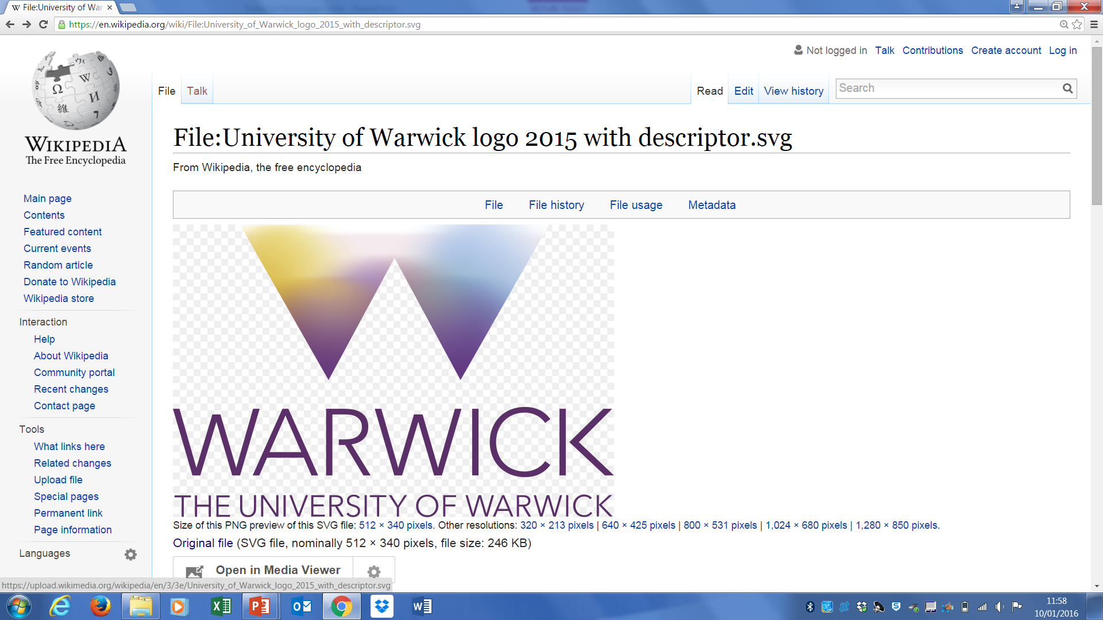


Digital Wildfires and the challenges of governance in social media
Rob Procter
Digital Wildfires Project
Notes:
Check title
Add slide(s) on causes …

Slide 2
Overview
What is social informatics?
The rise of social media.
Digital wildfires and their impacts:
  Rumours
  Provocative content
  Explanations
How should society respond?
  Legal measures
  Monitoring and counter speech
  Digilantism
  Education
Can technology provide a fix?

Slide 3
What is Social Informatics?
  “The interdisciplinary study of the design, uses and consequences of information technologies that takes into account their interaction with institutional and cultural contexts.” Rob Kling
Emphasis on innovation as a participatory process of experimentation and learning where meanings of technologies are collaboratively explored and co-produced.

Slide 4
The Rise of Social Media
Social media platforms such as Facebook, Instagram, Snapchat and Twitter enable users to share content instantly.
This brings many benefits to society but also poses difficult problems.
  ‘digital wildfires’, in which false or provocative content spreads rapidly, may damage the reputation individuals, or put groups and communities at risk.
How might conduct in social media might be better managed.
  Should police and legal system have a greater role or should we expect social media platforms to be more actively involved?
  To what extent is it incumbent on civil society groups and individuals to take responsibility?

Slide 5



Social Media: Some Statistics
Twitter:
  300M active users, 500M tweets per day
Facebook:
  1.4B active users, 44M posts per day
Tumblr:
  110M active users, 114M posts per day
Notes:
Add graphs?

Slide 6
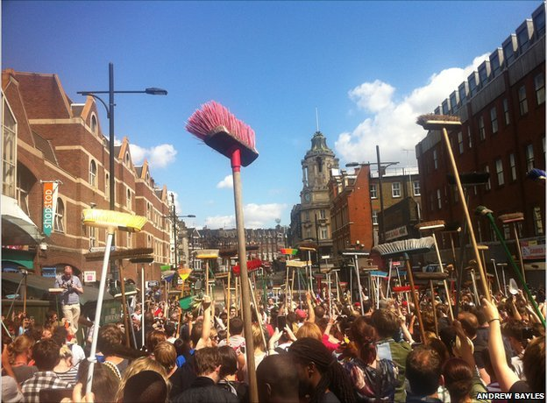

Slide 7
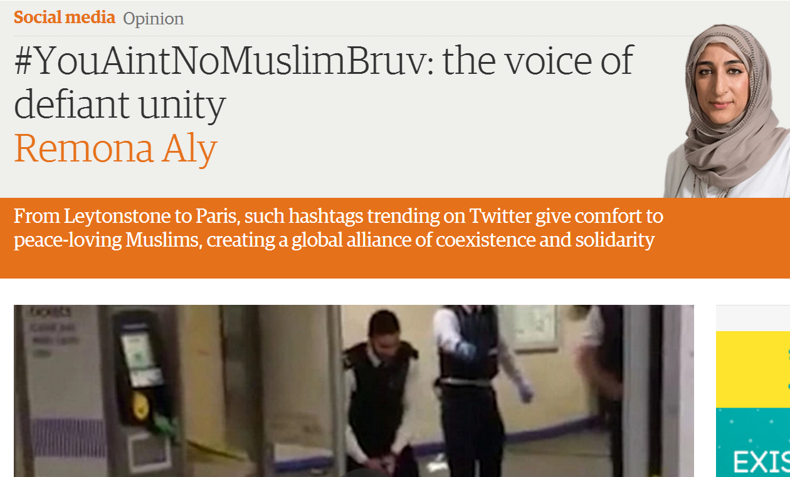
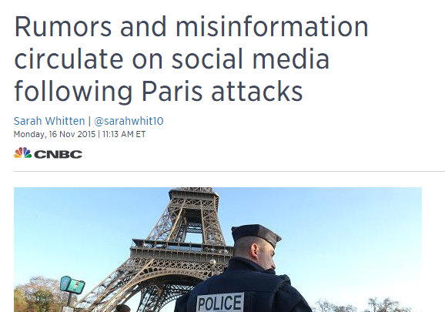
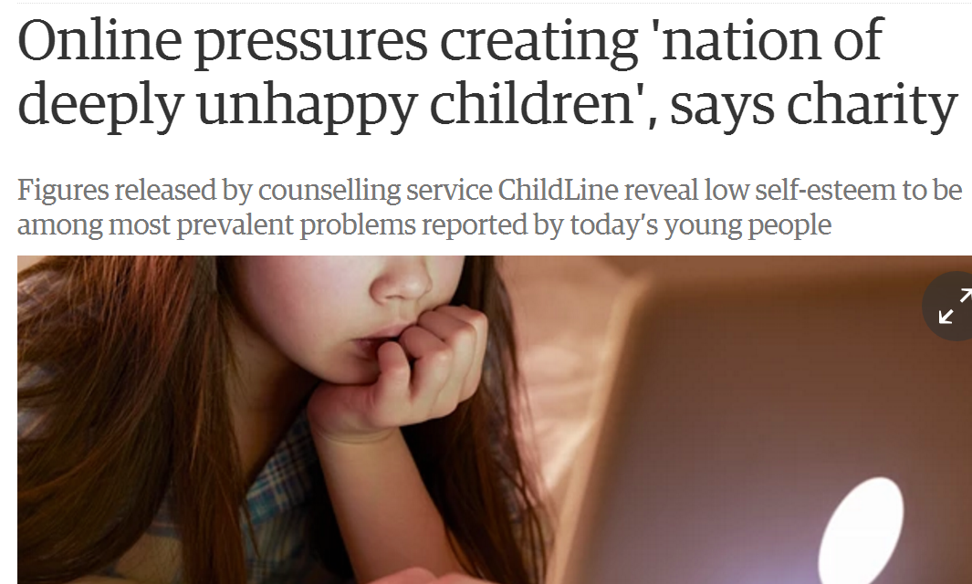
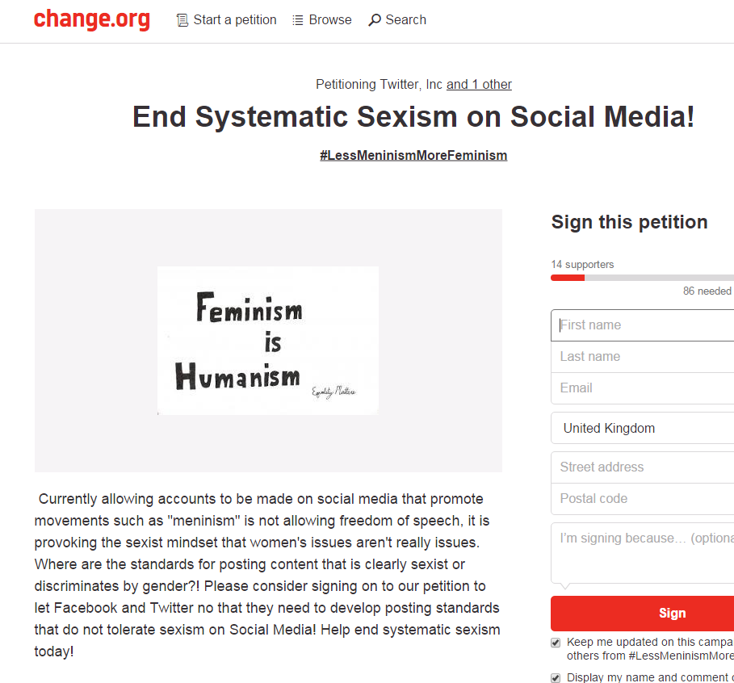
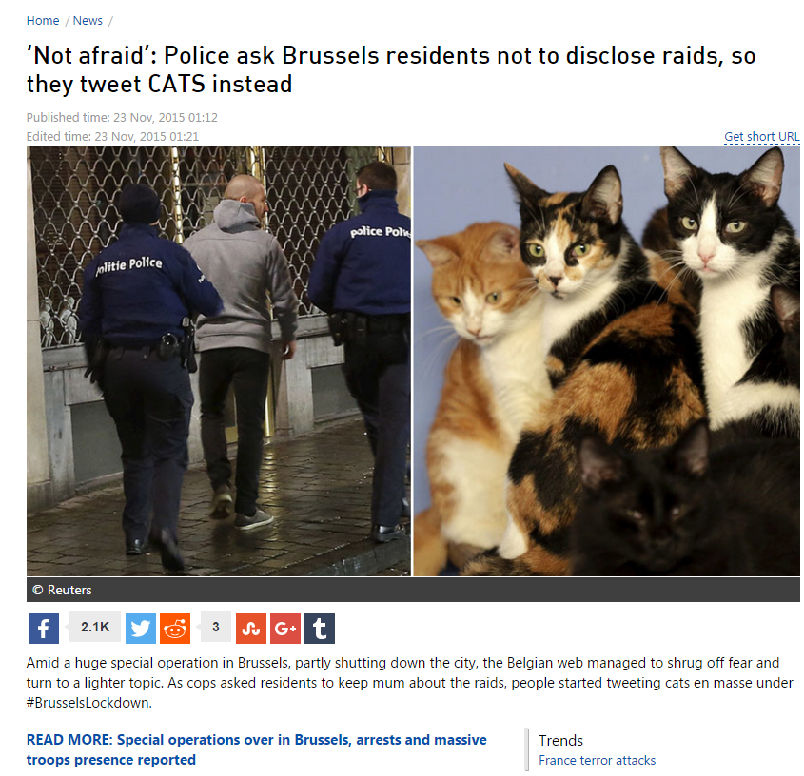
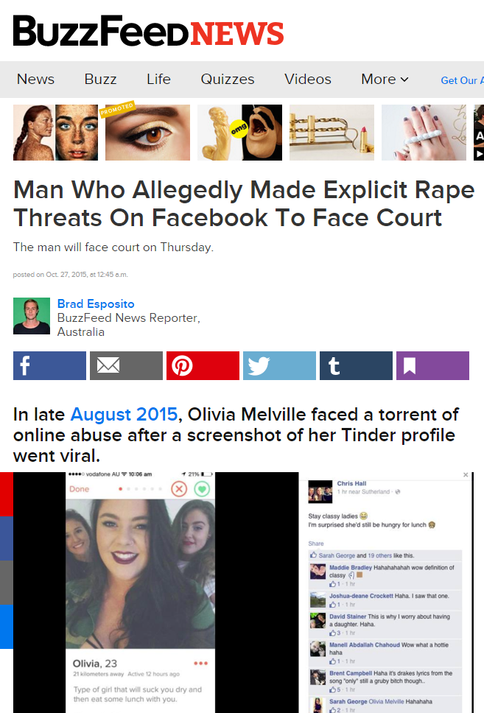
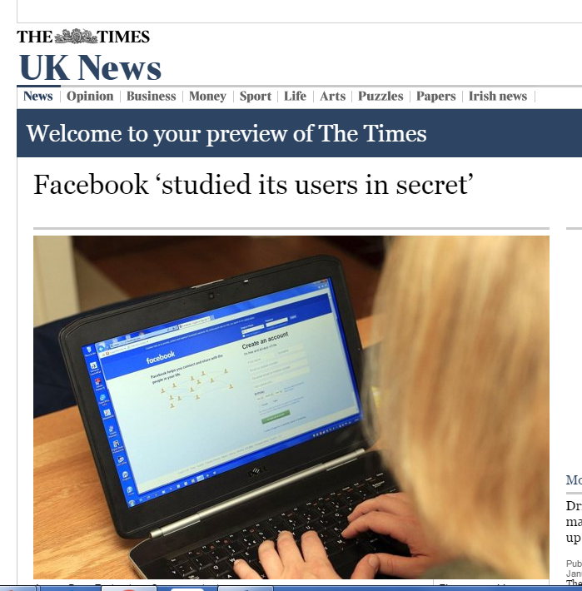
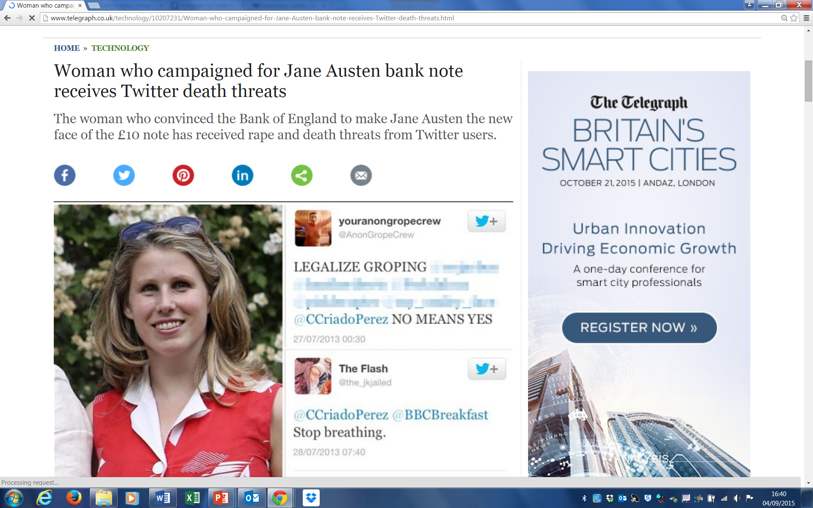
Notes:
Rising popularity of social media, mass posting of content by people all over the world which can spread rapidly and have multiple impacts on society
Social media can have the capacity to promote resilience and cohesion in times of crisis – for instance following recent security crackdown in Brussels and response to apparent terror attempt in London. Social media also become known for facilitating the posting and spread of provocative content. Can take various forms, such as spread of rumour about offline events, hate speech or inflammatory posts addressed to individuals or groups. Can cause damage to reputation and well being of different communities and also puts pressure on different agencies who might are required to deal with the consequences of these posts and might be expected to intervene in some way to prevent them spreading.
Increasing awareness that children and young people are a particularly vulnerable population on social media – have access to use it and expectation that they will be online users, but exposed to a variety of risks and lack digital resilience to recover from harm.
Also questions over how far social media posts can be regarded as public and how digital social spaces transform established understandings of privacy and ownership. Important issues to consider for everyone with an interest in responding to spread of provocative content on social media – researchers, government and protection agencies, journalists, social media platforms.

Slide 8
Digital Wildfires
How can we understand social media content and its impacts?
Who is responsible for managing the spread of provocative content?
How can we balance concerns about harm with rights to freedom of speech?

Slide 9
Global risk of digital wildfires = the rapid viral spread of information that is either intentionally or unintentionally misleading or provocative with serious consequences
World Economic Forum 2013: Digital wildfires in a hyperconnected world
Notes:
Report goes on to describe DW as a challenge to social media governance. Capacity to cause harm suggests we should think of ways to prevent and limit them but we also think of internet as a space that champions freedom of speech. So in essence face an ethical choice to balance out.
Report acknowledges this and calls for a move towards a global digital ethos that secures responsible use of social media across world. Does not say how this can be achieved.

Slide 10
Digital wildfires as a challenge to the governance of social media
“Establishing reasonable limits to legal freedoms of online speech is difficult because social media is a recent phenomenon, and digital social norms are not yet well established.”

Slide 11
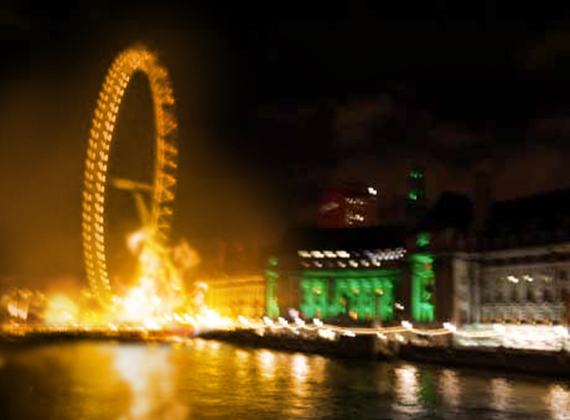
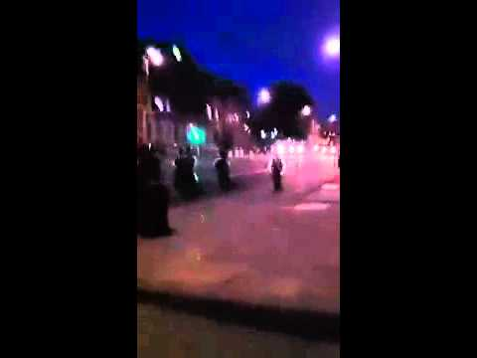
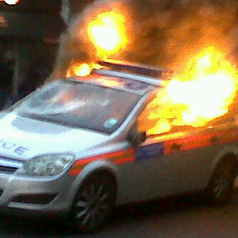
The riots study: How was Social Media Used?

Slide 12
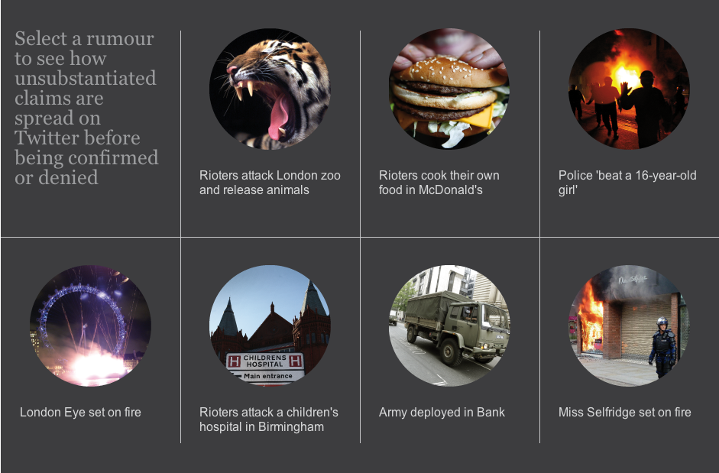
Rumours on Twitter

Slide 13
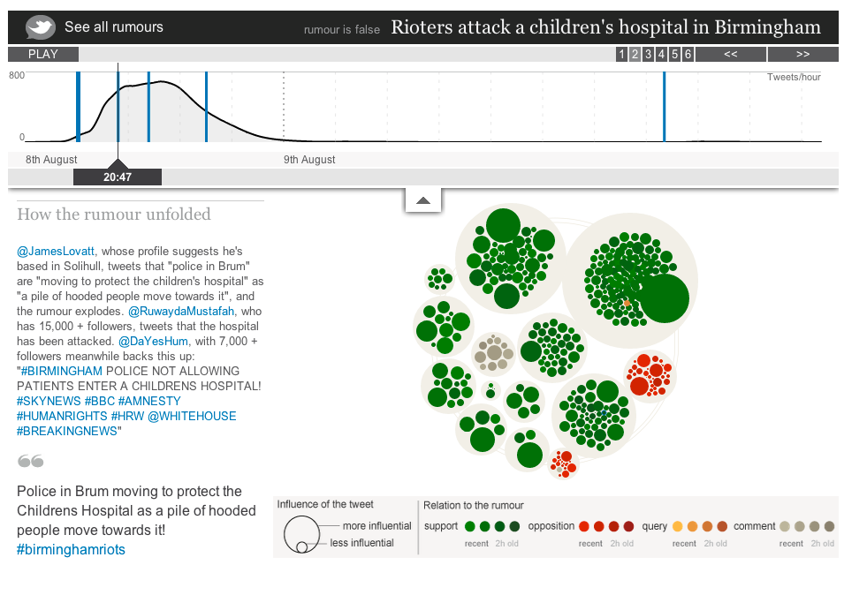

Slide 14
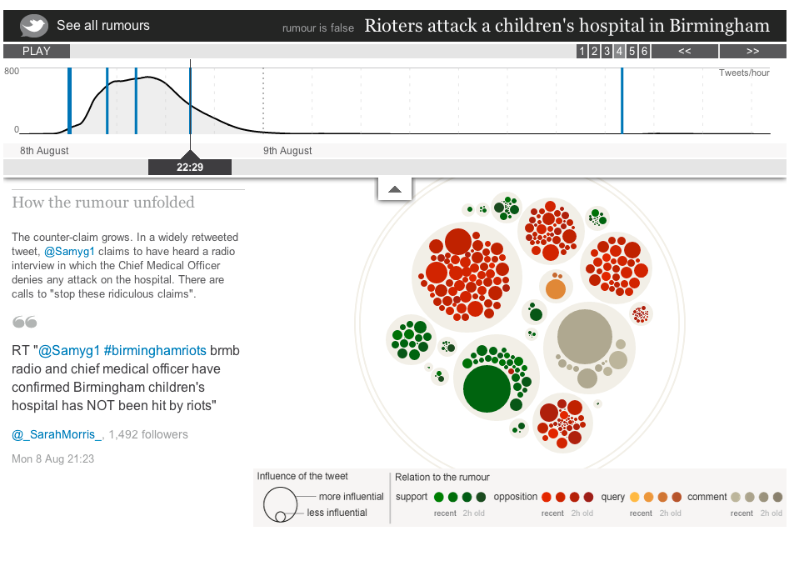
Notes:
The contagion model… and the natural resistance iof the social organism.

Slide 15
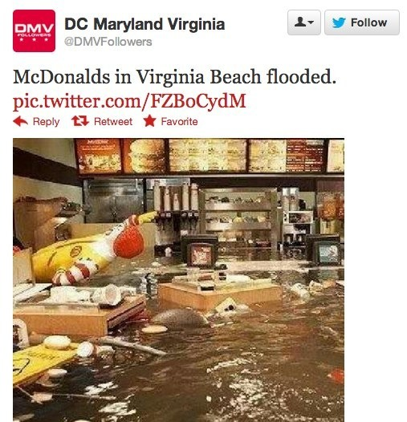
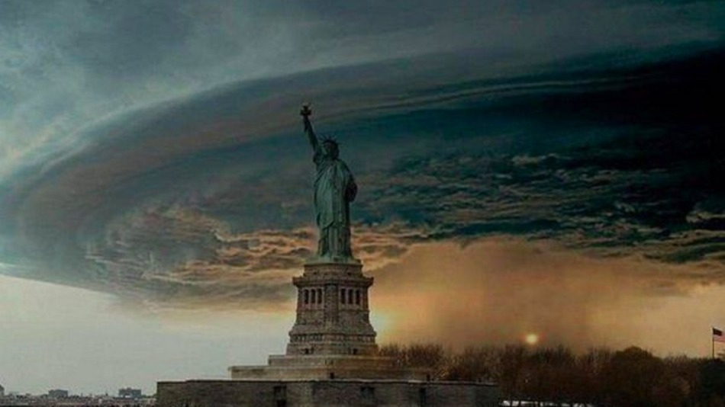
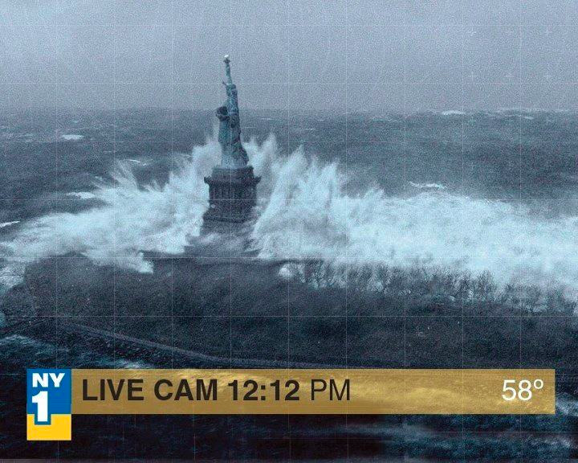

Rumours and Social Media

Slide 16










PHEME
Computing Veracity Across
Media, Languages, and Social Networks
© The University of Sheffield, 2014-2016
This work is licensed under the Creative Commons Attribution-NonCommercial-ShareAlike Licence

Slide 17
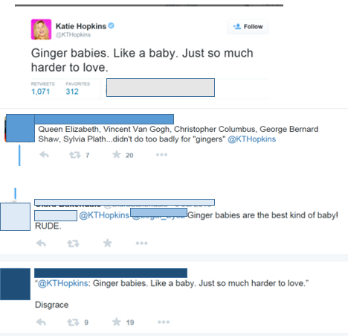
Provocative posts on social media
Notes:
Here are some of our findings so far: Capacity for social media posts to provoke (deliberately or otherwise) strong reactions that can lead to further inflammatory interactions. Even where users ‘know’ the best response is to ignore some posters are very skilled at provoking to ensure a reply. Responses to provocative posts can also take the form of ‘shaming’ – causing harm in revenge for the original post. E.g. site that encourages others to ID users who have posted racist comments and get them fired from their jobs. So provocative postings can escalate.

Slide 18
Legal regulation
“When we’ve reported something to the Police sometimes they take it seriously and sometimes they don’t. I think they struggle … to know is it against the law or not... It’s a very grey area.”
Staff member at equality organisation
Notes:
For many people who work in organisations that attempt people affected by social media content, the current law in the UK is unclear. Some posts can be acted on – for example those that make specific threats of violence. But the thresholds of evidence to pursue prosecutions can be high and it can appear unclear what posts might be illegal.
Also tell us that social media platforms can appear unwilling to engage with police and other agencies. As they tend to be based in the US, they tend to follow a model that prioritises freedom of speech and so are reluctant to remove content that is harmful but not necessarily illegal. It is important for their own brand image to allow freedom of expression.

Slide 19
Deindividuation
How people seem to respond when social norms are withdrawn because identities are concealed.
Not subject to the same opportunities for inter-subjective moderation of behaviour.
Long history of incidents in computer-mediated communications:
  Flaming in News groups and email

Slide 20
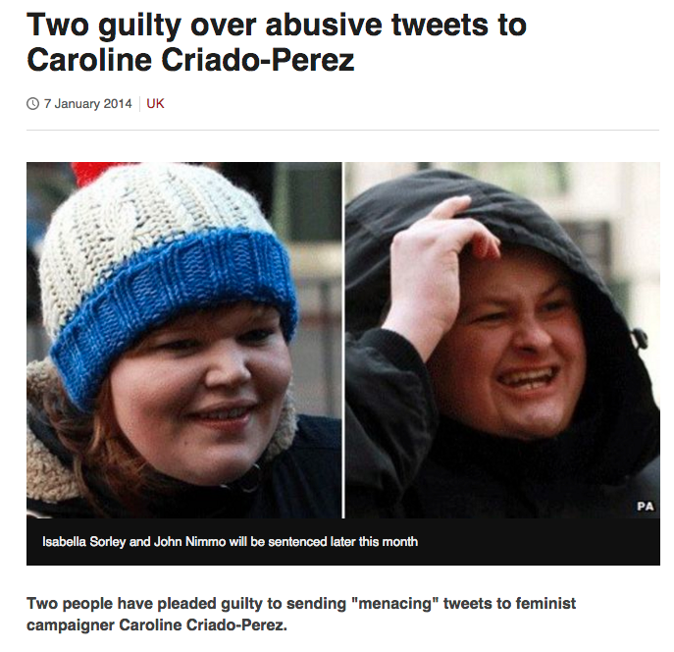
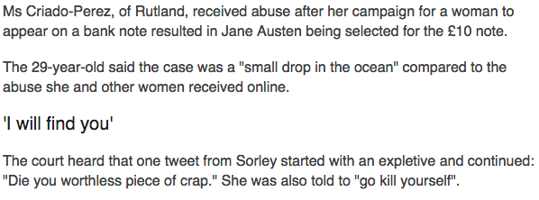
Caroline Criado-Perez

Slide 21
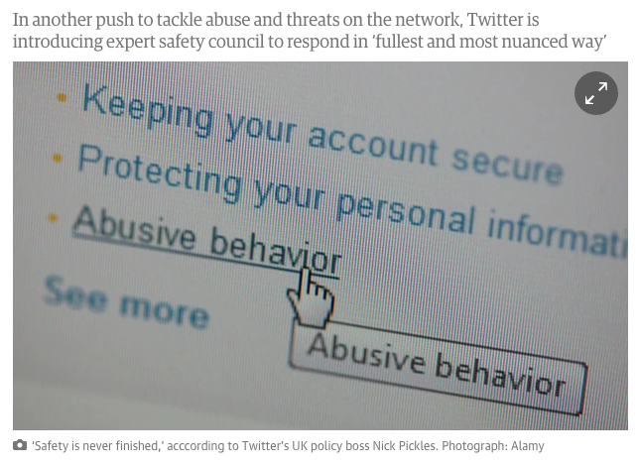
Responses from social media platforms
“We would report it to Twitter to try to take [racist posts] down and again, the majority of the cases don’t get taken down.”
Staff member at anti harassment organisation
Notes:
For many people who work in organisations that attempt people affected by social media content, the current law in the UK is unclear. Some posts can be acted on – for example those that make specific threats of violence. But the thresholds of evidence to pursue prosecutions can be high and it can appear unclear what posts might be illegal.
Also tell us that social media platforms can appear unwilling to engage with police and other agencies. As they tend to be based in the US, they tend to follow a model that prioritises freedom of speech and so are reluctant to remove content that is harmful but not necessarily illegal. It is important for their own brand image to allow freedom of expression.

Slide 22

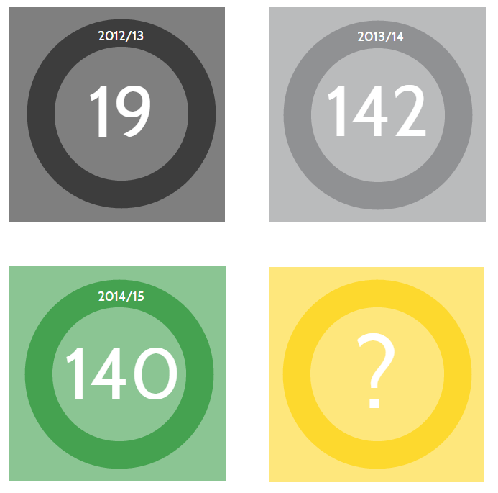
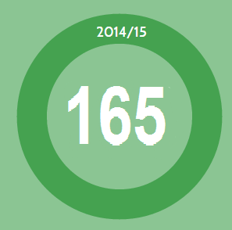

Slide courtesy of KICK IT OUT
Notes:
Kick It Out started receiving complaints of social media abuse during the season 2012/13. The organisation had never dealt with these kind of incident before, and after receiving advice from the CPS and APCO started reporting the incidents to True Vision, a national reporting facility which had been developed to report hate crimes online. The challenge for the organisation was, and still is, that incidents that occur on social media is not under any football regulation, which meant that we could not use or normal route of reporting it to football authorities or clubs. As an organisation we realised that much of the abuse happening online was left unchallenged, and we therefore took it upon ourselves to deal with it as we understood early on that this would become a growing issue.
And as you can see the reports are going up. During the season 2012/13 we received 19 complaints, The following season, 2013/14, the number was 142. At the end of March his season the number was 140, indicating that the reported incident keep on increasing.
As you can see this is a growing challenge for Kick It Out, and football as a whole – so how do we tackle it?

Slide 23
Opportunities to further responsible governance of social media
Counter speech: “The best response to bad speech is more speech… Online communities have a right to ostracize, call out, criticize bad actors.”
Delphi panel survey respondent
Education: “One of the best ways to address ‘responsible’ behaviour on social media is through education and social media literacy.”
Delphi panel survey respondent
Notes:
With these perceived limitations in mind it is possible to identify opportunities to further the governance of social media in ways that can be effective in the prevention and management of digital wildfires but still recognise the value of freedom of speech.

Slide 24
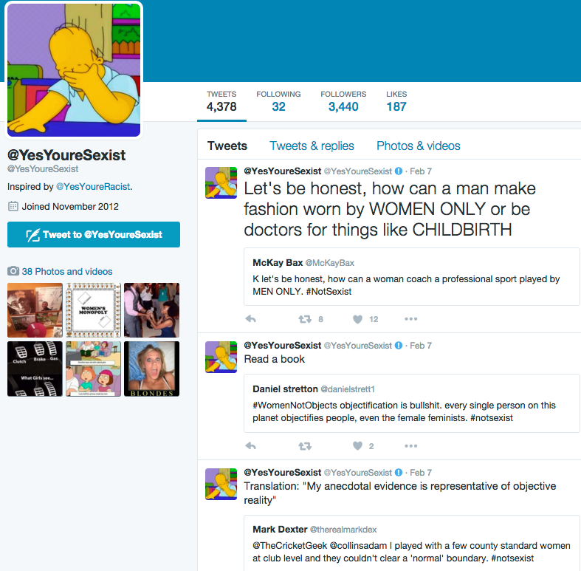
Counter speech

Slide 25
Digilantism
Punishing public exposure of wrongdoing to a (usually selected) online audience.
Status of action as wrongdoing sometimes disputed.
Addressed online audience reacts with hate speech and threats of injury.
Usually a reaction from untargeted online audiences as well.
Wrongdoing can be subcriminal and reaction bypasses law-enforcement agencies.

Slide 26
Dimensions of digilantism
Seriousness of wrongdoing exposed.
Severity of hate speech in response.
Occurrence of physical attack in addition to hate speech.
Economic loss.
Reputational damage and its duration.
Dependence of target of digilantism on digital world.
Effects on (local) rule of law.

Slide 27
Cat in the bin woman
Cat in bin for 15 hours.
Video posted to identify culprit.
https://www.youtube.com/watch?v=eYdUZdan5i8

Slide 28
Aftermath
Culprit identified.
Culprit fined £250, ordered to pay legal costs and prevented from owning animals for five years.
Suffered online abuse, death threats.

Slide 29
Justine Sacco
German man on the plane from New York: ‘Weird German dude: You’re in first class. It’s 2014. Get some deodorant. – Inner monologue as I inhale BO. Thank god for pharmaceuticals.’ Then the layover at Heathrow: ‘Chili – cucumber sandwiches – bad teeth. Back in London!’ Then the final leg: ‘Going to Africa. Hope I don’t get AIDS. Just kidding. I’m white!’
Ronson, Jon (2015-03-09). So You've Been Publicly Shamed (p. 68). Pan Macmillan. Kindle Edition.

Slide 30
Aftermath
Sacked from her PR dream job.
Vilified on social media.
Out of work for a long time.
Driven into depression.

Slide 31
Important features of this case
Confidence that public tweets would be understood in the way intended by Justine Sacco.
PR naiveté from PR woman.
Disadvantaged group as a source of humour.
Snowballing offense and notoriety.
Offense and notoriety as liability not only to individuals but employers.

Slide 32
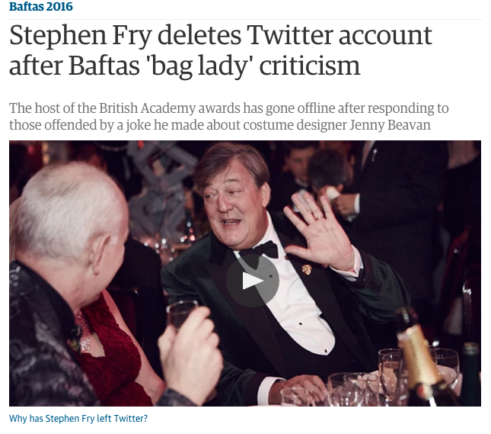

Slide 33




Digital Wildfires Project
Scope ethical and regulatory issues in relation to digital wildfires.
Analyse misleading and provocative content.
Seek informed opinion of individuals on governance of social media.
Develop ethical security map.
Create resources to promote responsible social media practices.
Marina Jirotka
Rob Procter
Bernd Stahl
William Housley
Omer Rana
Adam Edwards
Matt Williams
Pete Burnap
Helena Webb
Barbara Gorayska
http://digitalwildfire.org/
@EthicsWildfire
Notes:
The DW project takes up the challenges presented by the WEF report.
We are a collaboration between …

Slide 34
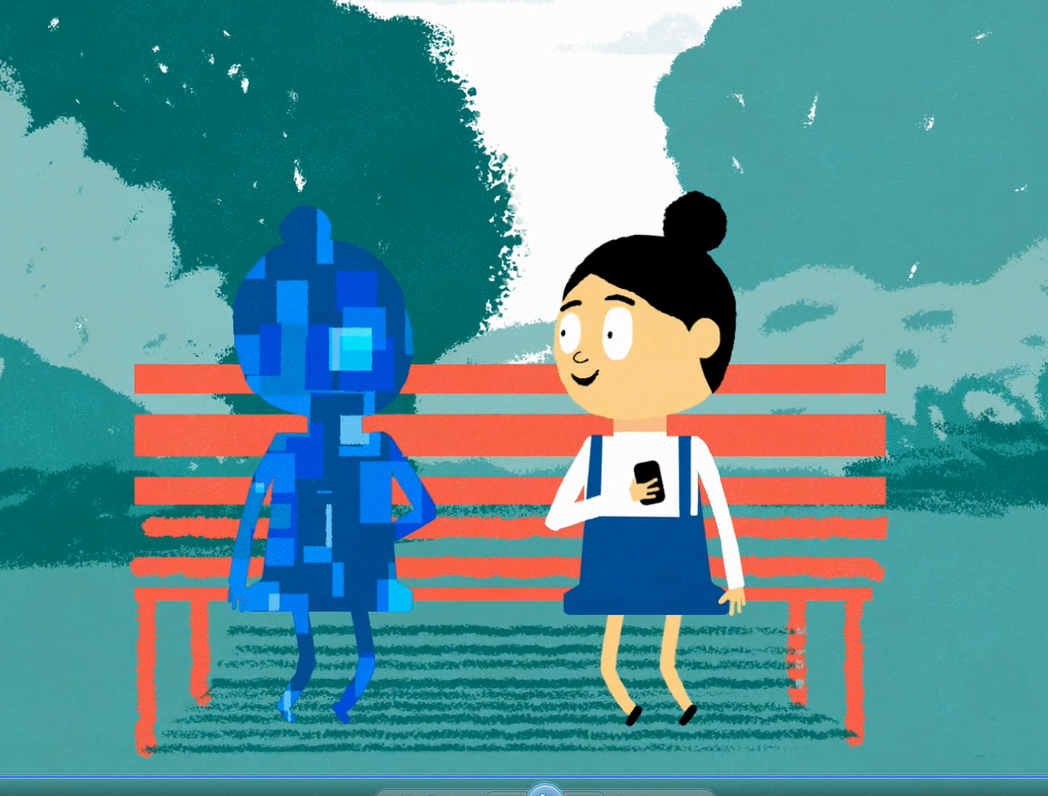
Resources for schools
Youth panel.
Teaching and learning materials to encourage digital resilience and maturity.
#TakeCareOfYourDigitalSelf
See us on YouTube!
Notes:
Delete image?

Slide 35

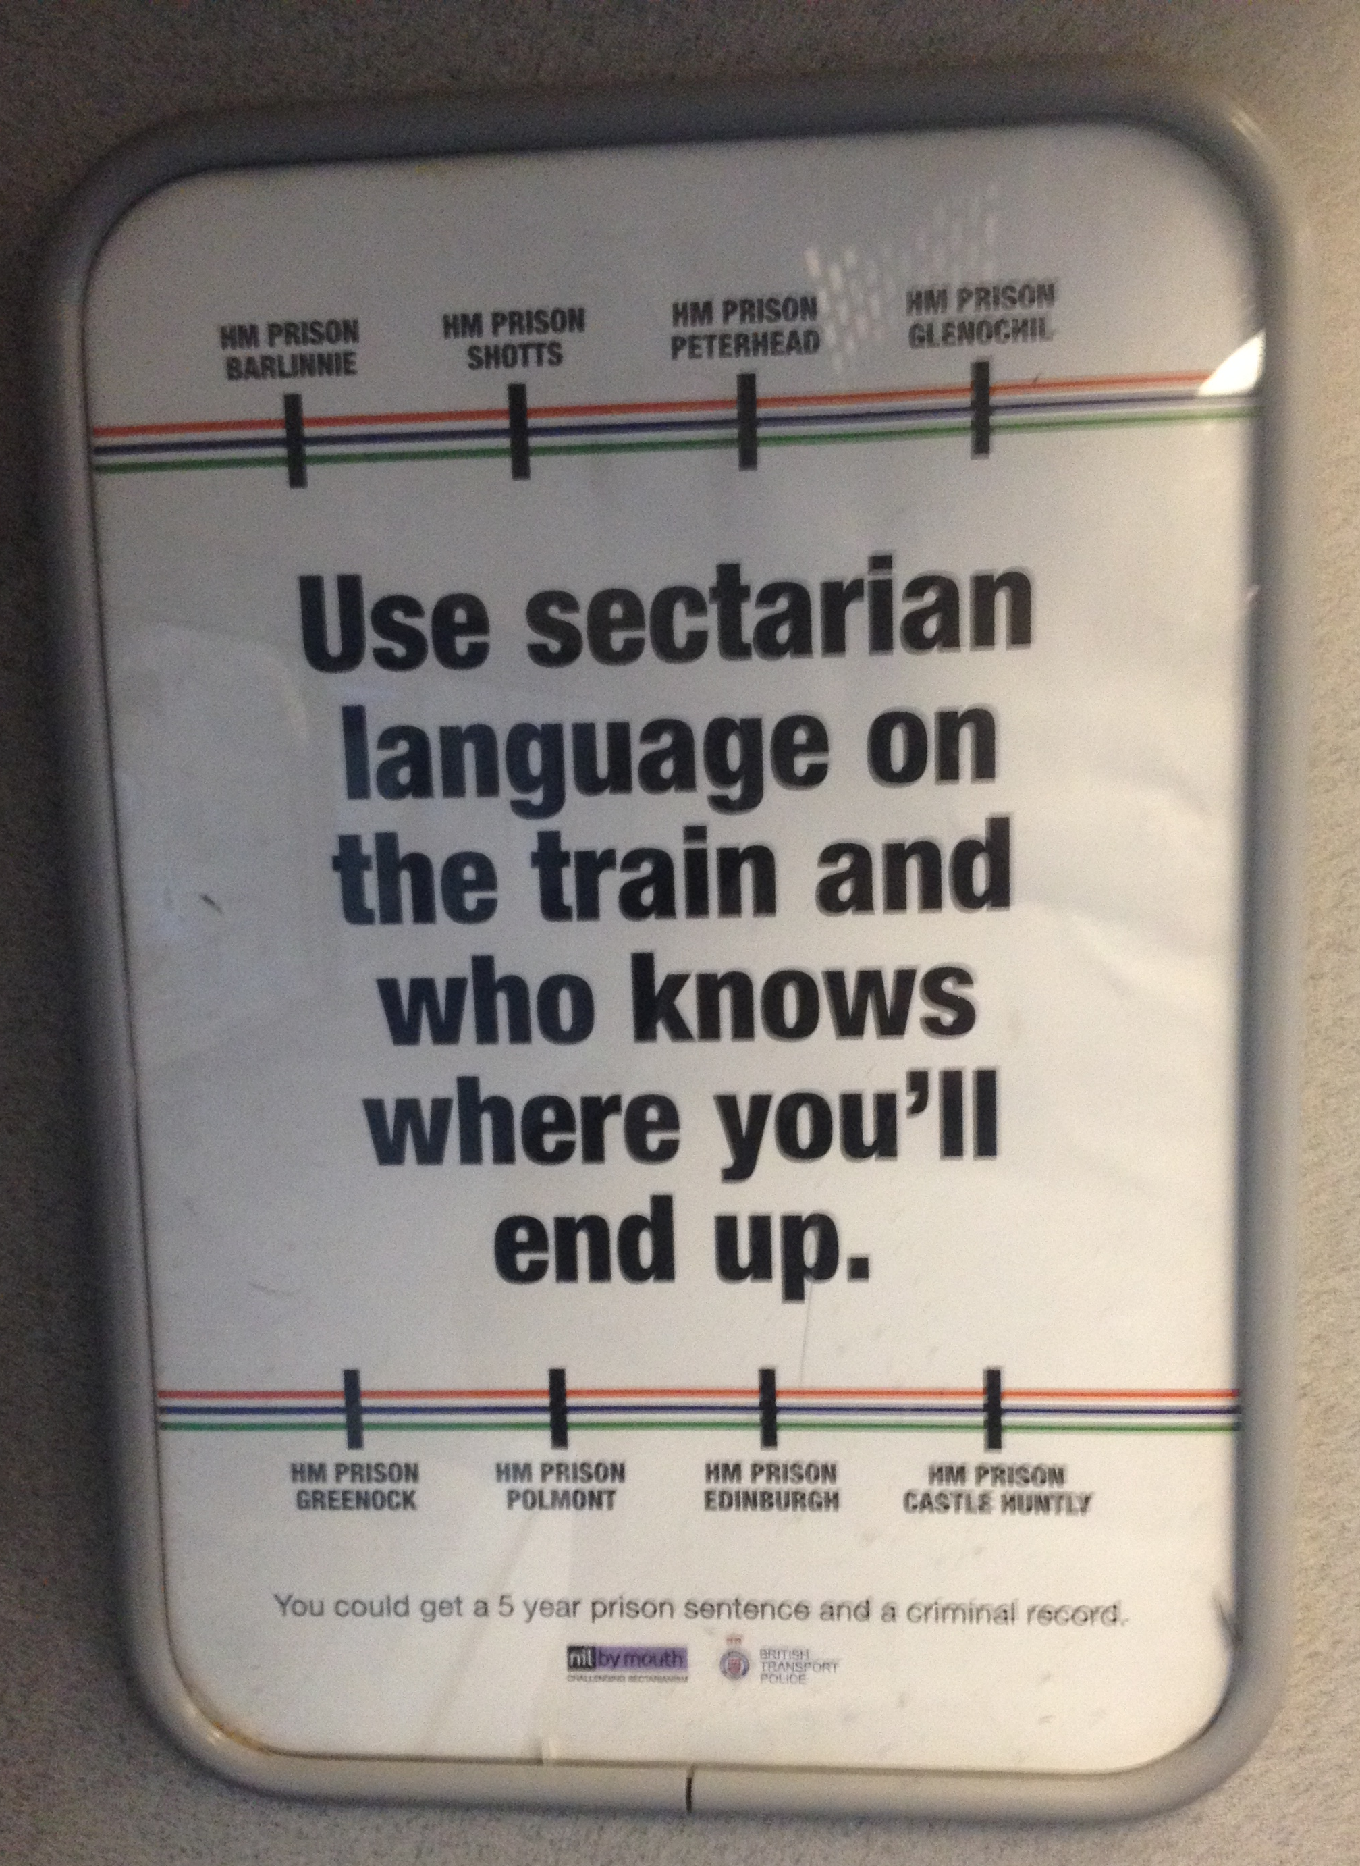
Is technology part of the answer?

Slide 36
Further reading
Webb, H., Jirotka, M., Procter, R., et al. (2015). Digital wildfires: hyper-connectivity, havoc and a global ethos to govern social media. ETHICOMP Conference, De Montfort University, September.
Procter, R., Vis, F. and Voss, A. (2013). Reading the riots on Twitter: methodological innovation for the analysis of big data. International Journal of Social Research Methodology, Special Issue on Computational Social Science: Research Strategies, Design & Methods.
Rohmeyer, R., Bradshaw-Hoppock, A., & Frederick, C. (2016). Deindividuation in Social Media.

Slide 37
Digital Wildfires Project
Scope ethical and regulatory issues in relation to digital wildfires.
Analyse misleading and provocative content.
Seek informed opinion of individuals on governance of social media.
Develop ethical security map.
Create resources to promote responsible social media practices.
Marina Jirotka
Rob Procter
Bernd Stahl
William Housley
Omer Rana
Adam Edwards
Matt Williams
Pete Burnap
Helena Webb
Barbara Gorayska
http://digitalwildfire.org/
@EthicsWildfire
Notes:
The DW project takes up the challenges presented by the WEF report.
We are a collaboration between …

Slide 38
Thank You
http://digitalwildfire.org/
@EthicsWildfire
http://www.pheme.eu
@PhemeEu
rob.procter@warwick.ac.uk

