Slide 1
My name is?
Create a name badge, before your name attach an adjective that not only describes a dominant characteristic, but also starts with the same letter as your name. For example: Loud Lucy or Dynamic Dave

Slide 2

Welcome to Censorship and Society
Module Convenor
Roxanne Bibizadeh
R.E.Bibizadeh@warwick.ac.uk

Slide 3
Ice Breaker
Conversation Challenge:
You will each be given a question to find the answer to and report back to the group. You have a few minutes to find the answer.

Slide 4
Censorship and Society: Education as a Crucial Site of Struggle
“Censorship looks forward to the day when writers will censor
themselves and the censor himself can retire […]
Writing does not flourish under censorship”
J.M. Coetzee Giving Offence: Essays on Censorship (1996)

Slide 5
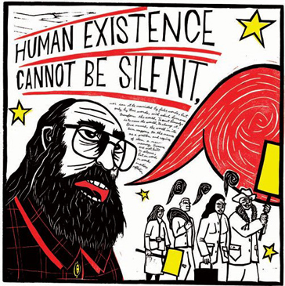
Paulo Freire Pedagogy of the Oppressed
“Education is suffering from narration sickness”
“Problem-posing education does not and cannot serve the interests of the oppressor. No oppressive order could permit the oppressed to begin to question: Why?”
How can we make knowledge critical and transformative?
How can we encourage students to question every aspect of society and to take responsibility for intervening in the world we inhabit?

Slide 6
Dates for Diaries
Next week both groups will combine for one lecture delivered by Dr Boase, the session will run from 9-11am on Monday 15 January 2018 for this week only. The session will be held in Ramphal R0.14.
Office hour in week 2 will be by appointment only.
Student Conference – Assessment –
Week 10 Term 2
Monday 12 March 2018 and
Tuesday 13 March 2018
All day

Slide 7
Course Structure
http://www2.warwick.ac.uk/fac/cross_fac/iatl/activities/modules/ugmodules/censorship
Optional Extra Workshop for Assessment Guidance / Office Hour:
Tuesday 16.30-17.30 OCO.05

Slide 8
Group Activity
Divide into four/five groups
You have 10 minutes to reflect on your question and write one collective response on the blog page.
Then we should share our discussions and record our responses to see if this changes at the end of the module.

Slide 9

What is censorship?
Is censorship ever necessary in the public domain – can it ever be justified?

Slide 10
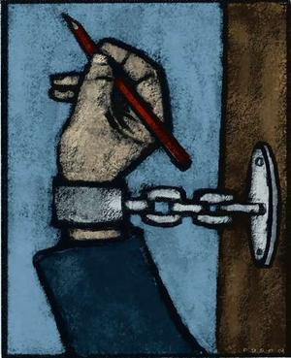
Do we have freedom of expression? Can we ever obtain freedom of expression?

Slide 11

Is literature capable of damaging or corrupting us?
Who defines the moral values that govern society?

Slide 12
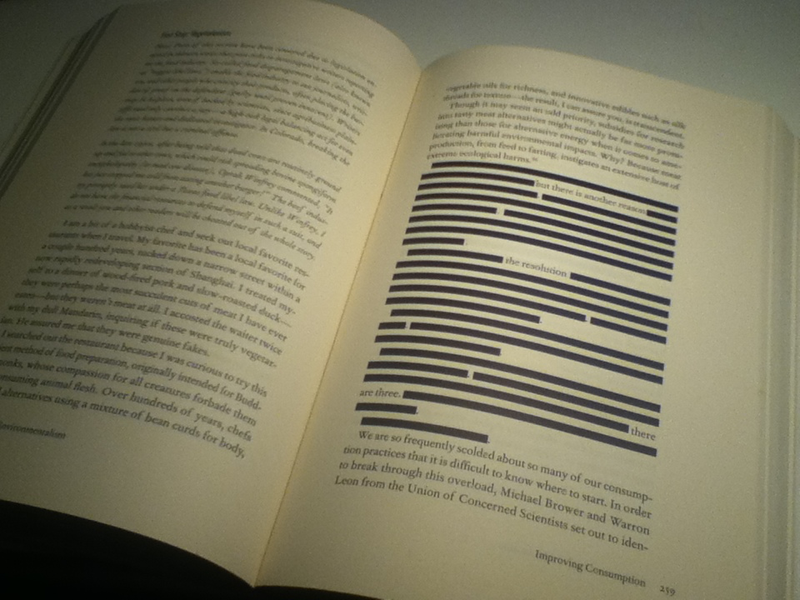
What is more effective in keeping the peace: blunt state censorship of “dangerous” texts, or safe interpretations of supposedly “respectable” ones?
Does literature have the power to change the world?

Slide 13
Students Disrupt University Lecture by Maryam Namazie
http://www.secularism.org.uk/news/2015/12/islamist-students-try-to-disrupt-ex-muslim-maryam-namazies-talk-on-blasphemy-at-goldsmiths-university
http://maryamnamazie.com/codeless_portfolio/goldsmiths-university-islamist-thugs-fail-disrupt-speech-blasphemy-apostasy/

Slide 14
Assessments
http://www2.warwick.ac.uk/fac/cross_fac/iatl/activities/modules/ugmodules/censorship/assessment/
45% - Essay or Blog Posting or Video Project - Term 3 Week 1 – 23 April 2018
45% - Presentation at a conference - the student conference will be held Monday 12 March 2018 (all day).
A group abstract of no more than 400 words must be submitted in class Tuesday 20 February 2018 - Week 7
10% - Reflective commentary on the conference or creative life writing- Due 26 March 2018

Slide 15
Conference Organisation
CONFERENCE
Publicity – create a poster/ front page for programme
Help design a programme
Conference chair for panels
Organise for the conference to be filmed and an edited video created to remember the event.
Can you think of anything else we need to consider?
If you intend to write a commentary this will be helpful

Slide 16
Divide and Conquer
Groups should be no larger than 4, but can be a pair.
Everyone will contribute to the paper for each group - 10 minutes – which equates to around 4 pages of 12 point font double line spacing – which generally takes 8/10 minutes to read.

Slide 17
Each group needs to:
Create a question/theme/title for your presentation which is based on one or multiple sessions over the course of this term.
You will then need to divide up who is responsible for each part of the presentation.

Slide 18
Possible Divisions:
Historical context and contemporary relevance of censorship
Language and structural devices used and to what effect (close reading of literature/extract)
Different interpretations, readings, debates surrounding the topic
Theoretical interpretations
Themes – feminism, law, education, internet.
Similarities and differences between different forms of censorship
What does it mean to ban/censor?

Slide 19
Plan of action 15 minutes:
Pick your group and share contact details
Create a title/theme/question
Decide how you will divide the presentation
Start to work on your abstract and decide how you plan to finish it
Decide if you want props – PowerPoint, video, photos etc…
Set a date for distributing your work and piecing it together – ie: the order of your presentation
Check out the 17 point marking scale and guide each other in ensuring your presentation meets the criteria for the mark you wish to acquire.
Perhaps arrange a coffee date to run through your presentation
Think about any questions that the class might ask
Present!

Slide 20
Abstract Help
Read through the programme for last year and the mark scheme online.

Slide 21
ANY QUESTIONS?

Slide 22
Session Aims:
To examine why Tess of the d’Urbervilles and Lady Chatterley’s Lover were censored or banned.
To explore how both Hardy and Lawrence deal with themes of sexual immorality.

Slide 23
Starter:
What do you know about the novels?
Why do you think they were banned/censored?
How do you think they were received at the time?

Slide 24
Publishing
Hardy had great difficulty finding a publisher for the novel, and magazines demanded radical revisions before serialising it.
Tillotson and Son, a Lancashire newspaper syndicate, were contracted with Hardy in 1889 to serialise the novel, but Hardy refused to make changes to the scene in which Tess is seduced/raped and in the improvised baptism of her dying baby.
Hardy then took the novel to Murray’s Magazine, but the editor Edward Arnold rejected the piece because the magazine “preferred girls to grow up in ignorance of sexual hazards.”
Mowbray Morris of Macmillan’s Magazine also rejected the novel because he was “profoundly upset by the book’s sexuality.”

Slide 25
Degrading Women
In addition to objections to the illicit relationship between Tess and Alec, Hardy was accused of taking a “low” view of women. His sensuous descriptions of Tess were labelled “French” and critics said that it was “degrading” to see women portrayed in this light.
How would you respond to this criticism that Hardy’s descriptions of Tess is “degrading” to women?

Slide 26
Revisions
Before offering the novel to another magazine Hardy revised the work to produce a version that would not cause offense.
In November 1890, Hardy agreed to terms with Graphic to begin serialisation in July 1891, and in Harper’s New Monthly in the United States soon after.
Hardy removed the seduction/rape scene and the improvised baptism. He was also forced to include a mock marriage staged by Alec to make Tess believe that she was actually his legal wife. The illegitimate baby was also omitted.

Slide 27
Banned
The novel was first published complete in three volumes in November 1891.
However, in 1891 the novel was banned by Mudie’s and Smith’s circulating libraries, leading to a virtual censorship over popular reading in England.
The popular circulating libraries had significant influence on book sales during the second half of the nineteenth-century.
Novels were expensive and authors made little money in sales unless the circulating libraries accepted their books.
In the same year the novel was also the object of banning by the Watch and Ward Society in Boston, which charged that the novel contained illicit sexuality and immorality.
The society forced Boston booksellers to agree that they would not advertise or sell Tess of the d’Urbervilles, and most adhered to the request.

Slide 28
Lady Chatterley’s Lover – Pornographic?
Lawrence began writing his last novel, Lady Chatterley’s Lover in 1926. It was published two years later and banned in England and the United States as pornographic.
His publisher was only prepared to consider a censored version, so Lawrence had it printed privately in Italy, in a limited edition for subscribers.

Slide 29
The Law and Lawrence
In November 1960 a Jury comprising of nine men and three women decided that the publication of the full text of Lady Chatterley’s Lover 1928 was for the public good.
The trial of the publisher, Penguin Books excited a great deal of media interest.
Lady Chatterley’s Lover is often considered the most notorious example of literary censorship in the twentieth century.

Slide 30
Publication, Confiscation and Republication
A period of some 30 years separates the book’s first publication, confiscation and republication.
In 1959 an American judge overruled restrictions on the uncensored edition.
The 1960 trial at the Old Bailey in the case brought against Penguin Books Limited for publishing the first uncensored version of the novel saw Lady Chatterley’s Lover subject to the first prosecution under the Obscene Publications Act of 1959.

Slide 31
Popularity
The publishing house was acquitted, and the novel sold in millions.
Film archives of the time show long queues formed around bookshops. Stories of the paperback slipped into the brown paper bag for discretion, or concealed by a ‘decoy’ book to save the reader’s reputation, have become part of the history and mythology of the novel.

Slide 32
Criticism
The QC for the prosecution Griffith-Jones urged the jury to concentrate on the moralistic dimension. He noted the novel might “induce lustful thoughts in the minds of those who read it”, and suggested that it celebrates “promiscuous and adulterous intercourse” and “encourages, and indeed even advocates, coarseness and vulgarity of thought and language”.
He was principally concerned by the thousands of copies for sale, making the book affordable to the majority and therefore available to those in possession of vulnerable minds.
How do you respond to this criticism?

Slide 33
Graham Hough
One of the experts asked to give evidence said “[the book] is concerned with a very important situation; it is concerned with the relations of men and women, with their sexual relations, with the nature of marriage, and these are all matters of deep importance to all of us”.
Do you agree? What is the central concern of the novel?

Slide 34
Double Standards
Is Hardy challenging Victorian morals, in particular the double standards associated with sexuality?
Are the themes of the novel still relevant today?
Can we relate the novel to any current debates in the media?
http://www.theguardian.com/commentisfree/2015/sep/23/sexual-consent-rape-prosecution-myth-consentis

Slide 35
A Pure Woman?
Why might Hardy have added the subtitle “A Pure Woman”?
The title offended many, who considered Tess an immoral “ruined” woman.
Hardy defended the subtitle in an 1892 interview with Raymond Blathwayt: “I still maintain that her innate purity remained intact to the very last; though I frankly own that a certain outward purity left her on her last fall. I regarded her then as being in the hands of circumstances, not morally responsible, a mere corpse drifting with the current to her end”.

Slide 36
Deconstructing Tess
Some critics have suggested that Tess has no character at all: she is only what others construct her as; and so she is only a “series of seemings” or “impressions”.
Tess becomes merely a construct of male socio-sexual images of her desired form – Angel idealises her, Alec sees her as a sexual object, the narrative voice fetishises her, society regards her as reckless, the novel presents her as a “pure woman”.
What might be Hardy’s intentions?
Is it possible that Hardy sought to dismantle or deconstruct these images?

Slide 37
Nature versus Convention
Hardy’s most obvious intent was to rebuke a society that lived according to restrictive rules rather than by feelings of the heart.
But what remains confused throughout his novel is his definition of sexual hypocrisy.
Hardy wanted to liberate sex as a forbidden type of knowledge.
However, some critics have argued that Hardy was unable to decide what should constitute the norms for ethical sexual conduct.
Some contend the controversy over the famous rape/seduction scene points to his ambivalence, because there seems to be no distinction between the sexual acts of seduction and rape.
How do you read this scene? Is Tess raped?
Watch the following clip of this scene - https://www.youtube.com/watch?v=Ww6_3YQB6B0
How does it compare to your perception of the scene?
Are there any clues in the scene to signify Hardy’s intended meaning?

Slide 38
The Politics of Lawrence’s Reception
The most overtly political debates regarding Lawrence’s writing have been about censorship and the legitimacy of explicit sexuality. Whether denounced as a patriarchal bigot and pornographer or defended as a moralist and prophet of sexual liberation, Lawrence has provoked political controversies.
Lawrence was more or less the only writer of working-class origin accorded canonical status in English Literature.
As a representative of white, working-class male consciousness, a deeper logic of political debate involving class and gender can be discerned in Lawrence’s critical reception.
Why might Lawrence’s position as a working class man have influenced the reception of the novel?

Slide 39
Group Activity
There are six discussion questions. Get into groups and pick a question.
In your groups decide if you would like to create a dramatic representation of the theme of censorship within either novel, or if you would like to dramatically represent your answer to the questions posed, or you can create a mind map on a board of your responses to the question.

Slide 40
Kate Millett berates Lady Chatterley’s Lover as a chauvinistic illustration of Lawrence’s alleged belief that ‘sex is for the man’. (Sexual Politics, 240) Do you agree? Is Connie portrayed as passive and Mellors active?

Slide 41
Although notoriously known to be a book about sex, Lady Chatterley’s Lover is also a novel about work and the alienation of industrial labour. The industrial landscape is portrayed as embodying social and ethical meaning. It dominates the lives of those who work in it turning them from human flesh to soulless mechanisms. How are the themes of work portrayed in relation to sexuality? How are the characters of the novel portrayed in relation to work and class?

Slide 42
Lawrence argues in “A propos of Lady Chatterley’s Lover” that “ we shall never free the phallic reality [i.e., sex] ... till we give it its own phallic language and use the obscene words”, his goal was to purify these words. Critics have disagreed as to whether he succeeded in this goal. Richard Aldington notes the words are “incrusted with nastiness” and “cannot regain their purity” and Graham Hough argues that “the fact remains that the connotations of the obscene physical words are either facetious or vulgar”. Do you think the novel is obscene or vulgar, or do you think Lawrence succeeds in his mission?

Slide 43
Does Alec d’Urberville rape or seduce Tess? Is this deliberately ambiguous?

Slide 44
What is at the root of tragedy in Tess? Is it sexual desire?

Slide 45
What does Tess tell us about the nature of suffering and human morality?

Slide 46
Plenary
Remember I am holding an optional workshop/office hour for you to meet with your groups and work on your presentation after our seminar each week.
I look forward to reading your blogs!

