Slide 1
Feminism, Pornography and Censorship
Britain, 2019-1877

Slide 2
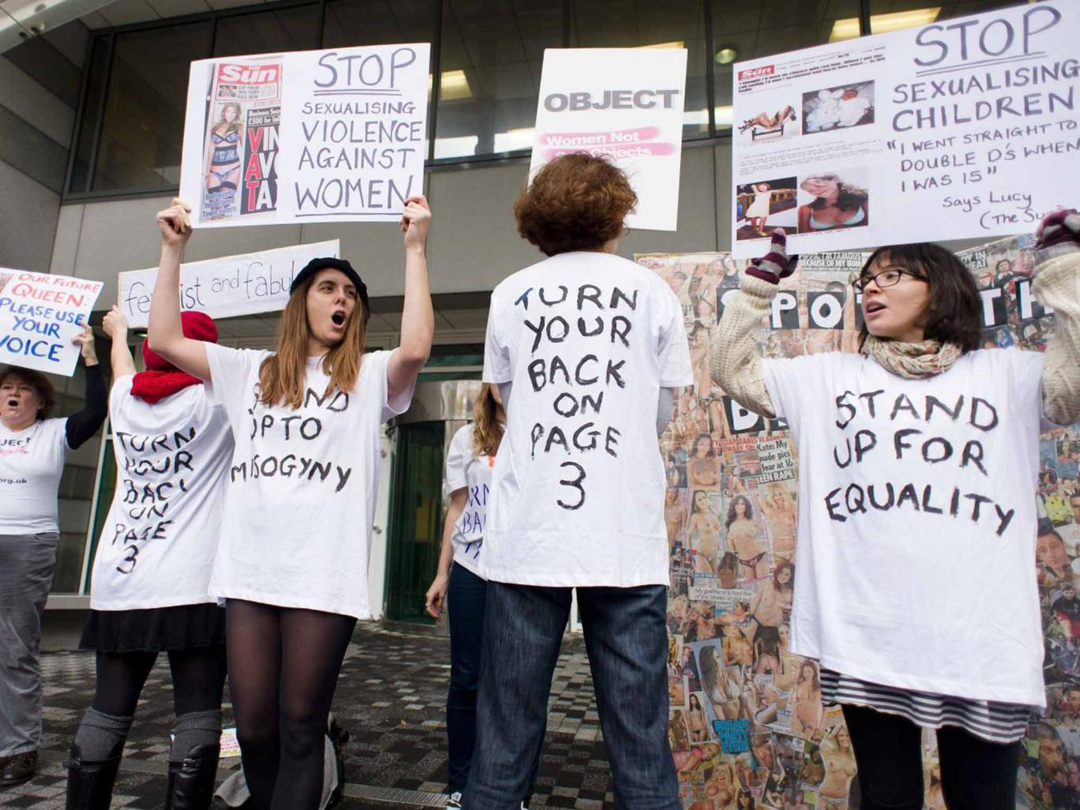


Slide 3
Anti-pornography developments…
Campaign Against Pornography (grassroots feminist campaign in the 1980s)
1979 Williams Report of the Committee on Obscenity and Film Censorship
1982 sex shops and sex cinema was brought under local authority control.
1986 Labour MP Clare Short presents Bill to ban page 3.
1989 Primarolo Bill (put forward by feminist Labour Party MP Dawn Primarolo)

Slide 4
(Dawn) Primarolo Bill (1989)
Defined pornography as:
'‘film and video and any printed matter which, for the purpose of sexual arousal or titillation, depicts women, or parts of women’s bodies, as objects, things or commodities, or in sexually humiliating or degrading poses or being subjected to violence.’

Slide 5
Robin Morgan “porn is the theory, rape is the practice”

Slide 6
Feminists Against Censorship (Established 1989)

Slide 7
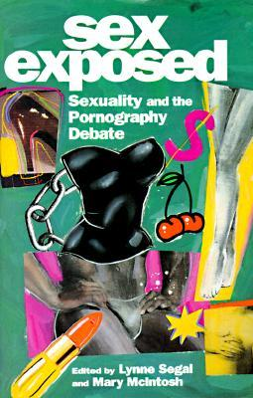

Slide 8
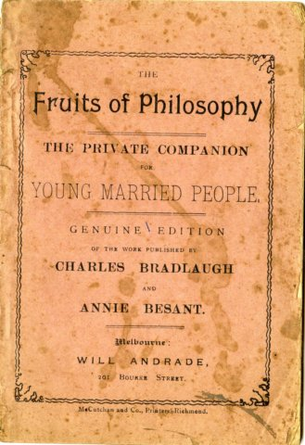
The Knowlton Trial (1877)

Slide 9
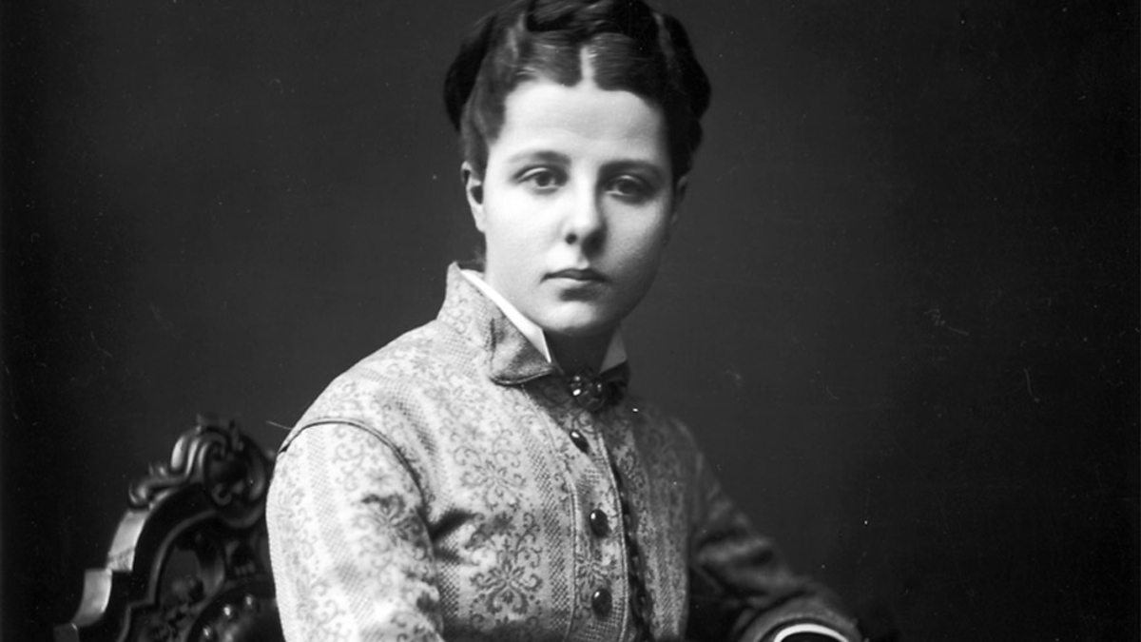
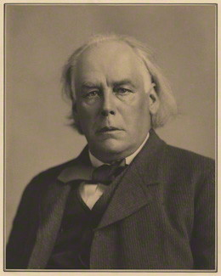
‘free discussion ought to be maintained at all hazards… So that the public, enabled to see all sides of the question, may have the materials for forming sound judgement’

Slide 10
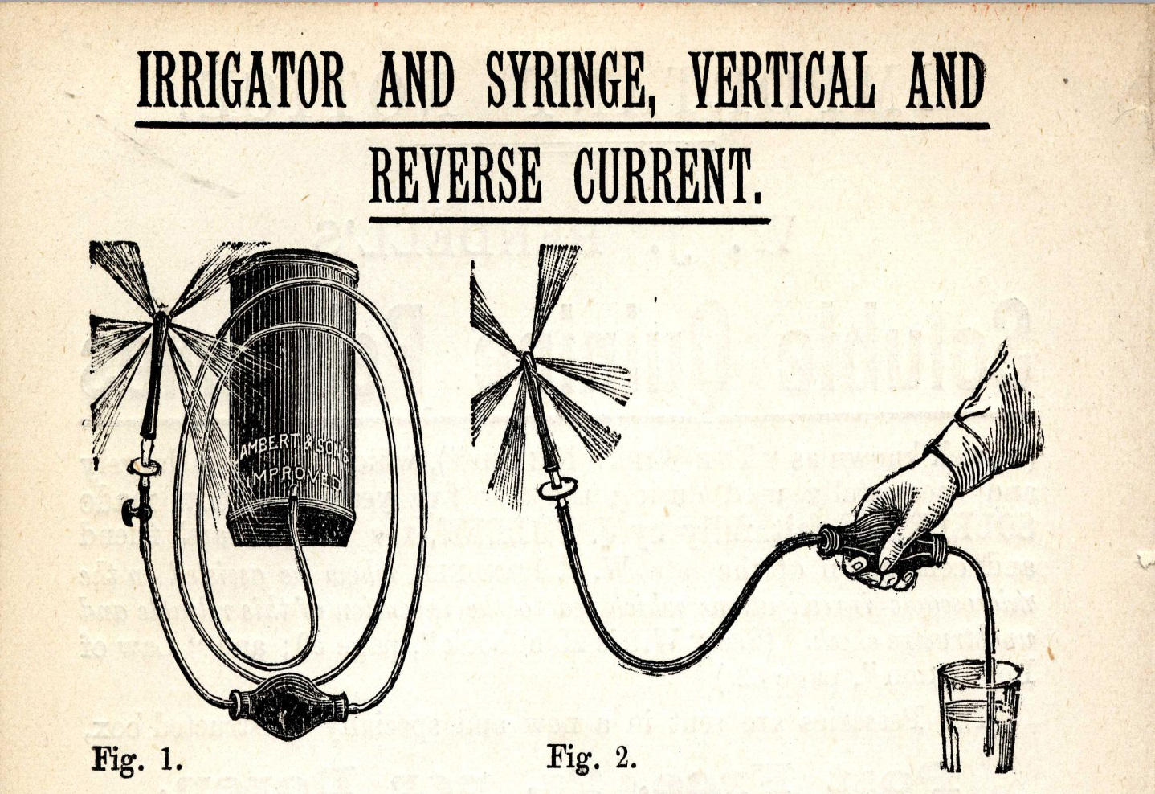

Slide 11
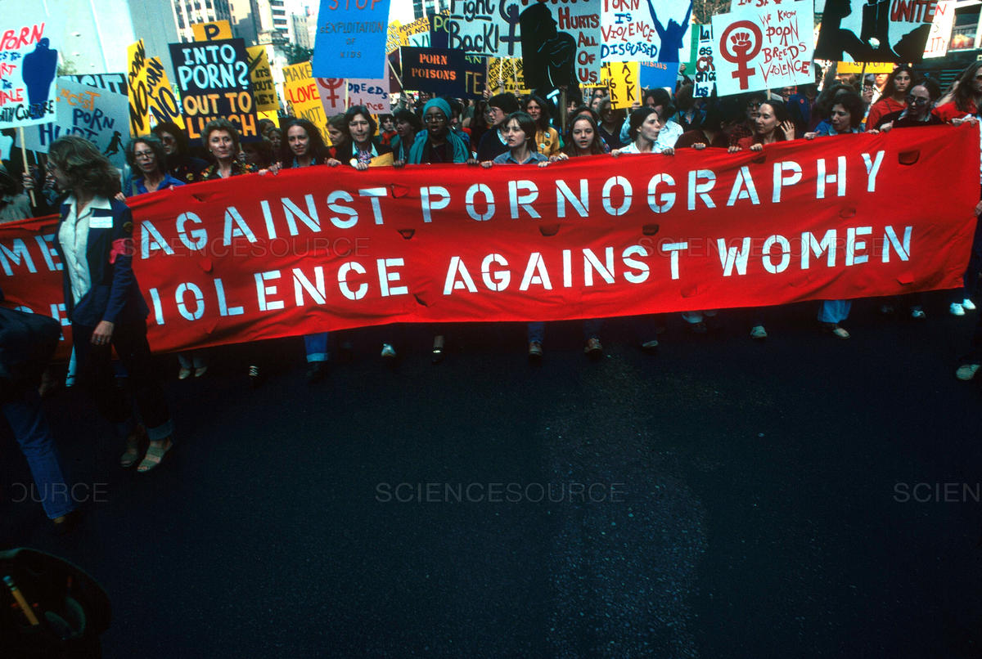
Why do feminists so often disagree on the subject of censorship?

Slide 12
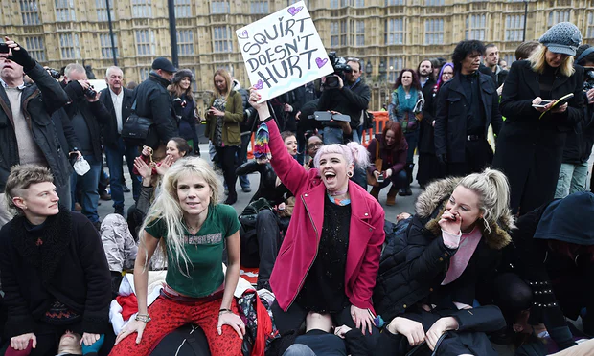
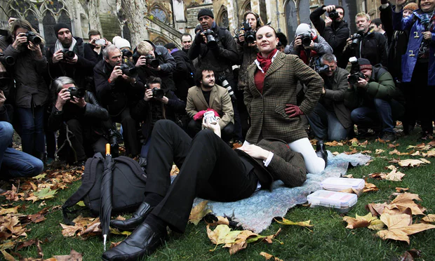
Changes to UK Pornography regulations
In 2014 the Audiovisual media services regulations 2014 requires that video-on-demand (VOD) online porn now adhere to the same guidelines laid out for DVD sex shop-type porn by the British Board of Film Censors (BBFC). The board effectively banned the following acts from being depicted:
Spanking
Caning
Aggressive Whipping
Penetration by any object “associated with violence”
Physical or verbal abuse (regardless of if consensual
Urolagnia (known as “water sports”)
Role-playing as non-adults
Physical restraint
Humiliation
Female ejaculation
Strangulation
Face-sitting
Fisting
Notes:
http://www.independent.co.uk/news/uk/a-long-list-of-sex-acts-just-got-banned-in-uk-porn-9897174.html
https://www.theguardian.com/culture/2014/dec/12/face-sitting-protest-outside-parliament-against-new-porn-rules

Slide 13
UK PORN BLOCK
Under the Digital Economy Act 2017 commercial providers of porn should have age checks on their websites to stop children from seeing explicit images and videos. This means that every user to a pornographic website will have to prove they are over 18.
The aim is to prevent children from seeing explicit images and videos.
Age verifications were meant to be in place by April 2018, but the technical challenges of implementing the law has pushed this back to April 2019.
The government has appointed the British Board of Film Classification (BBFC) to regulate porn online. The BBFC set the age ratings on films that are shown in British cinemas. The BBFC will regulate commercial pornographic websites to ensure they implement age verification.
What are the potential opportunities and limitations of this legislation?
Notes:
https://www.wired.co.uk/article/porn-block-ban-in-the-uk-age-verifcation-law

Slide 14
Prohibiting female-focused sex toys
Lora DiCarlo designed a personal massager for women that was awarded an Innovation award at the International Consumer Electronics Show (CSE) in 2019.
Administrators with the Consumer Technology Association (CTA) (the organisation behind the CSE) contacted Lora DiCarlo, rescinding the award, and informed them they were not allowed to showcase their product at CES 2019.
CTA stated entries “deemed by CTA in their sole discretion to be immoral, obscene, indecent, profane or not keeping with CTA’s image will be disqualified”. The CTA explained they revoked the award because the product “should not have been accepted for the Innovation Awards Program” because it “does not fit into any of our existing product categories”.
The founder and CEO of Lora DiCarlo drew attention to the fact that a sex doll for men was launched at the CES in 2018, and VR porn company exhibits there annually, allowing men to watch pornography in public as consumers walk by.
Notes:
https://www.theguardian.com/technology/2019/jan/08/ces-dildo-gender-sex-toy-ose-personal-massager

Slide 15
Revenge Porn
It has been illegal in England since April 2015 to post private sexual images online without consent.
What happens if videos or images are posted online prior to April 2015?
What do you know about Chrissy Chambers?
A YouTube star whose ex-boyfriend posted videos of her in 2011, this meant the criminal law did not apply. She brought a civil case to court in December 2017. By this point the videos had been shared on more than 35 different porn sites and viewed hundreds of thousands of times.
The case was settled out of court.
Notes:
https://www.theguardian.com/technology/2018/jan/17/youtube-star-chrissy-chambers-wins-damages-in-landmark-uk-revenge-porn-case

Slide 16
The Power of the law
Can we change the way we deal with discrimination?
What’s next after “Me Too”?
If you could write a law that dealt with revenge porn what would it look like?

Slide 17
Racism and Pornography
“In pornography, all of culture’s racist myths become just another turn-on. Thus, Asian women are portrayed as pliant dolls; Latin women are sexually voracious yet utterly submissive; and black women as dangerous and contemptible sexual animals” (Dorchen Leidholdt 1981).
“White women were featured in most pornography (92 percent of total) presumably because they fulfil the prevailing racist equation of beauty with whiteness” (Mayall and Russell 1993)
Alice Walker has pointed out “where white women are depicted in pornography as “objects”, Black women are depicted as animals. Where white women are at least depicted as human bodies if not beings, Black women are depicted as shit” (1980).

Slide 18
Pornography as a Mirror
“Rape as a liberatory experience for women is a popular male fantasy in pornography? (Mayall and Russell 1993)
“Mirrors can be dangerous, and pornography is a mirror. Pornography as a mirror shows us how men see women. […] It is unsettling to look into that mirror” (Jenson 2007).
“[Pornography] is not a passive reflector of pre-existing sexist attitudes: it is the material objectification of sexism that plays a functional role in the concealment of those sexist attitudes from ourselves. Pornography is a mode of externalised sexism that provides a form of mediated domination and exploitation that bypasses the usual mechanisms of personal moral evaluation. In this way, pornography represents a significant obstacle to overcoming sexist oppression and should remain a feminist topic of serious concern” (Crawston 2018)
Should we hold the pornography industry accountable?
Is the industry passive or active in sexist oppression?

Slide 19
Pornography harms
Will legislative or regulative approaches to pornography merely control women’s behaviour and sexuality, and enable other harms?
Pornography is considered to be harmful in three main ways:
Contributes to the violation of women’s right to free speech by silencing women (by discouraging women to speak, undermining the authority of their speech or causing their speech to be misunderstood). For example: women’s attempts to refuse sex are frequently ignored or disregarded in pornographic material.
Increase the rates of rape and other violence against women
Supports and promotes gender inequality, contributing to women’s subordination

Slide 20
Critical perspectives
“[i]t is impossible to prove that pornography – in any form – causes violence against women” (Boyle 2000).
The assertion that pornography silences women critiques women’s choices, understandings of their sexuality and the value of their consent (Crawston 2018).
Some pornography can offer liberation, economic freedom and an outlet for women’s power (Walter 2012) (Power 2009)
Should we distinguish between “good” and “bad” porn? If so, how might we do this?
Is there a connection between the consumption of explicitly violent and degrading pornography and sexist and misogynistic attitudes?

Slide 21

Erika Lust: Ethical Adult cinema
“We need to rethink what is offensive or dangerous and what is, in fact, normal human nature, and remember that it’s more important to educate than regulate”
If porn is produced under fair conditions and relations of respect (no domination/exploitation in its production) should it be excluded from the standard criticisms of porn?
Can we ensure this porn is consumed with egalitarian intentions?
Are the intentions of the consumer important?
Can pornography reinvent itself?
Notes:
http://www.independent.co.uk/voices/comment/the-new-uk-porn-legislation-will-turn-erotic-film-into-boring-unrealistic-male-fantasy-9898052.html

Slide 22
Group Activity
Circle the room spending 5 minutes with each question below, discussing and making notes of your ideas. You could take a picture of the four boards when the activity is complete to help with blog posting.

Slide 23
Does censorship ever benefit feminism?

Slide 24
“The penis’ as a ‘symbol of terror’. Dworkin tells us, is ‘even more significant than the gun, the knife, the bomb, the fist, etc.’ Women, she concludes in her lurid book on pornography, ‘will know that they are free when the pornography no longer exists.’ […] Pornography does typically encapsulate all that is most distressing and depressing in the portrayal of women’s bodies in our own culture: women become sexual commodities, usable, disposable, endlessly available for the titillation of men.” (Segal 105-6)
Do we need to eradicate all pornography
for women to be free?

Slide 25
Robin Morgan contends,
“porn is the theory, rape is the practice”. Discuss.

Slide 26
How do we define what is pornographic and what is art? What are legitimate and illegitimate representations of nudity and sexuality?

Slide 27
Whole group discussion
Review all the questions and share your ideas with the group.

Slide 28
Student Conference

Slide 29
Student Organisation

