Slide 1
Feminism, Pornography and Censorship
Britain, 2015-1877

Slide 2
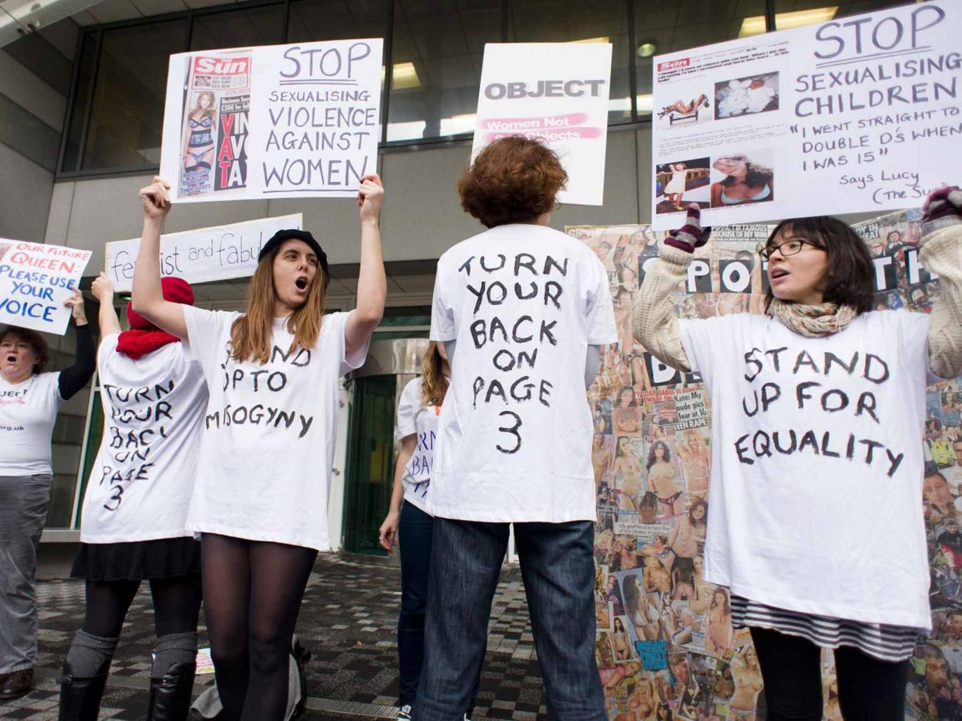
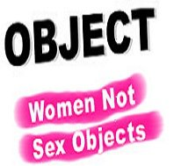

Slide 3
Anti-pornography developments…
Campaign Against Pornography (grassroots feminist campaign in the 1980s)
1979 Williams Report of the Committee on Obscenity and Film Censorship
1982 sex shops and sex cinema has brought under local authority control.
1986 Labour MP Clare Short presents Bill to ban page 3.
1989 Primarolo Bill (put forward by feminist Labour Party MP Dawn Primarolo)

Slide 4
(Dawn) Primarolo Bill (1989)
Defined pornography as:
'‘film and video and any printed matter which, for the purpose of sexual arousal or titillation, depicts women, or parts of women’s bodies, as objects, things or commodities, or in sexually humiliating or degrading poses or being subjected to violence.’

Slide 5
Robin Morgan “porn is the theory, rape is the practice”

Slide 6
Feminists Against Censorship (Established 1989)

Slide 7
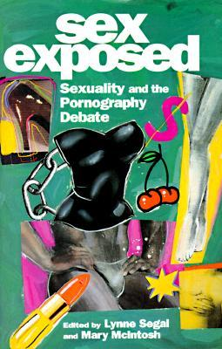

Slide 8
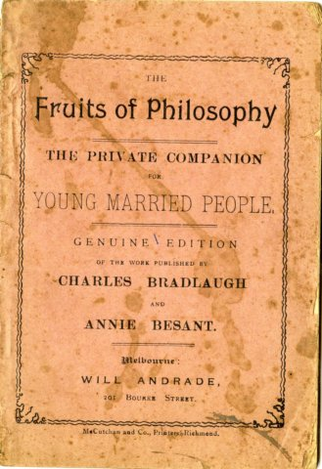
The Knowlton Trial (1877)

Slide 9
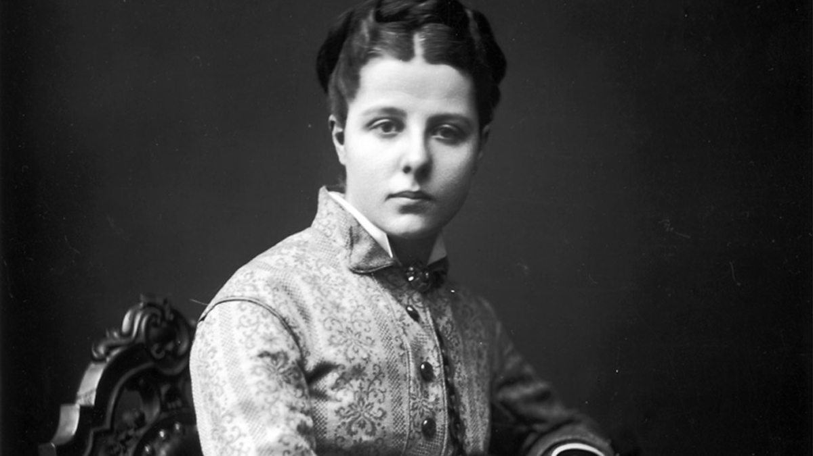
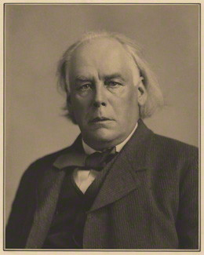
‘free discussion ought to be maintained at all hazards… So that the public, enabled to see all sides of the question, may have the materials for forming sound judgement’

Slide 10
