Slide 1
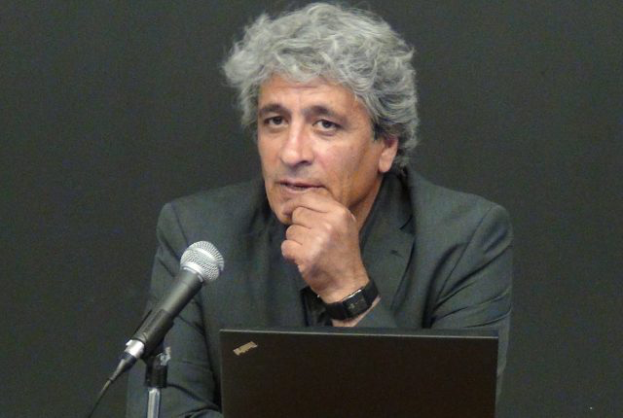
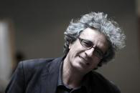

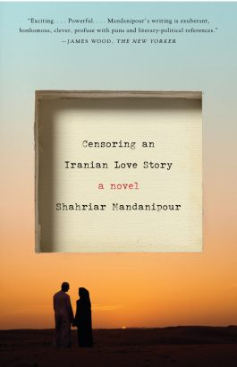
Censoring An Iranian Love Story
Shahriar Mandanipour
“Death to freedom, death to captivity”
What might this mean?

Slide 2
Two Concepts of Liberty
In 1958 Isaiah Berlin delivered a lecture at the University of Oxford entitled “Two Concepts of Liberty”, in which he distinguished between two basic types of freedom: negative freedom (freedom from) and positive freedom (freedom to). The concept of negative freedom is, put simply, freedom from interference, “I am normally said to be free to the degree to which no man or body of men interferes with my activity” (Berlin 2002, 169). Berlin argues a man’s economic and social conditions can be a form of interference with freedom, if those conditions are brought about as a result of the actions of others. “What is freedom to those who cannot make use of it? Without adequate conditions for the use of freedom, what is the value of freedom? (Berlin 2002, 171). Positive freedom is the freedom to “be his own master” (Berlin 2002, 178)

Slide 3
Catherine MacKinnon attempted to outlaw pornography:
“femininity as we know it is how we come to want male dominance, which most emphatically is not in our interest” (MacKinnon 1987, 54).
You may be “free”, but within that “freedom” you may desire your own subordination. Catherine MacKinnon argues for an intervention. Is there ever a justification for intervening in the name of “freedom”?

Slide 4
Rousseau said there is sometimes a need to be “forced to be free” (2003, 30)
“it is possible, and at times justifiable, to coerce men in the name of some goal (let us say, justice or public health) which they would, if they were more enlightened, themselves pursue, but do not, because they are blind or ignorant or corrupt. This renders it easy for me to conceive of myself as coercing others for their own sake, in their, not my, interest. I am then claiming that I know what they truly need better than they know it themselves” (Berlin 2002, 179).

Slide 5
How important is self-mastery to freedom?
According to Charles Taylor “one is free only to the extent that one has effectively determined oneself and the shape of one’s life” (2007, 153).
“the presence of opportunities – the absence of restraints – is irrelevant to the true nature of her unfreedom […] negative liberty is simply incomplete as a full accounting of human freedom. The free person must be guided by values that are her own” (Christman 1991, 345).

Slide 6
Where to draw the line?
“where to draw the line demarcating free (informed) action from unfree (less informed) actions” (Christman 1991, 356).

Slide 7
Is there a need to redefine freedom?
“what may appear to be a case of deplorable passivity and docility from a progressivist point of view, may actually be a form of agency – but one that can be understood only from within the discourses and structures of subordination that create the conditions of its enactment. In this sense, agentival capacity is entailed not only in those acts that resist norms but also in the multiple ways in which one inhabits norms” (Mahmood 2005, 14).

Slide 8
If a person autonomously chooses to be unfree, does that make them free?
“if the desires and values that a person develops are generated in accordance with the procedural conditions of autonomous preference formation that are constitutive of freedom, then no matter what the “content” of those desires, the actions which they stimulate will be (positively) free […] some extremely constrained individuals will count as positively free because they (autonomously) choose to be under those constraints.” (Christman 1991, 359)

Slide 9
Epictetus’ solution…
“He is free who lives as he wills, who is subject neither to compulsion, nor hindrance nor force, whose choices are unhampered, whose desires attain their end, whose aversions do not fall into what they would avoid” (Scaltsas and Mason 2007, 127). Epictetus claims that freedom is not dependent on the absence of obstacles, but “the elimination of the desire for things that are under the control of others” (Scaltsas and Mason 2007, 129).
Epictetus was an ancient Greek philosopher, he was born a slave, and became a teacher of philosophy.

Slide 10
How would you define freedom?
“one should not equate freedom with freedom to do what one wants, regardless of the causal origins of those wants” (Arneson 1985, 433).

Slide 11
Freedom and Unfreedom
As a group write a definition of freedom and unfreedom.
How do we define when a person is free or unfree?
Is there ever a time when we should interfere in order to enable a person to achieve a “‘higher’ level of freedom” (Berlin 2002, 179)?
What do you understand “death to freedom, death to captivity” to mean?

Slide 12
Sadia Abbas, "The Echo Chamber of Freedom: The Muslim Woman and the Pretext of Agency"
“in the wake of September 11, 2001, it is virtually impossible to hear the word “freedom” without an entire colonial history, and the consequences of the encounter between Muslim societies and the West, being summoned” (2014, 44).
“the West beats Muslims and calls into question the civilization of all Islamicate cultures; they have been pressed into service to “liberate” Muslim women, secularize Muslim culture, “save” the “Muslim world”” (2014, 44)

Slide 13
Under Trump, we are all women –
Soraya Chemaly
““The problems we face are so much more than about abortion.” The point isn’t abortion per se, but the model establishment by a right wing Christian ideology. It’s a model of strategies and tactics, arrayed against women’s rights during the past fifty years, now being applied more broadly. When public harm is going to be done, perpetuators usually practice first on women and children, to see what society will tolerate. This situation is no different. […] Along the way, and via techniques well honed in the battle against women’s rights and access to safe and legal abortion, great damage will be done to women, LGTBQ communities, racial, religious and ethnic minorities, immigrants, the economy and the environment. In other words, less palatable words, heterosexual white male supremacy will have politically exerted itself.”
How do you interpret the connection drawn between censorship and gender inequality in Mandanipour’s text?

Slide 14
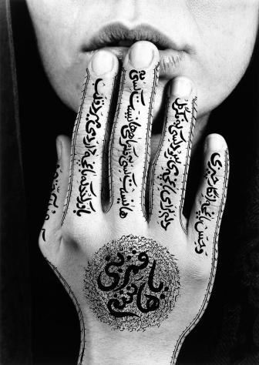
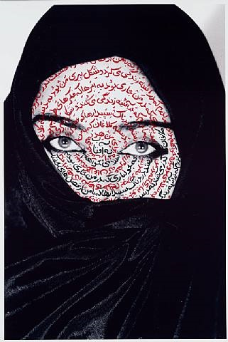
The currency of silence
Censorship has become part of the Iranian discourse of communication.
This is why proverbs such as:
  ‘hefz-e aberu [to save face]
  Hefz-e zaher [to protect appearances]
  Ba sili surat-o sorkh negah dashtan [to keep the face red with a slap]
  Play a central role within Iranian family dynamics, even today.

Slide 15
Self-Censorship
“Working under censorship is like being intimate with someone who does not love you, with whom you want no intimacy, but who presses himself in upon you. The censor is an intrusive reader, a reader who forces his way into the intimacy of the writing transaction, forces out the figure of the loved or courted reader, reads your words in a disapproving and censorious fashion.” Coetzee, J. M., Giving Offence: Essays on Censorship, p.38
If censorship succeeds when language is no longer able to represent or resist the governmental structures that control it, does Mandanipour escape censorship through creative means?

Slide 16
Petrovich and Mandanipour
How do you interpret their relationship?
What role does Mandanipour play in the text?
Does this role remind you of any other literature you have read?
What is Petrovich’s role in the text?

Slide 17
If on a winter's night a traveler
Italo Calvino (1979)
You are about to begin reading Italo Calvino's new novel, If on a winter's night a traveler. Relax. Concentrate. Dispel every other thought. Let the world around you fade. Best to close the door; the TV is always on in the next room. Tell the others right away, "No, I don't want to watch TV!" Raise your voice--they won't hear you otherwise--"I'm reading! I don't want to be disturbed!" Maybe they haven't heard you, with all that racket; speak louder, yell: "I'm beginning to read Italo Calvino's new novel!" Or if you prefer, don't say anything; just hope they'll leave you alone.
How does Mandanipour compare to Calvino?
Why might Mandanipour have chosen this style of writing?

Slide 18
Sadia Abbas, "The Echo Chamber of Freedom: The Muslim Woman and the Pretext of Agency"
“The women’s decision to veil very quickly gets manipulated by everyone.” (44)
“the figure of the Muslim woman for whom the metonym is increasingly the veil. The Muslim woman is object of imperial rescue, justification for imperial warfare, Orientalist cipher, target of jihadist violence, and increasingly, the discursive site on which the central preoccupation of our time – how do you free yourself from freedom? – is worked out.” (45)

Slide 19
Whose freedom?
“the idea that Western women choose while Islamic women are coerced ignores the extent to which all choice is conditioned by as well as imbricated with power, and the extent to which choice itself is an impoverished account of freedom, especially political freedom” (Brown 2012, 10).

Slide 20
Free or oppressed?
“it is rarely a case of being free or oppressed, choosing or being forced. Representations of the unfreedom of others that blame the chain of culture incite rescue missions by outsiders. Such representations mask the histories of internal debate and institutional struggles over justice that have occurred in every nation. They also deflect attention from the social and political forces that are responsible for the ways people live. […] [including the fact that] the most basic conditions of these women’s lives are set by political forces that are local in effect but national and even international in origin.” (Abu-Lughod 2013, 20-24)

Slide 21
Sadia Abbas’ Thesis
“The current discussion rotates the conversations about freedom, seeming to eschew it, and makes the very notion seem like an imposition. Muslim female agency reveals the Western imposition of freedom to be manifestly enslaving […] What Muslim women require most is to be freed from “our” freedom.” (70)
How do you respond to this argument?

Slide 22
Sara’s choice between Dara and Sinbad
“She knows with all her being that she is not willing to repeat her mother’s life, to let her youth and dreams be frittered away in the kitchen for the ideal ambition of how best to feed the family, with only hardship on the kitcheny horizon. […] Each time she thinks of marrying Dara, all the financial and political difficulties that await her flash before her eyes, and consequently she thinks of Sinbad, […] She sees herself with him in the capital cities of Europe, drunk on the beauties and joys that await her there, with all the things that she knows can only be attained with money and Western freedom.” (195)
What does this tell us about Sara’s choice?

Slide 23
Are there moments in the text that examine censorship in the West?

Slide 24
Are there moments in the text that examine censorship in the West?
“The anti-riot police, armed with the most sophisticated paraphernalia, including stun batons purchased from the West, stand facing the students” (1)
“we will argue whether this is a new conspiracy by the British or the Americans or our own government” (231-2)
Western participation and complicity in technological instruments to facilitate censorship in Iran, “special software that we purchased from a Western country.” (141)
What purpose does this serve in the text?

Slide 25
Karima Bennoune – Your Fatwa Does Not Apply Here: Untold Stories from the fight against Muslim fundamentalism
“Many wanted the United States to take a long look at its own policies that had promoted fundamentalism – whether collaborating with the Saudi government, financing fundamentalist groups in Afghanistan, or violating international law in our own treatment of Muslim majority populations in places like Iraq. […] Empowering civil society is not a strategy that has really been tried in combating Muslim extremism. The West has mostly empowered autocrats […] [who] have often constrained liberal civil society any way they could because they are more afraid of its democratic spirit than of fundamentalism.” (332-3)

Slide 26
Language Displacement
Mandanipour discusses picking words which are not only difficult to translate but have also become obsolete.
‘The word vessāl, in the ages-old Iranian literature, has many explicit and implicit religious, mystic, amorous and sexual connotations and hence is not really translatable.’ (57)
What effect does this have on the reader?
Does it serve to intensify the linguistic distance between the text and its Western reader?
Why might Mandanipour have incorporated language such as this when the novel was intended to be published in English?

Slide 27
“Proverbialization”
Amy Motlagh contends that “the lines between scholarly writing and memoir are increasingly blurred”.
Femi Osofisan termed this “proverbialization” which is a mode of transational explanation which “reduces the writer’s world to the trado-mythical level and his linguistic universe to the proportions of a museum, if not a prison”.
“Proverbialization” in Iranian-American memoirs takes the form of over-explanation of cultural terms geared towards a non-Iranian, though not always American audience.

Slide 28
Mandanipour’s Awareness
Is Mandanipour aware of his position as a cultural translator?
How does Mandanipour navigate this position within his auto-fiction?

Slide 29
Political Maneuvering
“I don’t like to interrupt the progress of my story constantly to offer explanations. But it seems I have no choice. Some things, certain actions in Iran are so strange and outlandish that without explaining them it is impossible for an Iranian story to be well understood by non-Iranians. These explanations are also important for young Iranian readers” (183).
What does this tell us?

Slide 30
Interpreting Censoring an
Iranian Love Story
Do you agree with the contention that only Iranian readers have the cultural knowledge and familiarity with socio-cultural conditions required to sufficiently interpret Censoring an Iranian Love Story?

Slide 31
Confessional Life Narrative
Mandanipour’s autofiction is not marketed as a confessional life narrative, therefore it escapes the obligation to connect the narrator’s life to historical events in Iran.
This is not an auto-historiographic project that aims to reconcile personal memories with historical and cultural representations of Iran.
He doesn’t agree with tracing the life of an author through a series of nationally significant events such as the 1953 coup, the Islamic Revolution or hostage crisis.

Slide 32
Global Censorship
The global nature of censorship is particularly urgent.
Then, in September of 2003, the Office of Foreign Assets Control (OFAC), the Treasury Department bureau that monitors transactions with countries under embargo, issued a ruling that informed the U.S.-based Institute of Electrical and Electronics Engineers (IEEE) that "the collaboration on and editing of manuscripts submitted by persons in Iran" was prohibited. What this meant was that the society's journals could only publish articles from Iran (and, by extension, from Cuba or any other embargoed country) if they received them "camera ready" from the authors-no editing or even formatting of the text was permitted. In another ruling later that month, OFAC stated that an U.S. entity could not publish a book written by an Iranian living in Iran because "inherent in the publication of a book are marketing, distribution, artistic, advertising and other services not exempt from" the OFAC regulations.
Read more: http://www.wordswithoutborders.org/article/doors-windows-and-the-office-of-foreign-assets-control#ixzz49Tzco3iS

Slide 33
What is the difference?
Not long after that suit was filed, Shirin Ebadi, the University of Tehran law professor who won the Nobel Peace Prize in 2003, filed a lawsuit of her own against the Treasury Department and OFAC. After she received the Nobel, Ebadi was approached by several American publishers who, mindful of the huge success of Azar Nafisi's Reading Lolita in Tehran, were eager for her to write a memoir for publication in the United States (a work of the kind she could not possibly publish in Iran). But the project would clearly have been in violation of several aspects of the OFAC regulations. In November, Ebadi wrote an extremely stirring editorial for the Times in which she finally and powerfully asked the question that unmasked the twisted logic underlying OFAC's restrictions on speech: "What is the difference," she wrote, "between the censorship in Iran and this censorship in the United States?" After a long legal battle, Ebadi won and was able to publish her memoir in the United States.
Read more: http://www.wordswithoutborders.org/article/doors-windows-and-the-office-of-foreign-assets-control#ixzz49U0KCOm5

Slide 34
In Iran today, generation must speak to generation
Shahriar Mandanipour
“The problem we Iranians have is that there has always been a gap, a great divide, between our generations. The new generation does not learn from the bitter experiences of the older generation and only winds up repeating them.
Perhaps the reason for this repetition is the severe censorship that has taken root in Iran. To erase people's memories of their history, each regime that has come to power has immediately set out to change the history books taught in schools and universities. They have banned previously published books from being reprinted and have gone as far as changing the names of streets that the previous regime had named after notable people and important events. Perhaps the reason for this repetition is that independent journals and newspapers have been banned and the older generation cannot convey its own experiences to the next generation.”
http://www.theguardian.com/commentisfree/2009/jul/03/iran-islamic-revolution-coup\

Slide 35
Intergenerational Learning
“We Iranians, having lived under the dictatorial rule of kings for twenty-five hundred years, have expertly learned that we should never leave any records or documents behind… It is for this reason that the records of our history are often limited to the travelogues of Westerners and reports by Western spies.” (13)
“Sara is studying Iranian literature at Tehran University. However, in compliance with an unwritten law, teaching contemporary literature is forbidden in Iranian schools and universities.” (12)
What impact does this censorship have on the history of Iran and modern Iranian literary heritage?

Slide 36
Life Narrative
Diasporic Iranian women writers often identify their purpose as one of historicizing their subjectivity rather than writing a political manifesto.
They seek to redefine the blurred lines between self and other.
Can first person life narratives create a space for deconstructive historicization that simultaneously destroy and preserve the position of the author?

Slide 37
Auto-Fiction
A term used in literary criticism to refer to a form of fictionalised autobiography.
Auto-Fiction combines two paradoxically contradictory styles, that of autobiography and fiction.
The self of the author becomes a living thing composed of fictions.
The life of the author becomes the novels organising principle.
The novel is alive with the author, and in a state of formation.
What are the limits and possibilities of auto-fiction?
Do you enjoy this style of writing?

Slide 38
Three Typographical Layers
Bold text is used for the love story between two subversive young Iranian’s named Sara and Dara, this text, it is imagined is approved by the censor.
The interior plot is in bold and struck-through, because had it been included it would have made the story too political or sexually charged to be published.
Non-bolded story of a frustrated author also named Shahriar Mandanipour, who struggles against a fictive censoring bureaucrat named after Dostoevsky’s Porfiry Petrovich from Crime and Punishment. Porfiry Petrovich is a magistrate in charge of investigating murders, and although he only appears sparingly in Crime and Punishment, his presence is constantly felt. In Censoring an Iranian Love Story Petrovich is a censoring bureaucrat from Iran’s Ministry of Culture and Islamic Guidance.
What is the impact of the three different styles?
Why do you believe the author might have employed this style?

Slide 39
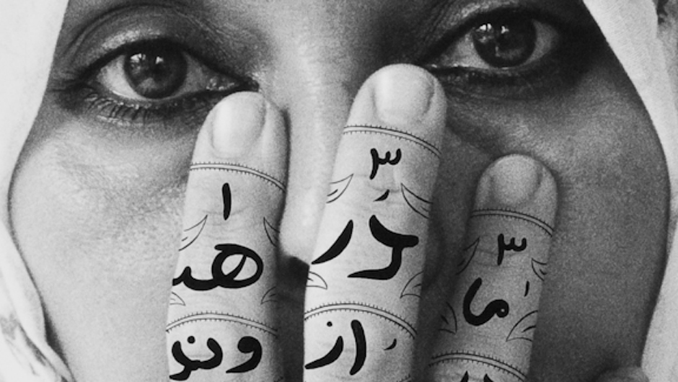
Creative Activity
Three Typographical Layers of Censorship
Bold font / colour font – what we feel able to say
Struck out/crossed out font – what we feel we cannot say
Non-bold – our internal monologue detailing the struggle over what we wish to say, our personal conflict with censorship.

Slide 40
“Islamic” Love Story?
Mandanipour won novel of the year at the Muslim Writers’ Awards in 2011.
Irfan Akram, the director of the awards explained in an interview that he hoped the organisation would “give Muslim writers confidence in their abilities and offer a platform to communicate their experiences and creativity through the power of the pen.”
How can we interpret this award?
What makes this text an “Islamic” love story?

Slide 41
Love Story?
Compare Dara with Sinbad, what do the two men represent?
How can we interpret the ending?
How do we read Mr Petrovich’s desire to marry Sara (290)?
Why does Mandanipour desire to write a love story?
Does he succeed?

Slide 42
Assassin
“Stunned, I look at this Dara who is walking out of the dead-end alley and I feel the blade of a knife against my Achilles tendon.” (264)
Who is the assassin?
Why is Dara pursued and under threat?
What does this assassin want?

Slide 43
Sara
Sara is objectified twice, by Dara but also his antagonist the wealthy bureaucrat Sinbad, who attempts to woo Sara with the privileged double lifestyle that allows him to drink whiskey in opulent Tehran restaurants and bribe prison guards to release Dara.
How can we read the fact that his narrative is never crossed out?
How can he function seamlessly within the censoring authority?

Slide 44
Male sexual anxieties
In the climax to Dara and Sara’s love story, Dara finally alone with Sara freezes in a moment of what some interpret as impotence, while Sara embraces her sexuality.
“Sara raises Dara’s hand to her lips and kisses the finger that bears the turquoise stain. A kiss so silent that neither Mr Petrovich nor even I can hear. […] He is tongue-tied, and no word or action comes to his mind.” (288)
Why is Dara stunned into immobility?
Why does Dara then say “Death to freedom, death to captivity” (289)?

Slide 45
“Death to freedom, death to creativity”
These words take us back to the words on Sara’s placard in the opening scene of the book. Why are we taken back to the beginning of the novel?
Does it highlight the problematized gaze on the political female subject? – All of the male characters have projected an image onto her body – from Dara to Sinbad, to Petrovich to Mandanipour.
Does Sara manage to reject the way in which she is reduced? Does she achieve freedom? Or does she suffer much the same fate as the author?

Slide 46
How can we interpret these lines?
“And at last, staring at her closed eyes, he opens his lips.” (289)
“She opens her eyes that had been closed to the fantasy of a kiss. She grins. “I was inspired…” This is the wisest and most ironic response that can come from the lips of an Iranian woman. […] “I am tired. I am very, very tired.”” (289)
What is the significance of crossing out Sara’s eyes opening?
How do we interpret what Sara says?

Slide 47
Petrovich’s Intervention
Petrovich falls in love with Sara and wishes to be written into the story so he can meet and marry her.
What does this tell us about censorship and it’s effect on the narrative and writer?
Mandanipour refuses, claiming “I can’t I have been completely scissored out of this story. I’m done in…” […] “Listen! Sara wants to speak for herself.”” (292) – How do we read Mandanipour’s refusal or inability to write Petrovich’s conclusion?
Mandanipour seems to be admitting defeat in the project of representing female subjectivity – how can we interpret this?

Slide 48
Conference Commentary
What did you learn from the experience? This can extend to what you learnt from others, from the experience of presenting, the physical and mental challenge it presented, including engaging in the problems or questions you were left with surrounding your topic and that of others.
Don’t just focus on the positive, what would you do differently? What difficulties did you encounter? How might you improve?
Reflect on the presentations of others, focusing on the content, what did you learn, were your ideas challenged, were you inspired to go in search of more knowledge on their topic?
Reflect on the questions you were asked, and your responses. Consider what you were not asked and what this might indicate, what did you wish you had said if you had more time, or what question would you have liked to receive from the audience?
What did you learn from chairing a panel? – Focus on the content of the presentations.
Remember don’t describe what you did, if you want to be descriptive pick the creative life writing option, you need to be critical and analytical in the commentary.

Slide 49
Any questions on the commentary or creative life writing assessment?
Group plans for the conference?
Helpers for the conference?
Blogging?

Slide 50
Plenary: Blogging Inspiration
Explore the meaning of "Death to freedom, death to captivity".
Does Mandanipour escape censorship through creative means?
Explore the quest for sexual and political freedom in Mandanipour's text.
Examine the meaning of freedom and unfreedom with reference to Mandanipour’s text.

