Slide 1
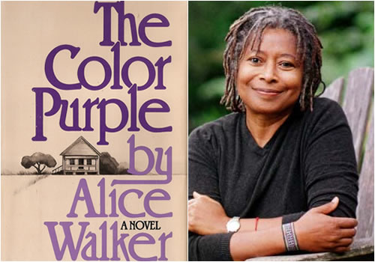
Gender and Power in Alice Walker’s The Colour Purple
Starter:
What were your first impressions of the novel?

Slide 2
Notices
Drug Laws: The Worst Censorship of Research Since the Catholic Church Banned the Telescope
Lecture tomorrow – 6-8pm WBS 0.004
https://drug-laws.eventbrite.com
Professor David Nutt will be available to sign copies of his book Drugs Without The Hot Air on the day!

Slide 3
What do we know about Alice Walker?
Her father’s brutality served as a model for Mr.____ in The Colour Purple.
She reconciled her feelings with her father once she understood the difficult life he had led and the abuse that he himself experienced (his mother was murdered coming out of church).
Walker became a literary scholar after her graduation, but her work was impeded by “the blind spot” in the education that she had received. Walker was fascinated by female writers such as Flannery O’Connor but eventually became frustrated by the lack of black women writers in the curriculum of colleges. Even when she did find black writers being taught, only prominent male writers such as Richard Wright and Langston Hughes were ever discussed. Walker eventually “discovered” the works of Zora Neale Hurston, a writer in the mid-twentieth century whose apolitical work was shunned in favour of authors such as Wright.

Slide 4
Celebrated and Censored
Her novel, The Colour Purple, won the Pulitzer Prize and National Book Award in 1983 – the following year it was challenged as inappropriate reading material for students. In the decades since, Walker has addressed censorship in speeches, essays and a book Alice Walker Banned.
According to the American Library Association, The Colour Purple was first challenged in Oakland, California schools in 1984—removed from or retained by schools and libraries after serious debates in 1985, 1986, 1989, 1990, 1992, 1995, 1996, 1997, 1999, 2002—and more recently challenged in Morgantown, North Carolina schools in 2008.
Why do you think The Colour Purple is both celebrated and censored?

Slide 5
Alice Walker on her reception:
Alice Walker: I found it very interesting; however I was very busy at the time working on making a film of the book with Steven Spielberg. I remember feeling, and understanding, the fear that drove some parents in the schools to wish to ban The Color Purple. I realized, given the sexism in our culture, that some of the complainers were probably people who had at some time sexually abused children. Or, they had been sexually abused themselves and could not bear thinking about it, as adults. There were also those who felt the language, or way of speaking, of their parents and grandparents would best be forgotten, since it was not “correct” standard English speech. I actually felt a lot of compassion for everyone. Black men had a fear they were being trashed in the character of Mister and had no faith that he could redeem himself. Which he does, by novel’s end. The lesbian nature of Shug and Celie’s relationship was especially hard to bear for people who believe sex, like marriage, should only occur between a woman and a man. It was a lot. And yet, for me, those considerations were all secondary to the overarching expression in the book of spirituality and the assurance found by many of the characters that the divine is all around us in Nature.

Slide 6
Why do you think The Colour Purple has been banned from schools?
What do you imagine critics have said of her work?
Critics of Walker have stated that she has portrayed black men as cruel in her works, which has sustained stereotypes of black male violence.
How would you respond to these critics?

Slide 7
Interview: Alice Walker: Writing What’s Right - Guernica
Guernica: What’s most at stake when a book like The Color Purple is banned? What’s at stake for women, and women of color, when a story like this is silenced?
Alice Walker: Great Literature is help for humans. It is medicine of the highest order. In a more aware culture, writers would be considered priests. And, in fact, I have approached writing in a distinctly priestess frame of mind. I know what The Color Purple can mean to people, women and men, who have no voice. Who believe they have few choices in life. It can open to them, to their view, the full abundance of this amazing journey we are all on. It can lift them into a new realization of their own power, beauty, love, courage. It is a book that unites the present with the past, therefore giving people a sense of history and of timelessness they might never achieve otherwise. And even were it not “great” literature, it has the best interests of all of us humans at heart. That we grow, change, challenge, encourage, love fiercely in the awareness that real love can never be incorrect.

Slide 8
Accused of “self-censorship”
Walker wrote on June 9, in which she declined a request from Israel’s Yediot Books to publish The Color Purple in Hebrew. Walker cited her participation in the Boycott Divestment Sanctions (BDS) movement, in response to Israel’s treatment of Palestinians within and outside its current borders. As she puts it, “I would so like knowing my books are read by the people of your country… I am hopeful that one day, maybe soon this will happen.” When change comes, she will happily release the book.
Read her letter, what are the benefits or limitations of using “censorship” as a form of protest?
What is your opinion of the use of “censorship” as an act of political resistance?

Slide 9
Review your Curriculums
Consider what your school or university curriculum is missing?
What would you like to study?
Review the modules on offer – what would you like to see more of, or what is missing/underrepresented?
If you can think of topics that are underrepresented, examine why this might be.

Slide 10
Design your own curriculum
What would you like to see in your school or university?

Slide 11
Language and Power

Slide 12
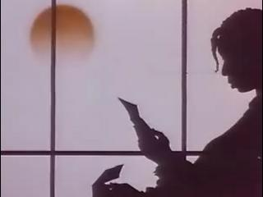
Celie’s Language
Compare one of the first letters Celie writes with one of the last.
How has her use of language changed?
Celie is often told to use the language of “white folks” but she never adopts Standard English. Why might this be?
Why might Walker have decided that Celie should always write in African American English?
If Celie had adopted the linguistic system of white people what would this imply? How might this alter our perception of the novel?

Slide 13
Eye Dialect
Eye dialect, in Hans Sauer’s words, “shows that Celie does not master the correct orthography* and that she tries to write as she speaks.”
Examples of this include: pore, neumonia, orkestra, and two berkulosis
Why do you think Walker adopts the use of eye dialect in Celie’s letters?
*the conventional spelling system of a language

Slide 14
Autonomy through Language
Walker has Celie speak vernacular because she wants Celie to maintain her autonomy. The two women who attempt to teach Celie to talk properly believe in speaking white people’s language, but they fail to persuade Celie to do the same thing. According to Janet Holmgren McKay and Spencer Cosmos, “all languages are complex, innovative systems and . . . it is inappropriate to say that one language . . . Is better than another on the basis of its vocabulary, inflectional system, or other inherent features.”
How does Celie’s language influence our initial impressions of the novel?
What difference would it make if all the characters were to speak in standard English?
Is it important that Celie writes in African American English?

Slide 15
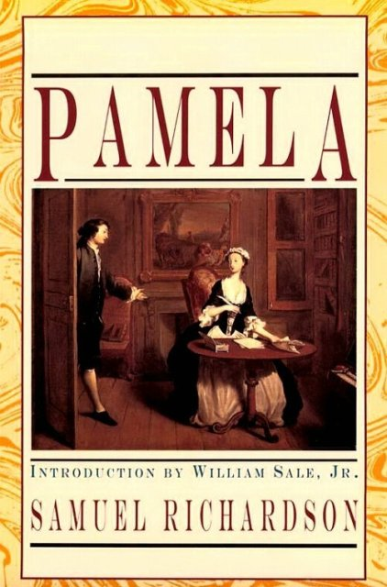
Letter Novels
In the eighteenth century when Samuel Richardson wrote Pamela and Clarissa, letter novels were a traditional genre which allowed the female heroine a voice. The epistolary form created a sense of immediacy, readers found themselves thrown into the novel with the narrator.

Slide 16
Nettie’s Letters
Unlike Celie, who is deprived of education because of pregnancy, Nettie has a good command of Standard English. Nevertheless, critics generally have a lower opinion of her letters. Elizabeth Bartlelme describes her as “a colorless character,” Robert Towers, “a mere reporter of events,” and Joan Digby, “a biographer of [Celie’s children] Oliver and Adam.” If Celie’s letters read like a diary, Nettie’s letters remind one of a textbook. As Walker’s spokesperson, Nettie addresses issues like slavery, women’s place in society, colonialism, and environmentalism.
Critical opinions suggest that Nettie’s language is “conventional and educational,” characterized by “dreary correctness.” Nettie’s letters are “largely [considered] ethnographic readings of African culture”.

Slide 17
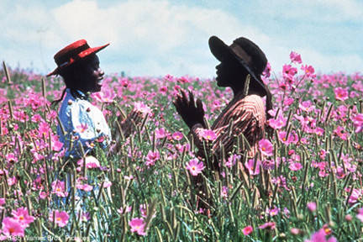
Nettie’s Letters
What is the function of her letters?
What are the tensions between the two narratives?
Are Nettie’s letters imperative to Celie’s story. If they were removed what difference would it make?

Slide 18
Nettie’s letters have three functions
First, they broaden the scope of the novel. Nettie’s African experience makes a grand narrative against which Celie’s confessional narrative stands out.
The letters also establish a connection between Celie and Nettie; therefore, Celie’s life and writing becomes meaningful.
Finally, they free Celie from hatred and a sense of guilt. From Nettie, Celie knows that their Pa, who rapes Celie, is their stepfather, and that Celie’s two supposedly abandoned children are raised in Africa by a missionary couple.

Slide 19
Language and Power
In addition to her vernacular, one thing that distinguishes Celie’s letters is “the model of spoken language.” Celie tells stories by faithfully recording the dialogues between the characters. This creates vivid characterization.
In her essay “In Search of Our Mothers’ Gardens,” Walker asserts that telling stories has made her mother “an artist.” Not having any access to written words, Walker’s mother as well as many other black women resort to the oral traditions to pass down her wisdom and creativity. Lizbeth Goodman further elaborates: “[T]he telling of stories is a way of presenting self in opposition to a language which is not your own, not part of your people’s tradition.”
Celie’s crude words represent Walker’s accusation of the political–economic plight that deprives black women of their education and hence their power.

Slide 20
Walker the Womanist/Black Feminist/ Feminist of Colour
Describing herself as a womanist, a “black feminist or feminist of color,” Walker strives to explore “the oppressions, the insanities, the loyalties, and the triumphs of black women” and to sustain their creativity. Severe attacks have been launched against the novel because of “its pernicious characterizations of black men,” but Walker claimed that she based the characterizations on her two grandfathers, who were “really horrible people,” “very misogynous, very mean,” but who became mild when they got old.

Slide 21
What might we read is Walker’s ultimate concern regarding gender politics?
What might we argue is Walker advocating in her creation of characters such as Shug?

Slide 22
bell hooks
“Nothing discounts the old antifeminist projection of men as all-powerful more than their basic ignorance of a major facet of the political system that shapes and informs male identity and sense of self from birth until death. I often use the phrase “imperialist white-supremacist capitalist patriarchy” to describe the interlocking political systems that are the foundation of our nation’s politics. Of these systems the one that we all learn the most about growing up is the system of patriarchy, even if we never know the word, because patriarchal gender roles are assigned to us as children and we are given continual guidance about the ways we can best fulfill these roles.”
What roles were you assigned as a child?
Can you think of examples of the silencing of women and feminists in contemporary society?

Slide 23
What do you know about GamerGate?
https://www.youtube.com/watch?v=gAyncf3DBUQ

Slide 24
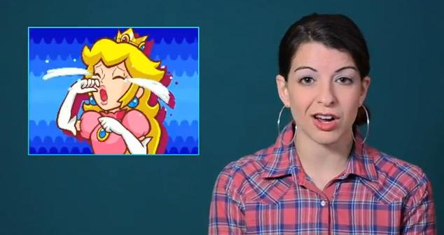
Should we live in a society where we are free to express all opinions?
Anita Sarkeesian set up a project posting a video web series called Feminist Frequency examining common tropes and stereotypes of female characters in video games
She exposed the fact that there are largely insignificant non-playable female characters whose sexuality or victimhood is exploited as a way to infuse edgy, gritty or racy flavouring into game worlds.

Slide 25
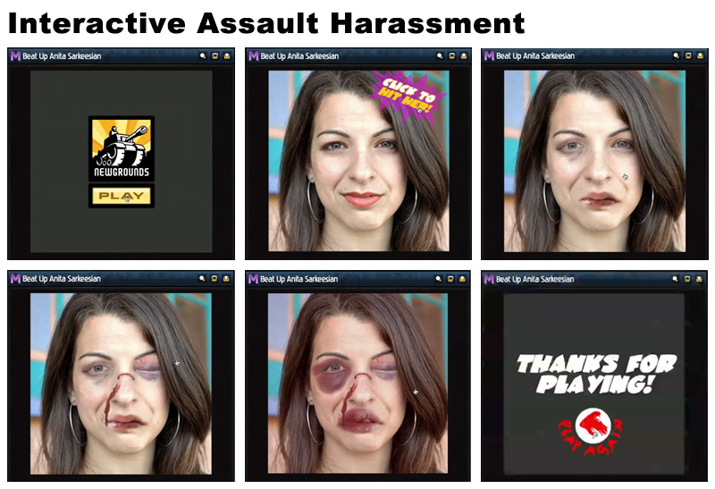
Should we live in a society where we are free to express all opinions?
Anita was subject to a torrent of abuse, including image based harassment - from vulgar photo manipulation to creating pornographic or degrading drawings of rape and sexual assault. These harassment images were sent en masse through email, Twitter, YouTube, Facebook or any other online service with messaging capabilities.
An interactive domestic abuse game called “Beat up Anita Sarkeesian” was created.

Slide 26
Anita Sarkeesian explained:
“Back in June of 2012, I never imagined that the initial surge of harassment would not only increase in volume, but continue for years to come. One thing was immediately apparent, however: the harassers had made it their mission to pick apart and distort every minuscule detail of my work and even my personal life in order to try to discredit, defame, and ultimately silence me.”

Slide 27
Anita Sarkeesian explained:
“It’s hard to quantify the emotional costs that accompany daily harassment both for me and those bystanders who support me online. Every time I post anything online there is a predictable wave of harassing messages in response. However, when I publish an episode of Tropes vs Women in Video Games the vicious wave of harassment can carry on for weeks or even months. Instead of the satisfaction that typically comes with completing and publishing a big project, I am often forced to turn off my computer and avoid Facebook, Twitter and email, sometimes for days at a time. In addition to the sexist harassment, the death and rape threats have been persistent and have ranged from annoying to criminal. Local and national law enforcement agencies are involved in investigating the worst of these crimes. While the harassment existed long before the mob began self identifying as “GamerGate”, the emergence of this organized backlash in August 2014 caused the hate and vitriol targeting women in gaming to intensify exponentially with widespread ramifications across the gaming industry.”
Is censorship ever necessary in the public domain – can it ever be justified?

Slide 28
Silencing Feminists
Returning to the novel…
Read the questions and consider your responses before feeding back to the group.
Also consider the following:
Why are women silenced?
Explore your experience of gendered roles. What does your experience tell us about society today?
Can censorship ever be constructive?
What should be incorporated into our curriculums?

Slide 29
Silence to Articulation
Walker and Sarkeesian have something in common, they both challenged dominant ideologies.
Both examine the experience of being silenced.
Have you ever experienced patriarchy?
What are the pertinent issues of your time/your life?
What would you like to challenge or change?
Close your eyes – think about something that angers/upsets you. Visualise it. What would you say to it if you could?
Write creatively or in the form of a letter what you would like to change or challenge. You can incorporate personal experiences which might have influenced your opinion or desire to make a difference.

Slide 30
Creative Writing Splurge
Review your creative writing splurge:
What does it tell you about yourself?
Is anyone prepared to share what they have written?

Slide 31
Extra Reading:
Harold Bloom - Alice Walker
Sara Mills et al - Feminist Readings/Feminist Reading
Alice Walker - In Search of Our Mothers’ Gardens: Womanist Prose
Alice Walker Banned – Alice Walker

Slide 32
Beauty in Truth
Alice Walker Q&A discussion: Beauty In Truth – YouTube
1.50-15mins
https://www.youtube.com/watch?v=H-a49NJIuH4

Slide 33
Assessment and Blogging
Lets take 10 minutes to review where we are with our planning and preparation.

