Slide 1
Week 6: Digital Citizenship
Consent Forms Please

Slide 2

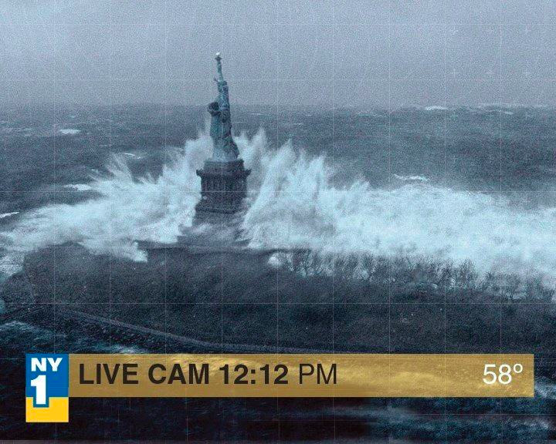
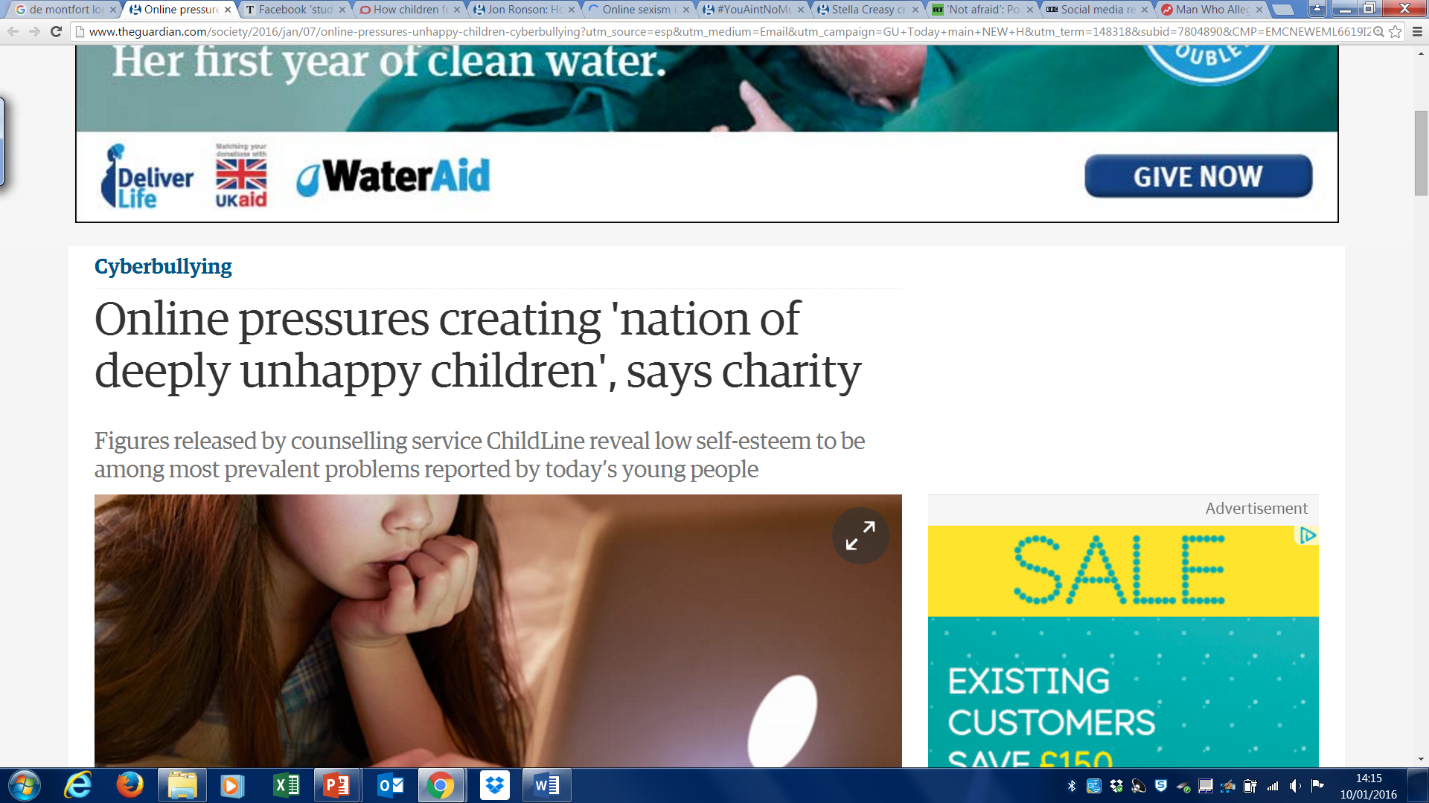

Digital wildfires as a challenge to the governance of social media
“Establishing reasonable limits to legal freedoms of online speech is difficult because social media is a recent phenomenon, and digital social norms are not yet well established.”
Notes:
Here’s the problem we begin with…

Slide 3
Divide into three and circulate the boards spending a few minutes with each question.
What are the advantages of using social media?
What are the disadvantages of using social media or the problems it presents?
What might be the solution to these problems?

Slide 4
Class Discussion
Explore the advantages and disadvantages of using social media including how the problems it presents might be solved.
How can young people stay safe online?
What messages did you receive about e-safety from teachers/parents?
What do you wish you were told?
What advice would you give parents/teachers educating young people about social media?
Should we govern social media?
If so, how?

Slide 5

Online Branding
How do you use social media?
What does your online profile tell us about you?
Do people perform when online?
How does your online persona compare to your offline persona?

Slide 6
Video Project
Create a short 2-4 minute video accompanied by a 400/500 word commentary. The video should be creative and reflective focusing on personal responses to debates surrounding digital awareness, social media governance, reflection of e-safety, and responsible digital citizenship.
For inspiration review these pages:
https://feministfrequency.com/video/not-your-exotic-fantasy/
https://www.youtube.com/watch?v=VyhsxUh2G8I
http://www.digitalwildfire.org/

Slide 7
17 Point Marking Scale and the Video Project
Creative, original, interdisciplinary approach
For example: you might conduct an experiment using social media constantly for a week and no social media for a week and reflect on the experience at the time. You might combine this with interviews or research and a more analytical commentary on the experience.
Show an ability to analyse rather than explain.
Organised delivery, clearly thought through presentation, with consideration to the audience, edited thoroughly, and should have some form of introduction and conclusion to create a cohesive finished product.
Intended message, argument, problem, solution, idea should be clear, easy to follow, and developed throughout.
Show an awareness of secondary sources, signpost the thought behind your process, the research and work done behind the scenes should be apparent in the depth/complexity of the video and enunciated in your commentary.

Slide 8
Video Project Ideas
How could you approach the video project?
What ideas do you have for delivery and presentation?
Any questions?

Slide 9
Design a Short Module about Digital Maturity and Resilience
What should it include?
How would you organise the time and delivery?
How can we take care of our digital selves?
Work as a group to divide the lessons and then create a lesson plan in pairs or small groups to help support the creation of a 5 week module.

Slide 10
Lesson Plan
Learning Objective
Starter – activity to inspire and energise
Main - activity/activities which make up the main body of the lesson
Plenary – check their learning and understanding and how far they have gone to achieving the objective
Extension – consider gifted and talented or students who might need extra support how might you facilitate this
Consider a combination of approaches, paired and/or group work with independent study, peer led/teacher led learning.
Be creative – throw out the rule book – what makes an amazing lesson?

Slide 11
Reminder
Please inform me of your group and title.
Your group abstracts are due next week, please email me before the session on Tuesday one abstract per group
Please also signal in your email if you wish to be involved in the organisation of the conference in some way.

Slide 12
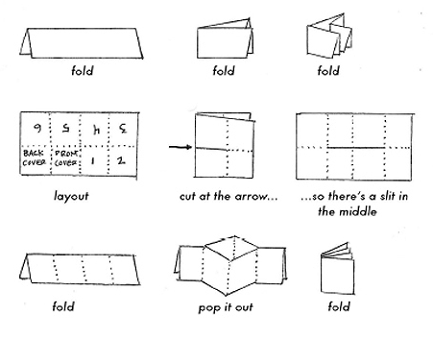
Let’s make our own Zine!

Slide 13
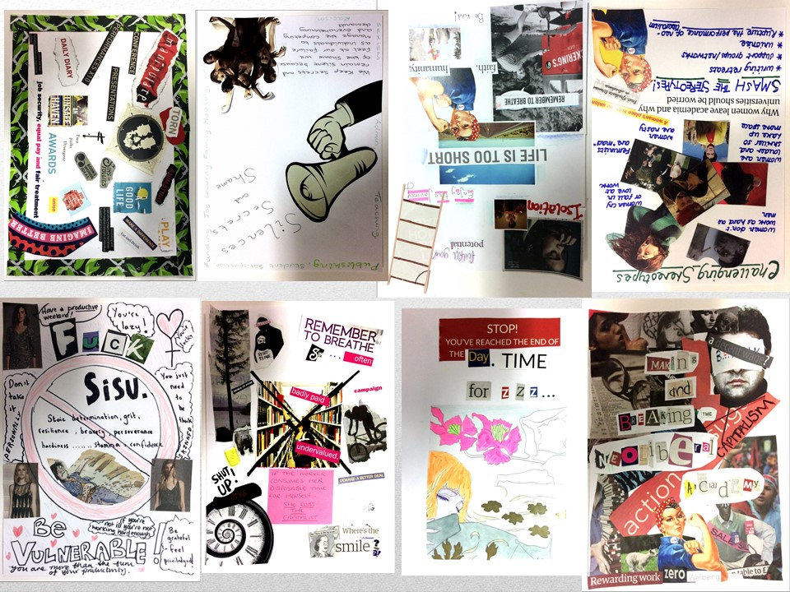

Slide 14
Create your own ZINE
Let’s divide into four groups and create four pages of our ZINE which seeks to answer the questions we’ve been discussing today –
How can young people stay safe online?

