Slide 1
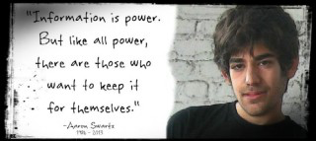
Education as a Crucial site of Struggle: The Right to Education

Slide 2
Session Structure
Assessments
Aaron Swartz
Decolonise the Curriculum
Internet Freedom

Slide 3
Student Conference
Abstracts due today.
Please ensure you hand in a paper and electronic copy
Please ensure you have added the times when you cannot attend the conference in week 10.
Change in order of sessions week 8 and 9 topics swapped.

Slide 4
AutoFiction
Toni Morrison: “I rewrite a lot, over and over again, so that it looks like I never did. I try to make it look like I never touched it, and that takes a lot of time and a lot of sweat” (1995).
Marking scheme
https://warwick.ac.uk/fac/cross_fac/iatl/activities/modules/ugmodules/censorship/assessment/

Slide 5
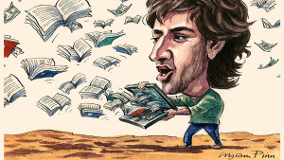
Education as a Crucial Site of Struggle
This session will explore the importance of the Internet as a tool for freedom of expression and creativity. Aaron Swartz downloaded millions of articles from JSTOR, an academic database, because he thought information should be freely available for all. Swartz was arrested in January 2011 and he committed suicide 11 January 2013, while waiting federal trail, his charges meant he was facing bankruptcy and a potential jail sentence of 35 years. We will analyse the censorship of the web in relation to education, and whether education in higher educational establishments encourages students to read the world critically, enabling freedom and democracy, or whether institutions use education as an instrument of power.

Slide 6
What is Swartz trying to achieve in his Guerilla Open Access Manifesto?
Stop the privatization of knowledge, where information becomes a currency that only the elite in power can purchase.
He believed sharing knowledge and information is a moral imperative.
He wrote “There is no justice in following unjust laws”.
He fought for all scholarship to be available to anyone with Internet access.
He asserted scholarship belongs to the entire world and should not be reducible to monetary exchange.

Slide 7
Intellectual Freedom
“MIT’s decision to hand over Swartz’s case to the FBI without a warrant or subpoena is the most obvious recent example of academia’s failure to protect civil disobedience and suggests how the scholarly community has subordinated free inquiry to the directives of the state. But the failure of the academic community reaches well beyond MIT. Our complicity is entailed in – and dangerously reinforces – the very distinction Swartz lamented between the intellectual and the academic in American higher education” (Gould 2014)
For Swartz an “intellectual: as opposed to an academic was someone who possessed the “intellectual drive”, “the tendency to not simply accept things as they are but to want to think about them, to understand them. To not be content to simply feel sad but to ask what sadness means”.
Was the persecution Swartz suffered an infringement on his right to freedom of expression?

Slide 8
Appropriate Punishment
Larry Lessig, the lawyer who represented Swartz writes: “So what was the appropriate punishment? Was Aaron a terrorist? Or a cracker trying to profit from stolen goods? […] Early on, and to its great credit, JSTOR figured ‘appropriate’ out: They declined to pursue their own action against Aaron, and they asked the government to drop its. MIT, to its great shame, was not as clear, and so the prosecutor had the excuse he needed to continue his war against the ‘criminal’ who we who loved him knew as Aaron”.
Carmen Ortiz district attorney stated “stealing is stealing, whether you use a computer command or a crowbar and whether you take documents, data, or dollars”
Swartz family wrote: “Aaron’s death is not simply a personal tragedy. It is a product of a criminal justice system rife with intimidation and prosecutorial overreach. Decisions made by officials in the Massachusetts U.S. Attorney’s office and at MIT contributed to his death”.
Should the government make a distinction between crimes committed for profit and those carried out as a public service?

Slide 9
Hannah Arendt On Violence (1970)
“Under certain circumstances, acting without argument or speech and without counting the consequences – is the only way to set the scales of justice right again.” Discuss.

Slide 10
“Academic Barbarism”
“Systems of exclusion, credentialization, and prestige promoted by universities reveal strong links between educational inequality and social inequality” (O’Sullivan 2016)

Slide 11
Noam Chomsky
Chomsky compares corporations to a psychopath, because their main goal is to “ensure that the human beings who [it is] interacting with, you and me, also become inhuman. You have to drive out of people’s heads the natural sentiments, like care about others and sympathy and solidarity” (2005)
Are universities acting as corporations?

Slide 12
“Testocratic”
Universities have embraced “testocratic” philosophy which has resulted in young people experiencing higher levels of anxiety, which are only exacerbated by the fact that when they graduate there are few jobs and large debts to pay off (O’Sullivan 2016).
How should we assess students?

Slide 13
“Post-human”
Rosi Braidotti argues capitalism reduces bodies “into a commodity for trade and profit” (2013)
Braidotti suggests we can salvage the “post-human” by reminding us of our “shared vulnerabilities”
Do you think universities have exacerbated rather than alleviated the capitalist commodification of life through systems of exclusion that perpetuate inequality?

Slide 14
Do universities favour wealthier students?
“Elite colleges and universities generally favour wealthier students […] There are strong controls on the numbers of students accepted on each programme in the top universities […] if universities want to have a high percentage of international students [they] […] keep the number of local students low. Internationalization can then be a key factor in keeping down the numbers of local students”

Slide 15
Theodor Adorno
Adorno connects the regression to barbarism with society’s systems of education, a “world which denies the mass of human beings the authentic experience of intellectual phenomena by making genuine education a privilege”.
Are university systems fair? Does everyone have access to the same opportunities?
Examine the link between social inequality and educational inequality.

Slide 16
Education as a Soft Power
“The ordering of society through credentialization, the conferment of honours relating to knowledge acquisition, and academic prestige might be described as a form of soft power” (O’Sullivan 2016)
Do we act and think like ranking bodies - do we measure a person by where they study or what they study?
Does education serve as a soft power committing a form of economic violence?

Slide 17
What is your experience of university?
Discuss whether you consider universities are exacerbating and perpetuating inequality.

Slide 18
Degree Pricing
Dr Gill Wyness found:
“the gap between disadvantaged students and their advantaged peers remains significant, particularly in the most selective universities. UCAS figures show that the most advantaged applicants are six times more likely to enter a high tariff institution compared to the most disadvantaged”
“money not merit is driving university choices: disadvantaged high attainers are less likely to choose courses that meet their potential, while advantaged low attainers are more likely to be on courses that exceed theirs”.
“the Schwartz commission on fair access to universities which concluded that the system in England of offering places based on predicted exam grades worked better for confident middle class students than for less advantaged young people who underestimated their own capabilities”
What is your opinion of the Tory plan for variable tuition fees?
Is education unequal?
Notes:
Rules of the Game: Disadvantaged students and the university admissions process – Gill Wyness – December 2017

Slide 19
Decolonising the University
The UK’s National Union of Students (NUS) has been running “Why is My Curriculum White?” and “Liberate My Degree” as two of their flagship campaigns since 2015. Both campaigns seek to challenge Eurocentric domination and lack of diversity in curricula across UK universities (Bhambra et al 2018).
“Subjects of Western scholarship are enduringly pale, male (and often stale); where people of colour do appear, they are all too often tokenistically represented, spoken on behalf of, or reduced to objects of scholarship” (Bhambra et al 2018). Discuss.

Slide 20
Criticisms of the Campaigns
“Campaigns to ‘decolonise’ the British academy are under attack and critics have provided a set of defences for academic tradition. Universities, they argue, should be sites of free thought and free speech, and the so-called ‘right of students not to be offended’ is detrimental to the ethos of these sites. Taking offense at a white curriculum and a white institutional space is considered a form of ‘cultural policing’ driven by a desire to ‘censor history, literature, politics and culture’. Not only a form of censorship, some point towards an almost fascistic urge by ‘young minds’ to ‘wipe away the past’ in order to avoid having to grapple with intellectually difficult questions” (Shilliam 2018). Discuss.

Slide 21
Disparities
“Black students of continental African heritage have been one of the fastest growing ethnic groups entering university and are the largest ethnic minority of the UK population. But Black students in general are recruited into less ‘prestigious’ institutions at percentages higher than any other ethnicity; their experience of higher education is significantly more negative than any other ethnicity; and their attainments are significantly lower than any other ethnicity” (Shilliam 2018).

Slide 22
Decolonising Philosophy
“generally speaking philosophy as a field or a discipline in modern Western universities remains a bastion of Eurocentrism, whiteness in general, and heteronormative male structural privilege and superiority in particular. One only has to look at curricular design and content, the overwhelming absence of people of colour in classrooms and philosophical reading lists despite the existence of a few, and to the criteria for merit and promotion in the field. It is no secret either, that this state of affairs is part of a legacy of Western imperialism, racialised slavery, white heteronormative male supremacy, and segregation, which highly elevated the value of civil and abstract universality and exclusively linked them with concepts, norms and values that were considered to be of European provenance” (Maldonado-Torres 2018).

Slide 23
Access to Higher Education
https://www.lse.ac.uk/website-archive/newsAndMedia/PDF/NuffieldBriefing.pdf
“Applications made by candidates from Pakistani, Bangladeshi, Black African, Indian, Black Caribbean, Chinese and various ‘other’ groups were all found to be less likely to yield an offer than those made by white British candidates”

Slide 24
Poorly Represented
“Of the UK’s 14,205 male professors, more than 12,000 are white, while only 90 are black”
“Of the UK’s 4,735 female professors, more than 4,000 are white, while only 25 are black”
“Only 6.7% of all academic staff identified as BME”
“0.6% of UK professors were black”
(2016-17 data)
https://www.ecu.ac.uk/publications/equality-higher-education-statistical-report-2018/

Slide 25
Spivak – “epistemic violence”
Spivak defines “epistemic violence” is violence inflicted through thought, speech, and writing that inaccurately records historic violence, it erases the history of the subaltern. This results in misconceptions of the subaltern’s perceptions of the world, convincing them they have nothing to offer the “modern” world and their only option is to blindly follow the “enlightened” coloniser.
Notes:
Spivak – Can the Subaltern Speak?

Slide 26
Should we still study?
Ngũgĩ Thiong’o wrote of Hegel: “Hegel gives historical, philosophical, rational expression and legitimacy to every conceivable European racist myth about Africa. Africa is even denied her own geography where it does not correspond to the myth. Thus Egypt is not part of Africa; and North Africa is part of Europe. Africa proper is the especial home of ravenous beasts, snakes and all kinds. The African is not part of humanity. Only slavery to Europe can raise him, possibly to the lower ranks of humanity. Slavery is good for the African. ‘Slavery is in and for itself injustice, for the essence of humanity is freedom; but for this man must be matured. The gradual abolition of slavery is therefore wiser and more equitable than in sudden removal’” (1993)
Should we remove certain philosophers from the curriculum?

Slide 27
Gender Studies and Academic Freedom
It is a turbulent time for gender studies and academic freedom in Europe.
Hungary’s prime minister Vicktor Orban has banned gender studies programmes at universities. He issued a decree revoking accreditation and funding for gender studies.
Deputy Prime Minister Zsolt Semjen has said gender studies has “no business in universities” because it is “an ideology, not a science”.
Notes:
https://www.telegraph.co.uk/news/2018/08/13/viktor-orban-moves-ban-gender-studies-courses-university-dangerous/
https://www.independent.co.uk/news/world/europe/hungary-bans-gender-studies-programmes-viktor-orban-central-european-university-budapest-a8599796.html

Slide 28
Decolonise the Curriculum
Decolonise SOAS for example demands the university “grant the same credence to metaphysical and transcendental systems of knowledge from the Global South as it does to systems of knowledge that have emerged from Western Europe”.
“Once, Martin Luther King dreamt of a day that people would be judged by the content of their character rather than the colour of their skins and the Roman playwright Terence argued that nothing that was human was alien to him. Today, however, it seems that everything not uttered by someone of the same skin colour and preferably gender as me is entirely alien. The decolonise the curriculum movement re-racialises knowledge – and ultimately the university – in a most regressive way.” (Williams 2017)
Notes:
https://www.opendemocracy.net/wfd/joanna-williams/decolonise-curriculum-movement-re-racialises-knowledge

Slide 29
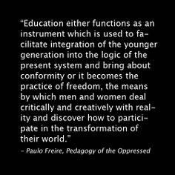
Social Agents?
Henry Giroux contends “power works through the production, distribution and consumption of knowledge within particular institutional contexts and seeks to constitute students as informed subjects and social agents”.
Can you think of any examples of when you have felt like a social agent?

Slide 30
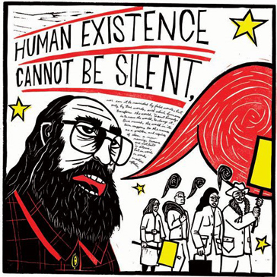
Paulo Freire Pedagogy of the Oppressed
“Education is suffering from narration sickness”
“Problem-posing education does not and cannot serve the interests of the oppressor. No oppressive order could permit the oppressed to begin to question: Why?”
How can we make knowledge critical and transformative?
How can we encourage students to question every aspect of society and to take responsibility for intervening in the world we inhabit?
What are the limitations of your education?

Slide 31
Rethinking Education as the Practice of Freedom - Giroux
“Freire believed that all education in the broadest sense was part of a project of freedom”
“Freire rejected those regimes of educational degradation organised around demands of the market, instrumentalized knowledge and the priority of training over the pursuit of imagination, critical thinking and the teaching of freedom and social responsibility.”
“the school and classroom being merely the instrument of official power or assuming the role of an apologist for the existing order”.
Think back over your experience in school or university.
Why did you decide to study your subject?
What is one of the most important things you have learnt?
Is there anything you were taught that you are still trying to forget?

Slide 32
Decolonising Reading Lists
https://globalsocialtheory.org/resources/reading-lists/
http://www.historyisaweapon.com/defcon1/lordedismantle.html
Do you have any ideas for initiatives in Warwick?

Slide 33
Internet Freedom
Swartz: “There’s these two polarizing perspectives” the first holds that “everything is great: the Internet has created all this freedom and liberty and everything’s fantastic”. The second insists “everything is terrible. The Internet has created all these tools for cracking down and spying and controlling what we say […] The Internet has done both”
He continues: “Which one will win out in the long run is up to us. It doesn’t make sense to say one is doing better than the other. They are both true and it’s up to us which ones we want to emphasise and which ones we take advantage of because they’re both there and they’re both always going to be there”
The answer: “it’s up to you. You get to decide what happens. This isn’t something playing out on stage somewhere where big giants fight each other and you get to sit and munch popcorn. This is a fight you can join in… It’s up to all of us to stop them”
Is it possible to achieve Internet freedom?
How can we achieve Internet freedom?

Slide 34
Cyberspace as an ‘international space’
Cyberspace has often been characterised as an ‘international space’ similar to the high seas, Antarctica and the outer space. The purpose of this analogy is to offer a theoretical/institutional framework for dealing with matters of jurisdiction and more generally governance in/of cyberspace.
However to treat cyberspace like an international space is reductive particularly in terms of governance, because it attempts to enclose this space and territorialise it as it fails to move beyond the conceptual, spatial and political stranglehold of state sovereignty.
Treating cyberspace as a common heritage of mankind based on the principles of non-appropriation makes Cyberspace dependent on territoriality of nation states.

Slide 35
Governance through enclosure
International spaces refers to a type of space over which no one has territorial jurisdiction or political/economic/social sovereignty.
According to Oran R Young’s definition international spaces “are regions and resources that lie beyond the reach of the legal and political jurisdiction of the individual members of international society”.
The history of these spaces dates back to 16th and 17th centuries when the seas gave rise to debates about the “right” of states to open waters and to what is meant by “high seas”.
Darrel C. Menthe contends “what makes [international spaces] analogous is not any physical similarity, but their international, sovereignless quality”.
This becomes more complex when you consider the exploitation of resources in these spaces by state sovereigns, thus there were calls for international regimes of governance.

Slide 36
International spaces to be treated as
Res Communis – “a thing of no one”
Res Communis – “a common thing”
“The sea is a thing so clearly common to all, that it cannot be the property of any one save God alone” Hugo Grotius (1609)
https://www.youtube.com/watch?v=v8nDWGBM2mM
Watch 31.30 mins to end lecture
Professor Matthew Craven argues the common heritage of mankind becomes a system of appropriation.
How might this idea enable a system of exploitation?
How might we apply this to cyberspace?

Slide 37
Does Cyberspace need “taming”?
Bederman in his treatment of global ‘commons’ argues that “[c]yberspace is... the next frontier of the global commonage, and likely to be much more commercially relevant and lucrative, and so much harder to manage, than “physical” places as the deep seabed... or outer space....” (Bederman 2008, 71-86)
But from the perspective of international law Cyberspace needs “taming” to avoid the “tragedy of the commons”.
What might this mean?
Notes:
Garrett Hardin coined the phrase “The Tragedy of the Commons” in his 1968 article published in Science Vol 162. The concept originated in “Two Lectures on the Checks to Population” which were first published in 1833 in Oxford by William Foster Lloyd. The tragedy of the commons is an economic theory where individuals acting independently in their own self-interests exploit a shared unregulated resource.

Slide 38
Disinformation and Fake News Report 18 February 2019 House of Commons DCMSC Report
“What does need to change is the enforcement of greater transparency in the digital sphere, to ensure that we know the source of what we are reading, who has paid for it and why the information has been sent to us. We need to understand how big tech companies work and what happens to our data. Facebook operates by monitoring both users and non-users, tracking their activity and retaining personal data. Facebook makes its money by selling access to users’ data through advertising tools”.
“In a democracy, we need to experience a plurality of voices and, critically, to have the skills, experience and knowledge to gauge the veracity of those voices. While the Internet has brought many freedoms across the world and an unprecedented ability to communicate, it also carries the insidious ability to distort, to mislead and to produce hatred and instability. It functions on a scale and at a speed that is unprecedented in human history […] the current use of technology is “hijacking our minds and society”. We must use technology, instead to free our minds and use regulation to restore democratic accountability. We must make sure people stay in charge of the machines”.
Is technology “hijacking our minds and society”?
Notes:
https://www.parliament.uk/business/committees/committees-a-z/commons-select/digital-culture-media-and-sport-committee/news/fake-news-report-published-17-19/

Slide 39
Disinformation and Fake News Report 18 February 2019 House of Commons DCMSC Report
“Democracy is at risk from malicious and relentless targeting of citizens with disinformation and personalised ‘dark adverts’ from unidentifiable sources, delivered through the major social media platforms we use everyday. Much of this directed from agencies working in foreign countries, including Russia.”
“We need a radical shift in the balance of power between platforms and the people. The age of inadequate self-regulation must come to an end. The rights of the citizen need to be established in statute, by requiring the tech companies to adhere to a code of conduct written into law, by Parliament, and overseen by an independent regulator. We also have to accept that our electoral regulations are hopelessly out of date for the internet age. We need reform so that the same principles of transparency of political communications apply online, just as they do in the real world. More needs to be done to require major donors to establish the source of their funds”
What rights should we have?
Design a code of conduct for tech companies.

Slide 40
Franco Moretti ‘Conjectures on World Literature’
“international capitalism is a system that is simultaneously one, and unequal: with a core, and a periphery (and semiperiphery) that are bound together in a relationship of growing inequality.”

Slide 41
A. Anghie, Imperialism, Sovereignty and the Making of International Law (Cambridge: CUP, 2005) 4
“the endless process of creating a gap between two cultures, demarcating one as ‘universal’ and civilised and the other as ‘particular’ and uncivilized”. Language and meaning are not stable, but shift to define what is included and excluded.”
“I have departed from the dominant theoretical paradigm of the discipline, which focuses on the problem of order among sovereign states in an attempt to reflect the realities of the colonial encounter. By adopting the model of cultural difference, it becomes possible to examine the complex relationship between culture and sovereignty and, specifically the manner in which sovereignty became identified with the cultural practices of Europe.”

Slide 42
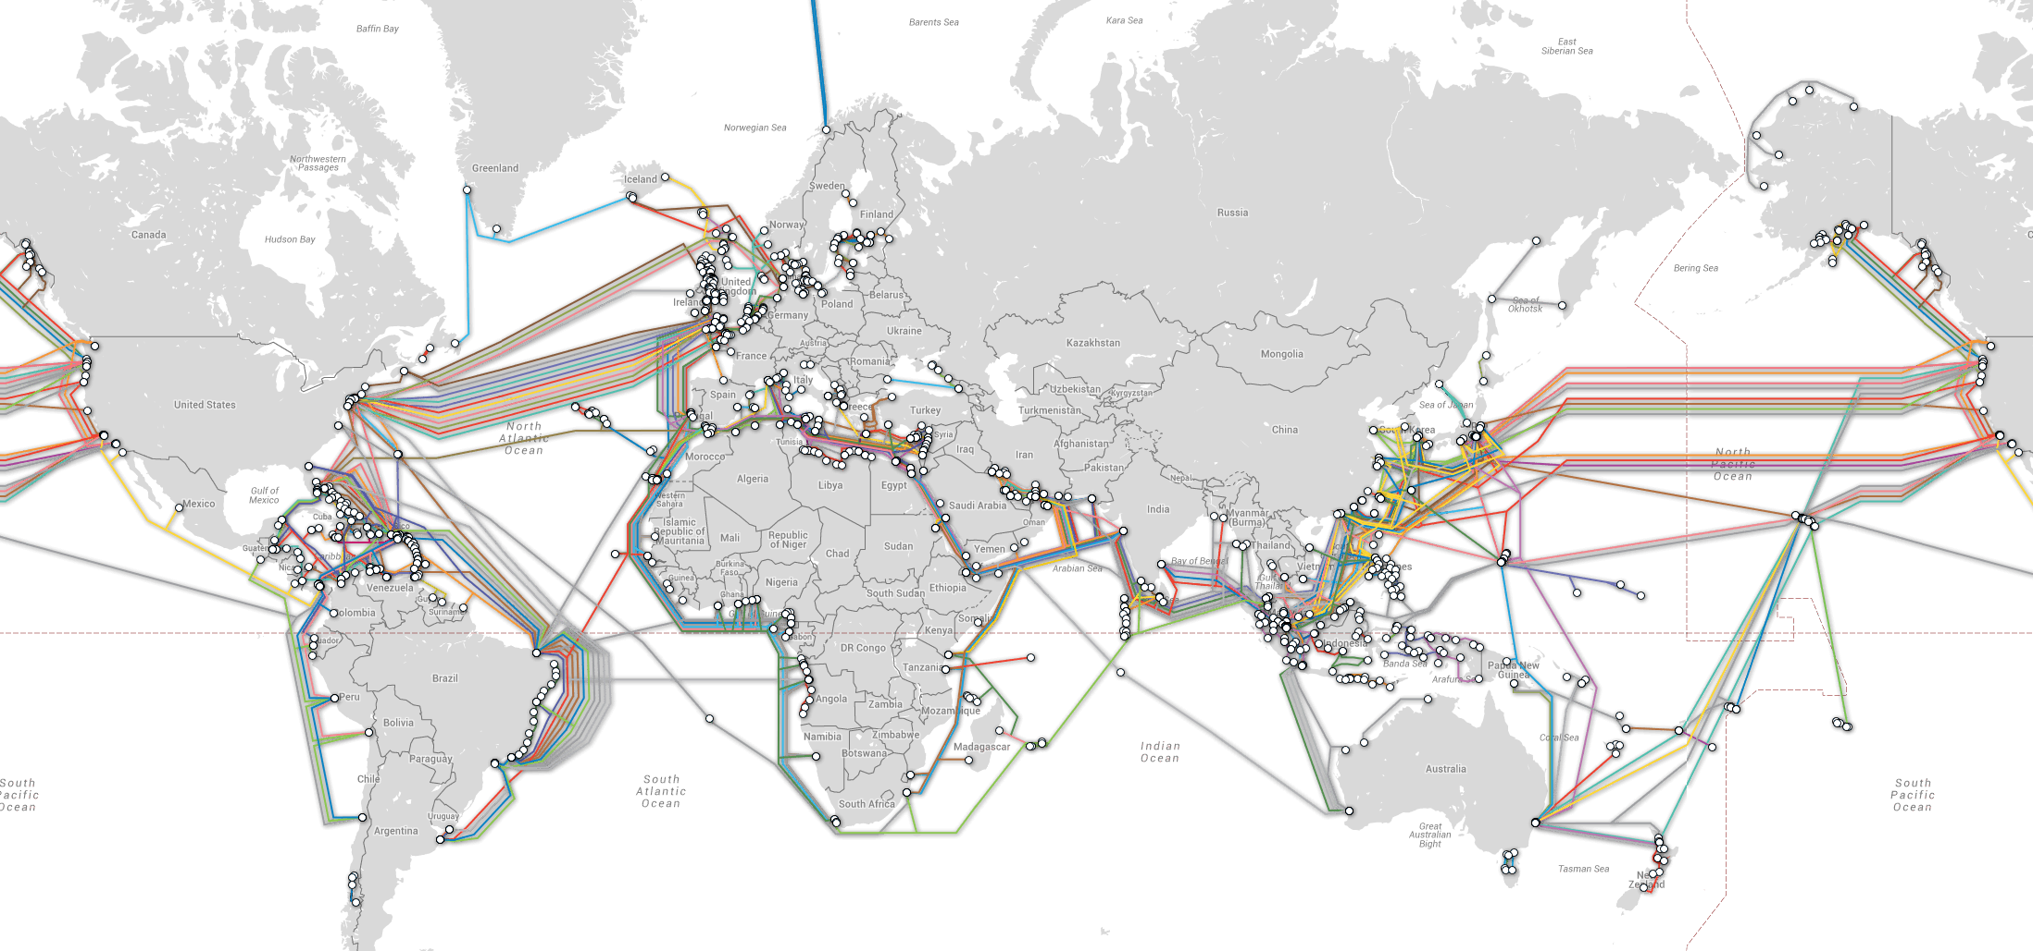
“In addition to gaining access to web companies' servers and asking for phone metadata, we've now learned that both the U.S. and the U.K. spy agencies are tapping directly into the Internet's backbone -- the undersea fiber optic cables that shuttle online communications between countries and servers. For some privacy activists, this process is even more worrisome than monitoring call metadata because it allows governments to make copies of everything that transverses these cables, if they wanted to.”
Notes:
https://www.theatlantic.com/international/archive/2013/07/the-creepy-long-standing-practice-of-undersea-cable-tapping/277855/

Slide 43
“Mastering the Internet”
The British surveillance programs have fittingly sinister titles: "Mastering the Internet" and "Global Telecoms Exploitation”.
This includes recordings of phone calls, the content of email messages, entries on Facebook and the history of any internet user's access to websites -- all of which is deemed legal, even though the warrant system was supposed to limit interception to a specified range of targets.
Edward Snowden called the British spy agency GCHQ "worse than" the NSA, saying it represents the first "full take" system, in which surveillance networks catch all Internet traffic regardless of its content. Snowden was asked if "anyone could escape” he states:
"Well, if you had the choice, you should never send information over British lines or British servers," Snowden said. "Even the Queen's selfies with her lifeguards would be recorded, if they existed.”
The British agency, the GCHQ, has defended their practices by saying that they are merely looking for a few suspicious "needles" in a giant haystack of data, and that the techniques have allowed them to uncover terrorist plots.
Notes:
The documentary Deep Web is useful

Slide 44
Manufacturing Consent: The Political Economy of the Mass Media
“entertainment has the merit not only of being better suited to helping sell goods; it is an effective vehicle for hidden ideological messages. Furthermore, in a system of high and growing inequality, entertainment is the contemporary equivalent of the Roman “game of the circus” that diverts the public from politics and generates a political apathy that is helpful to preservation of the status quo” (Herman and Chomsky xviii)
Notes:
Useful article: https://www.alternet.org/media/noam-chomsky-why-internet-hasnt-freed-our-minds-propaganda-continues-dominate

Slide 45
Net Neutrality
The Federal Communications Commission voted to discard the Net Neutrality rules in December 2017
Notes:
https://www.nytimes.com/2017/12/15/technology/net-neutrality-repeal.html

Slide 46
Education as a crucial site of struggle
What effect does the privatisation of knowledge by corporations have on freedom of information? Discuss with reference to Aaron Swartz's Guerrilla Open Access Manifesto.
How can we create curriculums that encourage students to read the world critically?
Explore what is meant by Henry Giroux’s contention that “power works through the production, distribution and consumption of knowledge within particular institutional contexts and seeks to constitute students as informed subjects and social agents”.
Explore whether it is important to create a space in Universities where students have “unconditional freedom to question and assert” (Giroux)
Examine how you might respond to some of the questions that Giroux poses: “What is the role of teachers and academics as public intellectuals? Whose interests does public and higher education serve? How might it be possible to understand and engage the diverse contexts in which education takes place? What is the role of education as a public good? How do we make knowledge meaningful in order to make it critical and transformative?”
Paulo Freire argued that for education to enable freedom, it must attempt to expand the possibilities for human agency and this in turn will enable democracy. Discuss.

Slide 47
Blogging
Examine the link between social inequality and educational inequality.
"Subjects of Western scholarship are enduringly pale, male (and often stale); where people of colour do appear, they are all too often tokenistically represented, spoken on behalf of, or reduced to objects of scholarship" (Bhambra et al 2018). Discuss.
The current use of technology is “hijacking our minds and society”. Discuss.

Slide 48
Swartz, Education and the Internet
What connections can be drawn between the way the Internet is being used by institutions, the government, and the way in which Swartz was hounded for trying to make information free and open access for all?

Slide 49


Social Media Influences Buying Decisions
The power of social media to influence buying decisions has surged. In one of the most comprehensive studies to date, McKinsey recently surveyed 20,000 consumers in Europe and found that social recommendations are behind more than a quarter of all purchases made.
This is well above the 10% to 15% that’s been estimated in earlier research. And in the majority of cases, the McKinsey report found, these social updates had a direct impact on buying decisions.
Notes:
https://www.fastcompany.com/3066100/how-companies-will-use-social-media-in-2017
http://www.mckin
Facebook prioritizes, using its own algorithms to auto-select what we see.
Users of Instagram, which the social network owns, now have their feeds curated by algorithm, with the order optimized based on “relationship with the person posting.” Even Twitter, long celebrated as the place to see real-time, streaming updates in the raw, is increasingly algorithm-driven, with the “best Tweets” auto-selected to appear at the tops of users’ feeds.
sey.com/business-functions/marketing-and-sales/our-insights/getting-a-sharper-picture-of-social-medias-influence

Slide 50
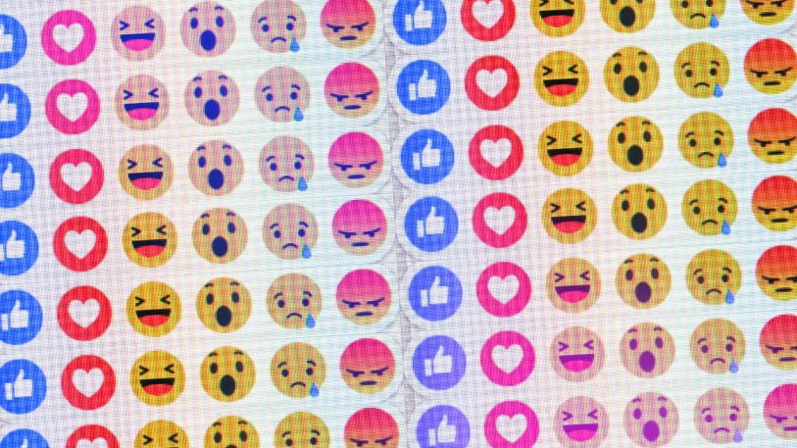
Facebook Exploits Users' Personal Data
Facebook executives promote advertising campaigns that exploit Facebook users' emotional states—and are aimed at users as young as 14 years old.
According to a report, the selling point of this 2017 document is that Facebook's algorithms can determine, and allow advertisers to pinpoint, "moments when young people need a confidence boost." If that phrase isn't clear enough, Facebook's document offers a list of teen emotional states that the company claims it can estimate based on how teens use the service, including "worthless," "insecure," "defeated," "anxious," "silly," "useless," "stupid," "overwhelmed," "stressed," and "a failure."
The documents also reveal a particular interest in helping advertisers target moments in which young users are interested in "looking good and body confidence” or “working out and losing weight."
Notes:
https://arstechnica.com/business/2017/05/facebook-helped-advertisers-target-teens-who-feel-worthless/

Slide 51
Social Media Responsibilisation
https://www.youtube.com/watch?v=JU7My4vGB4Y
https://www.google.com/webmasters/tools/legal-removal-request?complaint_type=rtbf

Slide 52
Right to be forgotten
Do we have a right to be forgotten?
https://www.theguardian.com/technology/2017/jul/20/ecj-ruling-google-right-to-be-forgotten-beyond-eu-france-data-removed
Notes:
http://curia.europa.eu/juris/document/document_print.jsf?doclang=EN&docid=152065

Slide 53
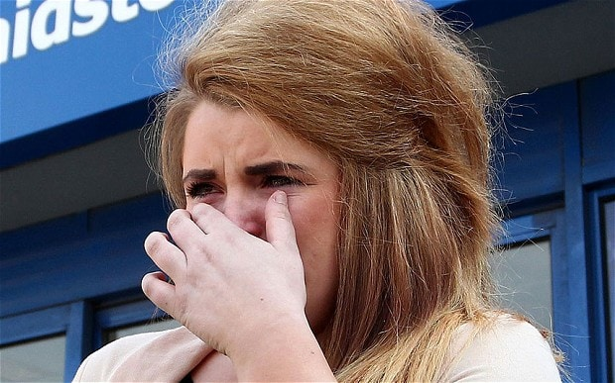
Paris Brown’s Twitter Comments
What is your opinion of the response she received from the public?
What are your thoughts on tweets made between the ages of 14 and 16 resulting in a 17 year old not taking up a job she was appointed to?
Notes:
https://www.theguardian.com/uk/2013/apr/09/paris-brown-stands-down-twitter
http://www.wired.co.uk/article/data-google-facebook

Slide 54

Social media 'should be fined' for failure to tackle online hate - VIDEO
Social media companies should be fined for failing to remove illegal or harmful material, a committee of MPs has said.
The Home Affairs Select Committee insists many websites are "shamefully far" from tackling the issue, with some putting profits before safety.
They want fines to be introduced as punishment and would also like companies to publish quarterly reports, outlining their safeguarding strategy.
Notes:
http://news.sky.com/story/social-media-should-be-fined-for-failure-to-tackle-online-hate-10858957
https://www.theguardian.com/technology/2017/may/24/facebook-youtube-tough-new-laws-extremist-explicit-video-europe

Slide 55
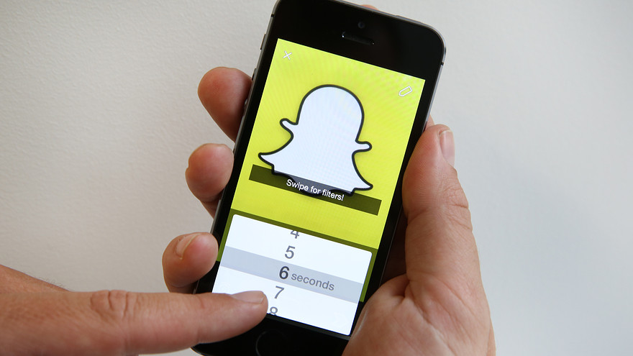

What are echo chambers?
Are they creating a tunnel vision of reality?
Do you use Snapchat?
Have you read their terms and conditions?
Notes:
http://news.sky.com/story/social-media-should-be-fined-for-failure-to-tackle-online-hate-10858957

Slide 56

Online Branding
How do you use social media?
What does your online profile tell us about you?
Do people perform when online?
How does your online persona compare to your offline persona?

