Slide 1
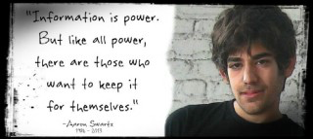
Starter
At 3.05 I will ask each of you to tell me one thing you know/learnt about Aaron Swartz.

Slide 2
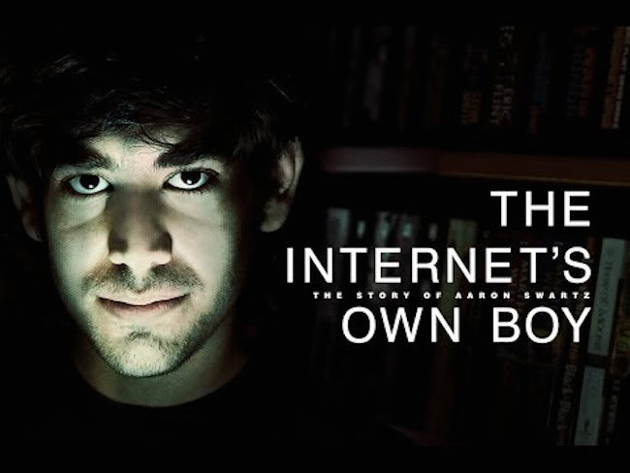
Education as a Crucial Site of Struggle https://www.youtube.com/watch?v=9HAw1i4gOU4

Slide 3

Education as a Crucial Site of Struggle
This session will explore the importance of the Internet as a tool for freedom of expression and creativity. Aaron Swartz downloaded millions of articles from JSTOR, an academic database, because he thought information should be freely available for all. Swartz was arrested in January 2011 and he committed suicide 11 January 2013, while waiting federal trail, his charges meant he was facing bankruptcy and a potential jail sentence of 35 years. We will analyse the censorship of the web in relation to education, and whether education in higher educational establishments encourages students to read the world critically, enabling freedom and democracy, or whether institutions use education as an instrument of power.

Slide 4
What would your internet use tell us about you?
https://www.youtube.com/watch?v=eiNzA0raLe4 - t=46
How can we make sure the web serves humanity?

Slide 5
What was Swartz trying to achieve in his Guerilla Open Access Manifesto?

Slide 6
What is Swartz trying to achieve in his Guerilla Open Access Manifesto?
Stop the privatization of knowledge, where information becomes a currency that only the elite in power can purchase.
He believed sharing knowledge and information is a moral imperative.
The government took the manifesto as a moral imperative that Swartz wasn’t just planning to break the law, he was seeking to nullify law.

Slide 7
Aaron Swartz paved the way for Jack Andraka's revolutionary cancer test
Jack Andraka's breakthrough pancreatic cancer test would have never come about were it not for access to online journals -- what Internet guru Aaron Swartz was promoting before his death. Andraka "religiously" used free online academic journals in his research because "in most online databases, articles cost about $35, and there are only about 10 pages.”

Slide 8
Explore the benefits of open access.
Are there any limitations?

Slide 9
What can we learn from Aaron Swartz’s story?

Slide 10
What can we learn from Aaron Swartz’s story?
Whilst everyone has a license to speak not everyone gets heard.
Everything you learn is provisional, it is always open to questions, the same applies to society.
The internet is a human right.
Secrecy serves those in power.

Slide 11
Using the Internet
What should we use the internet for?
  Creating freedom and liberty?
  To spy and control
Should we govern the use of the internet?
What governance mechanisms exist and what is your opinion of them?
  Legal governance
  Social media governance
  Institutional
  Self-governance
If we should govern the internet, how should we govern it?

Slide 12
The Role of the Law
Is this an example of the justice system being used to scare people and capture the politics of fear and anger?
Why is criminal justice intervention such as jail, prison, punishment being used to resolve problems that were not historically seen as criminal justice problems?
How has the law been used to govern the internet?
Should the law be used to govern the internet?

Slide 13
The Role of the Law
SOPA - The proposed legislation is designed to tackle online piracy, with particular emphasis on illegal copies of films and other forms of media hosted on foreign servers. The bill proposed that anyone found guilty of streaming copyrighted content without permission 10 or more times within six months should face up to five years in jail. The US government and rights holders would have the right to seek court orders against any site accused of "enabling or facilitating" piracy. This could theoretically involve an entire website being shut down because it contains a link to a suspect site.
Computer Fraud and Abuse Act - users who violate terms of service can face prison and, because of redundancies in the CFAA, people can be tried for the same crime more than once under different provisions. Due to these redundancies, charges can be compounded and penalties can be severe if convicted.
Aaron’s Law - bill proposed amending the language of the CFAA to make punishments in both prison terms and fines for downloading copyrighted material less punitive and more reflective of the value of the material stolen. The bill also sought to clarify vague statements and remove redundancies. (NOT ENACTED)

Slide 14
Rethinking Education as the
Practice of Freedom - Giroux
“Freire believed that all education in the broadest sense was part of a project of freedom”
“Freire rejected those regimes of educational degradation organised around demands of the market, instrumentalized knowledge and the priority of training over the pursuit of imagination, critical thinking and the teaching of freedom and social responsibility.”
“the school and classroom being merely the instrument of official power or assuming the role of an apologist for the existing order”.
Think back over your experience in school or university.
Why did you decide to study your subject?
What is one of the most important things you have learnt?
Is there anything you were taught that you are still trying to forget?

Slide 15
Students – Agents in the Classroom?
How can we make knowledge critical and transformative?
How can we encourage students to question every aspect of society and to take responsibility for intervening in the world they inhabit?

Slide 16
Social Agent?
Explore what is meant by Henry Giroux’s contention that “power works through the production, distribution and consumption of knowledge within particular institutional contexts and seeks to constitute students as informed subjects and social agents”.
Can you think of any examples of when you have felt like a social agent?

Slide 17
Group Blogging
Pick a question ideally from this week, but you can pick another week.
Work as a group to mind-map your ideas and then submit either an individual post or group post signed off by you all.
You have 15 minutes!

Slide 18
What connections can you see to the other sessions on censorship?

Slide 19
Aaron Swartz
https://www.youtube.com/watch?v=eFGa9sGKqpE
https://www.youtube.com/watch?v=9HAw1i4gOU4

Slide 20
Group Abstract Due
A group abstract of no more than 400 words must be submitted in class on Tuesday 23 February 2016 - Week 7.
The abstract should provide an overview of your group presentation, you might decide to write around 100 words each, and allocate one person in the group to bring the abstract together. The abstract must include the title/question/theme of your presentation and the names of those within the group.

Slide 21
Student Conference
Where are we with preparations?
Any questions?
We need to organise the programme and collection of abstracts.

Slide 22
Student Conference
Self-censorship in online feminist discourses – Cindy, Keren, Wendy
What motivates censorship using a law and psychoanalysis – Naomi, Lena, Tam
“State Censorship” – Bisma, Sonia, Jenny, Tara
Censorship, education and feminism - Leigh-Ann, Rachel
Drug Laws - – Lewis, Ibrahim
Contemporary Censorship – Emily and Su
Students should work in groups to write an academic paper and presentation, their individual contribution to the group should last no longer than 10 minutes.
Does anyone have a time they cannot present due to other commitments?

Slide 23
Student Organisation
Programme etc – Keren, Wendy, Cindy
Filming – Yinsu, Jenny, Tara
Publicising – Sonia, Bisma
Setting up on the day – Emily, Naomi, Tam, Lena, Ibrahim, Lewis
Guest Lecture Admin – Rachel, Leigh-Ann
Has everyone got a role?
What has been done so far?

Slide 24
Workshop
Programme planners can you come along?
Wednesdays 18.00-19.00 R3.41

