Slide 1





Digital Wildfires and the challenges of governance in social media
Rob Procter
Digital Wildfires Project
Notes:
https://www.youtube.com/watch?v=lTljU2rB17c
https://www.youtube.com/watch?time_continue=1313&v=VDX34XBgRLA

Slide 2
Overview
What is social informatics?
The rise of social media.
Digital wildfires and their impacts:
  Rumours
  Provocative content
  Explanations
Digital Generation
How should society respond?
  Legal measures
  Monitoring and counter speech
  Digilantism
  Education
Case Studies
Can technology provide a fix?

Slide 3
What is Social Informatics?
  “The interdisciplinary study of the design, uses and consequences of information technologies that takes into account their interaction with institutional and cultural contexts.” Rob Kling
Emphasis on innovation as a participatory process of experimentation and learning where meanings of technologies are collaboratively explored and co-produced.

Slide 4
The Rise of Social Media
Social media platforms such as Facebook, Instagram, Snapchat and Twitter enable users to share content instantly.
This brings many benefits to society but also poses difficult problems.
  ‘digital wildfires’, in which false or provocative content spreads rapidly, may damage the reputation individuals, or put groups and communities at risk.
How might conduct in social media might be better managed.
  Should police and legal system have a greater role or should we expect social media platforms to be more actively involved?
  To what extent is it incumbent on civil society groups and individuals to take responsibility?
Notes:
https://www.youtube.com/watch?v=5nXaEctiVhs

Slide 5
Digital Wildfires
“Global risk of digital wildfires = the rapid viral spread of information that is either intentionally or unintentionally misleading or provocative with serious consequences”
World Economic Forum 2013: Digital Wildfires in a hyperconnected world

Slide 6
Digital wildfires as a challenge to the governance of social media
“Establishing reasonable limits to legal freedoms of online speech is difficult because social media is a recent phenomenon, and digital social norms are not yet well established.”

Slide 7
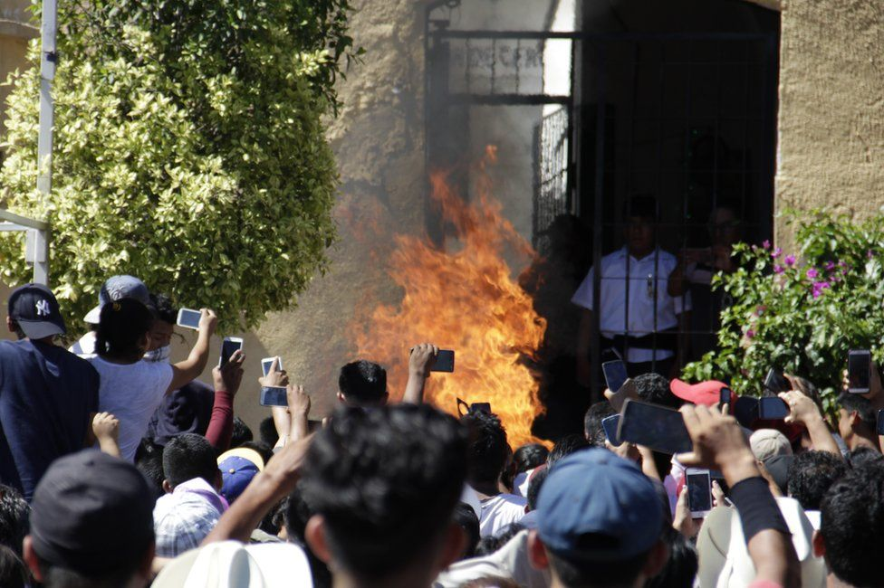
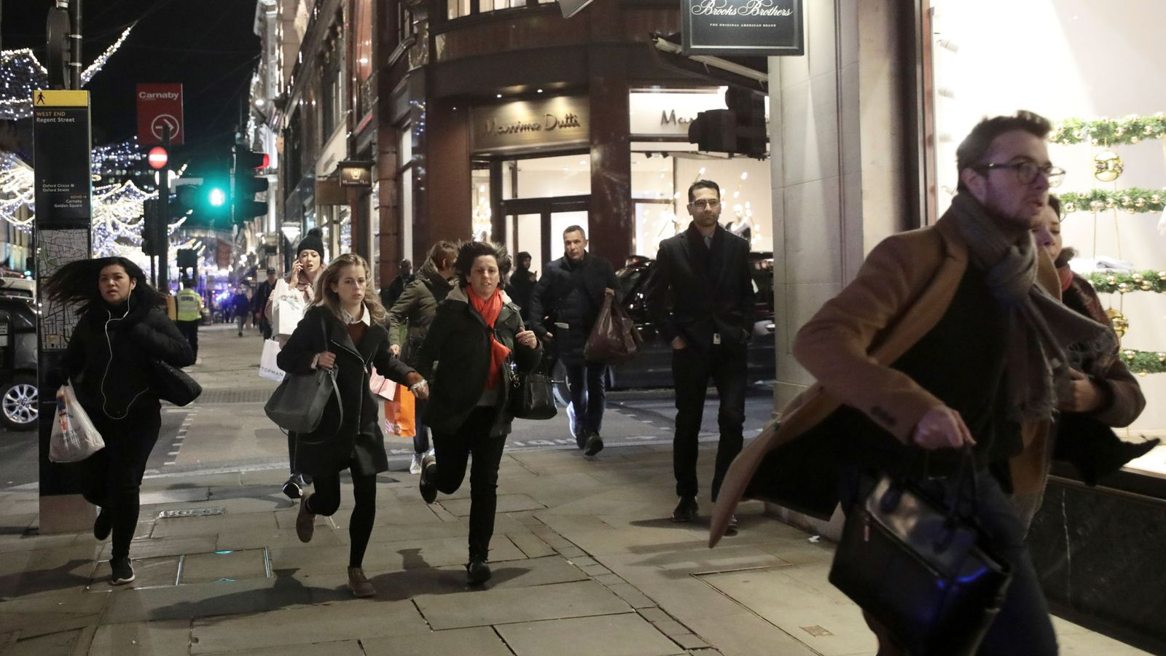
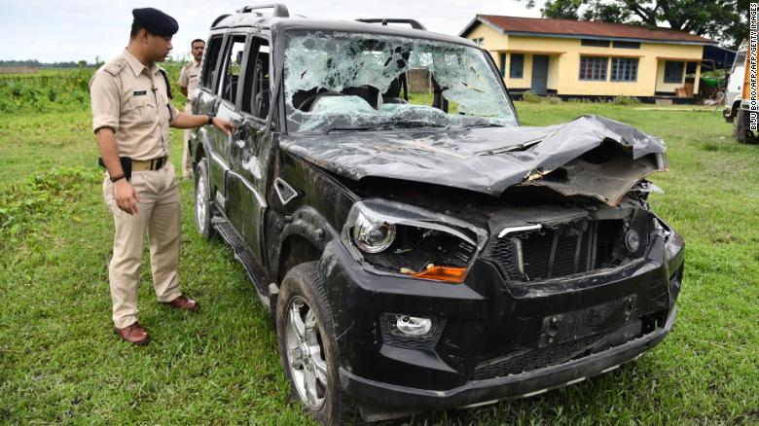
Digital Wildfires
“Oxford Street: What happened to cause ‘terror’ scare in central London?”
https://news.sky.com/story/oxford-circus-what-happened-to-cause-terror-scare-in-central-london-11142665
“Burned to death because of a rumour on WhatsApp”
https://www.bbc.co.uk/news/world-latin-america-46145986
“India WhatsApp rumours: Mob kills man in latest attack, 30 arrested”
https://edition.cnn.com/2018/07/16/asia/india-whatsapp-lynching-intl/
https://edition.cnn.com/2019/01/21/tech/whatsapp-forwarding-limits-india/index.html

Slide 8
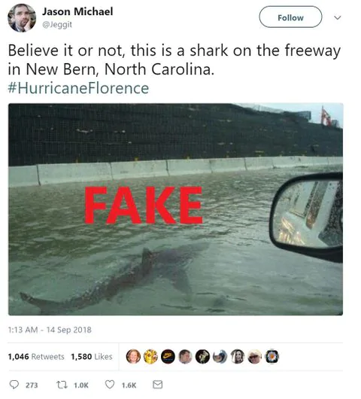
Social Media Saves Lives
Weather Warnings
  Weather updates sent to phones
  Evacuation information
  Contact emergency workers
  Hoax/Rumour/False Information
Notes:
https://www.washingtonpost.com/news/the-intersect/wp/2018/09/13/sharks-dishwashers-and-guns-a-running-list-of-viral-hoaxes-about-hurricane-florence/?noredirect=on&utm_term=.d944fe1cb0bc

Slide 9
Advanced Solutions
Hala System – reduce the number of casualties in Syria caused by air strikes by 27% by sending alerts via social media to civilians and aid workers that a certain area is likely to come under heavy bombardment and the duration of the raids
https://halasystems.com/
Digital Volunteers
Digital Humanitarian Network:
http://digitalhumanitarians.com/about
Food waste apps

Slide 10



Social Media: Some Statistics
Twitter:
  300M active users, 500M tweets per day
Facebook:
  1.4B active users, 44M posts per day
Tumblr:
  110M active users, 114M posts per day
Notes:
Add graphs?

Slide 11
Regulation vs Freedom
[C]oncerns have led to calls for more effective regulation of digital spaces – for instance, through the criminalization or restriction of certain kinds of user content. Inevitably, however, these calls are contradicted by other arguments that position the internet as a medium that supports and encourages freedom of speech and therefore label any increased regulation as unethical (Web et al 2015, 2).

Slide 12

Social Media
Write down one advantage
Write down one disadvantage
Write down what you would change.

Slide 13
Object to Subject
The United Nations 1989 Convention on the Rights of the Child established a shift from children being objects of protection to subjects and rights holders.
Current “safety” based approaches that focus on prevention and protection fail young people and deny them their fundamental human rights (Phippen 2017).
As Frank La Rue, the former UN Special Rapporteur for Freedom of Expression, contends, the internet is ‘[a]n important vehicle for children to exercise their right to freedom of expression and can serve as a tool to help children claim their other rights’ (2014).
Notes:
The right of the child to be heard (Article 12 CRC 1989), the Committee on the Rights of the Child General Comment 12 (2009).

Slide 14
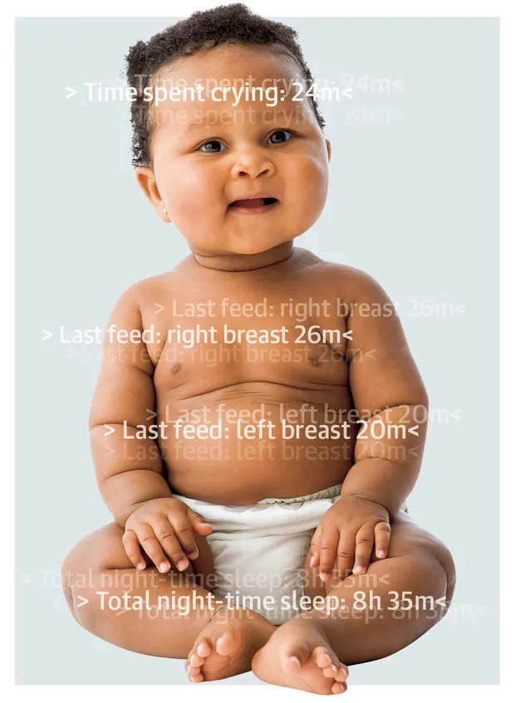
Digitise Baby
“Jenny is part of a generation whose entire lives will be quantified – sometimes all the way from conception, thanks to fertility tracking apps”
“Technology has definitely become a major theme in parenting”
“We trade our data for a sense of control, but we’re never actually going to have control. Life isn’t like that. And in trading that, we trade our ability to be in unmediated relationships with our kids. The relationship becomes embedded in consumer corporate culture”
Notes:
https://www.theguardian.com/lifeandstyle/2019/mar/02/apps-that-track-babies-and-give-data-to-tech-firms-parents?CMP=share_btn_tw

Slide 15
Pressure to be Online
‘by age four 53 per cent of children use the internet, and by the age of 10 almost half have their own smartphone’ (NSPCC, 2018: 4).
Woods and Scott (2015) have researched the link between social media use during adolescence and wellbeing. They reported the pressure to be online 24/7 has resulted in poorer sleep quality and lower self-esteem, higher anxiety and depression levels.
This is further supported by the Secretary of State for Health and Social Care Matt Hancock confirming that the Chief Medical Officer Professor Dame Sally Davies has been instructed to prepare official guidance to help parents ensure children do not use social media in a way that harms their mental health (2 October 2018)

Slide 16
Digital Literacy
“every aspect of their lives is mediated through technology: from health to education, from socialising to entertainment. Yet the recognition that children have different needs to those of adults has not been fully accepted in the online world” (House of Lords Report 2017)
Commercial considerations overshadow the needs of children.
Digital literacy needs to become the fourth pillar of education alongside reading, writing, and mathmatics.

Slide 17
UK Safest place to be online?
In 2017 the UK Government ‘pledged to make the UK the safest place to be online’ (NSPCC, 2018: 4).
A new Internet Safety Strategy, will propose a code of practice for social media networks.
Crucially, however, these codes will be voluntary.
In 2008, Byron made 38 recommendations but, a decade later, only 13 have been fully implemented and 25 issues remain unaddressed (NSPCC, 2018: 14).

Slide 18
Responsibilisation
Barnard-Lewis pointed out “responsibility [is] placed upon children and young people to play an active part in protecting themselves from online threats” (2012: 248).
Barnard-Lewis contends that “[t]he governance of children is conducted at a distance through the family, formalizing both ‘parental responsibility’ and a stand-off role of the state” (2012: 247).

Slide 19
Regulation at Home
Home most prominent and most challenging location for regulating internet.
The most recent Ofcom study (2017) found that ‘[p]arents use a combination of approaches to mediate their child’s access to and use of online content and services, including: regularly talking to their children about staying safe online, using technical tools, supervising their child, and using rules’ (16).
National findings indicate levels of parental supervision, mediation, and knowledge of online risks varies according to: educational attainment, socio-economic status, age, the gender of child, disability, ethnicity, and family structure (Bond and Rawlings 2016: 31).

Slide 20
Sharenting
According to the findings of the AVG Technologies survey carried out in the US, Canada, Australia, New Zealand, Japan, France, UK, Germany, Italy, Spain, 81% of children under the age of two already have a digital footprint created by their parents (2010)
71.3% of UK children aged 12-16 thought their parents did not respect their privacy online (Levy 2017)
Brosch identified there is a growing problem of ‘sharenting’, where parents actively share personal information and images of their children online (2016: 1).
Should a parent ask permission to upload child-related content on social media?
What constitutes acceptable information sharing on social media?
How can we balance the parents right to share with their children’s right to privacy?
Notes:
https://journals.sagepub.com/eprint/9mTmCxB85k8s45Evm5QW/full?fbclid=IwAR3WcoTCY7CQXJUK38Th9GJdr2o-ulNbTix7mS4L5FzV4ssbItbO3-kkSaQ&#articleShareContainer

Slide 21
Disparity in Knowledge
The Childnet Digital Leaders Programme is an example of peer-led learning, where Digital Leaders educate their peers, parents and teachers about staying safe online.
Hope (2015) contends such an approach is flawed, ‘when children are given a voice in such documents it is often to reinforce the dominant adult ideas […] what children have to say is dis-privileged’ (2015: 347).
Hope considers this a form of ‘responsibilisation’:
  [Whereby] such participation [in establishing school e-safety policies] could be seen as a widening of democratic practice, subsequent discussion within policy documentation often tends to focus on the strengthening of existing social controls […] not only encouraging children to help develop guidelines for safe online behaviour (as recognised by adults), but also enculturing them into self-policing behaviour (2015).
What are the limitations and opportunities for collaborative online safety policies/learning?

Slide 22
Online-Offline
Young people do not tend to perceive there to be a division between their ‘online’ and ‘offline’ lives, instead they define the distinction according to their school and social life (Phippen 2017, 55).
Coleman et al. contend ‘children and young people expect their online experiences to be governed by the same moral standards as the offline world’ (2017: 42).
Do you see a division between your offline and online lives?
What are the dangers and opportunities in online and offline lives becoming blurred?

Slide 23
Digital Body
Boyd describes online profiles ‘as a form of digital body where individuals must write themselves into being’ (2008: 129). Social media profiles are performative, they offer a space of re-invention and re-creation, where individuals can ‘present the side of themselves that they believe will be well received by [their] peers’ (Boyd, 2008: 129).
Are your social media profiles performative?

Slide 24
Deindividuation
Phippen points out that this “online environment seems to provide a disconnect in empathy – when one cannot see the impact of one’s words or actions on a peer, it is less impactful than if it were to happen in person” (Phippen 2017; 73).
“legitimization of antisocial behaviour because it is facilitated by a piece of technology - [which acts as] the “buffer” that softens the unacceptability of something” (Phippen 2017; 95).
What can be done to address anti-social behaviour online?

Slide 25
Privacy
“Net Geners are making a serious mistake, and most of them don’t realize it. They’re giving away their personal information on social networks and elsewhere and in doing so are undermining their future privacy. They tell me they don’t care; it’s all about sharing. […] I think they should wake up, now, and become aware of the extent to which they’re sharing parts of themselves that one day they may wish they had kept private” (2009; 7).
Is digital technology destroying childhood?

Slide 26
Internet on our own terms
The 5Rights were devised as a way of broadening the policy debate beyond discourse of fear and risk. They are
i) the right to remove, enabling children to easily edit, delete, retract, correct and/or dispute content they have created and/or data that refers to them;
ii) the right to know, designed to increase transparency concerning how young people’s information is being used and who is holding and profiting from such information;
iii) the right to safety and support, promoting the same age appropriate and compatible protection, care and support online as in the offline world;
iv) the right to informed and conscious use, empowering children to disengage at will;
v) the right to digital literacy, aimed at providing young people with the digital skills necessary for using, creating and critiquing digital technologies and giving them the tools for negotiating changing social norms.
Notes:
https://5rightsframework.com

Slide 27
Snapchat Terms and Conditions
3. Rights you grant us
Many of our Services let you create, upload, post, send, receive and store content. When you do that, you retain whatever ownership rights in that content you had to begin with. But you grant us a licence to use that content. How broad that licence is depends on which Services you use and the settings you have selected.
We call Story submissions that are set to be viewable by Everyone as well as content you submit to crowd-sourced Services, including Our Story, “Public Content”. For all content you submit to the Services other than Public Content, you grant Snap Inc. and our affiliates a worldwide, royalty-free, sublicensable and transferable licence to host, store, use, display, reproduce, modify, adapt, edit, publish and distribute that content. This licence is for the limited purpose of operating, developing, providing, promoting and improving the Services and researching and developing new ones.
Notes:
https://www.snap.com/en-GB/terms/

Slide 28
Hate Speech
Facebook defines hate speech as “anything that directly attacks people based on […] their ‘protected characteristics’ – race, ethnicity, national origin, religious affiliations, sexual orientation, sex, gender, gender identity, or serious disability or disease.”
Twitter uses the term “hateful conduct” which they define as promoting “violence against or directly attacking or threatening other people on the basis of race, ethnicity, national origin, sexual orientation, gender, gender identity, religious affiliation, age, disability, or serious disease”. This extends to hateful imagery and display names, so it is not just what you tweet but what you display on your profile page.
The European Court of Human Rights directly employed a definition of the term “hate speech” “as speech likely to produce the effect of legitimising, spreading or promoting racial hatred, xenophobia, anti-Semitism or other forms of discrimination or hatred based on intolerance”. For words to be defined as “hate speech” they must go beyond offending, shocking, or disturbing, they must be capable of inciting hatred or violence.
What measures might we introduce to tackle hate speech?

Slide 29
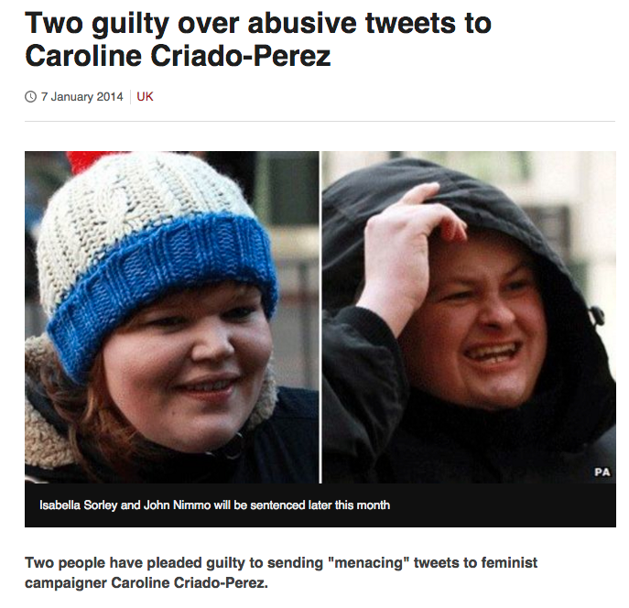
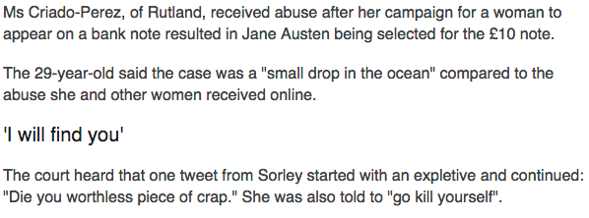
Caroline Criado-Perez

Slide 30
Digilantism
Punishing public exposure of wrongdoing to a (usually selected) online audience.
Status of action as wrongdoing sometimes disputed.
Addressed online audience reacts with hate speech and threats of injury.
Usually a reaction from untargeted online audiences as well.
Wrongdoing can be subcriminal and reaction bypasses law-enforcement agencies.

Slide 31
Dimensions of digilantism
Seriousness of wrongdoing exposed.
Severity of hate speech in response.
Occurrence of physical attack in addition to hate speech.
Economic loss.
Reputational damage and its duration.
Dependence of target of digilantism on digital world.
Effects on (local) rule of law.

Slide 32
Cat in the bin woman
Cat in bin for 15 hours.
Video posted to identify culprit.
https://www.youtube.com/watch?v=eYdUZdan5i8

Slide 33
Aftermath
Culprit identified.
Culprit fined £250, ordered to pay legal costs and prevented from owning animals for five years.
Suffered online abuse, death threats.

Slide 34
Justine Sacco
German man on the plane from New York: ‘Weird German dude: You’re in first class. It’s 2014. Get some deodorant. – Inner monologue as I inhale BO. Thank god for pharmaceuticals.’ Then the layover at Heathrow: ‘Chili – cucumber sandwiches – bad teeth. Back in London!’ Then the final leg: ‘Going to Africa. Hope I don’t get AIDS. Just kidding. I’m white!’
Ronson, Jon (2015-03-09). So You've Been Publicly Shamed (p. 68). Pan Macmillan. Kindle Edition.

Slide 35
Aftermath
Sacked from her PR dream job.
Vilified on social media.
Out of work for a long time.
Driven into depression.

Slide 36
Important features of this case
Confidence that public tweets would be understood in the way intended by Justine Sacco.
PR naiveté from PR woman.
Disadvantaged group as a source of humour.
Snowballing offense and notoriety.
Offense and notoriety as liability not only to individuals but employers.

Slide 37
Legal regulation
“When we’ve reported something to the Police sometimes they take it seriously and sometimes they don’t. I think they struggle … to know is it against the law or not... It’s a very grey area.”
Staff member at equality organisation
Notes:
For many people who work in organisations that attempt people affected by social media content, the current law in the UK is unclear. Some posts can be acted on – for example those that make specific threats of violence. But the thresholds of evidence to pursue prosecutions can be high and it can appear unclear what posts might be illegal.
Also tell us that social media platforms can appear unwilling to engage with police and other agencies. As they tend to be based in the US, they tend to follow a model that prioritises freedom of speech and so are reluctant to remove content that is harmful but not necessarily illegal. It is important for their own brand image to allow freedom of expression.

Slide 38
Opportunities to further responsible governance of social media
Counter speech: “The best response to bad speech is more speech… Online communities have a right to ostracize, call out, criticize bad actors.”
Delphi panel survey respondent
Education: “One of the best ways to address ‘responsible’ behaviour on social media is through education and social media literacy.”
Delphi panel survey respondent
Notes:
With these perceived limitations in mind it is possible to identify opportunities to further the governance of social media in ways that can be effective in the prevention and management of digital wildfires but still recognise the value of freedom of speech.

Slide 39
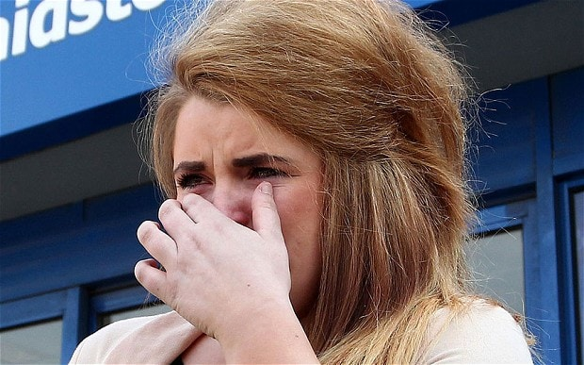
Paris Brown’s Twitter Comments
What is your opinion of the response she received from the public?
What are your thoughts on tweets made between the ages of 14 and 16 resulting in a 17 year old not taking up a job she was appointed to?
Notes:
https://www.theguardian.com/uk/2013/apr/09/paris-brown-stands-down-twitter
http://www.wired.co.uk/article/data-google-facebook

Slide 40
Case Studies
Share your group discussions and reflections.
What can we learn from these case studies?

Slide 41

Online Branding
How do you use social media?
What does your online profile tell us about you?
Do people perform when online?
How does your online persona compare to your offline persona?

Slide 42
Governance and Internet
Explore the advantages and disadvantages of using social media.
Do social media platforms enable a rapid and global spread of harmful content?
Does the risk of digital wildfires necessitate new forms of social media governance? How do you propose social media should be governed?
Explore some examples of when social media has become harmful. Perhaps you might like to reflect on current/historical events, on your own experiences, or experiences of those you know.
How do you respond to the assertion that the internet "supports and encourages freedom of speech and therefore label any increased regulation as unethical"?
What impact does social media have on offline behaviour? Consider the effect of deindividuation in digital spaces.
Does preventing/delaying/monitoring the posting of content signify a barrier to freedom of speech?

Slide 43
Freedom Online
Imagine you were creating a module for secondary schools on "Digital Maturity and Resilience", what would it include? How can we take care of our digital selves?
Imagine you were asked to draw a creative representation of a digital wildfire, what would it look like? Take a picture of your digital wildfire and post online or write a creative story demonstrating the effect of digital wildfires.
“Establishing reasonable limits to legal freedoms of online speech is difficult because social media is a recent phenomenon, and digital social norms are not yet well established.” Discuss.
Social media is no more vulnerable to rumours than any other form of communication. Discuss.
“The best response to bad speech is more speech… Online communities have a right to ostracize, call out, criticize bad actors.” Discuss.
How is social media used to expose people who have behaved inappropriately? Examine some examples of digilantism in social media.
How we can govern social media - is technology part of the answer?

Slide 44
Abstracts and Conference
Review abstracts – offer advice and make plans for group presentation.
Discuss with chair questions.
Any questions

Slide 45
2020
What censorship topics would you like to see included next year?
Moodle Module Feedback

