Slide 1
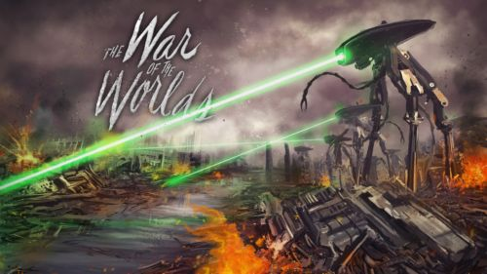
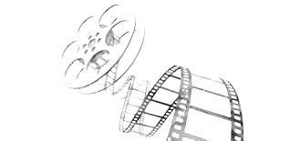
‘The War of Worlds', bacteria and antibiotic resistance (film, 2005)
This film in which aliens that had no immunity to the bacteria on Earth were killed trough the spreading of an infection, is the starting point of a lecture about microbes, genetic manipulation of bacteria and antibiotic resistance.
Students are hosted by a Chemical Biology group (University of Warwick)
with the opportunity to see how bacteria are grown and manipulated.
Science on Screen
Outreach Project

Slide 2
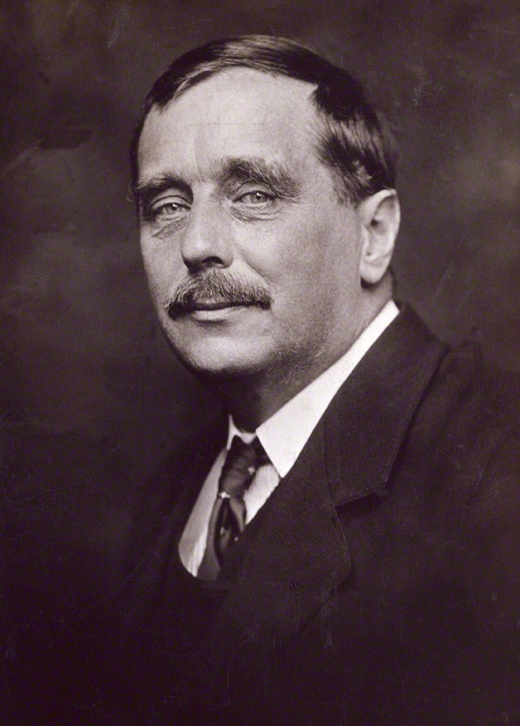
The War of the Worlds is a science fiction novel by English author H. G. Wells.
It first appeared in serialized form in 1897, published simultaneously in Pearson's Magazine in the UK and Cosmopolitan magazine in the US.
The first appearance in book form was published by William Heinemann of London in 1898.
It is the first-person narrative of an unnamed protagonist in Surrey and that of his younger brother in London as Earth is invaded by Martians. It is one of the earliest stories that detail a conflict between mankind and an extraterrestrial race.
The novel has been variously interpreted as a commentary on evolutionary theory, British imperialism, and generally Victorian superstitions, fears and prejudices.
The War of the Worlds has been both popular (having never gone out of print) and influential, spawning half a dozen feature films, radio dramas, a record album, various comic book adaptations, a television series, and sequels or parallel stories by other authors. It has even influenced the work of scientists, notably Robert Hutchings Goddard.

Slide 3
Natural selection
H.G. Wells was a student of Thomas Henry Huxley, a proponent of the theory of natural selection. In the novel the conflict between mankind and the Martians is portrayed as a survival of the fittest, with the Martians whose longer period of successful evolution on the older Mars has led to them developing a superior intelligence, able to create weapons far in advance of humans on the younger planet Earth, who have not had the opportunity to develop sufficient intelligence to construct similar weapons.
Human evolution
The novel also suggests a potential future for human evolution and perhaps a warning against overvaluing intelligence against more human qualities.
Martians as having evolved an overdeveloped brain, which has left them with cumbersome bodies, with increased intelligence, but a diminished ability to use their emotions, something Wells attributes to bodily function.

Slide 4
Colonialism and imperialism
In The War of the Worlds, Wells depicted an imperial power as the victim of imperial aggression, and thus perhaps encouraging the reader to consider imperialism itself.
And before we judge them [the Martians] too harshly, we must remember what ruthless and utter destruction our own species has wrought, not only upon animals, such as the vanished Bison and the Dodo, but upon its own inferior races. The Tasmanians, in spite of their human likeness, were entirely swept out of existence in a war of extermination waged by European immigrants, in the space of fifty years. Are we such apostles of mercy as to complain if the Martians warred in the same spirit? —Chapter I, "The Eve of the War“
This also challenged the Victorian notion that the British Empire had a right to rule by their own superiority over subject races.
The novel also presents ideas related to Charles Darwin's theory of natural selection, both in specific ideas discussed by the narrator, and themes explored by the story.

Slide 5
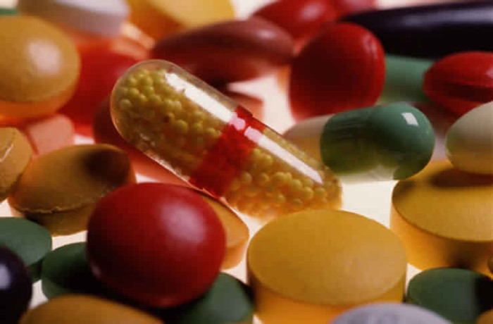
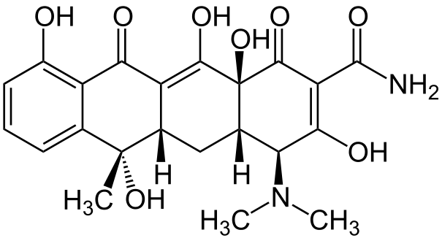
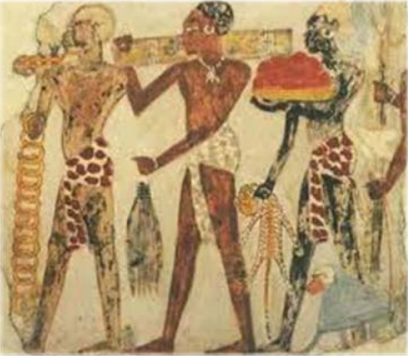
The history of antibiotics
Antibiotics or antibacterials are a type of antimicrobial used in the treatment and prevention of bacterial infection. They may either kill or inhibit the growth of bacteria. Several antibiotics are also effective against fungi and protozoans, and some are toxic to humans and animals, even when given in therapeutic dosage.
350-550 AD traces of tetracycline have been found in human skeletal remains from ancient Sudanese Nubia (Armelagos, 1980). Source of the antibiotic = the Nubian beer. The grain used to make the fermented gruel contained the soil bacteria streptomyces, which produces tetracycline.
The ancient Egyptians and Jordanians used beer to treat gum disease and other ailments.
In traditional Chinese medicine a paste from chewed barley and mouldy apple was made and put on the surface of wounds.
In the Jewish Talmud a therapeutic is mentioned that consist of mouldy corn soaked in water or date wine.

Slide 6
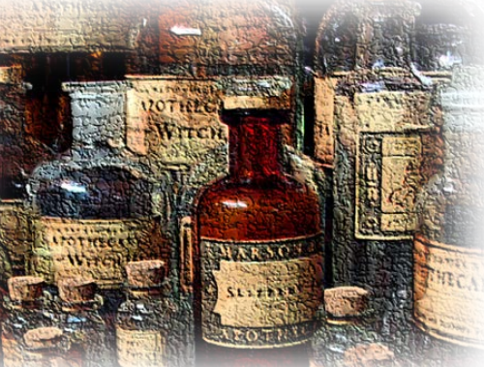


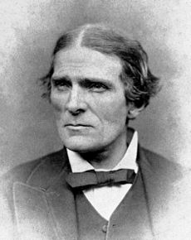
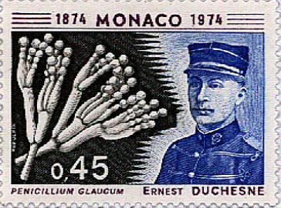
The history of antibiotics
In 1640 John Parkington, London apothecary and King‘s herbalist advises that moulds have a curative effect when applied to infections.
In 1870, Sir John Scott Burdon-Sanderson observed that culture fluid covered with mould did not produce bacteria.
1877 Louis Pasteur observed that cultures of the anthrax
bacilli, when contaminated with moulds, became inhibited -
bacteria kill other bacteria.
1897, Ernest Duchesne healed infected guinea pigs from typhoid using mould (Penicillium glaucium); doctorate thesis ‘Contribution to the study of vital competition in micro-organisms: antagonism between moulds and microbes’.

Slide 7
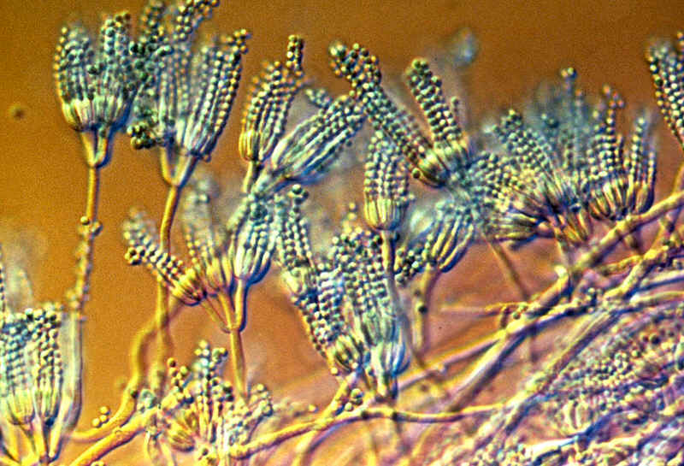
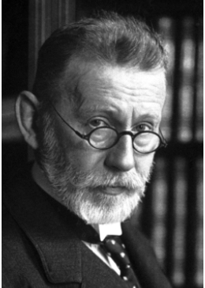
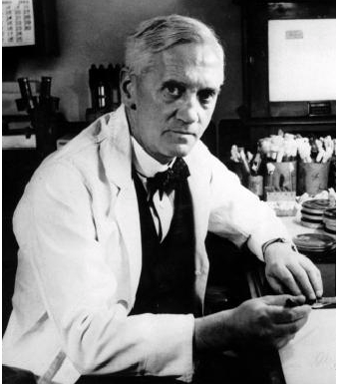
The history of antibiotics
In 1893 Bartolomeo Gosio (1863-1944) is able to isolate Mycophenolic acid out of moulds from the genus penicillium and showed that it was able to inhibit the grow of bacillus anthracis. His work never found international recognition probably because it was written in Italian and not translated.
In 1909 Paul Ehrlich discovered arsphenamine, the first synthetic antibiotic as a treatment for syphilis.
1928, Sir Alexander Fleming
“When I woke up just after dawn on September 28, 1928, I certainly didn't plan to revolutionise all medicine by discovering the world's first antibiotic, or bacteria killer. But I suppose that was exactly what I did.”
Fleming was born on 6 August 1881 at Lochfield farm, Scotland as the third of the four children. In 1903 he enrolled at St Mary's Hospital Medical School and qualified with an bachelor degree from the school with distinction in 1906. He became assistant bacteriologist to Sir Almroth Wright, a pioneer in vaccine therapy and immunology.

Slide 8
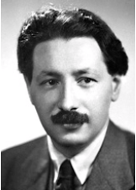
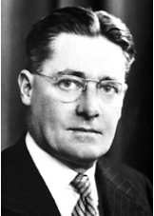
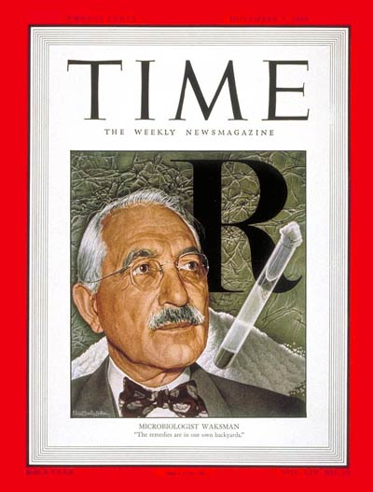
The history of antibiotics
1928, Sir Alexander Fleming
In 1928, while working on influenza virus, he observed that mould had developed accidently on a staphylococcus culture plate and that the mould had created a bacteria-free circle around itself. He was inspired to further experiment and he found that a mould culture of Penicillium fungi prevented growth of staphylococci, even when diluted 800 times.
In 1939 Ernst Chain began, with Sir Howard Florey, a systematic study of antibacterial substances produced by micro-organisms. This led to his best known work, the reinvestigation of penicillin and to the discovery of its chemotherapeutic action.
Fleming, Florey and Chain jointly received the Nobel Prize in Medicine in 1945.
In 1943, Selman Waksman discovered that soil Streptomyces produce antibiotics. Nobel prize in 1952 for discovery of Streptomycin.
He discovered over twenty antibiotics (a word which he coined) and introduced procedures that have led to the development of many others.

Slide 9
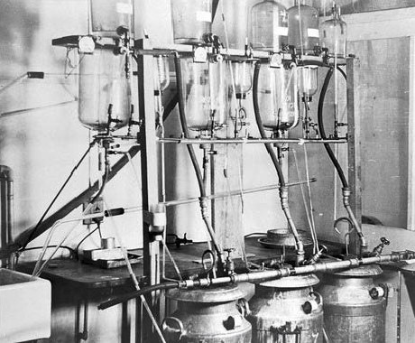
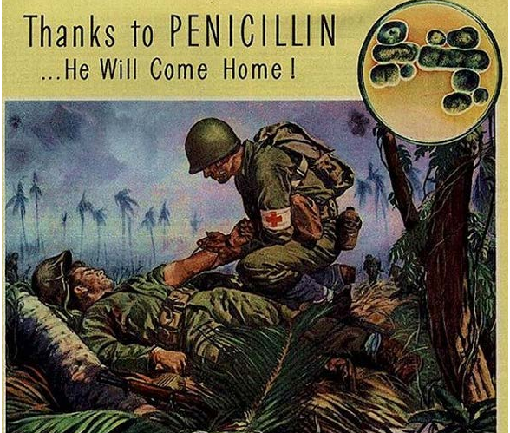
The history of antibiotics
Penicillin production in the beginning:
glass flasks and milk churns used for making early forms of penicillin
The United States to produce 2.3 million doses in time for the invasion of Normandy in the spring of 1944.

Slide 10
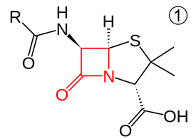
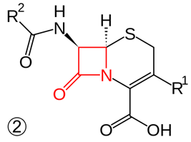
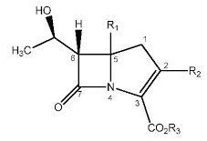
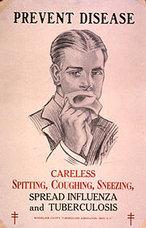
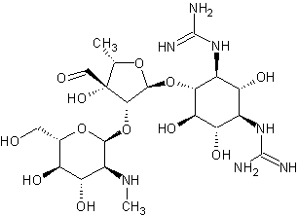
The production of antibiotics
With advances in medicinal chemistry, most modern antibacterials are semisynthetic modifications of various natural compounds.
Semisynthetic : beta-lactam antibiotics. Penicillins -produced by fungi in the genus Penicillium- and cephalosporins vs bacterial infections caused by staphylococci and streptococci. Carbapenems - one of the antibiotics of last resort for many bacterial infections, such as Escherichia coli and Klebsiella pneumoniae. (developed from the carbapenem thienamycin, a naturally derived product of Streptomyces cattleya).
Natural : aminoglycosides. Aminoglycoside antibiotics display bactericidal activity against gram-negative aerobes and some anaerobic bacilli where resistance has not yet arisen, but generally not against Gram-positive and anaerobic Gram-negative bacteria. They include the first-in-class aminoglycoside antibiotic streptomycin derived from Streptomyces griseus, the earliest modern agent used against tuberculosis.

Slide 11
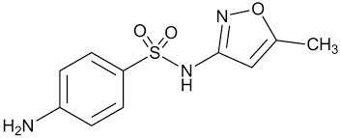
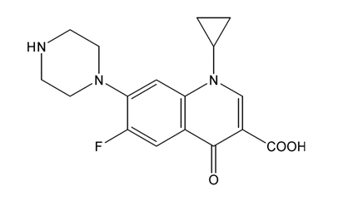
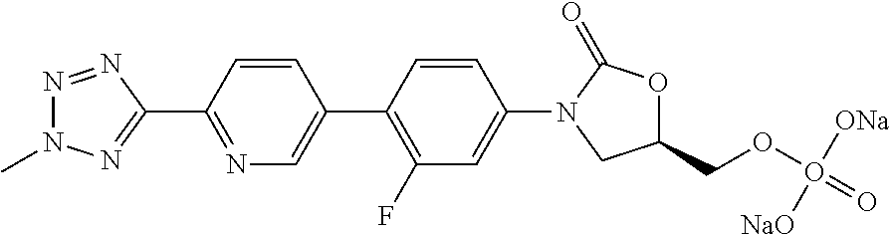
The production of antibiotics
Synthetic: the sulfonamides, the quinolones, and the oxazolidinone.
Sulfamethoxazole: It is commonly used to treat urinary tract infections. Alternative to amoxicillin-based antibiotics to treat sinusitis. It can also be used to treat toxoplasmosis and it is the drug of choice for Pneumocystis pneumonia, which affects primarily patients with HIV.
Fluoroquinolones are broad-spectrum antibiotics (effective for both Gram-negative and Gram-positive bacteria) that play an important role in treatment of serious bacterial infections, especially hospital-acquired infections and others in which resistance to older antibacterial classes is suspected. (i.e. Ciprofloxacin).
Some of the most important oxazolidinones are the last generation of antibiotics used against gram-positive pathogens, including superbugs such as methicillin-resistant Staphylococcus aureus. These antibiotics are considered as a choice of last resort where every other antibiotic therapy has failed (i.e. Tedizolid).

Slide 12
The Ideal Drug
Selective toxicity: against target pathogen but not against host -greater harm to microbes than host, done by interfering with essential biological processes common in bacteria but not human cells.
Bactericidal vs. bacteriostatic
The level of anti-microbial activity that kills an organism (99.9% death of test organism - Minimal Bactericidal Concentration; MBC)
The level of anti-microbial activity that inhibits the growth of an organism (Minimal Inhibitory Concentration; MIC)
Favorable pharmacokinetics: reach target site in body with effective concentration -
drug interns, how drug is distributed, metabolized and excreted in body.
Spectrum of activity: broad vs. narrow.
Lack of “side effects”- effective to toxic dose ratio
Therapeutic index: the lowest dose toxic to the patient divided by the dose typically used for therapy.
Little resistance development
There is no perfect drug.
Notes:
Selective toxicity - greater harm to microbes than host, done by interfering with essential biological processes common in bacteria but not human cells.
LD₅₀ vs. MIC - Therapeutic index (the lowest dose toxic to the patient divided by the dose typically used for therapy). High TI are less toxic to the patient.
Bactericidal vs. bacteriostatic
Static rely on normal host defenses to kill or eliminate the pathogen after its growth has been inhibited. (UTIs) CIDAL given when host defenses cannot be relied on to remove or destroy pathogen.
Favorable pharmacokinetics - drug interns, how drug is distributed, metabolized and excreted in body (unstable in acid, can it cross the Blood-brain barrier, etc)
Spectrum of activity
broad spectrum - wide
Narrow spectrum - narrow range (pathogen must be ID’d)
Lack of “side effects” allergic, toxic side effects, suppress normal flora
Little resistance development

Slide 13
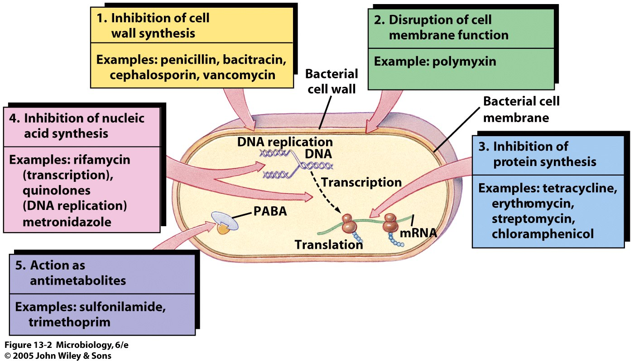
Antibiotic Mechanism of Action
Notes:
Selective toxicity - greater harm to microbes than host, done by interfering with essential biological processes common in bacteria but not human cells.
LD₅₀ vs. MIC - Therapeutic index (the lowest dose toxic to the patient divided by the dose typically used for therapy). High TI are less toxic to the patient.
Bactericidal vs. bacteriostatic
Static rely on normal host defenses to kill or eliminate the pathogen after its growth has been inhibited. (UTIs) CIDAL given when host defenses cannot be relied on to remove or destroy pathogen.
Favorable pharmacokinetics - drug interxns, how drug is distributed, metabolized and excreted in body (unstable in acid, can it cross the Blood-brain barrier, etc)
Spectrum of activity
broad spectrum - wide
Narrow spectrum - narrow range (pathogen must be ID’d)
Lack of “side effects” allergic, toxic side effects, suppress normal flora
Little resistance development

Slide 14
Antibiotic Mechanism of Action
ACTION AS ANTI-METABOLITES:
Sulfonamides are structural analogs and competitive antagonists of para-aminobenzoic acid (PABA). They inhibit normal bacterial utilization of PABA for the synthesis of folic acid, an important metabolite in DNA synthesis. The effects seen are usually bacteriostatic.
Folic acid is not synthesized in humans, but is instead a dietary requirement. This allows for the selective toxicity to bacterial cells (or any cell dependent on synthesizing folic acid) over human cells. Bacterial resistance to sulfonamides is caused by mutations in the enzymes involved in folic acid synthesis that prevent the drug from binding to it.
INHIBITION OF PROTEIN SYNTHESIS:
The inhibition of protein synthesis is mediated through binding to bacterial ribosome. Aminoglycoside presence in the cytosol generally perturbs peptide elongation at the 30S ribosomal subunit, giving rise to inaccurate mRNA translation and so biosynthesis of proteins that are truncated or that bear altered amino acid compositions at particular points. Specifically, binding impairs translational proofreading leading to misreading of the RNA message, premature termination, or both, and so to inaccuracy of the translated protein product.
Aminoglycosides: bactericidal activity against most gram-negative aerobic and facultative anaerobic bacilli and most gram-positive bacteria. They require only short contact time, and are most effective against susceptible bacterial populations that are rapidly multiplying
Notes:
Selective toxicity - greater harm to microbes than host, done by interfering with essential biological processes common in bacteria but not human cells.
LD₅₀ vs. MIC - Therapeutic index (the lowest dose toxic to the patient divided by the dose typically used for therapy). High TI are less toxic to the patient.
Bactericidal vs. bacteriostatic
Static rely on normal host defenses to kill or eliminate the pathogen after its growth has been inhibited. (UTIs) CIDAL given when host defenses cannot be relied on to remove or destroy pathogen.
Favorable pharmacokinetics - drug interxns, how drug is distributed, metabolized and excreted in body (unstable in acid, can it cross the Blood-brain barrier, etc)
Spectrum of activity
broad spectrum - wide
Narrow spectrum - narrow range (pathogen must be ID’d)
Lack of “side effects” allergic, toxic side effects, suppress normal flora
Little resistance development

Slide 15
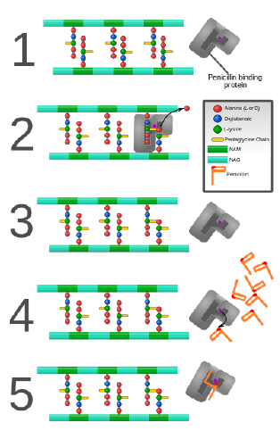
Antibiotic Mechanism of Action
INHIBITION OF DNA/RNA SYNTHESIS:
Quinolones exert their antibacterial effect by preventing bacterial DNA from unwinding and duplicating.
INHIBITION OF CELL WALL SYNTHESIS:
Bacteria constantly remodel their peptidoglycan* cell walls, simultaneously building and breaking down portions of the cell wall as they grow and divide.
β-Lactam antibiotics inhibit the formation of peptidoglycan cross-links in the bacterial cell wall; this is achieved through binding of the β-lactam ring of penicillin to the enzyme DD-transpeptidase. As a consequence, DD-transpeptidase cannot catalyse the formation of these cross-links, and an imbalance between cell wall production and degradation develops, causing the cell to rapidly die.
(β-lactam ring has structural similarity with normal substrate for the enzyme).
Some bacteria make beta lactamase, an enzyme that breaks down the ring structure and thus inactivates penicillins.
*polymer consisting of sugars and amino acids
Notes:
Selective toxicity - greater harm to microbes than host, done by interfering with essential biological processes common in bacteria but not human cells.
LD₅₀ vs. MIC - Therapeutic index (the lowest dose toxic to the patient divided by the dose typically used for therapy). High TI are less toxic to the patient.
Bactericidal vs. bacteriostatic
Static rely on normal host defenses to kill or eliminate the pathogen after its growth has been inhibited. (UTIs) CIDAL given when host defenses cannot be relied on to remove or destroy pathogen.
Favorable pharmacokinetics - drug interxns, how drug is distributed, metabolized and excreted in body (unstable in acid, can it cross the Blood-brain barrier, etc)
Spectrum of activity
broad spectrum - wide
Narrow spectrum - narrow range (pathogen must be ID’d)
Lack of “side effects” allergic, toxic side effects, suppress normal flora
Little resistance development

Slide 16
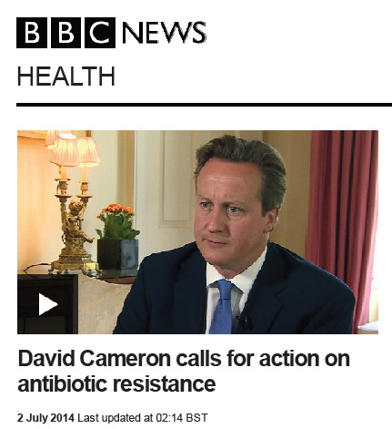
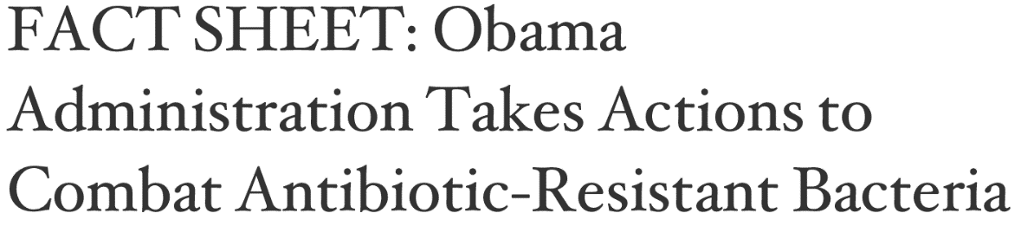
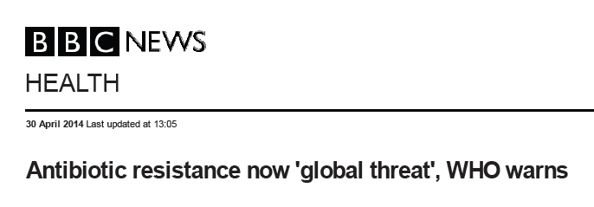
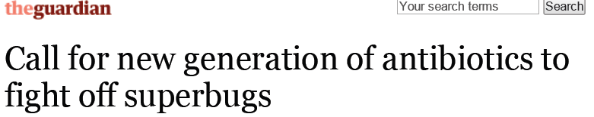
Antibiotic Resistance
Notes:
Selective toxicity - greater harm to microbes than host, done by interfering with essential biological processes common in bacteria but not human cells.
LD₅₀ vs. MIC - Therapeutic index (the lowest dose toxic to the patient divided by the dose typically used for therapy). High TI are less toxic to the patient.
Bactericidal vs. bacteriostatic
Static rely on normal host defenses to kill or eliminate the pathogen after its growth has been inhibited. (UTIs) CIDAL given when host defenses cannot be relied on to remove or destroy pathogen.
Favorable pharmacokinetics - drug interxns, how drug is distributed, metabolized and excreted in body (unstable in acid, can it cross the Blood-brain barrier, etc)
Spectrum of activity
broad spectrum - wide
Narrow spectrum - narrow range (pathogen must be ID’d)
Lack of “side effects” allergic, toxic side effects, suppress normal flora
Little resistance development

Slide 17
Antibiotic Resistance
Antimicrobial resistance (AMR) is when microbes are resistant to one or more antimicrobial agents, used to treat infection or as an antiseptic.
Resistance is either innate or acquired.
Most commonly antimicrobial resistance refers to acquired resistance – which may be a result of either novel mutation or transfer of genes causing resistance.
Microbes which are resistant to multiple antimicrobials are termed multidrug resistant (MDR) (or, sometimes in the lay press, superbugs).
Antimicrobial resistance is a growing problem in the world, and causes millions of deaths every year.
As resistance to antibiotics becomes more common, a greater need for alternative treatments arises. Despite a call for new antibiotic therapies, there has been a continued decline in the number of newly approved drugs.
http://antibiotic-action.com/

Slide 18
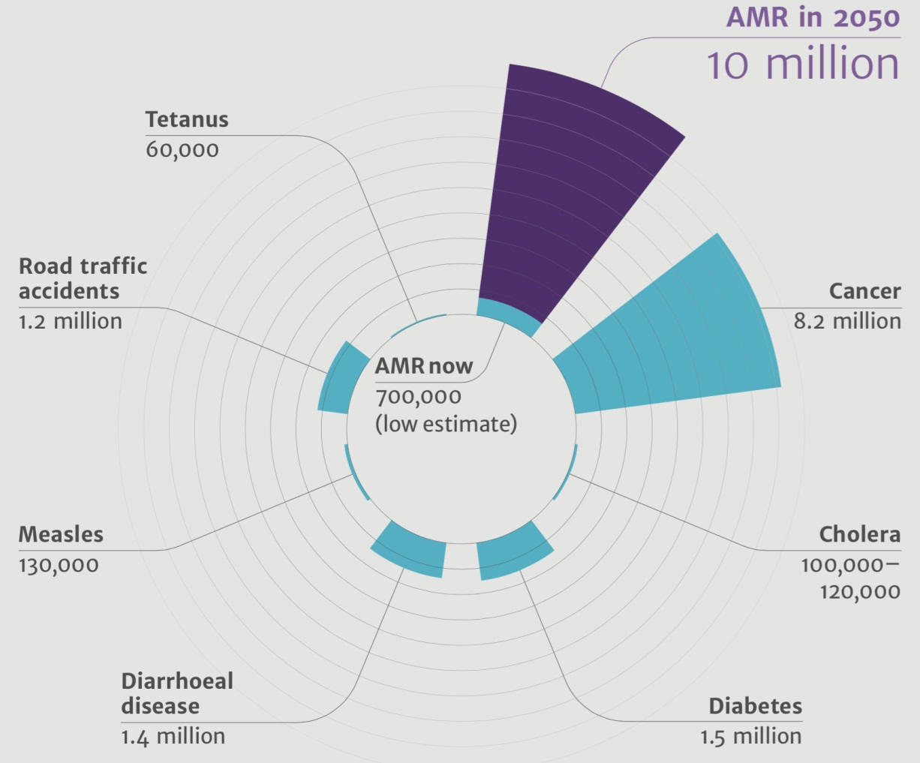
Antibiotic Resistance
Antibiotic resistance poses a grave and growing global problem: a World Health Organization report released April 2014 stated, "this serious threat is no longer a prediction for the future, it is happening right now in every region of the world and has the potential to affect anyone, of any age, in any country. Antibiotic resistance—when bacteria change so antibiotics no longer work in people who need them to treat infections—is now a major threat to public health."

Slide 19
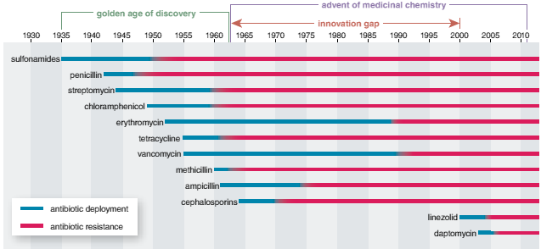
Antibiotic Resistance
Clinical deployment of new antibiotics (blue bars) has quickly been followed by the evolution of bacteria able to resist their effects (red). During the golden age of discovery, 150 types of antibiotics were developed. Since then, the spread of resistance has greatly outpaced the rate of drug development. The Infectious Disease Society of America estimates that 70% of hospital-acquired infections in the United States are now resistant to one or more antibiotics.

Slide 20
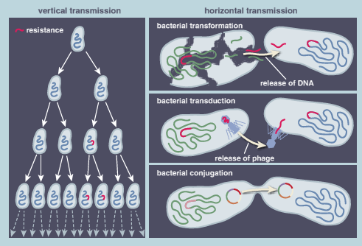
Antibiotic Resistance
Antibiotic resistance can be acquired in two basic ways. In vertical transmission, a bacterium accumulates errors or mutations in its genome during replication; some of those changes (red) give the ability to resist antibiotics and are passed on to subsequent generations. In horizontal transmission, resistant genes are swapped from one microbe to another.
This can occur via three mechanisms: transformation, when bacteria scavenge resistance genes from dead bacterial cells and integrate them into their own genomes; transduction, when resistance genes are transferred by bacteriophages (viruses that infect bacteria); or conjugation, when genes are transferred between bacterial cells through tubes called pilli.

Slide 21
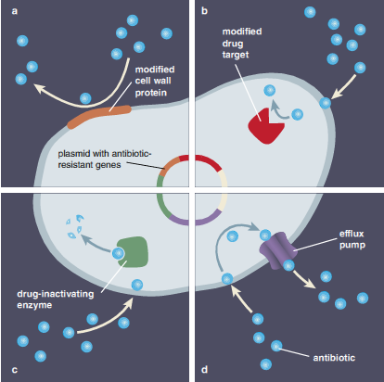
Antibiotic Resistance
Four mechanisms of resistance: impermeable barrier (a) blocks antibiotics (blue spheres) because the bacterial cell membrane is now impermeable to the drug.
Target modification (b) alters the proteins inhibited by the antibiotic, so the drug cannot bind properly. Antibiotic modification (c) produces an enzyme that inactivates the antibiotic.
Efflux (d) employs genes coding for enzymes that actively pump the antibiotic out of the cell.
Understanding factors that influence resistome evolution and dissemination may both extend the life of current drugs and point toward new diseasefighting strategies.

Slide 22
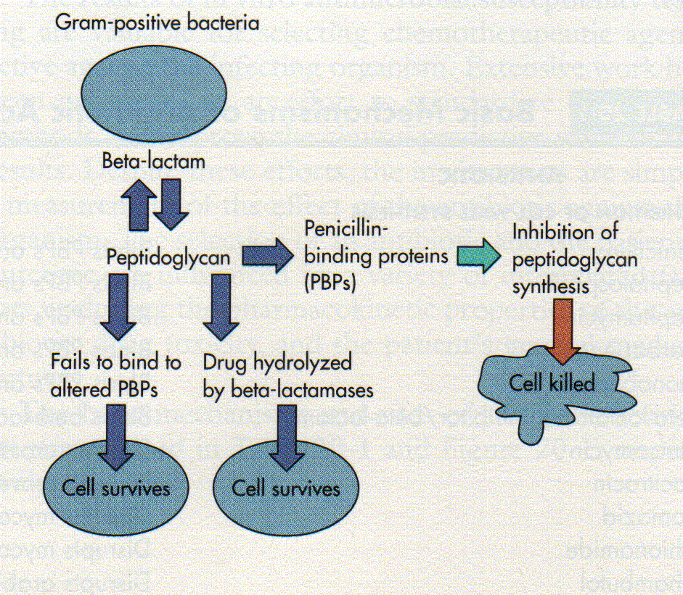
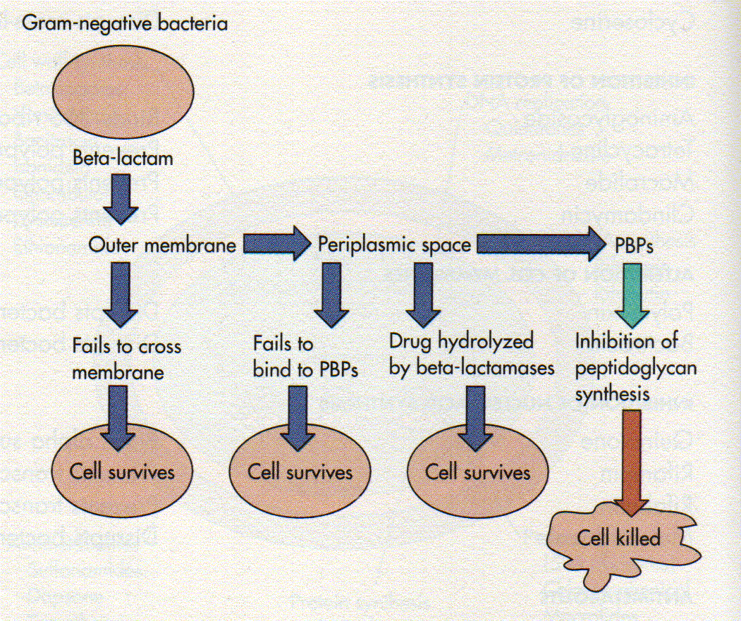
Antibiotic Resistance
The four main mechanisms by which microorganisms exhibit resistance to antimicrobials are:
Drug inactivation or modification: enzymatic deactivation of penicillin G in some penicillin-resistant bacteria through the production of β-lactamases, enzymes that breaks down the ring structure and thus inactivates penicillins.

Slide 23
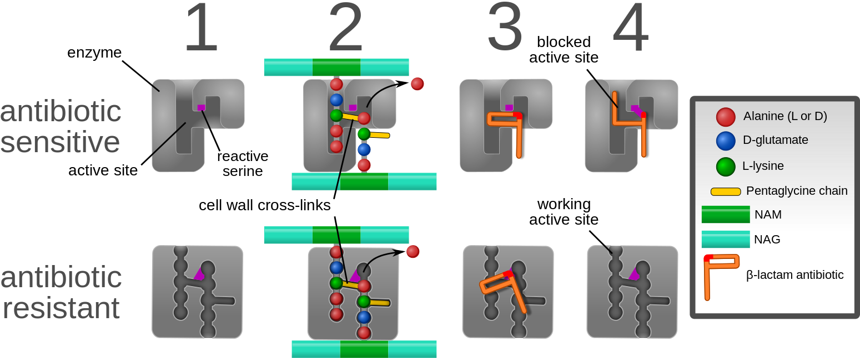
Antibiotic Resistance
Alteration of target site: for example, alteration of PBP (Penicillins Binding Proteins) in penicillin-resistant bacteria.
Beta-lactam antibiotics permanently inactivate PBP enzymes, which are essential for bacterial life, by permanently binding to their active sites. MRSA (Methicillin resistant Staphylococcus aureus), however, expresses a PBP that does not allow the antibiotic into its active site.
Alteration of metabolic pathway: for example, some sulfonamide-resistant bacteria do not require para-aminobenzoic acid (PABA), an important precursor for the synthesis of folic acid and nucleic acids in bacteria inhibited by sulfonamides, instead, like mammalian cells, they turn to using preformed folic acid.
Reduced drug accumulation: by decreasing drug permeability or increasing active efflux (pumping out) of the drugs across the cell surface.. These efflux pumps are often activated by a specific substrate associated with an antibiotic. Some types of efflux pumps can act to decrease intracellular fluoroquinolone concentration.

Slide 24
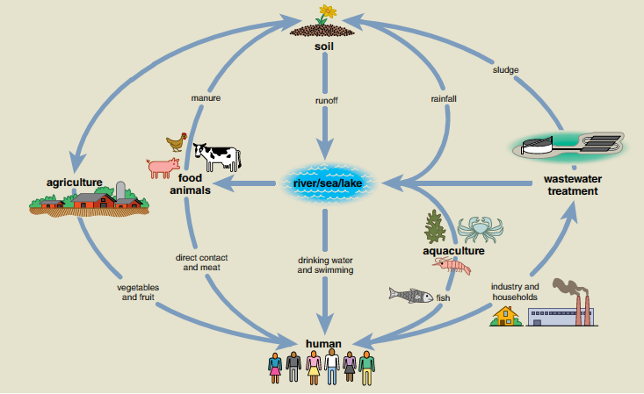
Antibiotic Resistance
Interconnections between people, animals, and the environment make it easy for antibiotic resistant bacteria to jump from one species to another.
For instance, a resistant strain living in soil could travel through runoff and get passed on to humans via drinking water or recreational swimming.
Multiple routes of exchange propel the evolution and spread of resistance.

Slide 25
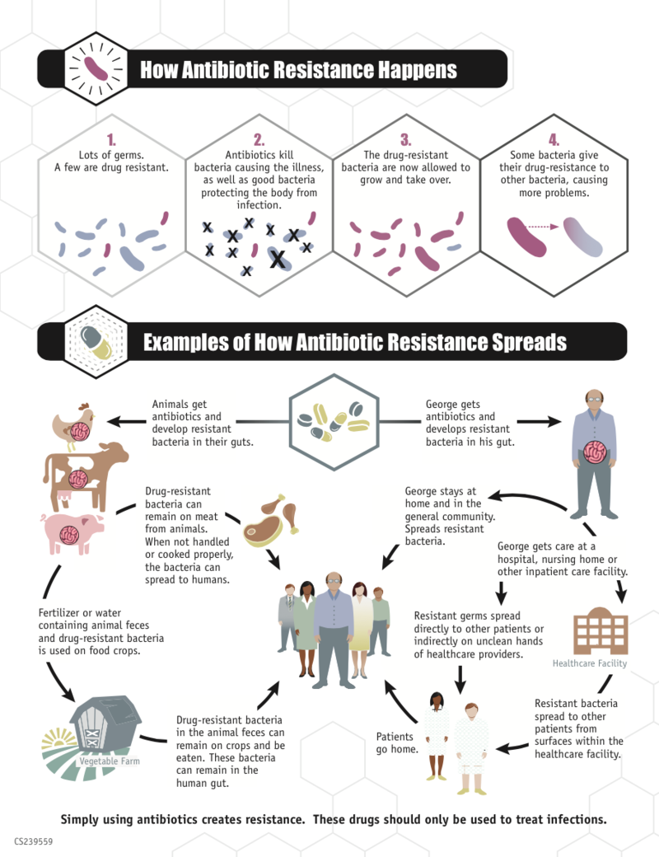
Antibiotic Resistance
Some bacteria with resistance to antibiotics predate the medical use of antibiotics by humans; however, widespread antibiotic use has caused more bacteria to become resistant, a process called evolutionary pressure.
Antibiotic increasing global availability over time since the 1950s
Their uncontrolled sale resulting in antibiotics being used when not indicated.
Prescribing or obtaining broad-spectrum antibiotics when not indicated: these are more likely to induce resistance than narrow-spectrum antibiotics.
Antibiotic use in livestock feed at low doses for growth promotion is an accepted practice in industrialized countries which leads to resistance.
Releasing large quantities of antibiotics into the environment during pharmaceutical manufacturing.

Slide 26
Antibiotic Resistance
World Health Organization recommendations
An April 30, 2014, report by the WHO addressed this issue, and a summary was described in a WHO press release as follows:
People can help tackle resistance by:
using antibiotics only when prescribed by a doctor;
completing the full prescription, even if they feel better;
never sharing antibiotics with others or using leftover prescriptions.
Health workers and pharmacists can help tackle resistance by:
enhancing infection prevention and control;
only prescribing and dispensing antibiotics when they are truly needed;
prescribing and dispensing the right antibiotic(s) to treat the illness.
Policymakers can help tackle resistance by:
strengthening resistance tracking and laboratory capacity;
regulating and promoting appropriate use of medicines.
Policymakers and industry can help tackle resistance by:
fostering innovation and research and development of new tools;
promoting cooperation and information sharing among all stakeholders.

Slide 27
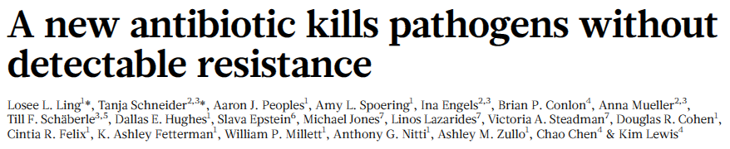
Antibiotic Resistance
Discovery of teixobactin = a new class of antibiotics, the first to be described in many years.
The authors showed that teixobactin was able to kill bacteria that cause wound infections from cuts and scratches such as Staphylococcus aureus including MRSA, those that cause pneumonia (Streptococcus pneumoniae) and Mycobacterium tuberculosis (TB).
Teixobactin was also effective in curing experimental infections of MRSA in mice.
However, for teixobactin to become a drug to treat infections in people, clinical trials will need to be carried out to make sure that the drug is safe and works in patients. To do this, first it will need to be formulated so that the antibiotic remains active when inside the human body.
Even if teixobactin itself cannot be turned into a new drug, it could well be the first of a series of new drugs in its class.

Slide 28
Antibiotic Resistance
Teixobactin works differently to other antibiotics currently used to treat bacterial infections in people (and animals).
No teixobactin-resistant Staphylococcus aureus were found under a variety of conditions, leading the authors to suggest that it will be difficult for bacteria that cause infections in people to become resistant to teixobactin.
Teixobactin comes from a microbe that lives in the soil.
Often the microbe that produces the antibiotic, and sometimes its close microbe neighbours, are resistant to the antibiotic.
Occasionally, these natural antibiotic resistance genes have found their way into bacteria that cause infections in people. This is the most likely route of any resistance to teixobactin. However, this could be a very rare occurrence because the bacterial strains that cause infection in people would need to have mixed with the teixobactin-resistant soil bacteria.
It is likely that any new drugs would be used much more carefully so that the emergence of resistance is minimised.

Slide 29
Antibiotic Resistance
According to the World Health Organization’s report in April 2014, one of the major concerns of doctors around the world is antibiotic resistance in bacteria that microbiologists call Gram-negative bacteria such as E. coli and Klebsiella.
These bacteria are different to MRSA and have a very different cell structure which makes it very hard to get antibiotics into Gram negative bacteria and once inside many antibiotics are pumped out.
Teixobactin is either unable to get into E. coli or it is pumped out or both.
Although teixobactin has no activity for E. coli, this work ‘opens the door’ on a new era of natural product antimicrobial discovery. The new tool, the iChip, allowed isolation of teixobactin from a soil microorganism that microbiologists had been unable to grow under normal laboratory conditions.
iChip can now be applied to find natural antibiotics produced by microorganisms from other environmental sources – and maybe one of these will be active against bacteria such as E. Coli and can be made into a drug for patients.

Slide 30
Gram-positive bacteria are bacteria that give a positive result in the Gram stain test. Gram-positive bacteria take up the crystal violet stain used in the test, and then appear to be purple-coloured when seen through a microscope. This is because the thick peptidoglycan layer in the bacterial cell wall retains the stain after it is washed away from the rest of the sample, in the decolorization stage of the test.
Gram-negative bacteria cannot retain the violet stain after the decolorization step; alcohol used in this stage degrades the outer membrane of gram-negative cells making the cell wall more porous and incapable of retaining the crystal violet stain. Their peptidoglycan layer is much thinner and sandwiched between an inner cell membrane and a bacterial outer membrane, causing them to take up the counterstain (safranin orfuchsine) and appear red or pink.
Despite their thicker peptidoglycan layer, gram-positive bacteria are more receptive to antibiotics than gram-negative, due to the absence of the outer membrane.

