Slide 1

CONNECT, COLLABORATE & CREATE: Get involved with the Institute for Advanced Teaching and Learning (IATL)
Welcome Week 2023

Slide 2

Connect, Collaborate & Create: What is IATL?
Interdisciplinary teaching and learning
Student research
Co-Creation
Project Funding

Slide 3
Take an IATL Module

Slide 4

What is Interdisciplinarity? How do we achieve it in IATL modules?
Objective: To facilitate the integration of disciplinary perspectives
Collaborative teaching and learning
Different voices / disciplinary perspectives
Challenging academic conventions that have traditionally kept us siloed in disciplines
Innovation in Assessment
Support access to a wide range of learning materials, methods and theories beyond disciplinary boundaries
Take risks, get creative and shape your own learning experience

Slide 5
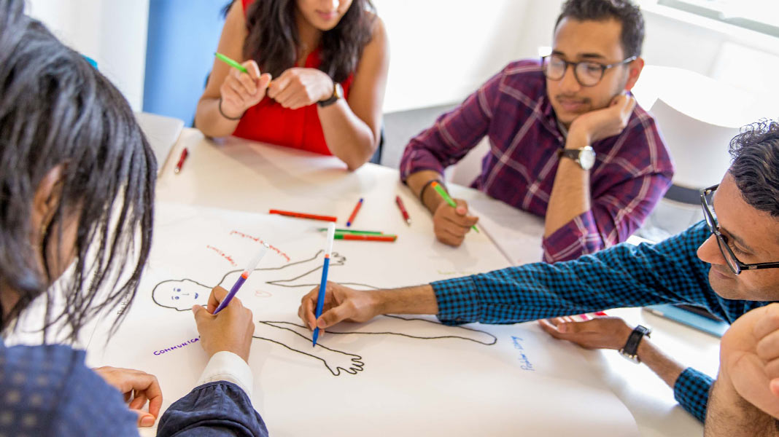
Our Modules
Work with students from across the university
Interdisciplinary – collaborative, problem-based, student-focused and student-led
Available to all undergraduates in years 2, 3 or 4 & PGT (with home department approval)
(PGR – Contribute on an IATL Module; Postgraduate Award in Interdisciplinary Pedagogy)
Typically 2 hours / week (usually involve weekly contributors from different disciplines)
Assessments vary, though tend to be student-led, and encourage creativity , innovation and alternative research formats
To find out more about our Assessments, please do visit our website!

Slide 6
IATL Modules 2023/24
(SAMPLES)

Slide 7

Understanding Wellbeing IL028/IL128
This module analyses the concept of wellbeing from the perspective of several disciplines.
It explores the benefits of taking an interdisciplinary and holistic approach to this topic and includes contributions from:
Guest lecturers
Counselling Team
Warwick Sports
Arts Centre
Convenor | Dr Lorenzo Serini and Dr Amanda Edwards (IATL)
Term | Autumn 2023
Assessment | Student Devised Assessment & Writing Piece OR Video (plus commentary)

Slide 8

Forms of Identity: An Interdisciplinary Approach IL001/IL101
This module offers a look at the topic of Identity through a number of different perspectives.
Each week, a new disciplinary specialist will introduce you to a new approach to Identity.
You will be encouraged to synthesize this learning to understanding the topic in an interdisciplinary way.
Convenor | Dr Heather Meyer (IATL)
Term | Spring 2024
Assessment | Interdisciplinary Critical Response & Student Devised Assessment

Slide 9

Reinventing Education IL008/IL108
On this module you will reflect on your own educational experiences and be asked to design and justify new educational modules that provide a better fit with our contemporary ways of living.
You will challenge existing theories on education, and have the opportunity to create your own educational utopia (or dystopia).
Convenor | Naomi de la Tour (IATL)
Term | Spring 2024
Assessment | Discussion & Educational Utopia/Dystopia

Slide 10

The Science of Music IL016/IL116
Convenor | Dr Oksana Trushkevych (Physics)
Term | Spring 2024
Assessment | Group Project (with individual component) & Continuous Assessment
This module introduces students to the relationships between Science, Music and Mathematics.
It offers:
A collaboration with the Royal Birmingham Conservatoire (including a tour of the building with contrasting acoustic properties)
An exploration of multiple facets of music, by integrating tools from a variety of disciplines.

Slide 11

Genetics: Science & Society IL023/IL123
This module explores genetics in its complexity, using an interdisciplinary approach.
It will prompt you to consider the pros and cons of genetic discoveries – particularly in terms of the societal and ethical questions.
Convenor | Dr Amanda Edwards (IATL)
Term | Spring 2024
Assessment | Essay & Student Devised Assessment

Slide 12


Global Connections: A Transdisciplinary Approach IL014 / IL114
This module explores globally-oriented problems in a transdisciplinary way – drawing on the expertise of academics working on wide ranging themes including:
- Globalization
- Migration
- Peace and Violence
- Global Governance
- Cultural Flows
This module provides HEAR accreditation & EUTOPIA certificate for participating in an online international project involving EUTOPIA partner universities.
Convenor | Dr Heather Meyer (IATL)
Term | Autumn 2023
Assessment | ePortfolio & Student Devised Assessment

Slide 13

Serious Tabletop Game Design and Development IL031/IL131
This module is your chance to learn about the mechanics, messages and motivations of serious games.
You will build your own educational tabletop game influenced by the degree you are studying at Warwick
Last year, students were offered to present the games they designed at the UK Games Expo in Birmingham.
Convenor | Chris Evans (WMG) & Dr Devon Allcoat
Term | Spring 2024
Assessment | Game Review & Serious Tabletop Game

Slide 14
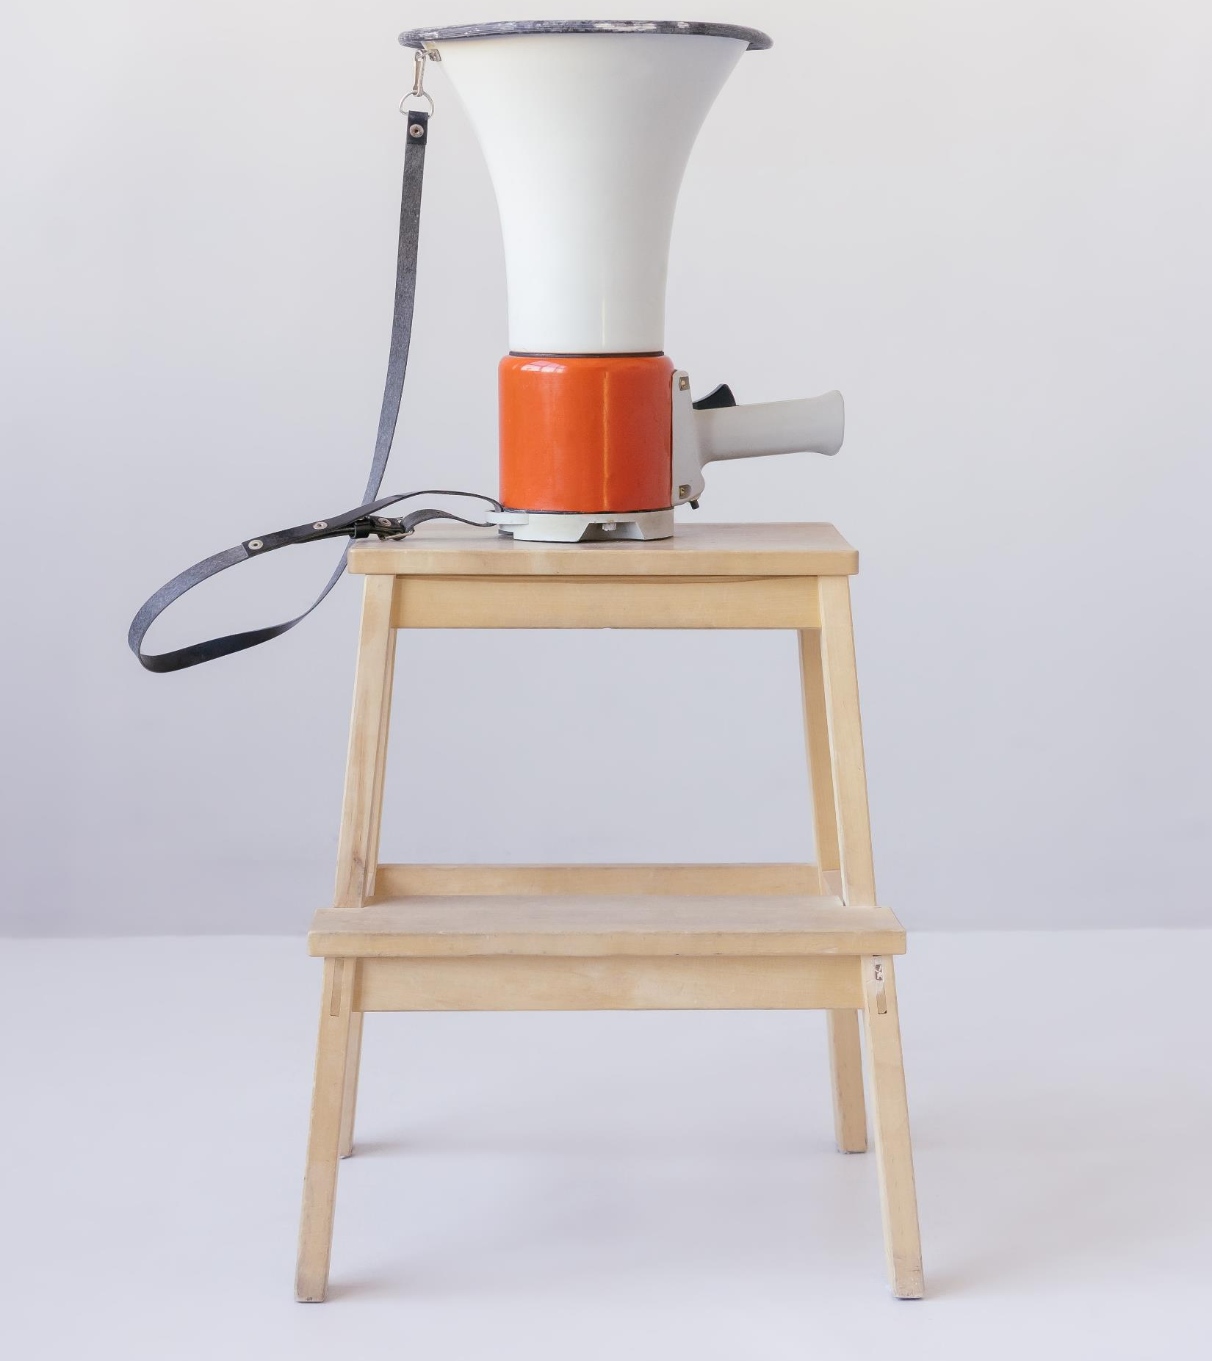
Student Research

Slide 15




Slide 16
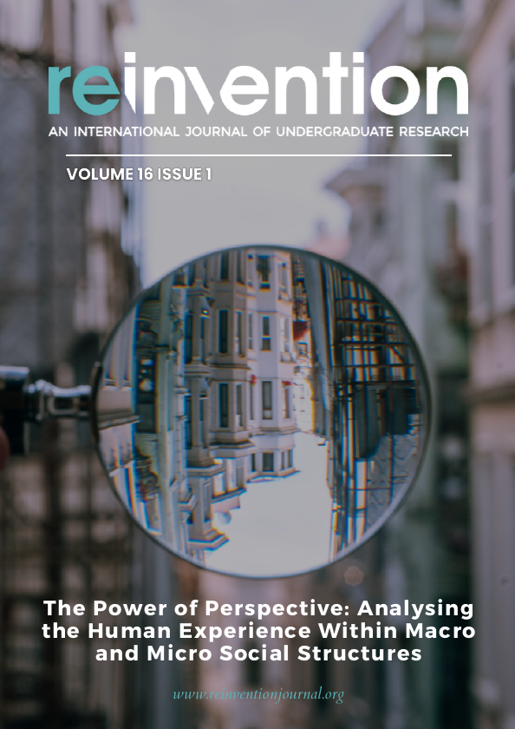

Bringing UG research to global readership since 2007
Published April & October

Slide 17


Slide 18





Slide 19


London School of Economics & Political Science
April 2024

Slide 20

2026

Slide 21


Slide 22
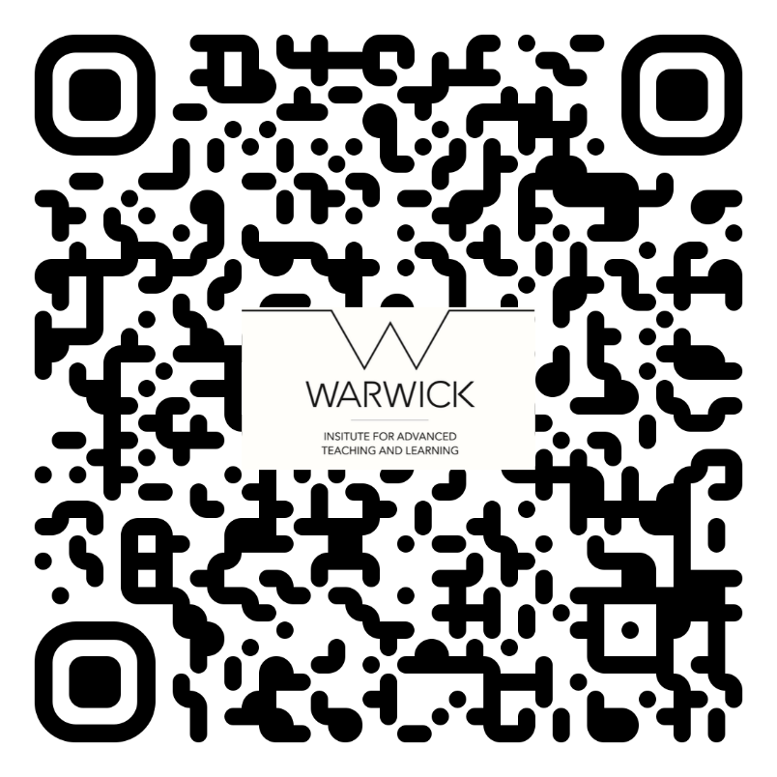


Slide 23
Co-Creation and Project Support

Slide 24
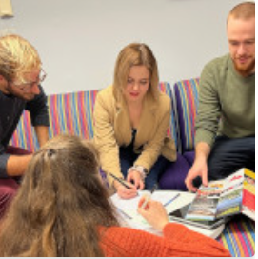
Co-Creation at IATL
Students and staff collaborating as equal partners:
Student Research
Co-Creation Officers
Project Support

Slide 25

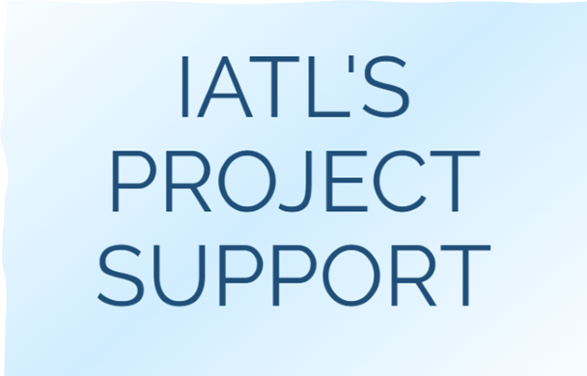
Project Support
Funding and guidance
Emphasis on co-creation and sharing learning
Students can apply for up to £1,500
Staff and co-led projects

Slide 26

Student Research - Daniel
Recent shifts in political decision-making process, in Europe and US
Aims to share learning through Reinvention, ICUR, social media

Slide 27
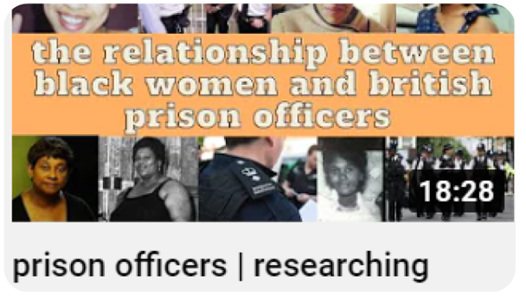
Student Research - Rachel
Black women’s experience with policing
Created a video series, available on her YouTube channel (byrachelaa)

Slide 28
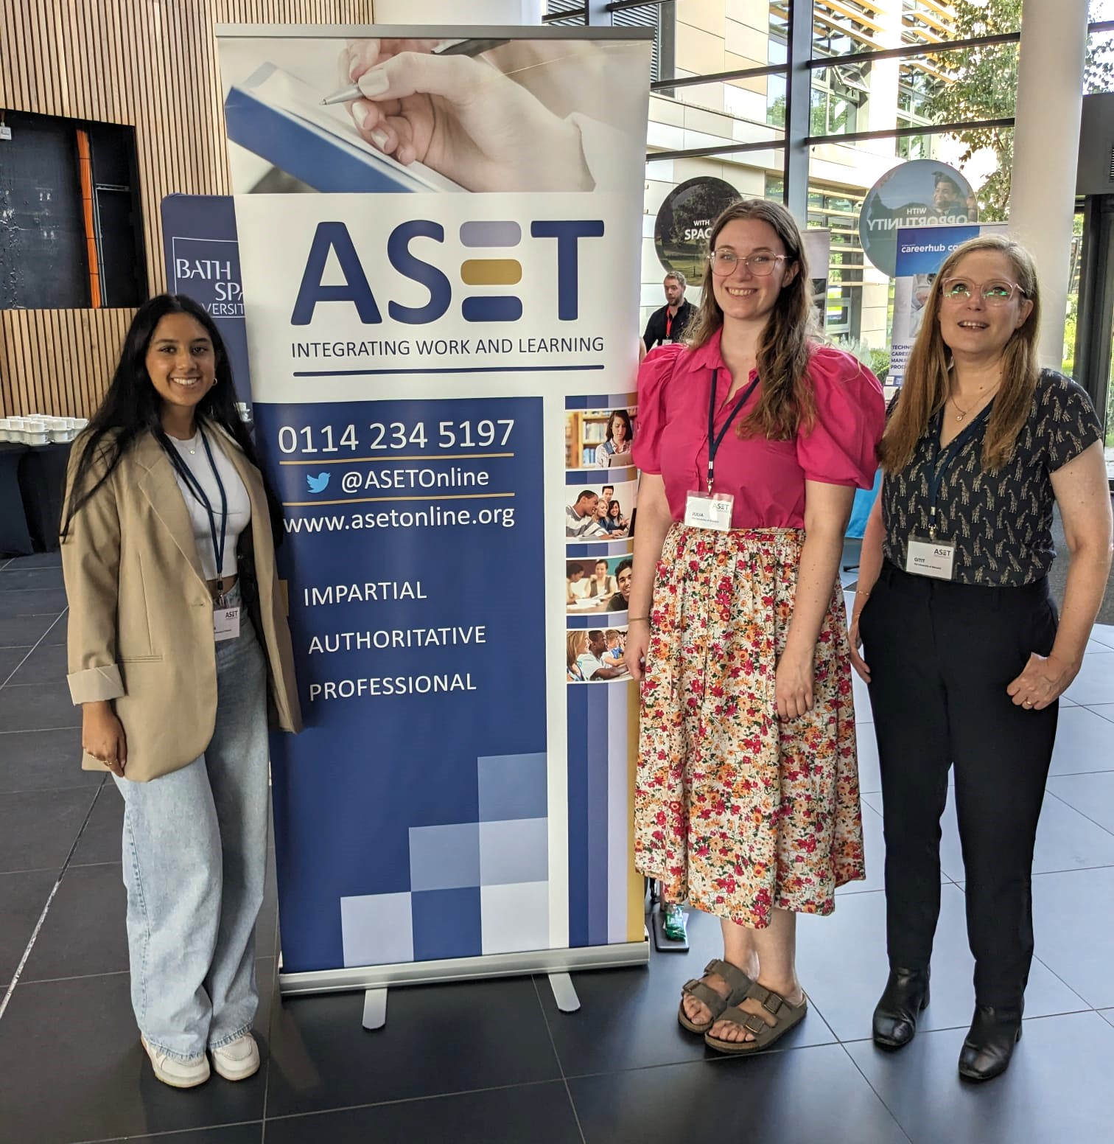
Student & Staff Co-Created Project
Employability resources for Psychology students
Developed website
Joint conference presentation

Slide 29
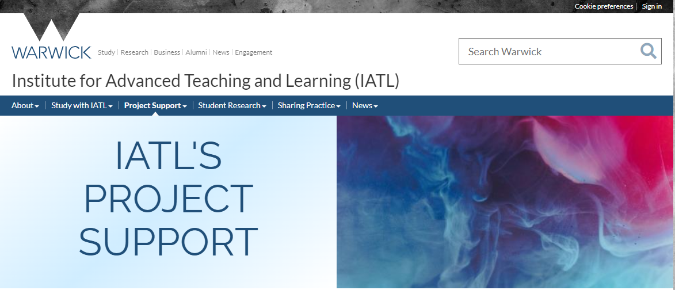

Slide 30


Slide 31
Want to Find out More?
Visit IATL's website to find more information.
Get in touch! IATL@warwick.ac.uk

