Slide 1

Your Idea, Your Investigation
How to pursue your passion project at Warwick
Dr Fiona Farnsworth| Institute for Advanced Teaching and Learning

Slide 2
Session Outline
Introduction to undergraduate research at Warwick:
  What is research?
  Is research for me?
  How do I get involved?
  Where could my research go?
Experiences of undergraduate research:
  Gentle Lung
  Daniel Knoth
  Georgios Pataikis
  Charlie Atkins
Q&A

Slide 3
Introductions
Who am I? I’m Dr Fiona Farnsworth. I’m the Journal and Conferences Coordinator in the University of Warwick’s Institute for Advanced Teaching and Learning.
My research interests have previously covered world-literature, food studies, and the environmental humanities – and now I’m interested in interdisciplinary, international, and sustainable research cultures (and especially undergraduate research within those!)

Slide 4
Introductions
Who are you?
What were you interested in before you came to university?
What are you interested in now?

Slide 5
Introductions
  Gentle Lung
  Daniel Knoth
  Georgios Pataikis
  Charlie Atkins

Slide 6

What is research?
Research comprises ‘creative and systematic work undertaken to increase the stock of knowledge – including knowledge of humankind, culture and society – and to devise new applications of available knowledge.’
(OECD. 2015. Frascati Manual)

Slide 7
What is research?
But does it always have to look like this?
←

Slide 8


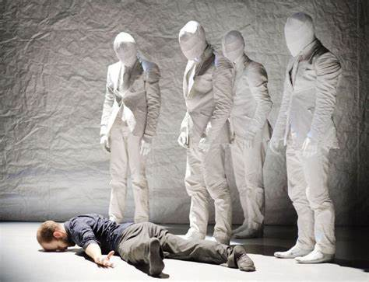
What is research?
No, research is endlessly diverse.
Science
Social Sciences
Arts and Humanities

Slide 9
How do undergraduates do research at Warwick?
If you have an idea – something you want to know more about, or that you think everyone should know more about – there are plenty of opportunities to get involved.

Slide 10
How do undergraduates do research at Warwick?
If you have an idea – something you want to know more about, or that you think everyone should know more about – there are plenty of opportunities to get involved.
Many undergraduate students will complete an undergraduate dissertation or project…

Slide 11
How do undergraduates do research at Warwick?
If you have an idea – something you want to know more about, or that you think everyone should know more about – there are plenty of opportunities to get involved.
Many undergraduate students will complete an undergraduate dissertation or project later on in their academic career…
… but there are so many ways to get involved earlier!

Slide 12
How can I get involved?

Slide 13
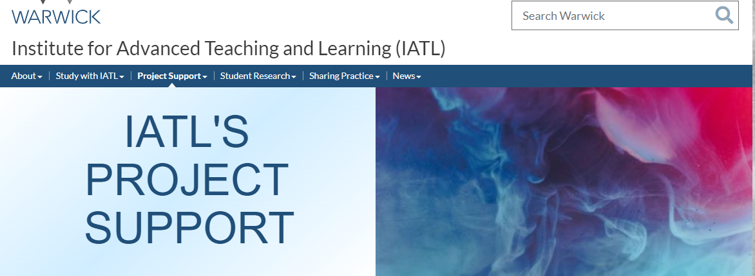
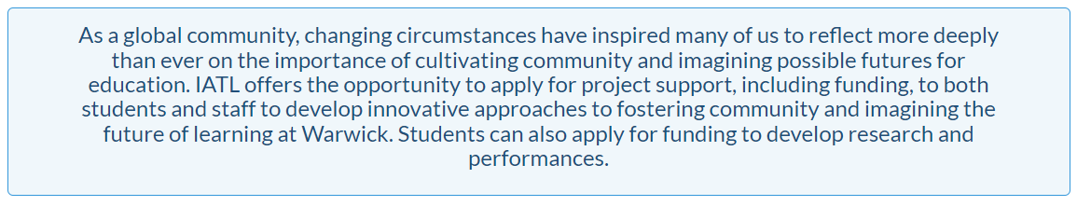
How can I get involved?
IATL’s Project Support has up to £1500 funding available for student-only projects, and up to £10,000 for co-created projects (projects created and collaborated upon by staff and students in partnership).
This doesn’t have to look like a “traditional” research project! Funding has previously been given to the development of performances and exhibitions, documentaries and podcasts - IATL is interested in supporting innovation and development, and giving you freedom to be critically and creatively expansive.

Slide 14
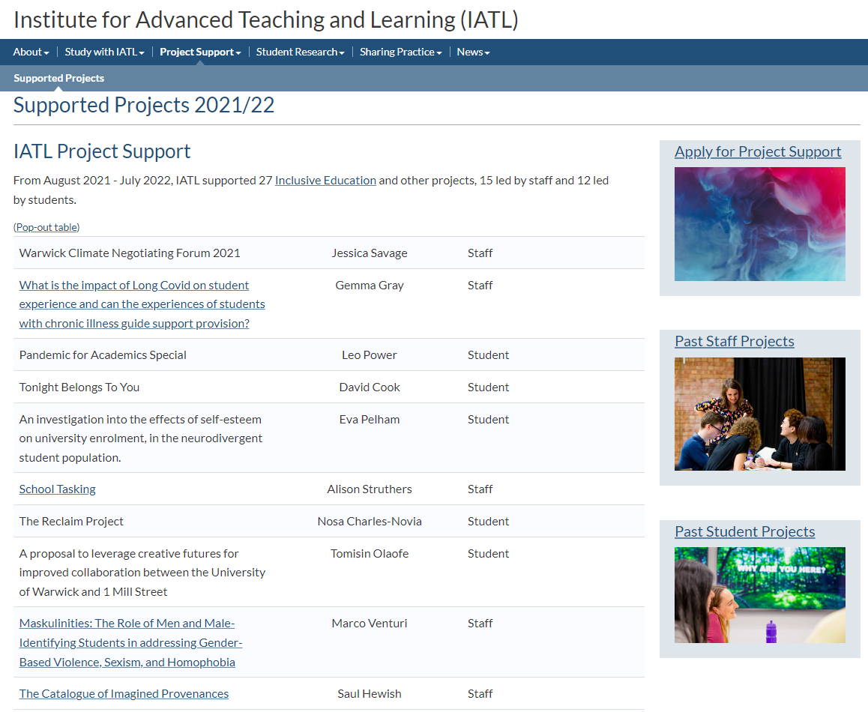

Slide 15
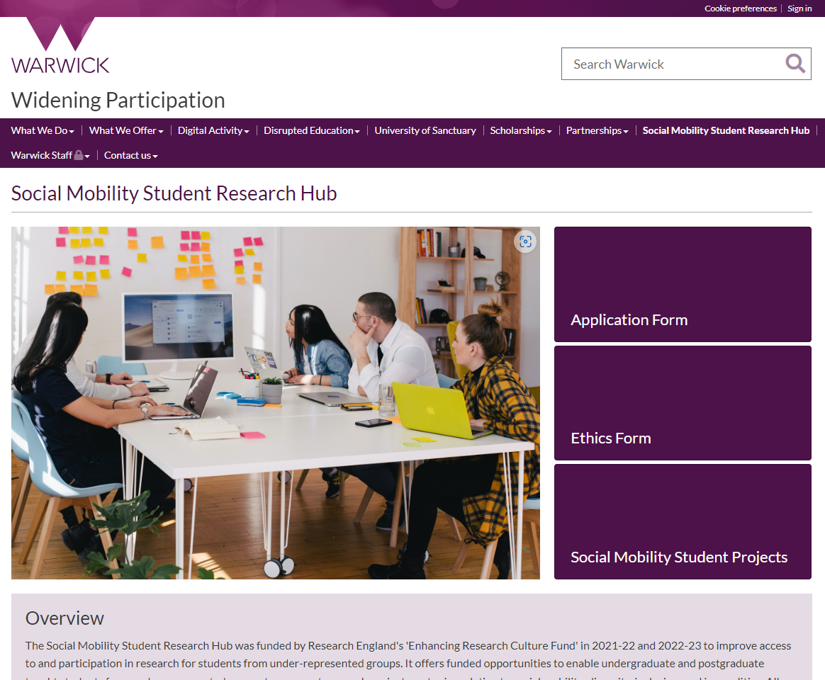
The Social Mobility Student Research Hub has funding available to support students from Widening Participation backgrounds to undertake research into issues of access, inclusion, and participation.
The Hub provides its students with funding and mentorship, as well as training throughout the programme.
Recent projects have included “An Exploration of the Relationship between Physical Spaces and Accommodation on Campus and Student Experience” and “The effectives of games on language teaching in socioeconomically deprived areas”

Slide 16
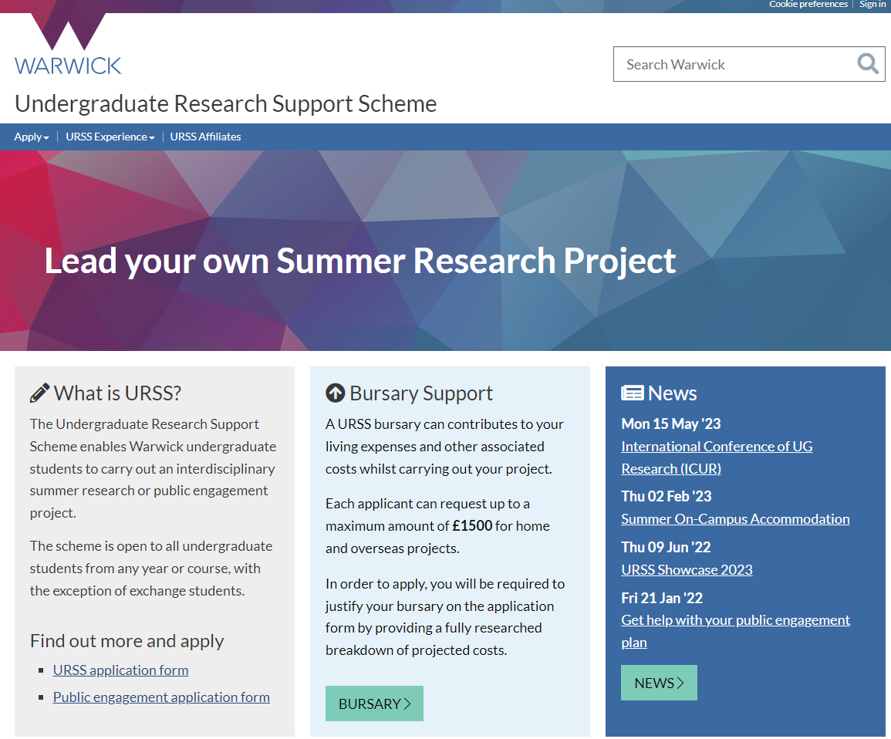
URSS (Undergraduate Research Support Scheme) offers up to £1500 funding for students interested in leading their own independent research project
The scheme is available for any student from any department, with any idea! You can join an existing project, come up with your own idea, or even do something totally unrelated to your degree study.

Slide 17
Check in with your department!
Every department has its own unique opportunities to get involved with research. Your department might have existing projects you can get involved in, or staff who might be interested in the same things as you.
Be curious – read your department newsletter and talk to your tutors!
IATL’s focus on co-creation means that there are often opportunities available for student involvement and ideas in research!

Slide 18
Where could my research go?
For research to contribute meaningfully to the stock of knowledge, it must be shared. This might take the form of:

Slide 19
Where could my research go?
For research to contribute meaningfully to the stock of knowledge, it must be shared. This might take the form of:
A published work (journal article, chapter, book, report)

Slide 20
Where could my abstract go?
For research to contribute meaningfully to the stock of knowledge, it must be shared. This might take the form of:
A published work (journal article, chapter, book, report)
An outreach activity (talk, blog, media appearance)

Slide 21
Where could my abstract go?
For research to contribute meaningfully to the stock of knowledge, it must be shared. This might take the form of:
A published work (journal article, chapter, book, report)
An outreach activity (talk, blog, media appearance)
A conference presentation (paper, poster, performance)

Slide 22
Where could my abstract go?
For research to contribute meaningfully to the stock of knowledge, it must be shared. This might take the form of:
A published work (journal article, chapter, book, report)
An outreach activity (talk, blog, media appearance)
A conference presentation (paper, poster, performance)

Slide 23

Keep in Touch!
The ICUR Portal and our ICUR 2022 Student Teams space are the best sources of conference information. You will also be able to attend our Student Director Drop-In Sessions and Abstract Writing Bootcamps via Teams.
or email our Student Directors at icurstudents@warwick.ac.uk.

Slide 24
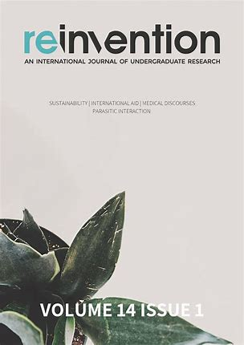
Reinvention
Reinvention is the International Journal of Undergraduate Research. It is managed by student editors from the University of Warwick, and open to submissions from undergraduates anywhere in the world.
Articles are between 2000 and 5000 words in length. Proposed articles are subject to peer review from world-leading academics. Find out more here, or email reinventionjournal@warwick.ac.uk!

Slide 25
Experiences of Undergraduate Research: RECAP

Slide 26
Gentle Lung
Presented “Read This Like a Performance” at the World Congress on Undergraduate Research (WorldCUR) 2023.
Currently undertaking a URSS project, previous research has been undertaken without funding – depending on the type of research, it’s possible to seek advice and support alongside (or without) funding from the same place.
Be guided by your interest – Gentle’s projects originated in (and followed) her interests first in ideas of “performance” and “audience”, and then in how those are thought about across sectors (theatre, medicine, the classroom…) If you’re interested in it, others will be too!
Projects change over time – the end result of your work may look very different to the idea you conceived originally, but that’s just the evolution of a research project. When approaching people for support, all you need is an initial idea.
Notes:
Time for questions.

Slide 27
Daniel Knoth
Applied for IATL Project Funding for a project looking at changes in the basis of political decision-making from reason to emotion and intuition.
Daniel’s project emerged out of his own reading and interest – he developed his idea out of the “Comments” sections on news websites!
To find his supervisor, Daniel approached academics via email.
Daniel recommended applying to the IATL Project fund because he found the application intuitive – the objectives and requirements are clearly set out, and lots of support is available if you’d like advice on completing the form.
IATL Project Support can also support you holistically, including with building your research network!

Slide 28
Georgios Pazaitis
Applied for IATL Project Funding for a project based on
Sometimes, doing research as an undergraduate allows you to see a more concrete path for and impact from the work you’re doing, rather than an assignment (which is often read by only a few people).
Georgios also suggested speaking to your tutors about your assignments – many will be open to you putting your own spin on these, whether by writing your own question or by developing research components.
Georgios spoke about working out your academic identity – what your interests are, what you’re hoping to get out of your time at university – rather than trying to pursue everything (or trying to pursue something you’re not passionate about because it feels “sensible” or as though you’re “maximising” your time at university.

Slide 29
Charlie Atkins
Applied for URSS for a project based around factors affecting the social capital of young people in the UK – particularly the importance of networks and network-building to social mobility
Presented at the International Conference of Undergraduate Research (ICUR) 2022
Charlie’s project fell outside of his degree discipline – showing that your academic identity doesn’t have to be confined to your department!
Charlie spoke about the importance of building your research network by approaching academics and researchers both within and outside your discipline. This is not just because they might be able to help you – but because they might know other people who can, too!
Academics are often interested in how your work might overlap with their own – it’s always better to ask.

Slide 30
Q&A – Key Advice From Our Panel
Research as an undergraduate gives you the opportunity to pursue your interests outside your degree – and to get other people interested in them, too.
You don’t need to have everything about your project figured out from the start – ideas change and so do research pathways!
Seek support – it’s out there!
Build your research network by talking about your research to friends, colleagues, tutors, staff…
If you are working on an original contribution to knowledge, then you are a researcher, no matter the stage of your career!

