Slide 1
In the name of identity
Cathia Jenainati
2 May 2014

Slide 2
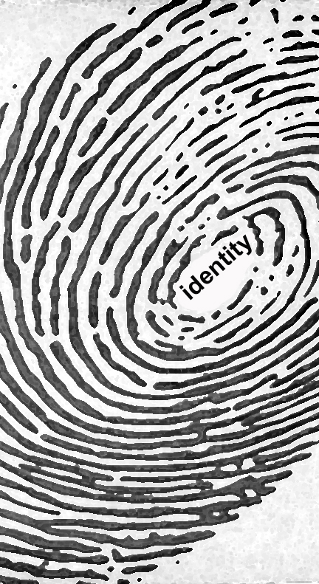
Decoding Amin Maalouf’s text
Critique and practical implications

Slide 3
1. Self and Allegiances
Consider the notion that our sense of self is tied to a sense of belonging and to a set of allegiances (11).
Maalouf argues: “every one of my allegiances links me to a large number of people. But the more ties I have the rarer and more particular my own identity becomes” (18).

Slide 4
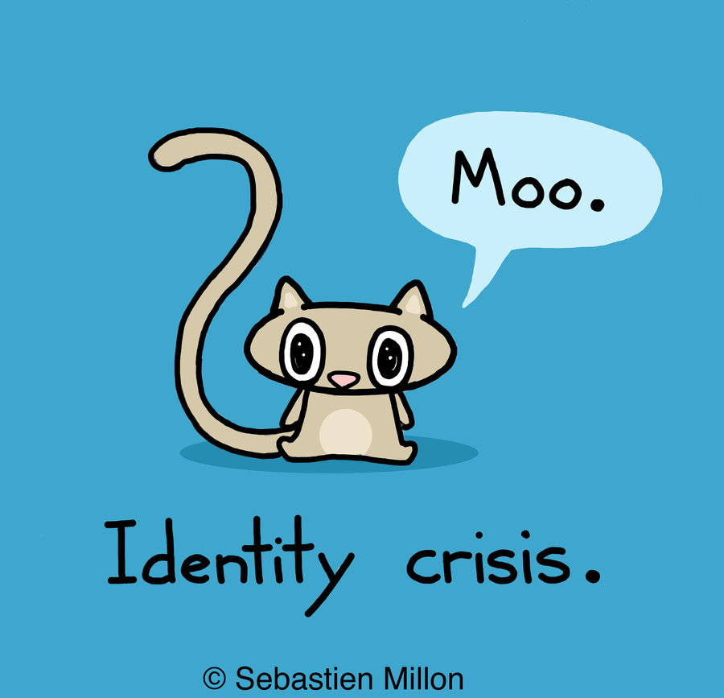
1. Self and Allegiances
Amin Maalouf advises that “it is often the way we look at other people that imprisons them within their own narrowest allegiances. And it is also the way we look at them that may set them free” (22).

Slide 5
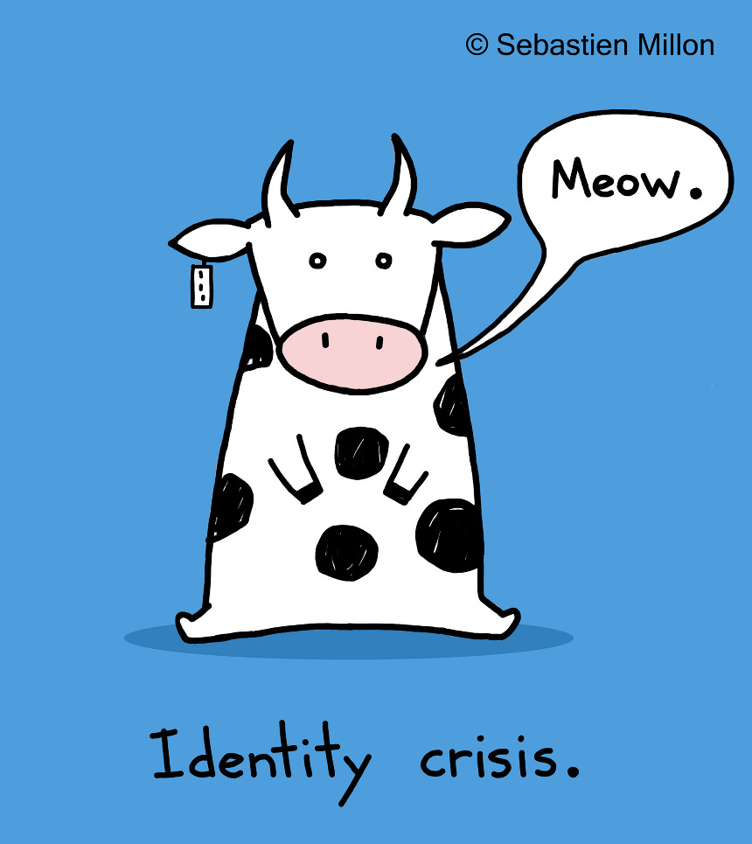
1. Self and Allegiances
“what determines a person’s affiliation to a given group is essentially the influence of others … who try to make him one of them; together with the influence of those on the other side, who do their best to exclude him” (25).
Let us consider the consequences of this statement.

Slide 6

1. Self and Allegiances
Leading up to his argument on the “tribal concept of identity” Maalouf proposes that “there is a Mr Hyde inside each one of us. What we have to do is prevent the conditions occurring that will bring forth the monster” (28).
Does this proposition make sense to you?

Slide 7
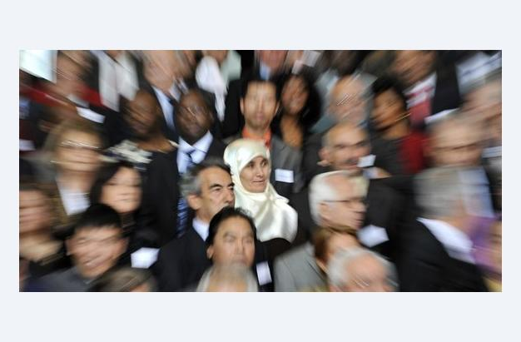
1. Self and Allegiances
“Before becoming an immigrant one is a migrant, an émigré” (38). How does Maalouf explain this process?

Slide 8

2. Modernity and the Other
According to Maalouf, what challenges does Modernity pose to our sense of identity? [62, 93]

Slide 9
2. Modernity and the Other
GROUP DISCUSSION: Let us examine Maalouf’s approach to doctrine. Especially his interpretation of the ways in which religion and society have influenced each other.
On page 67 he writes: “too much emphasis is often laid on the influence of religions on people, and not enough on the influence of peoples and their history of religions. The influence is reciprocal, I know. Society shapes religion, and religion in its turn shapes society”.
To what extent does this statement apply to your own experience of religion in your social setting?

Slide 10
2. Modernity and the Other
Maalouf argues that “everything in history is expressed in symbols … and above all identity” (73) how helpful is this statement in understanding the public manifestations of identity? (p120 and the section taming the panther)

Slide 11
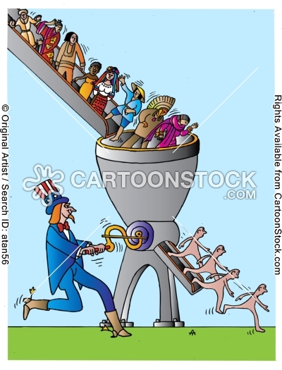
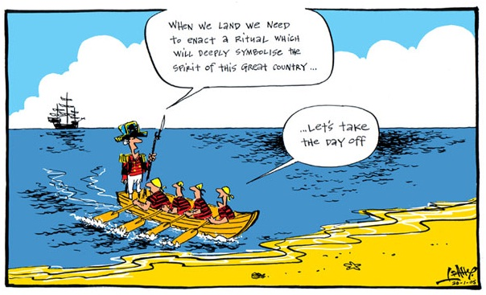
On Australia Day we wear our national identity and symbols lightly. Australia Day is not an occasion for great rhetoric or formal ceremony.
Mincing-machine and nationals

Slide 12
3. The Age of Global Tribes
“mistrust one of the keywords of our age” (97). Let us consider this statement and its consequences.

Slide 13
In the name of identity
What is Maalouf’s ultimate vision about? Does it speak to you?

