Slide 1
Digital Storytelling

Slide 2
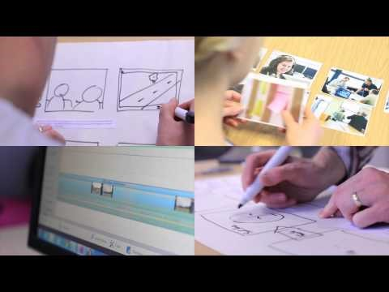

Slide 3
The format
Short – 2-3 minutes
Recorded voiceover
Still images (with effects, if you wish)
Text
Optional music and sound effects

Slide 4
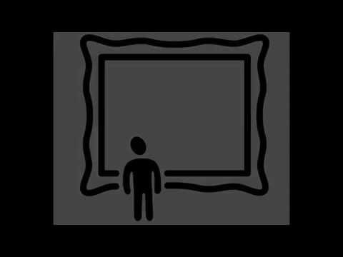

Slide 5
Writing digital stories
What makes a good story?
Small stories – big points
Shapes of stories
Writing for the medium

Slide 6
Good stories
Are
Memorable
Engaging
Thought provoking
Identifiable
Are about:
Journeys
Impact
Overcoming challenge
Change

Slide 7
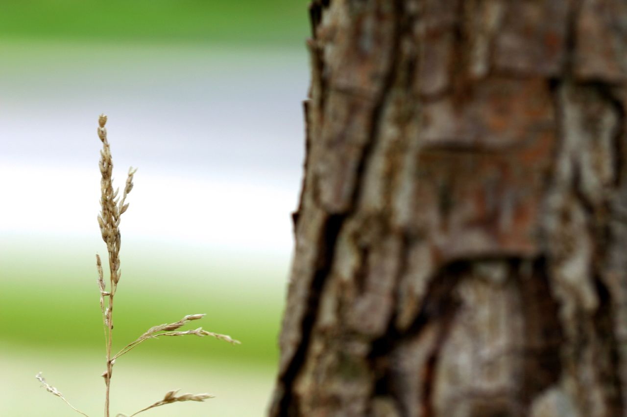
Small to big

Slide 8
Story shapes
Linear
Re-ordered
Episodic
Parallel

Slide 9
Writing for the medium
Write as you speak
Keep it lean
Tinker, iterate, repeat

Slide 10
The workflow
Storyboard
Narrate
Add visuals
Tinker, iterate, repeat

Slide 11
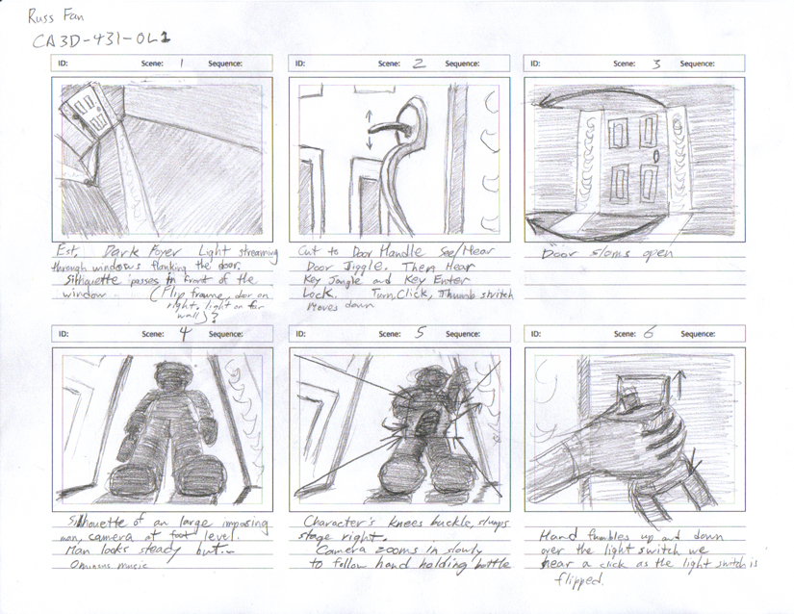
storyboard

Slide 12
narrate
Speak slowly, clearly, but with emotion.
Best quality you can manage (microphone, environment)
Edit, iterate, improve (Audacity- see this tutorial)

Slide 13
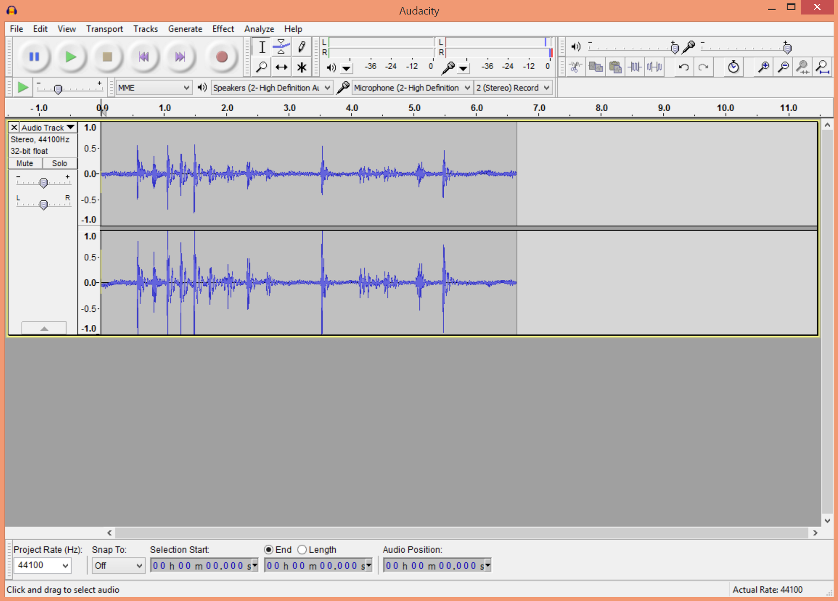
narrate

Slide 14
visuals
Sourcing images & copyright
http://jiscdigitalmedia.ac.uk/guide/photo-sharing-sites
Flickr allows you to search for CC-licensed images
Remember to attribute

Slide 15
visuals
www.wevideo.com (free for 5 minutes export time)
Think about:
Transitions
Blank screen
Animation

Slide 16
