Slide 1

Moderating the online book of condolence
Death of the Monarch
Last reviewed 19 July 2022 / Helen Thorne

Slide 2

Context
When the Queen passes away, we think that colleagues, students and alumni might want to pay tribute
This might be a personal tribute, or it might be on behalf of a team, a society, or a whole faculty.
The online book of condolence creates a space where they can do this personally. It will open on the day that the death is announced and will close at the end of the day following the funeral. So, it will probably be open for 11 days.

Slide 3
You will be:
Coordinating with each other to make sure all entries are reviewed
Moderating the submitted tributes to ensure they are in line with our online moderating policy
Publishing the entries to the book of condolence web page
If there are any issues, notify a team leader in the corporate communications team
This will happen every working day while the condolence book is live
What’s our role?

Slide 4
Coordinating to make sure entries are reviewed
You have all been added to a distribution list: MemoriamQE2@warwick.ac.uk.
The address won’t be publicised, it is just there to facilitate the online book of condolence
Tributes will be submitted via a webform that is linked to the email address. Once a day, a list of entries will be sent to the email address. You will need to allocate some each to make sure all are reviewed, and none are missed.

Slide 5
Moderating the submitted tributes
When you have some tributes to moderate, review them against our moderating guidelines. You can find these here.
Don’t delete any of the submissions, and keep a brief written record of why you decided not to publish a tribute
Do your best to be decisive over which ones to publish, and which to not publish. If you are really uncertain, speak to a leader in corporate comms team.
If you are in any doubt, and can't get time with someone in corporate comms, don't publish and don't delete – wait until you've spoken with someone.

Slide 6
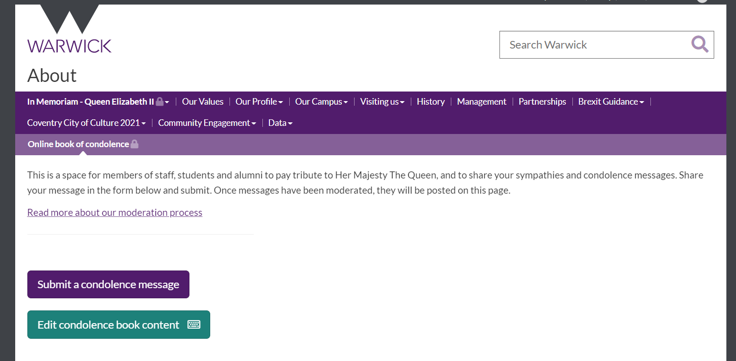
Publishing the approved entries
When you have an approved entry, you can go ahead and publish it straight to the book of condolence
Visit the page and click ‘edit condolence book content’
Scroll down to find the blue ‘add a new entry’ button.
Upload their name, job title / society name etc as header text, and the body of their tribute as para text. If they have sent images, they can be added too.
Remember to tag if they are staff, student or alumni. You can select more than one.

Slide 7
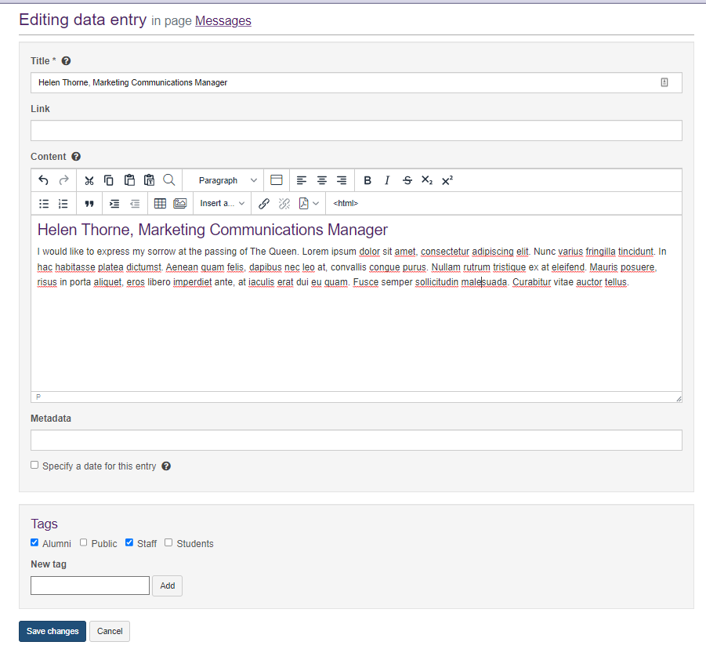
A standard sitebuilder content builder will open.
For title, add name and in what capacity they are submitting their tribute (student? Head of X department? Chair of X society? Alumni? Etc.)
Repeat this in the content box, using Heading 2 for the title etc.
Use paragraph for the rest of their tribute.
Select whether they are alumni, public, staff, or student (you can select more than one).
There isn't an upper word limit
Hit Save changes.

Slide 8
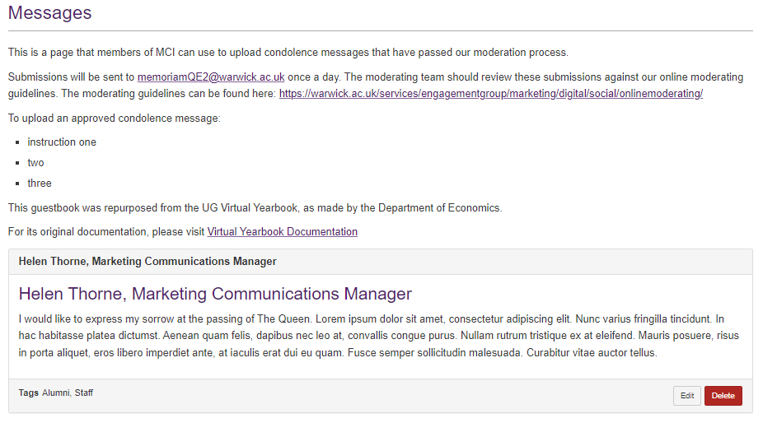
You'll come back to the 'edit book of condolence' page, and you'll see your entry listed. If you spot an error, or need to edit the entry, you can do that here by clicking edit.

Slide 9
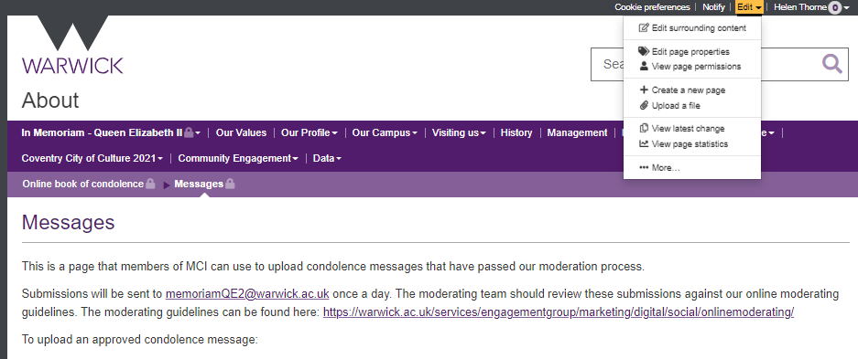
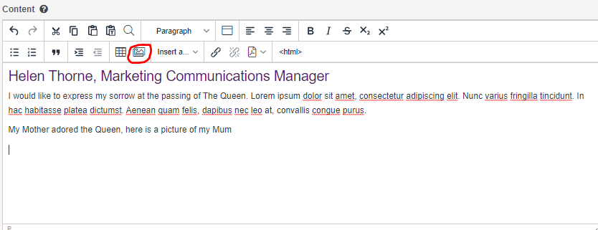
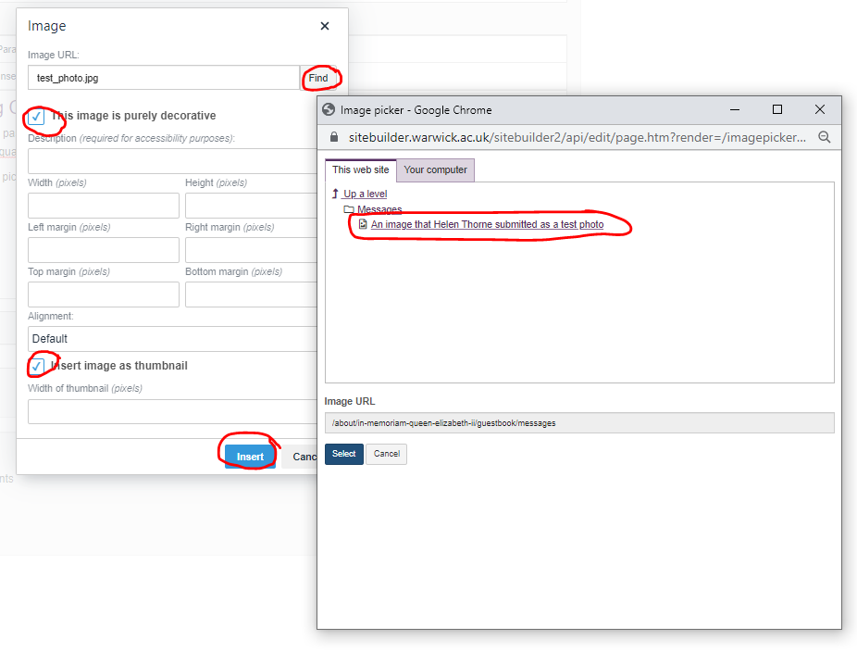
To add a submission with an image, select edit at top right of page, and add Upload a file. Save the image using the first name and surname of the submitter.
When that's saved, enter the submission as the previous slide. At the end of the text, select the photograph icon (circled left).
On the pop up box, select Find. The subsequent photo box will show the photo that you previously uploaded – select it. Click the 'image is decorative', and the 'insert image as a thumbnail' checkboxes, and then insert (all circled left).
You will see your image inserted into the entry. When ready, press 'save changes'.

Slide 10
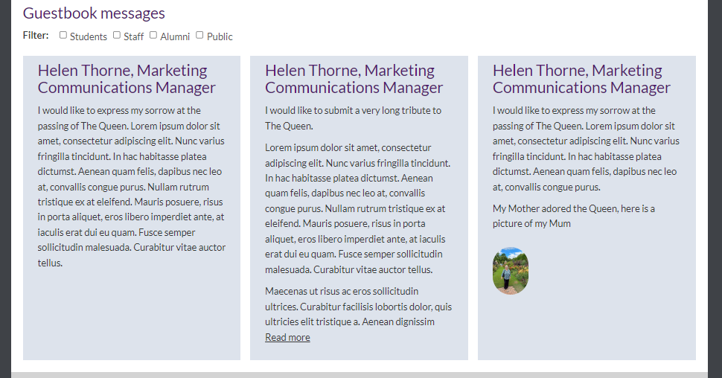
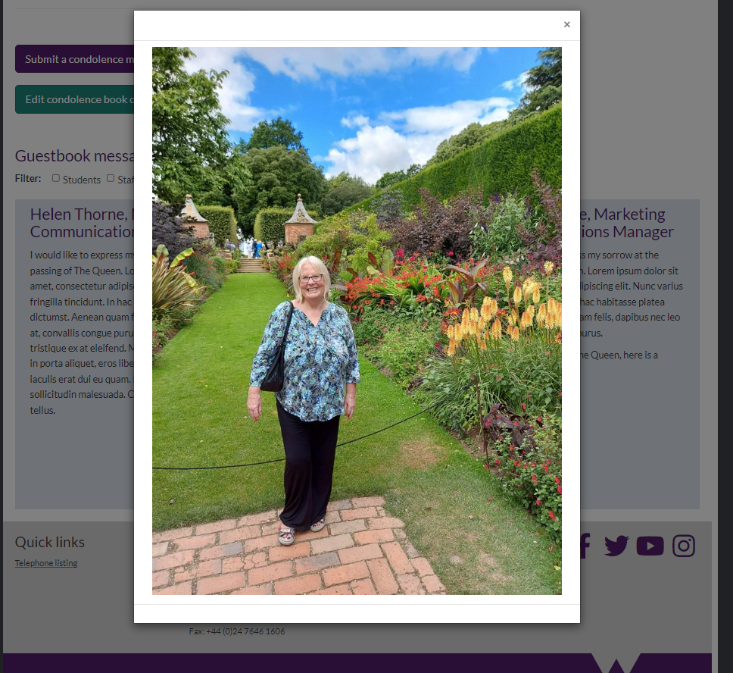
If we look at the public facing Book of Condolence page now, you can see my three entries. A standard one on the left, a long text version in the centre, showing how the 'read more' works, and a submission with an image on the right. If you click that thumbnail, the image enlarges:

