Slide 1
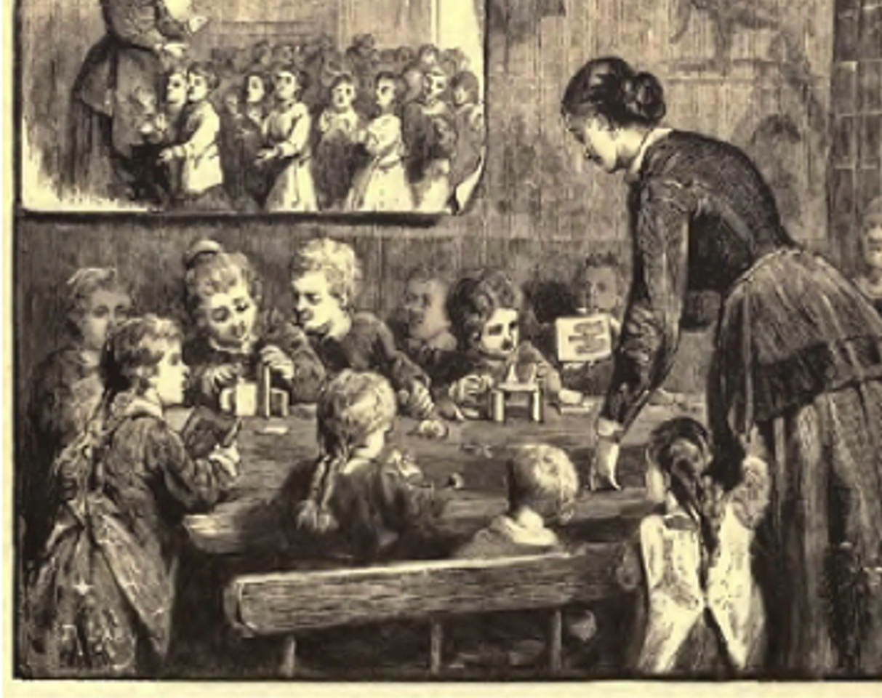
Generating HERstory of ELT
Richard Smith, University of Warwick

Slide 2
Plan
Why HERstory, not just history? (5 mins.)
Looking for ELT women before the 1960s (10 mins.)
Formulating questions: 1960s–1980s (15 mins.)
A collaborative project? (10 mins.)

Slide 3

1. Why HERstory, not just HIStory?

Slide 4
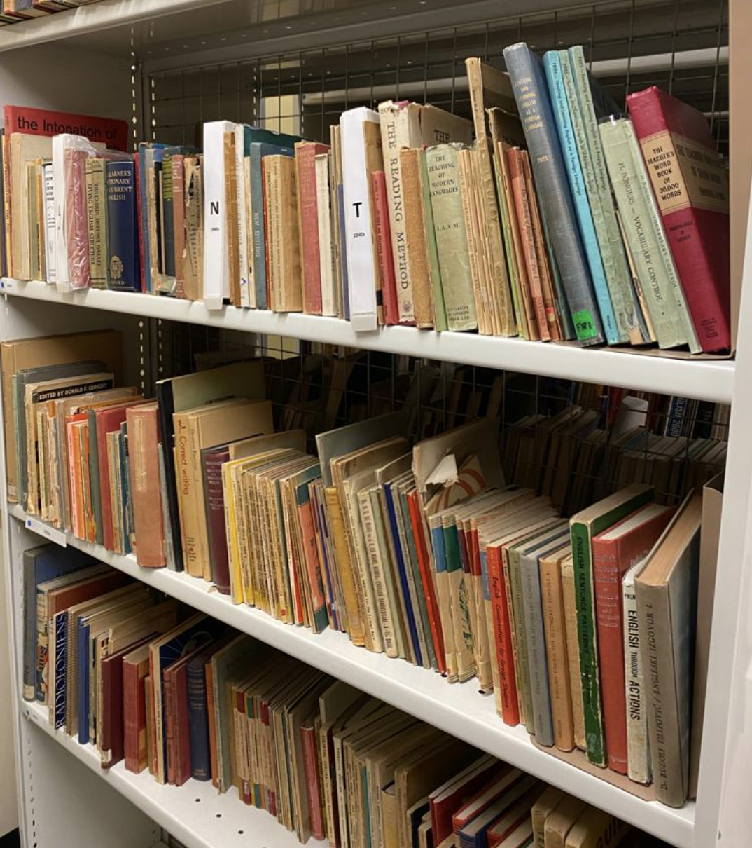
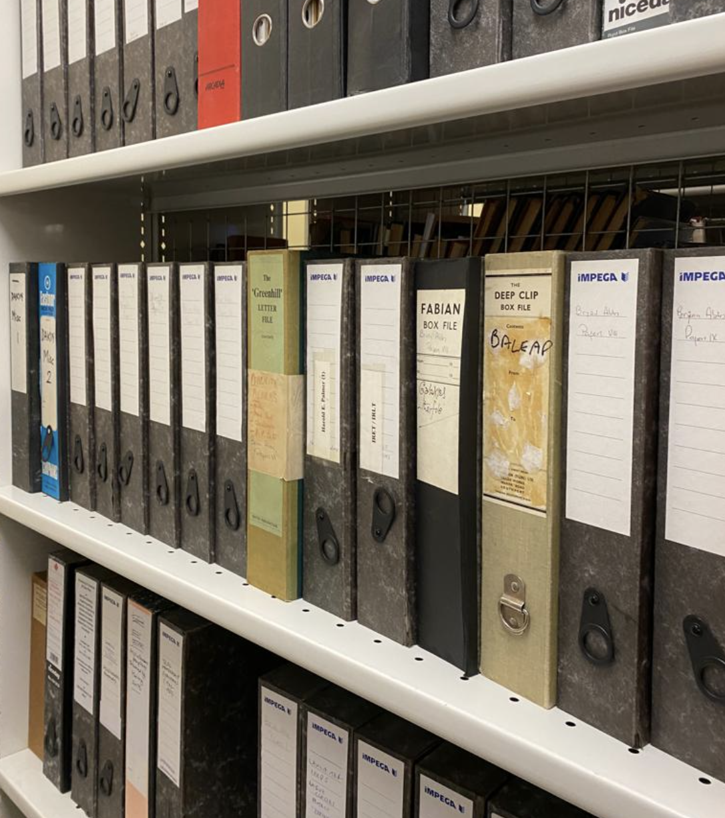
The Warwick ELT Archive

Slide 5
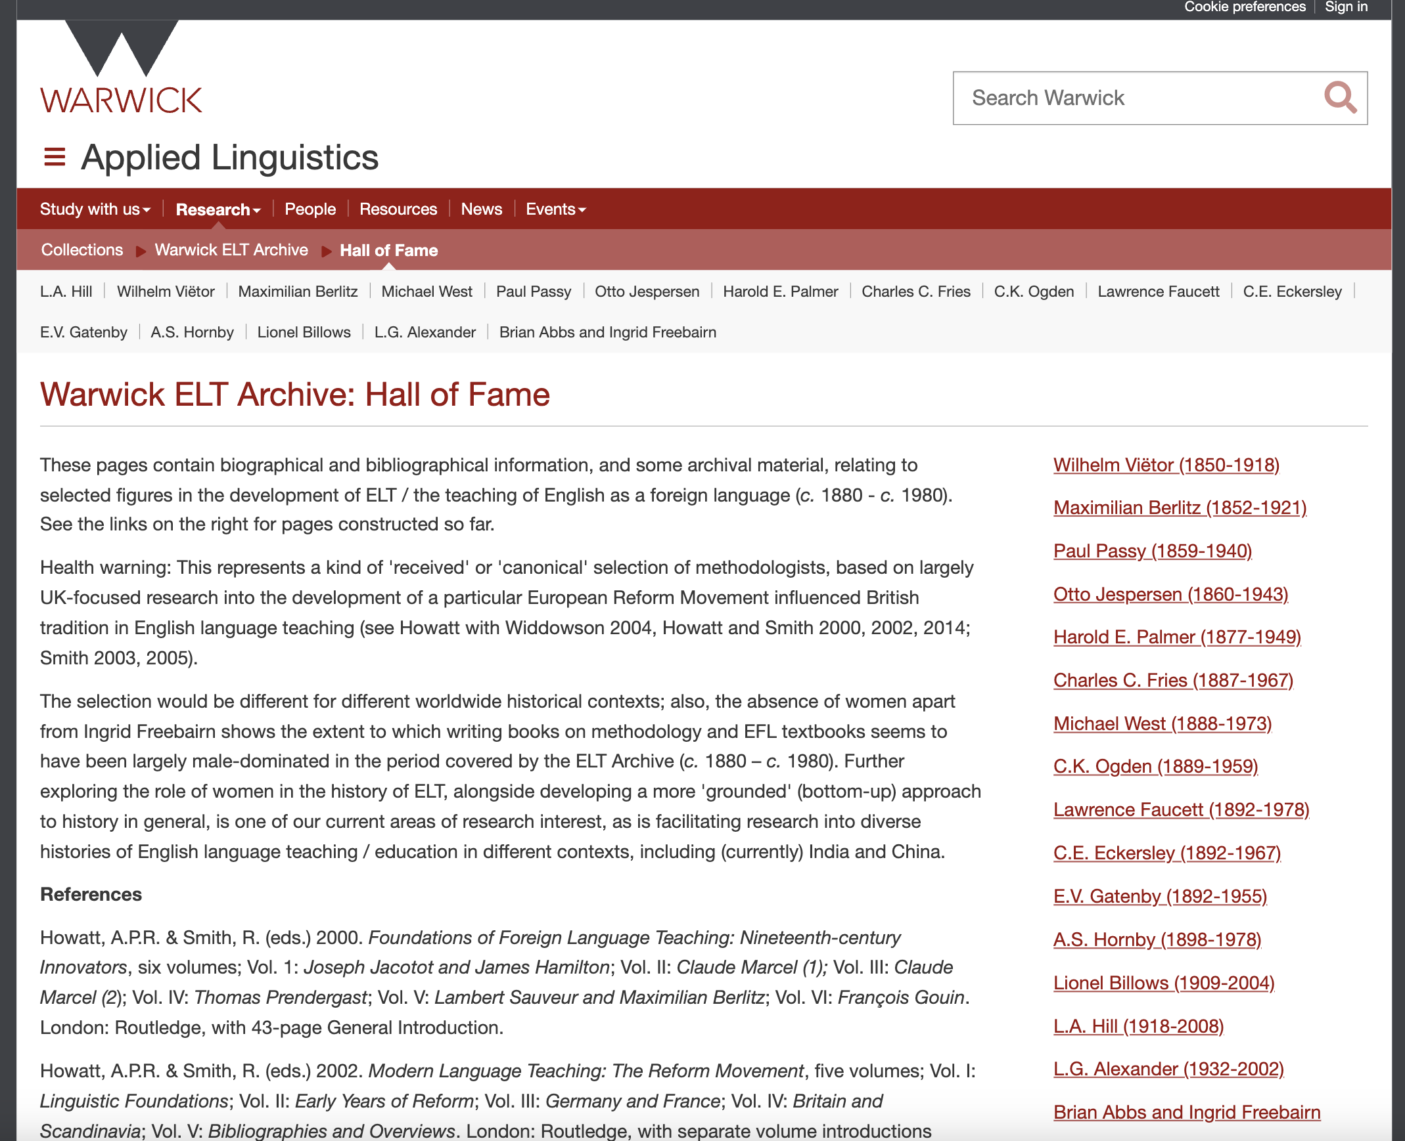

Slide 6
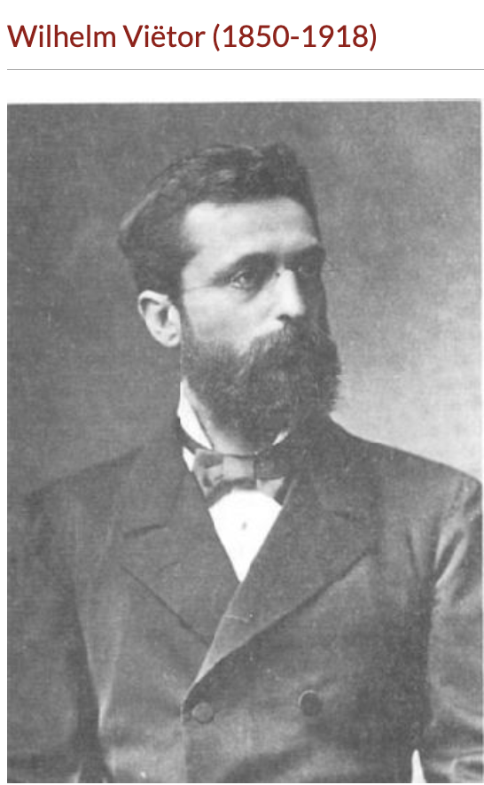
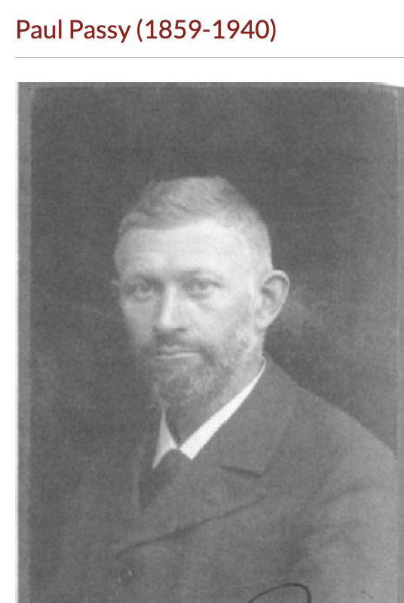
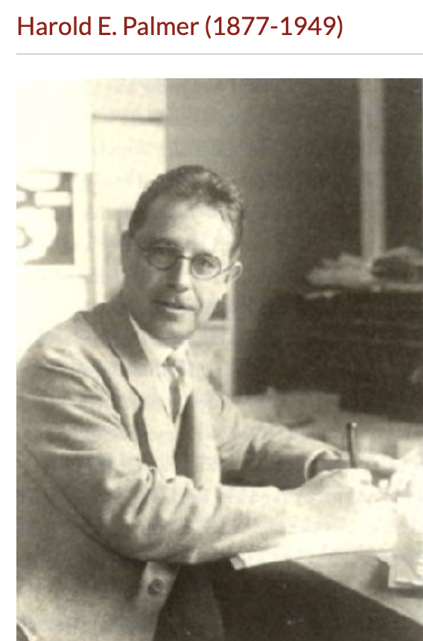
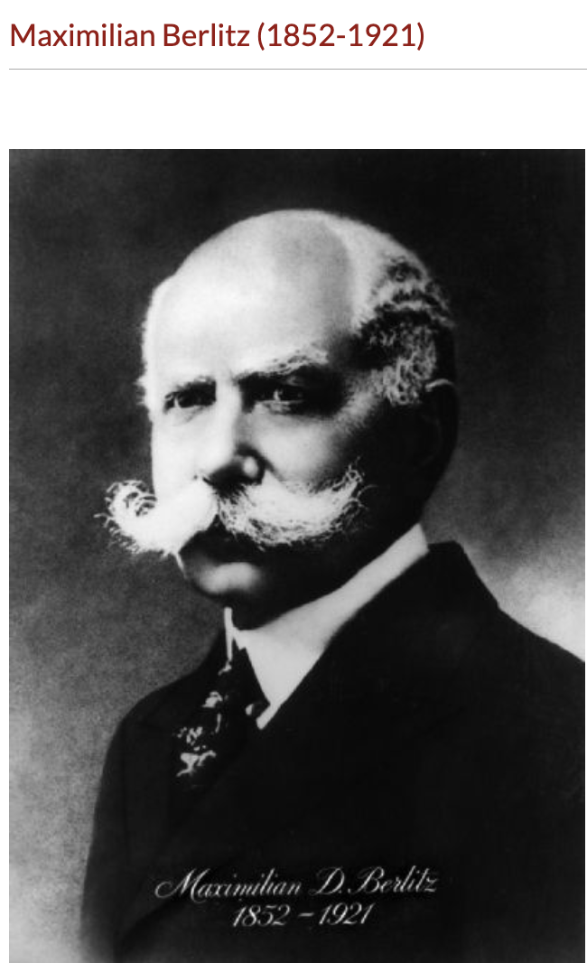
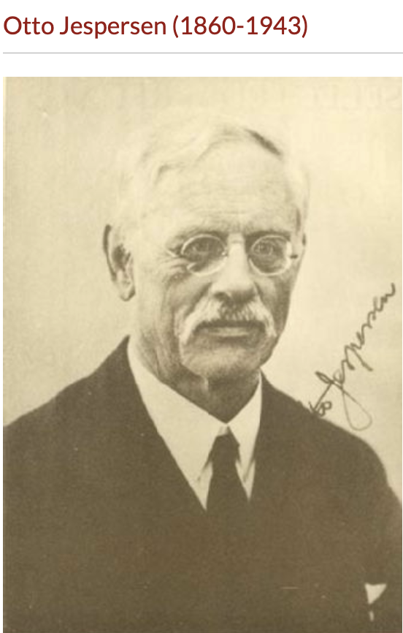

Slide 7
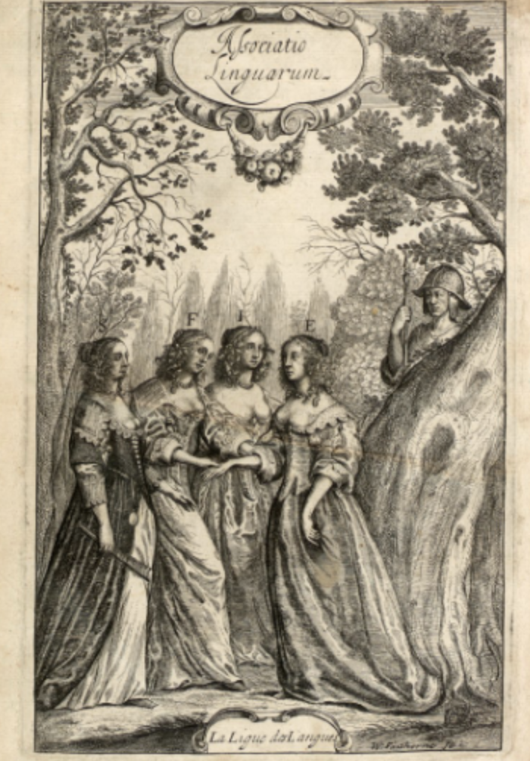
2011
Conference on ‘Female Voices: Women
and Foreign Languages in Modern
Europe, University of Milan
(Finotti & Minerva, 2012)

Slide 8
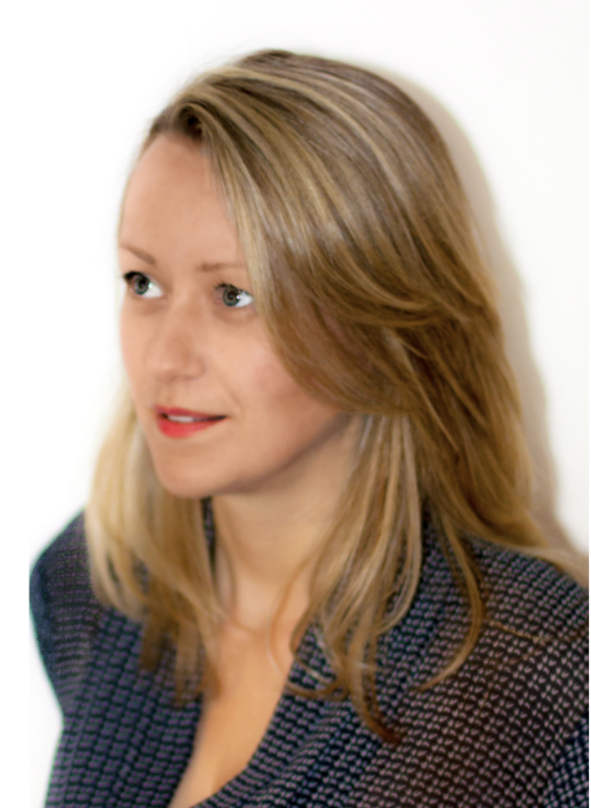
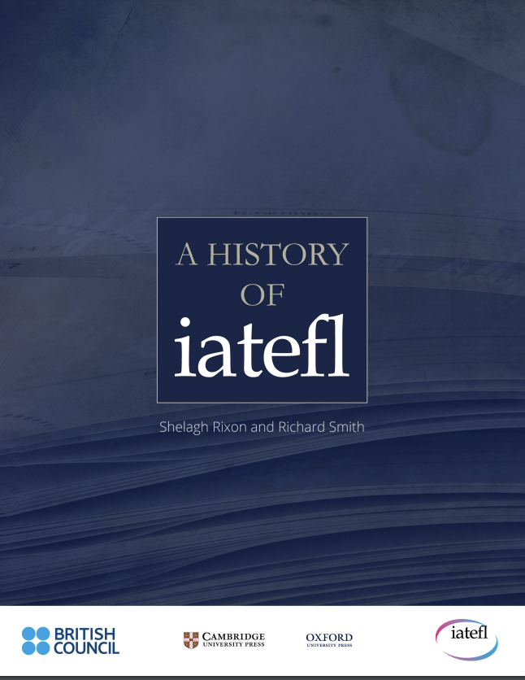
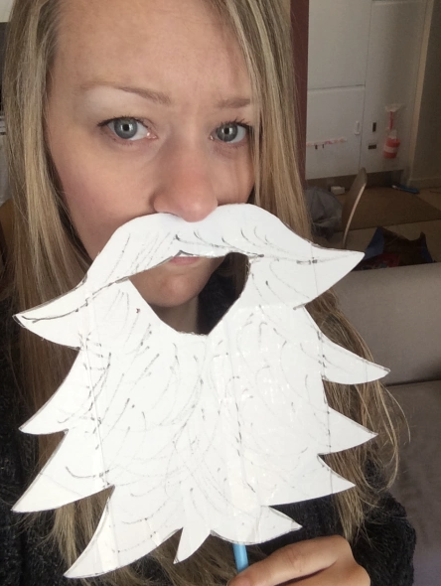
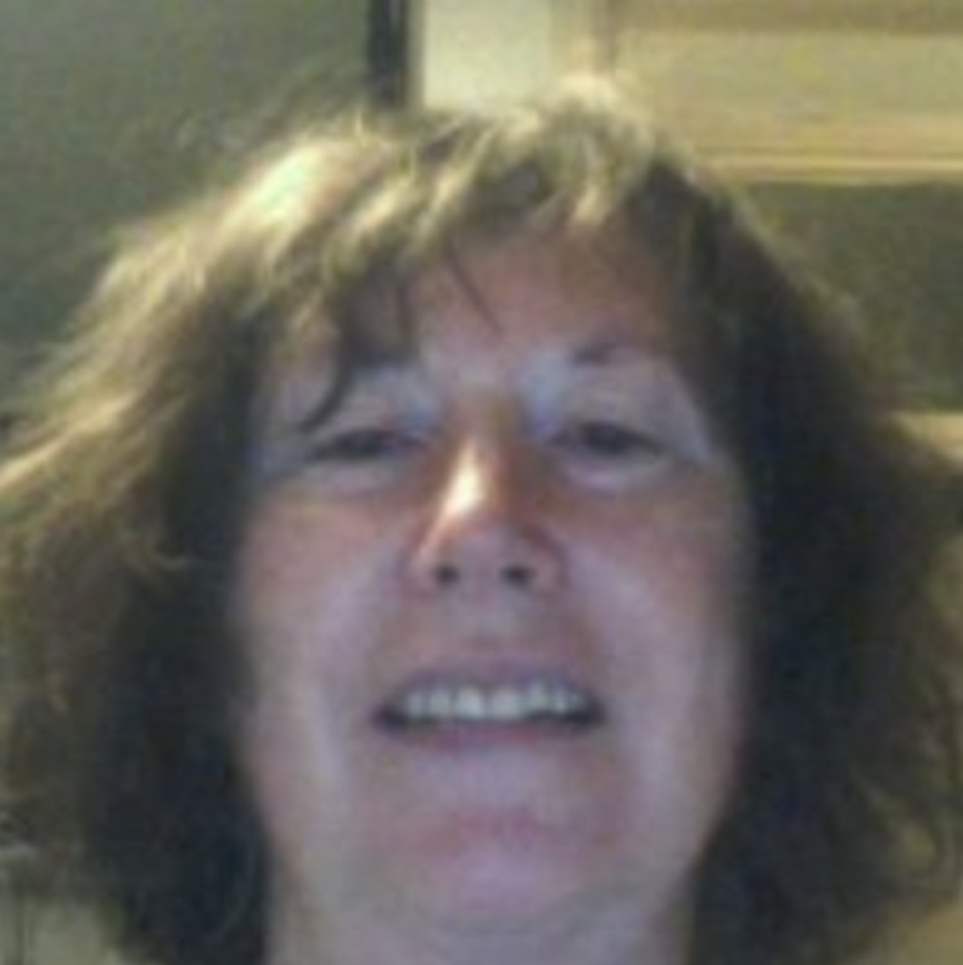
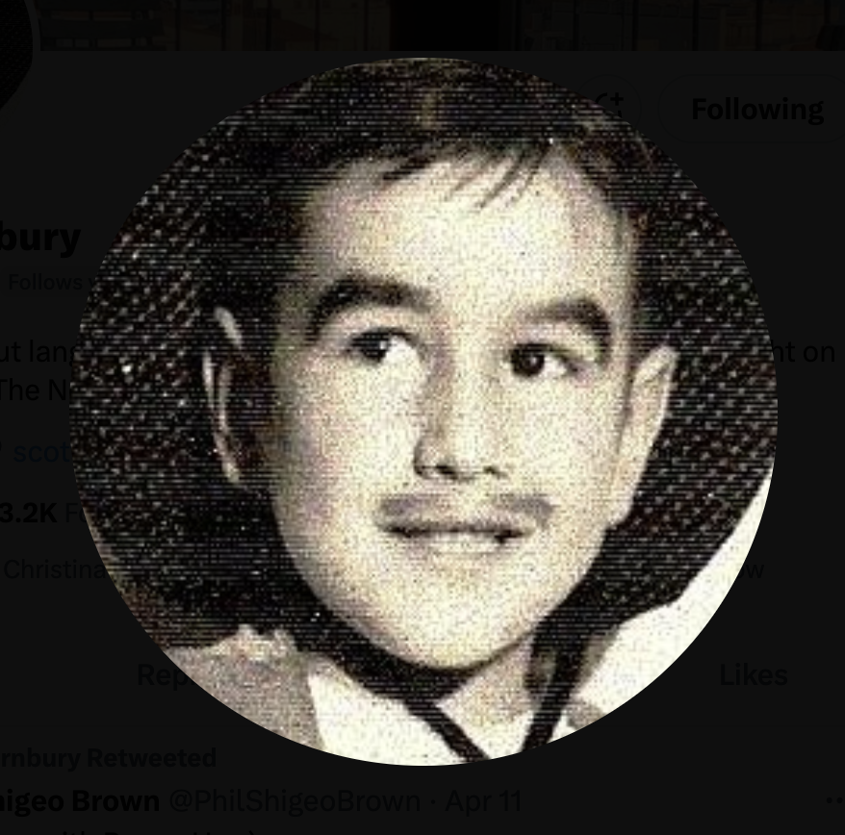
2015–17

Slide 9
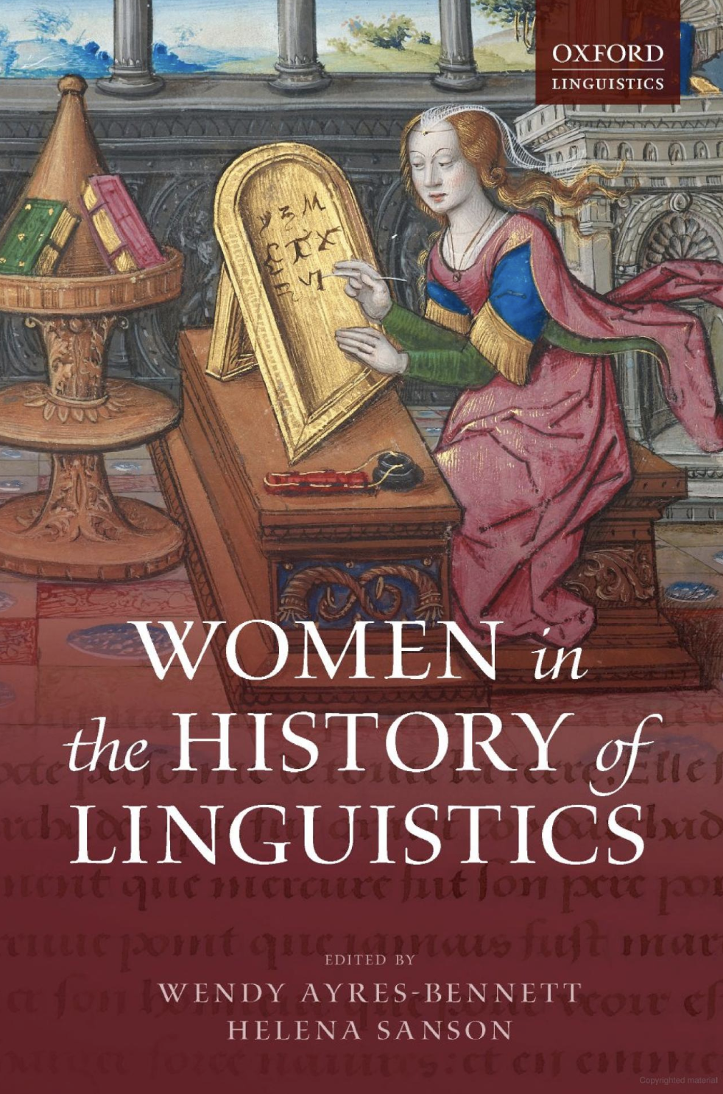
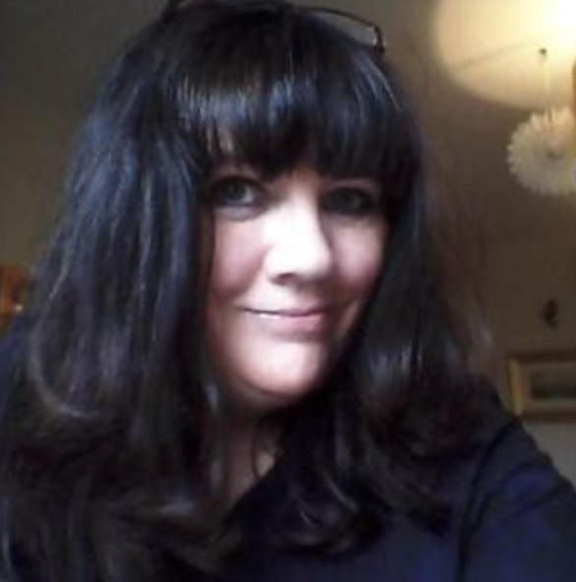

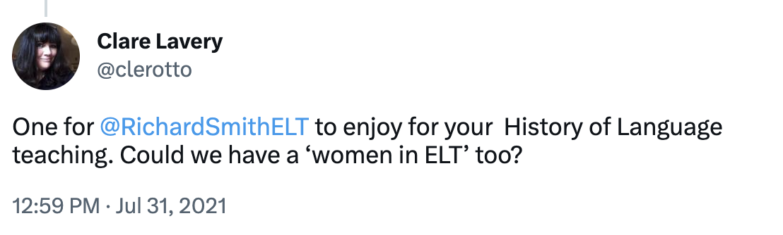
2019–21
[2017 – #MeToo]

Slide 10
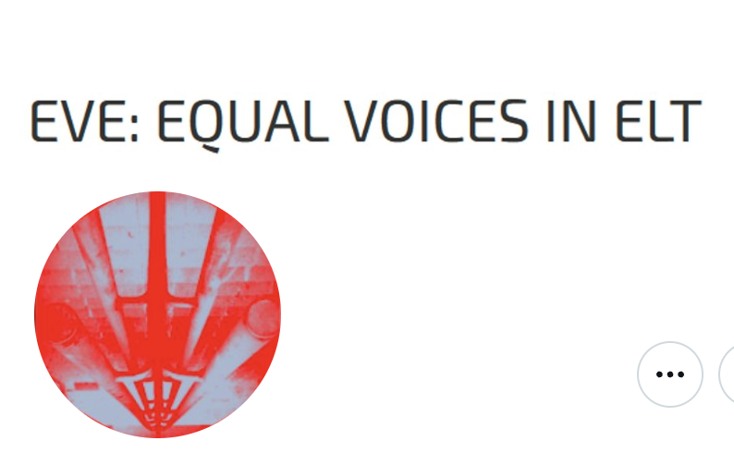
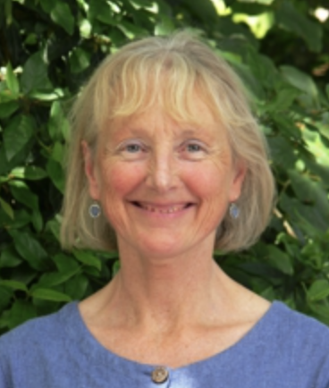
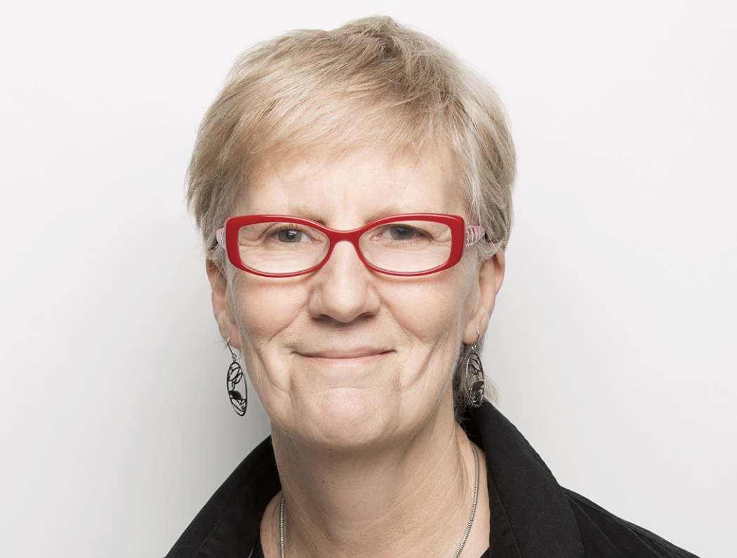
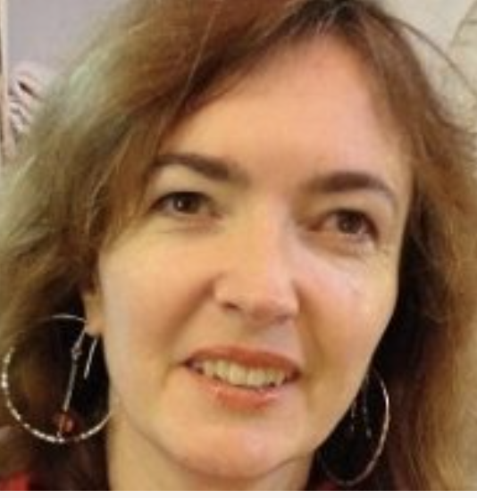

2013+
2018+

Slide 11
So, why / what is Herstory?

Slide 12
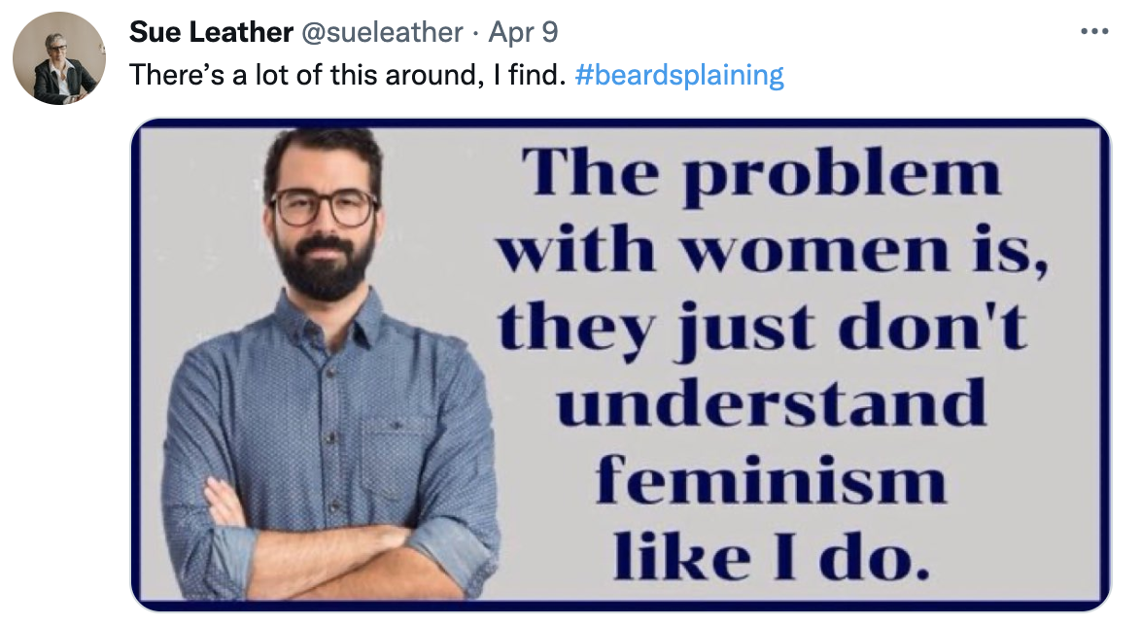
[but first … a warning to myself …]

Slide 13
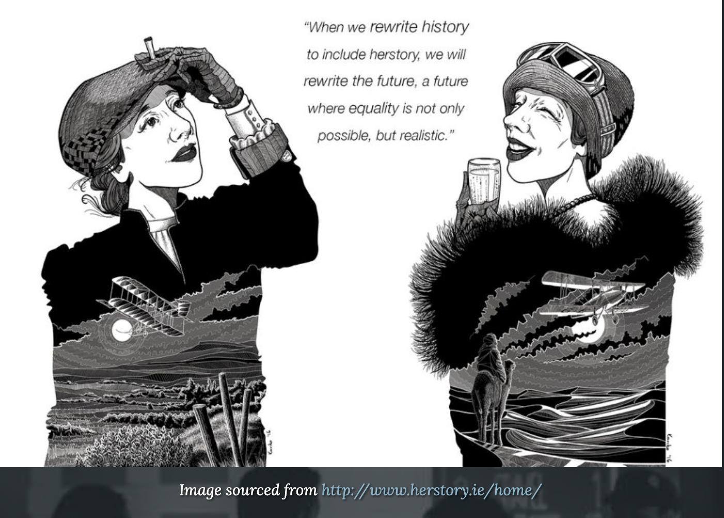

Slide 14
Feminist history (Herstory)
Dual mission of feminist history:
[1] “recover the lives, experiences, and mentalities of women from the condescension and obscurity in which they have been so unnaturally placed” [women’s history]
[2] “reexamine and rewrite the entire historical narrative to reveal the construction and workings of gender.” [history of gendering/sexism/activism]
(Pedersen 2000)

Slide 15
Interconnected reasons for lack of HERstory of ELT (barriers to overcome)
Over-emphasis on contributions of theory and theorists (vs. practice and practitioners)
Until late 19th century, limited educational opportunities; women’s contributions were in less public domains than men.
Lack of extant sources; over-emphasis on particular kinds of source
When there are publications, subordination of women's authorship / pseudonymous publication

Slide 16

But what can we discover?

Slide 17
2. Looking for ELT women before the 1960s

Slide 18
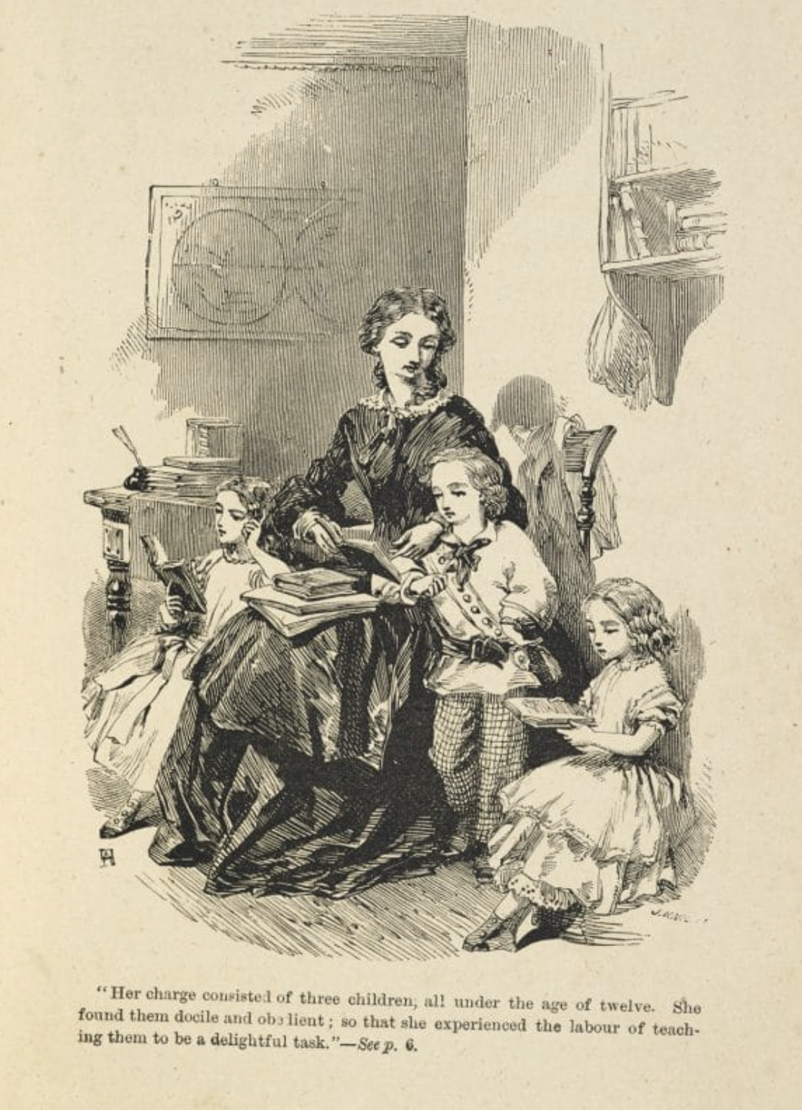
Governesses (19th century)
“I mean now to open a second school, for girls. I have hired a building for the purpose, with a cottage of two rooms attached to it for the mistress’ house…Will you be this mistress?”…In truth it was humble—but then it was sheltered, and I wanted a safe asylum; it was plodding—but then, compared with that of a governess in a rich house, it was independent; and the fear of servitude with strangers entered my soul like iron; it was not ignoble—not unworthy—not mentally degrading. I made my decision.”
(Jane Eyre – Charlotte Brontë)

Slide 19
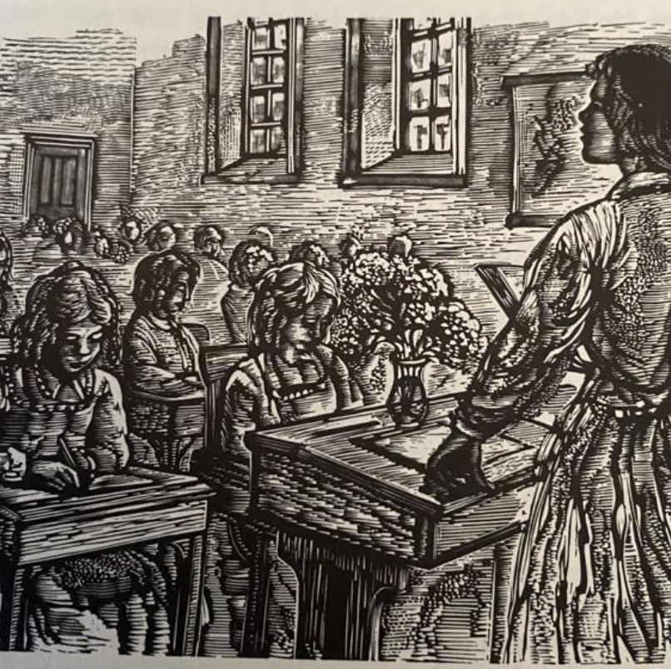
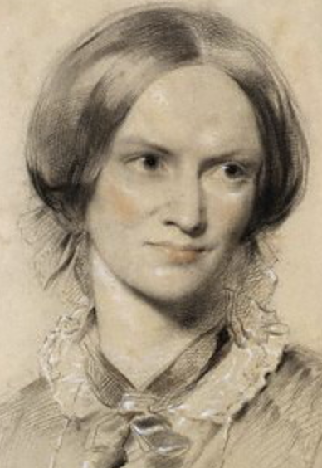
Women as language teachers in girls’ schools (late 19th century)
[In Germany] due to their knowledge of / interest in modern languages [gendering of this area of study], women language teachers were often in the vanguard of entry into the male domain of secondary school teaching.
(see Doff, 2008)

Slide 20
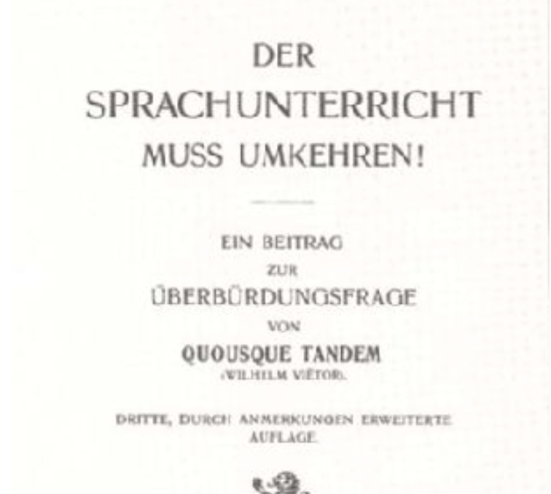
Women’s ‘conversational teaching’ in 19th century German girls’ schools as a (major?) source of Direct method?
(see Doff, 2008)

Slide 21
Standing HIStory on its head!

Slide 22
Cf. Doff’s (2008) ‘plea for replacing the study of isolated big (and usually male) names by an understanding of the history of foreign language education as a complex contextual network of a substantially larger number of participants, a considerable number of whom happened to be female’

Slide 23
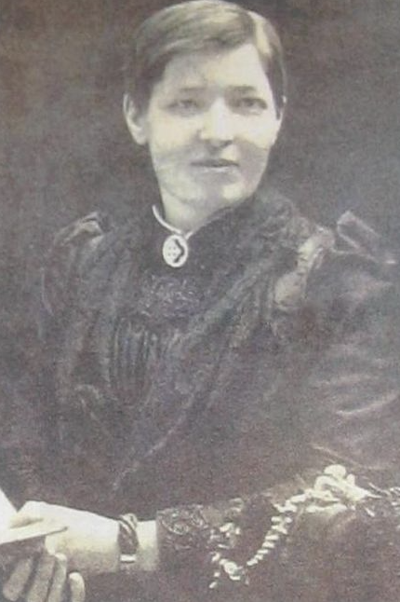
Women as missionary teachers of English?
e.g. Mary Slessor?
“Mary Slessor (1848-1915) was a Scottish Presbyterian missionary who went to Calabar (now part of Nigeria) in 1876. She learned the Efik language and began teaching English [??] and Christianity to local children and adults. Slessor became known for her fearless attitude and willingness to go to dangerous places to spread the gospel.” (ChatGPT)

Slide 24
Earlly 20th century – in a group, what can you find out (within 5 minutes, just using the internet) about the ELT lives of one or two of these pioneers?
Ida Ward
Lilias Armstrong
M. [Mariel] G.M. Faucett
Dorothée Palmer
Constance Ripman
Isabelle Frémont
What more would you like to know about them?
What other sources could be consulted?
Who else would you like to find out about?

Slide 25
A) Ida Ward

Slide 26
B) Lilias Armstrong

Slide 27
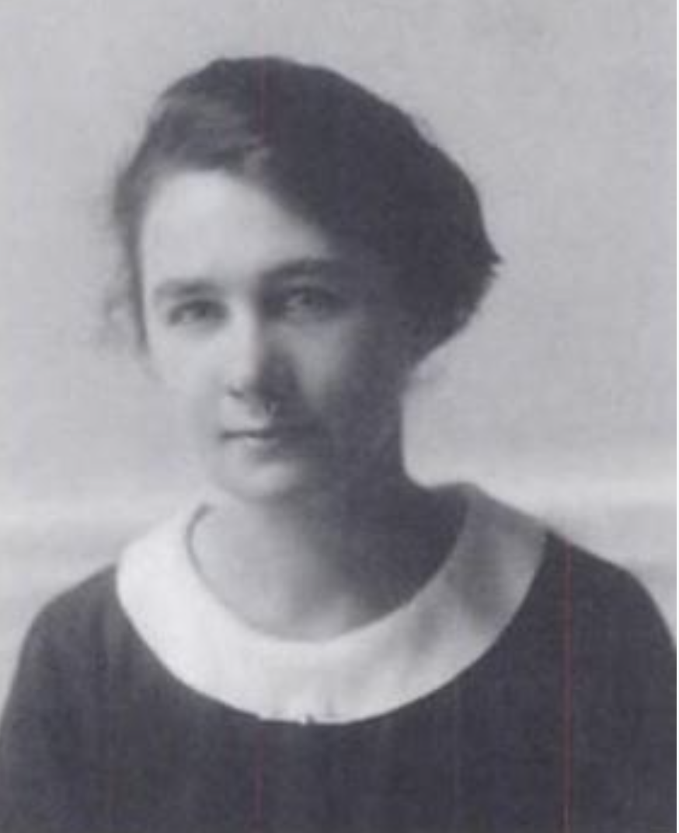
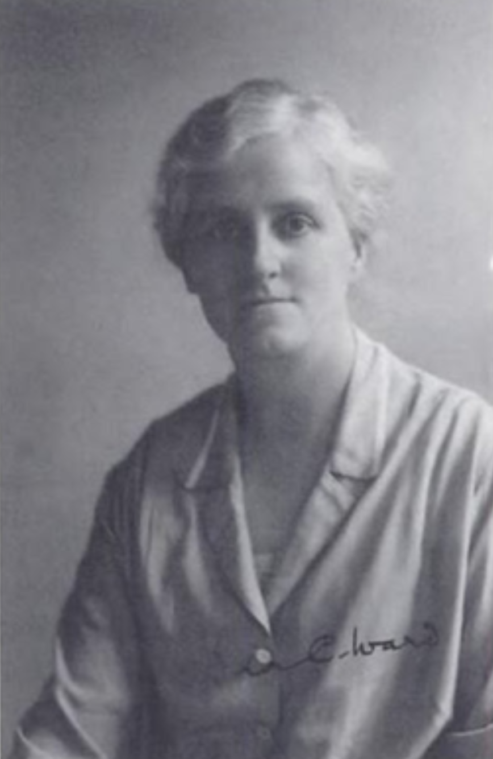
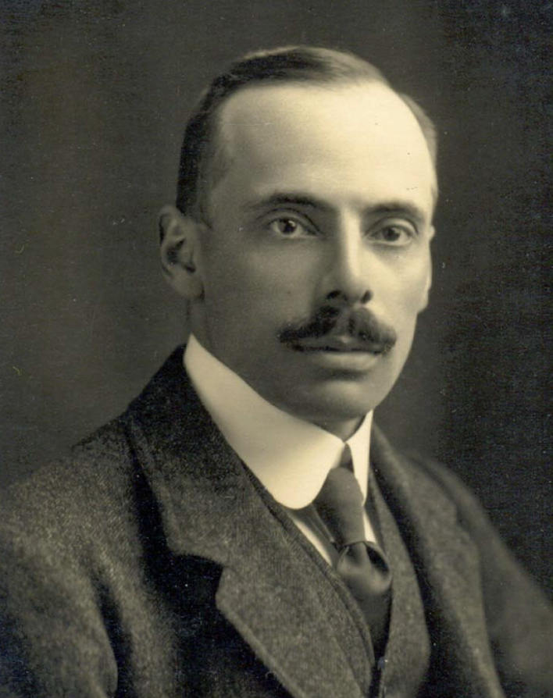
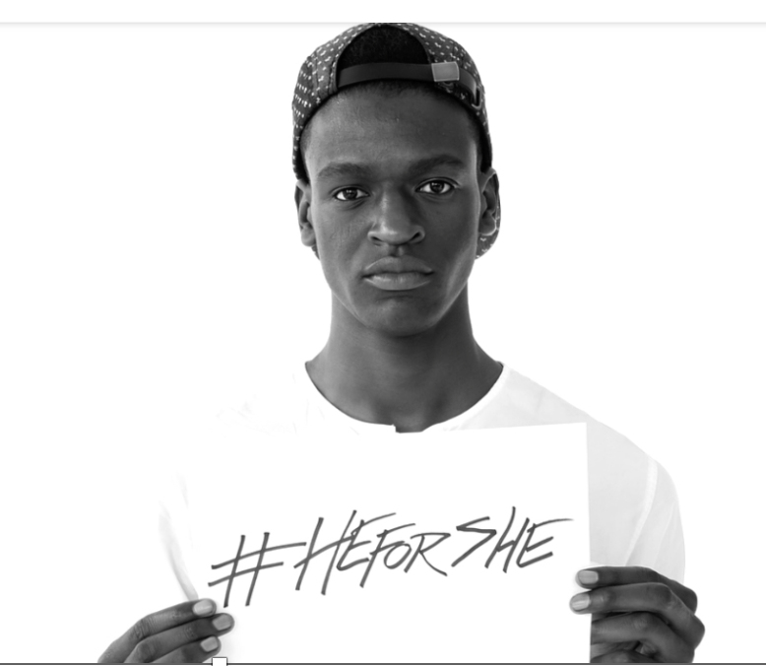
Ida Ward (1880–1950) and Lilias Armstrong (1882–1937), co-authors of A Handbook of English Intonation (Heffer, 1926). Employed by Daniel Jones in the UCL Department of Phonetics, c. 1920s–30s.

Slide 28
C) M. [Mariel] G.M. Faucett

Slide 29
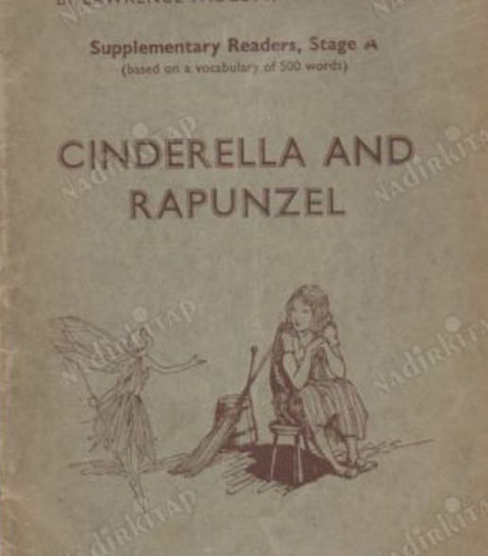
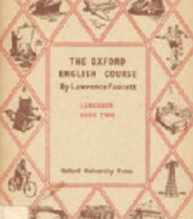
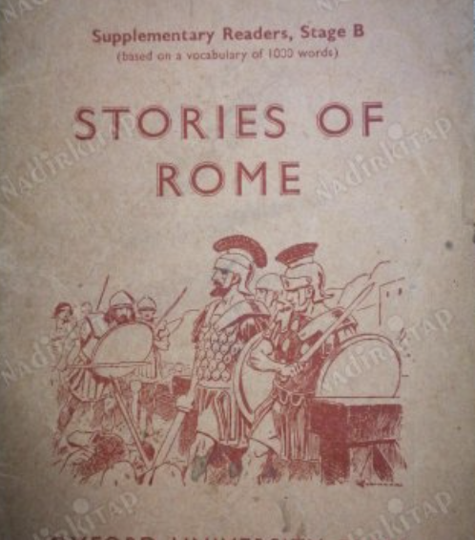
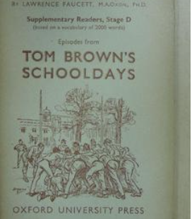
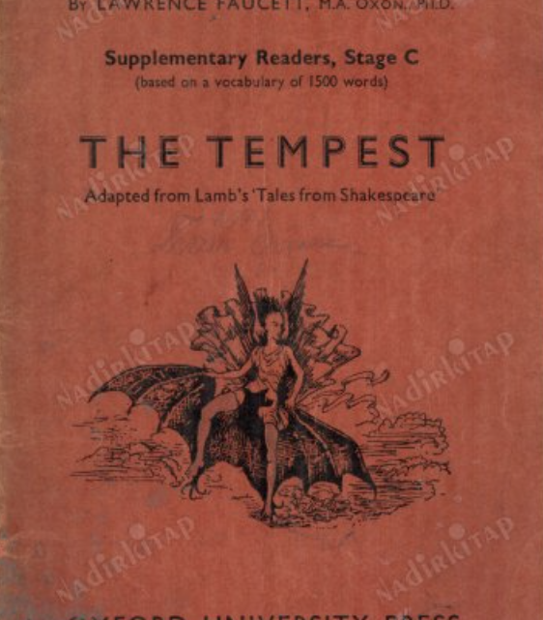
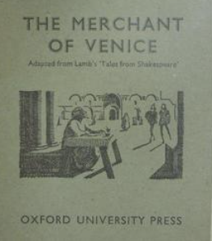
Mariel G.M. Faucett - co-author of Supplementary Readers to the Oxford English Course (OUP, 1933–36), with (husband) Lawrence Faucett

Slide 30
D) Dorothée Palmer

Slide 31
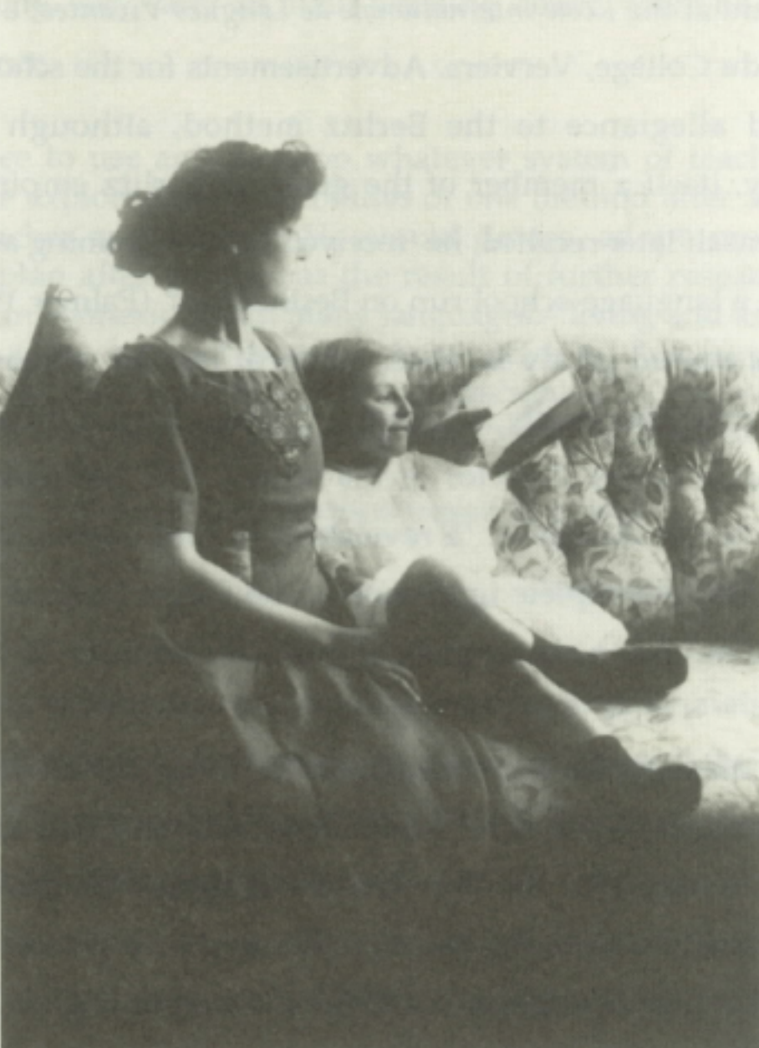
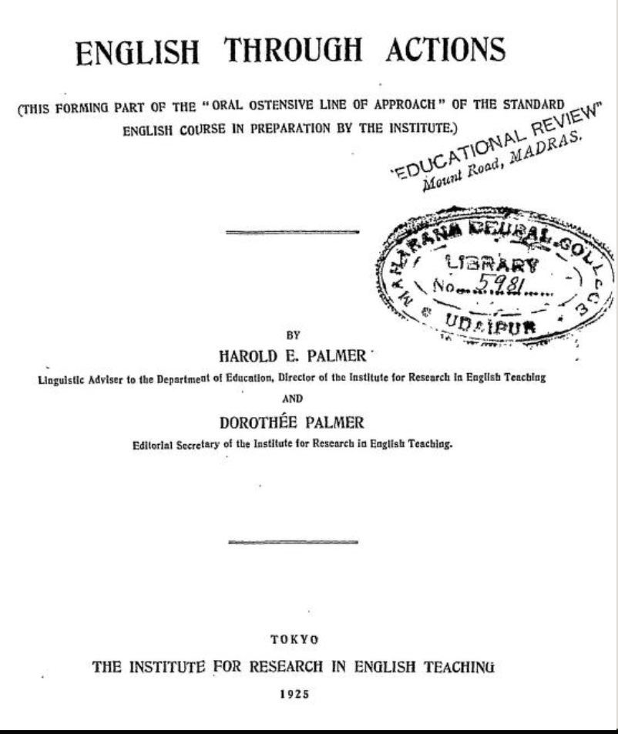
Harold E. Palmer &
Dorothée Palmer
English through
Actions (1925)
At the time, Dorothée was ‘Editorial Secretary’
of the Institute For Research in English Teaching
in Tokyo

Slide 32
E) Constance Ripman

Slide 33
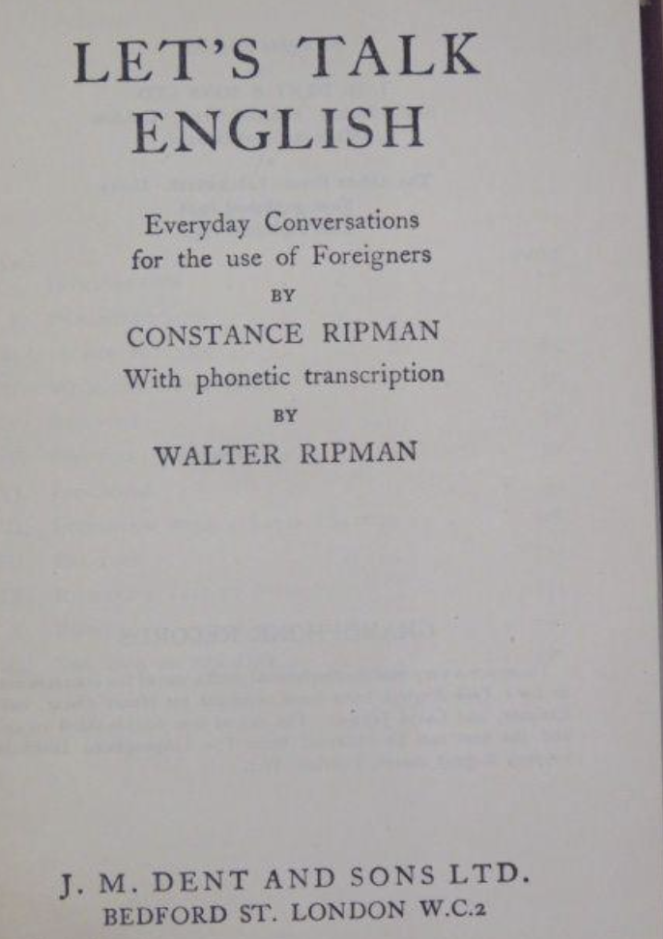
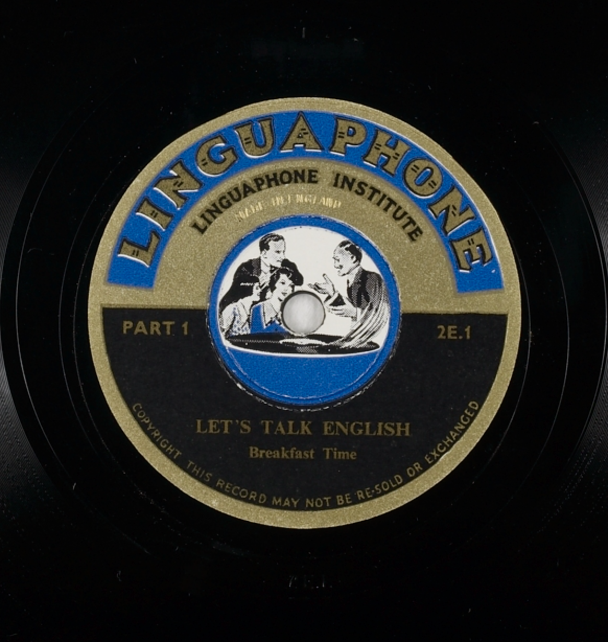
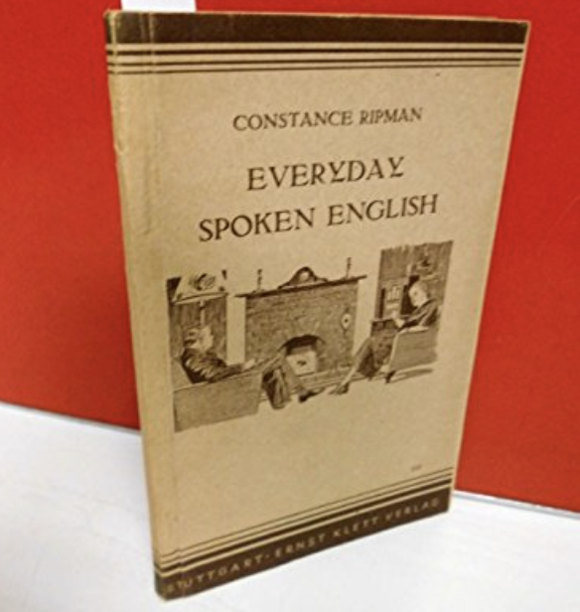
Constance Ripman: author of Let's Talk English: Everyday Conversations for the Use of Foreigners (1938)
          Hear a dialogue from this book here: https://sounds.bl.uk/Accents-and-dialects/Early-spoken- word-recordings/024M-1CS0011520XX-0100V0

Slide 34
F) Isabelle Frémont

Slide 35
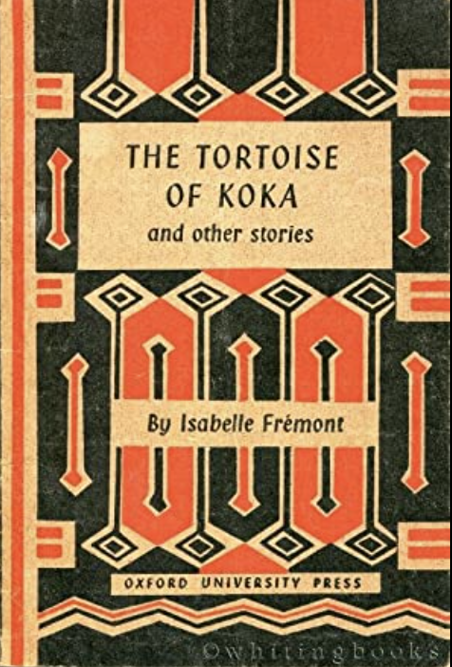
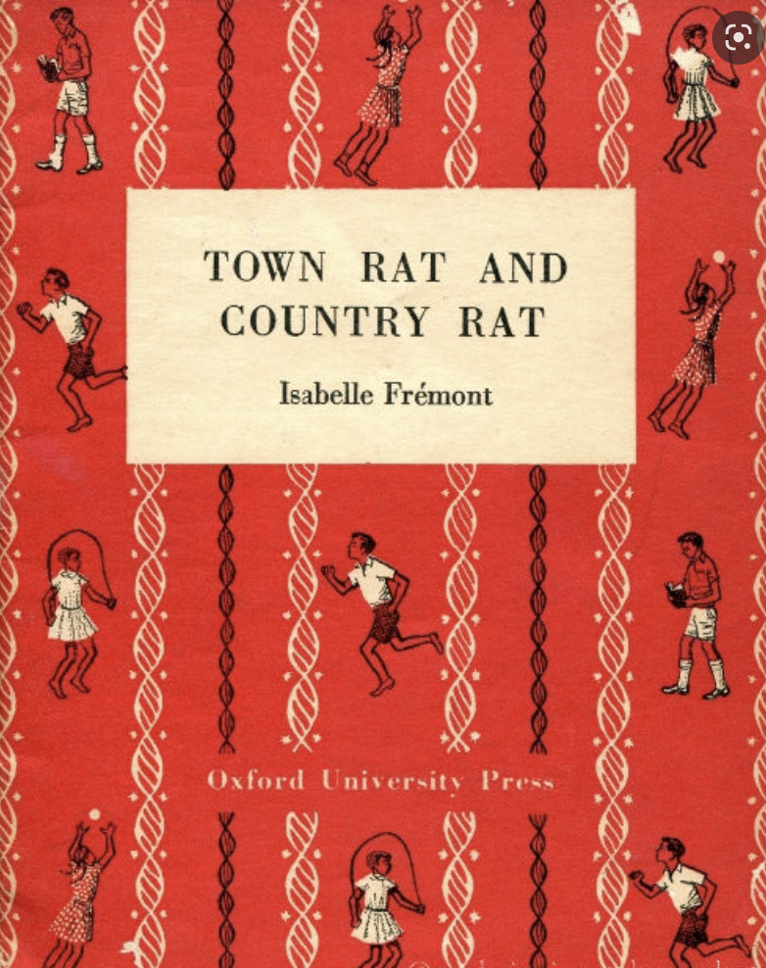
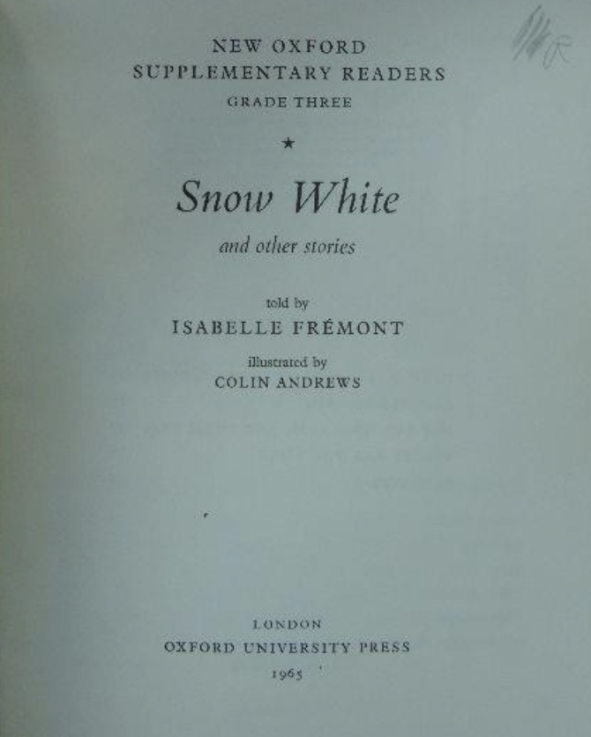
Isabelle Frémont - author of various Oxford English Readers connected with L. Faucett's Oxford English Course. Missionary in Tanganyika

Slide 36
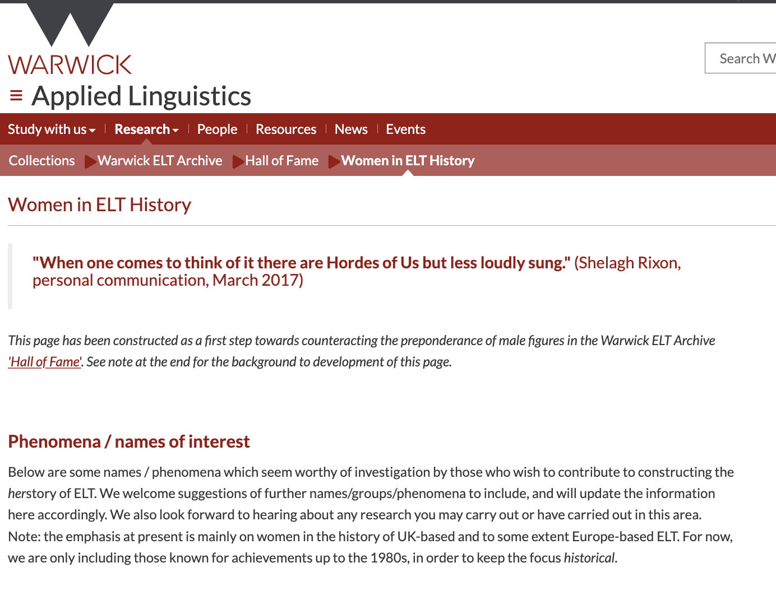
Warwick ELT Archive > Hall of Fame > Women in ELT

Slide 37
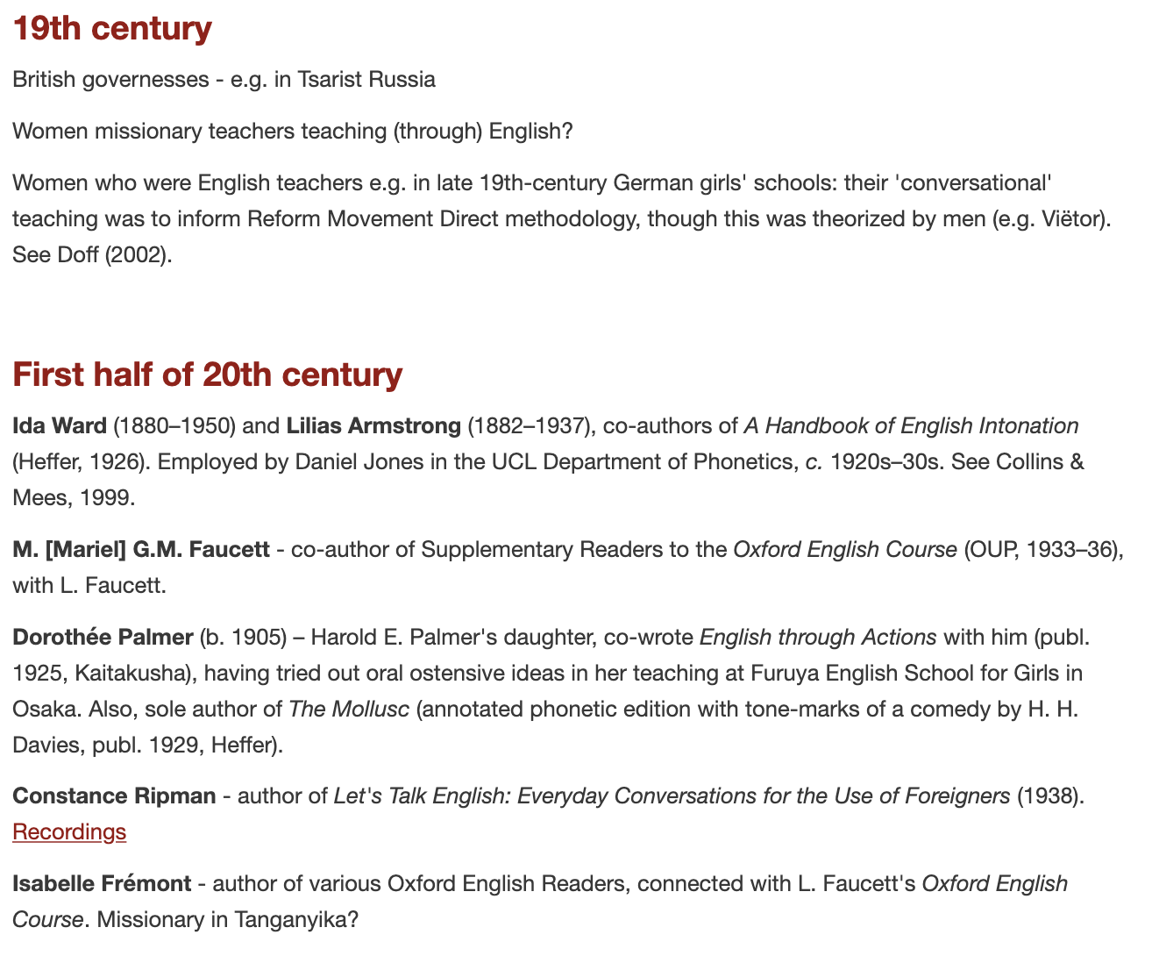

Slide 38
3. Formulating questions: 1960s–1980s

Slide 39
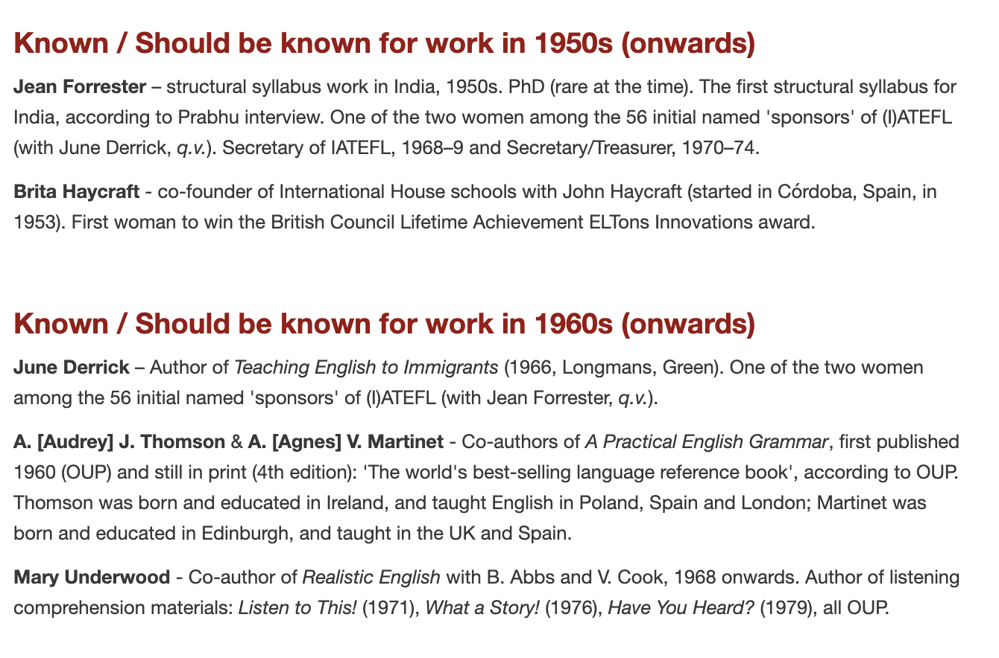

Slide 40

1967

Slide 41

Women teaching English to immigrants and refugees (1960s)
June Derrick, and …?

Slide 42


Slide 43


Slide 44



1984–85: new committee, new IATEFL conference format – Gill Sturtridge, Janet McAlpin, Marion Geddes

Slide 45



Methodologists associated with the British Council’s English Language Teaching Institute, in the 1970s–80s / 1980s+ IATEFL
(Marion Geddes / Gill Sturtridge / Janet McAlpin / Shelagh Rixon)

Slide 46


Slide 47

Women in TEFL (later called ‘Women in EFL Materials’) (mid-1980s)

Slide 48
“A small number of us got together in the mid 1980s – we included women from the world of ELT publishing, myself from the British Council and one or two teachers. […] Coursebooks in those days […] included male and female characters of stereotypical occupations and interests. Jobs and positions of authority were invariably held by male characters, while women held the role of child carers, and the wives, girlfriends etc of the men. The women who disliked this unequal representation of women and men were often regarded as unnecessarily confrontational and not prepared to face up to the "realities" of … real life. In fact, of course, real life included many women of power and ability, and a good many who were not interested in being wives, mothers or girlfriends.”
(Jenny Pugsley, personal communication, in Magoga 2016)

Slide 49


Slide 50
‘A brief history of ELT Journal’ (ELTJ 75/1)
“Aside from editing a special issue which drew attention to under- or misrepresentation of women as a problem in ELT generally (43/3, 1989), [Norman] Whitney was instrumental in bringing a greater number of women into the Editorial Advisory Panel—by 1990 (44/1: front matter), six women and two men were included, in a big turnaround even from the early 1980s. In 1992, Tricia Hedge became the first woman to edit the journal’
1993 – Catherine Walter, 1st woman Chair of IATEFL
1995 – Madeleine du Vivier, 2nd woman Chair of IATEFL

Slide 51

Discuss in groups (10 minutes)
What (more) would you like to know about one of the following groups of women? Please make lists of questions
A) Women teaching English to immigrants and refugees in the UK (1960s)
B) Methodologists associated with the British Council’s English Language Teaching Institute (1970s–80s) – Geddes, Sturtridge, McAlpin, Rixon
C) ‘Women in TEFL’ [publishing movement] (1980s)
And/or A different historical group(ing) of ELT women of your choice
How could we find answers (with what sources)?
https://bit.ly/HERstory-ELT

Slide 53
4. A collaborative project?

Slide 54
“Negotiating further steps, for a collaborative ‘History of Women in ELT’ project in which all can be involved.”

Slide 55
Looking forward …

Slide 56

Tomorrow (Wednesday) 3pm, King’s Suite

Slide 57
Papers presented in summer 2021 (HoLLTnet)

Slide 58
Suggested topics – including …
Language schools and institutes for women
Language books for women / construction of gender and gender stereotypes in language books
Women, education and languages / women as language educators and learners
Sexism/discrimination against women within language education

Slide 59
Etain Casey, SOAS
From the Renowned to the Obscure: female language teachers in the UK 1900 -1950
Rachel Allan (Mid Sweden University) English for Foreigners
A study of female-authored textbooks for immigrants in early twentieth century America

Slide 60
Polina Shvanyukova (University of Udine):
First women authors of English language teaching materials in Italy
Irmina Kotlarska (University of Zielona Góra)
Women’s Role in Promoting English Culture through English-language Education in Poland (the First Half of the 20th Century)

Slide 61
Marta Banducci Rahe, Universidade Federal de Mato Grosso do Sul
Maria Junqueira Schmidt and the Scientific Method: more than a Brazilian foreign language teacher
R. Vennela, NIT Warangal, Telangana
Women teachers and teachers for women: a review of Zenana and Mission instruction in 19th century India

Slide 62
Layenne De Oliveira (Federal University of Minas Gerais):
Race and English teaching: discussing narratives of black female teachers in the Brazilian context

Slide 63

Away from binaries – towards THEIRstories?
LGBTQ+
Intersectionality
Other neglected voices and practices

Slide 64

https://theirstorymovt.wordpress.com/

Slide 65
Email: R.C.Smith@warwick.ac.uk
Enjoy the rest of the conference ☺
I’d be happy to hear from you!
Twitter: @RichardSmithELT

Slide 66
References
Ayres-Bennett, Wendy & Sanson, Helena. 2021. Women in the History of Linguistics. Oxford University Press.
Doff, S. (2008). How language teaching started afresh: Origins and repercussions of the Reform Movement in German foreign language teaching curricula. Journal of the American Association for Curriculum Studies 4 (February 2008): n. pag.
Finotti, I. & Minerva, N. (eds.) (2012). Voix Féminines. Ève et les langues dans l’Europe moderne. Themed issue of Documents pour l’histoire du français langue étrangère ou seconde, 47–48.
Magoga, B. (2016) Women in EFL: Fifty years of women’s representation in EFL textbooks. MA dissertation, Department of Applied Linguistics, University of Warwick.
Pedersen, Susan. 2000. ‘The future of feminist history’. https://www.historians.org/publications-and-directories/perspectives-on-history/october-2000/the-future-of-feminist-history\
Pennycook, A. (1989). The concept of Method, interested knowledge, and the politics of language teaching. TESOL Quarterly 23(4), 589–618.
Smith, Richard . 2016. Building "Applied Linguistic Historiography": Rationale, scope and methods’. Applied Linguistics 37/1: 71-87.
Smith, Richard. 2021. HERstory of ELT: ‘There are Hordes of Us, but less loudly sung’. https://richardsmithelt.wordpress.com/2021/08/03/herstory-of-elt-there-are-hordes-of-us-but-less-loudly-sung/

