Slide 1
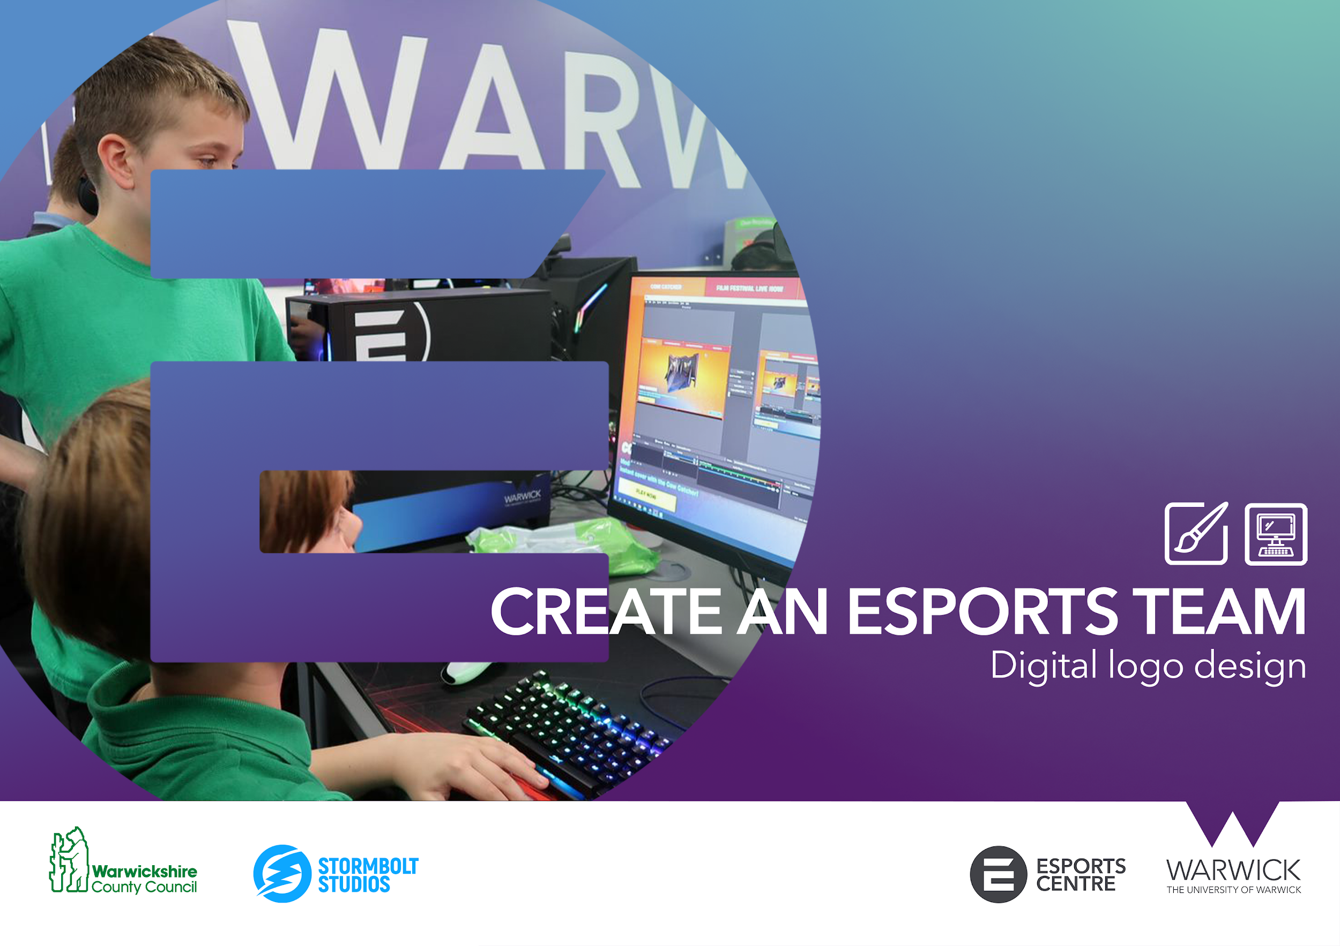


Slide 2


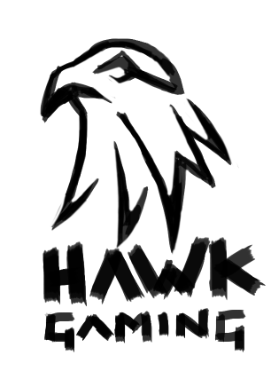
ACTIVITY 2: DIGITAL LOGO DESIGN
Materials and equipment needed
Computer with internet access
Pixlr.com access
In this exercise you will use Pixlr to create a digital copy of your chosen esports team logo concept. This logo can then be used on any future designs or projects you develop for your very own esports brand.

Slide 3
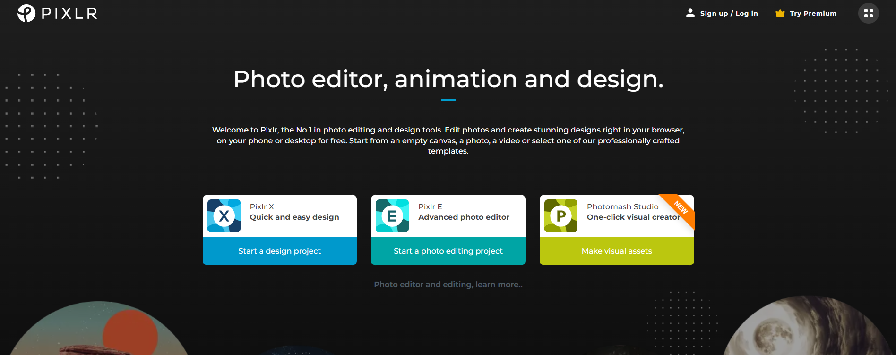
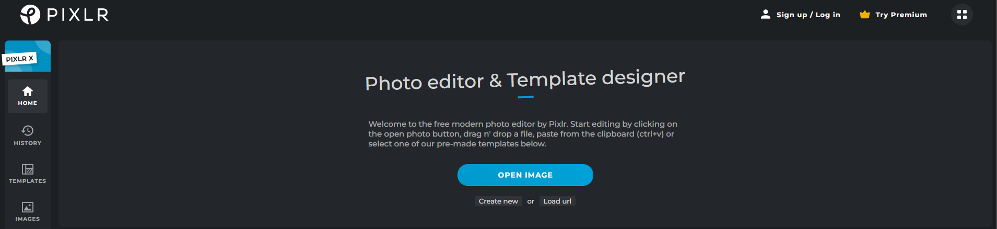
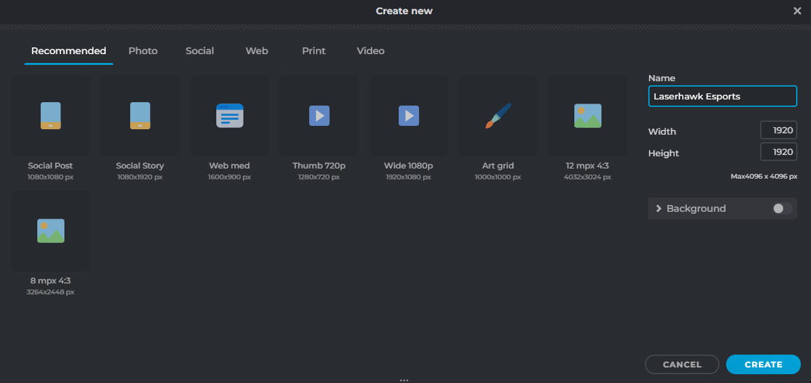
ACTIVITY 2: DIGITAL LOGO DESIGN
Step 1: Create a new Document
Navigate to https://pixlr.com/ and click on the ‘Pixlr X - Quick and Easy Design’ option
Select ‘Create New’
in the pop-up window, name your project and set the width and height values to 1920x1920 pixels.
Ensure that the ‘background’ tab is set to ‘off’. This makes the background transparent.
Having a ‘transparent’ background ensures that you have a clean transferable logo asset to use in for any future media you create for your esports team.

Slide 4
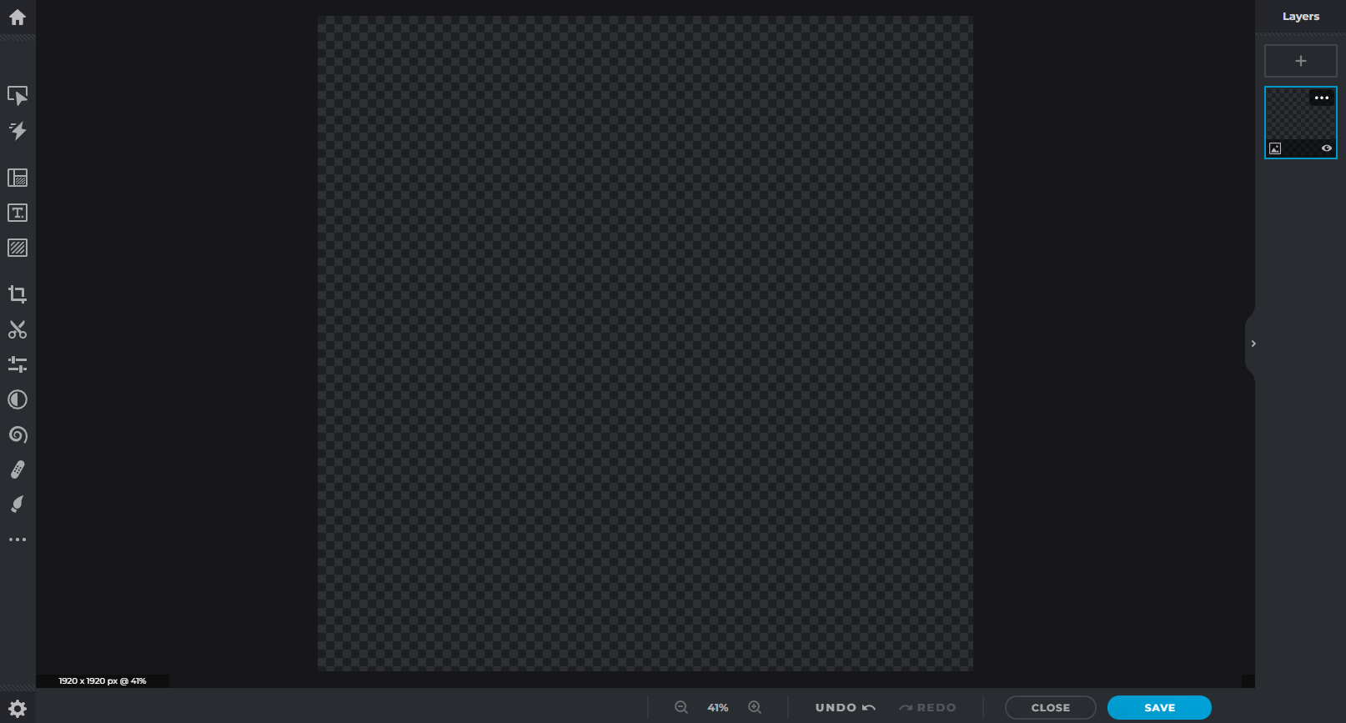
ACTIVITY 2: DIGITAL LOGO DESIGN
The Pixlr workspace will open. Here we can begin to draw, type or import elements to build our team logo.
The left side of the workspace contains the tools. The central panel is the work area and on the right the layer menu.
Ensure that the design area background is checkered. This means that the image background is transparent.
Layers allow us to put media assets on top or below one another to build our logo.
Pixlr gives us a lot of creative freedom to use pre-made assets or draw and build our own from shapes and presets.
You may begin to explore the toolset and see what features can be used within Pixlr.
Tool Menu
Work Area
Layer Menu

Slide 5
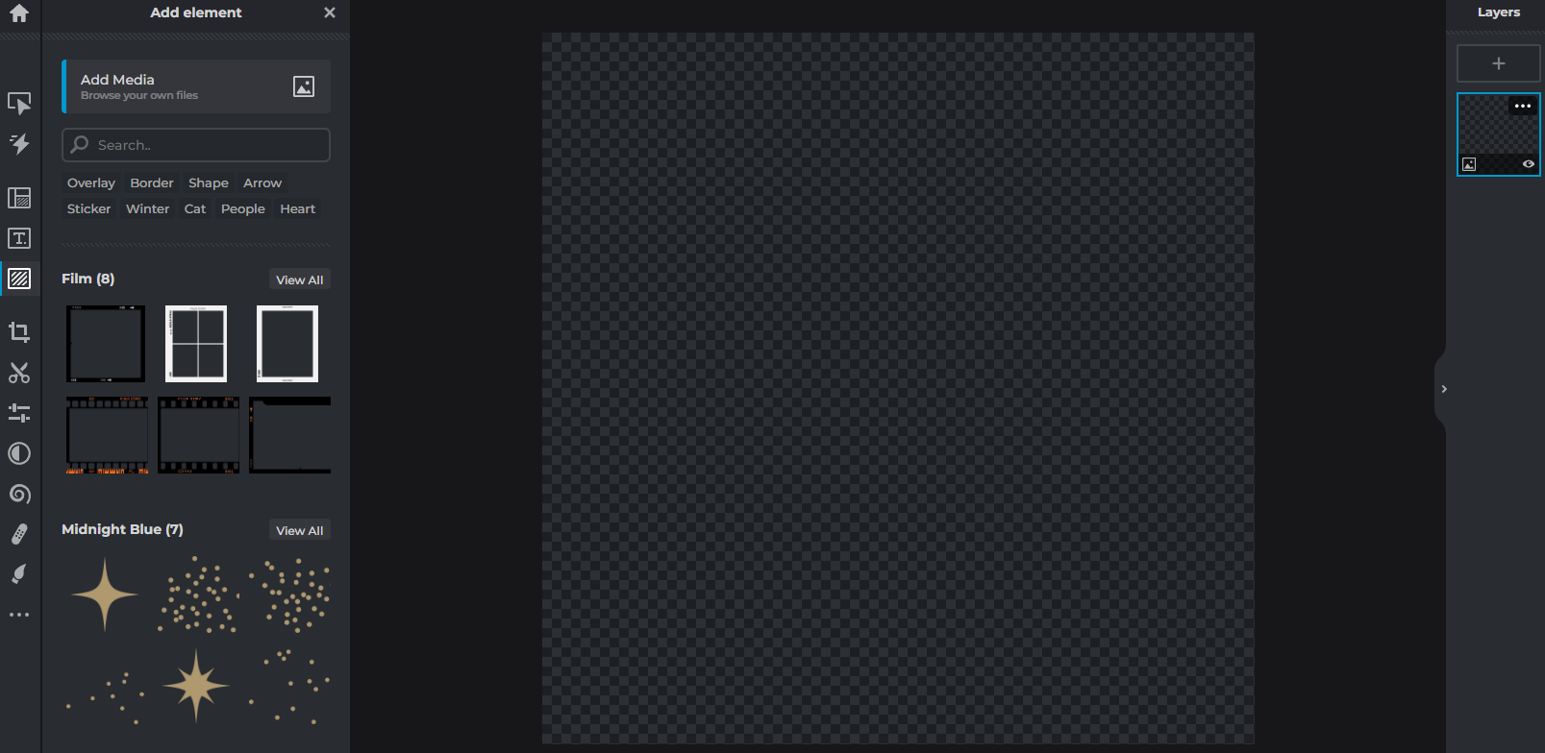
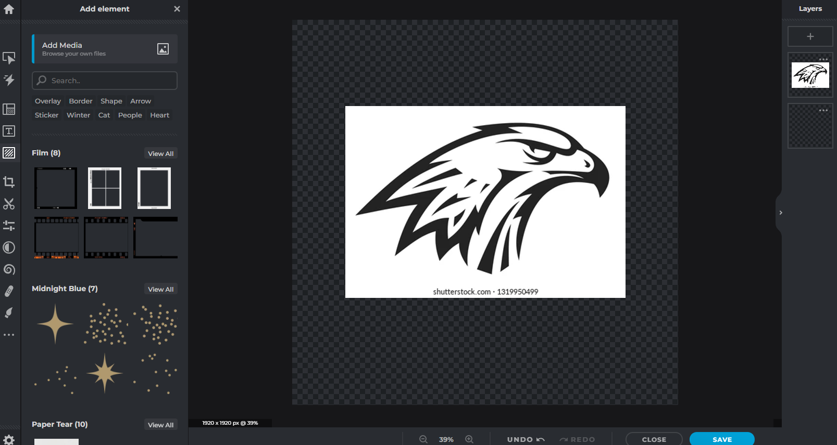
ACTIVITY 2: DIGITAL LOGO DESIGN
Step 2: Pixlr Design
For the purposes of this exercise, follow the example design process, implementing your own assets. In this example, we will be designing a brand called ‘Laserhawk Esports’.
Our first goal will be to collect images from the internet that we can use to collage and piece together the logo using existing images or stock.
We have found a simple vector image of a hawk head, similar to our concept, which we have saved to our computer. It can be added to the Pixlr document by:
Selecting ‘add element/image’ from the tool menu.
Then selecting ‘add media’. From the new window that appears
Select the image file and it will then appear in the design space.

Slide 6
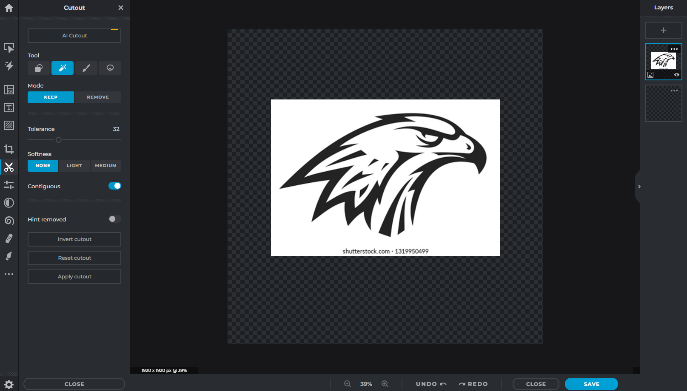
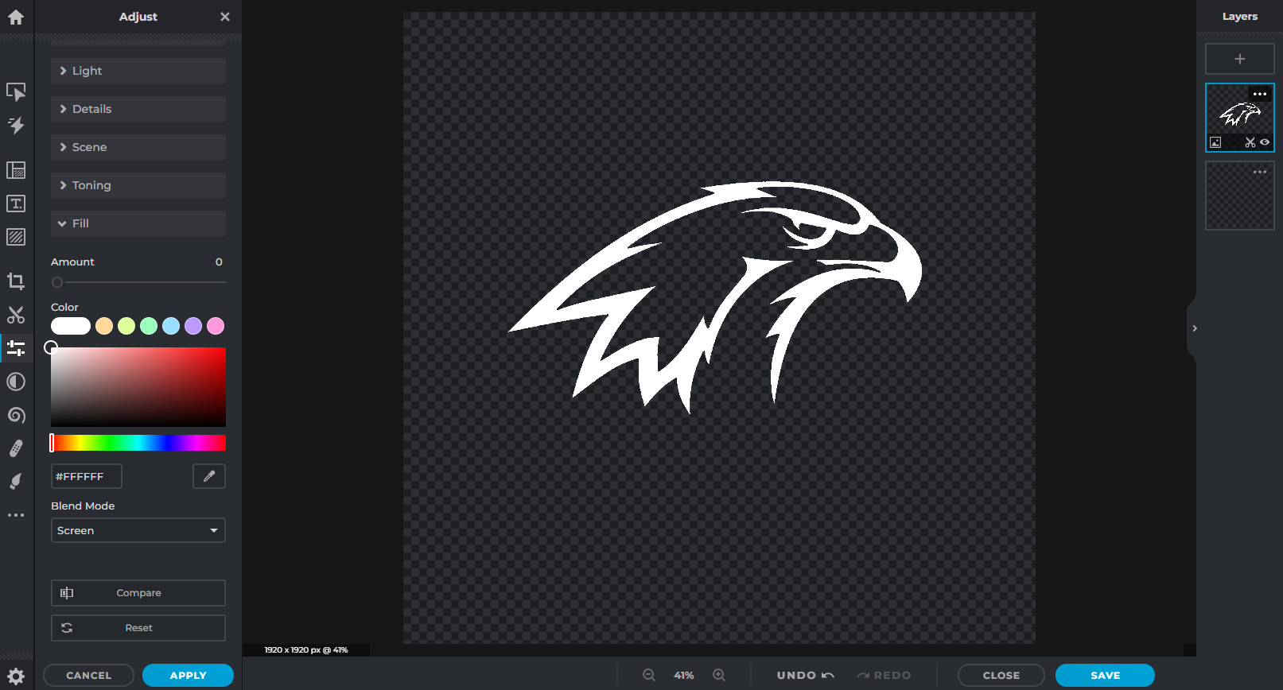
ACTIVITY 2: DIGITAL LOGO DESIGN
As the hawk image has a white background and unwanted text, we want to remove this so we are left with just the hawk design. To do this we:
Select ‘Cutout’ from the tool menu.
Ensure that the ‘Magic Cutout’ tool is selected and the ‘keep’ option is highlighted.
Click on the part of the design you want to keep.
This should remove any white from your image, leaving the main design intact.
The next step is to recolour the image. We do this by:
Selecting ‘Adjust & Filter’ from the tool menu
Selecting ‘Fill’ from the options.
Set the colour to white and ensure that the ‘Blend Mode’ is set to ‘Screen’.
We now have a white cutout of the Hawk image ready to add other elements and assets to develop our digital logo.

Slide 7
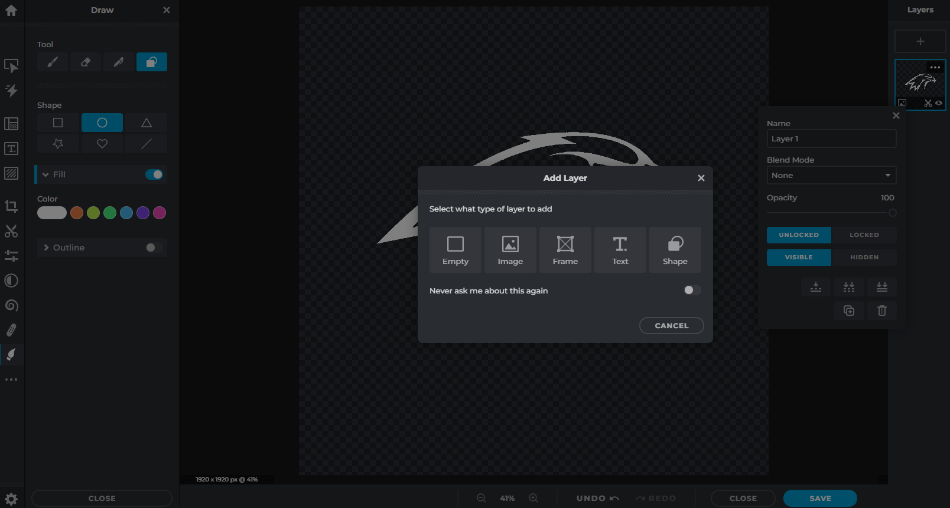
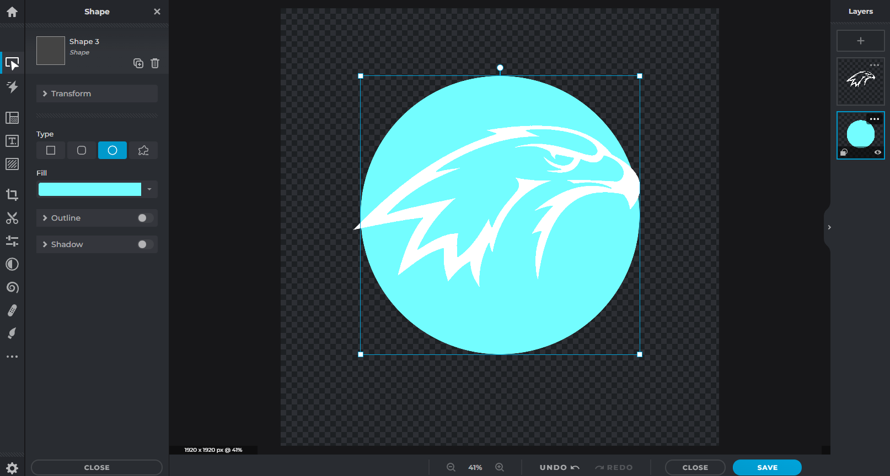
ACTIVITY 2: DIGITAL LOGO DESIGN
The next step is to create a new layer underneath the hawk cutout to add other elements to the logo. We added a circle to the logo to act as a background for the main imagery.
To add a shape to a new layer:
Click on the ‘+’ symbol on the layer panel.
From the layer pop-up menu chose ‘shape’
From the shape tool panel, select the shape and colour
Drag the layer below the hawk image layer on the layer panel

Slide 8
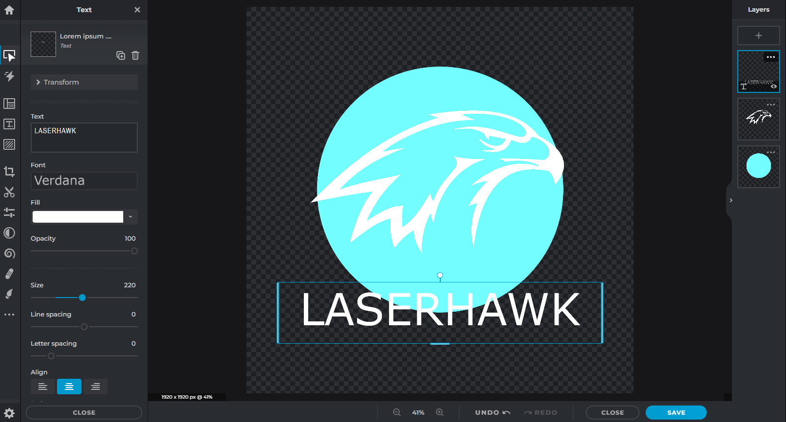
ACTIVITY 2: DIGITAL LOGO DESIGN
The same process can be followed to add a text layer.
To add text to a new layer:
Click on the ‘+’ symbol on the layer panel.
From the layer pop-up menu chose ‘text’
From the text tool panel, select the font, size and colour
Drag the text layer above the hawk image layer and shape layer on the layer panel
We now have a very simple design we can work with. By adding more elements using the same methods of utlising images and layers, we can build upon this foundation to create the final logo design.

Slide 9
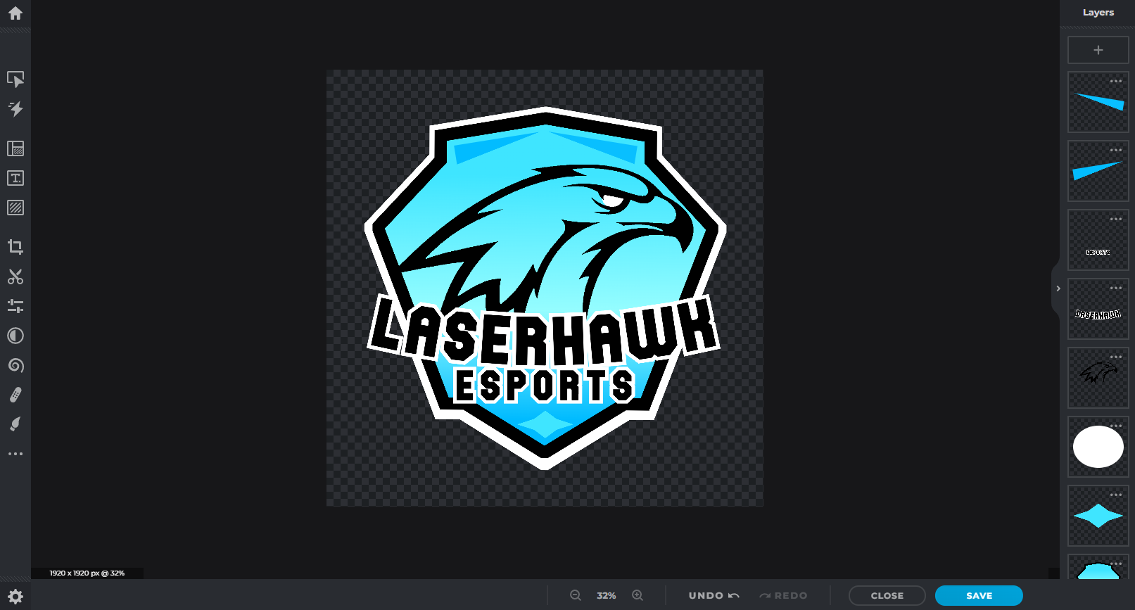
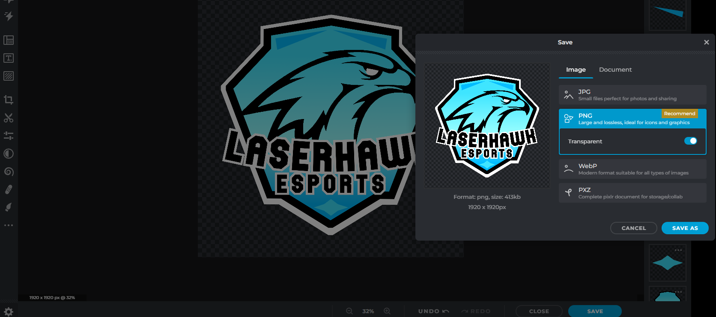
ACTIVITY 2: DIGITAL LOGO DESIGN
Each tool within Pixlr has many more options such as custom shapes, colours, gradients, borders and outlines, text curving and plenty more functionality. Explore and play around with these different options to create something completely unique for your logo.
When you are happy with your new esports logo, save the file as a .PNG image which will preserve the transparency of the background. Meaning you can now import the standalone image onto any other media asset you create for your esports team!

