Slide 1
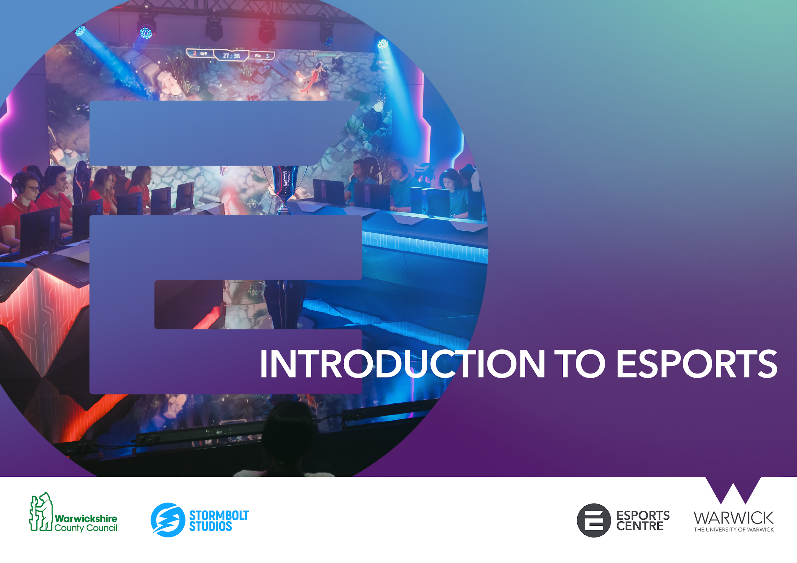


Slide 2



INTRODUCTION TO ESPORTS
Esports is a term to describe competitive video gaming.
Esports differ from standard video game activities in that it (almost always) strictly involves player-vs-player competition and typically has a spectator element to it, much like traditional sports.
You can participate in esports at any level, from amatuer grassroots play to top tier events and competition. Players can compete regardless of age, gender, physical or mental ability.
At the top level of competitive play, esports pros hone their skills and knowledge to the highest levels, much like a professional athlete would in their respective sport.
Whilst the competitive nature of esports is at its core, the esports industry has many different roles and positions that require a wide range of skills to lead and support esports teams and organisations. The educational opportunities around esports span into almost every traditional career path.

Slide 3
INTRODUCTION TO ESPORTS
Esports has a wide range of career pathways. As a creative industry that is centred around digital entertainment and media, opportunities for people continue to expand as esports continues to grow.
Available roles can be broken down into different areas. Whilst this is not an exhaustive list, it will give you a good overview of the types of positions open to you within esports.
Competitive
Media and Entertainment
Business and Administration
Professional players
Coaches
Team managers
Analysts
Performance psychologists
Nutritionists
Scouts
Physical trainers
Therapists
Casters / hosts
Observers
Broadcast production
Social media
Streamers / content creators
Graphic designers
Photographers
Videographers / editors
Journalists
Senior managers / directors
Business strategists
Partnerships and sales
Sponsorships
Human resources
Accountants
Legal personnel
Press officers
Advertisers

Slide 4


INTRODUCTION TO ESPORTS
How can you get involved?
Practice your hobby and develop your skills
Try out new things and explore the different roles within esports
Talk and network with people from the industry
Build an online presence
Consider if you can study a subject area at school, college or university
Set goals and measure your progress

Slide 5

INTRODUCTION TO ESPORTS
Transferable skills
Transferable skills are the type of skills that you achieve in one area of your life, which can then be applied to different backgrounds.
Esports help develop the following:
Teamwork
Leadership
Communication
Resilience
Problem solving
Strategic thinking
Ability to multitask
Analytical skills

