Slide 1
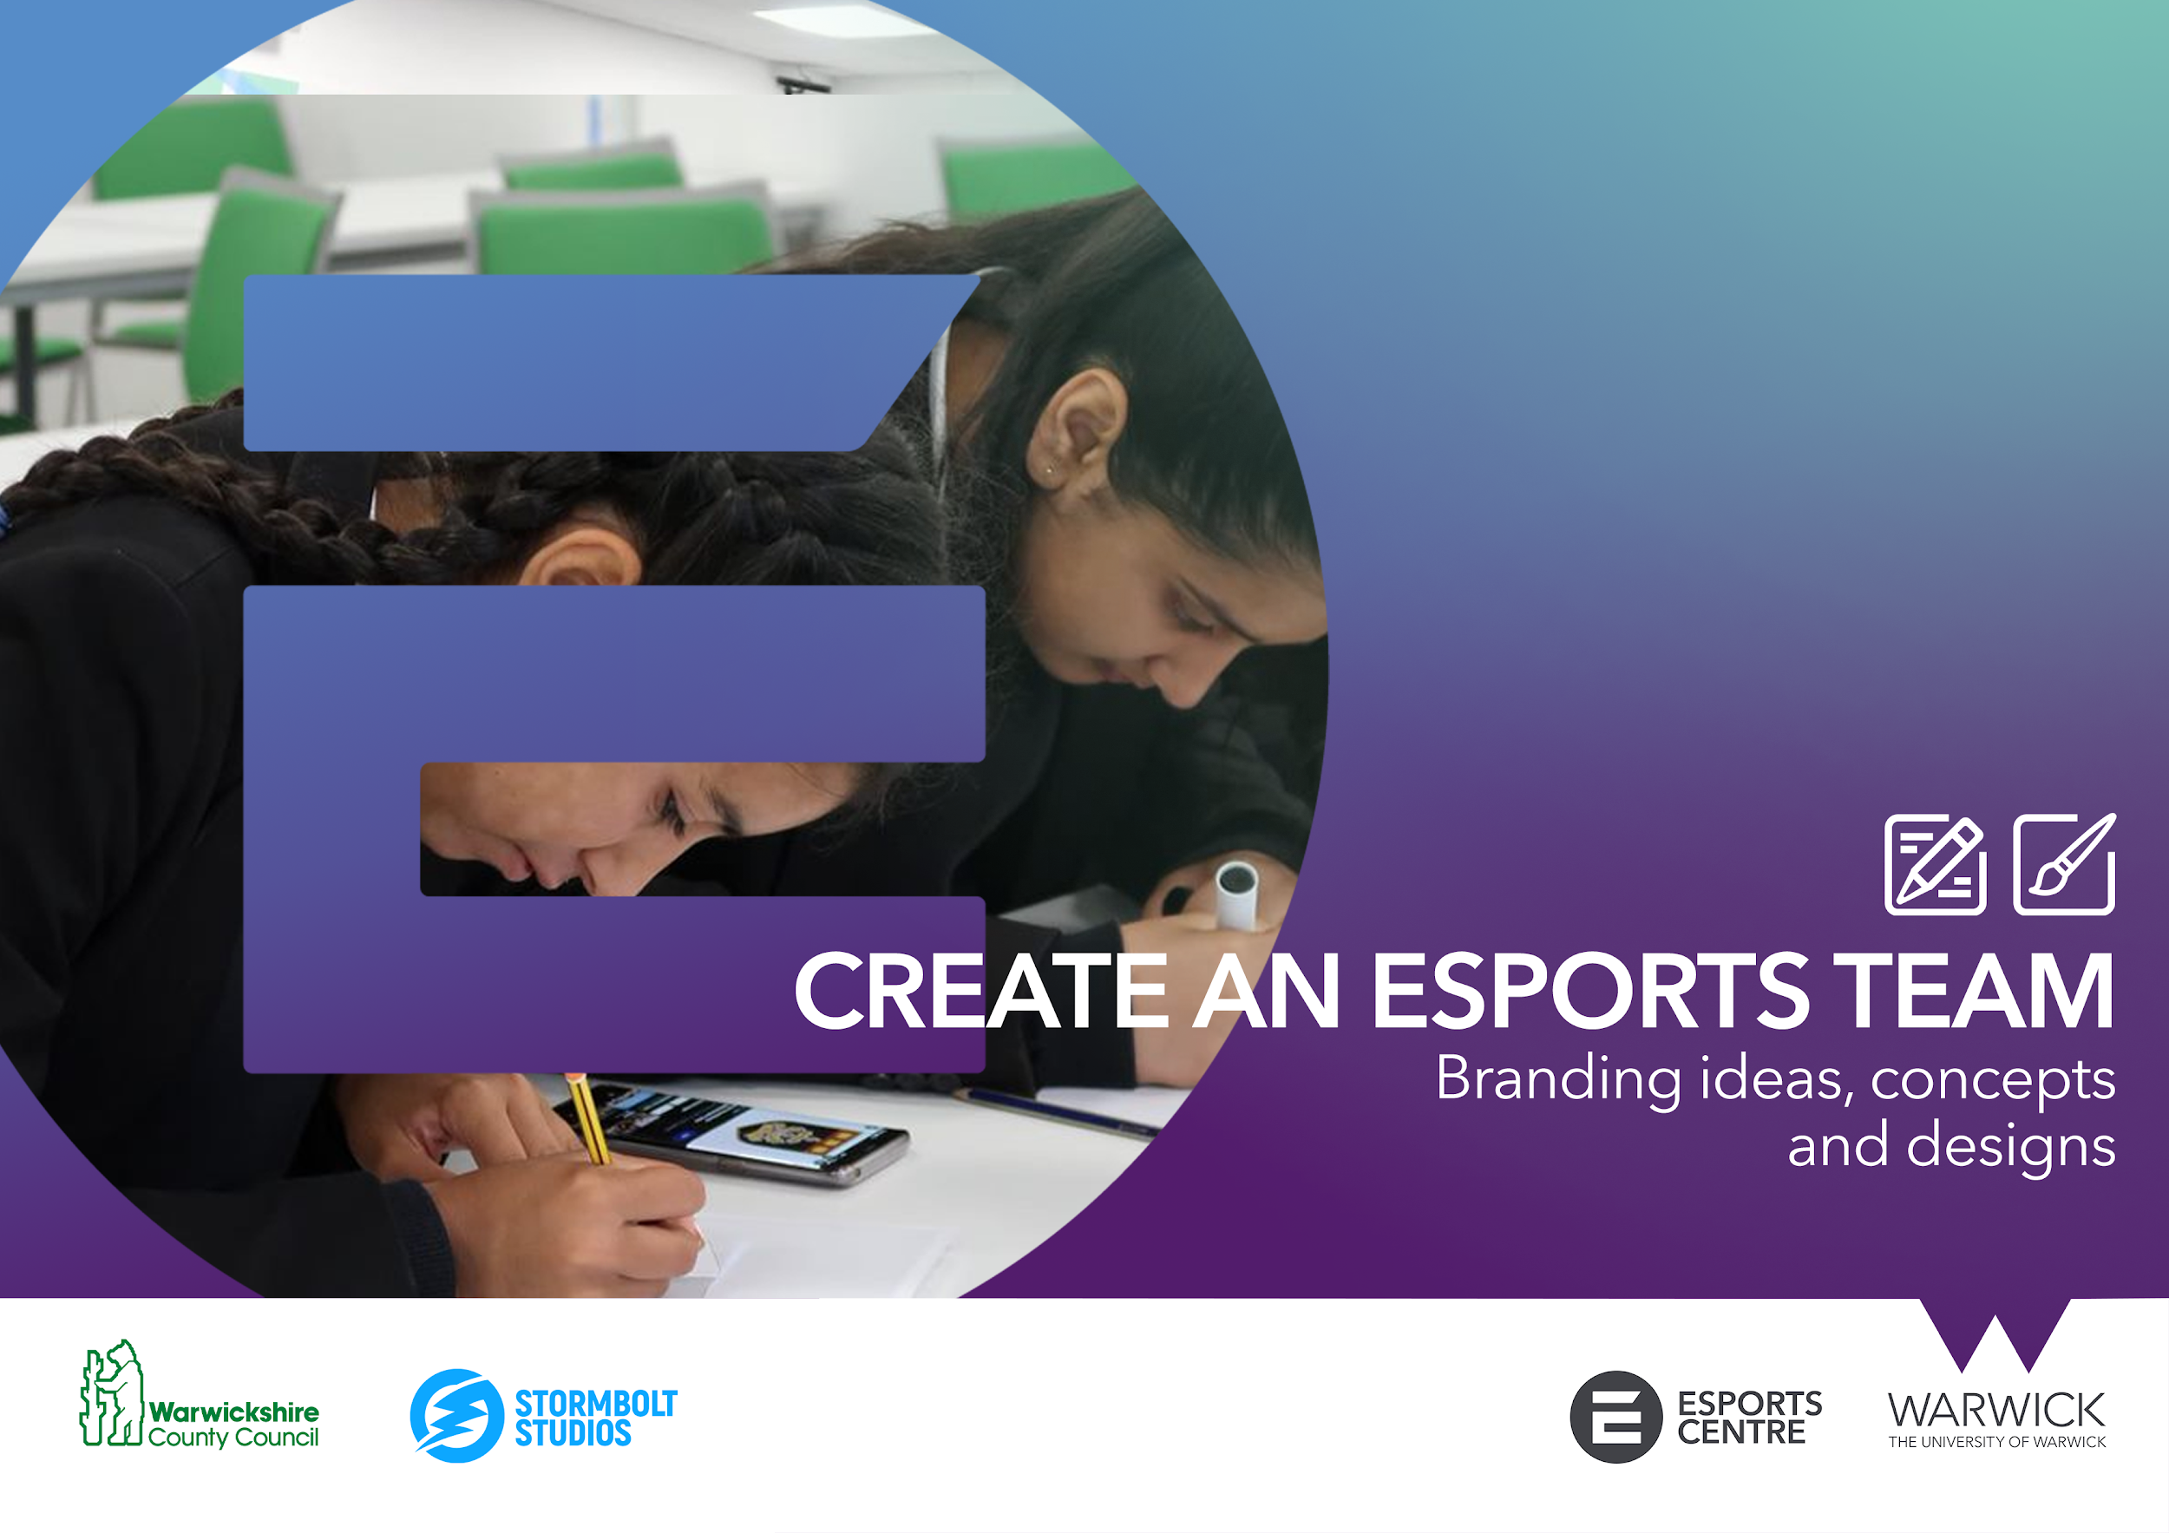


Slide 2





ACTIVITY 1: TEAM LOGO AND NAME
A logo is a symbol made up of images and/or text to help us identify a brand.
Your team logo and name represents your esports brand to the public and what identifies and differentiates your team to others. Having a recognisable logo and memorable name is key to standing out in the crowd.
Logos and names often reference key information about the brand. Often referencing or using a mascot, their theme, their location and what they do.
In the context of esports, brands often use terms like ‘Gaming’, ‘Team’ and ‘Esports’ before or after their main title to identify their position as an esports organisation. However in some instances teams may use single, combined or altered words to identify themselves. Some teams use obscure names that fit their branding.
CLOUD 9
COMPLEXITY GAMING
G2 ESPORTS
FNATIC

Slide 3



ACTIVITY 1: TEAM LOGO AND NAME
As esports continues to grow so does the collegiate esports scene. Many academic institutes throughout the UK and the world now have their own esports teams and societies.
This example comes from Keele University and showcases a number of design elements that you can consider when thinking about your own esports brand.
Identifies the named location of where the team is situated
Uses alliteration to create a thematic title and mascot for the brand
Uses simple mascot design to provide readability and recognition
Uses a minimal colour palette using only 3 variations of purple.
The ‘Krakens’ name is coloured white to stand out from the rest of the design as the main brand identifier.

Slide 4

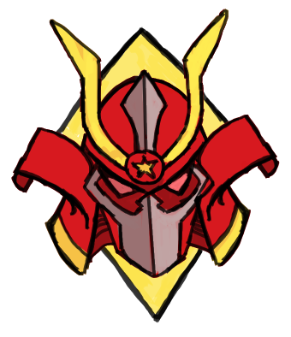
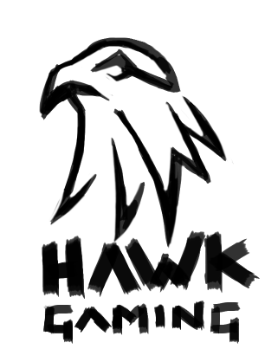
ACTIVITY 1: TEAM LOGO AND NAME
Branding Concepts
Materials and equipment needed
Logo design templates
Pencils (Standard and colour)
Pen and colour markers
Erasers
Using pencil, sketch a range of different logo concepts within the design template boxes.
Consider the theme of your potential esports team. Reflecting on the examples of existing esports teams will you use characters, images, words or shapes to design your brand?
You should also colour your designs. Think about the colour scheme your team will use throughout their branding.
Here are a few things to think about as a starting point to help you with your ideas.
You could use your favourite animal
You could use your favourite era or people in history
You could use your favourite vehicle
You could use your nearest town or city
You could use your name

Slide 5

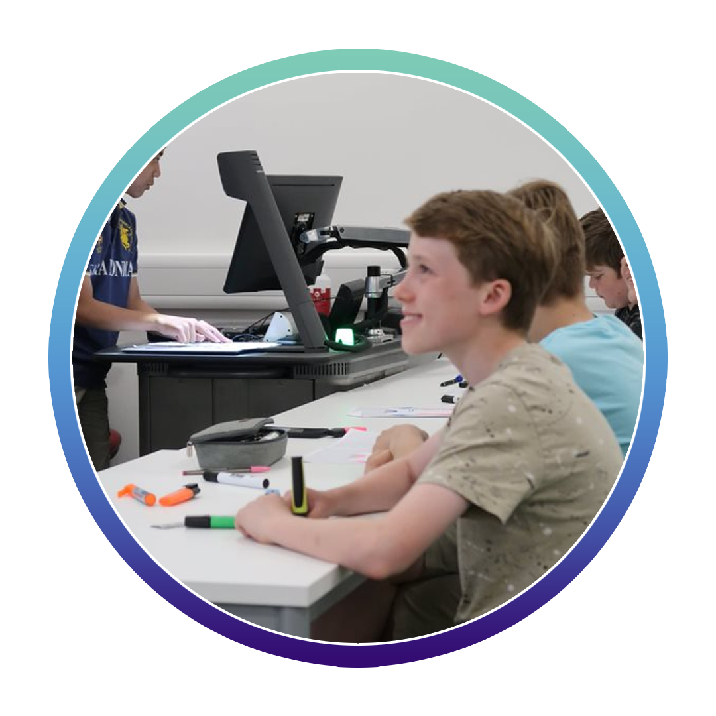
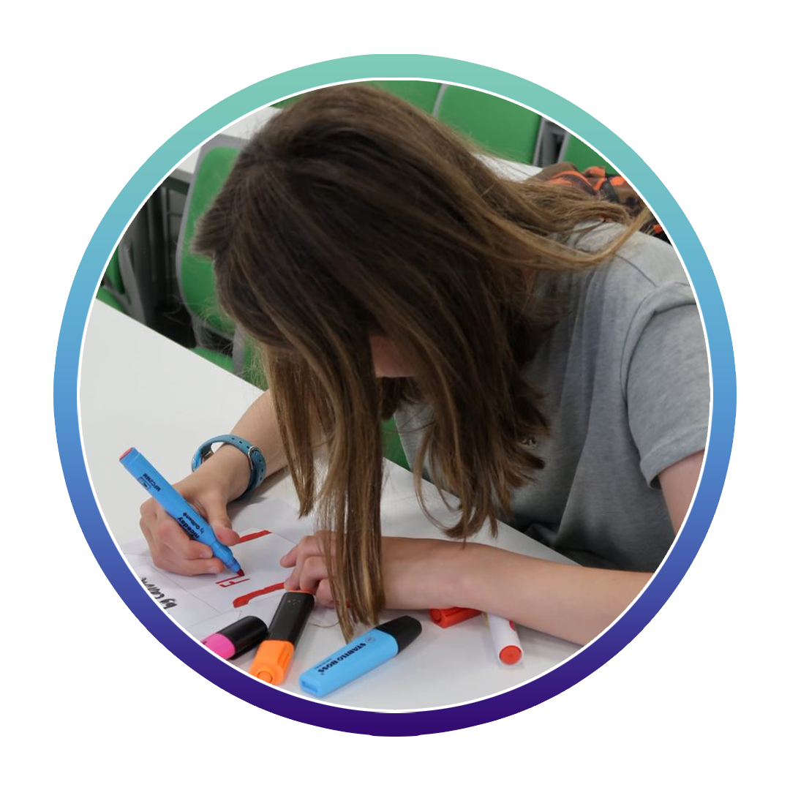
ACTIVITY 1: TEAM LOGO AND NAME
Remember, at this stage you aren't looking for the finished product. You are simply looking to explore and develop some ideas to take forward to produce a final design.
Things to consider when designing a logo
Less is more. Complex or detailed designs lose readability when reduced in size.
Make it personal. This is your brand, make something close to you.
Be bold. You want your brand to stand out.
Be unique. Esports is fast becoming a saturated industry, set yourself apart.
Keep it clean. You want your brand to have a positive image, avoid anything offensive/rude.

Slide 6
ACTIVITY 1: TEAM LOGO AND NAME
LOGO DESIGN TEMPLATE
Team name
Team name
Team name

