Slide 1
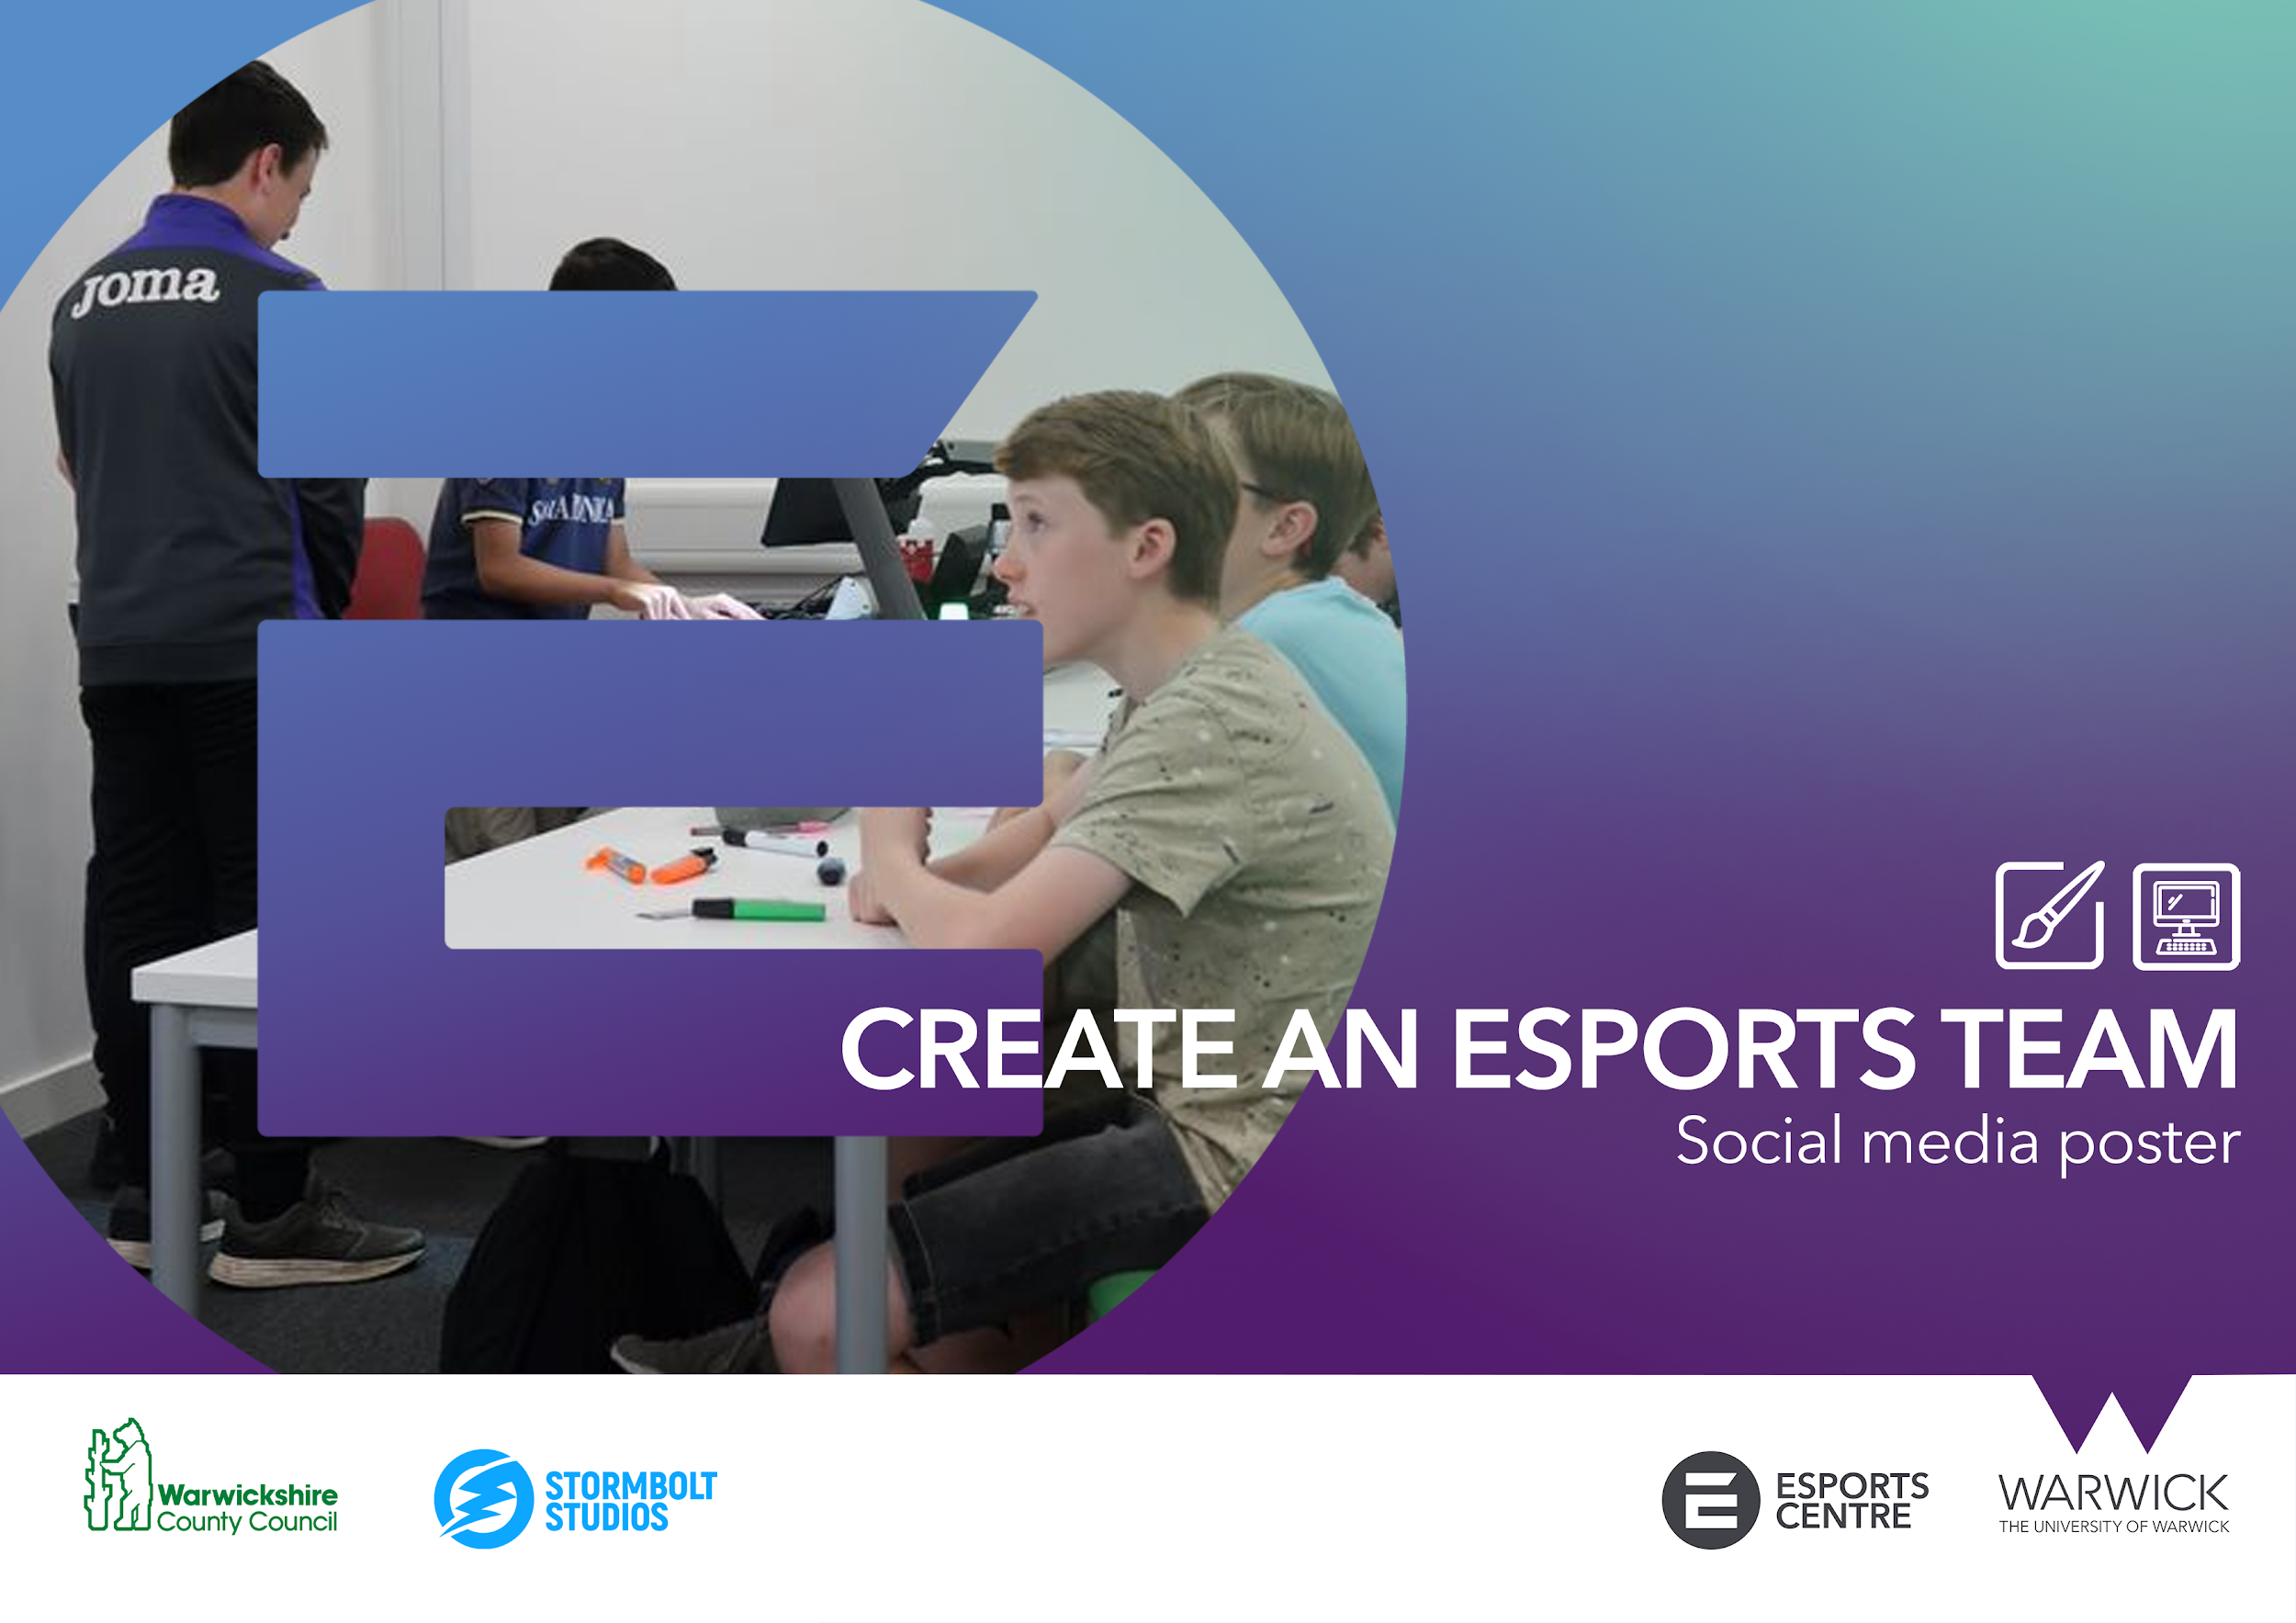


Slide 2

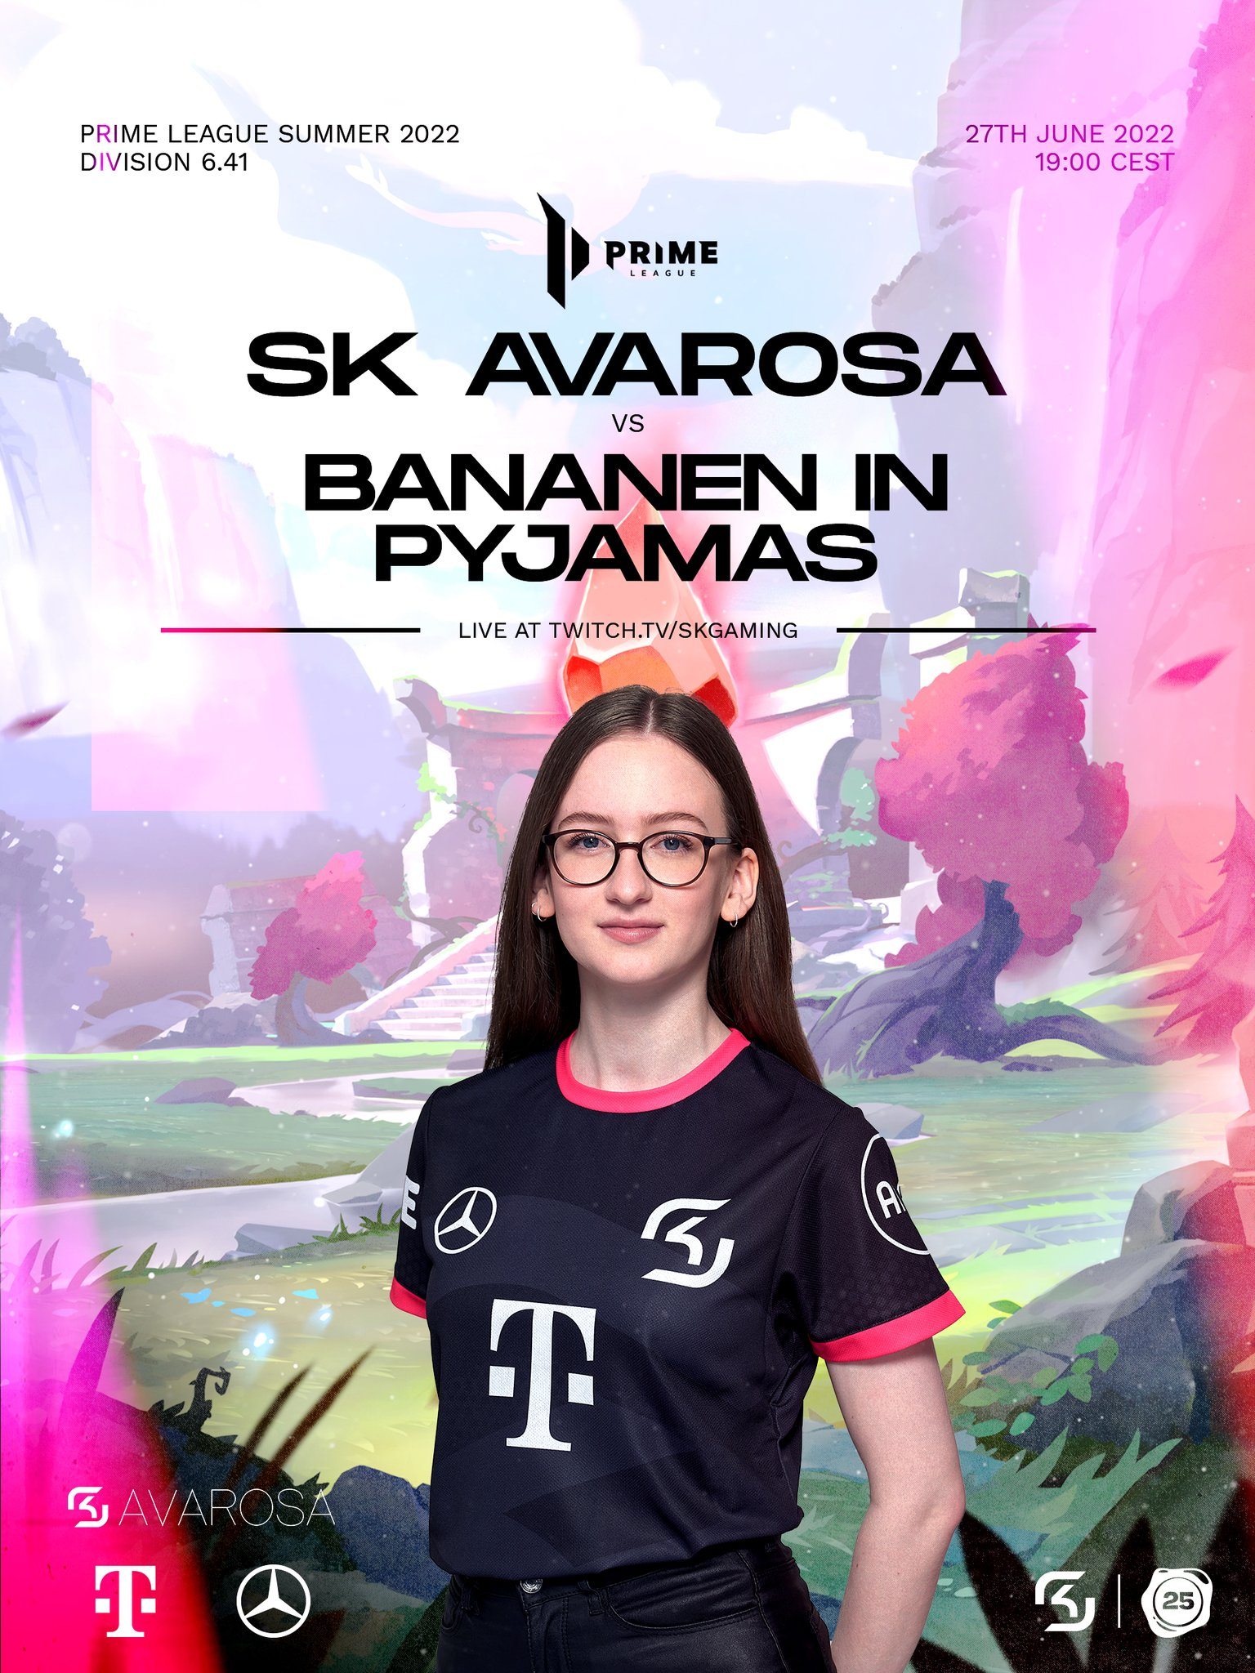
ACTIVITY 5: SOCIAL MEDIA POSTER
As esports is predominantly a digital industry, using social media is essential for esports teams and organisations.
Social media allows esports teams to:
Have cost effective platforms to promote their brand
Have an online presence
Connect and communicate with their audience
Use their platform and audience for paid advertising for sponsors and partners

Slide 3
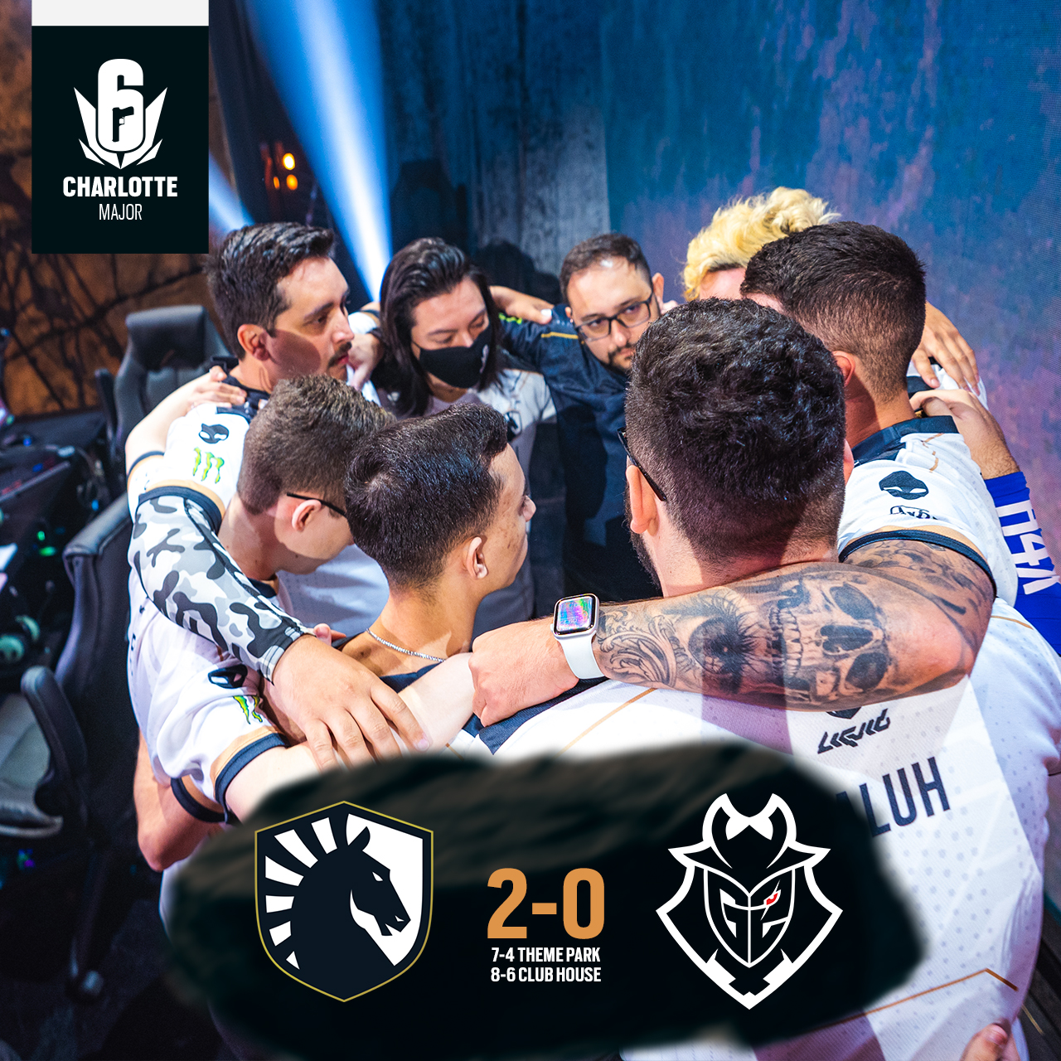
ACTIVITY 5: SOCIAL MEDIA POSTER
Social media posts communicate news or updates to an audience. In esports, these updates are commonly told through visual media such as a poster or video.
Typical types of social media posts
Product / launch announcements
Partnership announcements
Event details
Player signings
Roster announcements
Tournament announcements
Game win/loss or score
Promotions / merchandise advertising
News or articles

Slide 4
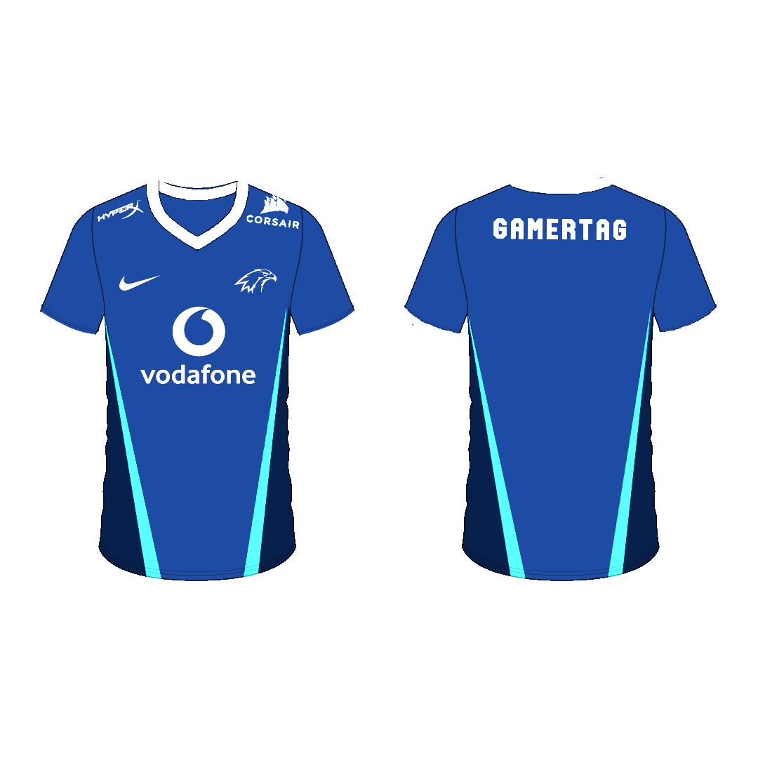
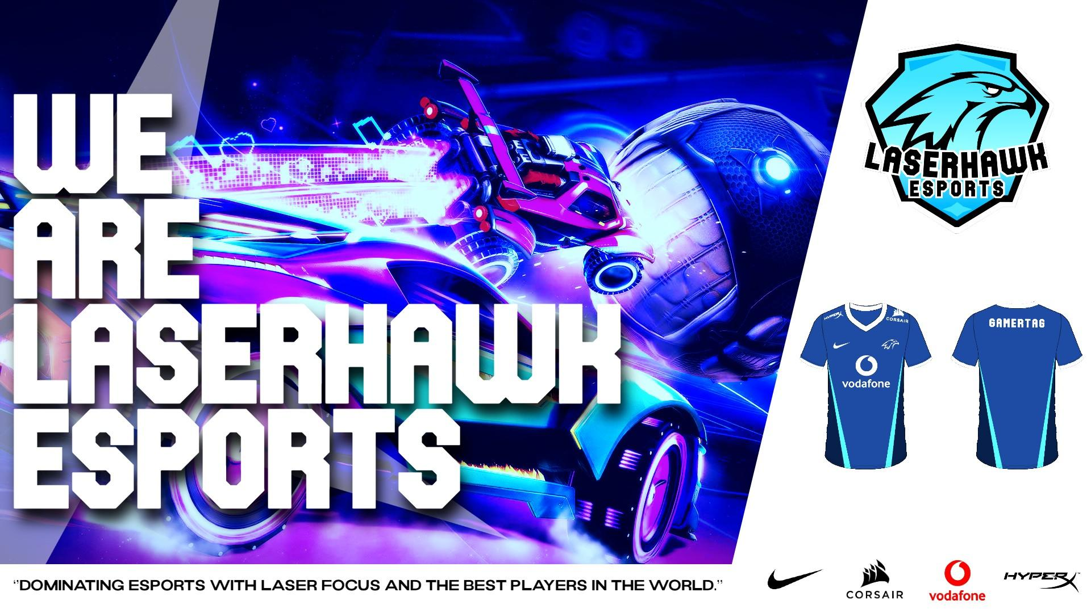

ACTIVITY 5: SOCIAL MEDIA POSTER
Social Media Poster
Materials and equipment needed
Computer with internet access
Pixlr.com access
For this task, we will be using all of the digital and written assets you have created. This includes the digital logo, mission statement and digital jersey design.
Combining all of these elements together to produce a launch poster to announce your newly created esports team in Pixlr.

Slide 5
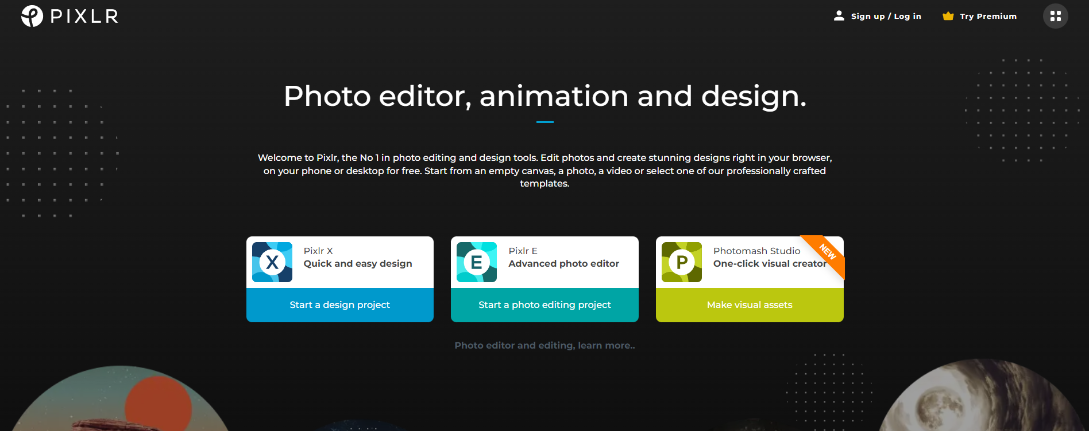
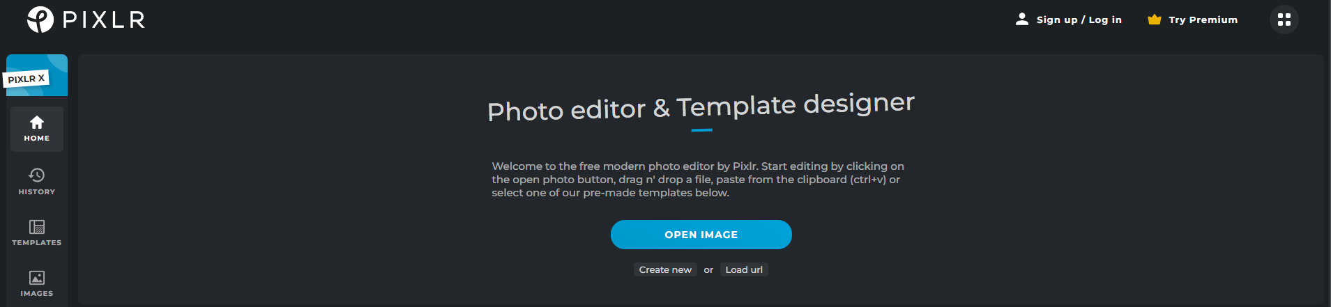
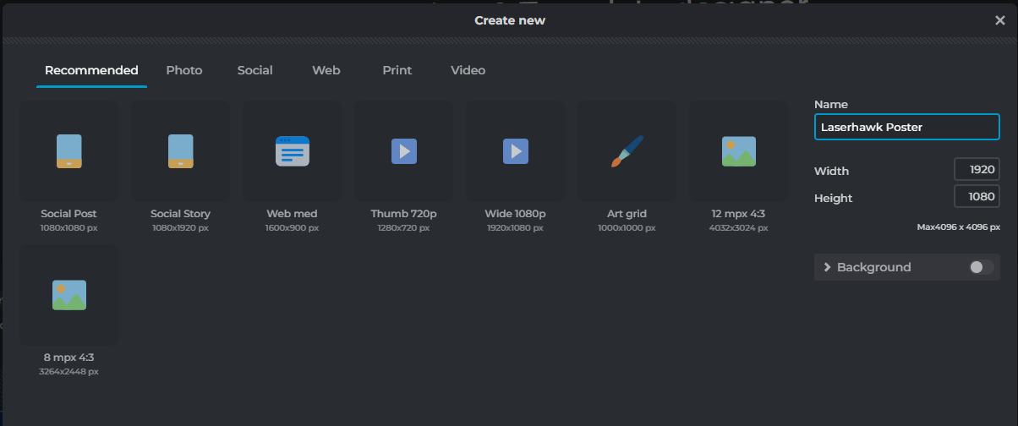
ACTIVITY 5: SOCIAL MEDIA POSTER
Step 1: Create a new Document
Navigate to https://pixlr.com/ and click on the ‘Pixlr X - Quick and Easy Design’ option
Select ‘Create New’
in the pop-up window name your project and set the width and height values to 1920x1080 pixels.
a Laserhawk example poster has been provided so that you can see how different shapes and layers have been added to produce the final design.
LASERHAWK POSTER EXAMPLE

Slide 6
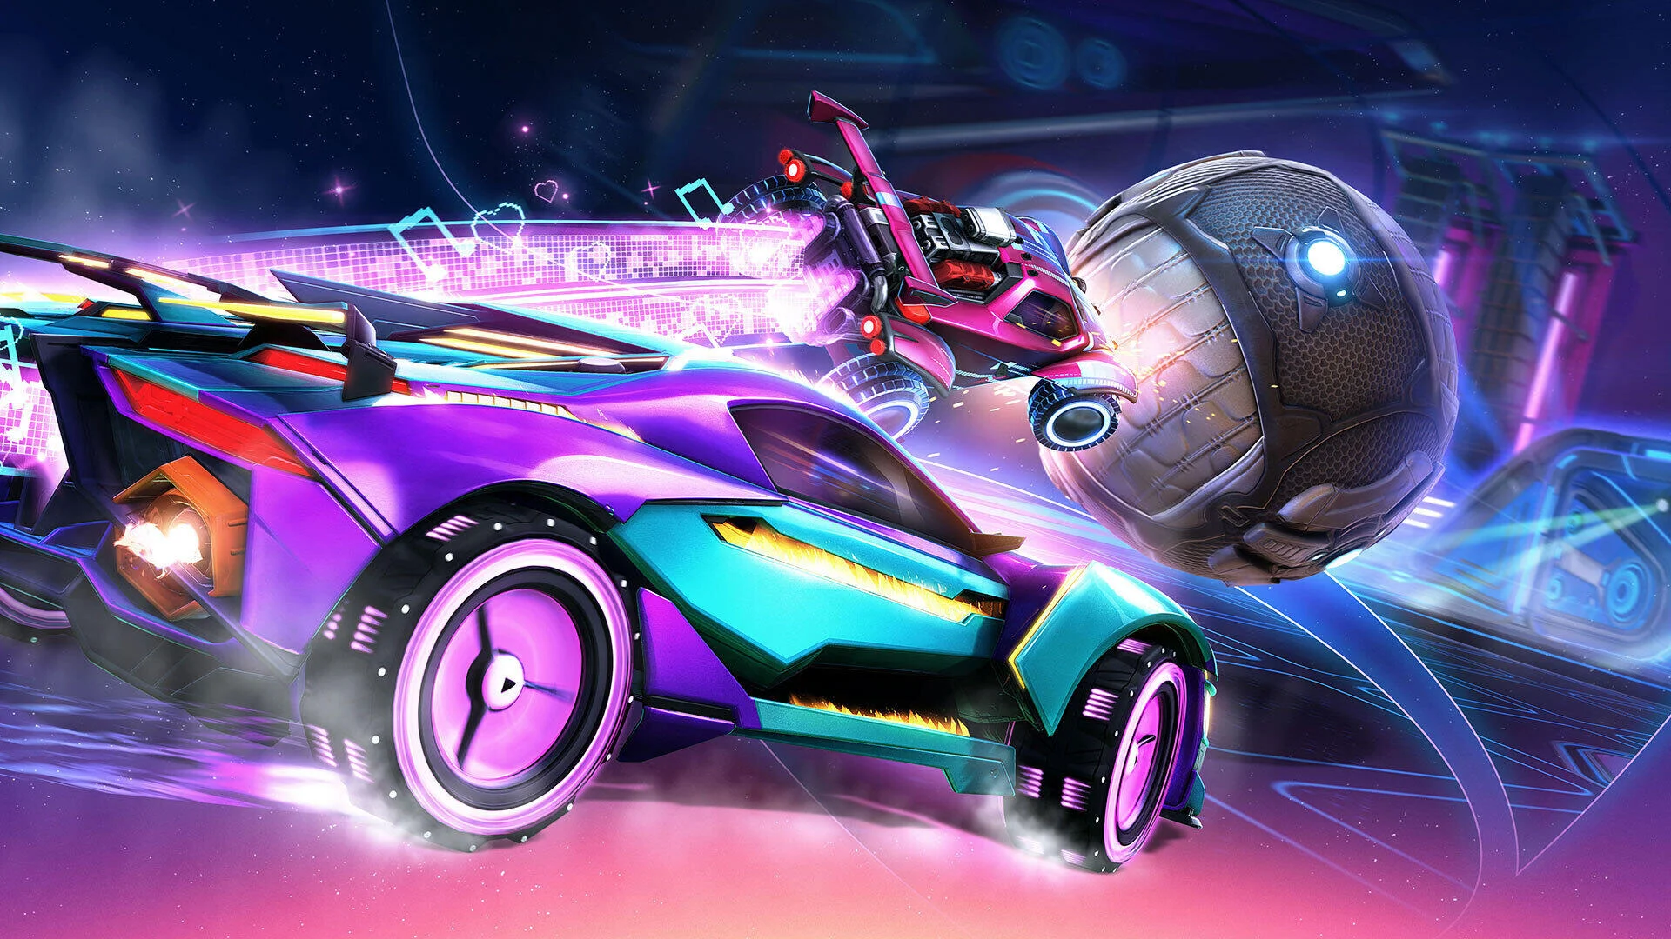
ACTIVITY 5: SOCIAL MEDIA POSTER
Step 2: Find an image that best represents what your esports team. Consider how eye catching and exciting the image will be to your audience.
This could related to:
The games your team compete in
The location of your team
In this example we have chosen an action shot from Rocket League.
The image does not need to be the correct colour for your brand at this stage
The image does not need to be 1920x1080 pixels (although it will help if it is)

Slide 7
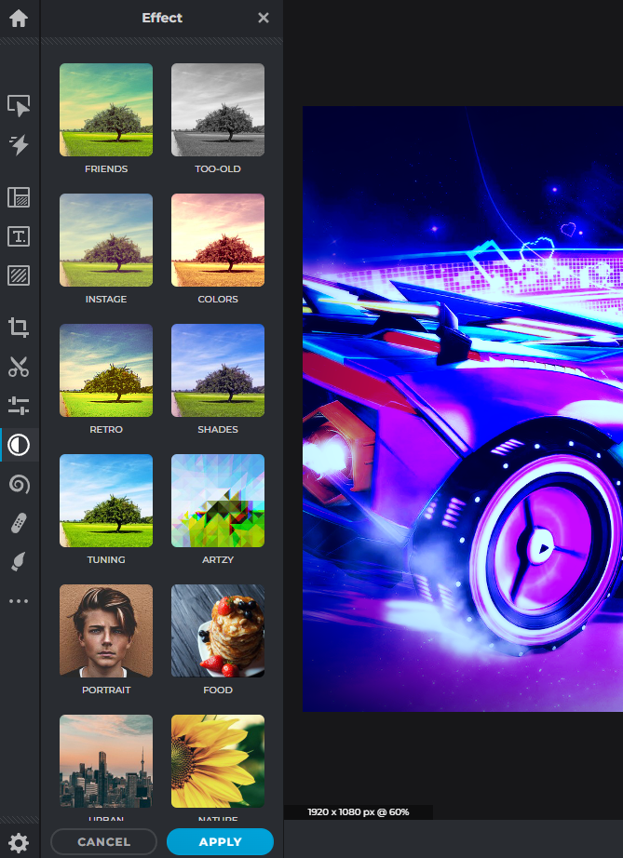
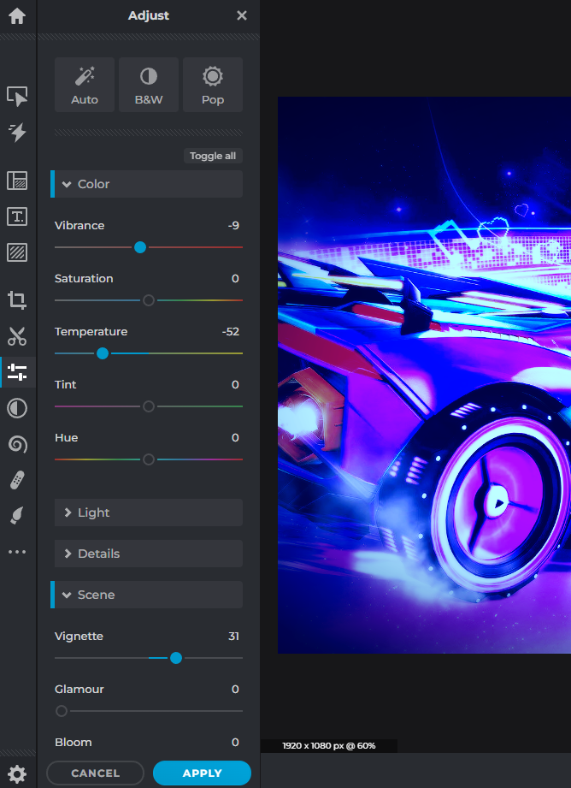
ACTIVITY 5: SOCIAL MEDIA POSTER
We can alter and edit the base image to fit the correct colour scheme to fit your esports team branding.
You can use two functions within Pixlr to achieve this.
Effects panel
The effects panel has a range of preset options that can change the colour and style of your image. Adding grain or pixelating the image as examples
Adjust and Filter
This tool allows you a little more control over your image, giving you functionality to adjust the colour, tone, vibrance and even adding a vignette.
Explore these tools and find a style and colour that you like.
Effects panel
Adjust and Filter

Slide 8
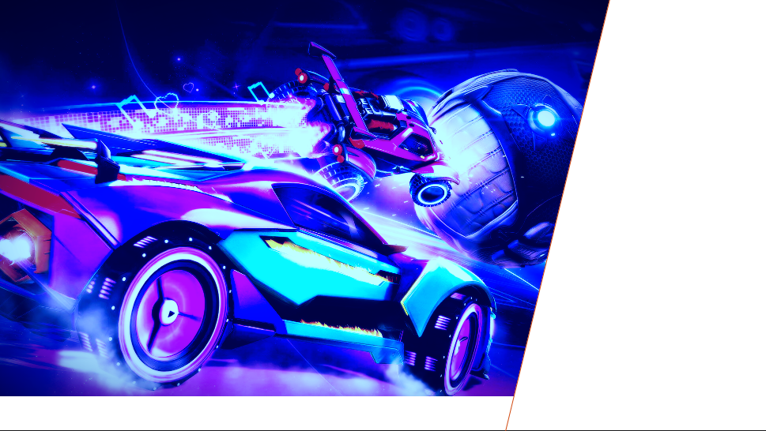
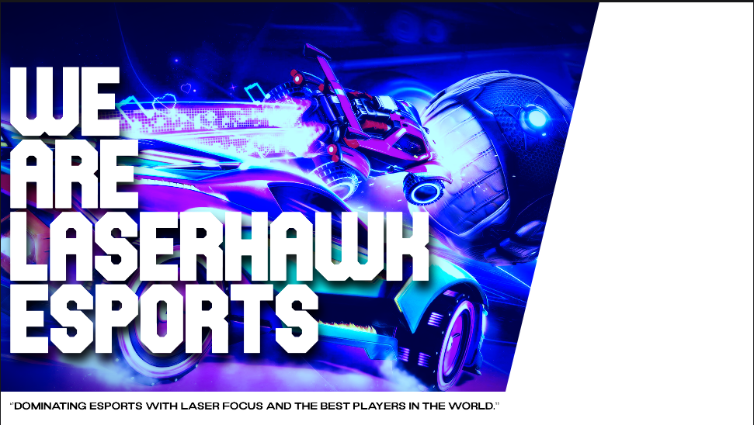
ACTIVITY 5: SOCIAL MEDIA POSTER
Next, we added a neutral white area to provide key information and break up the image. During this stage keep in mind where you want to place your assets or any text within the poster.
Neutral areas can be any colour
Play around with different shapes and designs
Be mindful of spacing and sizing. Allow for all your design elements to be visible without overcrowding the poster.

Slide 9
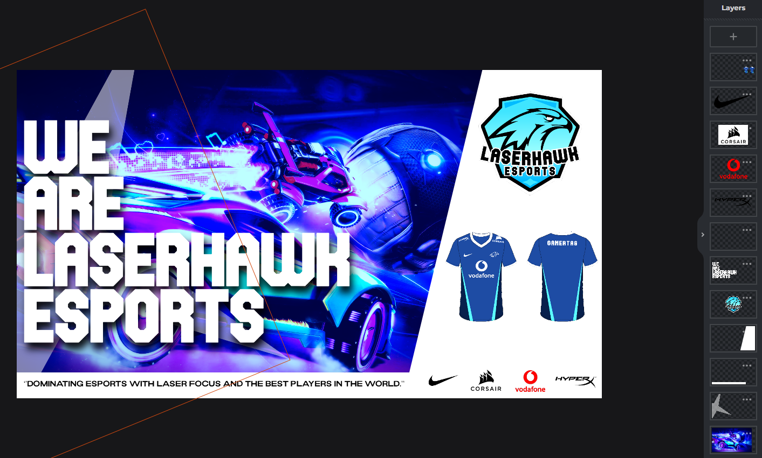
ACTIVITY 5: SOCIAL MEDIA POSTER
Continue to build up the image using the layer system. If you feel confident in your skills within Pixlr, try using the different layer options such as masking and multiply to enhance your image.
Use the skills you have developed in previous activities within Pixlr, such as ‘cutout’ and ‘recolouring’.
Your final poster should include:
A relevant background image to your brand
Your team name
Your team mission statement
Your team logo
Your team jersey
Sponsors (optional)

