Slide 1
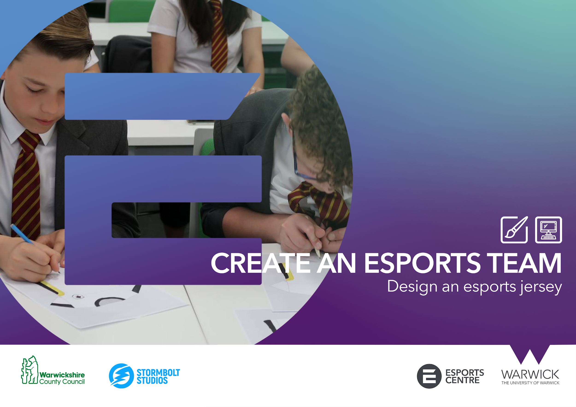


Slide 2


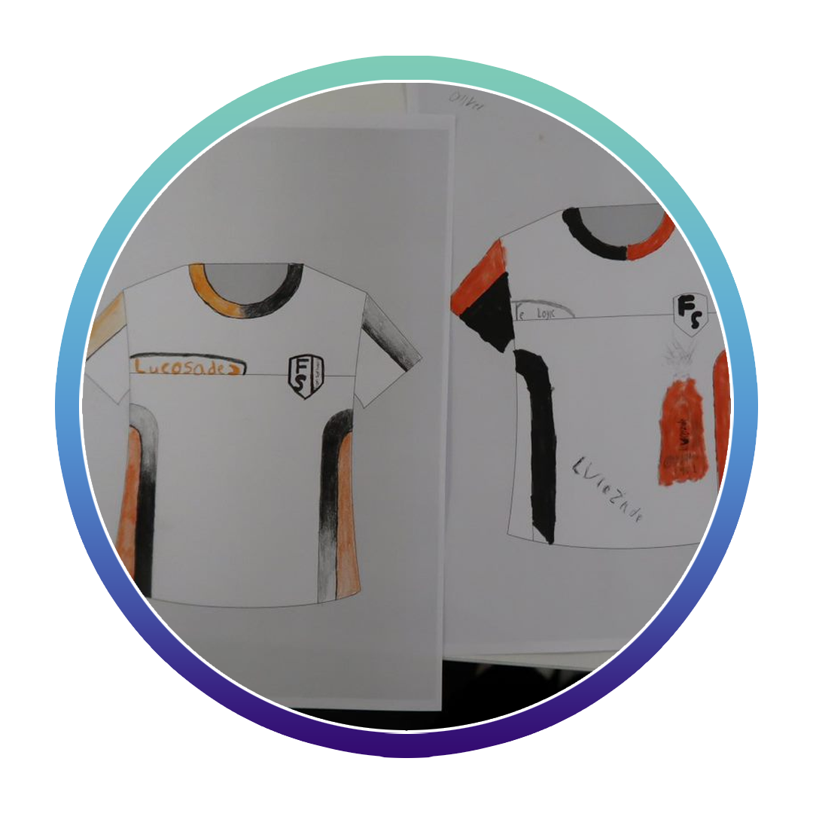
ACTIVITY 4: DESIGN AN ESPORTS JERSEY
A team jersey is a key brand asset to any esports team.
Not only does it visually represent the teams colours and style. It has a number of important functions for esports organisations as a business.
Visual representation of the brand
Recognisable and unique to your team
Saleable asset for fans to purchase (merchandise)
Has retail space for 3rd party sponsors and partners to advertise their own brand.

Slide 3
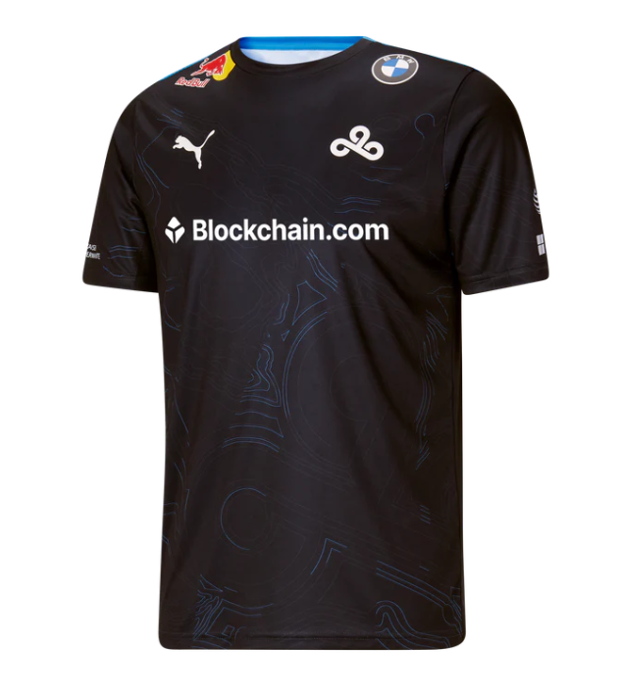
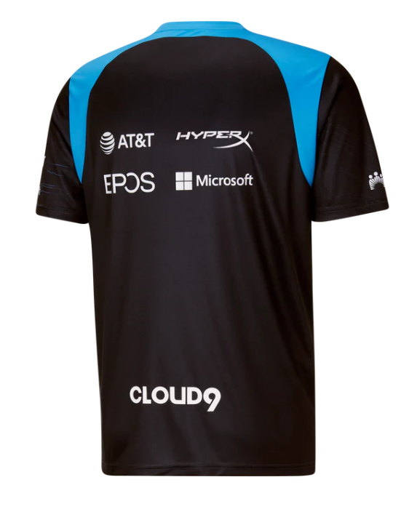
ACTIVITY 4: DESIGN AN ESPORTS JERSEY
Jersey designs can vary in style and colour across the wide range of esports teams.
However there are standard elements to consider when designing an esports jersey.
TEAM LOGO & NAME
TEAM COLOURS
PLAYER NAME
SPACE FOR SPONSORS
Take a look at the example jersey from Cloud9.
4
4
5
2
1
3
4
6
Team logo
Manufacturer
Main sponsor
Other sponsors
Player name (area)
Team name (optional)

Slide 4
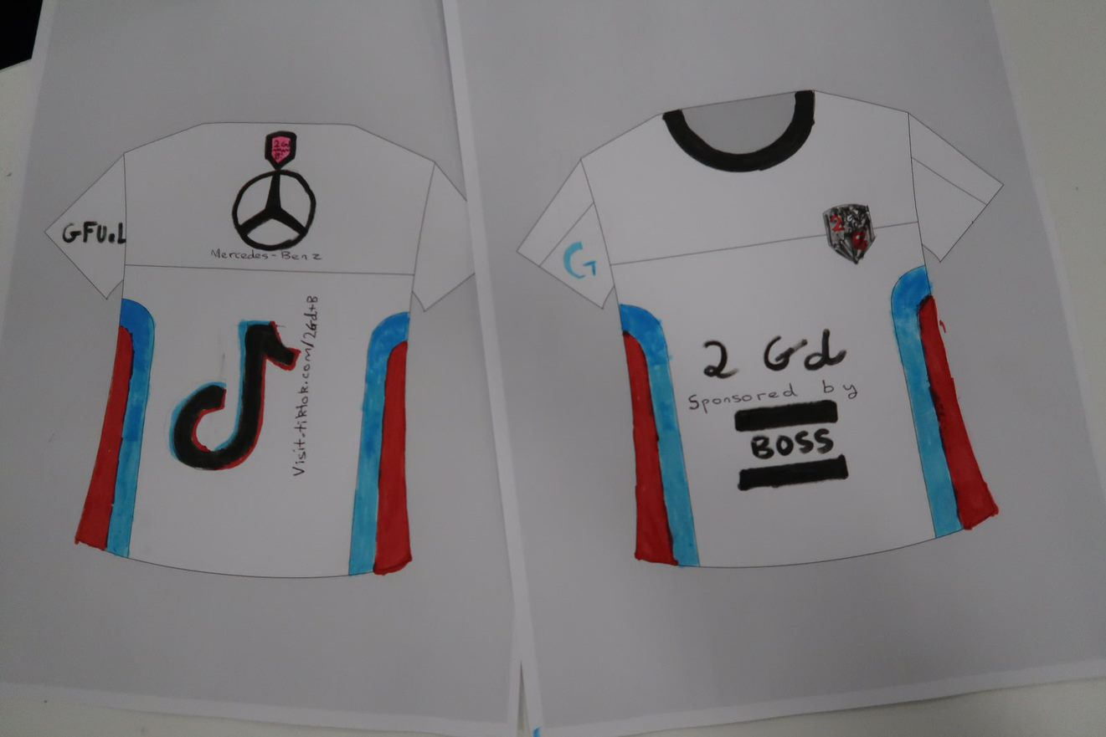
ACTIVITY 4: DESIGN AN ESPORTS JERSEY
Jersey Concepts
Materials and equipment needed
Jersey design template
Pencils (Standard and colour)
Pen and colour markers
Erasers
Using pencil, sketch a your jersey design within the jersey design template. Then, colour your designs in using either colour pencils or markers.
Consider the team colours and branding you have already chosen for your esports brand.
Think about the spacing and areas of your jersey design. Reflecting on the Cloud9 example,
Other sections of the jersey can be utlised for design elements and/or sponsors
Shoulders
Colars
Sleeves
Waist

Slide 5
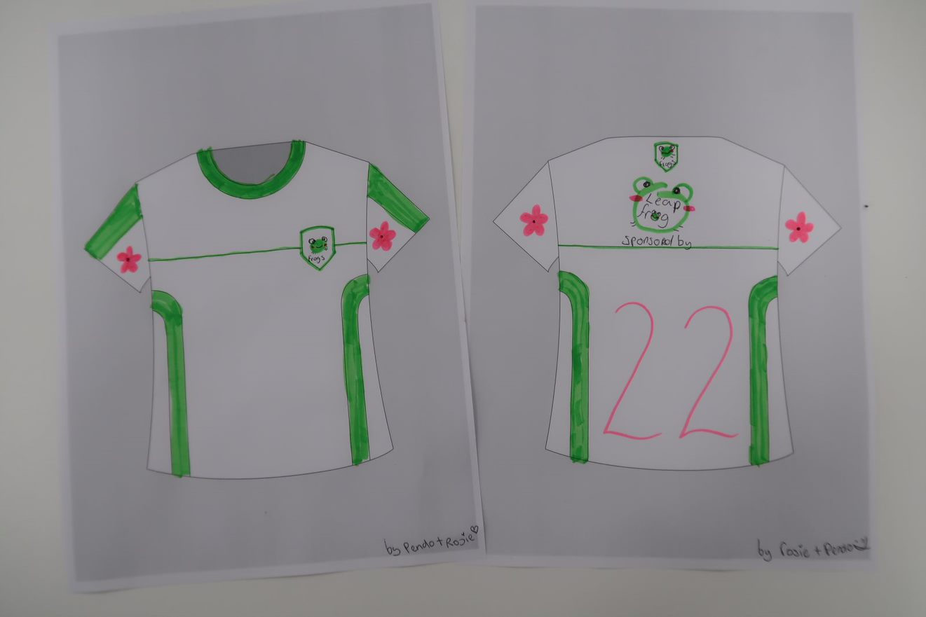
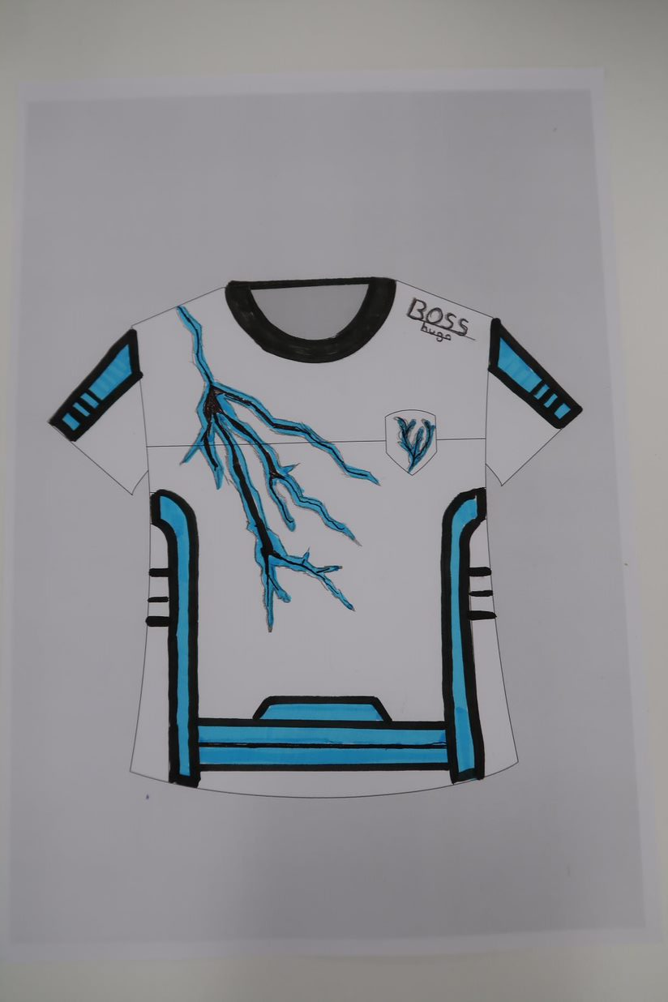
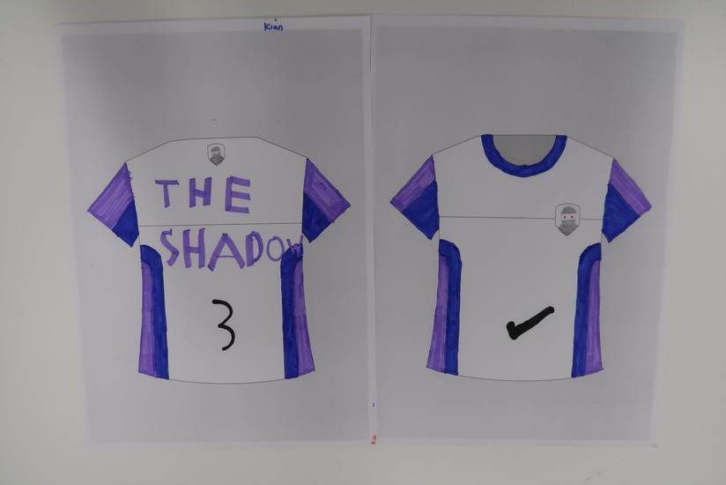
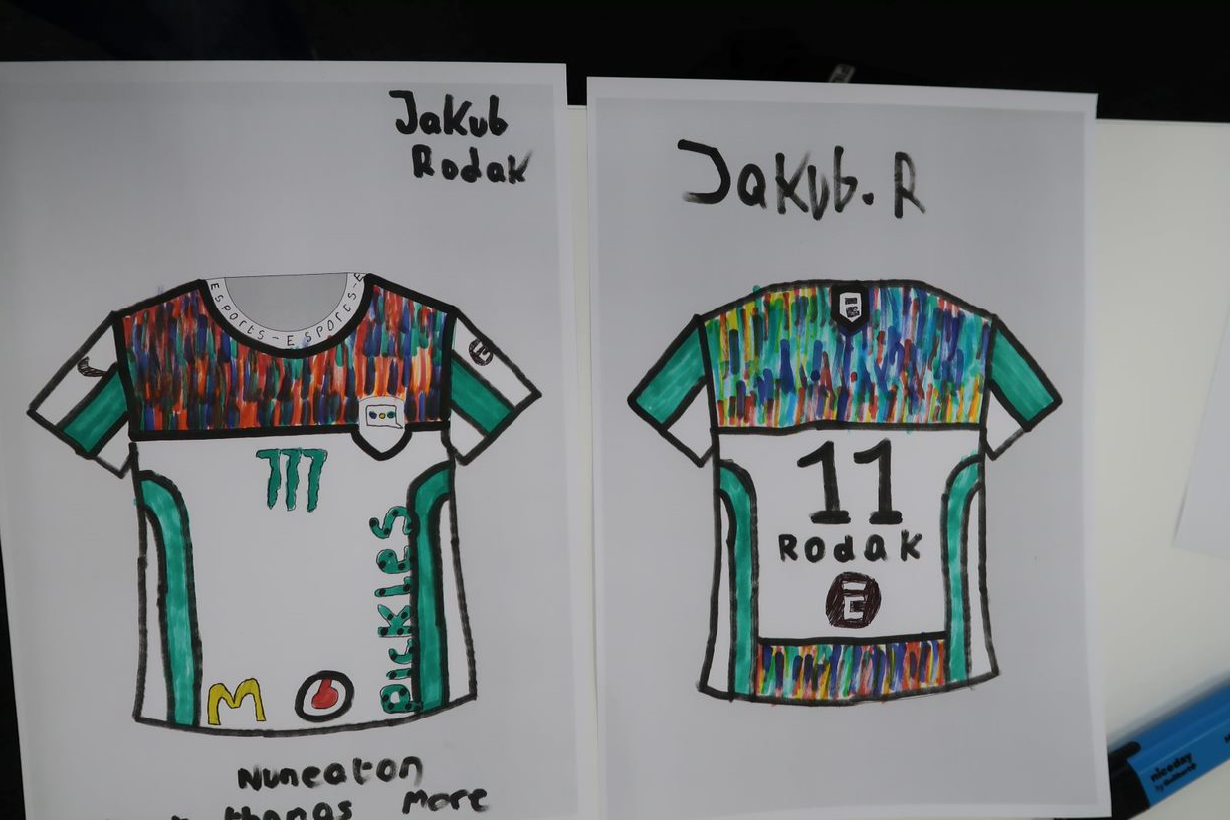
ACTIVITY 4: DESIGN AN ESPORTS JERSEY
EXAMPLE DESIGNS FROM OTHER STUDENTS

Slide 6
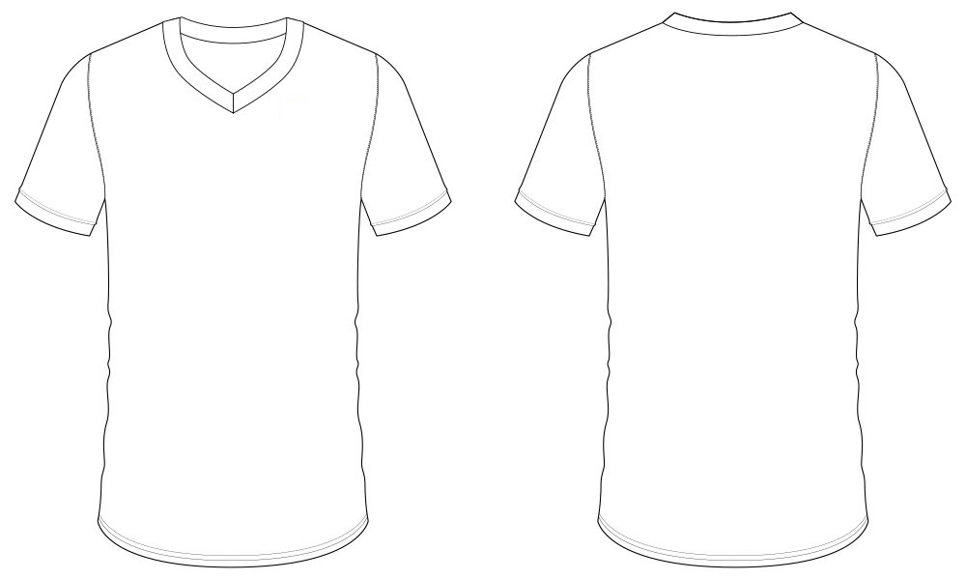
JERSEY DESIGN TEMPLATE
ACTIVITY 4: DESIGN AN ESPORTS JERSEY

Slide 7
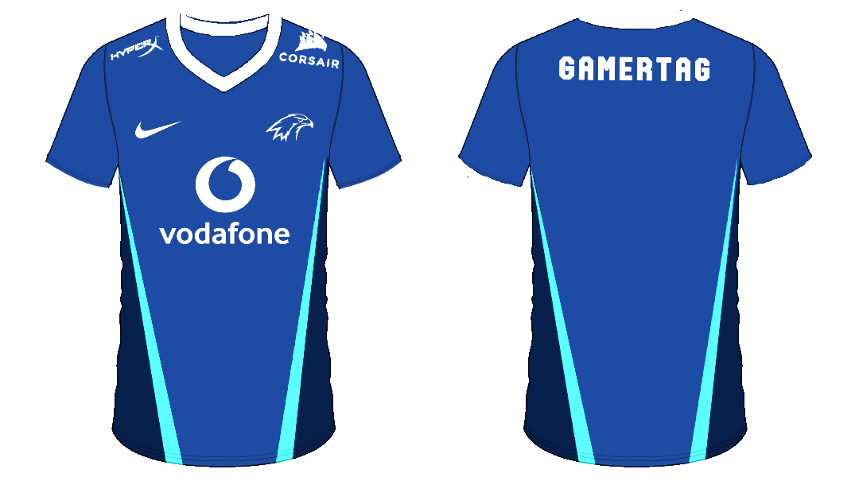
ACTIVITY 4: DESIGN AN ESPORTS JERSEY
Materials and equipment needed
Computer with internet access
Pixlr.com access
For this exercise, you will use the skills learnt in the digital logo design exercise. You will use Pixlr to produce a digital copy of your jersey as a media asset.
As there are more technical elements to this task with the use of advanced layer masks and options, a base template is available to download to give you a head start.
In addition to the base jersey, a Laserhawk example jersey has been provided so that you can see how different shapes and layers have been added to produce the final jersey design.
BASE JERSEY DESIGN FILE
LASERHAWK JERSEY DESIGN FILE

Slide 8
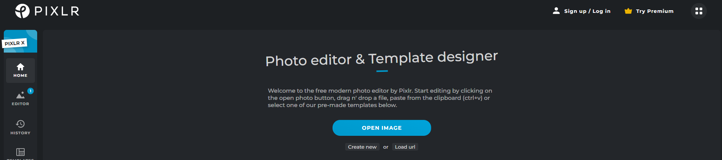
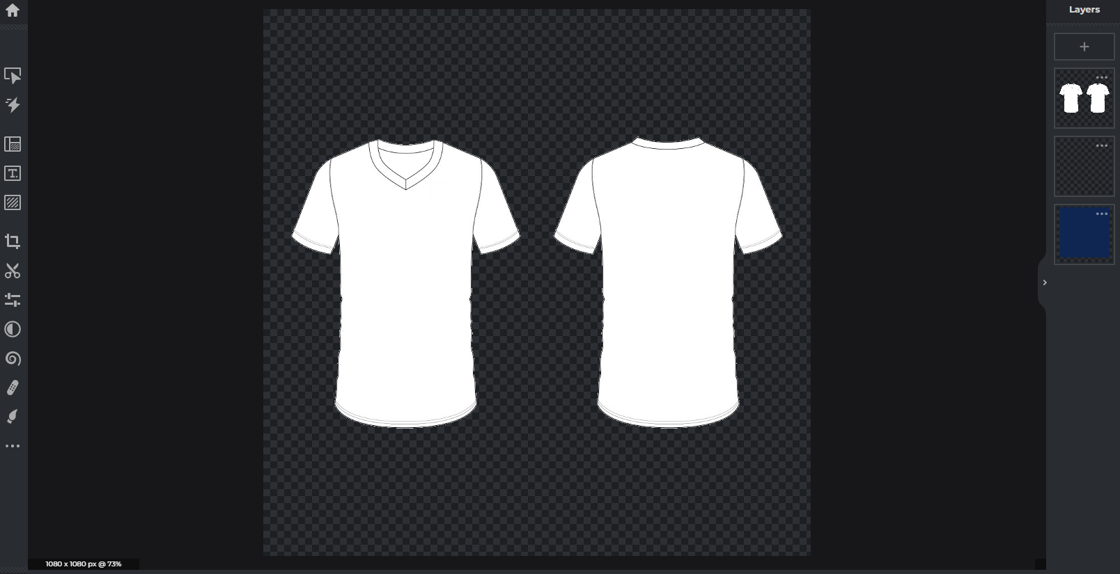
ACTIVITY 4: DESIGN AN ESPORTS JERSEY
Step 1:
Download the two base design documents provided
BASE JERSEY DESIGN FILE
LASERHAWK JERSEY DESIGN FILE
Navigate to https://pixlr.com/ and click on the ‘Open Image’ option
From your files, click on base jersey design file which will open the pre-designed jersey template.
You may wish to take a look at the Laserhawk example first to see how the example has been structured. However for the purposes of the tutorial you will be following process from the blank jersey.

Slide 9
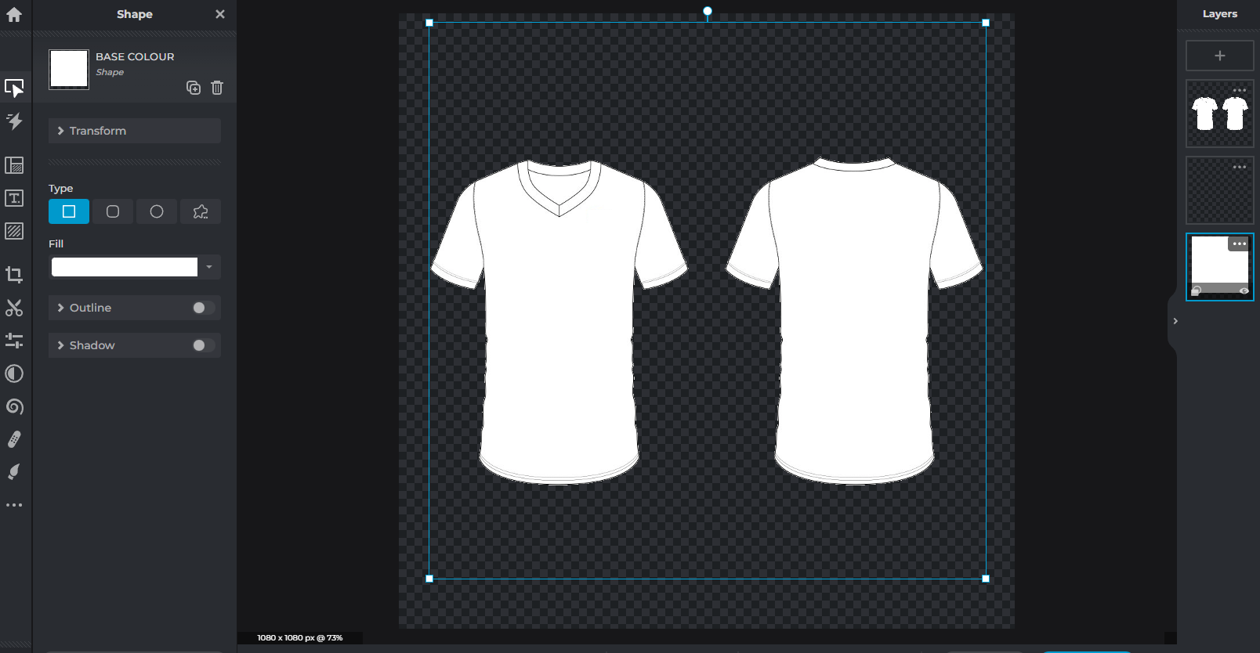
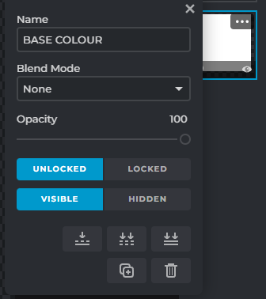
ACTIVITY 4: DESIGN AN ESPORTS JERSEY
LAYERS EXPLAINED.
As you will see, there are 3 pre-designed layers in your document. These all have different layer options that interact with each other.
LAYER 1: BASE COLOUR
Layer 1 is a simple square shape that covers the both the front and back of the design. By clicking the 3 dots on the layer menu, you can view its properties. This is a ‘standard’ layer from which you can alter the base colour of your jersey.

Slide 10
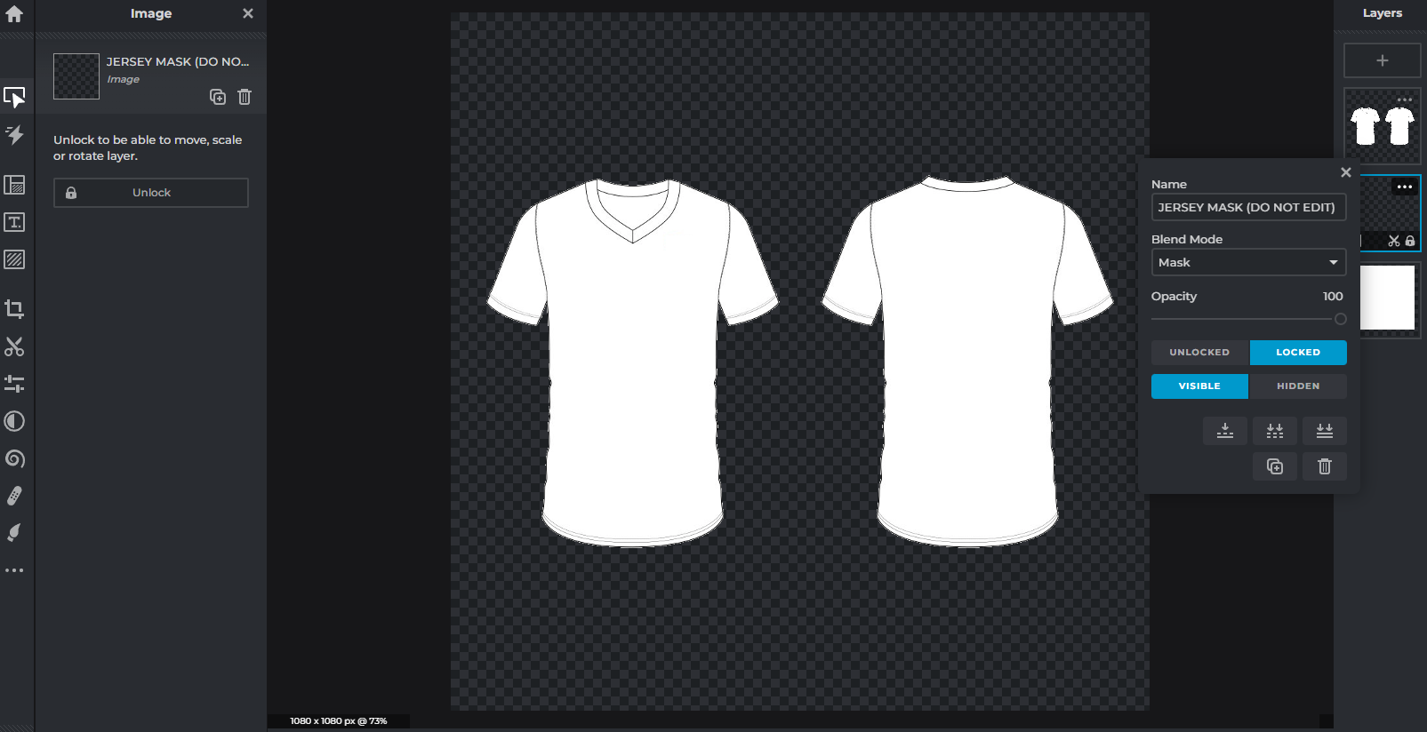
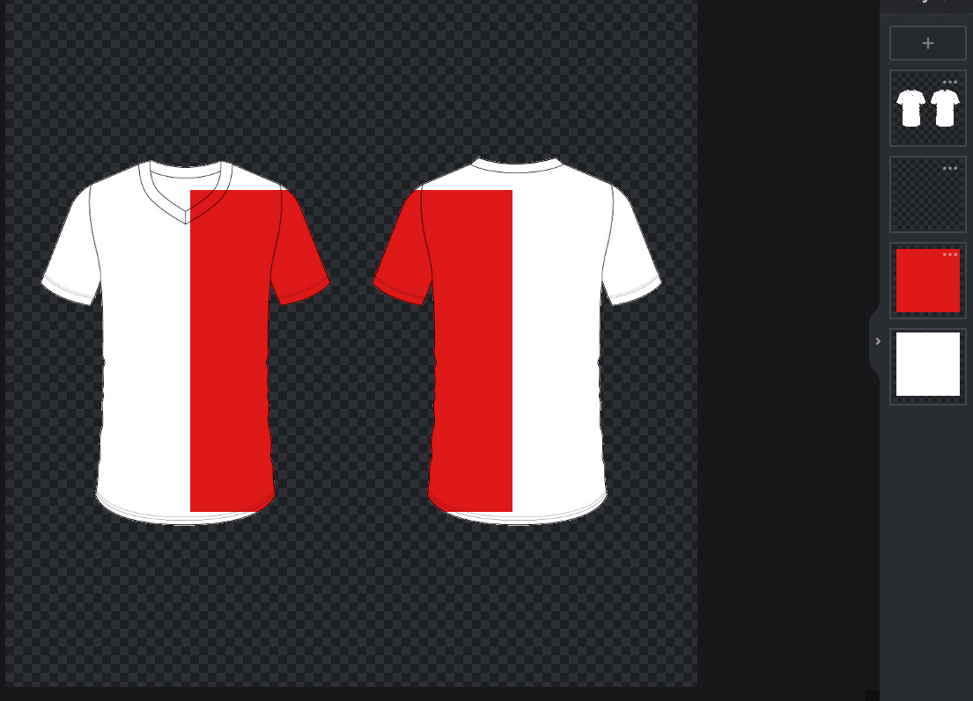
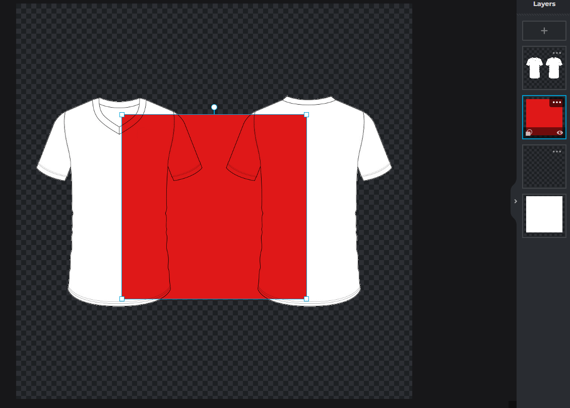
ACTIVITY 4: DESIGN AN ESPORTS JERSEY
LAYER 2: JERSEY MASK
Masks are a quick and easy way to ‘cut out’ a shape and hide anything that doesn't appear within the shape area.
This means that any layers created underneath the mask layer will not exceed it’s edges.
Add another coloured shape layer in between layer 1 and layer 2 - see how this interaction works with the mask layer.
If you add the new colour shaped layer above the layer mask, you can see how the mask no longer affects the shape and it exceeds the boundaries of the jersey.
This allows you to have greater control over retaining the shape of your design.
DO NOT EDIT OR UNLOCK THIS LAYER

Slide 11
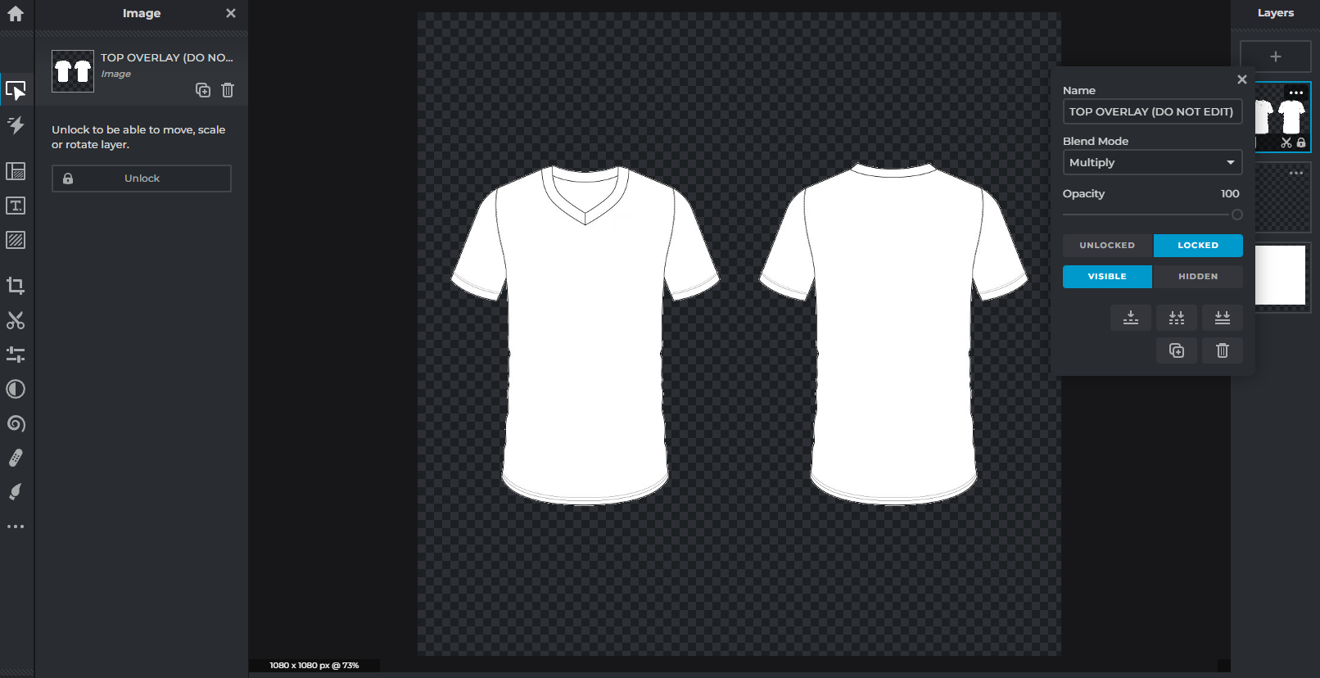
ACTIVITY 4: DESIGN AN ESPORTS JERSEY
LAYER 3: TOP OVERLAY
The 3rd layer in this file is a ‘multiply’ layer.
A multiply layer allows any elements underneath it to be visible through it, whilst retaining any linework or detail in the media.
This will allow you to add different shapes, colours, add logos and any other creative elements whilst retaining the linework of the jersey. Giving you the freedom to create your design and preserve its detail.
DO NOT EDIT OR UNLOCK THIS LAYER

Slide 12
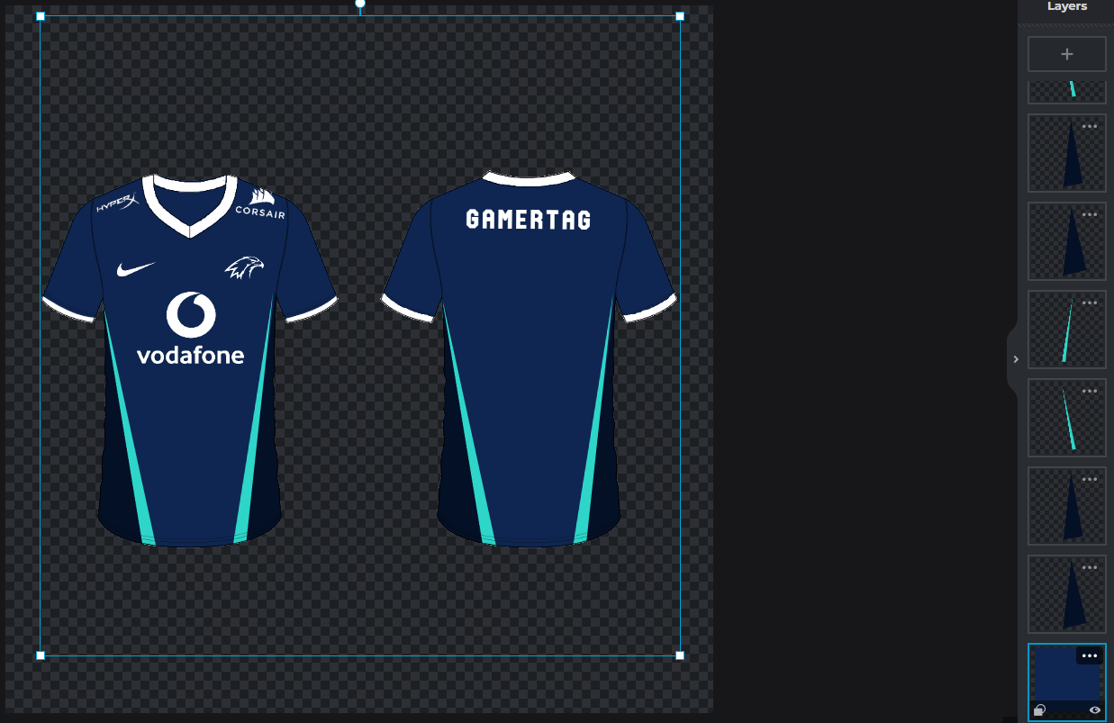
ACTIVITY 4: DESIGN AN ESPORTS JERSEY
Now it’s your turn to create your jersey. Remember to take a look at the Laserhawk example to see how that has been constructed. Be creative with how you use shapes and layers to create different patterns or areas for your jersey.
REMEMBER
Do not adjust, edit or unlock the mask or multiply layers
Take advantage of masks and always create new shapes or layers below the mask layer for your main jersey design.
You may add sponsor logos, text and other details above the mask and multiply layer but ensure they do not exceed the mask boundary.

