Slide 1
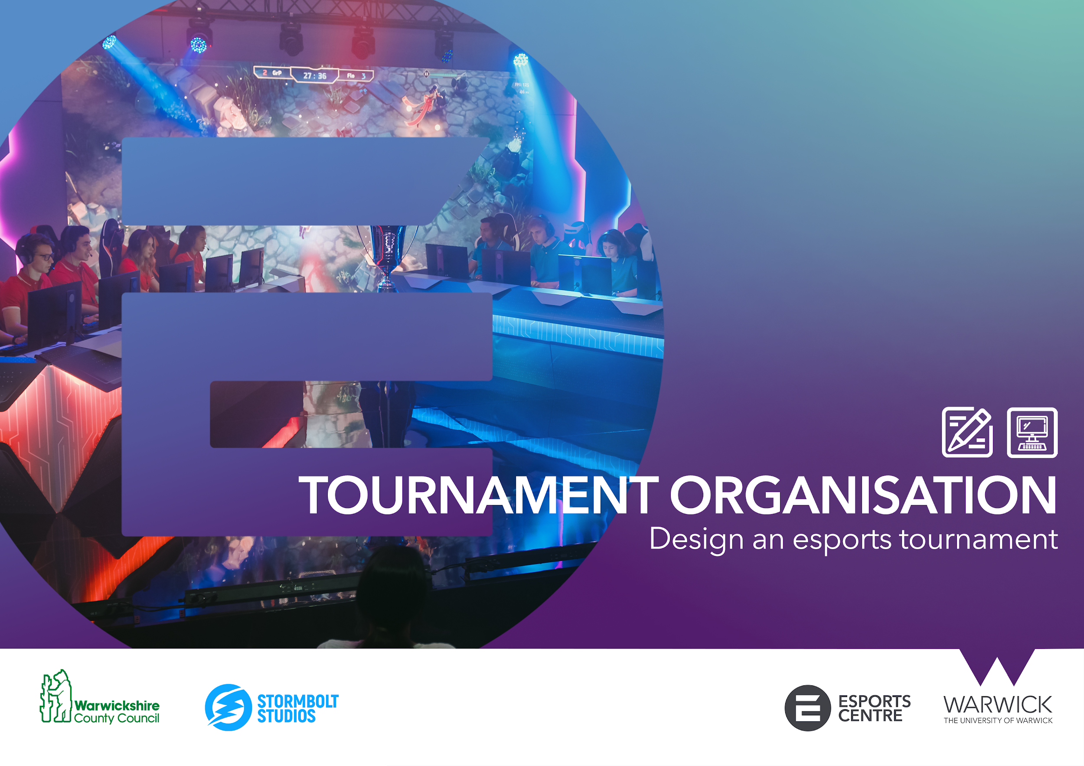


Slide 2



ACTIVITY 6: TOURNAMENT ORGANISATION
Competition is at the heart of esports.
Events and tournaments are on the rise due to the demand and popularity of esports as a whole. Captivating large audiences both online and in arenas around the world.
From grassroots events to elite tournaments, anyone with any budget can set up and organise an esports tournament!
Some of the biggest events are watched by millions of esports enthusiasts.

Slide 3


ACTIVITY 6: TOURNAMENT ORGANISATION
At elite tournaments and events, there are a large number of roles and positions that need to be fulfilled to produce a top tier esports tournament.
Event Support
Broadcasting
Tournament Organiser​
Administrators​ (referees)
Event manager​s
Talent manager​s
Social media managers
Photographer​s
Videographer​s
Journalists
Broadcast director
Producer​s
Observer​s
Caster​s
Hosts

Slide 4

ACTIVITY 6: TOURNAMENT ORGANISATION
There are different types of tournament formats that are commonly used within esports. These wholly depend on the type of tournament organisers want to produce and factor in:
The time / length of the tournament
The type of tournament (league or one-of event)
Entertainment factor
The two most common tournament formats are:
GROUP STAGES
ROUND ROBIN
Another point to consider is the amount of games won decides who wins a match or series.
Games can often be decided from a best of 1, best of 3, best of 5 and so on.
This is often shortened to BO3, BO5 etc.
SWISS
KNOCK OUT
SINGLE ELIMINATION
DOUBLE ELIMINATION

Slide 5
ACTIVITY 6: TOURNAMENT ORGANISATION
ROUND ROBIN
TEAM | WINS | LOSSES
1 | III | 0
2 | II | I
3 | I | II
4 | 0 | III
Very simple to follow
Every competitor gets a fair chance to compete
Can take a considerable amount of time to complete the rounds dependant on how many teams enter
Not as entertaining (no risk)
A non-eliminating tournament in which each competitor plays in turn against every other.
DOUBLE ROUND ROBIN
A non-eliminating tournament in which each competitor plays in turn against every other twice.
ROUND 1 | ROUND 2 | ROUND 3
2 VS 1 | 4 VS 2 | 4 VS 1
3 VS 4 | 1 VS 3 | 2 VS 3
SWISS
Quite a complex format
Requires teams to be initially seeded based on skill
Every competitor gets a fair chance to compete
Quicker to complete
A tournament format that features a fixed number of rounds of competition. Teams progress through group stages based on their win / loss ratio.
If a team loses 3 times, they are out. If they win 3, they qualify.
2-0
1-0
2-1
0-0
1-1
2-2
1-2
0-1
0-2

Slide 6
ACTIVITY 6: TOURNAMENT ORGANISATION
SINGLE ELIMINATION
Very simple to follow
Very quick format
Very high risk and unforgiving
Requires seeding
Entertaining
TEAM 1
A single-elimination, knockout, or sudden death tournament is a type of elimination tournament where the loser of each match-up is immediately eliminated from the tournament. Each winner will play another in the next round, until the final match-up, whose winner becomes the tournament champion
TEAM 1
Champions
TEAM 2
TEAM 1
TEAM 3
TEAM 4
TEAM 4
Winners from upper bracket
DOUBLE ELIMINATION
Simple to follow
Relatively quick format (if competitors play at the same time / off-air)
Slightly more forgiving in that competitors get a second chance to play
Requires seeding
Entertaining
A double-elimination tournament is a type of elimination tournament competition in a competitor is removed from competition if they lose two matches. It is structured into upper and lower brackets.
The final game will be between the winners from the upper bracket and winners of the lower bracket.
TEAM 1
TEAM 4
TEAM 4
TEAM 2
TEAM 3
Winners from lower bracket
TEAM 3

Slide 7




ACTIVITY 6: TOURNAMENT ORGANISATION
Design an esports tournament
Materials and equipment needed
Computer
Word or word processing software
Excel or spreadsheet software
Group Activity 1
Using your word processing software. Plan out your esports tournament detailing the following.
The name of your tournament
The game title that your tournament will be played on
What roles need to be assigned to run the tournament.
  Tournament lead
  Admins
  Players
What type of tournament format your event will follow.
Best of 3 Single elimination for example.

Slide 8
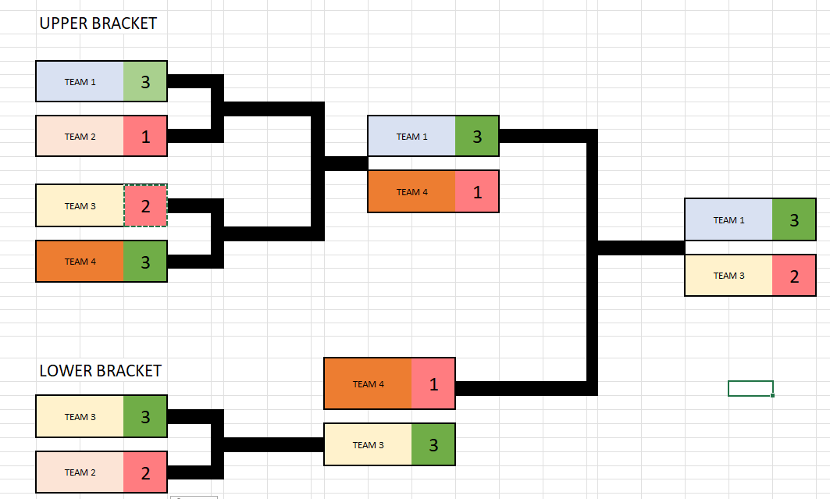
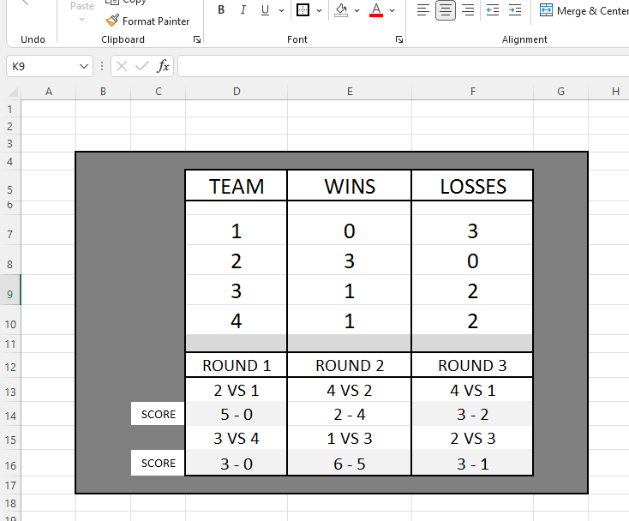
ACTIVITY 6: TOURNAMENT ORGANISATION
Design an esports tournament
Materials and equipment needed
Computer
Word or word processing software
Excel or spreadsheet software
Group Activity 2
You will need to create a spreadsheet document to tally scores and results based on your chosen tournament format.
You can create a basic spreadsheet that you can simply input scores / results in. Or if you are more experienced you may consider creating cells that calculate points and scores.

