Slide 1
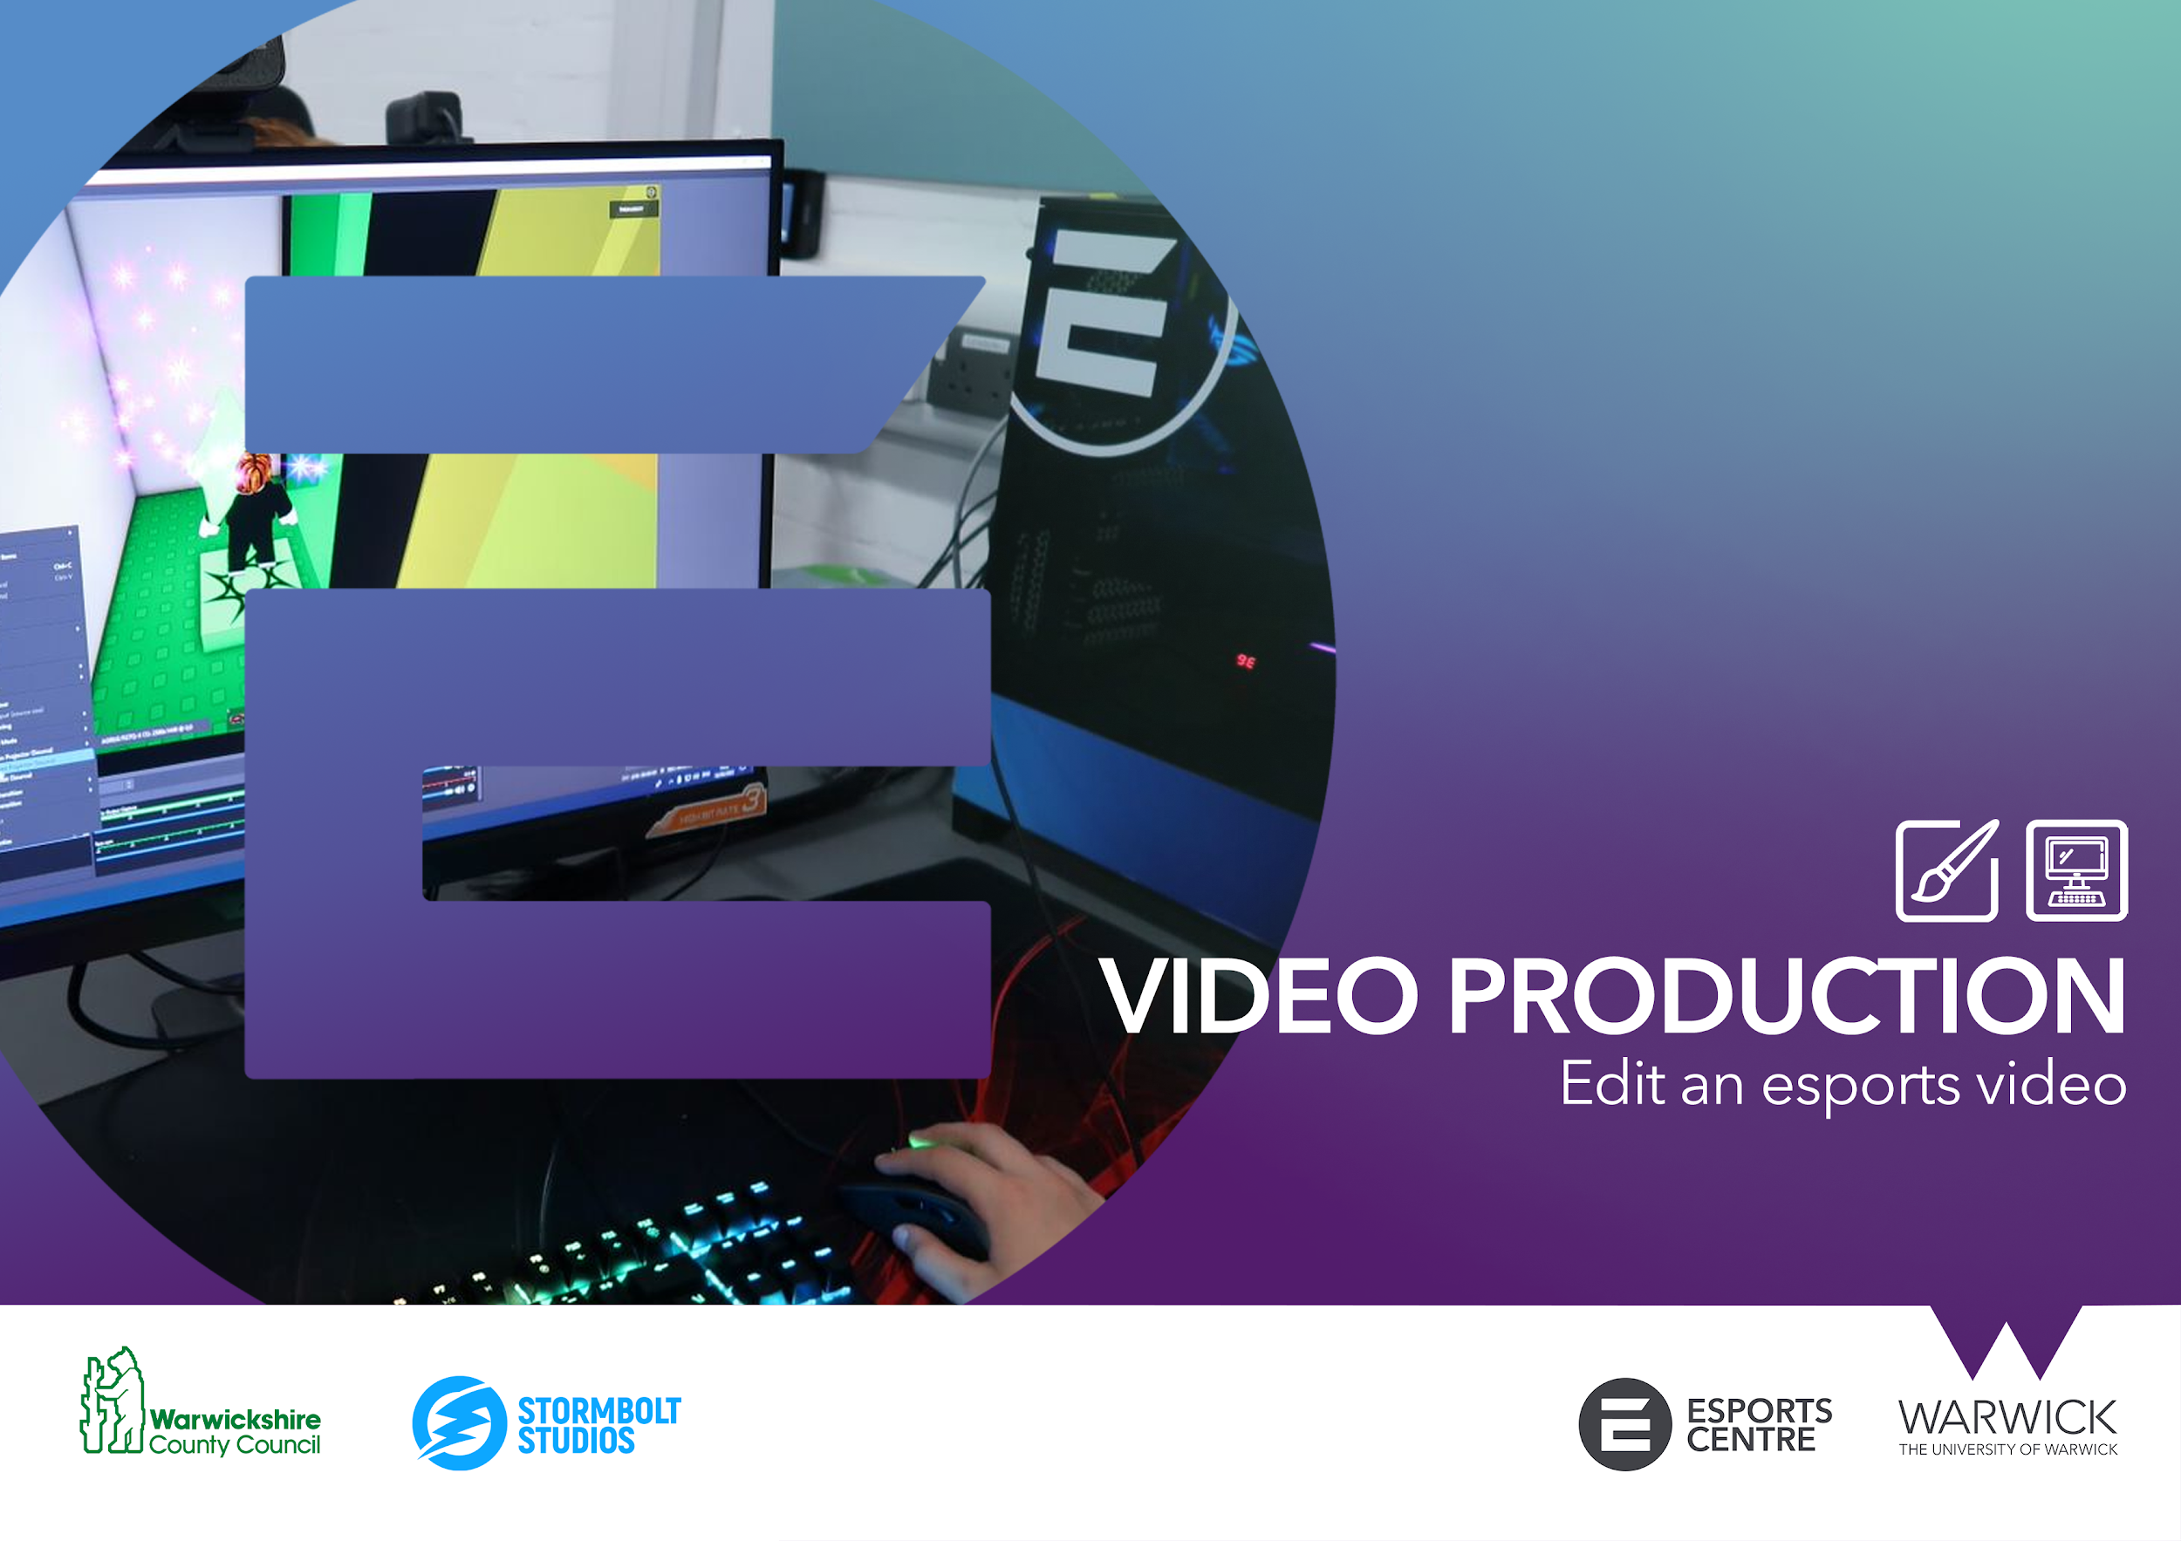


Slide 2


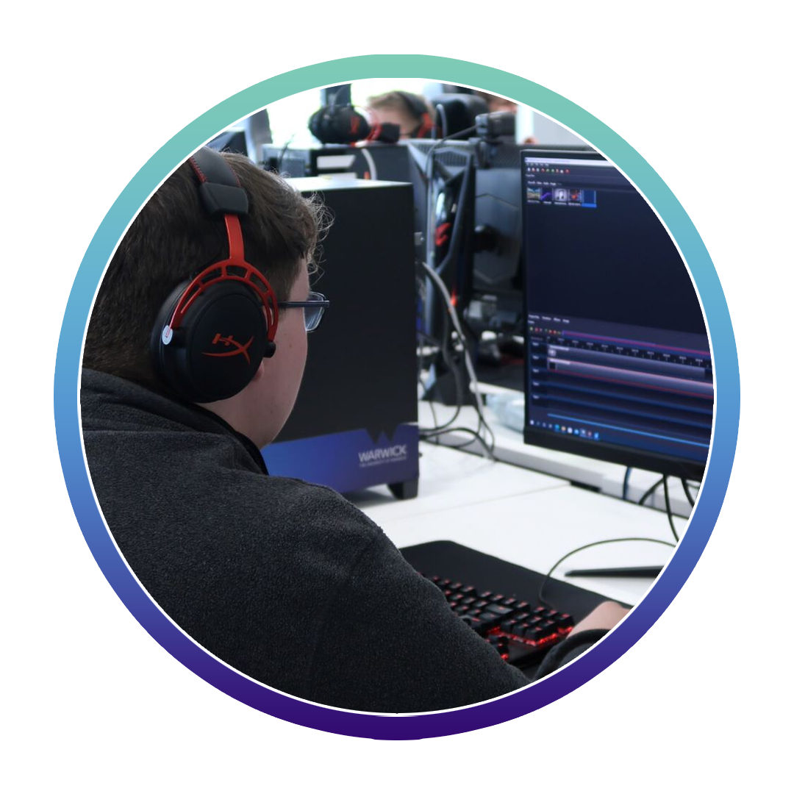
ACTIVITY 9: EDIT AN ESPORTS VIDEO
Both long and short form video is the most consumed form of online content. Esports organisations use video as a way to communicate many subjects to their audience.
With multiple platforms to publish to, it’s easy to make your mark with eye catching, informative or funny video content.
Creating video content is key to:
Creating an online presence
Engaging your audience
Showcasing your brand, news, entertainment
Creating ad space for sponsors and partners

Slide 3
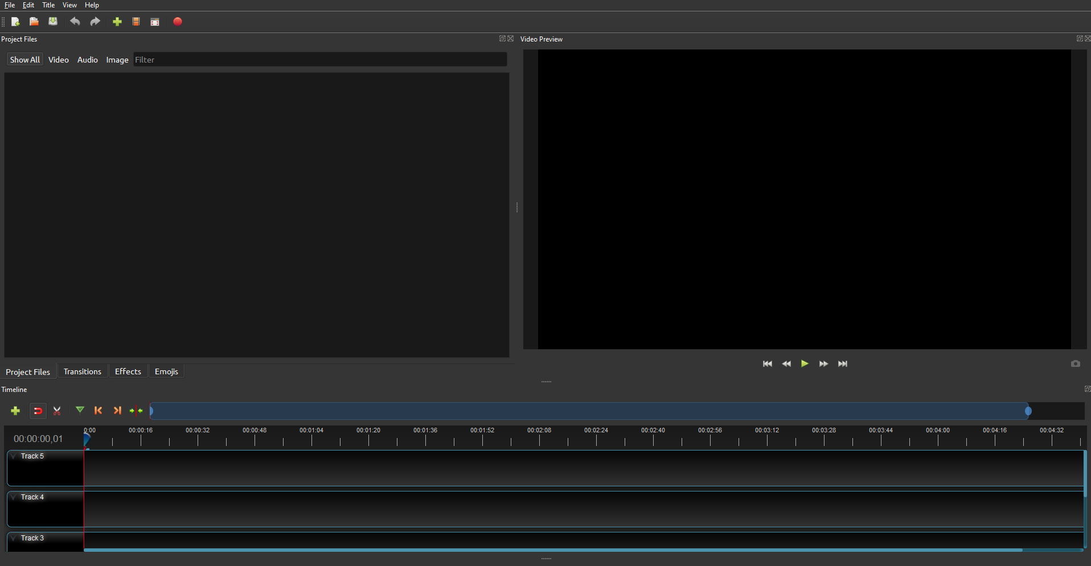

ACTIVITY 9: EDIT AN ESPORTS VIDEO
Materials and equipment needed
Computer with internet access
OpenShot video editing software
In this exercise you will use the footage of your esports tournament or play session captured with OBS.
You will then learn basic video editing skills using OpenShot, an open source editing program. The skills learned will allow you to produce an esports video.

Slide 4
ACTIVITY 9: EDIT AN ESPORTS VIDEO
Download and install OBS Studio
Navigate to https://www.openshot.org/ and click on the correct operating system to begin your download. Install to the computer and open OpenShot.
OpenShot Interface
The default OpenShot interface consists of three main areas.
File explorer
Video preview
Timeline
File explorer
Displays the different video, image and audio files you will import.
Video Preview
Allows you to see your video project in real time.
Timeline
Consists of ‘tracks’ where you can cut, edit, and add effects your media.

Slide 5
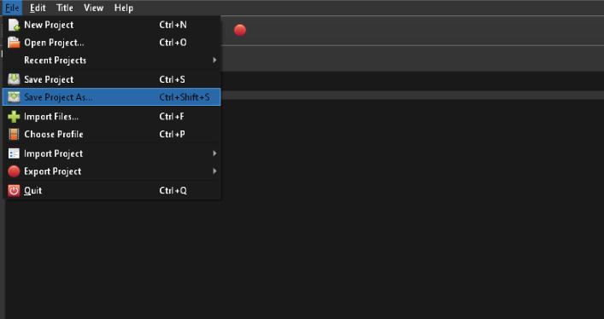
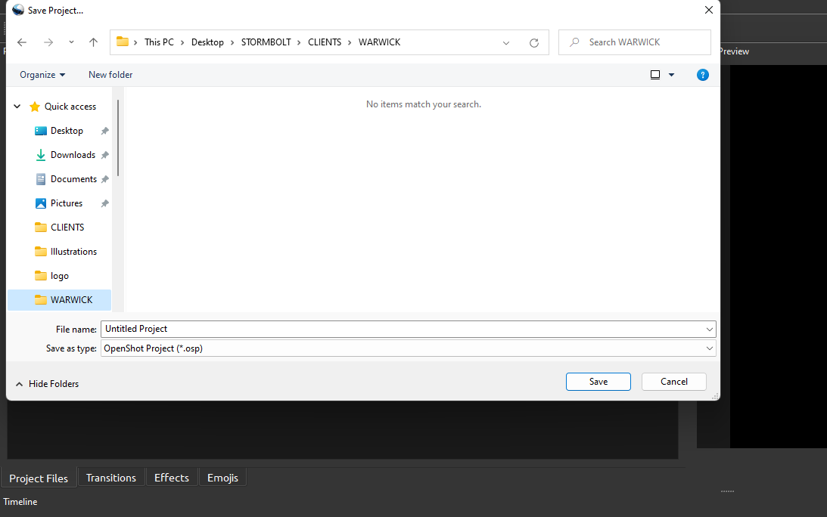
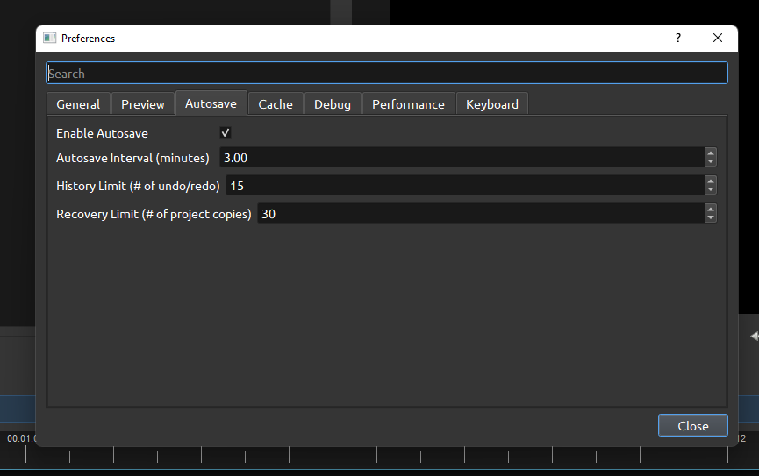
ACTIVITY 9: EDIT AN ESPORTS VIDEO
Saving/ Autosaving
The first rule of editing is SAVING and checking our AUTOSAVE settings. The worst thing to happen when you get deep into a project is loosing your work to a software or hardware crash.
SAVING
Let’s focus on saving our project first in a suitable location.
Go to File > Save Project As
The save menu will then appear allowing you to select the desire dolaction. Once you’ve named your project click ‘save’.
AUTOSAVING
Go to Edit > Preferences.
Ensure that autosave is enabled and set to an interval of between 2 and 5 minutes.

Slide 6
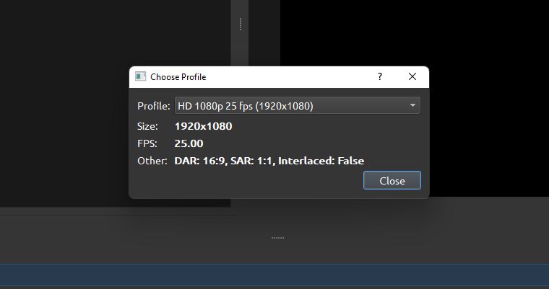
ACTIVITY 9: EDIT AN ESPORTS VIDEO
Video Formats
Videos come in all formats. Formats are the shape, size and quality of your video image.
We will be working in 1080p meaning the video size will be 1080 pixels long by 1920 wide. This is also known as 2K.
We will also be working at 25fps which stands for 25 frames per second. We are seeing the image change 25 times within a second..
To set your video profile, Go to File > Choose Profile
Select the drop down ‘Profile box’ and select the option that says: “HD 1080p 25 fps (1920x1080)”
Then click close and your project is ready in the correct format.

Slide 7
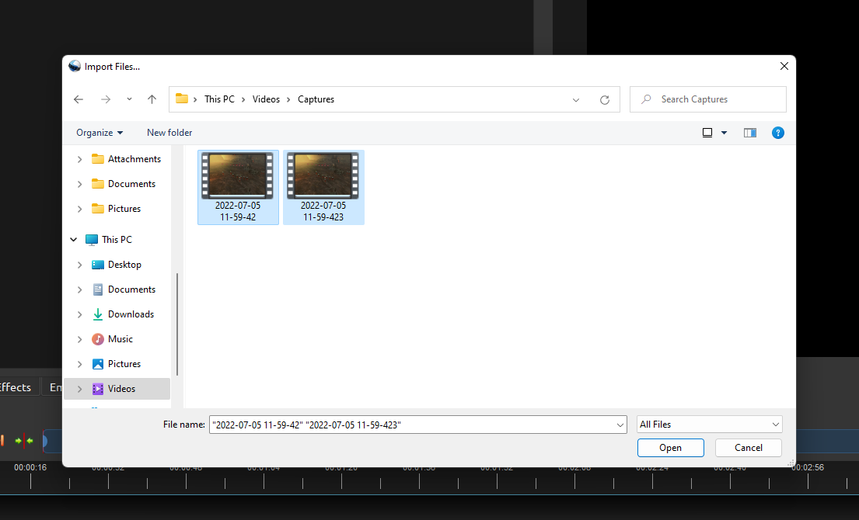
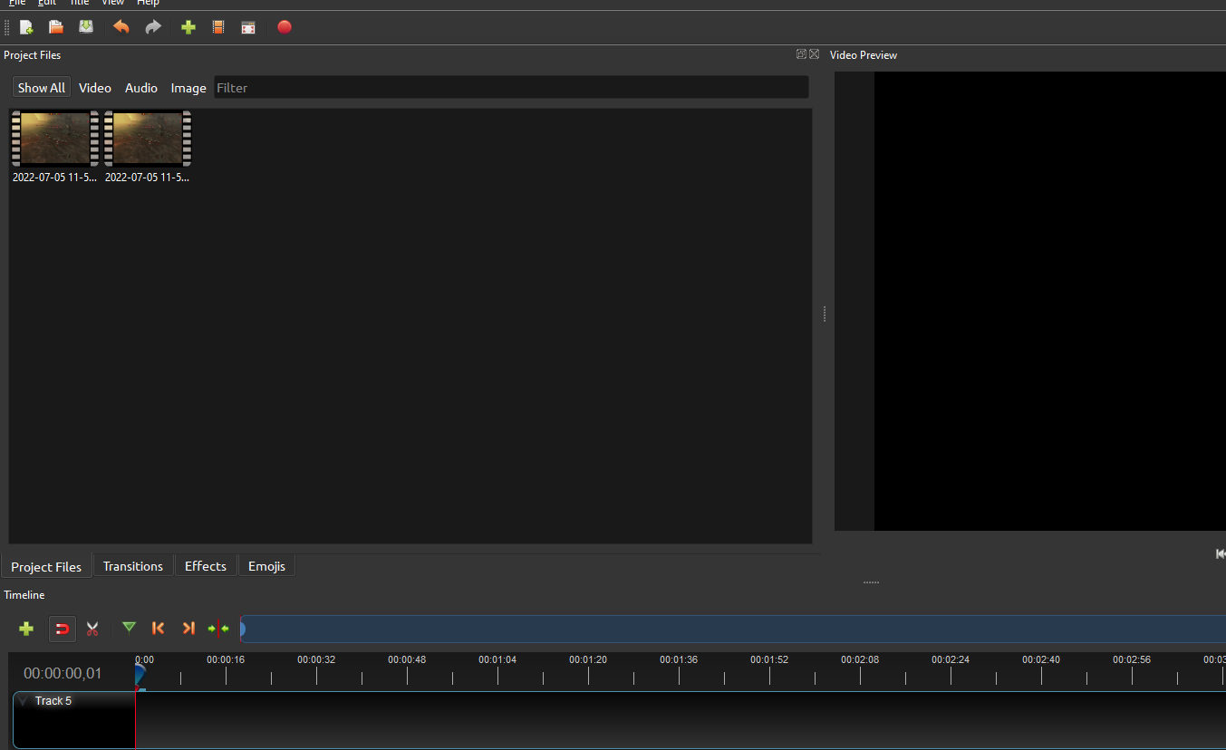
ACTIVITY 9: EDIT AN ESPORTS VIDEO
Importing Media
To be able to edit video and audio clips in OpenShot we must first import these assets into our Project Files within the programme. Go to File > Import Files...
This will bring up your file explorer box. From here navigate your way to your recorded video and music clips.
By holding “Shift” on your keyboard, you can select multiple files at once. Select all of the files you wish to import and select “Open” when ready.
If you have found more files you’d like to add to your project
(such as a music track), you can repeat this process using “File> Import files” as many times as you like and your new files will be added to the Project Files section pane. You won’t lose the ones you’ve already imported.

Slide 8
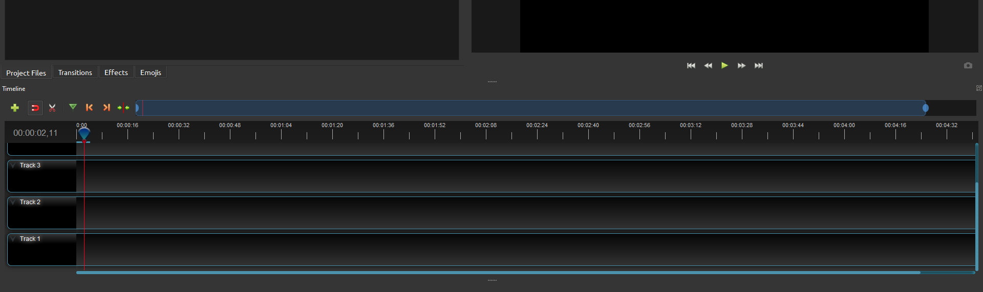
ACTIVITY 9: EDIT AN ESPORTS VIDEO
Using The Timeline
After importing your files into your saved project, we can now look at using our timeline within OpenShot. This is found at the bottom of the window and as a default we are provided with 5
tracks.
Timeline Tools
A scroll bar, which when adjusted zooms in and out of the timeline.
A tool menu with shortcuts and timeline options, allowing you to cut, add markers and more.
A playhead, which is the vertical line on your timeline which indicates the current position of video playback.
Once mastered, these are tools you can use to make your workflow quicker.
.

Slide 9
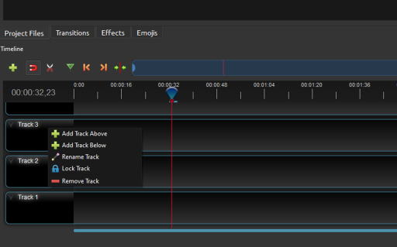
ACTIVITY 9: EDIT AN ESPORTS VIDEO
Adding And Removing Tracks
OpenShot gives you 5 tracks as a default project setting. If this is too many it is very simple to delete them. You can do this by right clicking on the track where it says the track name which will bring up a pop-up menu:
From this menu you can:
Add tracks above and below this one
Rename a track
Lock this track (this is so you don’t accidentally move anything on this track while editing another)
Remove a track

Slide 10
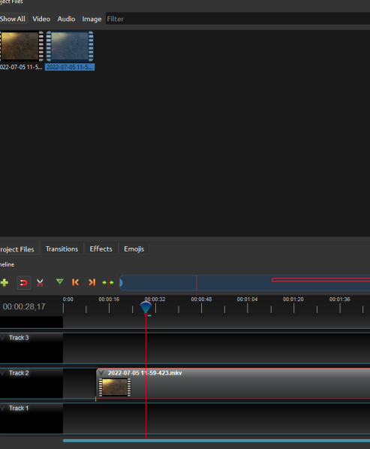
ACTIVITY 9: EDIT AN ESPORTS VIDEO
Adding Clips To The Timeline
To do this, simply click and drag the clip you want to edit into one of the tracks below and let go to place it there.
From here you can slide it along the timeline or place it on different tracks by clicking and dragging it elsewhere. You can now see that your clip is showing in the Video Preview Pane.
You can press “Play” on the Video preview pane to play this back in real time
You can also move the Playhead along the timeline and you will see the Video Preview will play your footage at the point of your Playhead.

Slide 11
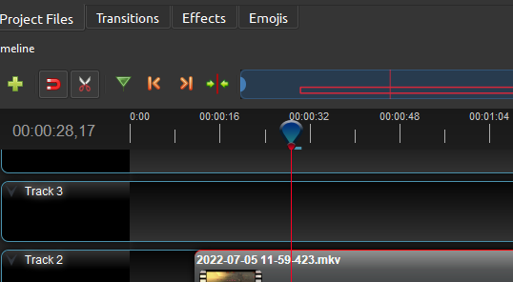
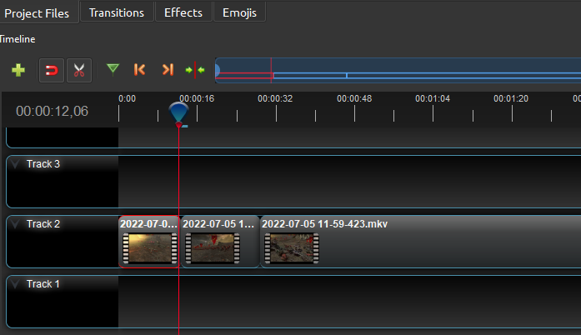
ACTIVITY 9: EDIT AN ESPORTS VIDEO
Video Editing On The Timeline
Now we have our clip on the timeline and we understand how the Video Preview pane works with our cursor. We need to slice our footage so you only have the ‘choice’ clips you want in your final video.
Firstly, use the playhead and drag it along the timeline until you find the moment you want in your final video.
Use the ‘Razor Tool’ to slice the clip.
Once you’ve selected the Razor Tool, as you hover your mouse over the clip in the track, you will see a cutting Icon. Left click on the track at the start of the important moment in your clip.
At the end of the important moment, cut again with the razor tool so that you have an isolated section of video.
Repeat this process throughout to cut out and isolate the parts of the footage you want to be in your final video. Delete sections of video in the track that you will not be using.

Slide 12
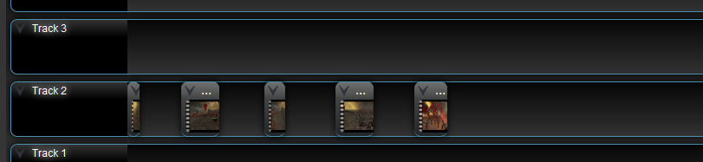
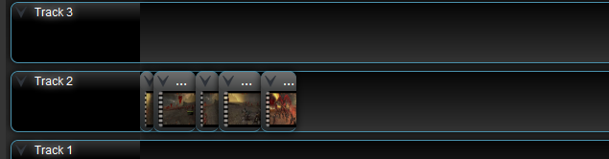
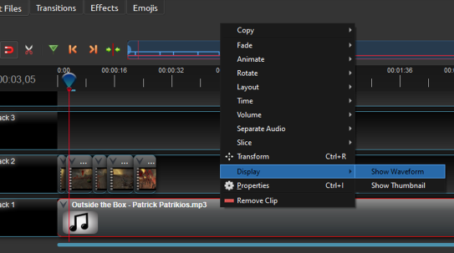
ACTIVITY 9: EDIT AN ESPORTS VIDEO
Video Editing On The Timeline
Once you have cut your footage you will be left with gaps in your video track.
At this stage, you want to bring your cut clips together to form the foundation of your esports video. To do this simply Left Click and hold on the clip and drag it forward on the timeline. The clips should then sit next to each other on the timeline.
Working With Audio
Using the same technique to add video on to the timeline works with audio/music tracks too. Just drag and drop the media on to the timeline.
When editing, it’s important to see where the beats are in the music to make the most impact when editing video to sound. In OpenShot you can view the music pattern as a waveform to allow us to see the bigger moments in the song.
The highest points in the waveform show where the beat is loudest and the exact moment the beat happens.
Be creative by using beats paired with your video edits and align exciting moments with peaks in the music.

Slide 13
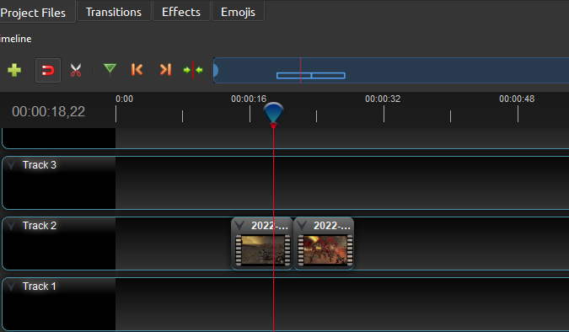
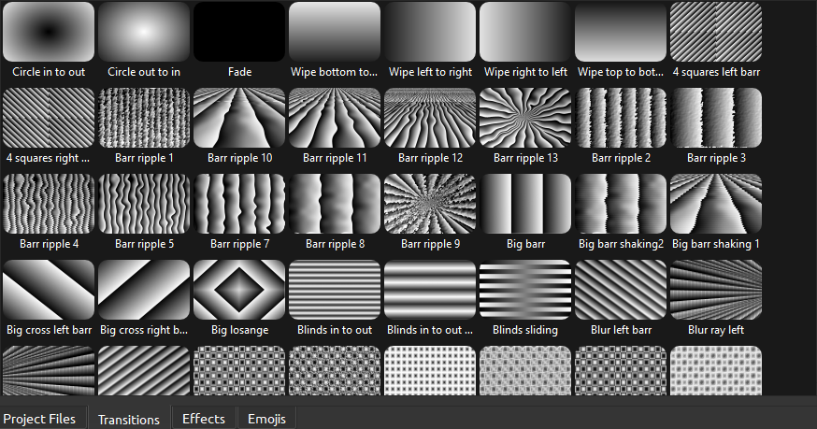
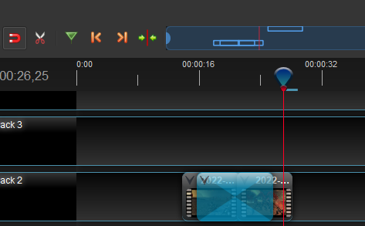
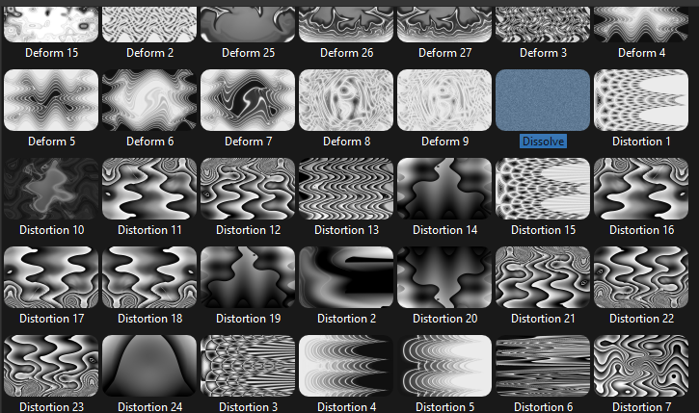
ACTIVITY 9: EDIT AN ESPORTS VIDEO
Transitions And Effects
Video transitions are a technique used in video editing to connect one clip to another or to move from scene to scene.
A range of transitions can be used when wanting to join two shots together, the most basic of these is to cut where the first image is instantly replaced by the next.
Apply A Transition
Using two connected clips in within your timeline, navigate to the transition menu. These are preset effects that are found within OpenShot
and can be found in the tab next to “project files” above the timeline.
.
instead of your project files in the window top-left of the screen, a
selection of transitions will appear. You can scroll through them using the scroll bar to the right of them.
Select any transition you like and Left Click hold and drag it directly on to the clips. Make sure it covers both clips and not just on one of them.
You can add a simple fade transition to clips by dragging them over one another in the timeline.

Slide 14
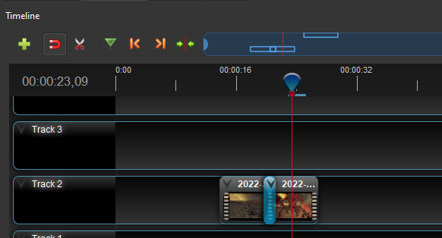
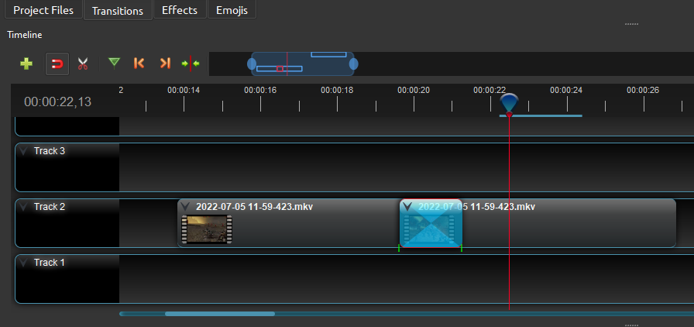
ACTIVITY 9: EDIT AN ESPORTS VIDEO
Edit A Transition
The default settings for the transition are typically quite slow and more often than not, you will want to make this transition much quicker.
Using your mouse, left click and hold on the edge of the transition and drag it inwards to the connecting point of the two clips. Make sure the transition is still covering the connecting point of the clips.
If you need to finely tune the transition, consider using the timeline zoom.
Press play on your Video Playback and you will see how the transition makes the clips interact with each other.
You can go back and adjust this as much as you like or simply delete it and try a different transition.
You don't have to use a transition every time you move from clip to clip and by using a mix of different transitions and no transitions you get a more dynamic feel to your film.

Slide 15
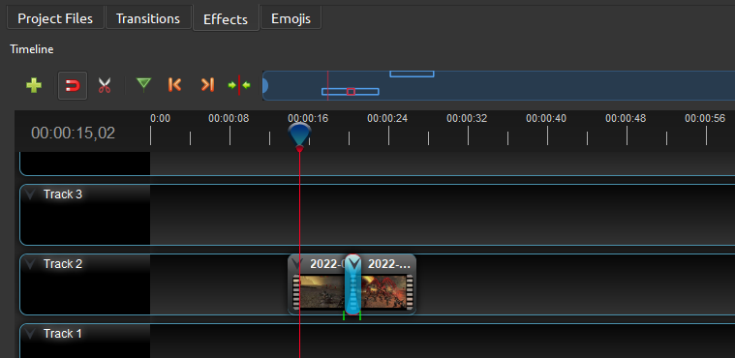
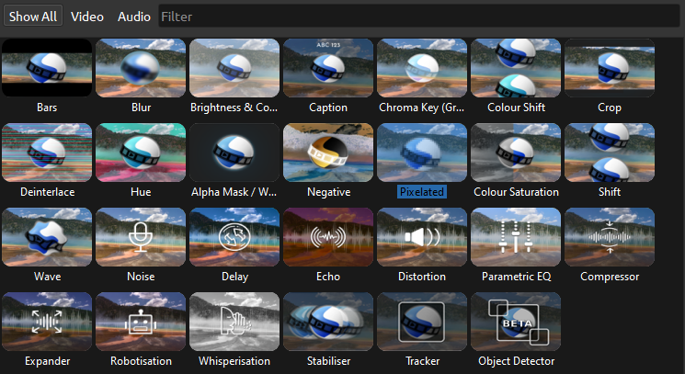
ACTIVITY 9: EDIT AN ESPORTS VIDEO
Effects
Effects are applied to a clip to adjust it in some way creatively. This might be a blur effect to make the visuals look fuzzy, altering the colours, adding bars to make it look more cinematic or bring a focus to a certain part of your film. There are a number of effect presets in OpenShot for you to try.
The process is very similar to how we apply transitions.
Find ‘Effects’ on the timeline menu
This will open the effects window. Left click, hold and drag an effect onto your clip in the timeline.

Slide 16
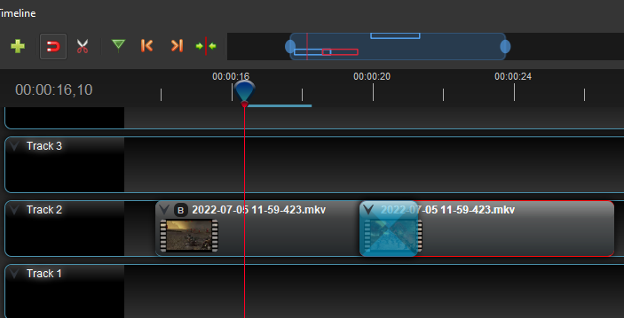
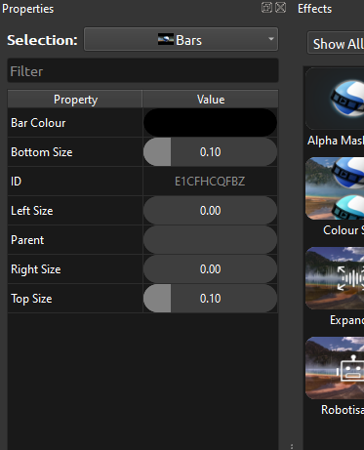
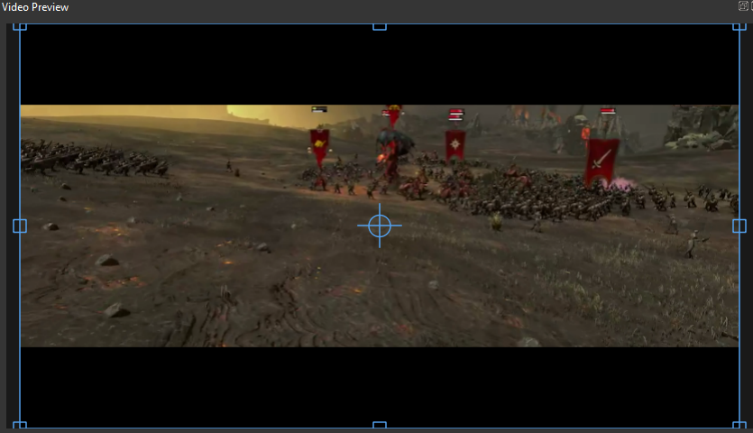
ACTIVITY 9: EDIT AN ESPORTS VIDEO
Effects
Once you have applied your effect, you will notice that a small icon will appear on your clip in the timeline. In this example we have added the ‘Bars’ effect, using the initial ‘B’ in the icon
You may right click on the icon to open its properties menu.
Within the properties menu, you can adjust the settings of the effect by moving the sliders until you have your desired effect.
By having your Playhead on the clip with the effect you are editing, you will see the adjustments change in real time in the Video Preview window.
All of the visual effects work in the same way, give them a try and adjust their properties to see what they do!

Slide 17
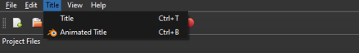
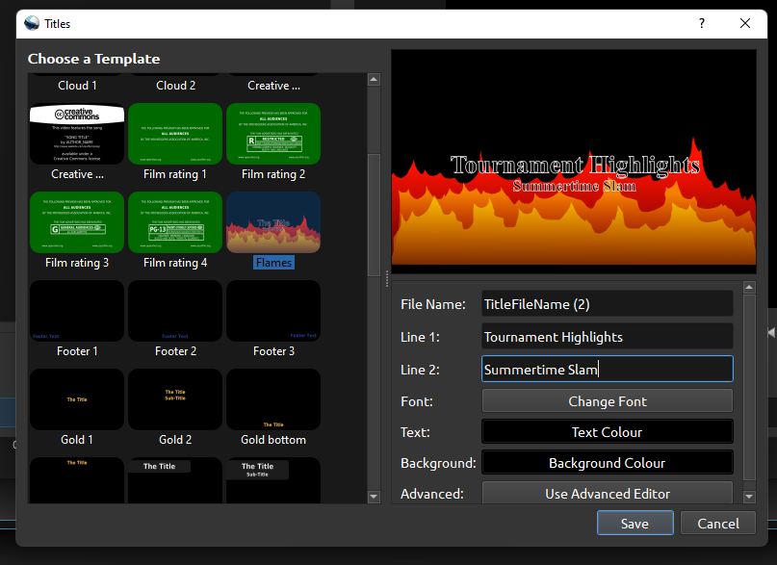
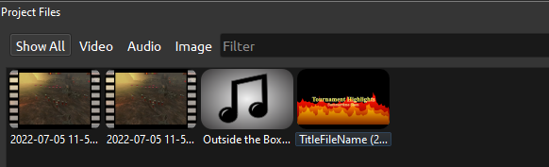
ACTIVITY 9: EDIT AN ESPORTS VIDEO
Titles
Titles can give our audience the essential information needed to understand the purpose of the video or key information.
OpenShot has a title editor within the software which you can put to great use in your video.
Click on ‘Title’ in the top menu, selecting ‘Title’ within the dropdown.
The ‘Title’ menu will open, allowing you to:
Select a preset title
Add text and change the colour / font
Change the background colour
Once saved, your title will appear in the Project Files window, allowing you to drag and drop the title on to the timeline in a new or empty track.
Create multiple titles to introduce your video, to explain key information within it and an outro title - a ‘Thanks for watching’ for example.
You can also add transitions and effects to titles.

Slide 18
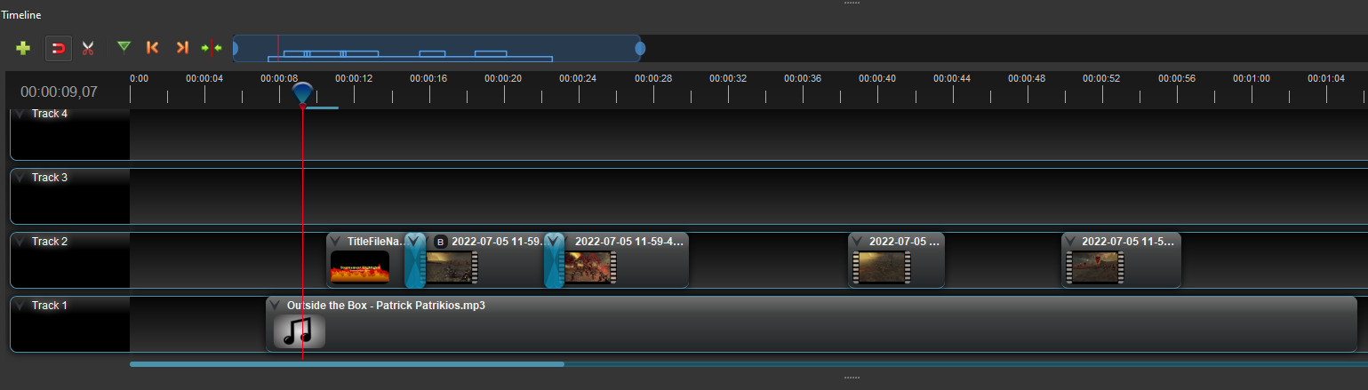

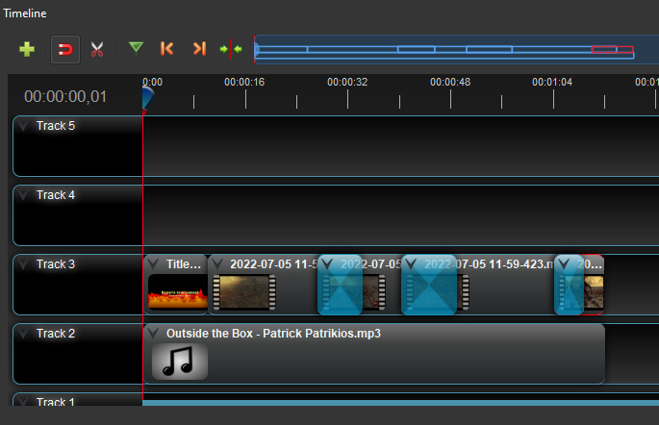

ACTIVITY 9: EDIT AN ESPORTS VIDEO
Exporting Video
Once we your video is complete, you need to export it to a format where it can viewed on applications like Windows Media Player and uploaded to video platforms and social media.
There are a few things we need to consider before we do this. When Exporting, OpenShot will automatically export everything on the timeline.
Ensure that there are no unwanted clips, cuts or audio within or further down the timeline. If these are not removed you will export these clips too. Audio files should not exceed the length of your edited video footage.
Ensure that your video begins at 0 seconds on the timeline. If the video starts later than 0 seconds, you will have a black screen until the first clips is played on the timeline.

Slide 19
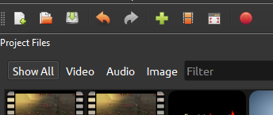
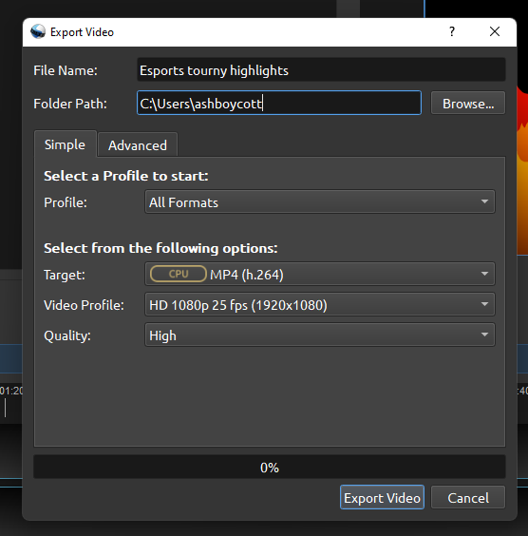
ACTIVITY 9: EDIT AN ESPORTS VIDEO
Exporting Video
To export your video, go to File > Export Project > Export Video Or simply press the red button within the top menu. An export pop up menu will appear.
Choose a name for your finished video and select where you would like to save your film to be able to find it later on. All of the video settings should be the same as when we set up the project earlier. If not make sure they are set to:
Target: MP4 (h.264)
Video Profile: HD1080p 25fps (1920x1080)
Quality:High
Click on ‘Export Video’ when you are happy with the settings. A blue progress bar will appear showing you the completion time of your video render. Once it’s finished, it will turn green and say ‘complete’.
Find your video in your files and enjoy the finished product!

