Slide 1
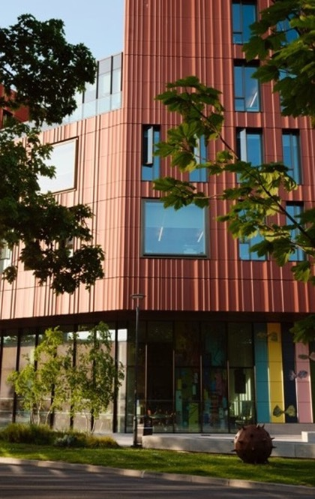
CADRE - Centre for Arts Doctoral Research Excellence​
CADRE Workshop 1 - PGR Introduction & Welcome ​
Tuesday 13th October 2026​

Slide 2
CADRE Team
Professor Anne Gerritsen (CADRE Director & M4C Site Director)
Lisa Millard (Doctoral Training Manager, Arts and Doctoral College)
Helen Jing (Doctoral Training Coordinator, Arts and Doctoral College)
Laura Woolley-Nunez (CADRE Workshop Facilitator)
Smriti Dutt (CADRE Workshop Facilitator)
Dr Rebecca Vipond (CDT & PG Scholarships Coordination Manager, Doctoral College)

Slide 3
Schedule for Today (1)
10.00am | CADRE What is CADRE and what opportunities do we provide? | Prof Anne Gerritsen
10.15am | Introduction to the CADRE Facilitators | Laura Woolley-Nunez Smriti Dutt
10:20am | Doctoral College | Dr Rebecca Vipond
10.30am | Disability Support Services and Wellbeing | George Morrell
10:40am | Warwick Sport | Katy O-Brien
10:50am | Warwick Students Union | Ronny Whetton
11:00am | Library | Andy Calvert, Josh Caldicot, Gabriel Clarke
11.15am | BREAK

Slide 4
Schedule for Today (2)
11.30am | Careers | Claire Halldron/Ellie Wetherhill
11:45pm | PG Cert in Transferable Skills | Dr Daniel Franklin
12.00pm | Humanities Research Centre (HRC) | Dr William Rupp
12:15pm | Faculty of Arts Introduction Hear from Prof Rachel Moseley about the community of Arts PGRs you are joining | Prof Rachel Moseley
12.30pm | Lunch and Networking
13.00pm | Close

Slide 5
What is CADRE​?
CADRE and Opportunities within the Faculty of Arts​
Prof Anne Gerritsen​
Director of CADRE and M4C Site Director​

Slide 6
What is CADRE?
Centre for Arts Doctoral Research Excellence
CADRE Workshop Series/professional development training
Monash Prato Workshop
PG Cert in Transferable Skills
PGR Zone, hot desks and allocated desks
Annual PGR Arts Festival
General enquiries and administration
For more information visit the CADRE pages.
Workshops and Events
Events Calendar
CADRE Welcome

Slide 7
CADRE Workshops
CADRE Workshops run from October to March and cover various aspects of the PhD journey and after.
Topics cover thriving in your PhD, presenting papers, impact and public engagement to completing the PhD, how to take care of yourself on the PhD and careers afterwards.
Schedule is published on the CADRE Workshop Programme pages and you should have hopefully received registration information.

Slide 8
CADRE Workshops Term 1
Date | Workshop Details | Location
13th October 2026 (10am - 1pm) | Workshop 1: Introduction and Welcome / M4C Introduction A chance for new PGRs to meet one-another and hear from staff from across the university about services for PGRs | Wolfson Research Exchange, The Library
20th October 2026 (11am - 1pm) | Workshop 2: Thriving in your PhD This session will be led by Professor Anne Gerritsen and our two CADRE facilitators who will give you the inside track on getting through the next 3.5 years. | Wolfson Research Exchange, The Library
3rd November 2026 (11am - 1pm) | Workshop 3: Locating Sources Led by academic support librarians, archivists, and current academics who will share their expertise in terms of accessing and using primary source material. | Wolfson Research Exchange, The Library
17th November 2026 (11am-1pm) | Workshop 4: Presenting Papers and Attending Conferences This session will cover how to successfully present papers and discuss the realities of attending conferences as a PGR. This will be facilitated by colleagues in the Doctoral College. Research Development team and PGRs who have been conference organisers sharing their experiences. | Wolfson Research Exchange, The Library
1st December 2026 (11am-1pm) | Workshop 5: Wellbeing, Community and Work Life Balance This session focuses on mental wellbeing for PGRs. It provides a space to identify issues PGRs face and to share tips on how to stay well across the period of the PhD. The session will be led by members of the university's Wellbeing team, Together At Warwick, Warwick Sport and the IATL Understanding Wellbeing project | Wolfson Research Exchange, The Library

Slide 9
CADRE Workshops Term 2
Date | Workshop Details | Location
12th January 2027 (11am - 1pm) | Workshop 6: Impact and Public Engagement The word 'impact' is used a lot these days when discussing research outputs. This session addresses how to create, measure, and evaluate impact, and introduces attendees to ways in which they can get involved in public engagement activities. | Wolfson Research Exchange, The Library
26th January 2027 (11am - 1pm) | Workshop 7: Writing For Others and Getting Published Hear from academics and journal editors about how to get published as well as our CADRE Facilitators on their PGR publishing experience | Wolfson Research Exchange, The Library
9th February 2027 (11am - 1pm) | Workshop 8: Completing Your PhD Hear about the process of completing your thesis: the last stages of writing up, submission, Viva, and corrections. This session will be led by our CADRE facilitators and our Doctoral College examinations team. | Wolfson Research Exchange, The Library
23rd February 2027 (11am-1pm) | Workshop 9: Careers Outside Academia Of course, academia isn't the only option after a PhD. This session provides guidance on moving into sectors inside of and outside the university and will include contributions from recently graduated Arts PGRs, and our CADRE facilitators | Wolfson Research Exchange, The Library
9th March 2027 (11am-1pm) | Workshop 10: How To Get Postdoctoral Research Funding The question of 'what now?' can seem daunting, especially on the back of 3 or 4 years working on a thesis. This session provides guidance on finding post-doctoral research funding, both at Warwick and beyond, and guidance on writing a successful application. | Wolfson Research Exchange, The Library

Slide 10
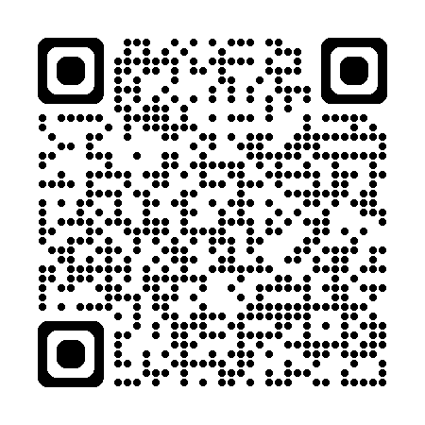
CADRE Workshops
Complete the sign-up form
  How to sign up?
  All workshops include lunch so please confirm any dietary requirements.
  Choose all the workshops you want to attend, and only register if you know you can attend, so that we can cater appropriately.
  Submit the form and the CADRE team will send you a calendar invite.
  Please decline the calendar invitation if you can no longer attend so that we can adjust catering and avoid food waste.

Slide 11
Professional Development Training
in the Arts
In addition to our CADRE workshops, professional/skills training are offered by:
LinkedIn Learning
Research Development Online (RDO)
Academic Development Centre (particularly for PGRs who teach)

Slide 12
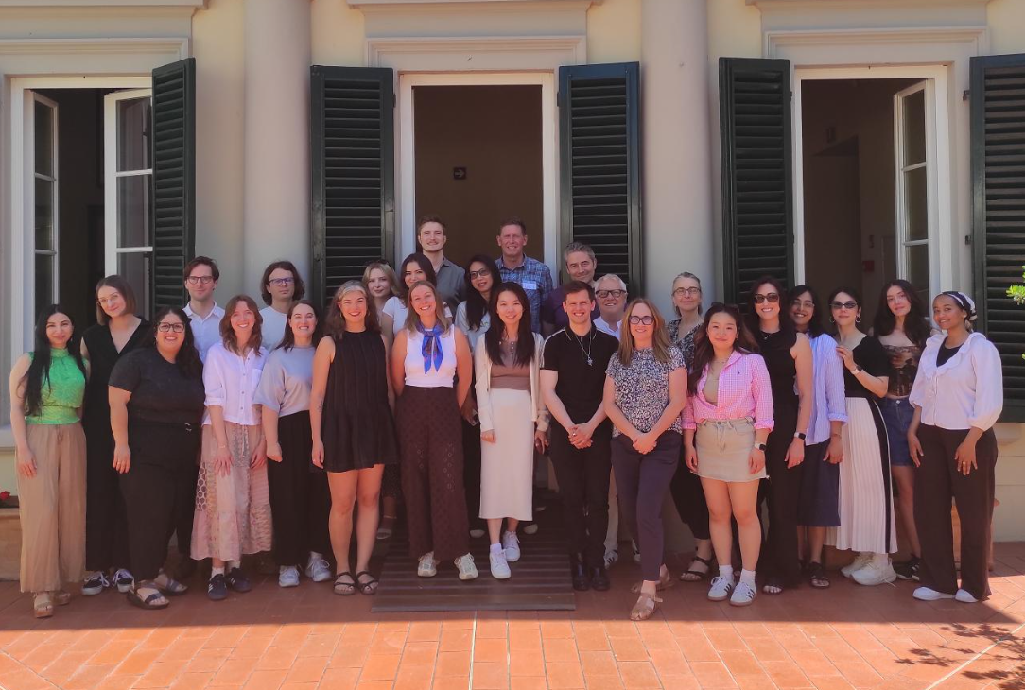
Monash Prato 2027
Faculty of Arts at Monash University runs a "PhD Writing & Publishing Workshop" at its Prato Centre in Italy.
Warwick postgraduate researchers from the Faculty of Arts, alongside others from Monash and other international partners, are invited to participate in this four- (or five-day) residency.
The doctoral training workshop is designed to provide expert advice regarding key strategies and approaches for writing high-quality journal articles and/or book chapters complemented with dedicated writing time and academic and peer feedback on writing progress.
Details for 2027 are still TBC

Slide 13
PGR Workspace
PGR Research Zone
FAB 2.37 is our dedicated PGR Research Workspace which we encourage you to use!
Hot Desks and Open Desk space available to all Arts PGRs
More information will be circulated via email via the Faculty of Arts office (artsfaculty@warwick.ac.uk).
More information including desk plan can be found here.

Slide 14
Contact CADRE
Please email all enquiries to: cadre@warwick.ac.uk (Lisa, Helen and Anne will be able to pick up any questions).
We will run termly drop-in sessions for informal advice – details will be circulated in the coming weeks.
The CADRE Office is located inside the PGR Research Zone (first door on the right as you come in through the door)
CADRE Website | CADRE Home Page – Faculty of Arts DTC (CADRE) CADRE Workshop Schedule - CADRE workshops 2026/27 CADRE Workshop Sign Up Form - CADRE Workshops sign up PGR Workspaces - PGR Workspaces Events Calendar - Events Calendar Monash-Prato Writing Workshop - Monash-Prato Writing Workshop 2027 - Details TBC
Doctoral College | Welcome to new students - Welcome Resources Information on Funding and Scholarships - Funding for Current PGRs PGR Hardship Support Fund - PGR Hardship Support Fund PGR Policies, including changes to registration, leave arrangements, progression, supervision, submission and examinations – Warwick - Policies for PGRs

Slide 15

Introduction to the CADRE Facilitators

Slide 16
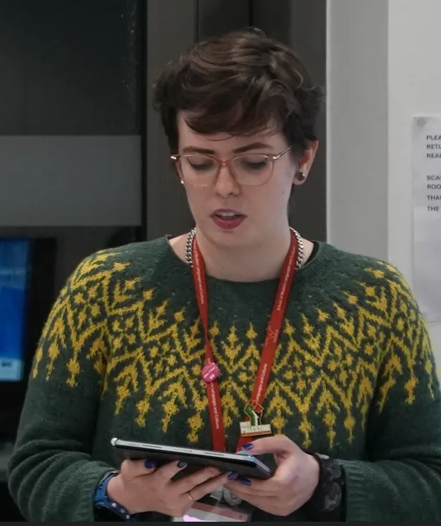
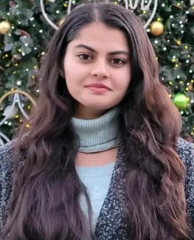
Our CADRE 2026/27 Facilitators
Laura Woolley-Nunez
Laura Woolley-Núñez is nearing the completion of her PhD in Translation and Transcultural Studies, which she expects to defend in December 2026. Her doctoral research was funded by Midlands4Cities. She is also a Senior Graduate Teaching Assistant in Spanish at the School of Modern Languages and Cultures.
Her practice-based thesis develops trauma-informed feminist translation strategies through her translation of María Teresa León’s Memoria de la melancolía (1970). This memoir explores gender, memory, ageing, loss, trauma and exile.
Smriti Dutt
My research project focuses on Chamba Rumal, an embroidery tradition from Himachal Pradesh in India. Traditionally, produced on sqaures of muslin, these works constitute a form of miniature art, which elaborates narratives derived from Pahari and Mughal Painting Traditions. Originally made by royal women as wedding gifts or ceremonial coverings, Chamba coverlets were lost to a fast-progressing world but have been revived in recent decades.

Slide 17
Doctoral College
Dr Becky Vipond

Slide 18
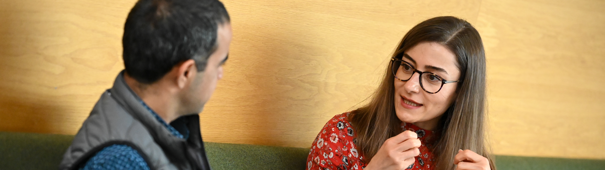
Getting the best out of your Doctoral College

Slide 19
Agenda slide
01
Who we are
02
Our Doctoral Values Development and training
03
PGR Life
04
PGR Events
05
PGR Policy Hub
06
Questions

Slide 20
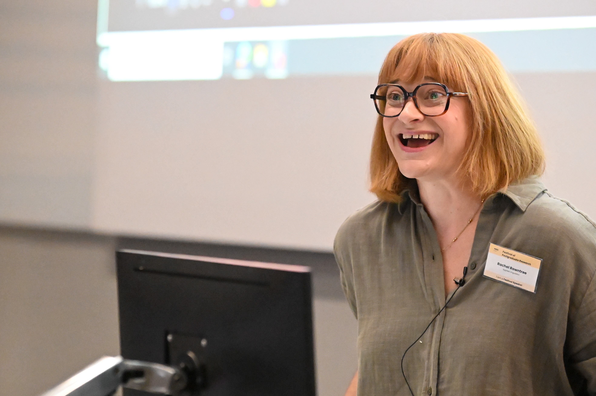
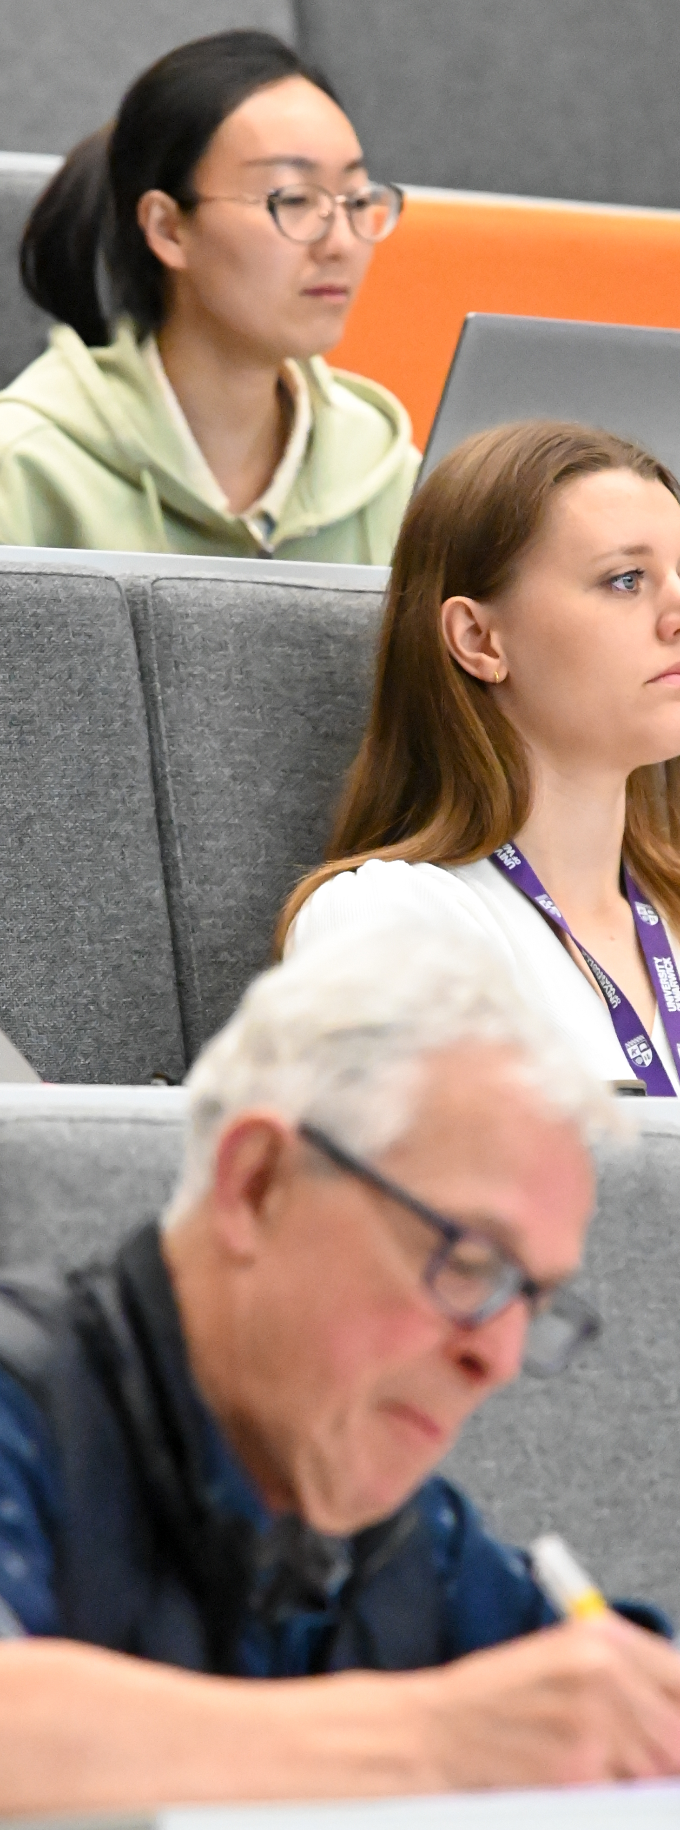
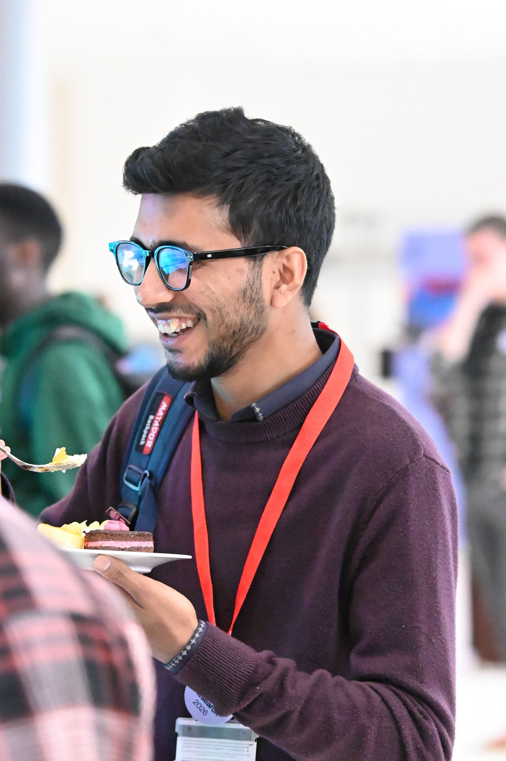
Who we are
A central team who set policy, advocate for and support all PGRs at Warwick
Academic Director (PGR)
Head of the Doctoral College
PGR Development & Training
PGR Community
PGR Scholarships
Centres of Doctoral Training
PGR Examinations

Slide 21
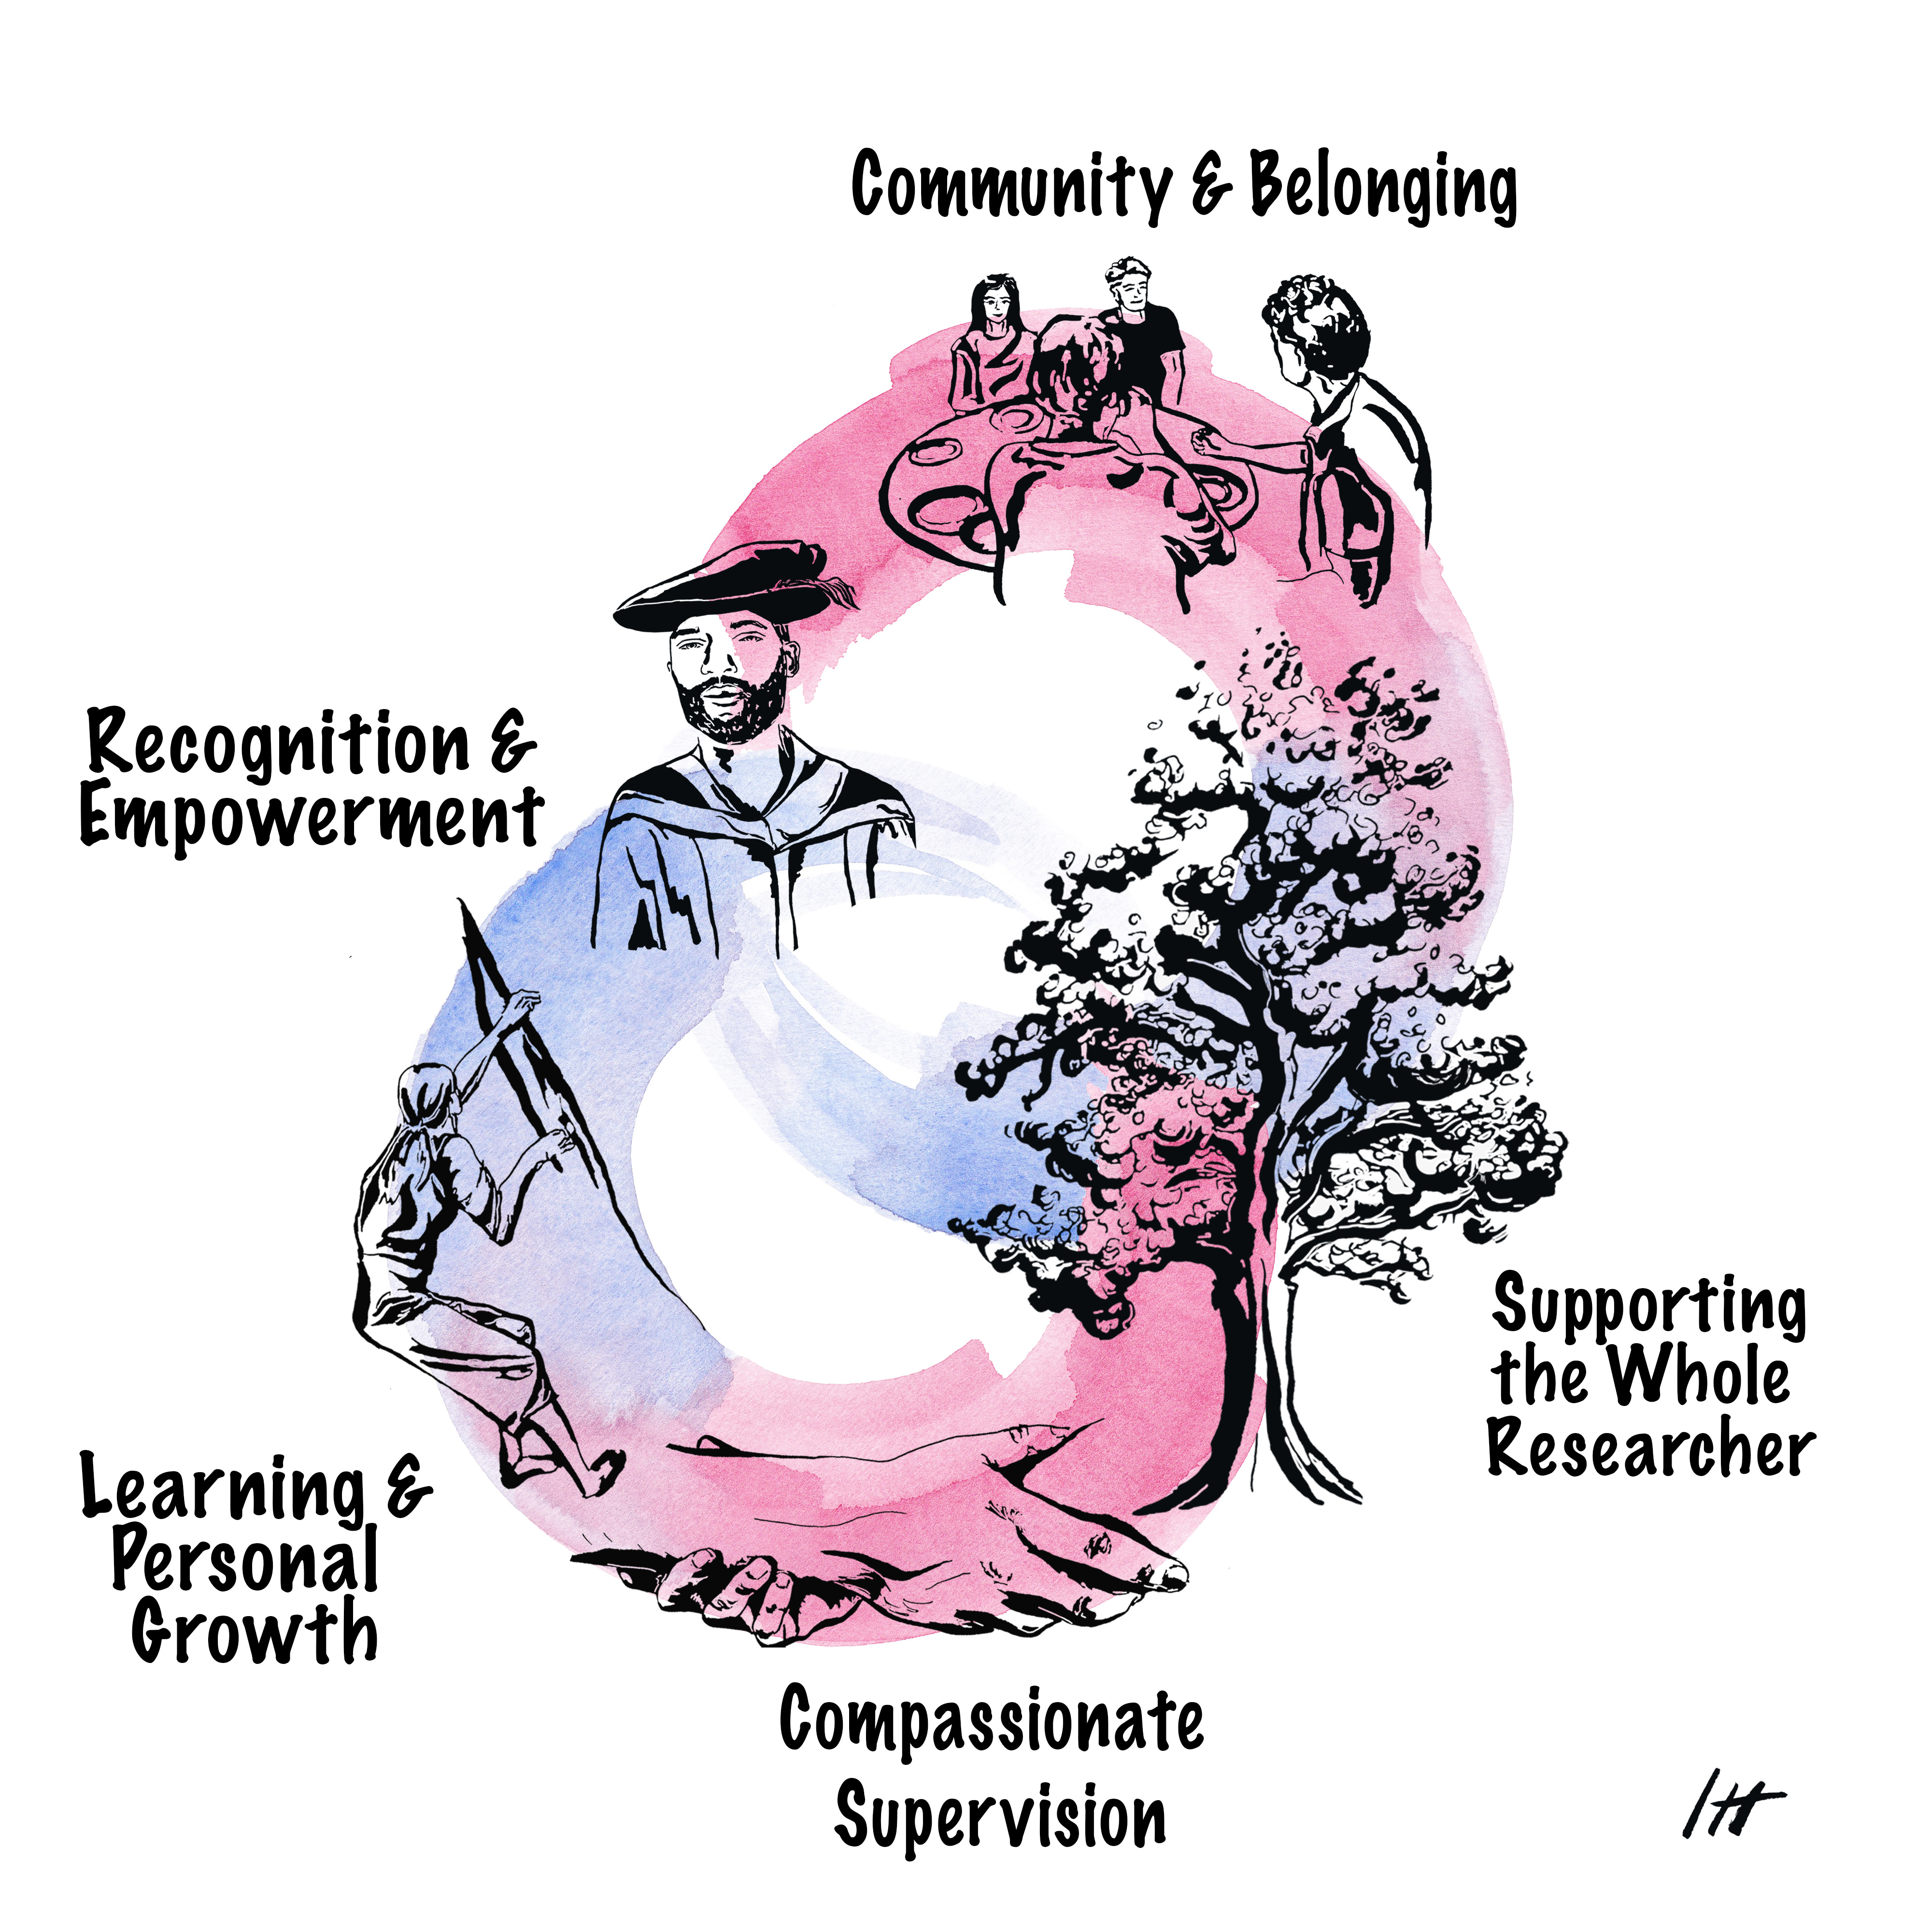
Our Doctoral Values
Co-created with PGRs
Know that your presence and contributions truly matter.
Compassion in supervision is a necessity.
Inviting a culture that nurtures growth as it happens.
You are seen and valued as both students and essential members of the academic community.

Slide 22
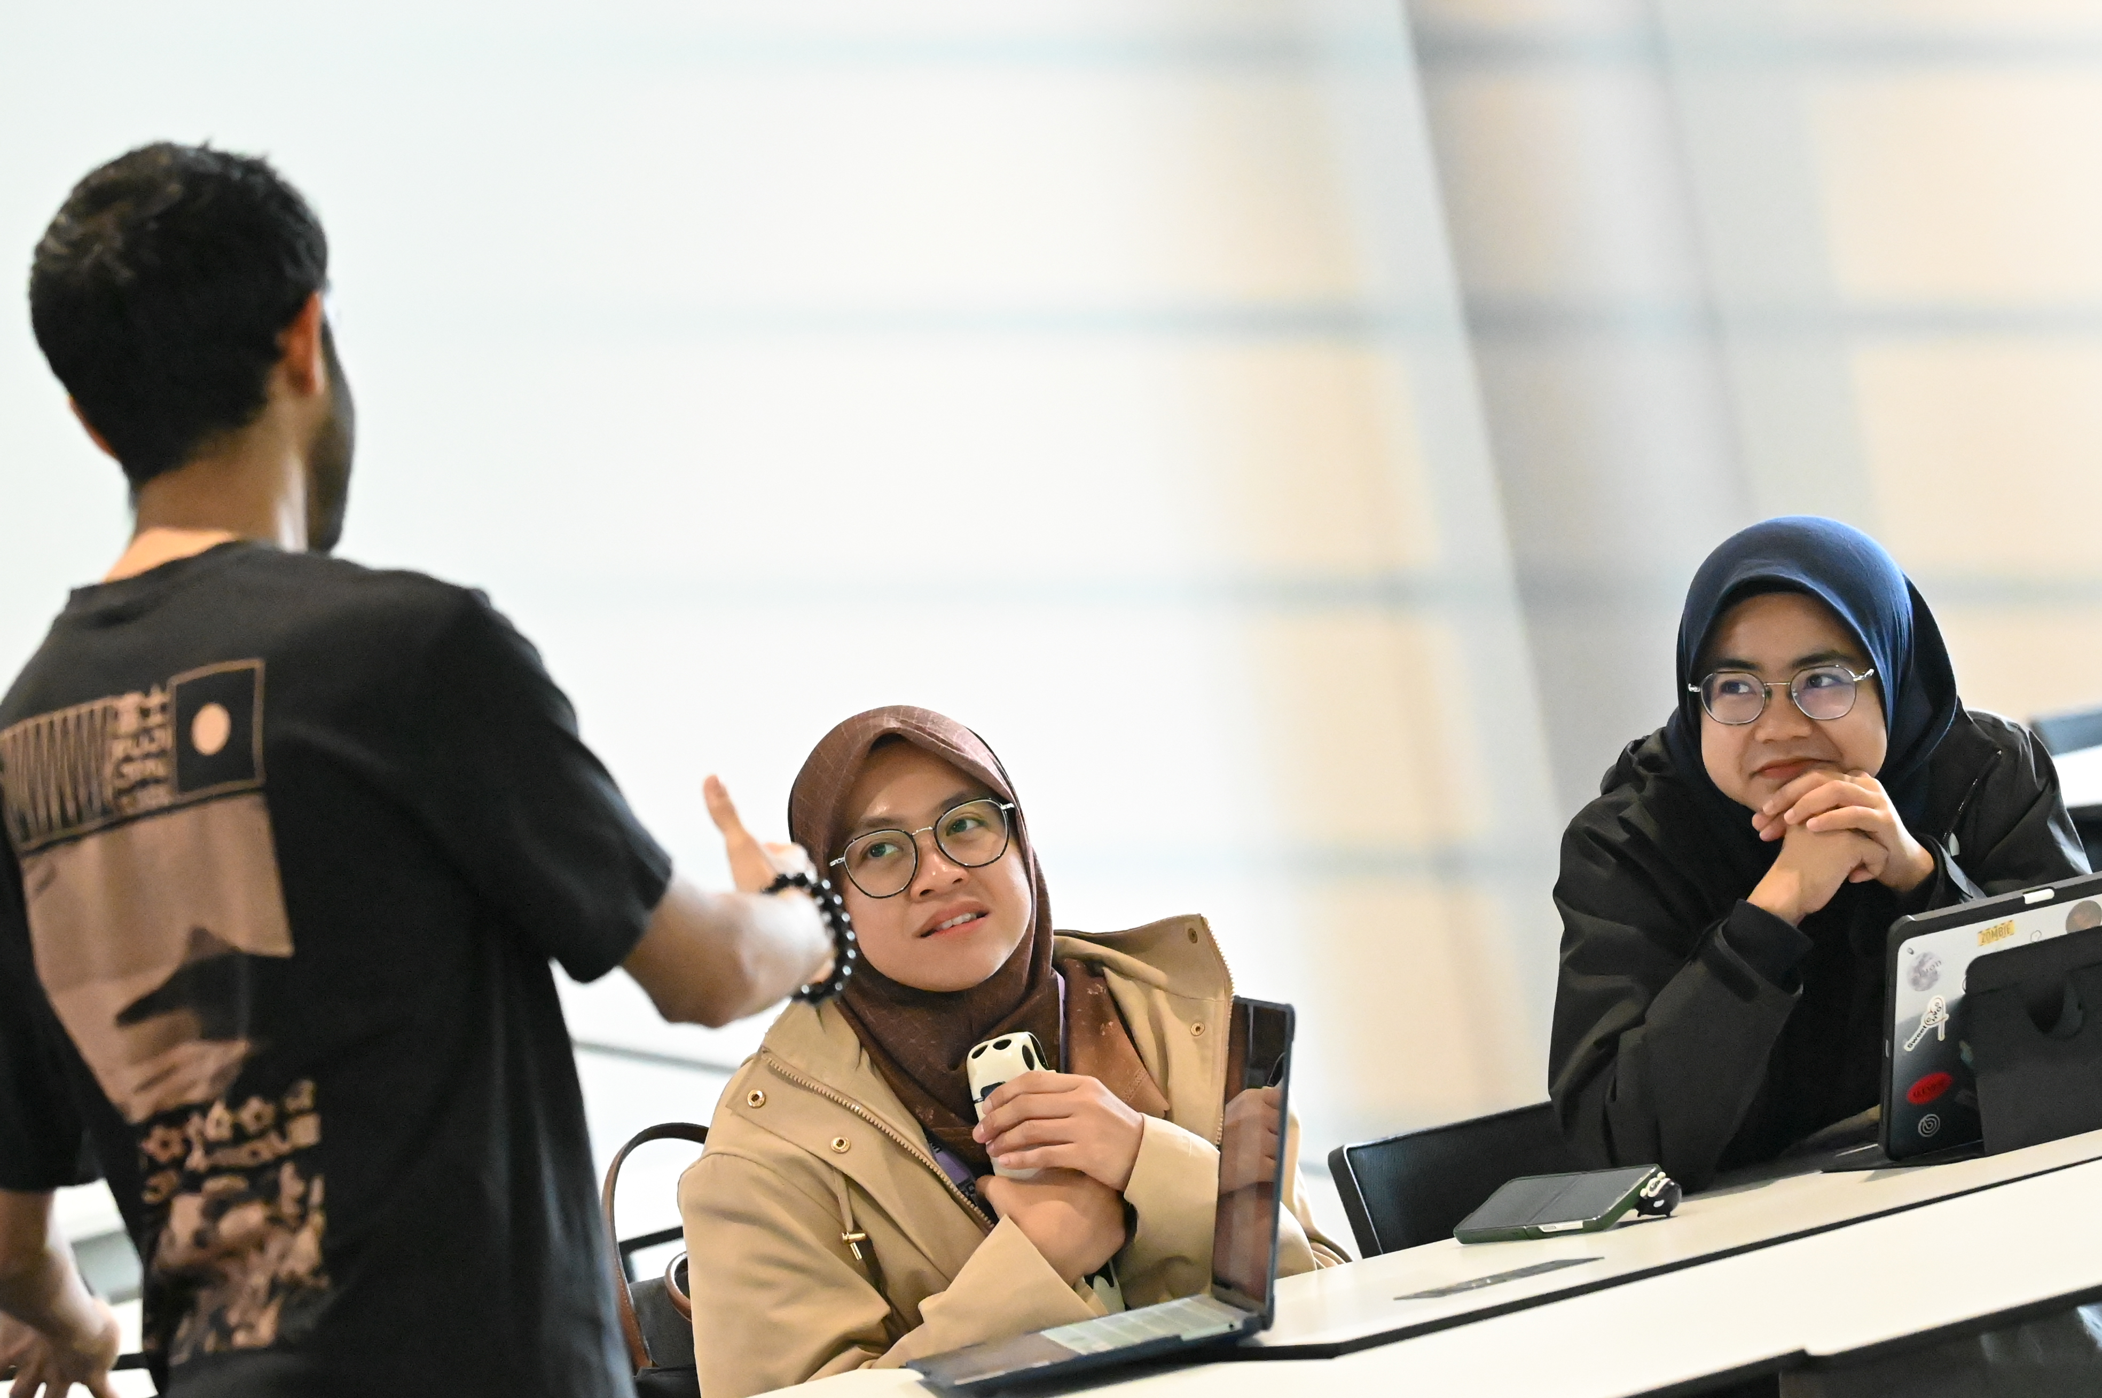
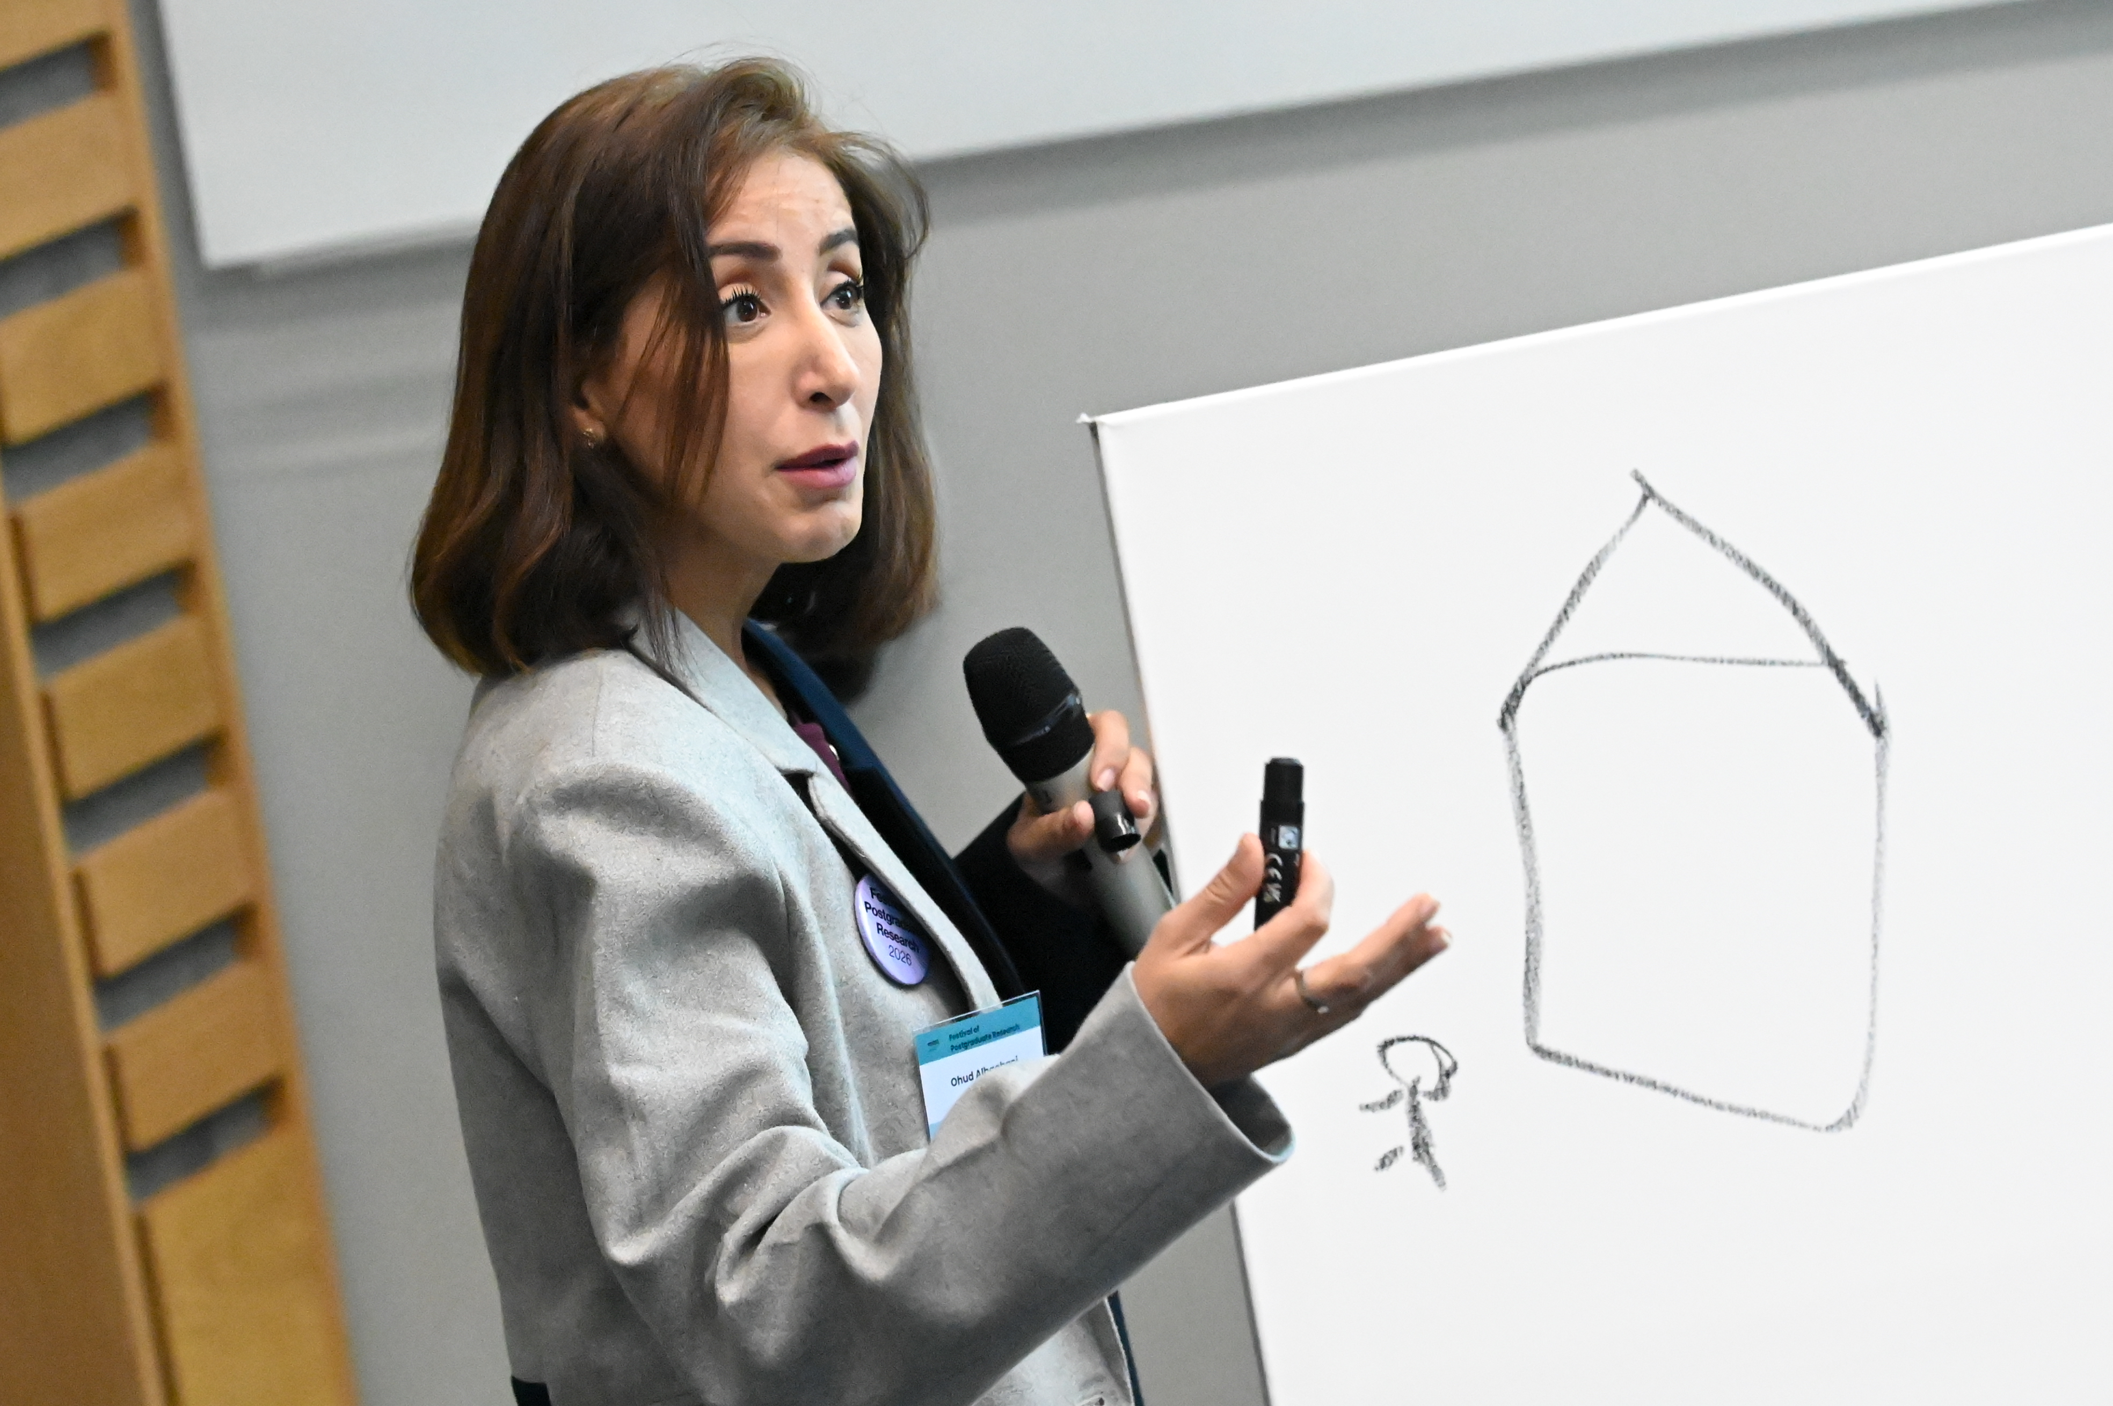
Development and Training
Professional development to enable you to get the best of yourself
Covering all disciplines and stages of research
Engage in individual 90 minute small-group sessions, or
Complete a postgraduate certificate
Recognise and maximise your talents for your future career

Slide 23
PGR Life
Make the most of your time at Warwick
Conduct world leading research
Join community events
Engage with PGR networks
Represent PGRs on committees
Read the PGR newsletter
Attend Focus Groups
Complete feedback surveys

Slide 24
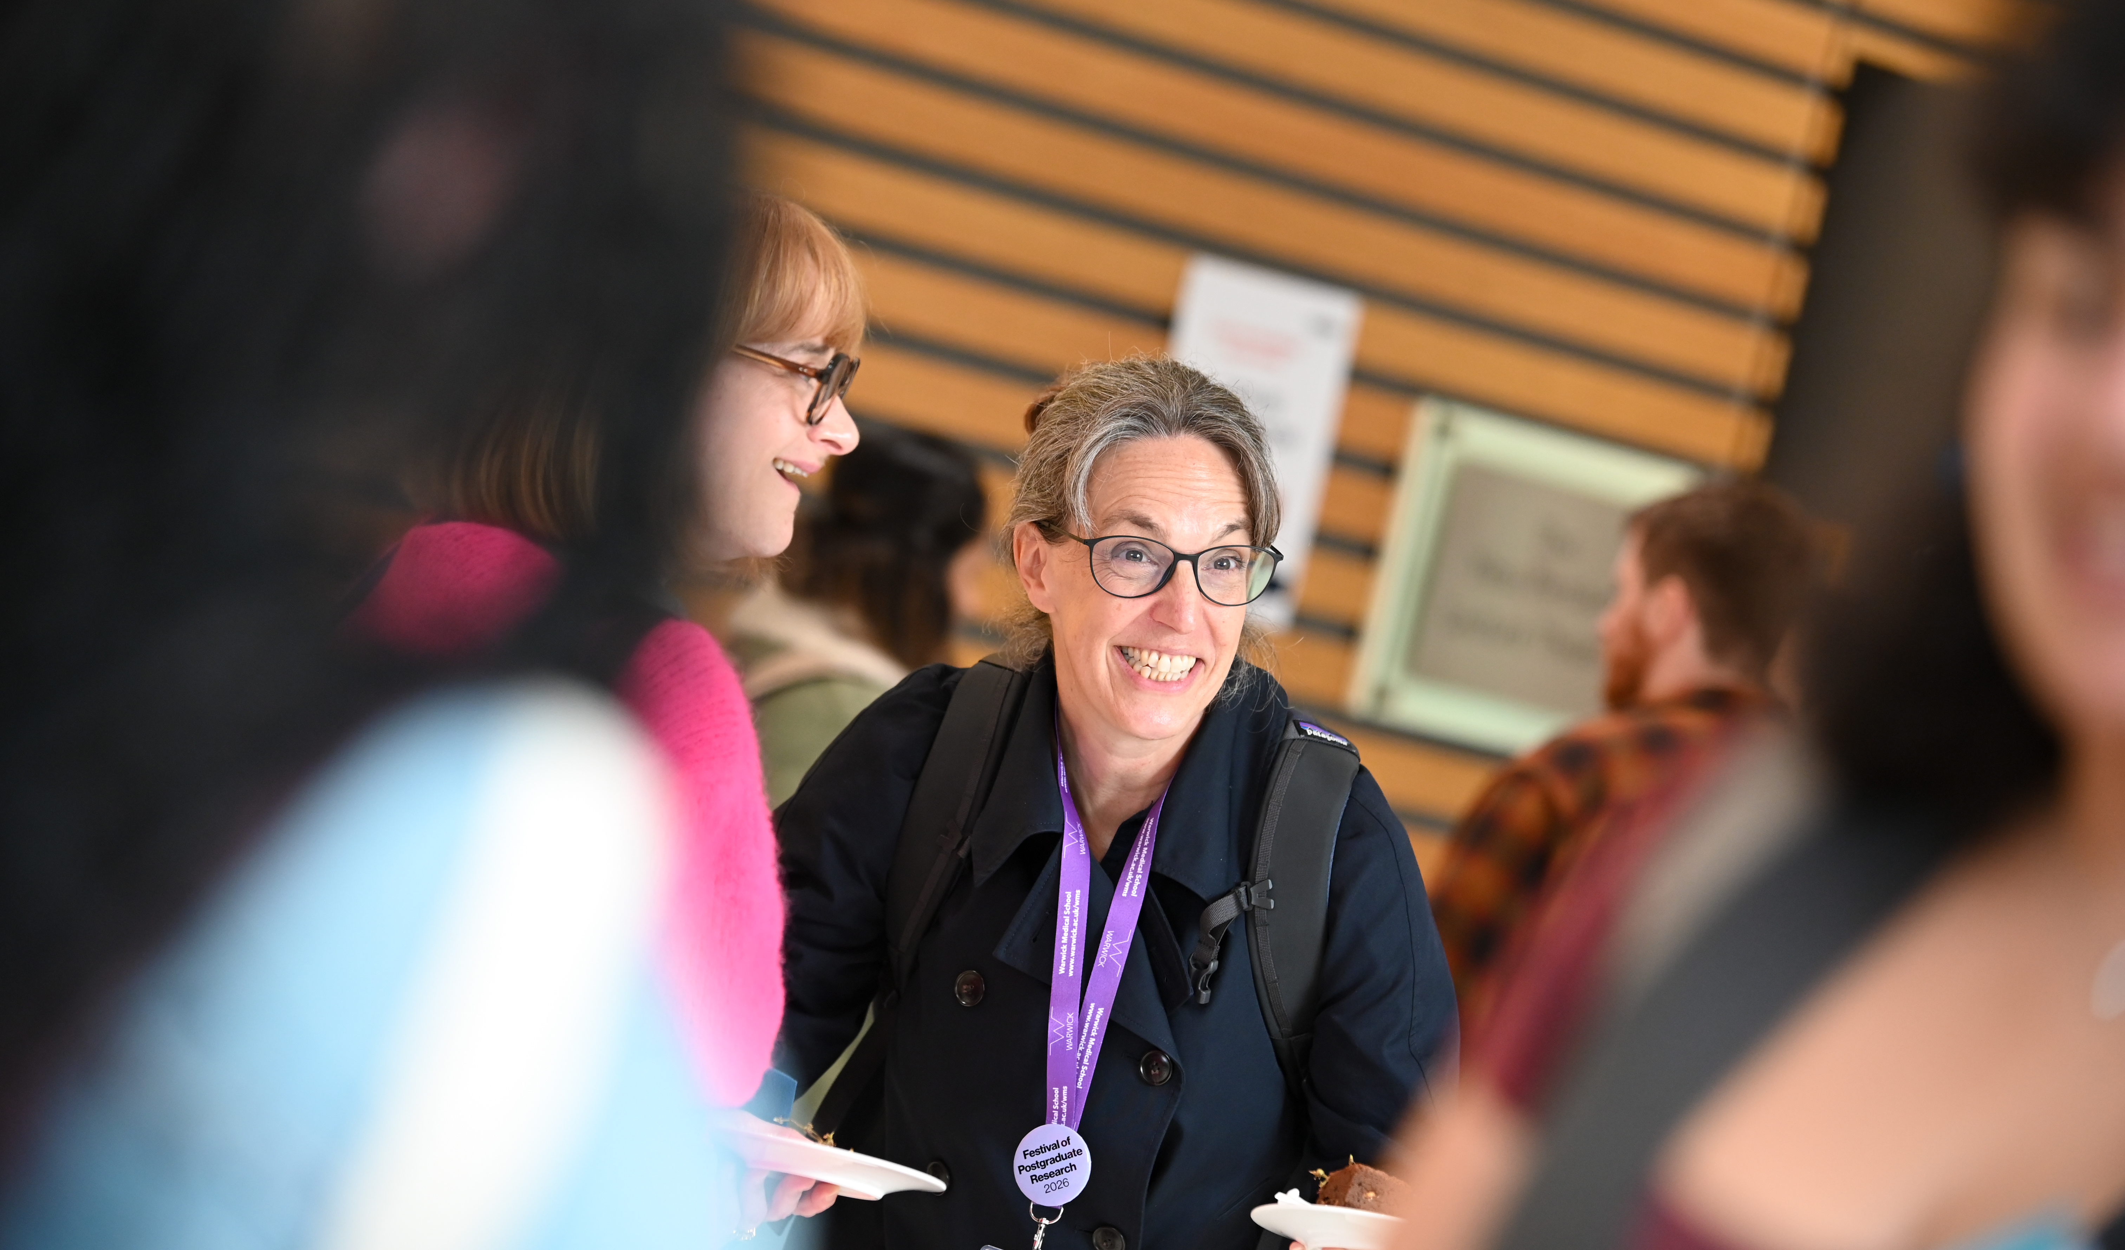
PGR Events
Get involved and meet the wider Warwick PGR Community
Doctoral College PGR Welcome Event
Monday 2 November, 12 pm (Panorama Suite Rootes Building)
Warwick Year of Postgraduate research – Throughout 2027.
Launch Event 13 January 2027 (The Slate)
Festival of Postgraduate Research: returning March 2027

Slide 25
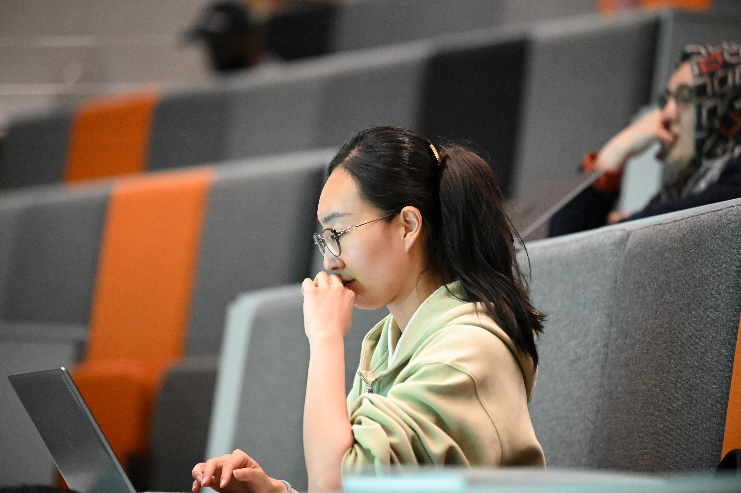
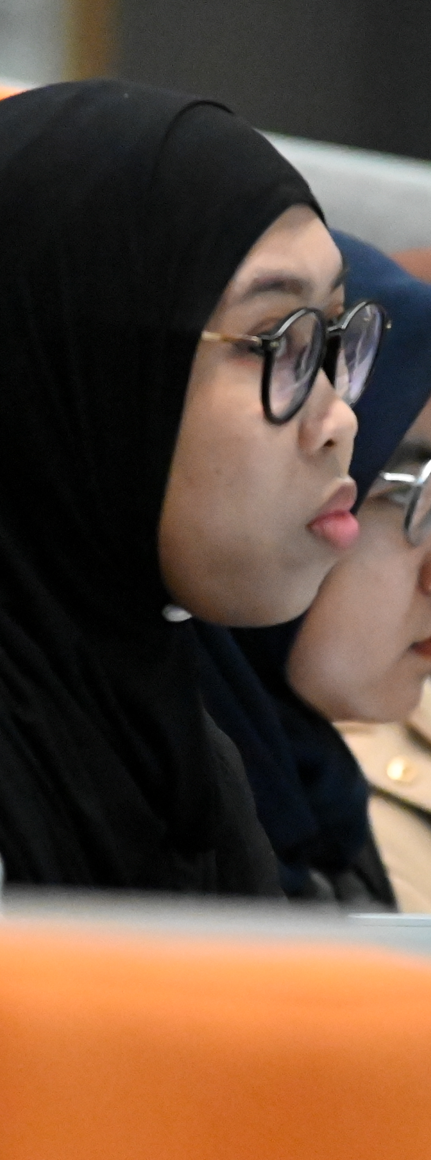
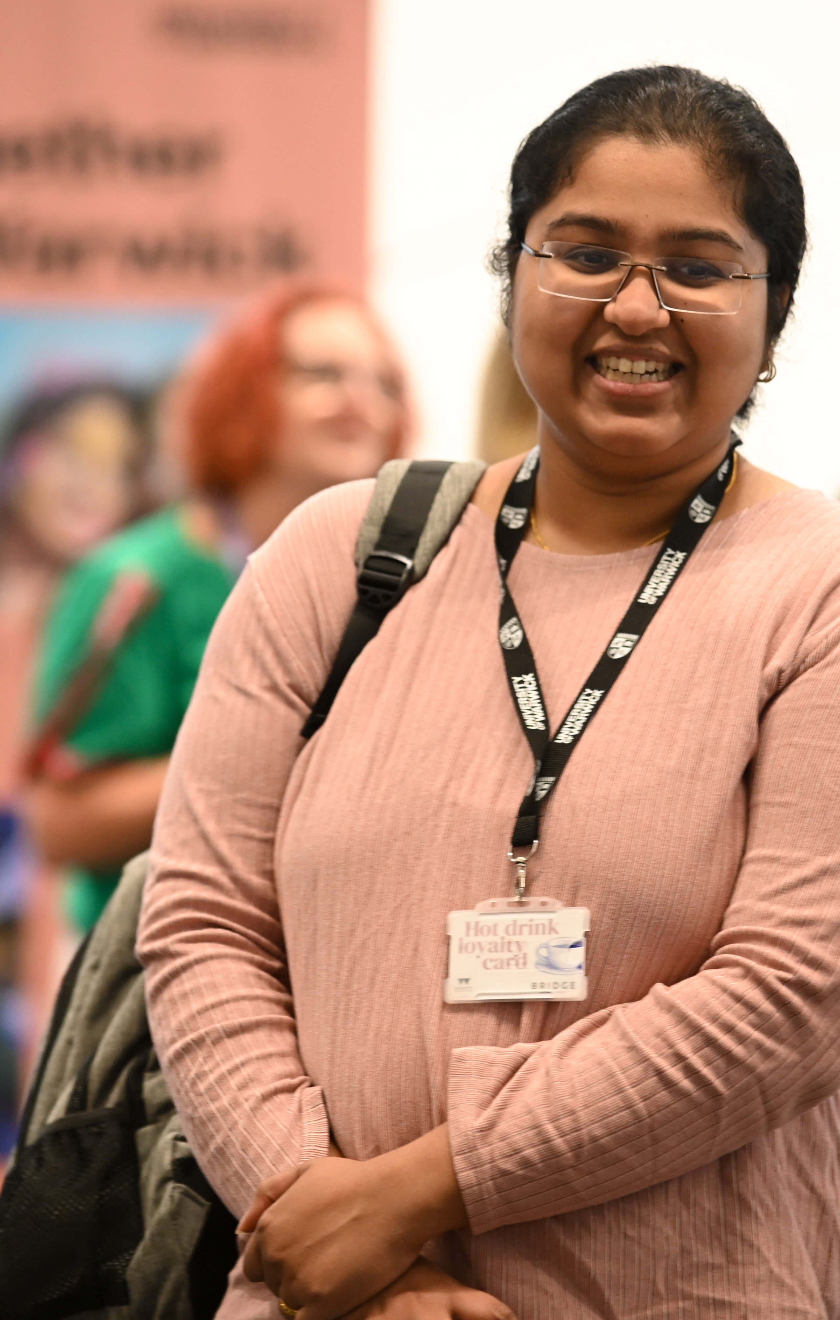
PGR Policy Hub
Know where to find it when you need it
Regulation 38: governs Research Degrees and Warwick
Supervision: who is responsible for what
PGR Leave: annual leave, temporary withdrawal, parental leave
PGR Funding Policy: when and how funding is dispensed
Guide to Submission & Examination

Slide 26
As you embark on your PGR journey, remember that it’s not just about the destination, but the experiences and lessons […] Embrace the challenges, connect with your community, manage your time effectively, celebrate your victories, and stay adaptable.
Alice Wang (Warwick Medical School)

Slide 27

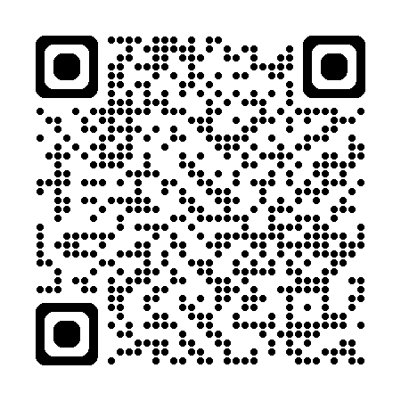
Thank you
Questions?

Slide 28
Disability Services and the Wellbeing Centre
George Morrell

Slide 29
Warwick Sport
Katy O’Brien

Slide 30
TEAM WARWICK - ACTIVE WELLBEING

Slide 31
WELLBEING BENEFITS OF EXERCISE
It's a scientific fact that regular physical activity and exercise can make us healthier and happier.
When we're active, the body releases feel-good hormones that can improve our mood and boost our energy.
Other benefits of exercise for mental health include:
•Boosting our self-esteem and confidence
•Increasing motivation and focus
•Reducing tension, anxiety, stress and mental fatigue
•Helping to calm the mind, especially when dealing with difficult emotions like anger, frustration and sadness
•Reducing loneliness by offering new ways to get together with family and friends and meet new people

Slide 32
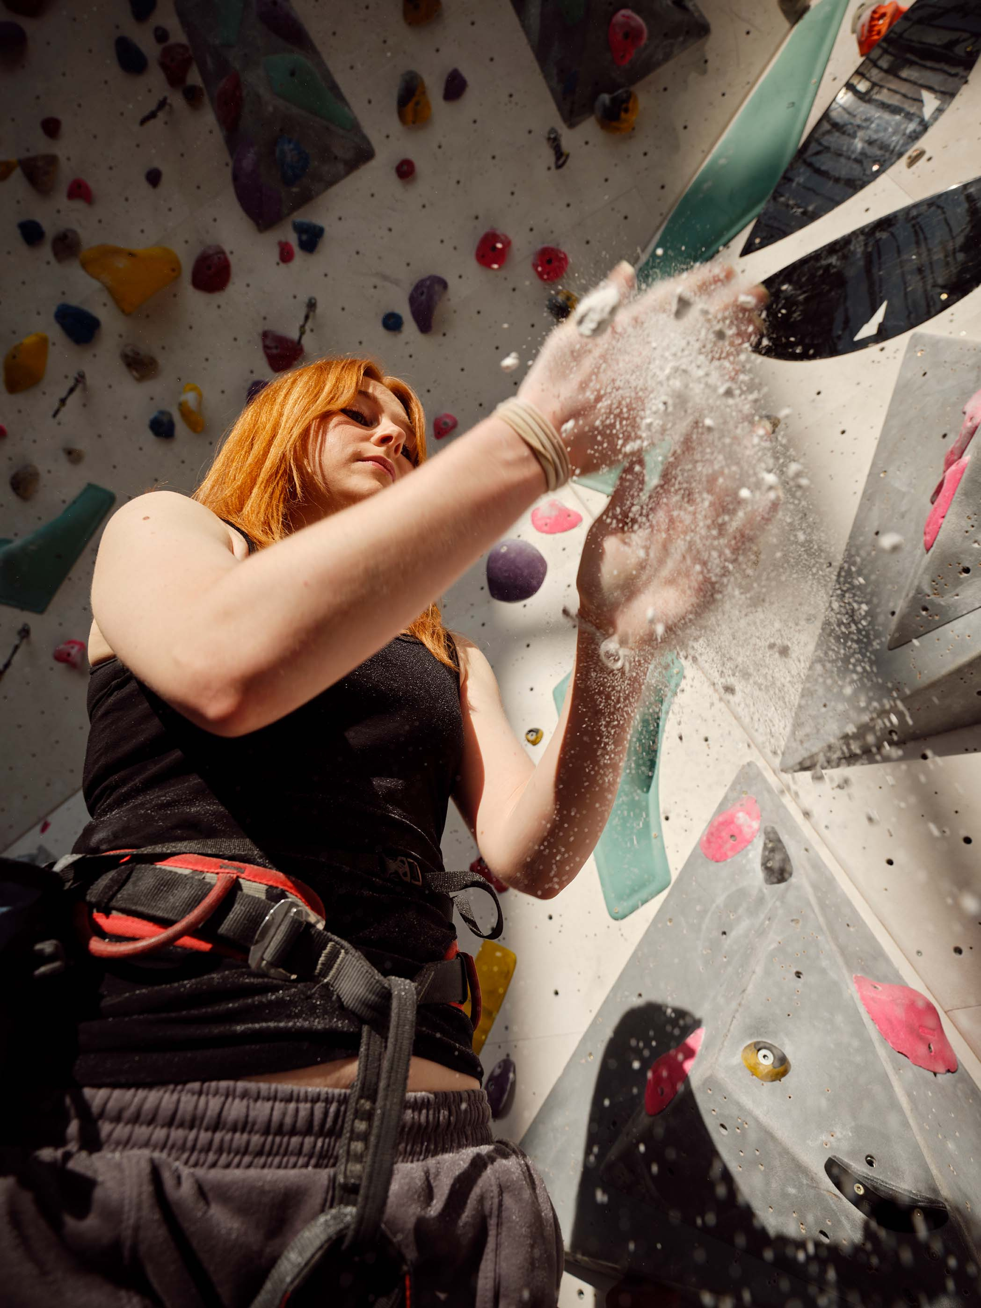
ACTIVE WELLBEING PROGRAMME

Slide 33
ROCK UP AND PLAY
•Over 60+ of FREE activities for Warwick staff and student
•Inclusive sessions
•20+ sports on offer
ACTIVE LEAGUES
•12 Intra-mural Active Leagues each term
•All abilities welcome.
EVENTS
•Term time events including This Girl Can, Warwick Women's Night In, One World Cup and more.

Slide 34
WAYS TO STAY ACTIVE FROM YOUR DESK
• Static stretches
• Walking meetings
• Standing desks
• Take the stairs
• Seated exercises
• Regular desk breaks
• Lunch time walk
• Isometric movements

Slide 35
VP Postgraduate
Warwick Students’ Union
Ronny Whetton

Slide 36
Welcome to
Warwick Students’ Union

Slide 37
Essential Info
We are a Union run by Students!
We are a charity
Operate independently of the University
A collective which represents the best interests of c.30,000 students at Warwick
Political and democratic
Champion students’ rights
Foster a safe and inclusive community
Provide facilities, opportunities and support

Slide 38
Who are your Officers?
Harri Paget
VP Welfare and Campaigns
Adam Skryzmowski
VP Societies
Raj Hacker
VP Education
James Varney VP Democracy and Development
Ronny Whetton VP PG
Nazrana Meghji VP Sports
Ollie Chapman President

Slide 39

What is the WSU Advice Centre?
Independent advice, support & representation
    Free
    Impartial
    Confidential
    Non-judgmental
    Professional
Information & empowerment service
    Empower clients to make an informed choice
    Act in best interests of clients

Slide 40
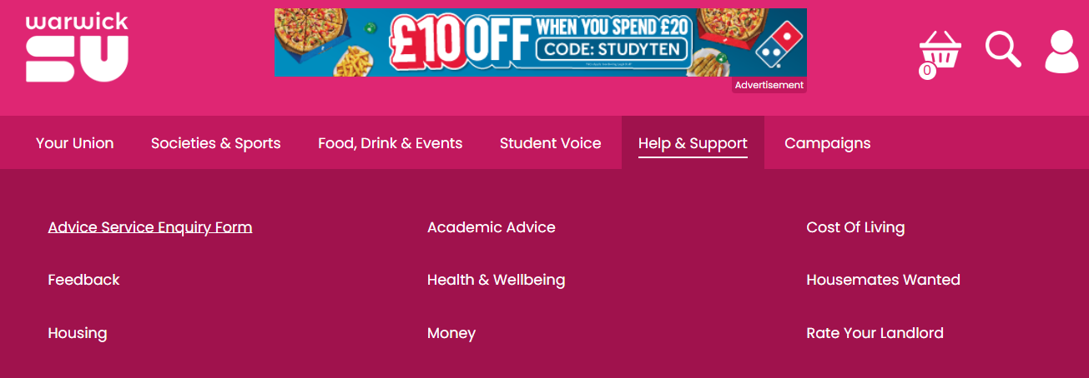
How can I get in touch?
Enquiry Form – 2 working days response time
  https://www.warwicksu.com/help-support/contact/

Slide 41
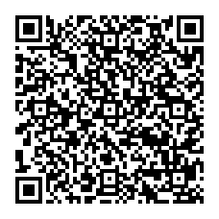
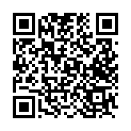
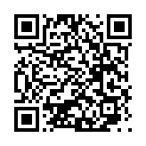
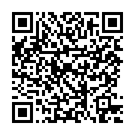
How can you get involved?
Our Clubs and Societies
Jobs
Our Elections
Our Campaigns

Slide 42
What's on this term?
What? | Where? | When?
Postgraduate Meet & Greet | Kevin Gately Room, SU North | October 1st, 11am
Postgraduate Intro to the SU | The Graduate, The Dirty Duck | October 9th, 5pm
PG Town Hall | Kevin Gately Room, SU North | October 15th, 4pm
PG Town Hall with PG Forum | Kevin Gately Room, SU North | October 29th, 4pm
PG Town Hall x Warwick Estates | A0.41, Warwick Medical School | November 25th, 4pm

Slide 43
How can you reach us?
Our Building
Our Website
Our Email
postgrads@warwicksu.com

Slide 44
Warwick Library
Andy Calvert, Josh Caldicott, Gabriel Clarke and Sarah Akhtaruzzaman

Slide 45
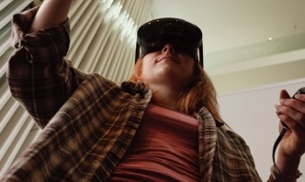
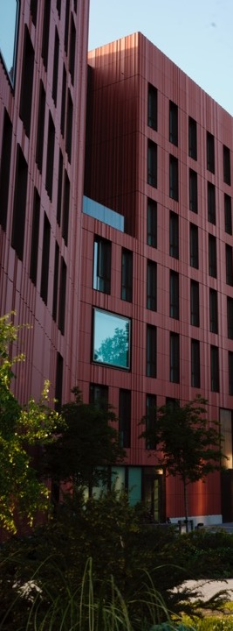
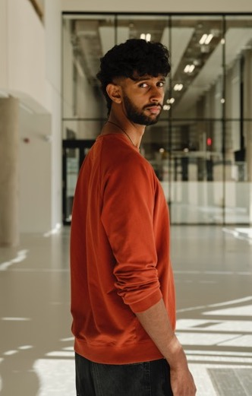
BREAK
15 Minutes

Slide 46
Careers
Claire Halldron and Ellie Wetherhill

Slide 47
CAREERS: CADRE
Clare Halldron: Senior Careers Consultant
Classics and Ancient History, History, SMLC
Ian Scrase: Senior Careers Consultant
Cross Faculty Studies
School of Creative Arts, Performance and Visual Cultures
Ellie Wetherhill: Careers Consultant
English and Comparative Literary Studies

Slide 48


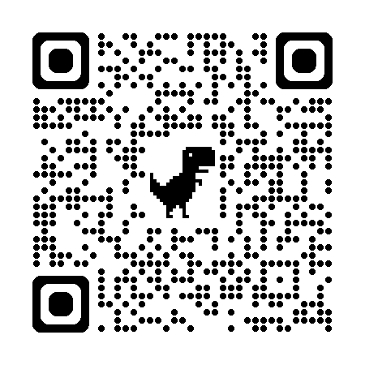
CAREERS, EMPLOYABILITY & SKILLS
OPPORTUNITIES TO DEVELOP EXPERIENCE
Warwick Volunteers, Work Experience, Thrive, Enterprise,
EVENTS, WORKSHOPS AND CONNECTIONS TO EMPLOYERS
Careers Fairs, Employer Presentations, Careers Workshops
ONLINE CAREERS RESOURCES
Careers information, advice and application preparation
1 TO 1 SUPPORT AND ADVICE

Slide 49

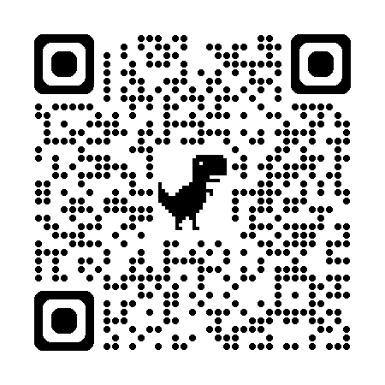
SOME OF OUR UPCOMING AUTUMN EVENTS
MEET THE PROFESSIONALS (IN-PERSON & ONLINE)
Careers in the Public Sector- Mon 12th Oct- 3 pm- 5 pm
Careers in HR and Recruitment- Mon 19th Oct- 6 pm- 7.30 pm
Careers in Marketing- Tues 20th Oct- 6.15 pm- 7.45 pm
Careers with Global Brands- Tues 27th Oct- 5 pm-7.30 pm
Careers in Film & TV- Mon 2nd Nov 6.00 pm- 7.30 pm
Careers in Museums & Culture- Tues 3rd Nov 6 pm-7.30 pm
Careers in Publishing- Tues 17th November- 6.15 pm- 7.45 pm
Careers in Diplomacy TBC
7.00pm
CAREERS FAIRS (Panorama, Rootes Building)
Autumn Careers Fair- Tues 13th Oct- 11am-4pm
Economics, Finance & Consultancy- Thurs 15th Oct- 11am- 3pm
Law Fair- Weds 21st Oct- 11am- 3pm
CAREERS WORKSHOPS THROUGHOUT THE TERM. For example……
Your Application Toolkit, Breaking into the Job Market: What Every Student Should Know, TeachFirst, Internal Communications.

Slide 50
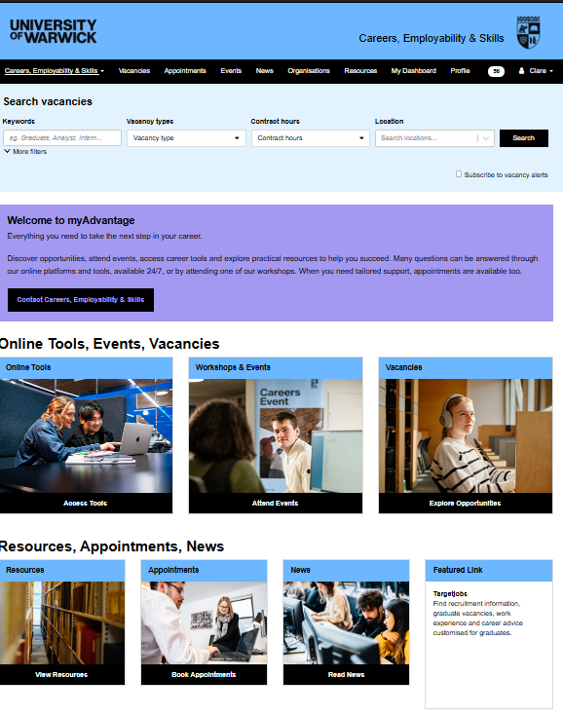
Accessing careers support
Log in to myAdvantage.warwick.ac.uk
Here you can:
Book events & workshops
Access online tools- e.g. Careerset and recruitment test practice
Search for vacancies
Book Career appointments

Slide 51

Questions to consider……
What do you want to get out of your time as a Postgraduate Researcher?
Do you have plans for after your research? Are you interested in academic or non-academic roles?
How can you frame your research skills to prospective employers and/or academia
How can you develop networks within and outside of academia to support your career pathway? Who can help you?
This Photo by Unknown Author is licensed under CC BY-NC-ND
Notes:
Only 1/3 have a defined career pathe Bring out the points that 1. Long journey to final submission; 2. Career planning may get ignored; 3. Earlier you think and engage the more prepared you will be; 4. Chance to develop relevant skills for your CV before rather than after submission

Slide 52

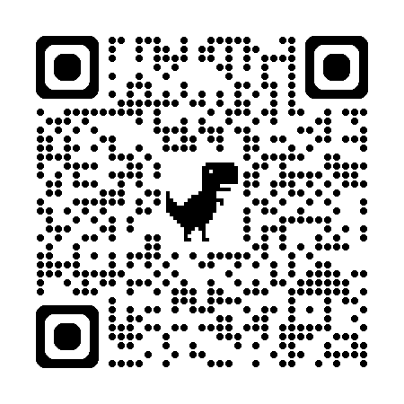
RESOURCES
warwick.ac.uk/services/careers
warwick.ac.uk/services/dc/pgr/careers
Vitae.ac.uk
Phd-careers.co.uk
Jobsontoast.co.uk
Creative Industries-warwick.ac.uk/services/careers/options/jobsectors/creative/
Thank You

Slide 53
PG Certificate in Transferrable Skills
Dr Daniel Franklin

Slide 54

PGCert in Transferable Skills
(PGCTS)
Dr Daniel Franklin

Slide 55
Student development
Your PhD develops your disciplinary expertise. PGCTS helps you develop how you work as a researcher and professional.
‘Essential’ skills boost income, predict job satisfaction, increase life satisfaction, decrease unemployment (Skills Builder Partnership, 2023)
“The labour market of most doctoral candidates will be outside academia.” (71%) – European University Association, (2025).
Overall student development is key to your progress while a PhD student.
We, the institution that is delivering your discipline specific education, is also telling you that (transferable) skills are important.

Slide 56

Student development is part of doctoral education
UKRI – fund half of the PhDs at the university. Hold universities to account – are students getting what is best for them? Through funding disciplinary research, UKRI interest is in the students’ overall experience and benefits.
transferable skills are non-negotiable. Core part of being prepared for careers in and out of academia (UKRI statement on doctoral training, 2024).

Slide 57
PGCTS
Through the programme, you will develop and apply skills in areas such as:
communication and collaboration
project management
reflection and self-awareness
planning, adaptability and professional judgement
applying/transfering your skills beyond your immediate research project
The aim is not simply to attend training, but to become more deliberate, effective and adaptable in how you work.
…because being a subject expert alone is unlikely to be enough.

Slide 58
Marginal gains
You are going to be an expert in your field.
You may or may not continue to work in that field.
There are always other candidates.
You will be elite, and to get ahead, you will only get marginal gains…

Slide 59
Capability development
The PGCTS directly trains you…
But there is equal focus on developing skills as part of your PhD.
i.e., within your discipline, but not about your discipline.
Skills for your PhD and for all careers, academic and non-academic

Slide 60
PGCTS
PG Certificate in Transferable Skills: Total 6 modules × 10 credits each. Usually, 2 per year.
PG Award in Transferable Skills: Total 2 modules × 10 credits each.
Standards and progress are formally overseen by the Exam Board. In practice you deal mainly with your supervisor and departmental Director of Graduate Studies (or equivalent).
This is training held to an academic standard.

Slide 61
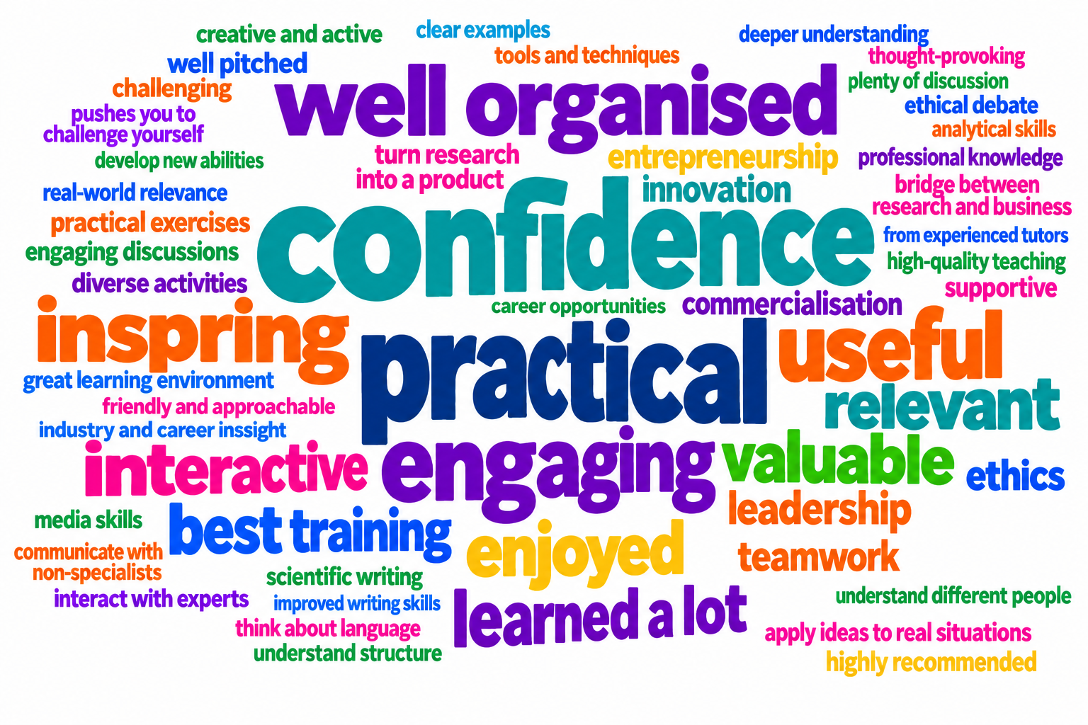
Student feedback

Slide 62
Structure of the course
Year 1 | Doctoral Skills 1 | Option
Year 2 | Doctoral Skills 2 | Option
Year 3 | Doctoral Skills 3 | Option

Slide 63
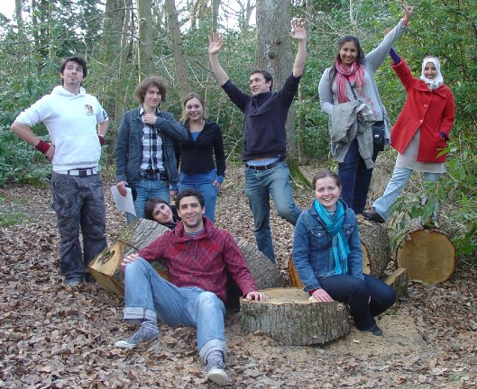
Option modules
‘Building collaborative professional relationships’ *
Communicating with non-specialists *
Decision-making & Leadership *
Research Ethics & Practice *
Business, Innovation & Commercialisation
Project management *
App development: From ideas to practical tools
Languages
Intro to teaching
Scientific writing for publication (SEM only)
You can really do as many as you like, when you like.

Slide 64
Doctoral Skills (core) modules
In these modules you gather evidence of what you are already doing.
Doctoral Skills 1-3 cover the skills needed and used by PhD students.
You collate a portfolio based around your research activities.
Tasks supported by supervisor feedback.

Slide 65
Doctoral Skills assessment
Assessment | DS1 | DS2 | DS3
1. Research Plan, literature review, project budget & risk analysis | x | x | x
2. Time Management | x | x | x
3. Critical review | x | x
4. Networking | x | x | x
5. Oral Presentation | x | x | x
6. Applications of research / Intellectual Property (IP) | x | x
7. Teaching / Supervision |  | x | x
8. Career Development | x | x | x
9. Problem Solving | x | x | x
10. Communication to Non-Specialists | x | x
11. Ethical principles | x |  | x
12. Skill transfer |  |  | x

Slide 66
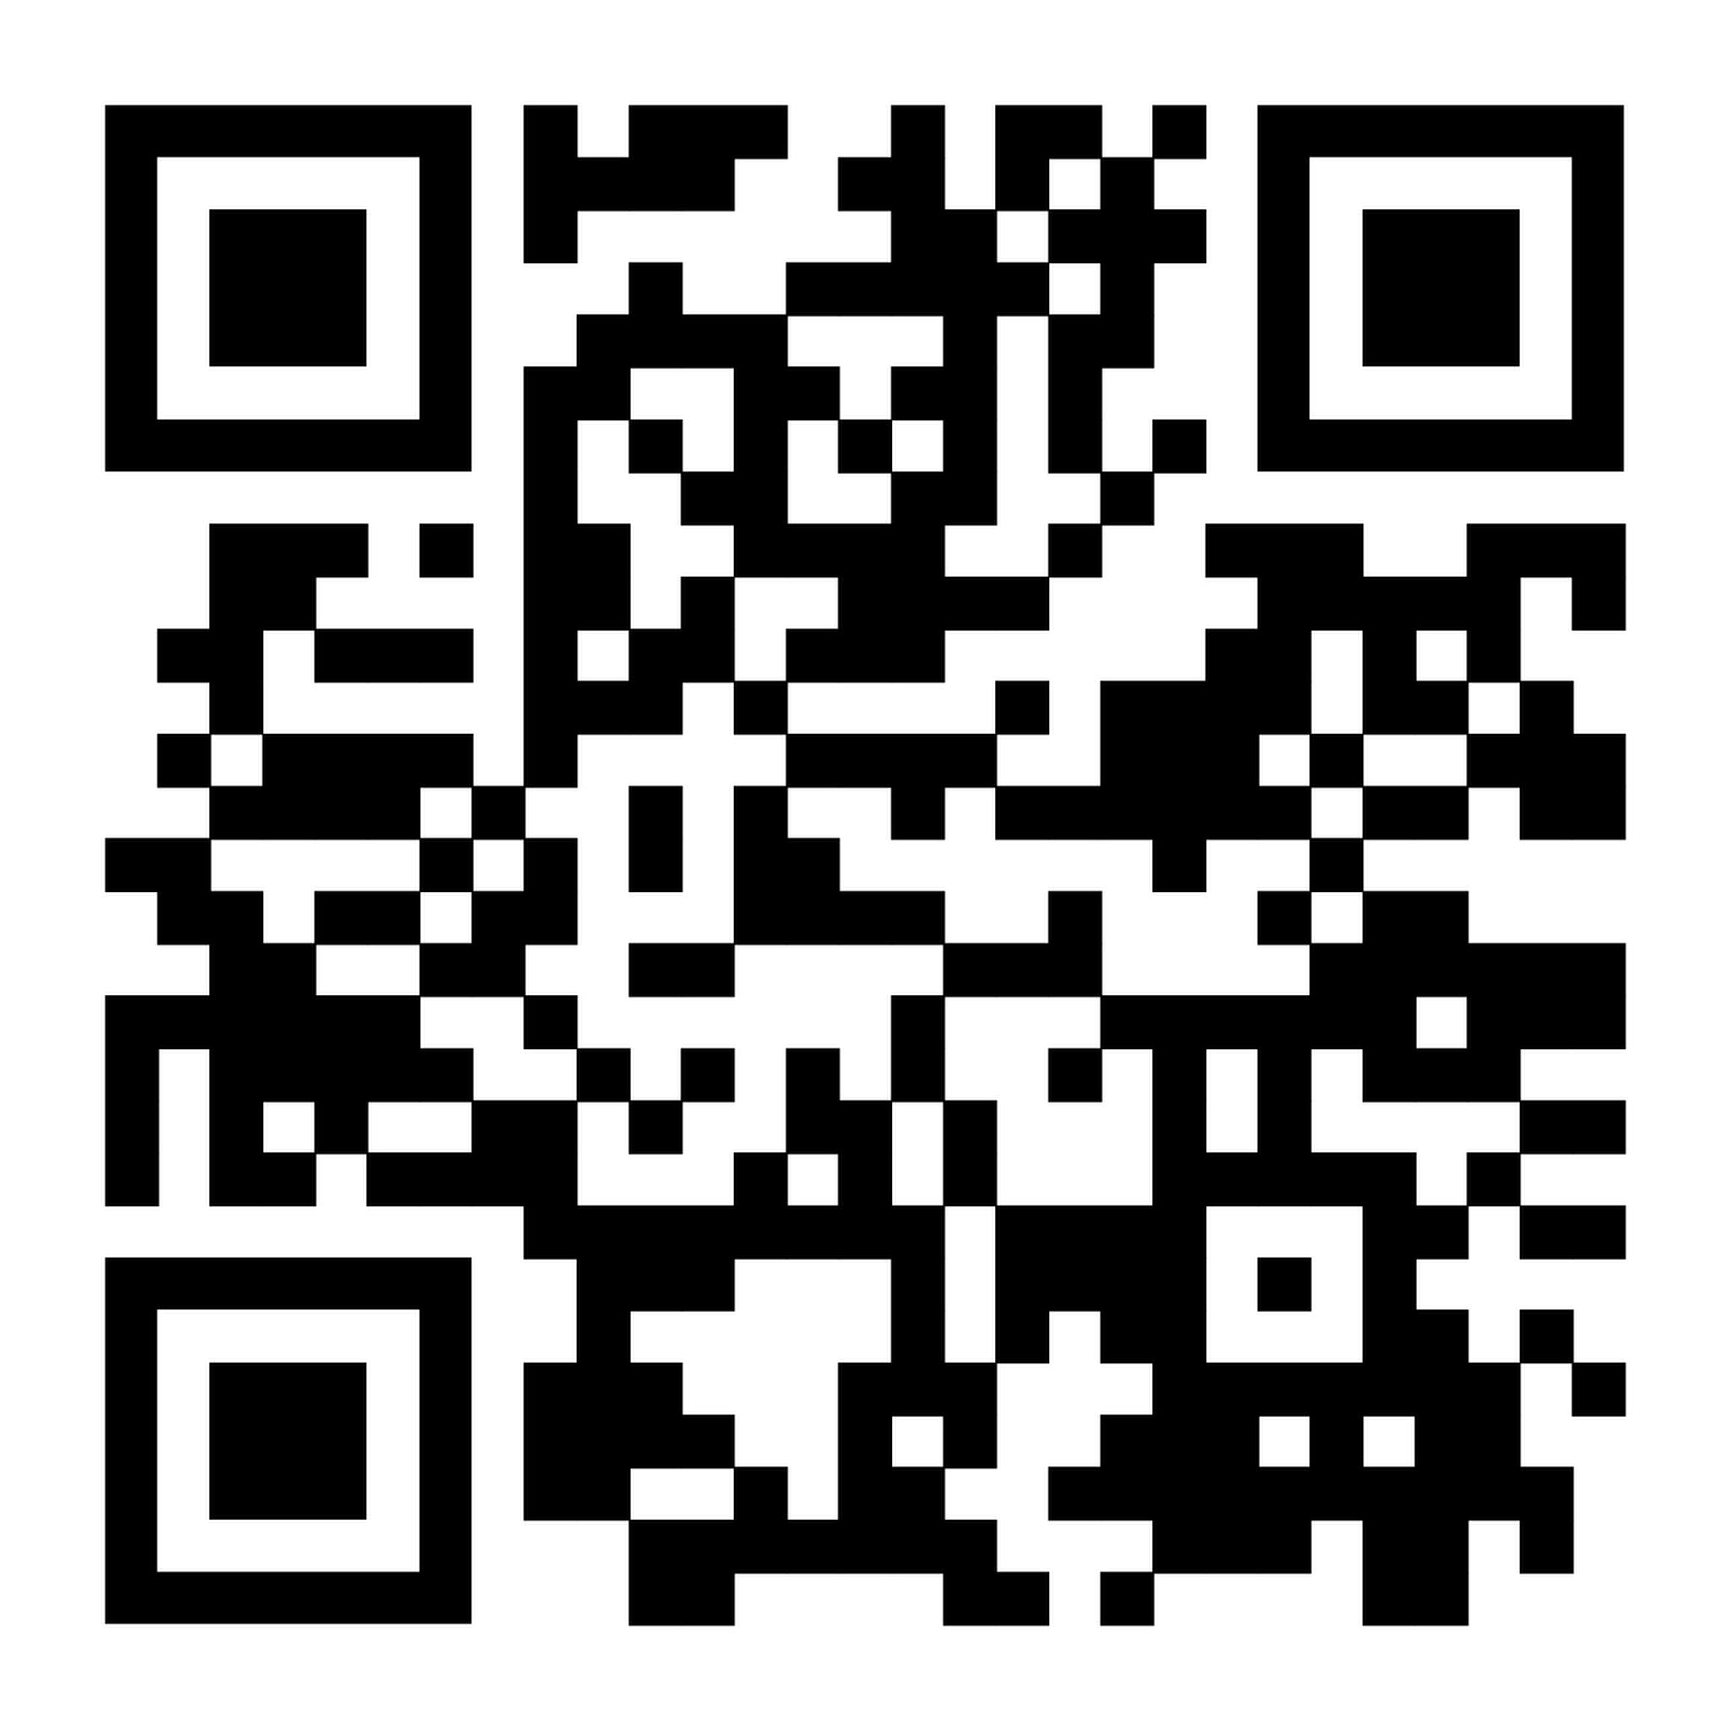
What to do…
Go to Transferable Skills website:
warwick.ac.uk/transferableskills
Sign up for Doctoral Skills 1 in SkillsForge
Pick some options according you your interests.
Any questions, email: transferable.skills@warwick.ac.uk
Notes:
QR code

Slide 67
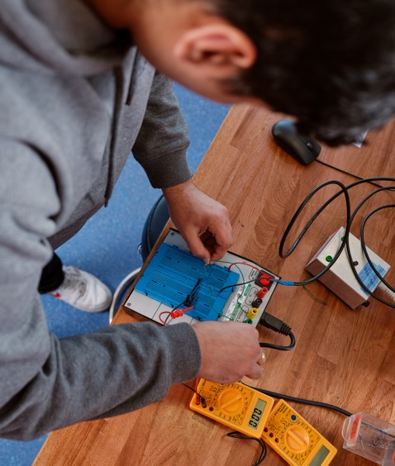
Always focus on your development…
It will be as important as your degree(s)

Slide 68
Humanities Research Centre
Dr William Rupp

Slide 69

Humanities Research Centre
Dr William Rupp, Director

Slide 70

What is the HRC?
A transdisciplinary space that…
… supports, amplifies, and celebrates humanities research across the Faculty of Arts and the wider University.
Provides funding, mentorship, and support for scholars in the Humanities across the whole range of roles and career stages.
  Currently the main focus is on supporting PGRs and ECRs.
Who is the HRC?
HRC Director: William Rupp (Liberal Arts)
  w.h.rupp@warwick.ac.uk
  Office in Ramphal, room R3.17.
HRC Administrator: Sue Rae
  hrc@warwick.ac.uk
HRC Committee
You!

Slide 71

Doctoral Fellowship Competition
Funding (£1,250) to put on a conference, plus a small personal research grant (£400) for each fellow in 2026/27.
Competition launch event 12:30 pm Wednesday 28 October 2026 at the Wolfson Research Exchange. First-year doctoral students eligible but any PGR is welcome to attend. Registration open!
Single and joint applications are welcome.
Applicants can be from different departments within the Faculty and including Philosophy.
Usually 3 awards.
Opportunity to publish via the ‘Warwick Series in the Humanities’ (Routledge).

Slide 72
This year’s Doctoral Fellowship conferences
Pride and Place: Negotiating Self, Civic, and National Identities in Space
  Aiden Diable (History) and Adam Coleman (History of Art)
  11 December 2026
Say a Body where None. Necromanticism and Thanatological Imagination of the Afterlife in the Modern and Contemporary Age
  Francesca Luppino (SMLC)
  27 February 2027
Empire’s Fruit: Colonial Ecologies, Food Systems, and Imperial Power
  Jade Lindo (History)
  20 March 2027

Slide 73
Other Funding
Conference Fund
Visiting Speakers’ Fund
Designed to support Warwick-based conferences
  Includes events on main campus, at the Shard in London, and at the Warwick Venice Centre.
Can be combined with other funding.
Up to £750 for one-day events or up to £1,250 for two- or three-day events.
Rolling application; eg. funding available until it is all allocated.
Events/expenditure must happen in the same fiscal year in which it is awarded.
Enables high profile speakers to come and present at Warwick.
Does not have to be linked with other HRC funding/events.
Can be used to cover travel costs as well as accommodation while at Warwick (but must comply with FinRegs.).
Rolling application.
Visits must take place in the same fiscal year the funding is awarded.
Full details and terms and conditions available on HRC website: https://warwick.ac.uk/fac/arts/hrc/

Slide 74
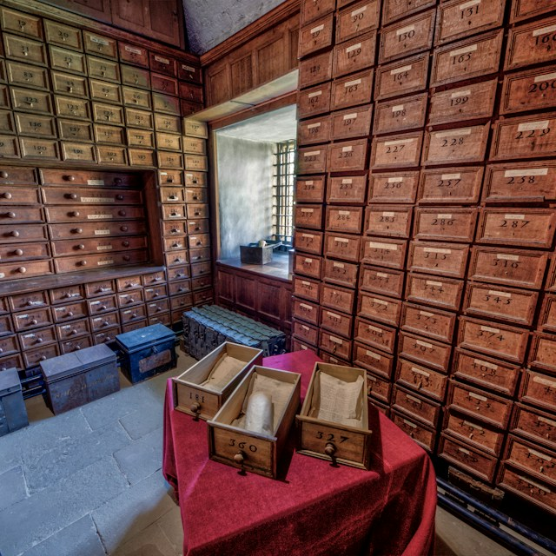
Keep in touch!
https://warwick.ac.uk/fac/arts/hrc/
hrc@warwick.ac.uk
Notes:
Photo by Stuart Jenkins on Unsplash

Slide 75
Vice Provost
Faculty of Arts
Prof Rachel Moseley

Slide 76
LUNCH!
  Next Workshop….
Workshop 2: Thriving in your PhD
  This session will be led by the CADRE Director and facilitators, who will give the inside track on thriving during your PhD journey.
20th October 2026 11:00-13:00
CADRE workshops 2026/27

