Slide 1
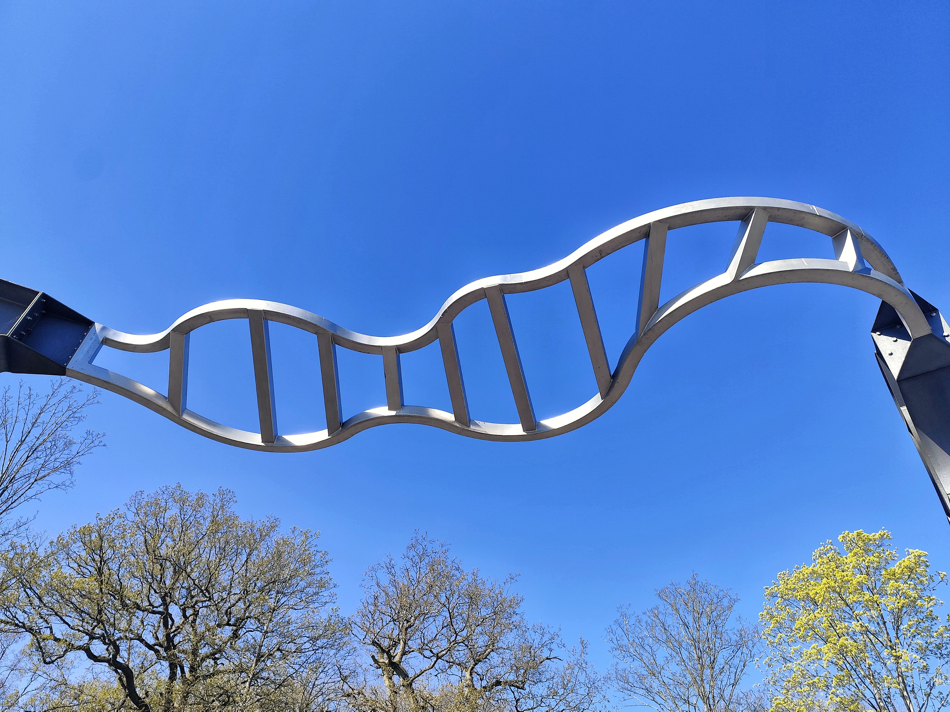
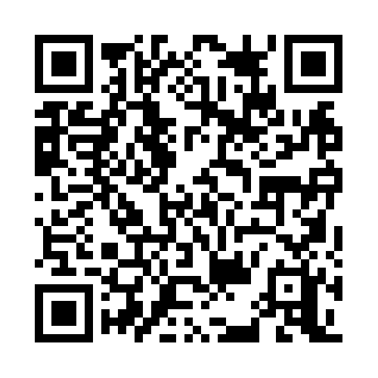
CADRE Workshop 2
Thriving in your PhD
20 October 2026

Slide 2
Session plan
Icebreaking activity
PGR-led discussion about “thriving”
PhD Survival top-tips: the supervisor’s perspective
Smriti and Laura’s PhD journeys
Useful information
Planning your PhD
Lunch (12.30 pm)

Slide 3
Ice-breaker
What are you most looking forward to about your PhD?
What are you most uncertain or unsure about?
Which aspects of the PhD would you like to know more about?
How are you feeling four weeks into the PhD?

Slide 4
What do we mean by “thriving”?
What does it mean to you?

Slide 5
Tips from a supervisor
Professor Anne Gerritsen (History Department, CADRE Director & M4C Site Director)

Slide 6
Two different PhD journeys

Slide 7
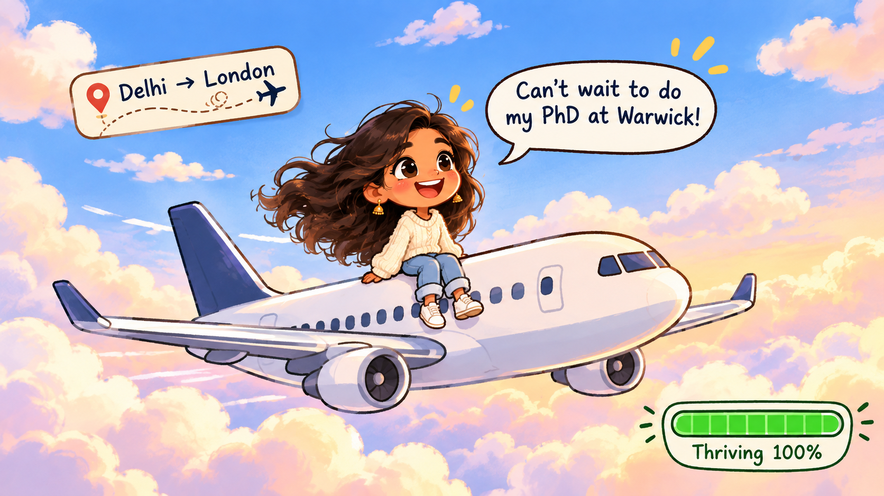
Smriti’s PhD journey

Slide 8
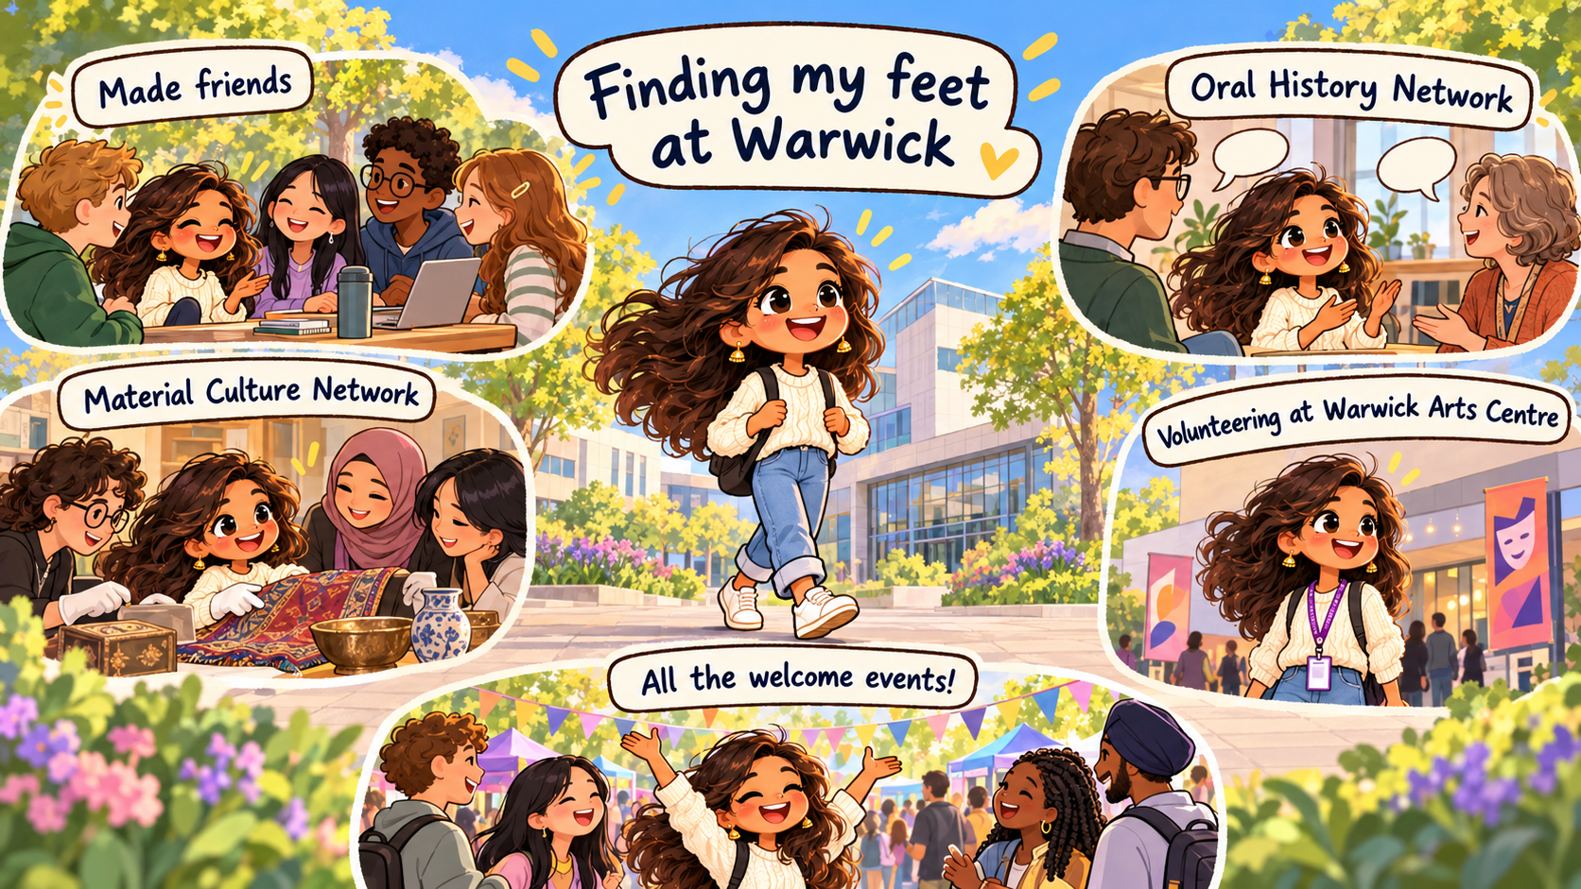

Slide 9
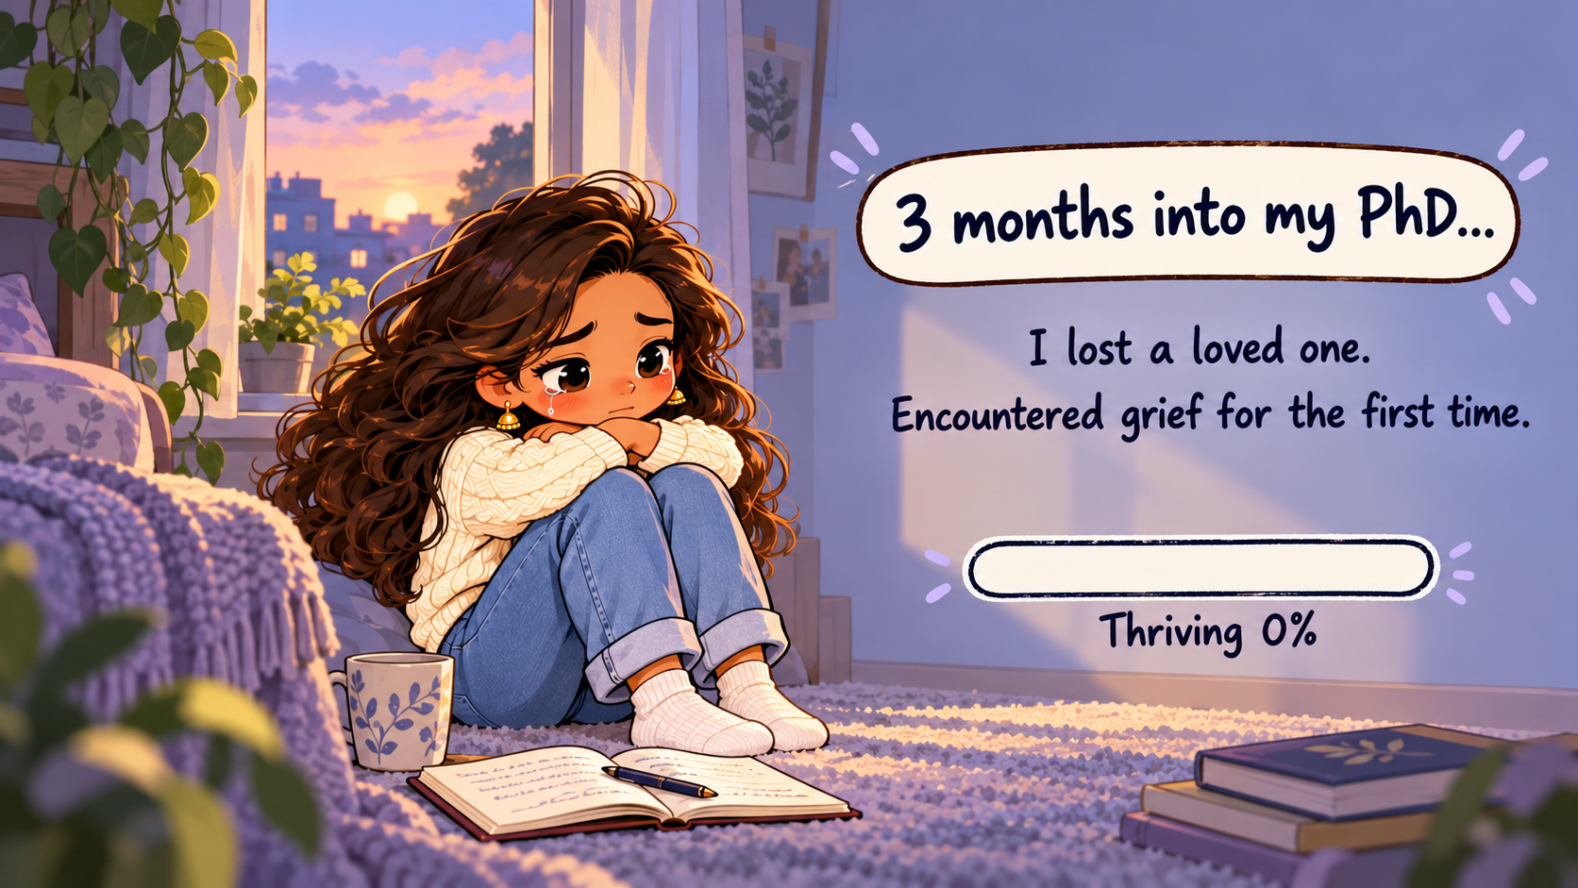

Slide 10
I was preparing to apply for HRC conference funding but missed the deadline.
I kept attending CADRE, RDO and departmental workshops, which gave me a reason to come to campus, and stay connected to my PhD.

Slide 11
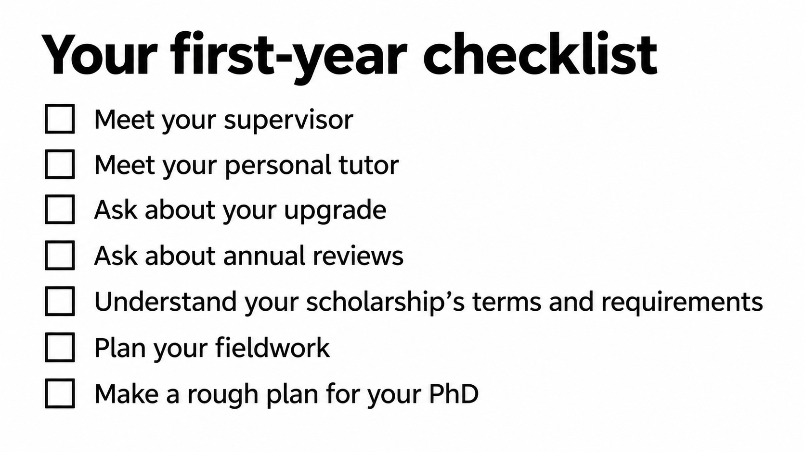

Slide 12
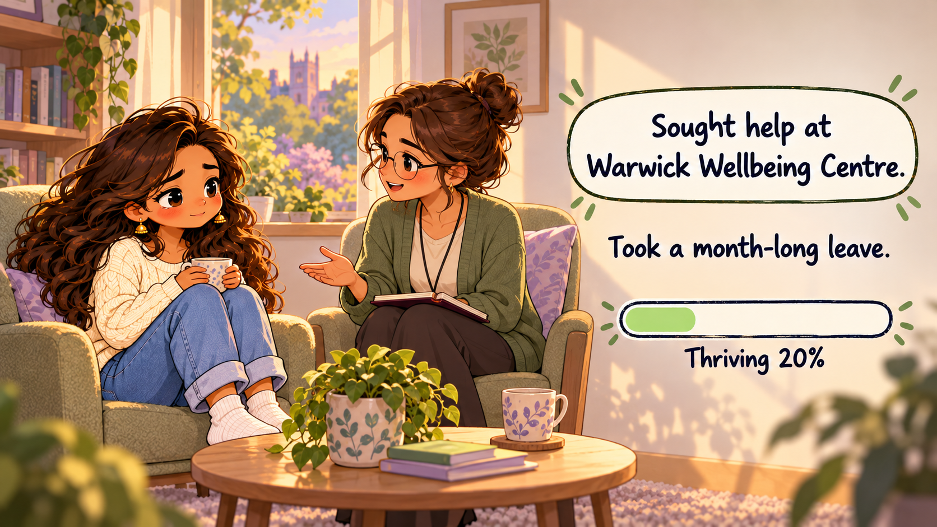

Slide 13


Slide 14
Your department has an annual fund. Ask about it. Claim it.
There are various funded opportunities advertised on outlook. Check your emails.

Slide 15
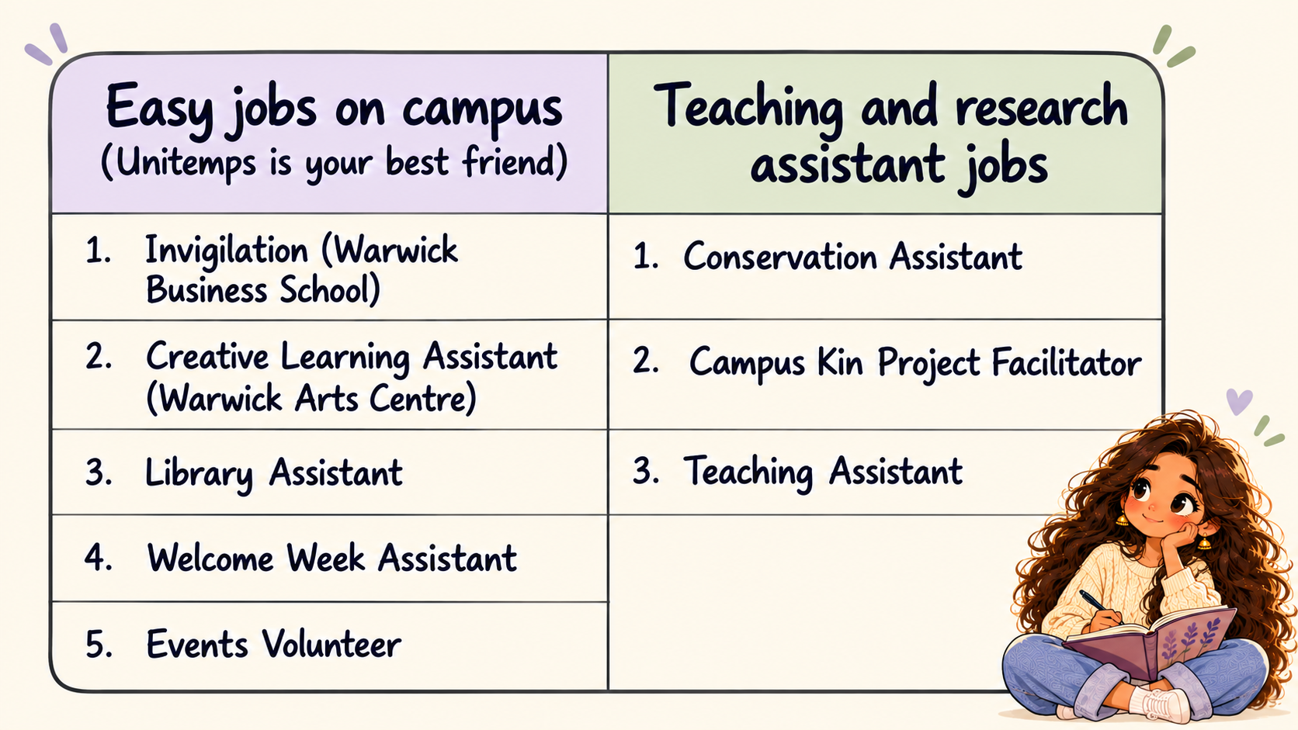
Email the departments directly.
Check Warwick internal Vacancies.

Slide 16
Teaching/working part-time was right for me.
Might not be right for you.
Choose wisely.

Slide 17
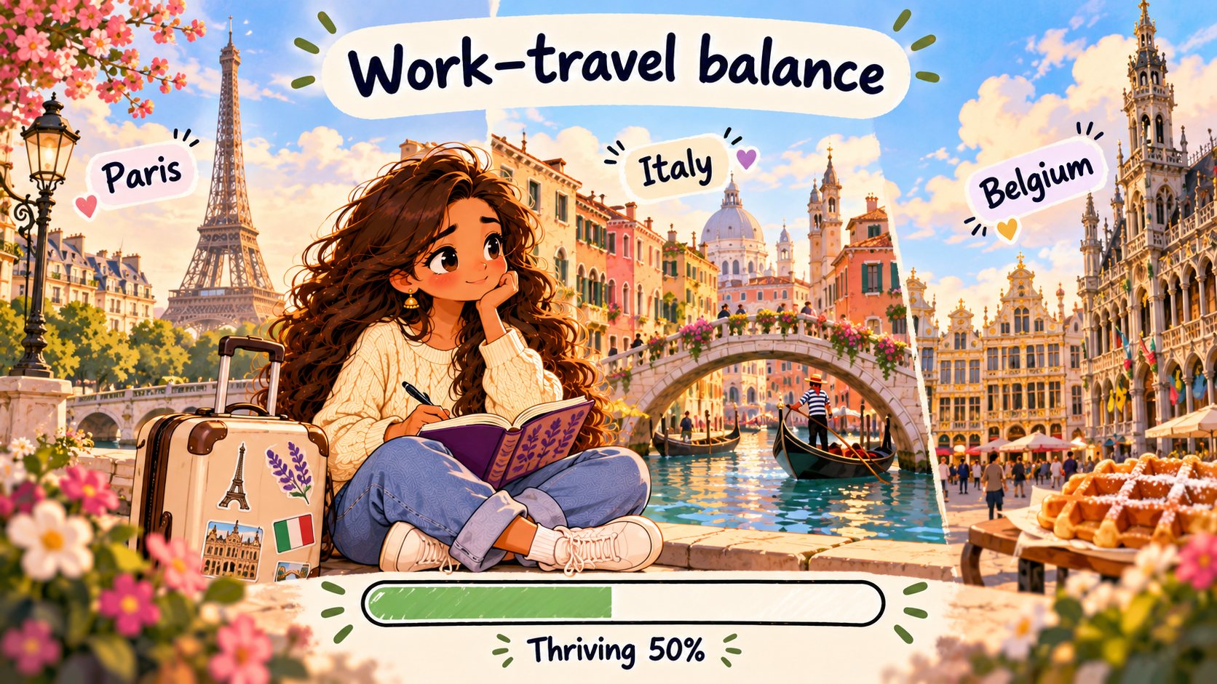

Slide 18
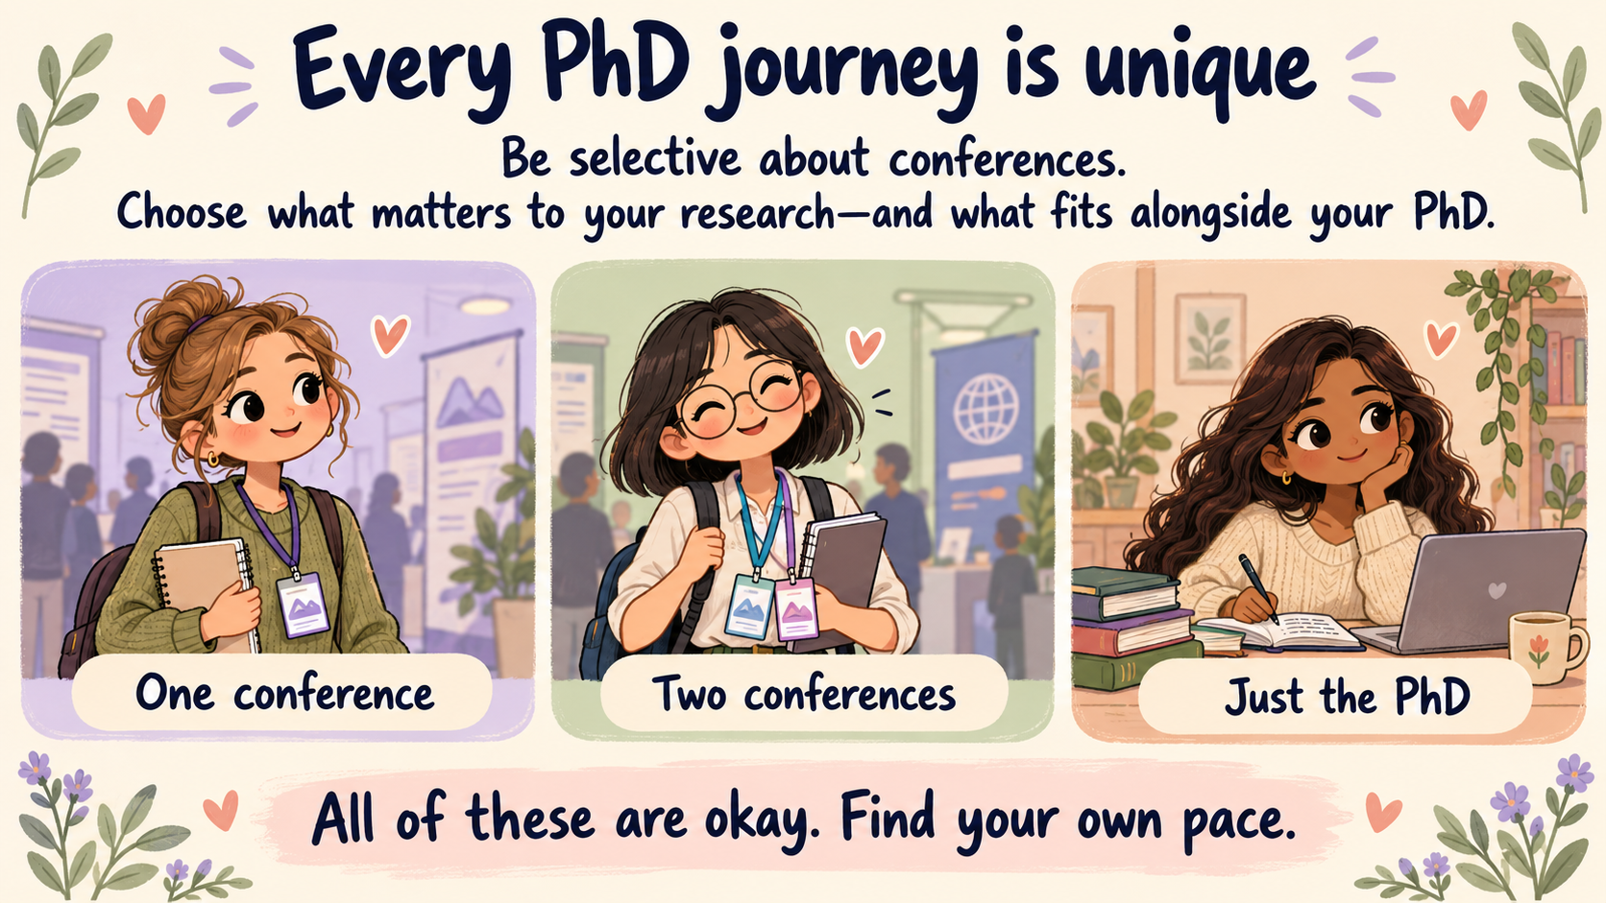

Slide 19
Don’t be afraid to apply for opportunities.
Many hold back because it seems competitive.
Sometimes you could be the one who gets it simply because you applied.

Slide 20


Slide 21
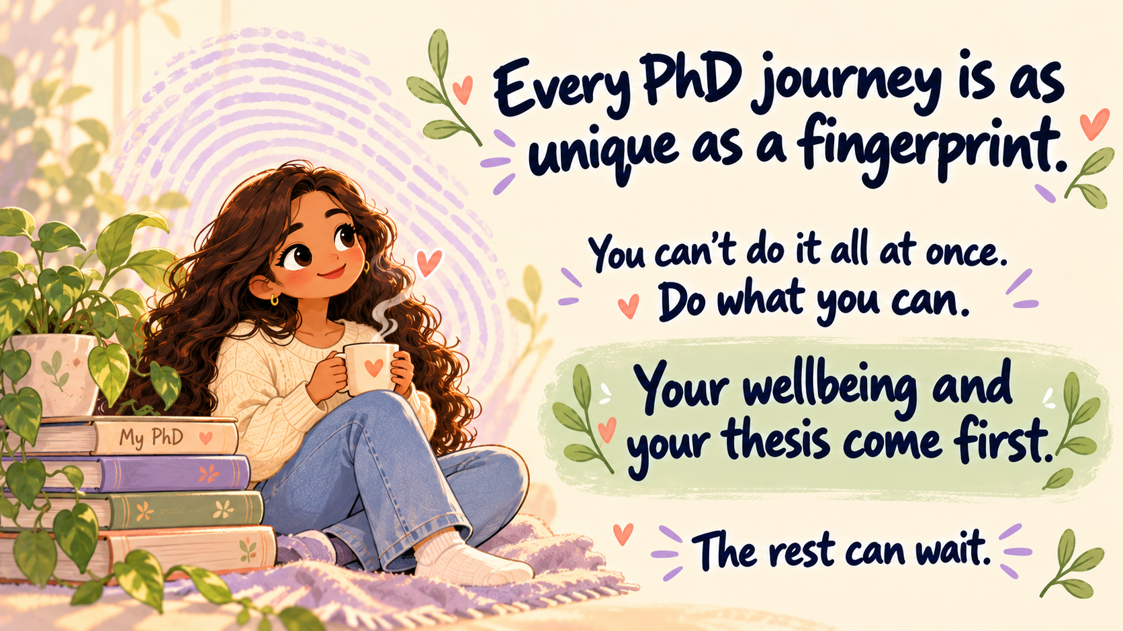

Slide 22
Laura’s PhD journey
PhD in Translation and Transcultural Studies (SMLC) funded by M4C
Practice-based thesis titled “Recovering Anti-Fascist Women’s Voices: A Trauma-Informed Feminist Translation of María Teresa León’s Memoria de la melancolía”
MA in Literary Translation (Warwick), BA in Journalism with Education (Ulster), questionable school results before university

Slide 23
Laura’s PhD journey
Conferences
Conference organisation: IPCITI 2025
Teaching
Placement
Publications (sort of)
Surprise Research Assistant Role in the summer before submitting (ill-advised, but would do it again)
Remembered to actually finish the thesis

Slide 24
Laura’s PhD tips
Avoid organising a conference in your final year 🥲
If you are doing a placement, don’t leave it for the last year and start early!
Don’t say yes to absolutely everything 🫠
If you overcommit, ask for help or try to adjust plans early.
But at the same time… Don’t be afraid to say yes to things that scare you.
Figure out your wellbeing basics and keep doing them when life gets stressful
Get the support you need: Wellbeing, Disability Team, DSA

Slide 25
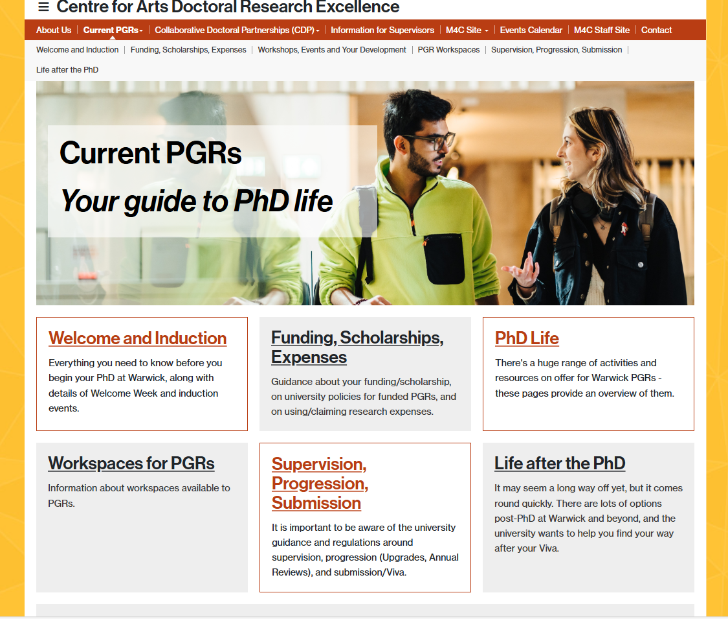
Useful information and links
Useful information and links
Useful information and links
Notes:
Refer to word doc

Slide 26
Start planning your PhD
Plan for the first year
Plan for the course of PhD (upgrade timescale practice)
Hobbies and interests to develop outside of research

Slide 27
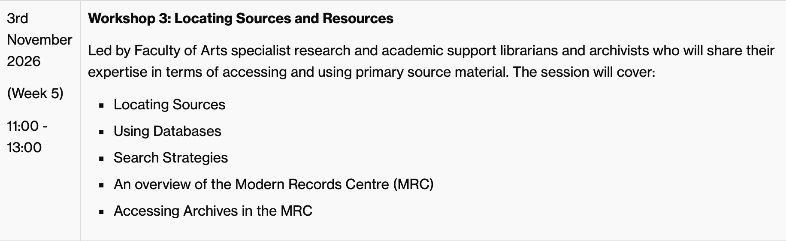
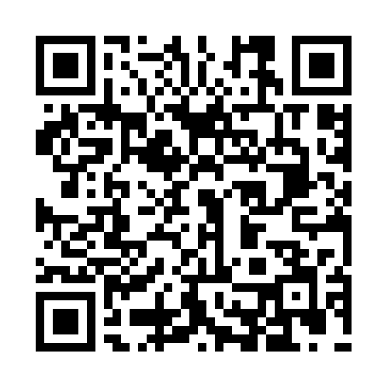
Coming up!
Scan to sign up:

Slide 28
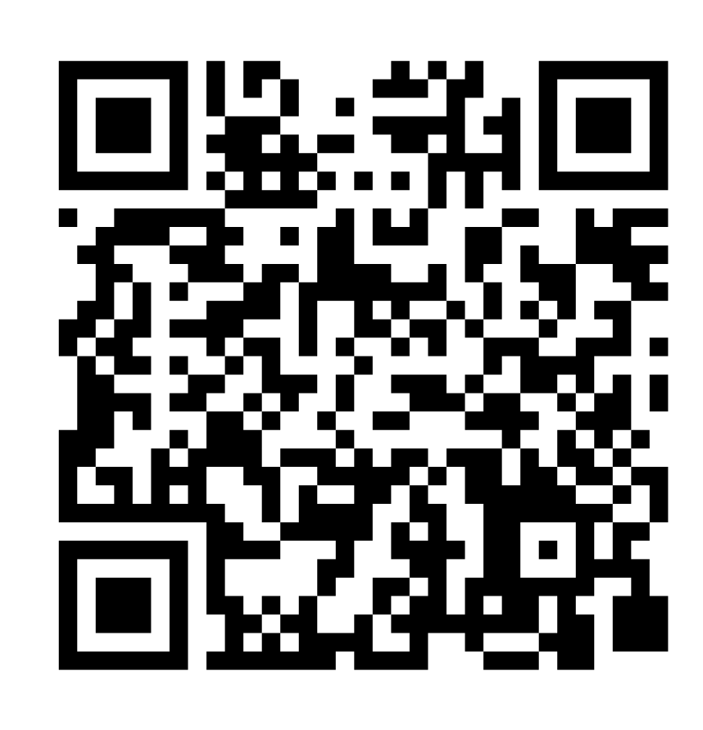
Thank you!
Please share your feedback about the workshop with us!

