Slide 1

CADRE Workshop 10: How to Get Postdoctoral Research Funding
Key Postdoc Schemes and Tips
Alan Ashton-Smith
Research Strategy and Development Manager (Arts)
IAS Fellowships
Fiona Fisher
Research Strategy & Programme Manager, Institute of Advanced Study
Applying for the ECF and Post-PhD Life
Claudia di Tosto
IAS Early Career Fellow, 2025-2026

Slide 2

CADRE How to get postdoctoral research funding – key funding schemes and tips
Alan Ashton-Smith
Research Strategy and Development Manager (Arts)
alan.ashton-smith@warwick.ac.uk
10 March 2026

Slide 3
Why apply for postdoctoral research funding?
To support the next stage in your career
To get support for research expenses, e.g. travel, organisation of events, etc.
To enable collaborations
To strengthen your CV and track record
To gain experience of funding applications

Slide 4

Key funders and schemes for postdoctoral funding

Slide 5
What do these postdoctoral opportunities have in common?
They provide salary costs and research expenses for the researcher/fellow
They are intended to support independent research projects that will result in a significant research output
The applicant chooses the topic of the project (bottom-up or responsive mode)
Institutional support and environment is important
They are highly competitive!

Slide 6

British Academy Postdoctoral Fellowships
Three-year fellowships in all humanities and social science fields
Two stage application process – outline in October, full in January each year
Supervisor/mentor required
Public engagement is encouraged
Applicants must be within three years of PhD viva
Research expenses of £6000 over the three years
Internal selection process applies – but there isn’t a cap on how many applications we can support

Slide 7

Leverhulme Early Career Fellowships
Three-year fellowships open to applications in all subject areas
Annual deadline in February
Applicants must be within four years of PhD submission
Research expenses of £6000 per year
The Leverhulme Trust provides partial support for the fellow’s salary costs (most recently 100% of costs up to £56,000 in year one, then 50% up to £28,000 in years two and three) – the balance is covered by the host institution
Internal selection process applies – likely to launch in summer 2026, details tbc

Slide 8

Wellcome Early Career Awards
Charitable foundation with a focus on health and wellbeing – open to all disciplines including the humanities
Early Career Awards offer up to five years of funding, supporting salary costs and research expenses
Applicants must have no more than three years of postdoctoral experience
Three application deadlines per year (usually February, May, October)

Slide 9

AHRC Catalyst Awards
Supports researchers without prior experience of leading a significant research project
Development of the lead applicant is central to the scheme
Responsive mode – open to all arts and humanities disciplines
Offers up to £300k FEC over up to 5 years – unlikely to support full time post for the lead applicant
Open deadline – applications accepted any time
Ensure support of host department
NB – this is not a fellowship scheme so the nature of the project should reflect that

Slide 10
UKRI Future Leaders Fellowships
For early career researchers who are establishing independence – no eligibility rule on years since PhD
Supports substantial 4 + 3 year programmes, including project team and research expenses
Warwick is limited to supporting 6 applicants in each round – two stage selection process with Faculty and University panels
Annual call – current (Round 11) deadline is 16 June 2026, internal deadline has passed for this round

Slide 11

Marie Sklodowska-Curie Postdoctoral Fellowships
Two/three-year fellowships for applicants with no more than eight years of postdoctoral experience
Mobility is central – applicants must not have lived or worked in the country of the host organisation for more than 12 months in the previous 3 years
Two routes – European Postdoctoral Fellowships and Global Postdoctoral Fellowships
Researchers currently at Warwick would be eligible for the Global route, spending up to two years working internationally followed by a one year ‘return phase’ which could be at Warwick
Training and development is highly important
Annual call, next deadline 9 September 2026

Slide 12
Oxford/Cambridge Junior Research Fellowships (JRFs)
Postdoctoral fellowships offered by Colleges of University of Oxford and University of Cambridge
Intended to follow on from PhD – generally aimed at applicants in final stages of PhD
Typically three-year duration and provide a stipend
May be subject specific or broader in range
Application requirements will vary from College to College
Very competitive but it’s possible to apply for multiple JRFs

Slide 13
Some other routes to postdoctoral funding
Look out for postdoctoral opportunities attached to funded projects
Some funding schemes allow for named PDRAs to be written into projects – and named PDRAs could have a role in designing and developing the project
IAS Early Career Fellowships
International opportunities

Slide 14
How to prepare a strong application

Slide 15
What are funders looking for in postdoctoral funding applications?
Person
Project
Place

Slide 16
Postdoctoral fellowship schemes – some practical points to bear in mind
Check eligibility rules carefully – there is variation between funders
Funders are looking for new and novel projects – your application shouldn’t be a continuation of your PhD or a proposal to turn your doctoral research into a book
Be aware of internal selection and proposal development processes managed by host institutions – these increase the lead-in time
Read the guidance carefully – make sure your application is not rejected on a technicality
Some schemes (e.g. Leverhulme, BA) have restrictions on reapplication – so you may be better off delaying your application (most BA Postdoctoral Fellowships are awarded to applicants at least 18 months post-PhD)
Remember that these schemes are competitive – success rates can be as low as 10%

Slide 17
Postdoctoral fellowship schemes – working with your host institution
Be aware of internal selection and proposal development processes managed by host institutions – these increase the lead-in time
Contact your prospective host department and identify a mentor as early on as possible
Allow as much time as possible to develop the application
Work closely with supervisors/mentors and seek as much feedback, support and peer review as you can
Think about how your project fits with the department/institution
Consider whether your project is best hosted at your current institution or elsewhere

Slide 18
Postdoctoral fellowship schemes – some hints and tips
Start early – think about bid development as a project in itself
Carve out time to write the bid – think about the payoff
Multiple drafts will be necessary
Get as much advice as you can, but expect to receive conflicting advice – it is your proposal and your responsibility to decide which advice to prioritise/take
Avoid jargon and acronyms as far as possible – some of the reviewers may not be subject specialists
Remember that writing a funding application is very different to writing e.g. a journal article
Draw on the support that’s available from colleagues in RIS and the host department
Don’t be afraid of rejection – it doesn’t mean your project isn’t fundable

Slide 19
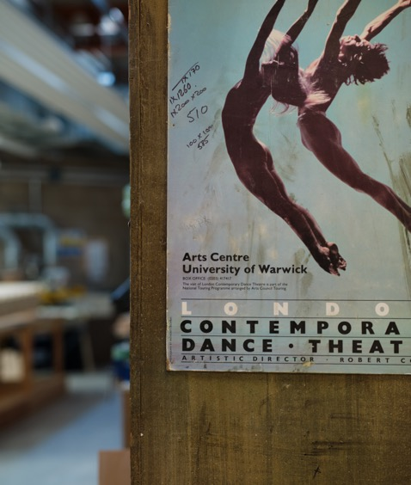
Thank you

Slide 20
IAS Fellowships (Fiona Fisher)

Slide 21

IAS Early Career Fellowships
Dr Fiona Fisher
Associate Director
Institute of Advanced Study

Slide 22
The Institute of Advanced Study
The Institute of Advanced Study was established in 2007 with the aim to:
Promote interdisciplinary research across all faculties at Warwick and beyond.
Foster new collaborative research activity
Enhance opportunities for international scholars to engage with Warwick
Enrich the research environment for postdoctoral researchers

Slide 23
What is a Fellowship?

Slide 24
Fellowships are about developing Research Independence
PhD
Post Doc
Academic
Research
originated & directed by a supervisor
New research ideas & leading others to deliver them

Slide 25
Major Fellowship funders - UK
Research Councils BBSRC, MRC, NERC, ESRC, AHRC, EPSRC, STFC, UKRI-FLF
Royal Society Sciences - University Research Fellowships, Dorothy Hodgkin (flexible working, return to research)
Leverhulme Trust Early Career Fellowship, very prestigious. – All subjects except medical research
European Union Marie Sklodowska Curie Fellowships, ERC
Wellcome Trust Biomedical research & Medical Humanities - range of awards for all career stages
British Academy Arts & Humanities, Social Sciences
Other Charities Many charities fund research – specific, problem solving
More info and links on the Postdoc Resources Portal on the IAS website

Slide 26
Being a competitive applicant
Publications – number / quality / citations/ authorship
Independent ideas
Funding – collaborations, small amounts, previous fellowships, prizes
Leadership - Event organisation, professional bodies, journal editing, student supervision
Teaching – developing & delivering content
Prizes & other esteem indicators
Talks, presentations (especially invited), workshops, reviewing, visits & networking (letter of support)

Slide 27
IAS Early Career Fellowships

Slide 28
What is the ECF for?
Supporting Warwick PhD students to make the transition to postdoc and laying the foundation for an academic career​
Extracting the the full value of your thesis and turning it into career enhancing outputs​ - papers, book proposals, conference papers
​Developing your next research idea in an interdisciplinary environment and laying the foundation for successful funding applications
​Being part of a supportive community of peers & other IAS fellows

Slide 29
ECFs are for completing Warwick PhD students immediately after submission of the thesis
Cohort | Deadline for Applications | Submit thesis between | Start Date | End Date
1 | April | 1st May & 31st Sept | 1st October | 31st July
2 | January | 1st October & 30th April | 1st May* | 31st March
Approximately 15 Early Career Fellows in each cohort

Slide 30
Offer to fellows
50% Funding at UKRI PhD Stipend rate
£600 for research related activities (Conferences, workshops, visits)
Workspace in the IAS & interaction with all disciplines and all career stages
Extension of affiliation (Library, IT account, building access card)
Access to IAS funding streams
Accolade training programme

Slide 31
The Accolade training programme
Weekly training sessions with other IAS fellows (ECFs, Associate Fellows, AAR Fellows & visitors)
Academic career skills - grant writing, fellowships, publication strategies, ethics, REF, TEF etc
Leadership skills (managing self & others)
Transferable skills – CVs & job applications, interviews, communications
Research presentations & networking with other disciplines

Slide 32
Where do ECFs end up?
Permanent lectureships & assistant professorships​
Research Fellowship Awards (Leverhulme, MSCA, BA etc ) ​
Teaching Fellowships​
Academic postdoctoral research positions​
Research related roles inside & outside academia​

Slide 33
Want to know more?
ECF Webpage https://warwick.ac.uk/fac/cross_fac/ias/earlycareer/funding/ecf/)
ECF “How to Apply” Workshop 17th March 11:00-12:30 IAS Seminar Room (C0.02 Zeeman) and a couple of months before each deadline if you’re not ready yet

Slide 34
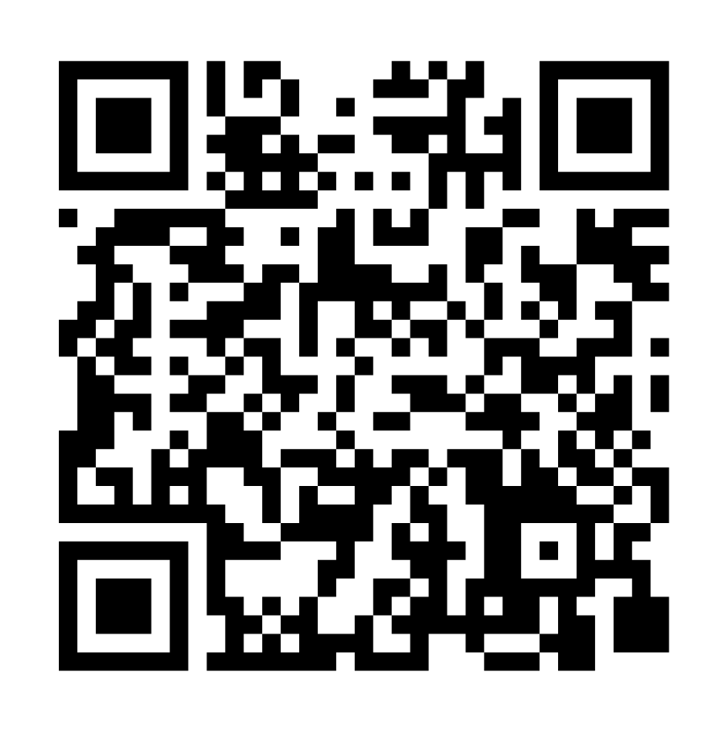
Thank you
Please share your feedback to the workshop series with us!

Slide 35










Iconography
Iconography Colour Usage
Our icons can use any of our brand colours and always appear within a square shape.
When placing icons on pastel or white backgrounds, the square should be black, and the icon itself should match the background colour.
If the background is purple or black, the square should be white, and the icon should match the background colour (purple or black).
These rules help our icons to stand out.

