Slide 1
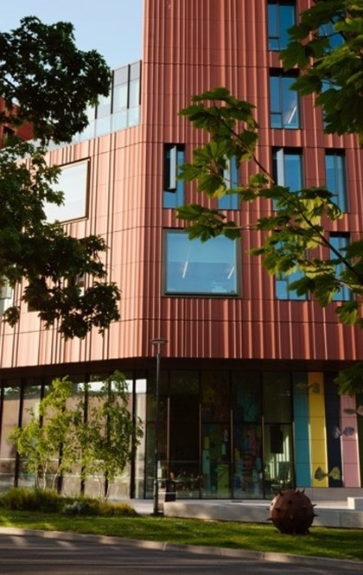
CADRE Workshop 4 – Presenting Papers and Attending Conferences
Dr. Luana Tavano Garcia
Researcher Developer, Doctoral College
Mia Edwards
PhD Researcher, History

Slide 2


Academic Conferences and Presenting
Mindset, Presence, and Practice
Dr. Luana Tavano Garcia

Slide 3

Why Conferences Matter
Academic conferences are transformative spaces where ideas meet community. They are essential stepping stones in your scholarly journey, offering far more than just a platform to present your work.
Join the Community
Step into the broader research community and claim your place
in scholarly conversations.
Share & Refine
Discover Opportunities
Build Your Academic Identity
Present your research and receive valuable feedback that sharpens your thinking and strengthens your work.
Uncover publishing prospects, job openings, collaborative projects, and funding possibilities.
Establish your presence in your field and shape your emerging academic persona.
Connect & Grow
Meet peers, find collaborators, and connect with
potential mentors who can guide your career.

Slide 4



Types of Conferences
Not all conferences are created equal. Understanding the landscape helps you choose events that align with your goals and prepare appropriately for each unique setting.
Large International Gatherings
Smaller Specialist Symposia
Arts-Specific Formats
Massive events featuring hundreds of presentations, keynote speakers, and networking opportunities across multiple tracks and disciplines. These offer broad exposure but can feel overwhelming.
Intimate, focused events centered on specific research areas or methodologies. These provide deeper engagement with like-minded scholars and often lead to meaningful connections.
Creative and practice-led events featuring performances, exhibitions, installations, and innovative panel discussions that blur the boundaries between scholarship and artistic practice.
Understanding what you need or want to experience from a conference is crucial. This self-awareness allows you to choose wisely and prepare strategically to maximize the value of your participation.

Slide 5



Conferences as Community
Conferences are about connection, not transactional networking. Approach these spaces with genuine curiosity and openness. The relationships you build at conferences often become the foundation of your academic support network.
Think connection, not networking
Approach conversations with authenticity rather than agenda. Real relationships matter more than collecting business cards.
Meet fellow early-career scholars
Your peers are navigating similar challenges. These relationships often become your strongest professional friendships.
Follow up after presentations
Send a brief email to presenters whose work resonated with you. These small gestures build lasting connections.
Embrace casual conversations
Coffee breaks and hallway chats often lead to unexpected collaborations, invitations, and opportunities.
Remember: You belong in these spaces. Your voice, your research, and your perspective add value to the scholarly conversation.

Slide 6




Common Feelings
(and completely normal)
These doubts are common among early-career academics, and acknowledging them is the first step toward moving through them.
'I don't know enough yet to be here.'
'Everyone else seems so much more confident than me.'
'My work isn't ready or polished enough.'
'What if someone asks a question I can't answer?'
Confidence grows through practice, not before it. Every experienced presenter once stood exactly where you are now. The only way forward is through.

Slide 7





Mindset: From Performance to Conversation
Shift how you think about presenting. Academic presentations aren't theatrical performances meant to dazzle - they're intellectual conversations designed to share ideas and invite dialogue.
Invitation to Dialogue
Understanding Over Impressing
Curiosity Over Certainty
Your presentation opens a door for exchange. You're inviting others into your thinking, not defending a fortress.
Your aim is clarity and comprehension, not to wow the audience with complexity. Accessible communication is a strength.
It is fine to explore ideas still in development. Intellectual honesty and curiosity are valued in academic spaces.
Audience is Curious
Purpose, Not Perfection
They are not here to judge. Most academics are genuinely interested in your work.
Focus on communicating your core message clearly rather than delivering a flawless performance.

Slide 8


Presenting: Presence
Your physical presence communicates as much as your words. How you inhabit the space, use your voice, and connect with your audience shapes how your ideas are received.
Grounded Posture & Open Gestures
Stand with feet shoulder-width apart, weight evenly distributed. Use natural hand movements to emphasize points. Open body language invites engagement.
Voice: Pace, Pauses, Projection
Speak at a moderate pace. Use strategic pauses to let ideas land. Project your voice to the back of the room without shouting.
Eye Contact: Connect with Individuals
Personality & Authentic Style
Make genuine eye contact with different audience members throughout your talk. This creates connection and helps you read the room.
Let your unique personality guide your delivery. Authenticity resonates
more than imitation.
Important: Academic presence doesn't mean imitating senior scholars. Your authentic voice and style are what make your presentation
memorable and distinctly yours.

Slide 9
Channel 'Nerves' into 'Energy'
That racing heart and heightened alertness iss not your enemy—it's your body preparing you to perform at your best. The key is learning to harness that physiological response rather than fighting it.
Adrenaline = Fuel
That rush of adrenaline is your body's way of giving you the energy and focus to share your passion for your research with conviction.
Breathe to Steady
Use deep, controlled breathing to regulate your rhythm. Inhale for four counts, hold for four, exhale for six. This activates your calm response.
Direct the Energy
Channel that nervous energy into your voice, gestures, and movement. Let it amplify your enthusiasm rather than undermine your confidence.
The difference between nerves and excitement is often just the story you tell yourself about what you're feeling.
Choose the empowering narrative.

Slide 10
What to Do After the Conference
The conference doesn't end when you leave the venue. The post-conference period is crucial for consolidating learning, maintaining connections, and building momentum for your next steps.
01
02
03
Reflect and Document
Update Your Materials
Connect with New Contacts
Write a short reflection while memories are fresh: What worked well? What would you do differently? What surprised you? This self-assessment is invaluable for growth.
Revise your slides and notes based on feedback received. Capture new ideas sparked by conversations. Document questions you couldn't fully answer for future research.
Send brief, personalized follow-up emails within a week. Reference specific conversations or shared interests. Connect on academic social networks.
04
05
Identify Next Opportunities
Celebrate Your Achievement
Research upcoming conferences relevant to your work. Note submission deadlines. Consider which connections might lead to collaborative presentations.
You prepared, presented, and participated in scholarly discourse. That's a significant accomplishment. Acknowledge your courage and growth.

Slide 11





Key Takeaways
Opportunities, Not Tests
Mindset Matters
Presence is Power
Conferences are spaces for learning, connection, and contribution—not examinations of your worth as a scholar.
Reframe nerves as energy, focus on growth over perfection, and view your work as contribution.
Use your body, voice, and authentic personality to create connection. Your unique presence is your strength.
Practice Small Rituals
Sharing, Not Defending
Develop grounding practices—breathing exercises, affirmations, preparation routines—that help you center yourself.
Presenting is about opening dialogue and inviting engagement, not protecting your ideas from criticism.
'When I dare to be powerful - to use my strength in the service of my vision - it becomes less and less important whether I am afraid.’
Audre Lorde, The Transformation of Silence into Language and Action, 1977

Slide 12
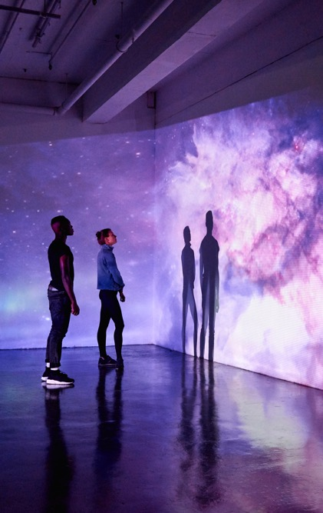
Organising Conferences & Presenting Papers
Mia Edwards
Anna Pravdica

Slide 13

Organising Conferences
01

Slide 14
Why Organise a Conference?
Share and develop research
Create interdisciplinary dialogue
Build academic networks
Gain experience in academic service and leadership
Strengthen your CV and professional profile

Slide 15
Choosing a Conference Theme
What is your core research interest? Should the theme be:
  Broad? e.g., American History in the 19th Century
    Pros: larger audience, diverse submissions
    Cons: less coherence
  Narrow/Niche? e.g., Gender and [other specific theme?] the Transatlantic World in the 19th Century
    Pros: targeted discussion, specialised feedback
    Cons: smaller participant pool
Consider current scholarly debates and gaps
Consider interdisciplinary relevance

Slide 16
Determining the Audience
Specialised audience
Field-specific scholars
Highly targeted feedback
Interdisciplinary audience
Broader perspectives
Can generate unexpected and valuable insights
Impacts of audience choice:
Shapes networking possibilities
Influences presentation tone and content

Slide 17
Interdisciplinary Opportunities
Benefits of crossing departmental or disciplinary lines
More dynamic roundtable discussions
Greater likelihood of innovative collaborative work
Possibility of co-organising with other Warwick departments
Example: The “Being Human” theme — why did it appeal to the HRC?

Slide 18


Slide 19
Working as a Team
Distributing labour: logistics, communications, finances, publicity
Complementary strengths: academic, administrative, creative
Ensures continuity if one organiser becomes unavailable
Supports problem-solving under time pressure

Slide 20
Funding a Conference
Sources within Warwick:
Humanities Research Centre (HRC)
Your home department
Research centres (e.g., IAS, Global History & Culture Centre)
External training programmes:
Midlands4Cities (M4C)
ESRC doctoral funding schemes
Each source has its own application timeline and requirements

Slide 21
How to Budget
Venue costs
Catering (coffee, lunch, dietary needs)
Speaker travel and accommodation
Printing (programmes, posters)
Tech requirements (hybrid options, recording)
Contingency fund (≈10%)
Keep transparent records for reporting back to funders

Slide 22
Calls for Papers
Write a clear, engaging CFP
Theme, key questions, and rationale
Submission guidelines (word limit, deadline, format)
Who is eligible? (PG, ECR, all scholars?)
Circulation platforms:
HRC mailing list
H-Net, academic Twitter/X, departmental networks
Setting realistic deadlines and review processes

Slide 23
Inviting Speakers and Keynotes
Identify scholars whose work aligns closely with the theme
Consider a mix of early-career and established researchers
Craft personalised invitations
Example: Inviting Henry and the value of a strong keynote
Budget implications: travel, accommodation, honorarium (if applicable)

Slide 24
Logistics and Practicalities
Room booking (capacity, AV support)
Accessibility (lifts, hybrid dial-in, seating)
Registration management
Name badges and programme design
Day-of coordination: volunteers, sign-in table, chairing panels

Slide 25
Presenting
02
Notes:
Now we’re going to think about how we can find the information sources we need for our work. We’ll take a look at how to use keywords and searching tools to find the most relevant sources. We will also talk about some academic searching tools that you might not be familiar with yet.

Slide 26
How to Structure an Academic Presentation
Introduction
- Research question
- Significance
Context / Literature
Methodology / Sources
Argument
Case studies / Evidence
Conclusion
- Contribution to field
- Future research directions

Slide 27
Knowing Your Audience
Specialists vs. non-specialists
Adjust depth of theoretical discussion
Explain any field-specific terminology
Don’t assume shared background knowledge

Slide 28
PowerPoint or No PowerPoint?
PowerPoint advantages:
Helps structure talk
Useful for visuals (charts, maps, images)
Supports accessibility
When not to use slides:
Short or informal talks
Highly text-based argumentation
When reading a close textual analysis
If using slides:
Minimal text
High-contrast colours
Consistent design

Slide 29
Delivering Your Presentation Well
Rehearse aloud (timing is key)
Speak slowly and clearly
Maintain eye contact if possible
Use signposting (‘three points…’, ‘in conclusion…’)
Avoid reading entirely from your script where possible
Bring printed notes as backup

Slide 30
Abstracts and Panels
There’s usually flexibility, but try to make sure your talk doesn’t stray too far from what you promised
Minor changes are acceptable, major changes should be signalled
If relevant, work to create coherent panels
Always want to help audience follow your argument without confusion

Slide 31
Keeping to Time
Standard conference slot = 15 - 20 minutes
Practise to approx. 90% of allotted time
Know which sections can be shortened if needed
A chair will stop you—don’t rely on extra minutes

Slide 32
Responding to Questions
Listen fully before answering
It’s okay to say ‘I hadn’t considered that’, etc.
Keep answers concise
If time is short, move extended conversations to the break
Treat challenging questions as constructive engagement

Slide 33
Final Tips and Takeaways
As both an organiser and participant, plan early: theme, funding, CFP
Understand your audience—both as organiser and presenter
Be clear, concise, and confident
Conferences are as much about community-building as scholarship
Enjoy the experience!

Slide 34
Upcoming Workshop 9 December 2025
Date | Workshop Details | Location
21st October 2025 (10am - 2pm) | Workshop 1: Induction and Welcome / M4C Introduction A chance for new PGRs to meet one-another and hear from staff from across the university about services for PGRs | Wolfson Research Exchange, The Library
28th October 2025 (11am - 1pm) | Workshop 2: PhD Survival This session will be led by Professor David Lambert and our two CADRE facilitators who will give you the inside track on getting through the next 3.5 years. | Wolfson Research Exchange, The Library
11th November 2025 (11am - 1pm) | Workshop 3: Locating Sources Led by academic support librarians, archivists, and current academics who will share their expertise in terms of accessing and using primary source material. | Wolfson Research Exchange, The Library
25th November 2025 (11am-1pm) | Workshop 4: Presenting Papers and Attending Conferences This session will cover how to successful present papers and discuss the realities of attending conferences as a PGR. This will be facilitated by colleagues in the Doctoral College. Research Development team and PGRs who have been conference organisers sharing their experiences. | Wolfson Research Exchange, The Library
9th December 2025 (11am-1pm) | Workshop 5: Impact and Public Engagement The word 'impact' is used a lot these days when discussing research outputs. This session addresses how to create, measure, and evaluate impact, and introduces attendees to ways in which they can get involved in public engagement activities. | Wolfson Research Exchange, The Library

Slide 35
Date | Workshop Details | Location
13th January 2026 (11am - 1pm) | Workshop 6: Wellbeing, Stress and Work Life Balance This session focuses on mental wellbeing for PGRs. It provides a space to identify issues PGRs face and to share tips on how to stay well across the period of the PhD. The session will be led by members of the university's Wellbeing team and Warwick Sport. | Wolfson Research Exchange, The Library
27th January 2026 (11am - 1pm) | Workshop 7: Writing For Others and Getting Published Hear from academics and journal editors about how to get published as well as PGRs who have recently attended the Monash Prato Writing workshop. | Wolfson Research Exchange, The Library
10th February 2026 (11am - 1pm) | Workshop 8: Completing Your PhD Hear about the process of completing your thesis: the last stages of writing up, submission, Viva, and corrections. This session will be led by our CADRE facilitators and our Doctoral College examinations team. | Wolfson Research Exchange, The Library
24th February 2026 (11am-1pm) | Workshop 9: Careers Outside Academia Of course, academia isn't the only option after a PhD. This session provides guidance on moving into sectors outside the university and will include contributions from recently graduated Arts PGRs. | Wolfson Research Exchange, The Library
10th March 2026 (11am-1pm) | Workshop 10: How To Get Postdoctoral Research Funding The question of 'what now?' can seem daunting, especially on the back of 3 or 4 years working on a thesis. This session provides guidance on finding post-doctoral research funding, both at Warwick and beyond, and guidance on writing a successful application. | Wolfson Research Exchange, The Library

Slide 36
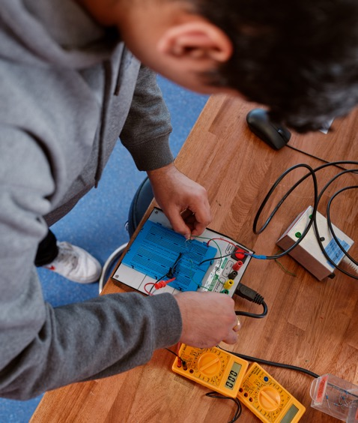
Thank you

