Slide 1
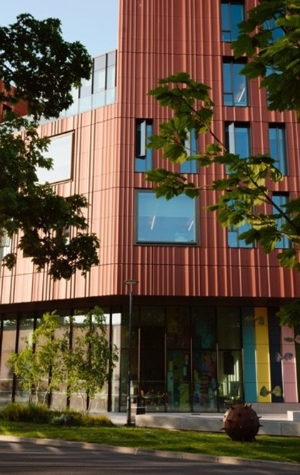
CADRE Workshop 8:
Completing your PhD

Slide 2
Schedule
Introduction
Doctoral College Procedure (Stella Neophytou)
Going through the Final Stage of PhD(Ragesree Roy)
Viva Experience (Dr Yangzi Zhou)
Q&A and Close
Lunch

Slide 3

Thesis submission and examination
Stella Neophytou, Administrative Officer (Doctoral College)
10 February 2026

Slide 4
Nomination of examiners
Completed Nomination of Examiners form should be sent to DC one month before thesis submission
Usually one internal and one external examiner, perhaps examination advisor (section 5 of the Guide to examinations)
Inform supervisor of any potential conflicts of interest
Don’t contact examiners once appointed
Notes:
Completed NoE form should be sent to DC for approval approx 1 month before thesis submission. You complete section 1 and supervisor will contact prospective examiners and complete section 2.
Students will usually have one internal and one external examiner, and potentially also an examination advisor. 2 externals if member of staff or to access suitable expertise. If on joint award or co-tutelle agreement there may be additional requirements.
Let supervisor know if any potential conflict of interest with prospective examiners e.g. if you have published with them etc
You shouldn't be in direct contact with your examiners once approved, must not send them a copy of your thesis.

Slide 5
Preparing thesis for submission
Ensure thesis meets presentation requirements (section 2 of the Guide to examinations)
Word limit for PhD is 80,000 exclusive of appendices, footnotes, tables and bibliography
Include Thesis Submission Declaration Form
Submit to Doctoral College using online form on or before end of registration period
Notes:
Refer to Guide to Examinations for Higher Degrees by Research. Section 2 refers to presentation of thesis and includes a template title page. If thesis doesn't comply we can't accept for examination, this may result in delays to your examination.
Ensure that a declaration is included - this should include confirmation that the work hasn't been submitted elsewhere, is the student's own work (highlighting any collaborative research and setting out the nature and extent of the candidate's original contribution.
Word limit for PhD is 80,000 excluding appendices, footnotes, tables and bibliography. Theses over word limit require approval from Academic Director via Doctoral College
Include thesis submission form and upload to DC website Can submit up to 23.59 on last day of registration; if need additional time discuss with supervisor in first instance as early as possible as extension may be required

Slide 6
Viva (oral examination)
Oral examination always required for PhD
Support available in preparing for your viva
Can be held online, in person or hybrid
Supervisor may attend if examiners agree, but to observe only
Examiners’ reports – independent and joint
Notes:
Registration period will be extended to cover the examination period when your thesis is processed
If your examiners have been approved your thesis will be sent to examiners usually within a week of submission
It is the responsibility of internal examiner/exams advisor to arrange viva, This should be on a mutually convenient date and can be face to face, fully online or hybrid (e.g. external joining remotely). You should be asked to confirm that you are happy with the arrangements.
It's not usual for supervisors to attend viva, but they may do if examiners agree although they are there to observe only and should not play any part in the examination
Examiners required to complete independent reports pre-viva and joint report post viva. Examiners will usually give you their recommendation at the end of the viva, recommendation needs to be approved by Faculty so you may not get official notification from DC for a couple of weeks. You will receive copy of joint report and can request independent

Slide 7
Examination outcomes
Pass without corrections – 10%
Minor corrections (up to 3 months) – 69%
Major corrections (up to 6 months) – 17%
Resubmission (up to 12 months) – 3%
Lower award/fail – <1%
See sections 15-17 of the Guide to examinations
Notes:
Outcomes:
Pass w/o corrections
Minor/major corrections - examiners should send list of required corrections to you to be completed in 3/6 months. You should send corrected thesis directly to examiners
Resubmission - DC will send official notification with details of amendments to be made and deadline (up to 12 months), resubmit to DC and pay resub fee. Examiners may require 2nd viva
Lower award/fail - v rare but would be able to appeal

Slide 8
After the viva
Doctoral College will contact you to request final submission (PDF/A format) and Library Declaration and Deposit Form
Pass lists approved by Senate on a monthly basis
Digital certificate provided within one month of conferral
Awards and Ceremonies team will be in touch about graduation – January/July
Notes:
DC will contact you to request submission of final thesis after approval of any corrections. You will need to submit electronic copy in PDF/A format. Also need to complete Library Declaration and Deposit Agreement, can apply embargo up to 2 years. Need Academic Director approval (via DC) for anything longer than this. Further info from Library
At completion of examination process name will be added to pass list for Senate approval - approved monthly. 2025/26 on DC website. Will be contacted by Awards and Ceremonies team in due course with an invitation to attend the next available graduation ceremony

Slide 9
Useful info
Guide to examinations for higher degrees by research
Forms for PGRs
FAQs
Contact: doctoralcollege@warwick.ac.uk

Slide 10
Voice of a PGR in post-submission 'limbo'
Ragesree Roy
PhD researcher, English and Comparative Literary Studies
CADRE Workshop Facilitator

Slide 11
What does a ‘successful submission’ look like to you?
Final Stages of submitting your thesis:
Discipline even when motivation is low
Managing the editing-proofreading loop
Integrating feedback
Prepare your own checklist
Speak to your supervisors about your external examiner
Remember: A good thesis is a finished one!

Slide 12
Viva Experience
Yangzi Zhou
PhD in Theatre Studies (SCAPVC)
CADRE Workshop Facilitator

Slide 13
The three stages of a viva
Pre-viva (that waiting stage between the submission and the big day)
The viva day
Post-viva

Slide 14
Pre-viva
Re-read the thesis at least twice – once well before the viva, and once close to the viva
It is okay to NOT think about it for a few weeks/months when you are in the 'limbo'
Could you summarise the entire thesis/each chapter? What were your main ideas, arguments and findings?
Look at common viva questions, and see if you could answer them (the Indeed questions and this really useful document with 40 questions)
Think about what’s likely to come up
Remember that you can ask them questions too – how can you use your examiners?
Ask your supervisors about potentially holding a mock viva

Slide 15
Viva Questions
Overview Questions:
In one sentence/minute, what is your thesis? What is the original contribution to the subject area?
How did your research emerge? What was the motivation for your research?
Literature Review Questions:
How did the literature inform your choice of topic and the overall thesis? How does your thesis support/expand/challenge/counter the main issues and debates in the subject area?
Research Design and Methodology Questions
What are the strengths/limitations of your method? How did you develop your research questions, and did they change over the course of the project? How did you pick your case studies? What have you excluded from the study, and could this present any problems?
Specific Questions about Your Analysis
Anticipate at least one question specific to each chapter
Review Questions:
What are the strengths and weaknesses of the project? Has your view/the field changed during the course of the research? To whom is your work relevant?What would you publish from this research?

Slide 16
The viva
Try not to stress – you’re going to have a conversation about your work
They are experts generally, but you know more about this niche than they do
Questions are not hostile – don’t be afraid to fight back or cede ground, but remember you can chat with them

Slide 17
Post-viva
Celebrate, be happy – have a party and a rest!
If you have corrections, it’s good to address them while everything is fresh in your mind
Thinking about publications – again, you’re in the headspace and you have expert feedback to work with

Slide 18
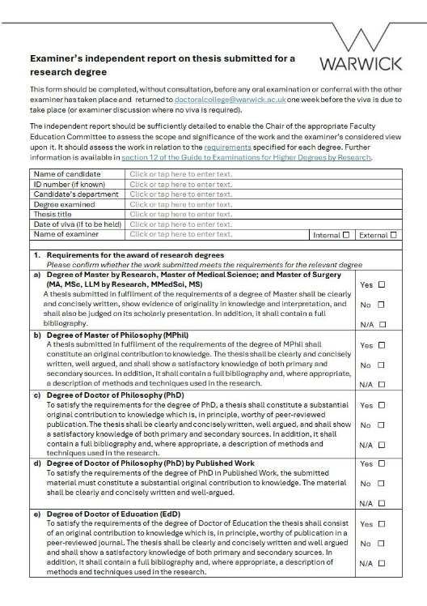
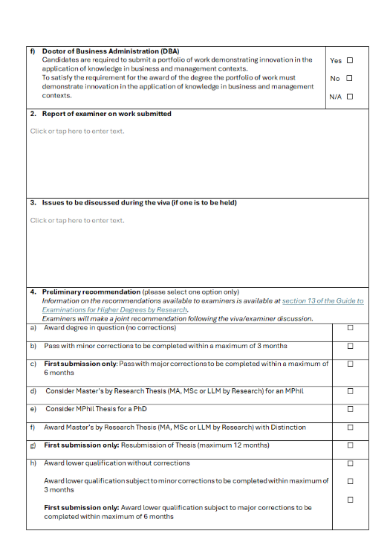

Slide 19
Any questions?

Slide 20
CADRE WORKSHOPS Term 2
Date | Workshop Details | Location
13th January 2026 (11am - 1pm) | Workshop 6: Wellbeing, Stress and Work Life Balance This session focuses on mental wellbeing for PGRs. It provides a space to identify issues PGRs face and to share tips on how to stay well across the period of the PhD. The session will be led by members of the university's Wellbeing team and Warwick Sport. | Wolfson Research Exchange, The Library
27th January 2026 (11am - 1pm) | Workshop 7: Writing For Others and Getting Published Hear from academics and journal editors about how to get published as well as PGRs who have recently attended the Monash Prato Writing workshop. | Wolfson Research Exchange, The Library
10th February 2026 (11am - 1pm) | Workshop 8: Completing Your PhD Hear about the process of completing your thesis: the last stages of writing up, submission, Viva, and corrections. This session will be led by our CADRE facilitators and our Doctoral College examinations team. | Wolfson Research Exchange, The Library
24th February 2026 (11am-1pm) | Workshop 9: Careers Outside Academia Of course, academia isn't the only option after a PhD. This session provides guidance on moving into sectors outside the university and will include contributions from Warwick Careers and Placement Specialists. | Wolfson Research Exchange, The Library
10th March 2026 (11am-1pm) | Workshop 10: How To Get Postdoctoral Research Funding The question of 'what now?' can seem daunting, especially on the back of 3 or 4 years working on a thesis. This session provides guidance on finding post-doctoral research funding, both at Warwick and beyond, and guidance on writing a successful application. | Wolfson Research Exchange, The Library

