Slide 1

CADRE Workshop 9: Careers Outside Academia
Alt-academia Careers
Ellie Wetherhill & Clare Halldron
Careers Consultant, Student Opportunity
Planning for an 'Industry' Career
Dr Chris Thompson (Chris.J.Thompson@warwick.ac.uk)
Midlands Graduate School Placements Manager

Slide 2

CAREERS:
Ellie Wetherhill
Clare Halldron
.
Ellie Wetherhill
Clare Halldron
Senior Careers Consultant

Slide 3

What will we cover?
What else can you do- alternatives to academia?
How do you go about securing a job outside academia (hints and tips)?
Effective CVs
Additional Resources

Slide 4
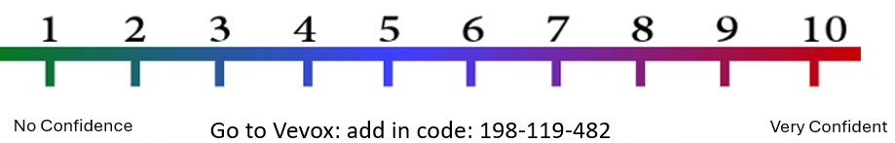
How do you feel about the transition from academia to a non-academic career?
Share your thoughts with the person next to you for 3 minutes… What careers are you considering?
What concerns or questions do you have What challenges might you face? What helps you feel confident?
Notes:
Add in name

Slide 5

What do humanities PhDs do?
Approximately
45% work in HE (teaching or research)
9% are in academic adjacent roles (professional services, libraries, administration)
46% work outside academia
- Teaching- non HE
- public sector
- creative industries
- policy
- cultural organisations
- research
Most Arts and Humanities PhD Graduates felt positive about their career direction
Vitae: What do Researchers do? (2022)

Slide 6
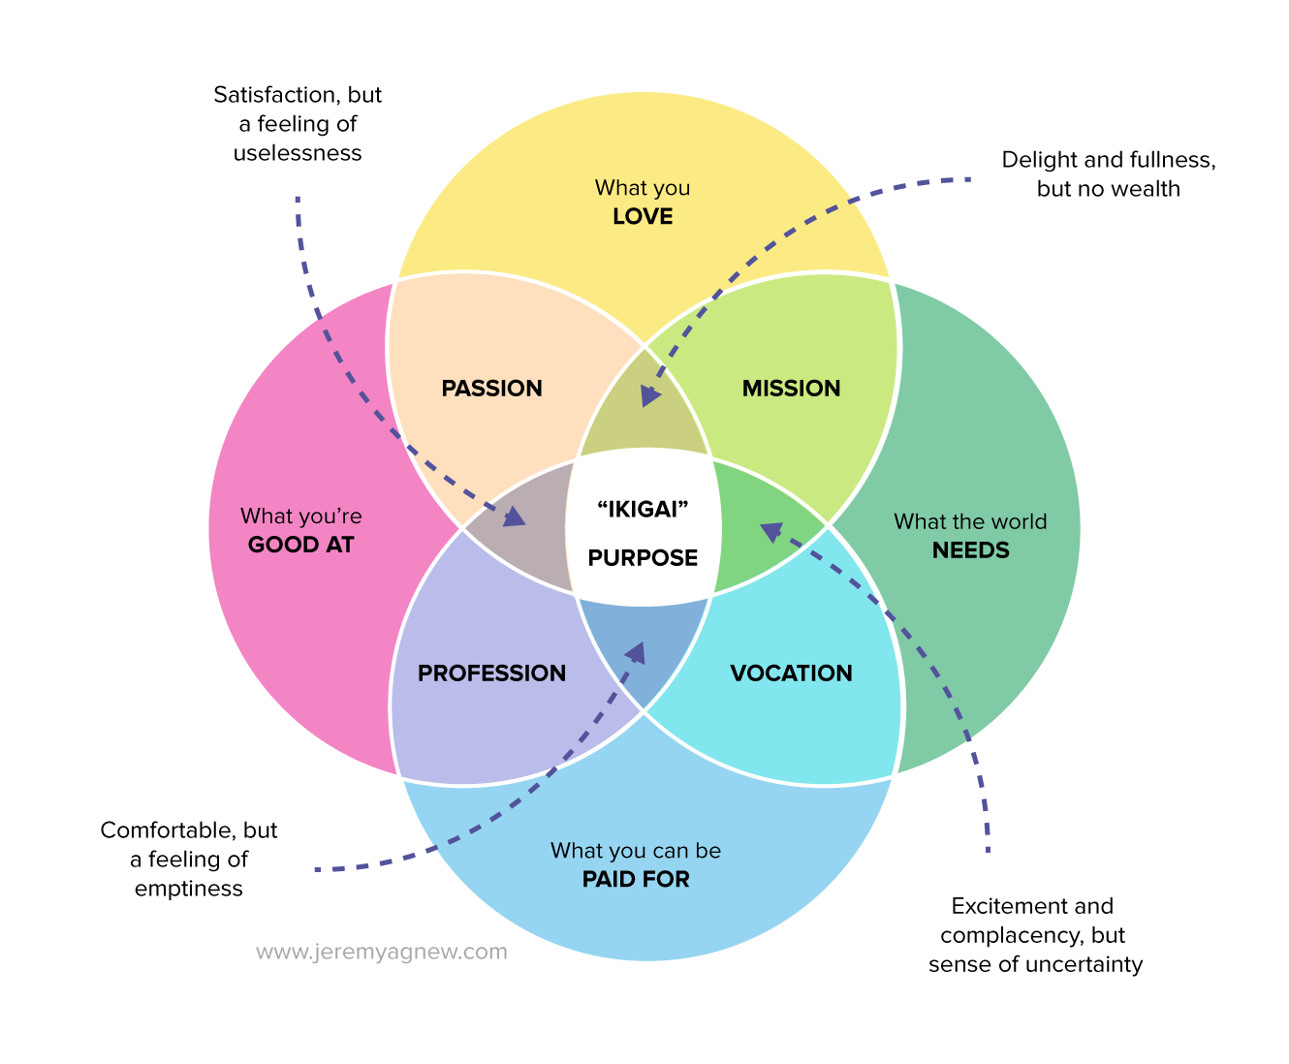
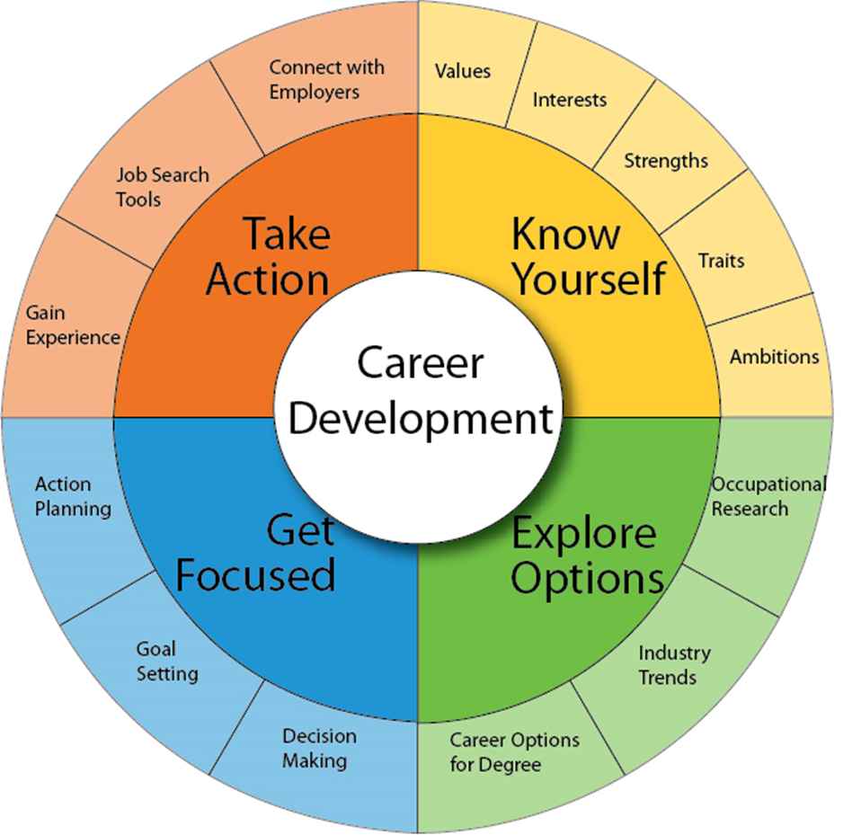
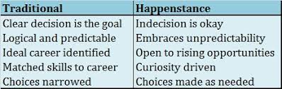
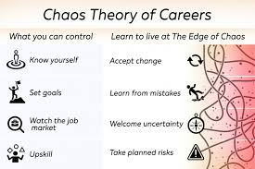
There’s more than one way to choose a career
This Photo by Unknown Author is licensed under CC BY-NC-ND

Slide 7
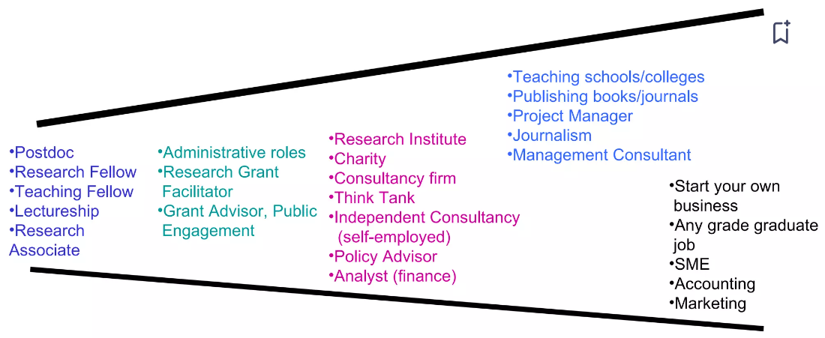
Choices open to you …
Narrow horizon: Known & Safe but insecure
A little wider. Still university based
Still research but transferring research to another setting
Using transferable skills rather than specific knowledge

Slide 8
Tips for non-academic job search
Map your skills- explore different ways they can be applied beyond academia
Know your values and interests– which organisations and sectors align with your values?
Understand your Strengths - what are you good at, what motivates you?
Build experience- small projects, LinkedIn learning, work experience, volunteering and internship
Be curious, attend events, research employers and roles, leverage your network- find support
Use multiple job search strategies- job boards, networks, recruitment agencies

Slide 9

What do employers value in applicants?
Transferable skills- analysis, adaptability, communication, project management
Evidence of Impact
Sector/role knowledge (commercial awareness)
Cultural fit: values and working style
Motivation

Slide 10
Re-frame your PhD as a “job” You will have extensive professional experience, including
Project Management - long, complex research projects, with significant ambiguity
Independent problem solving
Gathering, analysing and synthesising complex information
Communicating clearly, through writing, presenting and teaching
Sourcing and making applications for funding
Breaking down complicated challenges into manageable tasks- often where there is no blueprint
Perseverance, resilience and self-belief
Event- management and organising activities- often with competing priorities
Public engagement: adapting communication styles to the audience, explaining complex information in an accessible way
Intellectual insight, critical thinking and creative thought
Technical skills- data analysis, teaching platforms, MS packages
Notes:
You can think about the various activities you undertake regularly as part of your study - Re-framing your PhD as a “job” You have expertise in: Many PhD candidates view their research as purely academic, but it’s useful to see it as professional work experience, demonstrating valuable competencies. Project management: Instead of saying, “I conducted independent research,” say, “I managed a multi-year research project, setting timelines, meeting milestones, and adapting strategies to overcome challenges.” Problem solving: Problem-Solving: Instead of, “I explored a niche research question,” say, “I tackled complex, open-ended problems using critical thinking and evidence-based decision-making.” Communication & Public Speaking: Instead of, “I presented at conferences,” say, “I delivered persuasive, data-driven presentations to diverse audiences, from specialists to non-experts. ”Writing & Reporting: Instead of, “I published academic papers,” say, “I wrote and edited high-quality reports, summarizing complex findings for different stakeholders.”

Slide 11
Translate your skills for employers
Scholarship - planning, research ability, creativity, analysis
Lecturing/Seminars - presenting, teaching
Tutoring - coaching, motivating
Examining – appraising, assessing
Thesis – project management, independent, autonomy
Writing articles - report writing, publications
Supervising - instructing, training, leading
Research Group - teamwork, creativity
Multi-disciplinary - flexibility, versatility, lateral thinking
Academic Rigour - continual scrutiny, quality control, quality assurance, integrity, impartiality

Slide 12



Effective non-academic applications

Slide 13
Purpose of CV/Cover Letter/Application
From your point of view:
To get an interview (not the job)
Demonstrate relevant skills, experience and motivation
“Market yourself”/”Present your narrative”
From the employers’ point of view
Make a short list of interview candidates
Sift out unsuitable candidates quickly

Slide 14

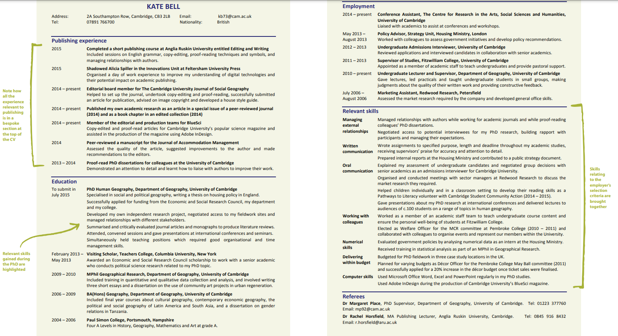
CVs
Choose your format: Chronological or Skills based
Consider the conventions of the employer: 1 page vs 2
It needs to look good! White space; alignment, font size
Clear, concise, bullet points focused on what you did, how and any impact you made
Add in numbers for scale- size of teaching groups, audience size at organised events
Use the language of your prospective employer
Tailor it to the role you are applying to
Source: University of Cambridge
Notes:
Add in sample CV

Slide 15
CVs
Choose your format: Chronological or Skills-based
Consider the conventions of the employer: 1 page vs 2
It needs to look good! white space; alignment, font size
Clear, concise, bullet points focused on what you did, how and any impact you made
Add in numbers for scale- size of teaching groups, audience size at organised events
Use the language of your prospective employer
Tailor it to the role you are applying to

Slide 16
COVER LETTERS
First paragraph
state position applied for, where you saw it advertised.
Middle paragraphs
next two or three paragraphs explain what attracted you to this vacancy and type of work
why you're interested in working for the company and what you can offer to the organization
demonstrate how your skills match the specific requirements of the job description.
Last paragraph
‘I believe my skills, enthusiasm and motivation to work for your company…I look forward to hearing from you.

Slide 17

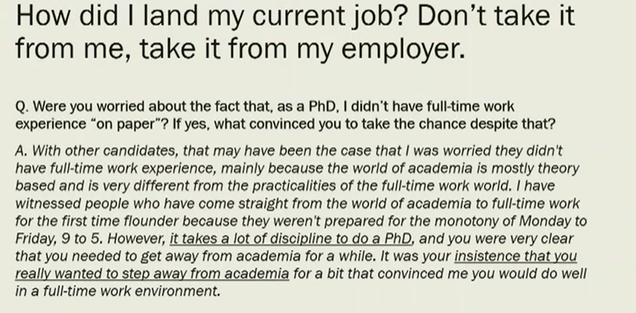
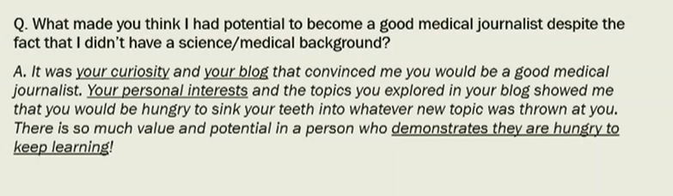

Slide 18
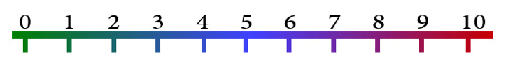
How do you feel about the transition from academia to a non-academic career?
No Confidence
Very Confident
What could you do to build your confidence?
Notes:
Add in name

Slide 19
ADDITIONAL RESOURCES
CAREER PLANNING/MAKING A DECISION
jobsontoast.com
warwick.ac.uk/services/dc/pgr/careers/
vitae.ac.uk/impact-and-evaluation/what-do-researchers-do
www.jobs.ac.uk/media/pdf/careers/resources/career-planning-for-phds-ebook.pdf
Imagine PhD (American focus but useful resources)
RESEARCHING EMPLOYERS & IDENTIFYING JOB OPPORTUNITIES
Explore sectors (warwick.ac.uk)
Prospects.ac.uk
The Times Top 100 Graduate Employers 2023-2024
CRAFTING YOUR APPLICATIONS
careers.cam.ac.uk/files/phdpostdoccvbook.pdf
OPTIONS AFTER YOUR PhD
https://www.prospects.ac.uk/postgraduate-study/phd-study/your-phd-what-next ​
https://blogs.lse.ac.uk/studentsatlse/2022/01/14/transitioning-from-phd-to-non-academic-careers-learning-from-lse-alumni-experience/
NON- ACADEMIC JOB MARKET
https://www.findaphd.com/guides/phd-non-academic-careers​
https://www.insidehighered.com/advice/2021/04/29/advice-leveraging-your-phd-successful-nonacademic-career-opinion

Slide 20
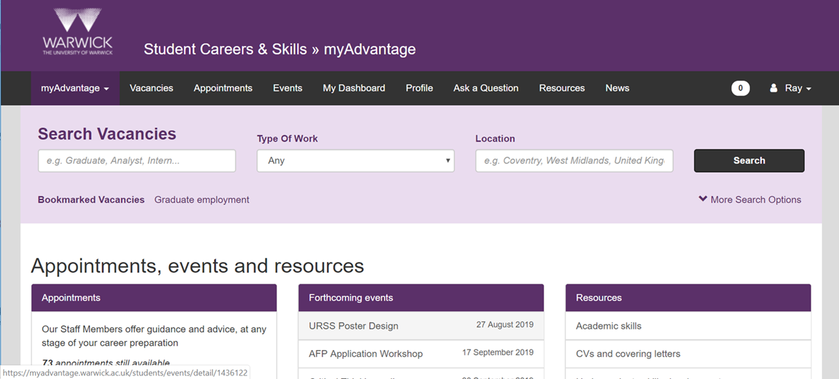
myAdvantage: Jobs, Appointments and Career Events

Slide 21



Thank You
Clare Halldron
& Ellie Wetherhill
Senior Careers Consultant

Slide 22


Slide 23
Session format:
I will run through a checklist of industry career considerations
Take the time to reflect on the points which stand out to you
Regular breaks will allow you to fill in the checklist during this session
Time will also be dedicated to any questions you may have

Slide 24
Stage 1: Clarify your career direction

Slide 25
1) Reflect on why you want to transition from academia to industry.
2) Google a range of career pathways in industry (and speak to people in industry).
3) Read job adverts for industry positions and gain an understanding of the essential and desirable criteria for each role.
4) Set short- and long-term career goals to guide your transition.

Slide 26

Stage 1: Clarify your career direction
Be prepared to justify this transition at an interview. The interview panel will want to know your motivations for switching, so make it convincing!
When learning about your career options, mix your independent learning (AI, reading job adverts) with conversations with mentors/professionals.
Learn this early into your PhD. The quicker you can obtain this information and insights, the more time you have to act upon it and boost your employability.

Slide 27
On the next slide is an email example of how to query the switch to industry roles (contact me if you want more template message support)…

Slide 28
Subject: Careers advice
Dear Dr Johnston,
My name is Chris Thompson, and I am a final year PhD student at Saarland University (Germany), where I am investigating Mental Fatigue in Football. I am originally from Leicester, and will be returning home following the end of my PhD in the summer.
I am considering my career options after my PhD, and becoming a Careers Adviser is one of my primary interests. Based on your move out of academia and into your current position at the University of Leicester, I just had a couple of quick questions I would like to ask:
What made you stand out from other candidates to get your position at the University of Leicester?
Did you face any challenges leaving academia and entering the careers sector? If so, how did you navigate them effectively?
Is there any advice you would give on how to increase the chances of securing a Careers Adviser position? Was there anything you did during your PhD which boosted your skillset and employability?
Thank you in advance for your insights. It is greatly appreciated.
Kind regards,
Chris

Slide 29
Take notes for Stage 1 in the checklist (2-minutes)

Slide 30
Stage 2: Gain relevant experience and skills

Slide 31
5) Pursue opportunities for industry placements, internships, or collaborative projects.
6) Identify any additional courses, certificates, or technical training required for your chosen field.
7) Conduct a skills audit to compare your current skillset against job requirements.
8) Reflect on the transferable skills developed through your PhD (e.g. project management, problem-solving, communication).
9) Develop familiarity with industry tools, technologies, and work practices.

Slide 32
Stage 2: Gain relevant experience and skills
Consider placement and internship opportunities and develop the appropriate skills and experience.
To be aware of the right skills and experience, read job advertisements in detail to create a checklist of the things you need to achieve.
Contact me to do an ‘audit’ of your pre-existing skills and how they fit to industry (I also have a document I can share if you wish to do this independently).

Slide 33
On the next slide is an email template to query placement opportunities (contact me if you want more template message support)…

Slide 34
Subject: PhD placement opportunity
Dear [employer’s title and surname; e.g. Dr Smith],
My name is [insert full name], and I am a [first year, second year, final year] PhD researcher at [insert university name]. My thesis is exploring [insert 1-2 short sentences summarising your thesis].
To complement my PhD, I am seeking applied experience in [insert the sector of interest]. More specifically, I would like to develop my skills and knowledge in [insert 2-3 key reasons why you want to do a non-academic placement].
Therefore I wanted to query if [insert company name] would consider hiring a part-time placement student for three months from [proposed start date] to [proposed end date]? If this is possible, I would be very interested in discussing opportunities further and/or submitting an application.
Attached is my CV. Thank you for taking the time to read my email. I look forward to hearing from you.
Kind regards,
[insert first name]

Slide 35
Take notes for Stage 2 in the checklist (2 minutes)

Slide 36
Stage 3: Prepare application materials

Slide 37
10) Create an industry-tailored CV highlighting results, skills, and impact.
11) Learn to write persuasive, concise cover letters for industry employers.
12) Gain experience in interviewing for industry roles through mock interviews or coaching.
13) Identify potential referees who can speak to both your technical and professional strengths.

Slide 38
Stage 3: Prepare application materials
Amend your academic CV and tailor it to industry. Remove academic ‘jargon’ and write in general terms to attract a new audience.
Work out your weak application points. Perhaps you struggle with a cover letter, or nerves get the better of you at interviews. Use university services regularly.
Find a mentor (or multiple mentors). This could be a supervisor, the careers service, or someone who is working in your preferred industry.

Slide 39
Take notes for Stage 3 in the checklist (2 minutes)

Slide 40
Stage 4: Build your professional brand and network

Slide 41
14) Audit and update your online presence (LinkedIn profile, university webpage profile, X) to reflect your industry ambitions.
15) Explore other professional branding options (e.g. online portfolio, personal website, professional social media).
16) Network strategically with professionals in your desired industry – both online and in- person.
17) Identify target companies, roles, and preferred locations.

Slide 42
Stage 4: Build your professional brand and network
Build contacts in industry as early as you can, even if you are just curious (you don’t need to be 100% sure on a career pathway before you network).
Additional projects (social media, website etc) can be time consuming, so be considerate of the effort it will take to run/maintain your online profile.
However, an online profile showcases your talent and passion for the preferred industry, so give it some thought, particularly if you lack applied experience.

Slide 43



My own post-PhD actions that helped me move into placements/careers
Career insights channel…
Career insights account…
Guest articles for other outlets…

Slide 44
Stage 5: Evaluate practical and lifestyle considerations

Slide 45
18) Research work–life balance expectations and typical cultures in your target industries.
19) Consider visa or sponsorship needs early if you plan to work abroad.
20) Plan your job search timeline, including application milestones and fallback options.

Slide 46
Stage 5: Evaluate practical and lifestyle considerations
Not all industries are the ‘escape the academia’ people think it may be. Do your homework (via networking) on the daily life working in that preferred industry.
Some roles may be challenging to attain for international candidates, so consider querying this when companies are hiring a year before the end of your PhD.
Remain organised and keep a spreadsheet of your industry applications. Consider separate spreadsheets if you are targeting a range of industries.

Slide 47
Take notes for Stage 4 and 5 in the checklist (2 minutes)

Slide 48
CADRE WORKSHOPS Term 2
Date | Workshop Details | Location
13th January 2026 (11am - 1pm) | Workshop 6: Wellbeing, Stress and Work Life Balance This session focuses on mental wellbeing for PGRs. It provides a space to identify issues PGRs face and to share tips on how to stay well across the period of the PhD. The session will be led by members of the university's Wellbeing team and Warwick Sport. | Wolfson Research Exchange, The Library
27th January 2026 (11am - 1pm) | Workshop 7: Writing For Others and Getting Published Hear from academics and journal editors about how to get published as well as PGRs who have recently attended the Monash Prato Writing workshop. | Wolfson Research Exchange, The Library
10th February 2026 (11am - 1pm) | Workshop 8: Completing Your PhD Hear about the process of completing your thesis: the last stages of writing up, submission, Viva, and corrections. This session will be led by our CADRE facilitators and our Doctoral College examinations team. | Wolfson Research Exchange, The Library
24th February 2026 (11am-1pm) | Workshop 9: Careers Outside Academia Of course, academia isn't the only option after a PhD. This session provides guidance on moving into sectors outside the university and will include contributions from Warwick Careers and Placement Specialists. | Wolfson Research Exchange, The Library
10th March 2026 (11am-1pm) | Workshop 10: How To Get Postdoctoral Research Funding The question of 'what now?' can seem daunting, especially on the back of 3 or 4 years working on a thesis. This session provides guidance on finding post-doctoral research funding, both at Warwick and beyond, and guidance on writing a successful application. | Wolfson Research Exchange, The Library

