Slide 1

RDF/EF Information Session – M4C Warwick
Friday 11th April 2025

Slide 2
Meet the M4C Warwick Team
Lisa Millard – Doctoral Training Manager
Emily Hardy – Doctoral Training Programmes Co-ordinator
Prof David Lambert – M4C Site Director
Dr Ross Forman – M4C Site Director
Ambika Raja – M4C SAF Rep
Airelle Amedro – M4C SAF Rep
We also have representatives from Administrative Support Teams in Academic Departments on the call.

Slide 3
Schedule
What is RDF and EF funding?
Example Activities
Application Process
Timescales and Deadlines
Example Applications and Reflections
Useful Links and Info
Questions

Slide 4
What is RDF and EF Funding?

Slide 5
What is RDF and EF funding?
Students funded by the Midlands4Cities scheme have access to additional funding streams that they can apply for to assist with their research and personal development. The streams of funding available are:
RDF – Researcher Development Funding
EF – Engagement Funding
CDF – Cohort Development Fund
We will cover RDF and EF, and signpost to more specific information on CDF.

Slide 6
Engagement Fund (EF)
Available to support costs relating to engagement and professional development activities.
Supervisory Team need to be involved to ensure this fits with any development areas in your Research Development Needs Analysis.
Need to have completed your first MYR to request more than £1200.
Minimum of £100 claim.
Maximum limit of 2 Conferences can be funded by the EF across the PhD

Slide 7
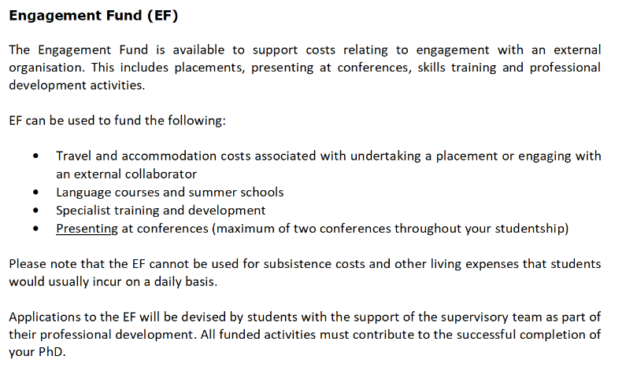
Engagement Fund (EF)
Taken from RDF/EF Guidance on VPP

Slide 8

Research Development Fund (RDF)
Research Development Fund (RDF) can be used by students for cost associated with your research. Specific criteria is detailed in the RDF Guidance Notes on the VPP.
RDF should not be used for broader professional training and development costs or presenting at conferences as these are covered by the Engagement Fund. Nor should it be used to support costs of working with an external partner, whether as part of a Collaborative Doctoral Award or as part of a placement.
Please note that RDF cannot be used for subsistence costs and other living expenses that students would usually incur on a daily basis.
The minimum amount that can be applied for is £100.

Slide 9
RDF and EF
Guidance and the latest forms to use are available on the VPP. M4C site on CADRE site links to the VPP link – always use the latest one.
Applications are Student-led, not Supervisor (you submit the application, not your supervisor).
Leave yourself plenty of time – all applications should be made at least 2 months prior to your travel, ideally longer.

Slide 10
RDF and EF
Travel insurance – Enrolled PGRs are covered by the University Travel
Insurance policy
https://warwick.ac.uk/services/legalandcomplianceservices/insurance/keypolicies/traveloverseas/
Risk assessment – for overseas travel a risk assessment is required (liaise with your department)
https://warwick.ac.uk/services/healthsafetywellbeing/guidance/travel_health/travelhub

Slide 11
RDF and EF
International Students and Visas for visiting other countries
From a Warwick and UKVI perspective, if you are visiting another country during your RDF/EF activity then please ensure you consult with the International Office to understand your monitoring requirements.
Read the guidance around Change of Study Location to see if this applies to you.
The Immigration and Visa Compliance team have some helpful advice on their pages regarding change of study location. Your department will be able to also support with this.
Check government websites for the country you are visiting to understand your individual visa requirements.
Give yourself plenty of time to allow for visa delays and extra processes to go through.

Slide 12
Cohort Development Fund

Slide 13
Cohort Development Fund
Supports students to design and facilitate research development activities and training opportunities – student-led.
VPP - News & Events
This is something you would talk to M4C Nottingham directly about.
Use your contacts, come up with your proposal and submit to M4C.
Once approved, M4C Warwick team are happy to support with any internal logistics/questions that you may need help with.
We have successful CDFs gone through so we can signpost to other PGRs for advice.

Slide 14
Example Activities

Slide 15
Example Activities
EF – professional development, placement funding, activities with an external organisation e.g. conferences, training courses
RDF – research related costs e.g. field trip costs, archive/collection visits.

Slide 16
Example Activities (RDF)
Library Visits to Florence
Library of the Society of Friends London
Royal Danish Library Copenhagen
National Library of Scotland Visit
Borthwick Institute Visit
CDA Partner Visits
Berlin German Language Course
Trip to India for Field Work

Slide 17
Example Activities (EF)
Collegium Phenomenological 2024, Summer School
College Art Association Annual Conference, New York
Venice Biennale Archive
Irish Studies Conference, Poland
UWI Summer School - Trinidad
Presenting at Conference in Paris
Northeast Modern Language Association Conference, Philadelphia
EACS Biennial Conference
3-week French Speaking Course
Italian Drawing Roving Seminar
International Postgraduate Conference in Translation and Interpreting
British School at Rome Workshop

Slide 18
Example Costs (not covered)
Books
Photocopying
Poster printing
Transcribing services
Membership fees
Capital equipment, including laptops, cameras and dictaphones, cameras
Subsistence, including conference dinners
Passports, Visa/ESTA
Travel and medical insurance
Specific forms of travel
Refer to RDF and EF guidance for full info.

Slide 19
Application Process

Slide 20
Application Process
The full application process including how to download and complete the form is available through the M4C site on the CADRE webpage.
M4C Site

Slide 21
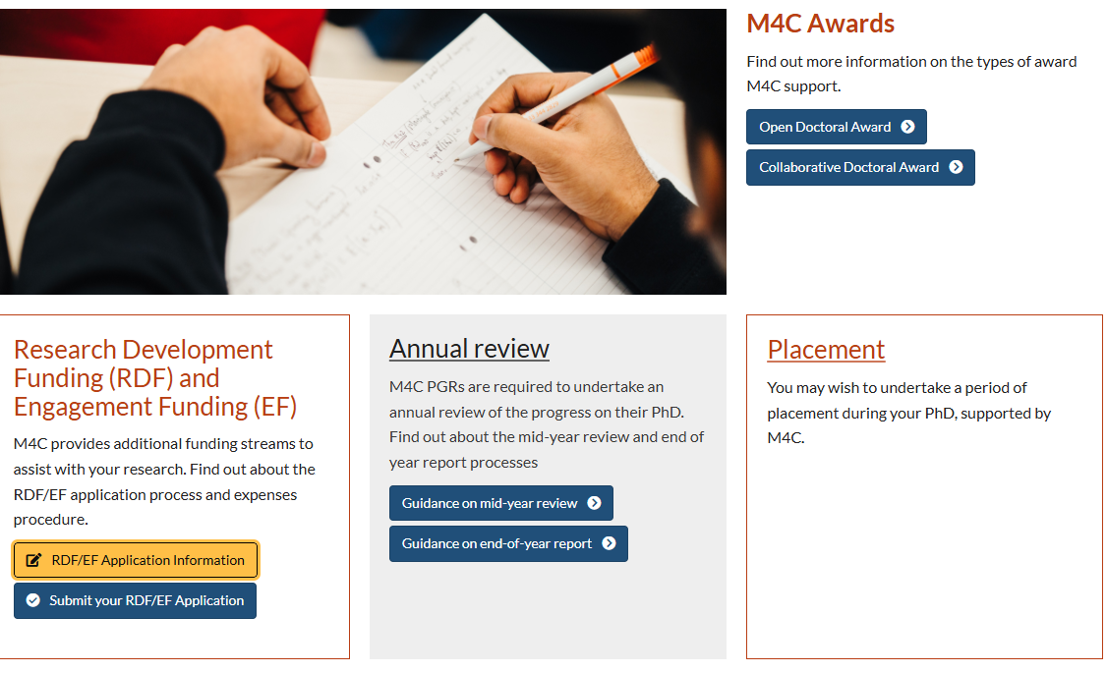
Application Process

Slide 22
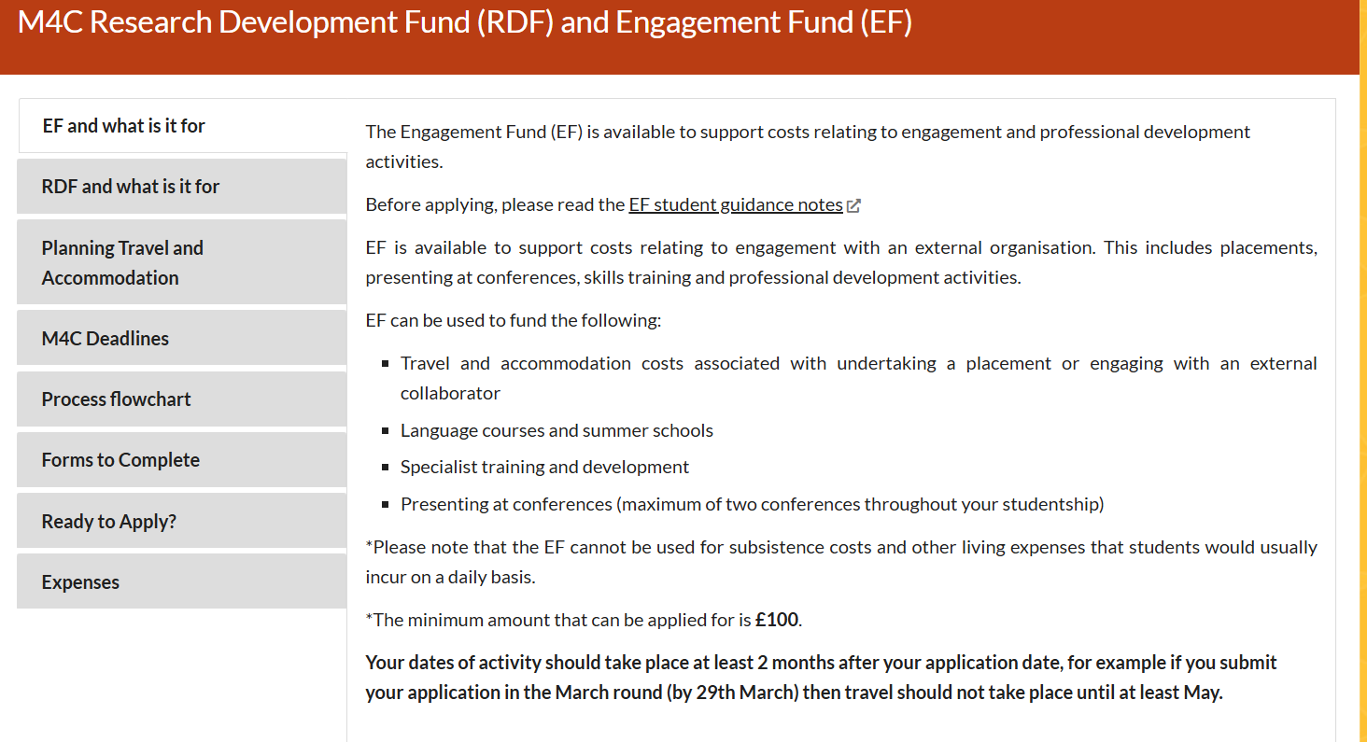
Application Process

Slide 23
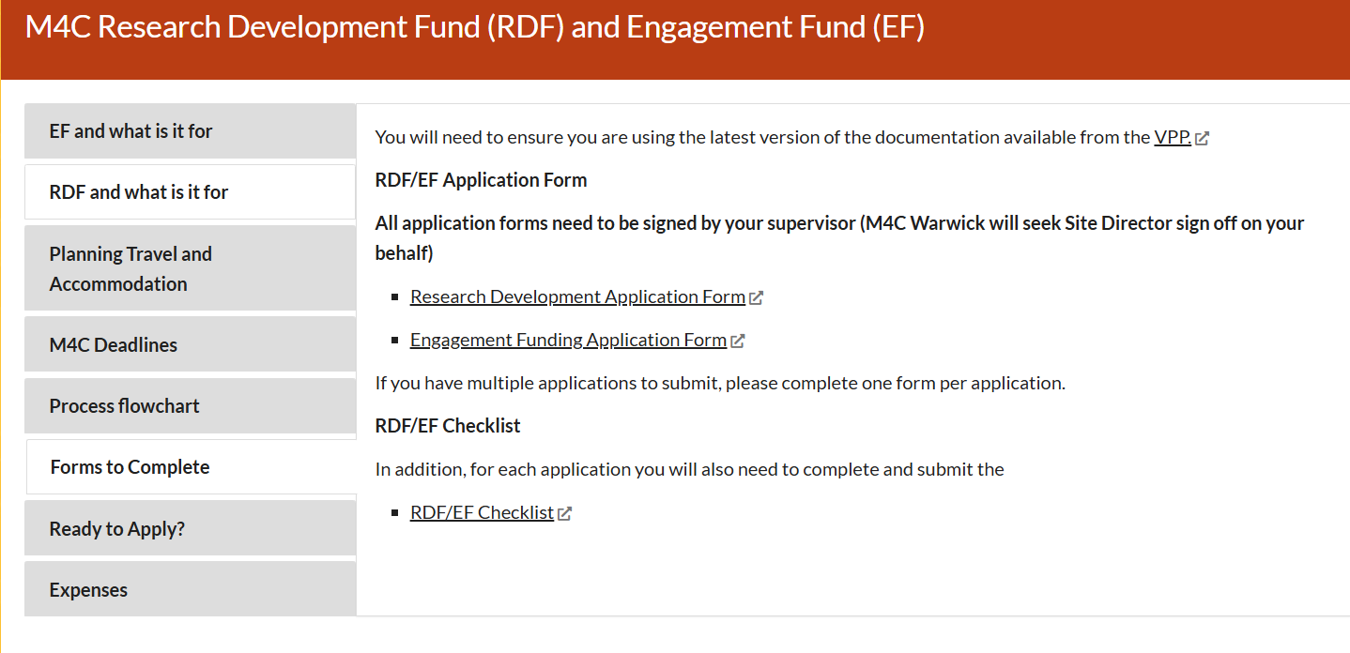
Application Process

Slide 24
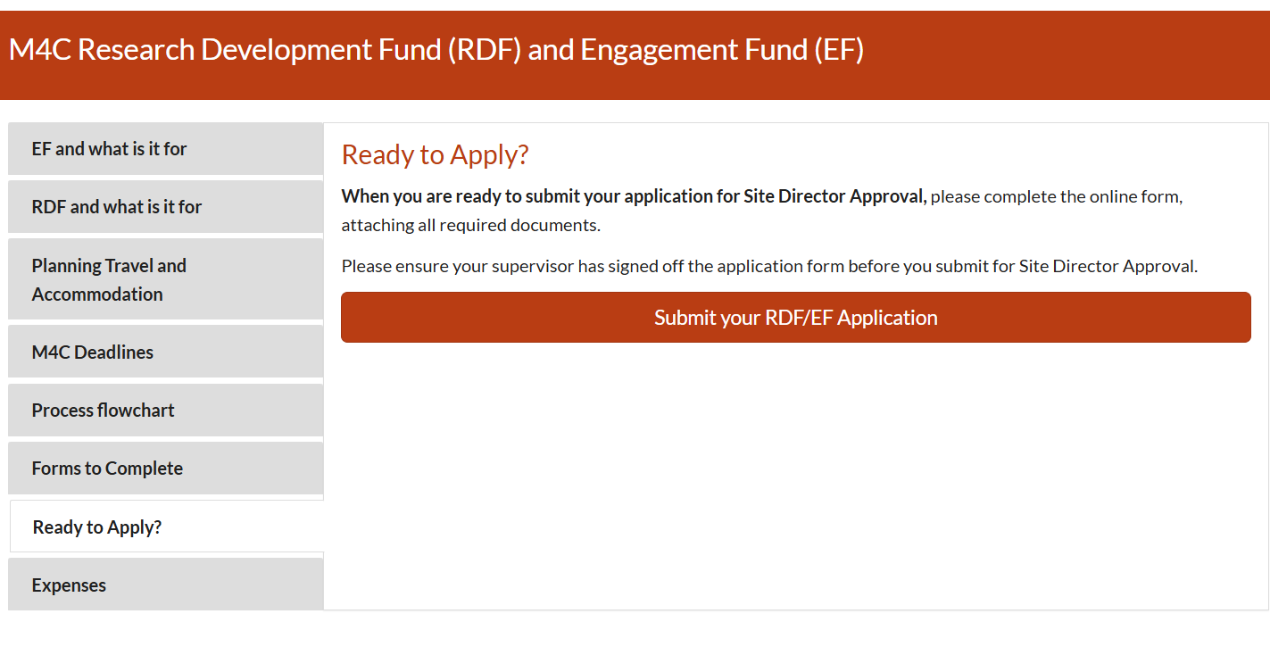
Application Process

Slide 25
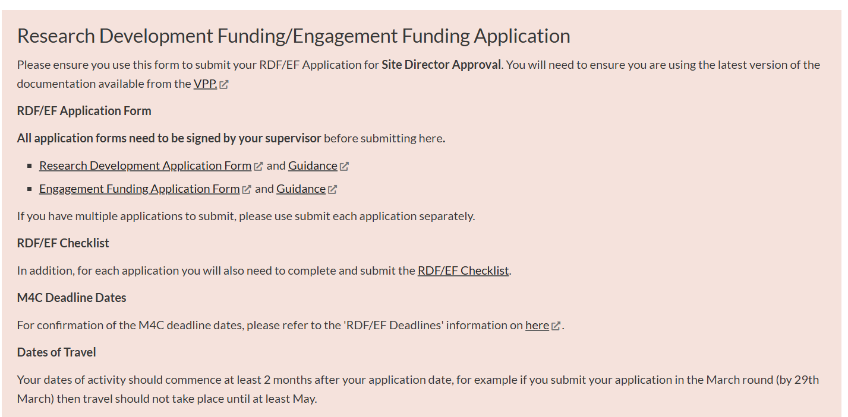
Application Process

Slide 26
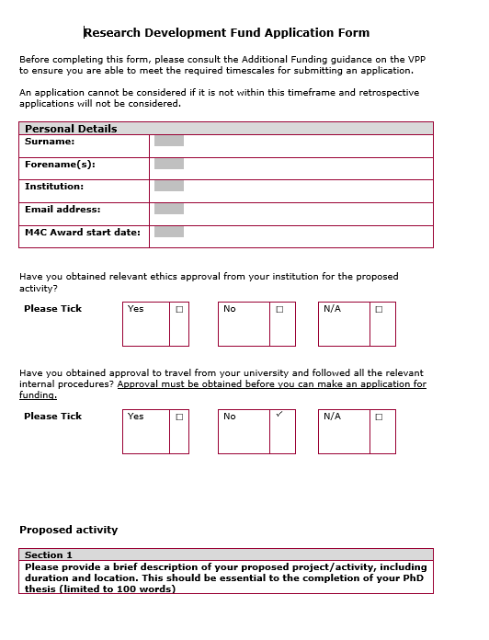
Application Process

Slide 27
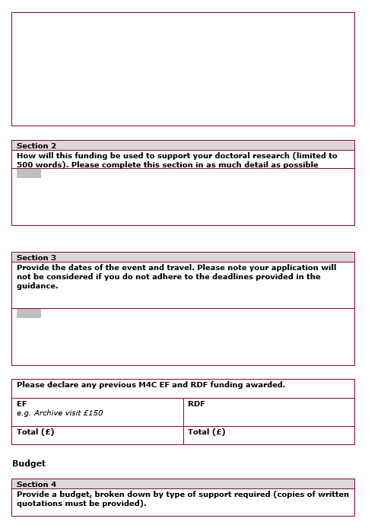
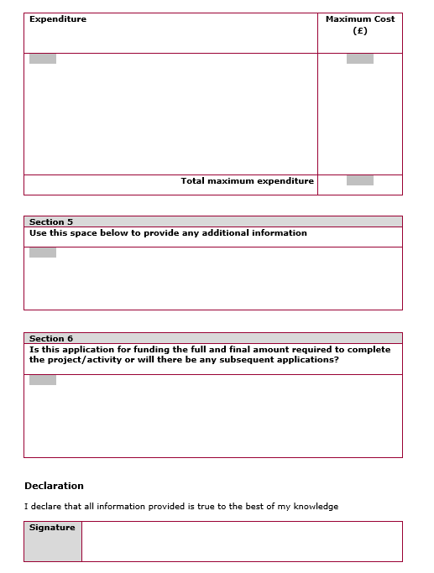
Application Process

Slide 28
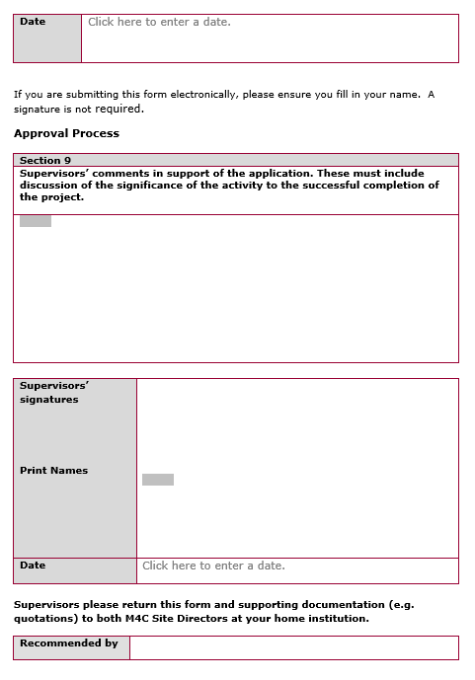
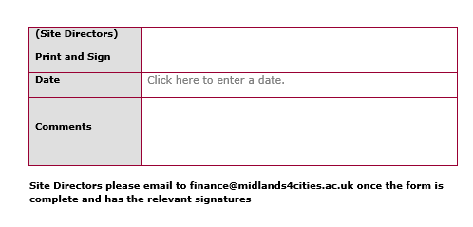
Application Process
You seek Supervisors’ signature and comments. M4C Warwick will seek Site Director sign off.

Slide 29
Application Process
Download and Complete the Application Form –
Give yourself plenty of time – it’s a lengthy form!
You will need to provide a clear budget overview and supporting estimate quotes as part of your application (see next slide).
Include all parts of your journey (e.g. Including travel from airport to accommodation/conference)
Don’t underestimate the cost of travel and accommodation – be realistic and sensible in what you expect it to cost.

Slide 30
Application Process
Download and Complete the Application Form –
Read the M4C guidance and Warwick’s expenses guidance to make sure you are following the rules.
Remember, you can’t claim more than what is awarded, so really think this through.
Ensure your supervisor has provided supporting statement and signed the Application Form.
No visits longer than 12 months can be approved.

Slide 31
Application Process
1. Download and Complete the Application Form -
Evidence on your application
  Screenshot of all costs
  Don’t use advance saver tickets (always quote standard fare)
  You don’t need to include hotel quotes (base rate £100/£120 per night)
  Key Travel screenshots where quotes are needed from Key Travel and not booking yourself
  Use mainstream websites and suppliers i.e. trainline, standard airlines.

Slide 32
Application Process
1. Download and Complete the Application Form
Evidence on your application
  Use mainstream websites and suppliers i.e. trainline, standard airlines.
  Email confirmation of conference acceptance needs to be clearly headed from the conference provider.
  If you need to use any websites/suppliers outside mainstream then you will need to seek advice before submitting your application as you may need FinRegs approval (not a guarantee).
  Visas – if you are in the process of applying for a visa for your visit, then submit your application with evidence of this whilst you wait (don’t delay your application).

Slide 33
Application Process
How you obtain your estimates, depends on where you are going:
 | Travel and Accommodation totalling less than £1000 | Travel and Accommodation totalling more than £1000
Travel within UK and Europe | FinRegs approval is not needed and can be booked independently. | this must be booked via Key Travel. If this isn't possible and you need to book independently from Key Travel (on their advise), then you must have FinRegs approval in place. Please ensure you follow the guidelines around what is and is not accepted.
Overseas Travel (outside of UK and Europe) | Any travel and accommodation costs outside of UK and Europe must be booked through Key Travel. | Any travel and accommodation costs outside of UK and Europe must be booked through Key Travel.

Slide 34
Application Process
Accommodation Ceiling Rates
London | Overseas | Elsewhere in UK
£120 per night | £120 per night | £100 per night
Remember you do not need to provide quotes for accommodation – you can only claim/arrange for Key Travel to book, these maximum rate amounts.
The maximum amount that may be claimed towards accommodation costs is the equivalent of 14 nights funding depending on the location of your stay. This would be £1,400 for a UK location other than London and £1,680 for London and overseas visits. You will need to use your own funds for any longer stays.

Slide 35
Application Process
  FinRegs
  What is FinRegs?
  Approval from the team at Warwick who look after Financial Regulations. Your department will email them on FinRegs@warwick.ac.uk if you need approval from them for your estimate.
  Your email confirmation from FinRegs will need to be included as part of your submission documents when you apply.
  FinRegs will usually only be approved if there is no alternative available (the exception not the rule).

Slide 36
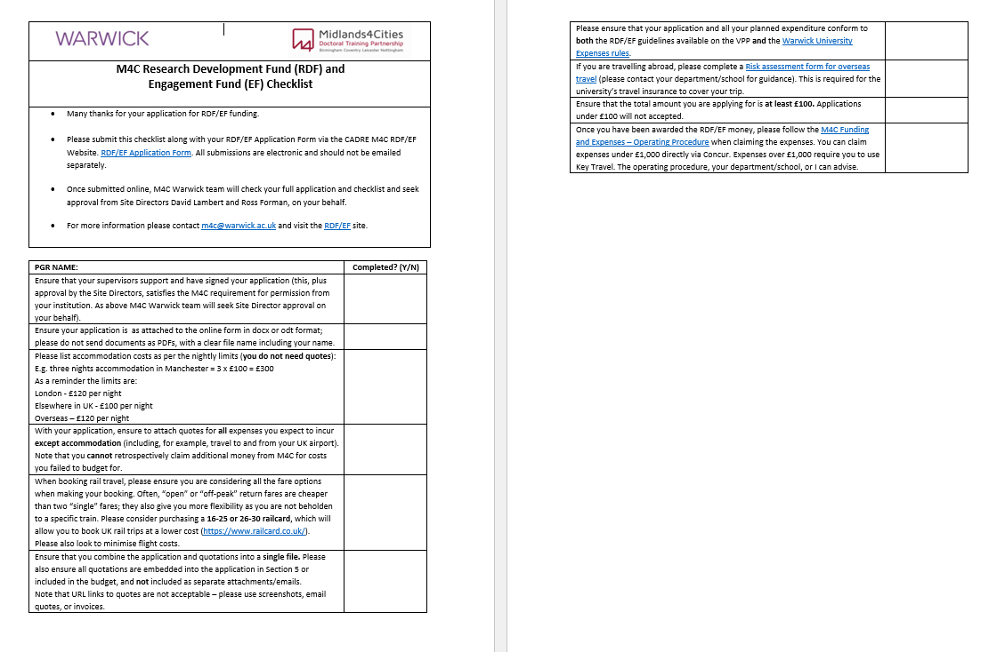
Application Process
2. Download and Complete the RDF/EF Checklist:

Slide 37
Application Process
3. Prepare any supporting attachments
FinRegs approval email
Supporting and relevant documentation from host
Risk Assessment if travelling abroad (through department)

Slide 38
Application Process
4. Submit your application for Site Director Approval via Online Form
Include your application form, checklist and supporting documentation.
Submit via the online form on the M4C Site section of the CADRE webpage.
Ensure you do this by the 29th of the month (or 28th in Feb!).
The form will then arrive in the m4c@warwick.ac.uk inbox where Lisa/Emily will check the application and forward to David/Ross for review.
If David/Ross approve, they will sign, and Lisa/Emily will forward to M4C Nottingham team for final approval.

Slide 39
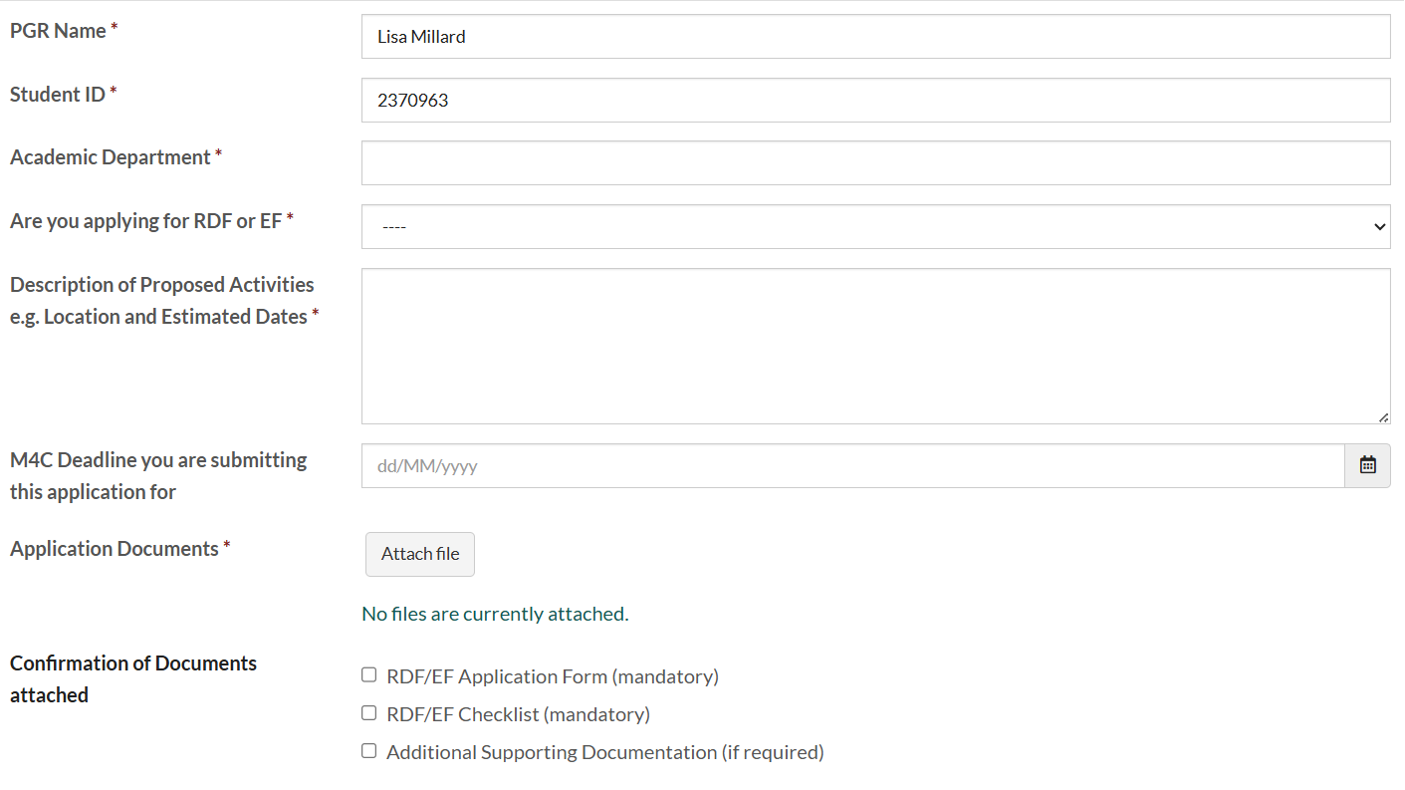
Application Process
Ensure you attach all of these!

Slide 40
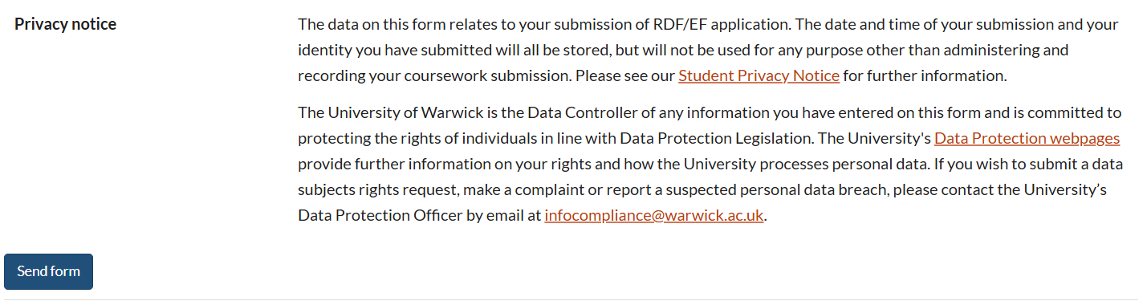
Application Process

Slide 41
Application Process
5. Outcome of Application:
If successful for either application, you will receive a confirmation from M4C Nottingham confirming the amount you’ve been awarded.
Crucially, you will be given a M4C Reference e.g. M4C RDFXXXXXX or M4C EFXXXXXX. This reference is extremely important for claiming your money back, so keep it safe and use it where needed!
M4C Warwick will keep a record of your approved awards and will help you with claiming this money back.

Slide 42
Booking Travel/Accommodation and Expenses

Slide 43
Booking Travel and Accommodation
Now you’ve been awarded your funding, next steps are booking your travel and accommodation:
Depending on what was approved in your application, you will either book the travel and accommodation yourself and claim it back, or it will be booked directly through Key Travel and costed to the correct cost code via your academic department.
You need to involve your academic department at this point so they can support and advise you on their local processes.
We will let your department know that your award has been approved, but when it comes to next steps, you need to keep them involved, particularly if they are supporting you with bookings!
Keep your own log of what you have spent against the total award and keep your receipts.
M4C Warwick nor Nottingham Central are involved in any booking processes

Slide 44
Booking Travel and Accommodation
Department | Who to contact? | UK/Europe visits | Overseas visits
Classics and Ancient History | Donna.davies@warwick.ac.uk Classics@warwick.ac.uk | Department will support in booking this | Department will support in booking this
Renaissance | Renaissance@warwick.ac.uk (Jayne Sweet) | Department will support in booking this | Department will support in booking this
Sociology | vicki.flower@warwick.ac.uk socphdresource@warwick.ac.uk | PGRs can book themselves | Department will support with booking this
SCAPVC | Clara.Cassidy@warick.ac.uk or Sarah.Shute@warwick.ac.uk | PGRs can book themselves or department can support | Department will support with booking this

Slide 45
Booking Travel and Accommodation
Department | Who to contact? | UK/Europe visits | Overseas visits
History | pghistoryoffice@warwick.ac.uk fao Kay Jones (Wednesday – Friday only) | PGRs can book themselves or department can support | Department will support in booking this
Applied Linguistics | SELCSResearchandPGR@warwick.ac.uk | PGRs can book themselves or department can support | Department will support in booking this
English and Comparative Literary Studies | pgrenglish@warwick.ac.uk or Dee Parker D.Parker.1@warwick.ac.uk | PGRs can book themselves | Department will support in booking this

Slide 46
Booking Travel and Accommodation
Department | Who to contact? | UK/Europe visits | Overseas visits
Global Sustainable Development | PGGSD@warwick.ac.uk | PGRS can book themselves or the department can support with this | Department will support in booking this.
Philosophy
School of Modern Languages and Cultures | smlcoffice@warwick.ac.uk | PGRS can book themselves or the department can support with this | Department will support in booking this.

Slide 47
Expenses Claims
If you are claiming back your RDF/EF expenses, you will need to this via Concur. Warwick will reimburse you (and we ask M4C for the money).
Expenses Claims can only be made if the criteria in previous slide has been followed.
First time claims - you won’t be set up on Concur so you’ll need to complete a FP16a form. After then, you’ll be able to use Concur.
Claims must be done within one month of the activity taking place.

Slide 48
Expenses Claims
Items to Upload:
  Upload your receipts and itemise the costs clearly.
  Upload any FinRegs approval if you have been given permission to book outside of Key Travel where you normally would need to.
Items to email:
RDF/EF Activity Form completed – your Concur expenses cannot be approved without this. (RDF/EF Activity Form) This should have been emailed to m4c@warwick.ac.uk within one month of your activity ending.

Slide 49
Expenses Claims
Important to remember:
You can’t claim for expenses that you haven’t planned for (and has been approved) on your RDF/EF application. In other words, you cannot use the money for another purpose on the trip. Any expenses outside of those approved in the original application will be declined.
Always use your M4C reference number in the header of the claim!

Slide 50
RDF/EF Activity Form
RDF/EF Activity Form
To be completed within 4 weeks of activity taking place and emailed to m4c@warwick.ac.uk and finance@midlands4cities.ac.uk.
This can be downloaded and completed via the link: RDF/EF Activity Form

Slide 51
Timescales and Deadlines

Slide 52
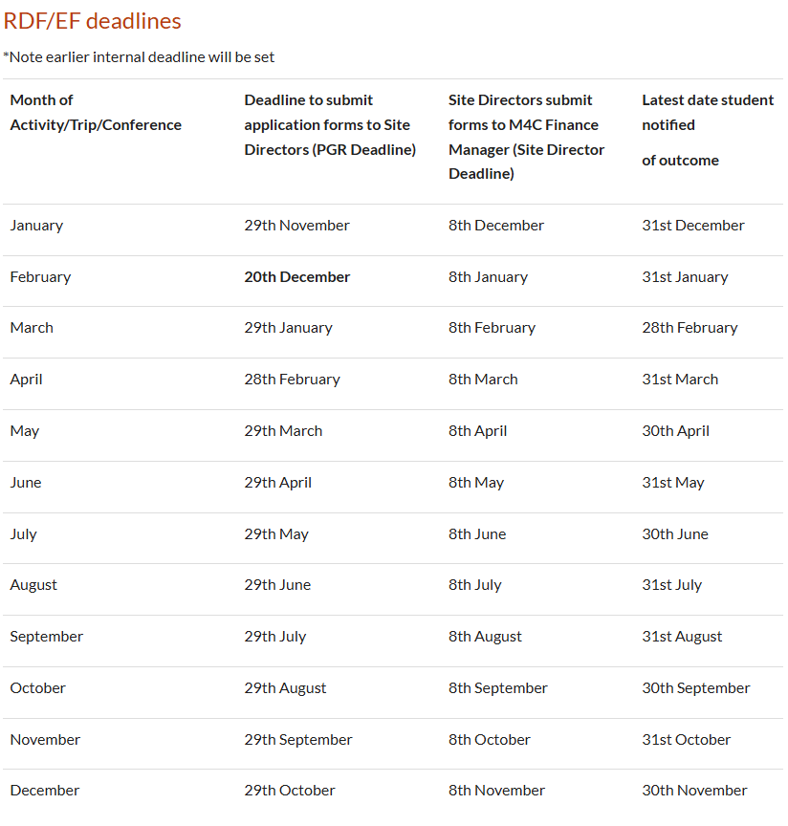
Timescales and Deadlines
Specific Deadlines to follow:
https://warwick.ac.uk/fac/arts/cadre/m4c/rdfef/
Usually 29th of the month unless February has 28 days and adjustment for Christmas break.
All applications are considered on a monthly basis, so keep to the deadlines – there is no flex at M4C on this.
The earliest you can travel is the month after your application is approved by M4C.
Look out for these timescales in the monthly newsletter as a reminder!

Slide 53
Example Applications and Reflections (please contact m4c@warwick.ac.uk to see these)

Slide 54
Useful Links and Info

Slide 55
Useful Links and Info
Key Info | Where to find it?
Concur | https://eu2.concursolutions.com/home
VPP | https://uniofnottm.sharepoint.com/sites/M4CVPP
CADRE Pages | https://warwick.ac.uk/fac/arts/cadre/
CADRE M4C Site | https://warwick.ac.uk/fac/arts/cadre/m4c/
FP16a Form | https://warwick.ac.uk/services/peopleteam/internal/payroll/expenses/fp16aphd.pdf https://warwick.ac.uk/services/peopleteam/internal/payroll/expenses/fp16aphd.xlsx
Fin Regs | https://warwick.ac.uk/services/finance/finregproc/finregs1516faqs/
Risk Assessment | https://warwick.ac.uk/services/healthsafetywellbeing/guidance/travel_health/travelhub

Slide 56
Useful Links and Info
Key Info | Where to find it?
Travel Insurance Policy | https://warwick.ac.uk/services/legalandcomplianceservices/insurance/keypolicies/traveloverseas/
RDF, EF and CDF Guidance | https://uniofnottm.sharepoint.com/sites/M4CVPP/SitePages/Additional-Funding.aspx
Change of Study Location | https://warwick.ac.uk/services/academicoffice/studentrecords/staff/proceduresguide/changeofstudylocationandworkplacement/
Visa and Compliance – Change of Study Location FAQs | https://warwick.ac.uk/study/international/visa/during-your-studies/absences/#faq-0

Slide 57
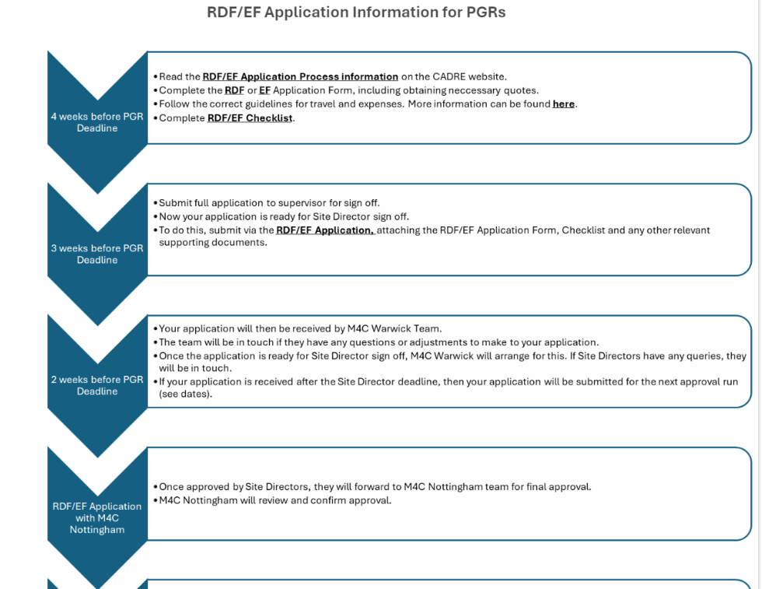

Slide 58
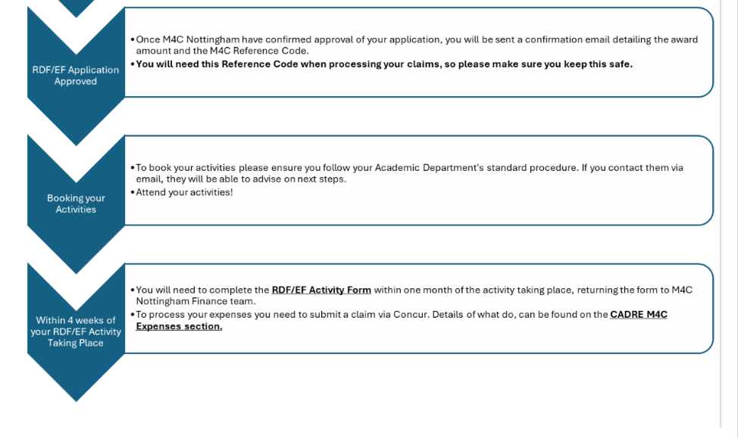

Slide 59
Questions

