Slide 1



Slide 2


Supervisor Briefing 2025

Slide 3

Welcome!
A little bit about Midlands4Cities
Your institution and M4C
3. M4C supervisory expectations
  Using the VPP
4. Additional resources for your students
  M4C events and training, Research Development Fund, Engagement Fund, Cohort Development Fund, Placements
5. M4C supervisor expectations
6. Other ways to get involved with M4C

Slide 4
In 2025, we will welcome M4C Cohort 7, a total of 100 students over the 8 institutions, including 20 CDAs.
They will join a group of about 400 current students, from all disciplines under the AHRC remit, and they will have opportunities to work with each other across cohorts and institutions, to devise and undertake specialist training, to enrich their own and others’ practice and research, and to use their skills and knowledge in placements.
Although this is the last M4C cohort, there will still be M4C Central staff and additional research support funds for them throughout their studies.

Slide 5

What a student gets
An M4C award covers home fees and a UKRI-set stipend; it offers additional funds for student activities and support, including bespoke training; and it encourages connections, networks and collaborations, to support students in their future careers, through events and other support.
UKRI’s current calculations on the average value of an individual PGR award is around £100,000.

Slide 6
Contacts
Institutional Teams
Central Team
University Site Directors and Administrators:
Director: Professor David Lambert
Director: Dr Ross Forman
Doctoral Training Manager: Kay Jones (Lisa Millard will return in October 2026 after maternity leave)
DTP Coordinator: Dr Yangzi Zhou
Director: Professor Nicola Royan
Manager: currently vacant
Placements Manager: Dr Jade Jenkinson
Finance Manager: Claire Thompson
Project Officers: Sam Offiler (Jessica Metcalfe will return in May 2026 after maternity leave).
Notes:
Do we need a new photograph?

Slide 7

Your Institution and M4C
M4C responsibilities
Institutional responsibilities
Academic progress
Essential skills development
Extenuating circumstances, interruptions, identifying appropriate support
Pastoral support
Careers guidance
Funding fees and stipend dependent on academic progress assessed by the institution
Responding to student need as supported by the institution, including disability support
Complementary, supplementary and specialist skills development, including cohort events, supporting training and field work, and facilitating placements

Slide 8

M4C supervisory expectations
Full-time M4C students have a minimum of 10 meetings a year, part-time students should have 6.
  Over the year, these meetings should involve the full supervisory team. Travel expenses are available if in-person supervisions are required. We would recommend that at least some supervisions taken place in person. NB: our meeting requirements are a minimum; where an institution requires more, the institutional regulations must be followed.
A mid-year review, completed in spring semester.
  The first MYR is the point at which extended funding can be confirmed (where a student, supervisory team and potentially assessors have identified essential extended training or fieldwork needs); after its completion, students have access to placements and more extended additional funding.
An end of year report, completed in June.
  This report records a student’s additional activities (publishing, placements, conferences, exhibitions and performances), for report to the AHRC.

Slide 9


All forms and reports are held on the VPP. Students and academic supervisors are provided with access at the student’s enrolment. This access must be used within 30 days, or it will be cancelled.
How to use the supervision space
How to find key forms
How to access and save (e.g. supervision forms, mid-year report forms)
DEMONSTRATATION OF KEY AREAS

Slide 10
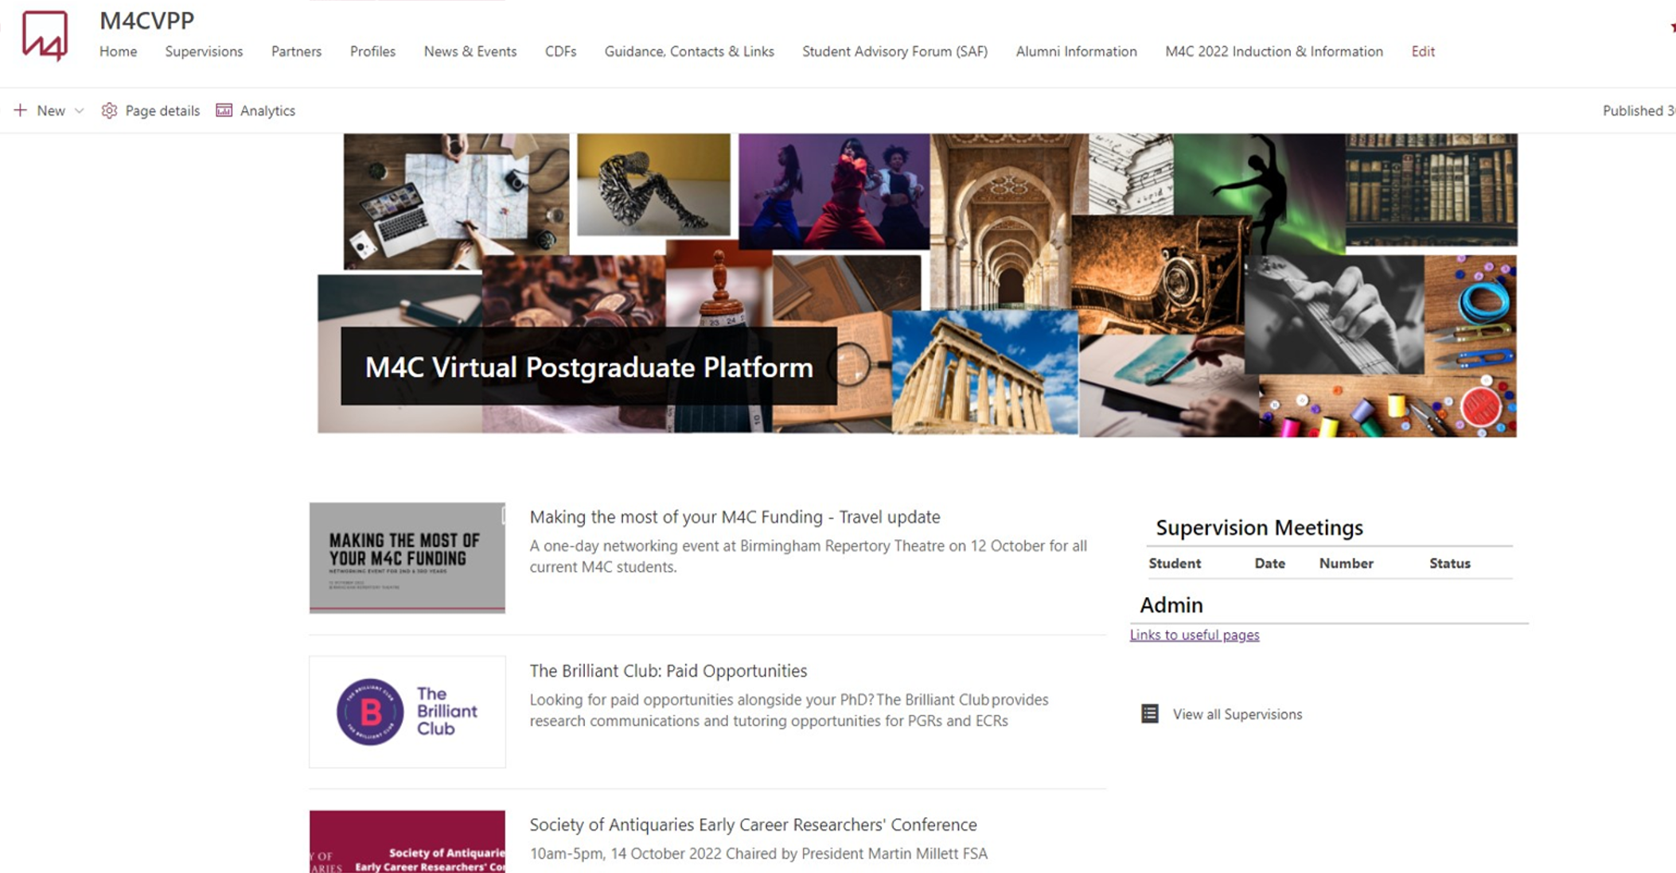
The front page looks like this:Platform?

Slide 11
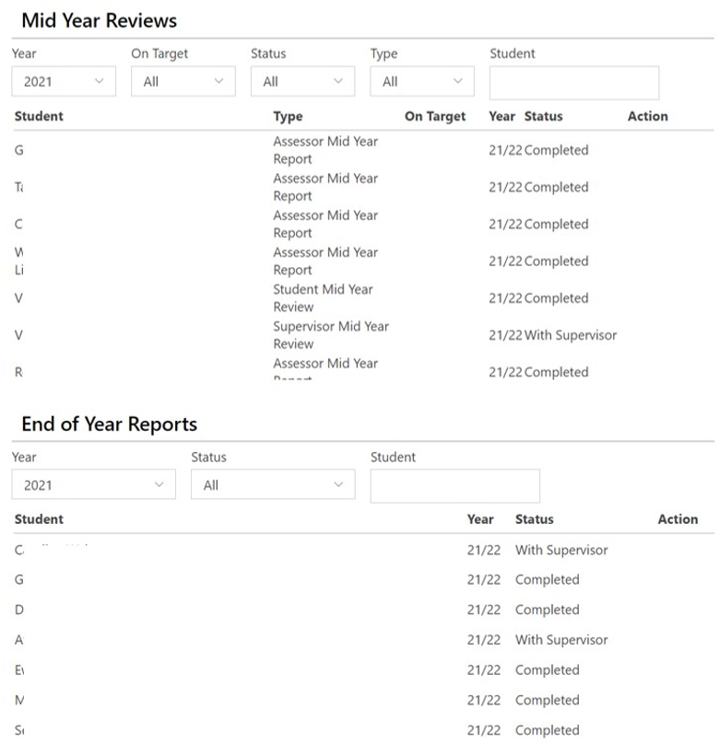
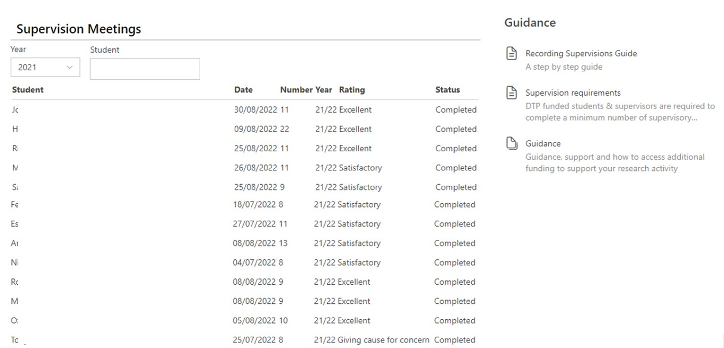
The supervision space provides access to these documents:
  homepage
  Recent supervisions
  Mid-year review
  End-of-year report
  Quick access to news and events, CDF listing and partner pages
  Guidance tab to take you to information and forms on additional funding, placements, student welfare and M4C, AHRC and UKRI regulations

Slide 12


The guidance page provides other useful information:. The Virtual Postgraduate Platform?

Slide 13
Additional Resources to Support the Project
Extended funding
  Open Competition awards are for 3.5 years, but where a student has clear extended training needs, after their first mid-year review, they may apply for up to an additional six months funding.
Engagement Fund
  The Engagement Fund (EF) is available to support costs relating to engagement and professional development activities and to deliver papers at conferences
Research Development Fund
  Research Development Fund (RDF) can be used by students to undertake overseas and UK study visits, fieldwork, and to cover some primary research costs. RDF will only be allocated to activities which are essential to the completion of the student’s thesis.
Further information on all these opportunities is available on the VPP. All of them require a supervisory supporting statement.

Slide 14
Additional Resources for Individual Students
Training
  M4C training opportunities are designed to complement institutional training. Regular offers include stage-appropriate sessions with the Royal Literary Fund, policy training, and MHFA training.
Placements
  Midlands4Cities works closely with partners in the cultural, creative and heritage sectors to develop placement activities which enhance student research.
  Placements can be advertised, or they can be developed by a student with a partner, in consultation with the Placements Manager

Slide 15

Current M4C partners also have their space on the VPP:

Slide 16
Additional Resources to Support the Cohort
Cohort Development Fund
  The Cohort Development Fund (CDF) is designed to fund groups of students and to support training, development and research activities for the cohort of DTP students and to include Arts and Humanities students outside the DTP wherever possible.
  The fund supports activity that enriches the Midlands4Cities community as a whole, and where the activity and the uptake allows, these projects can be opened to self-funded/alternatively-funded students.
  These activities are some of the most innovative and exciting associated with the DTP, and students who organise and participate in them often make dynamic connections.

Slide 17
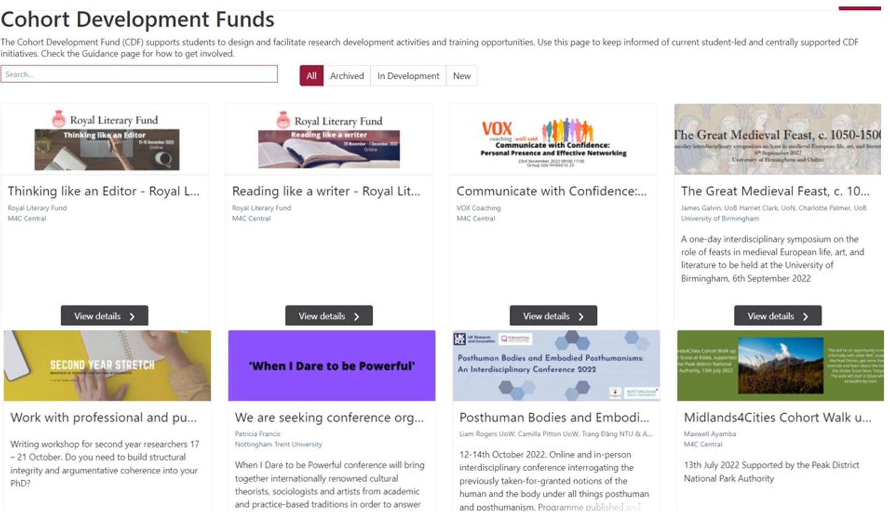
Current Cohort Development Fund activities?
Notes:
New examples

Slide 18
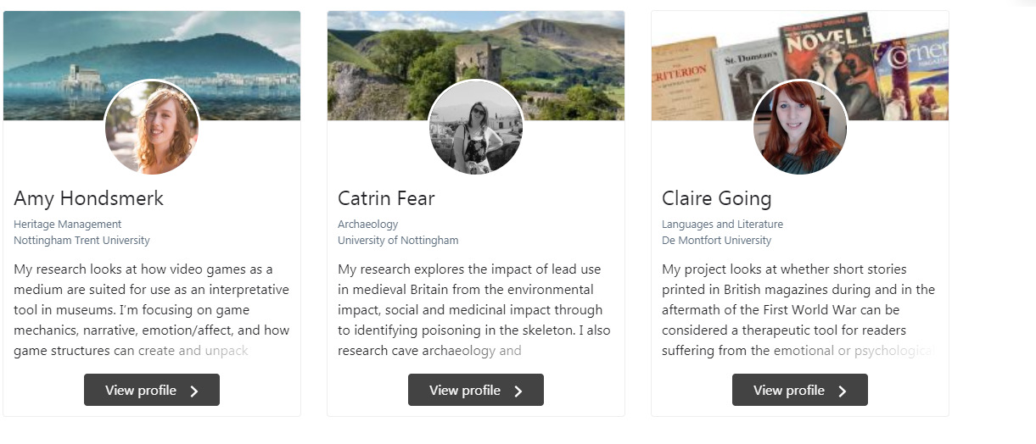
Student profiles sit on both the VPP and the M4C webpages?
Notes:
New examples

Slide 19
M4C supervisor expectations
1. We expect all supervisors to engage with the VPP, and to do so promptly after the student starts. If first registration does not occur within 30 days, the supervisor will be deregistered.
2. We expect all forms to be completed online as far as possible on the VPP. Please don’t use previously downloaded forms, as they are regularly updated on the VPP.
3. Please engage with the supervisor CPD that your institution offers, particularly around EDI support, student welfare and best practice. M4C offers some additional briefings for CDA supervisors.
4. Please encourage your students to participate in M4C activities, and help us build our cohorts. All opportunities are advertised on the VPP.

Slide 20
M4C support for supervisors
All supervisors, particularly if new to M4C, are welcome to attend any of the online briefings for students
CDA supervisors, both new and returning, will be invited to an online briefing in early November, and M4C is keen to support further briefings and a network for both academic and partner CDA supervisors.
Supervisors of practice-led students also have a network, and details will be circulated through Site Directors and the newsletter
Some experienced M4C supervisors are also available to share some techniques learned from the Royal Literary Fund to support students struggling to write. Please contact your SDs if you would like to talk to one of them.
If you have suggestions for specialist supervisor training, not available in your institution, please let your SDs and M4C know. M4C is working with the RSVP project (https://www.rsvp.ac.uk/) and is keen to share ideas and support development.

Slide 21
Support to help your students write
In July 2025, supervisors from across M4C participated in a writing retreat run by the Royal Literary Fund.
The programme introduced supervisors to techniques to prompt and sustain writing and editing that can be shared with students who are challenged by writing. This includes:
  Students with specific learning differences
  Students returning to academic study from professional life
All participants in the retreat have agreed to share their knowledge with staff and students at their institutions. UoW’s participant is Dr Elise Smith (History) (e.smith.10@warwick.ac.uk).

Slide 22
Other Ways to Get Involved
1. Dialogue Days
  Events proposed and organised by academic staff to address particular methodologies or research questions. The 2025 call will be circulated in October 2025, for events to be held before September 2026.
2. EDI Advisory Group
  Now in its fourth year, this group has been set up to challenge M4C to embed EDI best practice in all activities and support innovative developments.
3. Research Festival
  All M4C students are expected to attend the Research Festival and present at least once. Supervisors are welcome to attend; please contact us in good time to book your place. The next is Wed 11 February 2026 in Birmingham.

Slide 23
Thank you for attending!
There will be further, refresher, briefings on CDA supervision, Mid-Year Review, and Placements during the year.
All supervisors should receive the monthly newsletter with details of upcoming training and research events.
Any questions, please contact your site directors or the M4C Central team:
  enquiries@midlands4cities.ac.uk

