Slide 1



Slide 2











M4C is one of ten AHRC Doctoral Training Partnerships (announced August 2018)
Shared student supervisory and training experience, drawing on best practices between eight universities and harmonised across the DTP
Cross HEI supervisions (currently 52% of all funded students)
Training that combines the best elements of each institution’s postgraduate training offer with an extensive cohort development programme (the M4C ‘Midlands Arts Programme’)
Extensive range of national, regional and international partners that provide training and placement opportunities for students
Notes:
Cross HEI supervisions – check numbers? Any partners we want to bring in, any leave out? CDAs foregrounded?

Slide 3


M4C priorities
  To fund and support outstanding research - 460 awards between 2019-2024, including a minimum of 40 Collaborative Doctoral Awards (CDAs); now extended by two years
  To enhance opportunities for postgraduate collaboration between partner universities
  To promote researcher engagement with non-university organizations
  To provide placement, training and skills development opportunities for funded researchers
Notes:
Extend dates on DTP, or leave to subsequent slide?

Slide 4

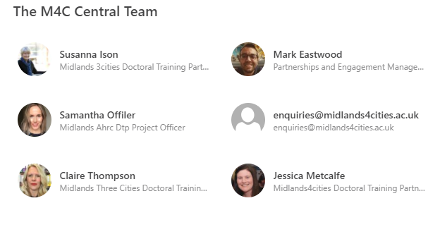
M4C CONTACTS
http://www.midlands4cities.ac.uk
enquiries@midlands4cities.ac.uk
CENTRAL
Director of Midlands4Cities: Professor Nicola Royan.
M4C Manager: Susanna Ison
M4C Partnership and placements manager: Dr Mark Eastwood
M4C Administrative officer: Jessica Metcalfe
M4C Project officer: Sam Offiler (from December 2021)
M4C Finance manager: Claire Thompson
INSTITUTIONAL
Two M4C Site Directors in each institution
Jenny Burns and David Wright
M4C Site Administrator
Sharron Wilson
m4c@warwick.ac.uk
Notes:
Change photos. Have I got Jess’s title right?

Slide 5

SUPERVISOR TRAINING AND INFORMATION
What do I need to know about . . . M4C as a doctoral training programme?
What do I need to know about . . . funding opportunities for M4C students?
What do I need to know about . . . placement and engagement opportunities?
What do I need to know about . . . the Virtual Postgraduate Platform?
What do I need to know about . . . Supervision?
What do I need to know about . . . mid-year review and end-of-year report?
QUESTIONS and ANSWERS
Notes:
I’ve added a heading for supervision

Slide 6


What do I need to know about . . . M4C as a doctoral training programme?
Midlands4Cities ethos
‘QUALITY THESIS PLUS’
‘The AHRC wishes to promote, not only subject-specific development, enabling students to become experts in their field, but also wider skills that provide students with the capability to pursue successful careers both within and outside academia’
AHRC Research Training Framework for Doctoral Students

Slide 7

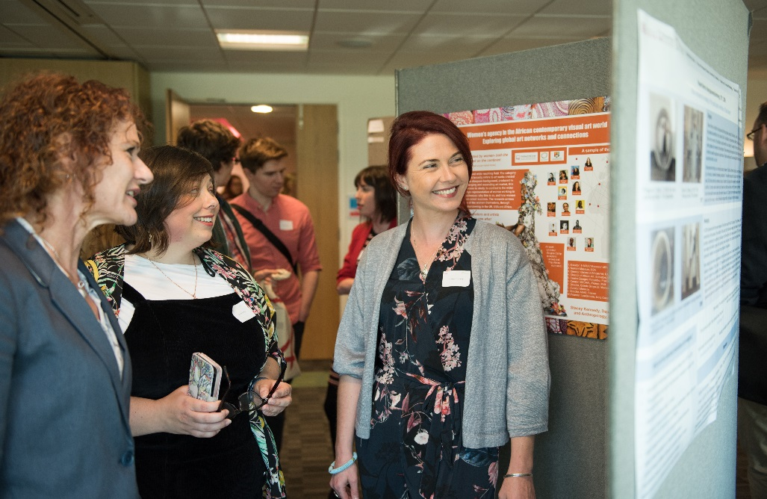
What do I need to know about . . . M4C as a doctoral training programme?
It is important to remember that your M4C student is part of a department and a university, but also a significant regional community of arts and humanities researchers, with unique opportunities to build cross-institutional networks and funded cohort activities.
The third M4C cohort includes 110 students from across 8 universities (with over 400 M3C researchers who are actively engaged members of the wider M3C/M4C community)
Notes:
Check student numbers. I wonder, should we continue to include M3C numbers here, since a proportion are on funded extensions?

Slide 8

What else do I need to know about …
M4C as a doctoral training programme?
Much of M4C’s training programme is responsive to student need and supervisor recommendation. Please let your Site Directors and the M4C Central Team know if:
You think we’re missing vital training from our programme
You have expertise you could offer to help develop our researchers’ skills across the DTP.
Currently missing from our provision are:
Digital arts and humanities (storage, management, interpretation);
Using social media platforms;
Developing vlogs, blogs and podcasts;
Running and participating in meetings;
Understanding GDPR

Slide 9

Duration of Award
Duration of award for M4C students:
3.5 years baseline (cases for extended funding will be assessed after the first mid-year review)
4 years for all Collaborative Doctoral Awards
While the AHRC has been sympathetic to some requests for extension to funding for those adversely affected by the pandemic, there is nevertheless an expectation that students starting now should have in mind a ‘Plan B’ if their original plans prove impossible to complete.
‘Doctoral projects must be designed and supervised in such a way that students are able to submit their thesis within the funded period, as defined at the outset of the project. . . There should be no expectation of an unfunded period when the doctoral programme is designed.’
(AHRC guidance to DTPs, April 2019)
Notes:
I’ve added in a paragraph about ‘Plan B’: the extensions can’t last forever, and I think it’s reasonable to ask students to think ahead.

Slide 10
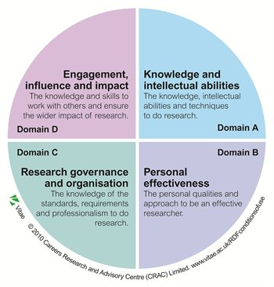
Engaging with development needs
The funded period is designed to enable the writing of a thesis but also to provide time and opportunity for students to undertake activities, workshops, training, and placements that enhance wider research and employability skills.
Completion rates are significant but the duration of award, as seen by the AHRC and M4C, should allow time for a student’s personal and professional development, and supervisors should help to encourage the ‘plus’ of ‘quality thesis plus’.

Slide 11
Institutional training
CADRE workshops programme: https://warwick.ac.uk/fac/arts/cadre/current_students/artspgrevents/
Researcher Development Programme (Doctoral College):
https://warwick.ac.uk/services/dc/pgr/programme/
HSSREC (student research): https://warwick.ac.uk/services/ris/research_integrity/researchethicscommittees/hssrec/student/
While M4C offers training opportunities, both centrally planned and designed by students, some core training will be delivered by institutions, particular Research Ethics and Research Integrity.
Please encourage your students to complete this training as required, and to take full advantage of other training opportunities provided by your institution.

Slide 12
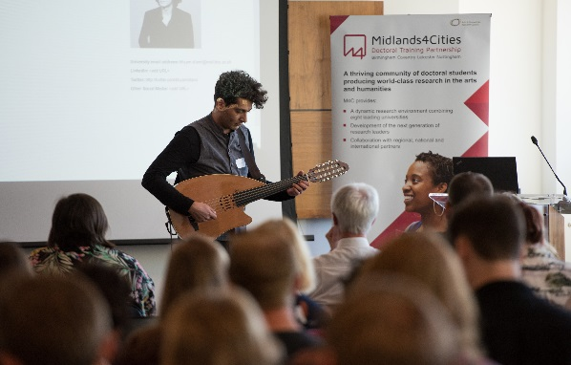
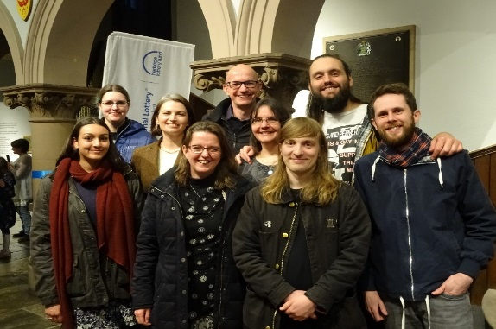
What do I need to know about . . . funding opportunities for M4C students?
Cohort Development Fund (CDF) - this scheme operates in the same way as M3C and supports student-led and centrally-organised training initiatives of benefit to cross-institutional groups of students within M4C. A minimum of 2 students from at least 2 institutions are required to participate in a CDF activity including the lead applicant (PI) and co-applicants (CoIs).
Please note: these funding opportunities are open to BOTH Collaborative Doctoral Award Students and Open Competition Students.
Research Development Fund (RDF) - this scheme replaces the Research Training Support Grant (RTSG). The application process works in the similar way to the previous Student Development Fund (SDF) .
Engagement Fund (EF) - this will allow students who are undertaking placements and other activities that are engaged with professional development to access additional funds to support them. The Engagement Fund will cover accommodation, travel and other associated costs.

Slide 13
What do I need to know about . . . funding opportunities for M4C students?
Process:
Students should consult their supervision team and submit an application to the M4C Site Directors at their institution by 29th of each month. Site Directors recommend approval or suggest amendments and submit the final application to the M4C Finance Manager for formal approval by the 8th of the following month. Applications are approved or rejected at the end of the calendar month.
There are no restrictions to the number of applications that can be made during the award period. However, applications must be for a MINIMUM of £100.
Research Development Fund
The RDF is designed to support primary research activities for individual students, including:
Participation in conferences (rather than just attendance)
Primary research/archive/fieldwork visits
Study visits in the UK and overseas
Notes:
I’ve added in the minimum amount here.

Slide 14

What do I need to know about . . . funding opportunities for M4C students?
Engagement Fund
The EF is designed to support needs-based training for individual students in the form of development and engagement opportunities, including:
Travel and accommodation costs for collaborating with an external partner
Specialist/tailored training e.g. languages, digital skills
Skills development where new skills are required to undertake fieldwork
Process:
Students should consult their supervision team and submit an application to the M4C Site Directors at their institution by 29th of each month. Site Directors recommend approval or suggest amendments and submit the final application to the M4C Finance Manager for formal approval by the 8th of the following month. Applications are approved or rejected at the end of the calendar month.
There are no restrictions to the number of applications that can be made during the award period.

Slide 15
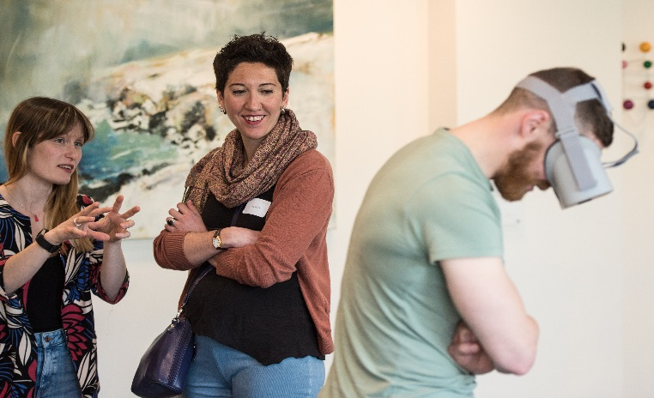
What do I need to know about . . . funding opportunities for M4C students?
Recent cohort initiatives
Pandemic Perspectives
The Academy: in Black and Whiteness
The Hidden in Performance, Visual and Literary Culture: conference
Change in A Post-War World: conference
Midlands Music Research Network
Mental Health First Aid Training
Culture, Things and Empire: Seminar Series
Prince 2 Project Management
M4C Digital Research Festival
The Cohort Development Fund (CDF) enables groups of M4C/M3C students to design training, development and research activities that build regional networks, involving arts and humanities students outside the doctoral training partnership wherever possible.
Notes:
Change some of the titles? Put in the brap ones, and the Pandemic Phd?

Slide 16



Midlands Arts Programme: examples of cohort training initiatives for 21/22
Royal Literary Fund – the Royal Literary Fund will be offering their popular writing workshops, immersive sessions, and writing retreats for 1st, 2^{nd,} 3rd year students online this year. Plus two new online stand-alone modules for 2nd and 3rd year researchers 'Reading like a Writer' and 'Thinking like an Editor'
Engaging with Policy Makers with the Institute for Government – Two online morning sessions on 10th and 11th November which will give students a sense of how policy-making works in practice, and how they can communicate effectively with policy makers.
‘Lifting the Lid’ on the Creative Industries and Cultural Sector –Bird&Gorton will be running two workshops designed to explore careers in the creative and cultural industries, and develop skills and networks for employment in the creative and cultural industries
‘Rome: changing landscapes of the eternal city’
This is the third M4C link-up with the British School at Rome, which hosts a unique community of artists and scholars in residence. It makes an ideal venue for researchers seeking to investigate and respond to the city of Rome. Dates of one-week residential workshop to be confirmed.
Notes:
Do we need to remove the BSR? Or will we pursue that again for next year?

Slide 17
What do I need to know about . . . funding opportunities for M4C students?
Special AHRC schemes
AHRC-Edinburgh Television Festival
opportunity for AHRC-funded PhD students to attend the Edinburgh Television Festival, participate in a programme of sessions, and receive training to help them to develop skills, make contacts and increase their knowledge of the television industry.
AHRC Policy Internship Scheme
opportunity for AHRC-funded PhD students to work at host partner organisations on one or more policy topics relevant to both the student and the host. Produce at least one briefing paper, participate in a policy inquiry and/or organise a policy event. Hosts include the Department for Digital, Culture, Media & Sport.
AHRC-ESRC International Placement Scheme
Harry Ransom Center, The University of Texas at Austin, USA
Huntington Library Huntington Library, California, USA
Library of Congress, Washington D.C. USA
Smithsonian Institution, Washington D.C., USA
Yale Center for British Art, New Haven, USA
National Institutes for the Humanities, Japan
Shanghai Theatre Academy, China

Slide 18

Why should your PhD researcher do a placement?
Placements are tailored to the PhD researcher’s career plans (Academic, Research or Industry)
  They can do what works for them (e.g. research, data analysis, programme management/ delivery, funding/grant writing, exhibition/performance, public engagement etc.). The Placement Manager will help develop and support project ideas (can provide ideas and contacts).
This is not a ‘work experience’ type of placement
  Projects are bespoke and developed by the student and host to meet real organisational needs.
The PhD researcher gains a new reference/network of contacts
  experience outside of their supervisory team/department and evidence of the application of their skills when they finish their PhDs.
  Placements can be up to 3 months, but can be as short as a month.
  They can be in one continuous block, or broken down to e.g. 1 day a week. Encourage your students to think about what works best with their Phd/submission plans.
They continue to receive their award while on placement
  The duration of award (3.5 years or more) is designed to allow for placement opportunities but their award can be extended in the case of employability placements

Slide 19
What do I need to know about . . . Placement opportunities?
WHEN?
Placements cannot begin until we have confirmation that the PhD researcher has passed their first mid-year review (beginning of April).
Ideally placement should take place during the very end of the 1st year or during 2nd and 3rd year (or equivalent if part-time)
Placement projects must be approved by 2.5 years into the PhD, and must start before year 3 ends.
We require at least 3 months advance notice (once the Project Brief is submitted) so please encourage your PhD researcher to get in touch early.
Notes:
I’ve added ‘at least’ to the final heading.

Slide 20
Crucial information for all activities requiring additional funding:
Pandemic restrictions and advice are constantly changing. This means that institutions have much tighter requirements for risk assessment and institutional approval. Please support your students to undertake proper risk assessment as part of their application for this funding, since its absence can result in funding being refused or the opportunity lost. Please ensure this is built into the timeline of application.
The intention is that the additional funding supports a PhD researcher’s research needs. All applications will be considered, but students applying for amounts above £2000 or for particularly complex projects should seek advice from Site Directors in the first instance.
Notes:
This is a new slide. I thought Neil’s question about risk assessment would fit best into a pandemic context – I mean, no one really thinks that going to the British Library is risky, but it is a bit now.

Slide 21

What do I need to know about . . . The Virtual Postgraduate Platform?
The VPP includes:
Supervision space - for supervision and mid-year review documents (Please use forms from the VPP only for these activities.)
Help and guidance
Forms for additional funding applications. Student resources (including details of cohort development training opportunities)
Fully searchable student profiles
M4C Partner organisations
The VPP (Virtual Postgraduate Platform) is a single online space for M4C Doctoral Researchers, Supervisors, Site Directors and Administrators.
Notes:
I’ve added in a comment about only the current VPP forms being valid.

Slide 22
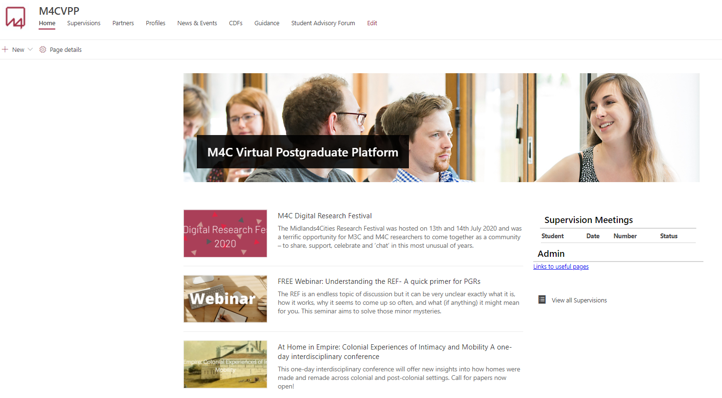
What do I need to know about . . . The Virtual Postgraduate Platform?
The supervision space
How to find key forms
How to access and save (e.g. supervision forms, mid-year report forms)
DEMONSTRATION OF KEY AREAS

Slide 23

What do I need to know about . . . supervision?
For full-time students, a minimum of 10 supervision records (using the M4C supervision form) must be completed and uploaded to the VPP each academic year. For part-time students, a minimum of 6 supervision records must be completed each academic year.
It is expected that students work with their supervision team and not just a single lead supervisor. Supervision meetings should, wherever possible, be made with the team and not individual supervisors.

Slide 24
What do I need to know about . . . supervision?
For CDA students, the supervisory team includes both academic and partner supervisors. Partner supervisors cannot access the VPP, so it is the responsibility of the student and the academic supervisor to ensure that the partner supervisor is kept fully informed.
For students with cross-institutional supervision, supervisions can be held on-line to enable the whole team to attend. It is the lead supervisor’s responsibility to ensure that the student meets the requirements of their home institution, and keeps supervisors from other institutions properly informed. The other supervisors should ensure that their role is registered with their own institution.
Notes:
This is a new slide with reference to CDA and x-institutional supervision. I’m not quite sure what Sian wanted here. We need a different image!

Slide 25
Date | Mid-year Review and End-of-year Report Actions
1 Feb | Student Mid-year review form due (completed online on VPP)
22 Feb | Supervisor Mid-year review form due (completed online on VPP)
22 March | Assessor Mid-year review form due (completed off-line and uploaded by university M4C administrators)
1 – 21 June | If a re-review is required student, supervisor and assessor repeat online review process in this period
1 June | Student End of Year Report due (competed online on the VPP)
8 June | Supervisor section 2 of End of Year Report due (completed online on the VPP)
28 June | Site Directors review and sign of End of Year Report (online on the VPP)
Full-time students in Year 1 and part-time students in Year 2 upload form and a 1500-2000 word research statement and a 5000-word sample of written work or practice-led equivalent piece of work. Part-time students in Year 1 upload a 1500-2000 word research statement
Students in Years 2 and 3 upload an updated 1500-2000 word research statement (they can be asked to provide a further 5000 word sample or practice-led equivalent at the discretion of their supervisors)
Read ‘Description of Mid-Year review process’ on VPP for full details
Notes:
Updated dates here?

Slide 26
What do I need to know about . . . Mid-year review and end of year report?
Possible outcomes of the mid-year review process are:
  that the student's progress is satisfactory, and s/he may proceed to the next year of her/his studies
  or
  2. that the student's progress is not satisfactory and, as a result, supportive or corrective action points will be agreed by the assessors which will result in a further review of the student's progress in June. If, after the second June review, progress is not deemed satisfactory by assessors on the Mid- Year Monitoring Second Report and Recommendations form, a student’s M4C and AHRC funding can be terminated.
As part of the mid-year review in year one only (or PT equivalent), the student and supervisors can make a case for extending the duration of funding if there are specific grounds or specialist needs that have emerged since the point of application.
End of year report: this report is to help M4C capture key information about student progress to inform its mandatory annual reporting to the AHRC. Student and supervisors submit report in June each year.

Slide 27

Questions?
Thanks for your time

Slide 28

Collaborative Doctoral Award workshop for academic and non-university partner supervisors
The Royal Society of Sculptors
Computer Arts Archive
M4C will be holding a dedicated workshop on CDA supervision in November 2021 to share insights, experience and reflections on collaborative supervision
Shakespeare Birthplace Trust
Ex Cathedra
National Portrait Gallery
Paul Mellon Centre for Studies in British Art
Sampad
ReConnect
National Railway Museum
Fircroft College of Adult Education
Phoenix (Leicester Arts Centre)
National Literacy Trust
Together in Action Trust
Nottingham Castle Trust
Stan’s Cafe
People Dancing
Dartmoor National Park Authority
Open Theatre
Herbert Art Gallery & Museum
Nottingham Museums and Galleries
Library of Birmingham
Notes:
Change to this year’s CDA partners? Also new dates?

