Slide 1


Midlands4Cities Supervisor Briefing 2024

Slide 2

Welcome!
What we will cover:
Some background about Midlands4Cities
Your university and M4C
3. Additional resources for your students:
  M4C events and training, the Research Development Fund, Engagement Fund, Cohort Development Fund, and Placements
4. M4C supervisory expectations
5. Other ways to get involved with M4C

Slide 3
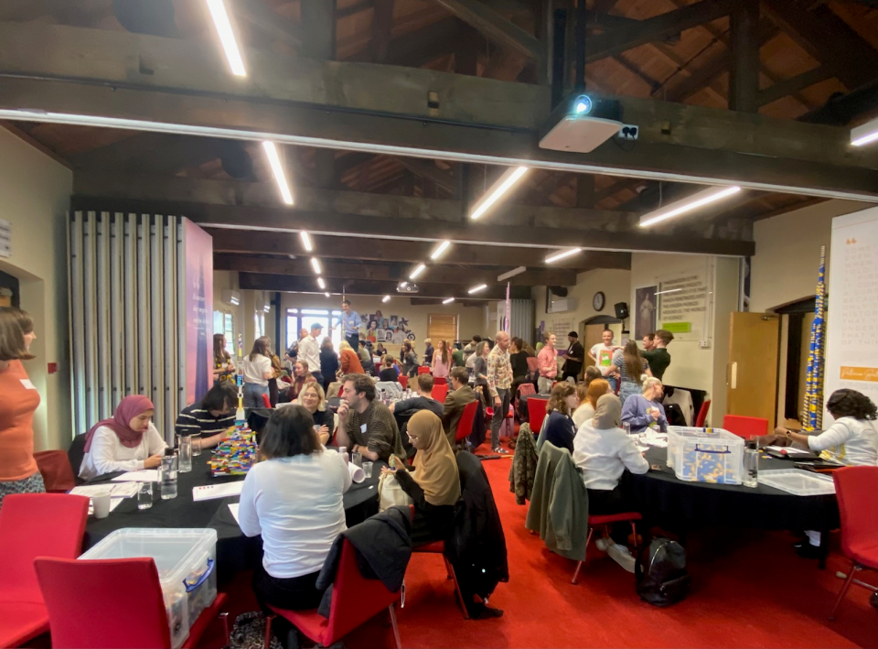
A little bit about Midlands4Cities
In 2024, we will welcome M4C Cohort 7, a total of 79 students over the 8 institutions, including 14 CDAs.
They will join a group of 430 current students, from all disciplines under the AHRC remit, and they will have opportunities to work with each other across cohorts and institutions, to devise and undertake specialist training, to enrich their own and others’ practice and research, and to use their skills and knowledge in placements.

Slide 4
What an M4C student receives:
An M4C award covers home fees and a UKRI-set stipend; it also offers additional funding for student activities and support, including bespoke training; and researcher development opportunities. M4C encourages connections, networks and collaborations, to support students in their future careers and professional development.
Based on 2024/5 UKRI figures, using home fees and the current stipend rate, an Open M4C award is worth around £84,000, and a CDA M4C award £96,000. Depending on the requirements of the project and the student, additional funding may take this closer to £100,000.
Note: like all UKRI-funded students, M4C PGRs are eligible for sick leave, maternity/paternity/adoption leave, etc.

Slide 5
M4C Contacts
The M4C Central Team
Nicola Royan: M4C DTP Director
Susanna Ison: M4C DTP Manager
Claire Thompson: M4C Finance Manager
Jade Jenkinson: M4C Placement Manager
Samantha Offiler: M4C Project Officer
Jessica Metcalfe: M4C Project Officer
enquiries@midlands4cities.ac.uk
Institutional Team
Site Directors
Dr Ross Forman (ECLS)
Professor David Lambert (History; also Director of Centre for Arts Doctoral Excellence)
Administrator
Lisa Millard (also CADRE Doctoral Training Manager): m4c@warwick.ac.uk
Notes:
Do we need a new photograph?

Slide 6
Your Institution and M4C
M4C responsibilities
Institutional responsibilities
Academic progress
Essential skills development
Extenuating circumstances, interruptions, identifying appropriate support
Pastoral support
Careers guidance
Funding fees and stipend dependent on academic progress assessed by the institution
Responding to student need as supported by the institution, including disability support
Complementary, supplementary and specialist skills development and training

Slide 7
M4C supervisory expectations
Full-time M4C students have at least 10 meetings a year, part-time students should have 6. This is a minimum and is subject to institutional regulations (Please insert here the number required by your home university)
  Across each academic year, these meetings should involve the full supervisory team. Travel expenses between institutions are available to support cross-institution in-person supervisions. We would recommend that at least some supervisions take place in person.
A mid-year review, completed in spring semester.
  The first MYR is the point at which extended funding can be discussed and confirmed (where a student has essential lengthy training or fieldwork needs). The application form for post MYR extended funding is available on the VPP After the completion of the first year MYR , students can access placement opportunites and other funding.
An end of year report, completed in June.
  This report records a student’s additional activities (publishing, placements, conferences, exhibitions and performances), for reporting to the AHRC.

Slide 8

All for supervisions and reporting are held on the VPP. Students and academic supervisors are provided with VPP access at the start of the academic year which enables students and supervisors to record supervision meetings. VPP access must be used within 30 days, or it will be cancelled.
How to use the supervision space in the VPP
How to access and save documents (e.g. supervision forms, mid-year report forms)
Where to locate key forms and guidance

Slide 9
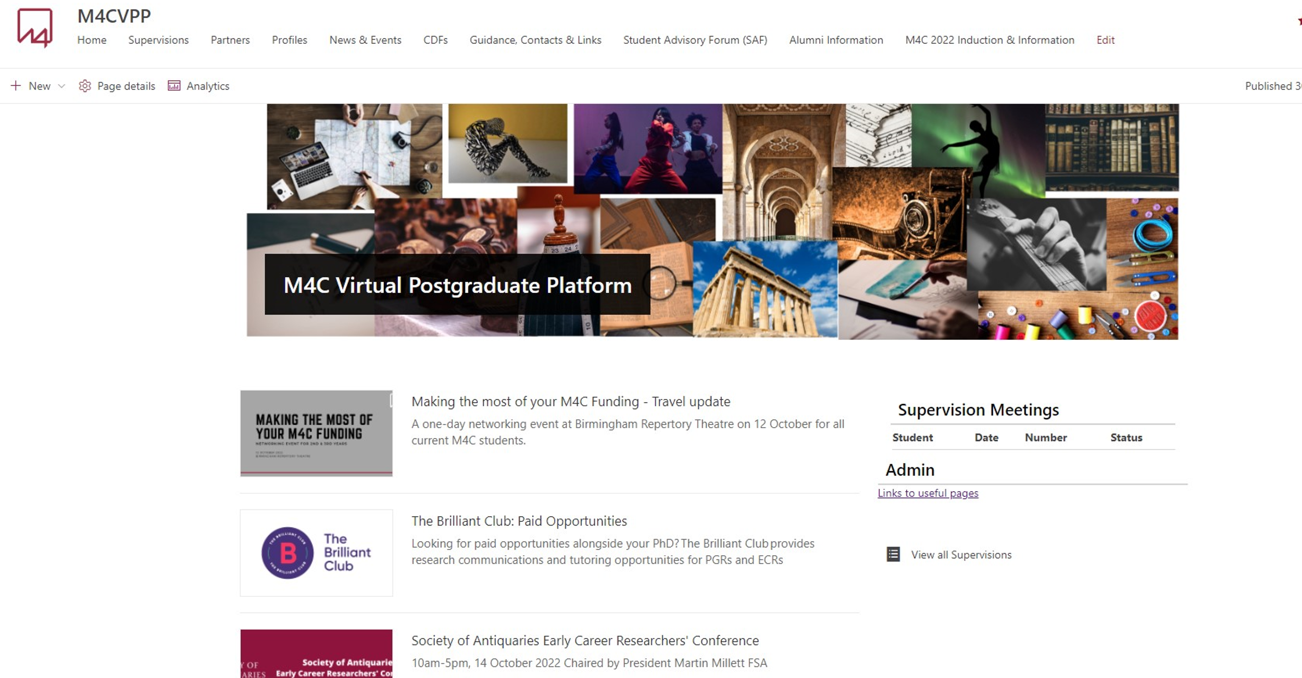
The VPP front page looks like this:

Slide 10
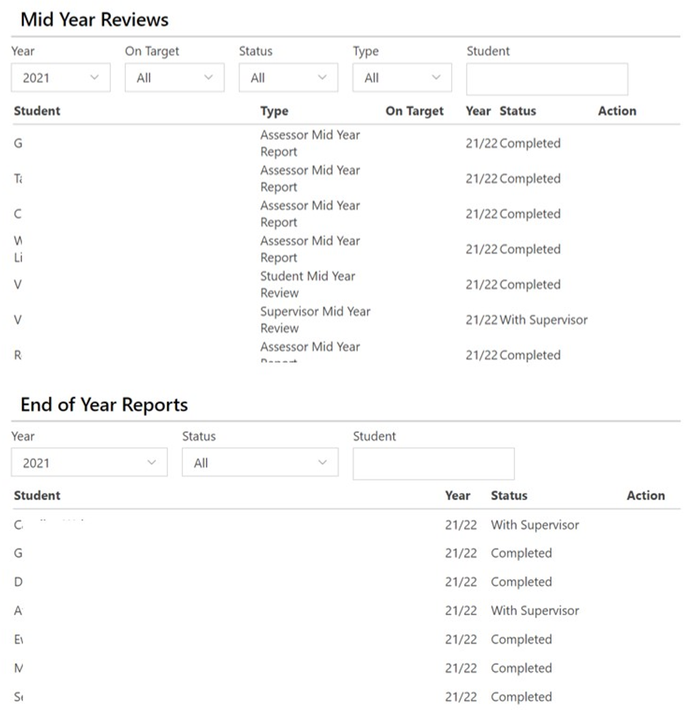
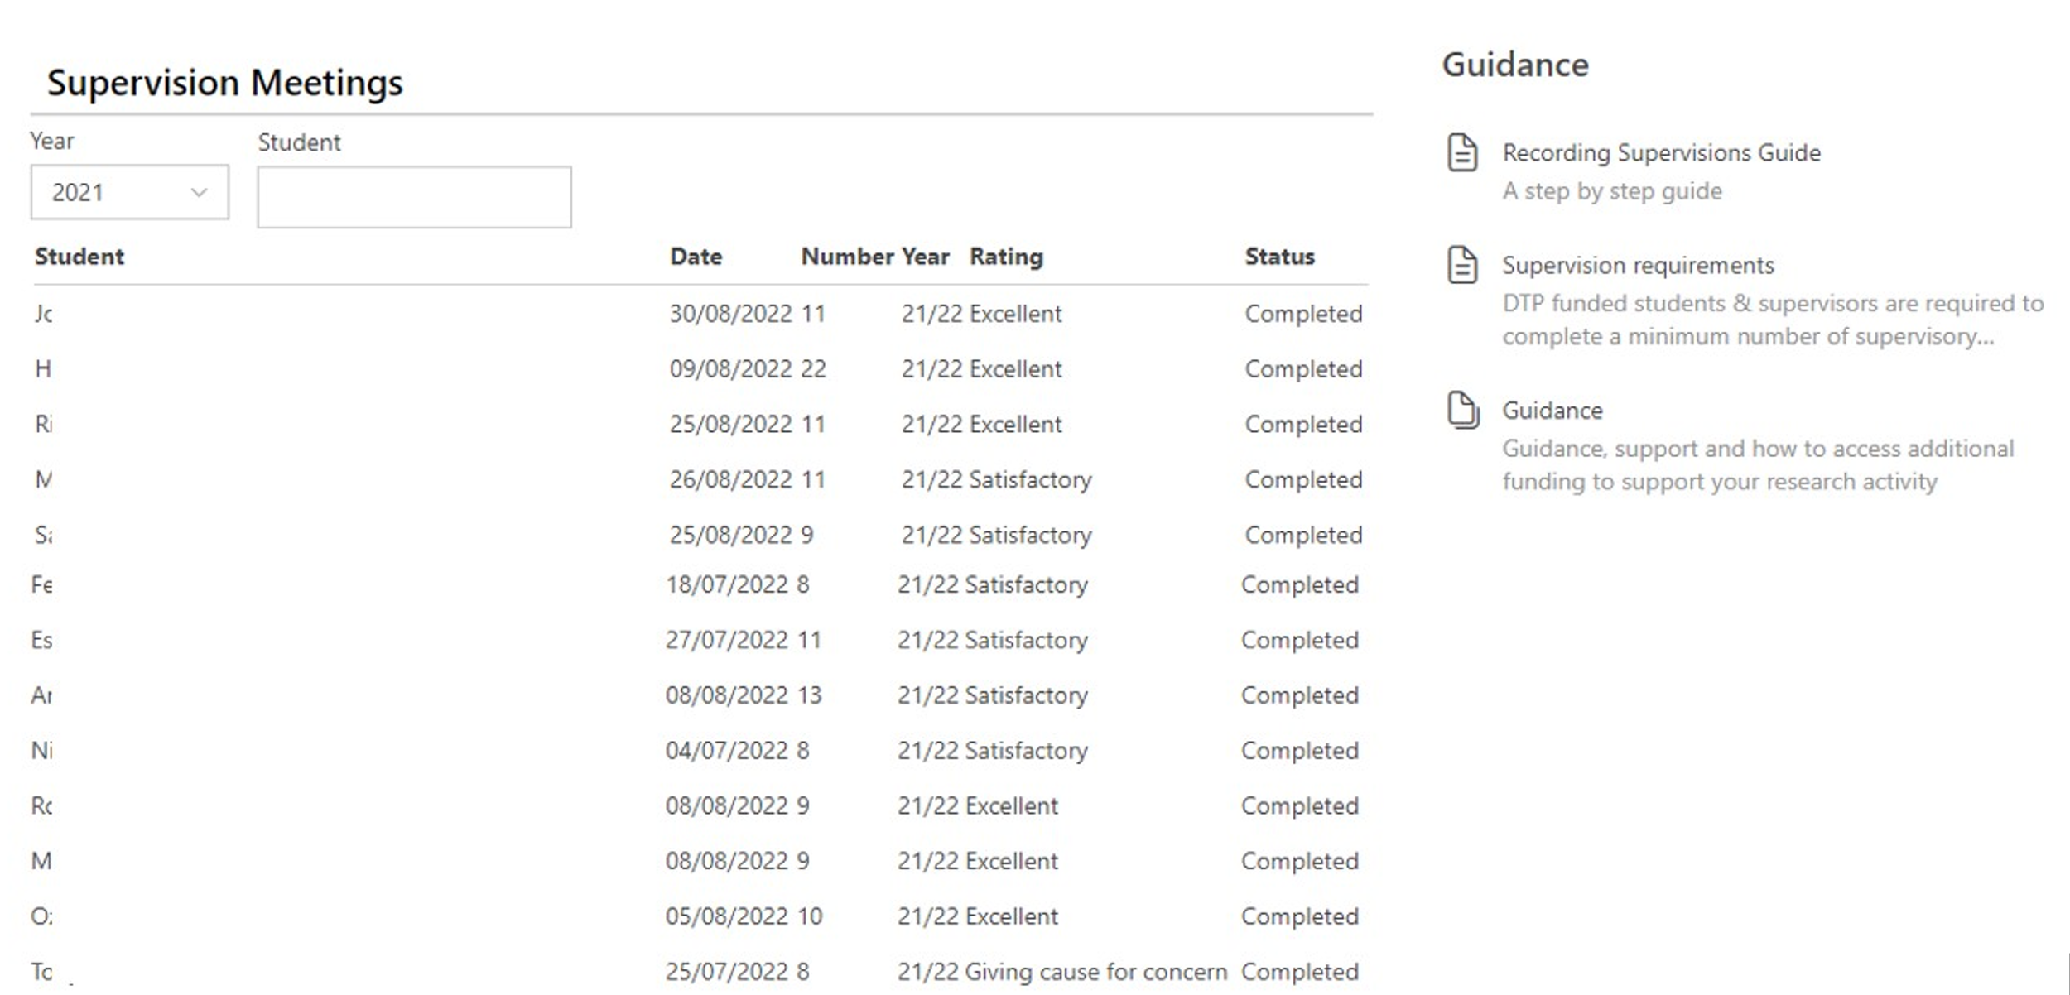
The supervision space on the VPP provides access to these documents:
  Recent supervision records
  Mid-year review documents
  End-of-year report
  Quick access to news and events, CDF listing and partner pages
  Guidance tab to take you to information and forms on additional funding, placements, student welfare and M4C, AHRC and UKRI regulations

Slide 11

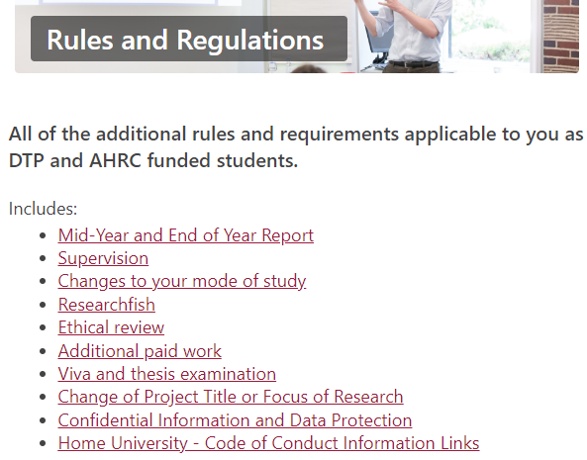
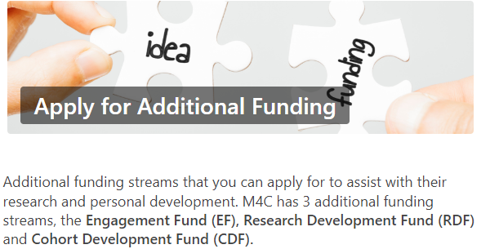

The VPP guidance page provides essential guidance https://uniofnottm.sharepoint.com/sites/M4CVPP/SitePages/Guidance%20&%20Links.aspx?csf=1&web=1&e=6fWgYI
The Virtual Postgraduate Patform?

Slide 12

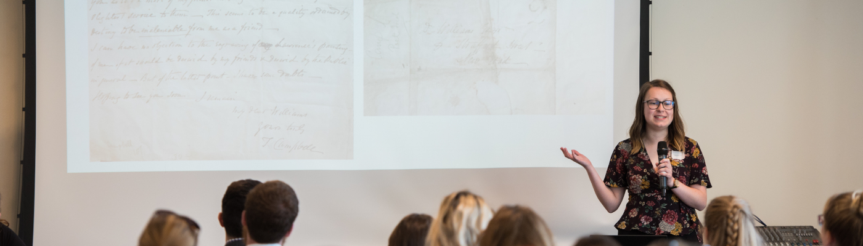
Additional funding to support research and student development
1. Extended funding
  Open Competition awards are for 3.5 years, but where a student has clear extended training needs, an extension may be requested during the first-year review period (or part-time equivalent). students may apply for up to a maximum of six months additional funding.
2. Engagement Fund​
The Engagement Fund (EF) is available to support costs relating to engagement and professional development activities and to deliver papers at conferences
3. Research Development Fund​
Research Development Fund (RDF) can be used by students to undertake overseas and UK study visits, fieldwork, and to cover some primary research costs. RDF will only be allocated to activities which are essential to the completion of the student’s thesis. ​
Further information on these opportunities is available on the VPP. All have an application process with deadlines and require supervisory supporting statement:
https://uniofnottm.sharepoint.com/sites/M4CVPP/SitePages/Additional-Funding.aspx

Slide 13
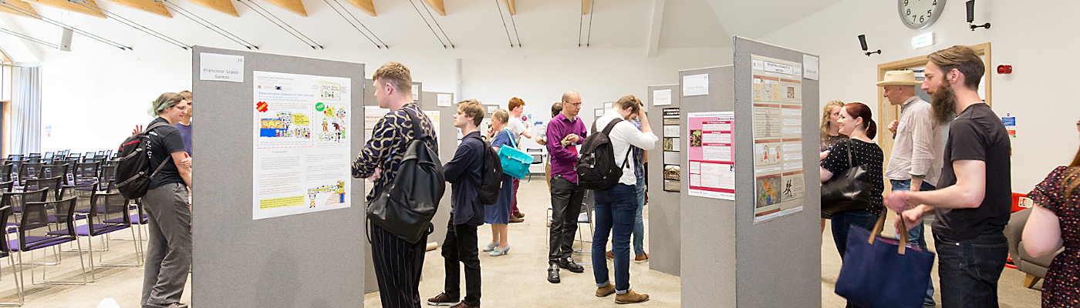
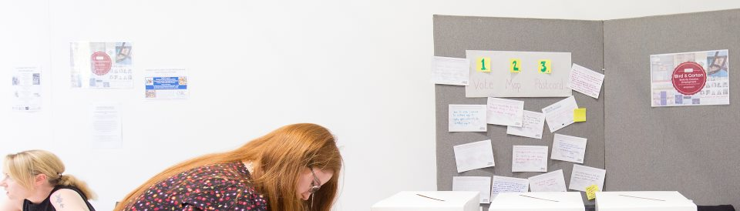
Additional Resources to Develop the Student
Training
The M4C training programme is designed to complement the student's institutional training. Regular offers by M4C include stage-appropriate writing workshoprs with the Royal Literary Fund, policy training, project management training and MHFA workshops. https://uniofnottm.sharepoint.com/sites/M4CVPP/SitePages/Training.aspx
Placements
Midlands4Cities works closely with partners in the cultural, creative and heritage sectors to develop placement activities which enhance student research.
Placements can be developed by a student with a partner organisation, in consultation with the M4C Placements Manager
placements@midlands4cities.ac.uk
Placement opportunities are also advertised on the VPP, all students are able respond to these opportunites.

Slide 14

Current M4C partners also have their space on the VPP:

Slide 15

Additional Resources to Support the M4C Cohort
Cohort Development Fund
The Cohort Development Fund (CDF) is designed to fund groups of students to design and deliver development and research activities for the M4C cohort and wherever possible to include Arts and Humanities students from outside the DTP.
The CDF fund supports activity that enriches the Midlands4Cities research community as a whole, and where the activity and the uptake allows, these projects can be opened to self-funded/alternatively-funded students.
All activities designed and delivered by M4C students must comply with Health and Safety regulations, Accessibility, Ethical issues, Equality, Diversity and Inclusion, Safeguarding and Data Protection.
These activities are some of the most innovative and exciting associated with the DTP, and students who organise and participate in them often make dynamic connections. Please encourage your students to consider working with others from across the consortium to apply for this funding.
https://uniofnottm.sharepoint.com/sites/M4CVPP/SitePages/Additional-Funding.aspx

Slide 16
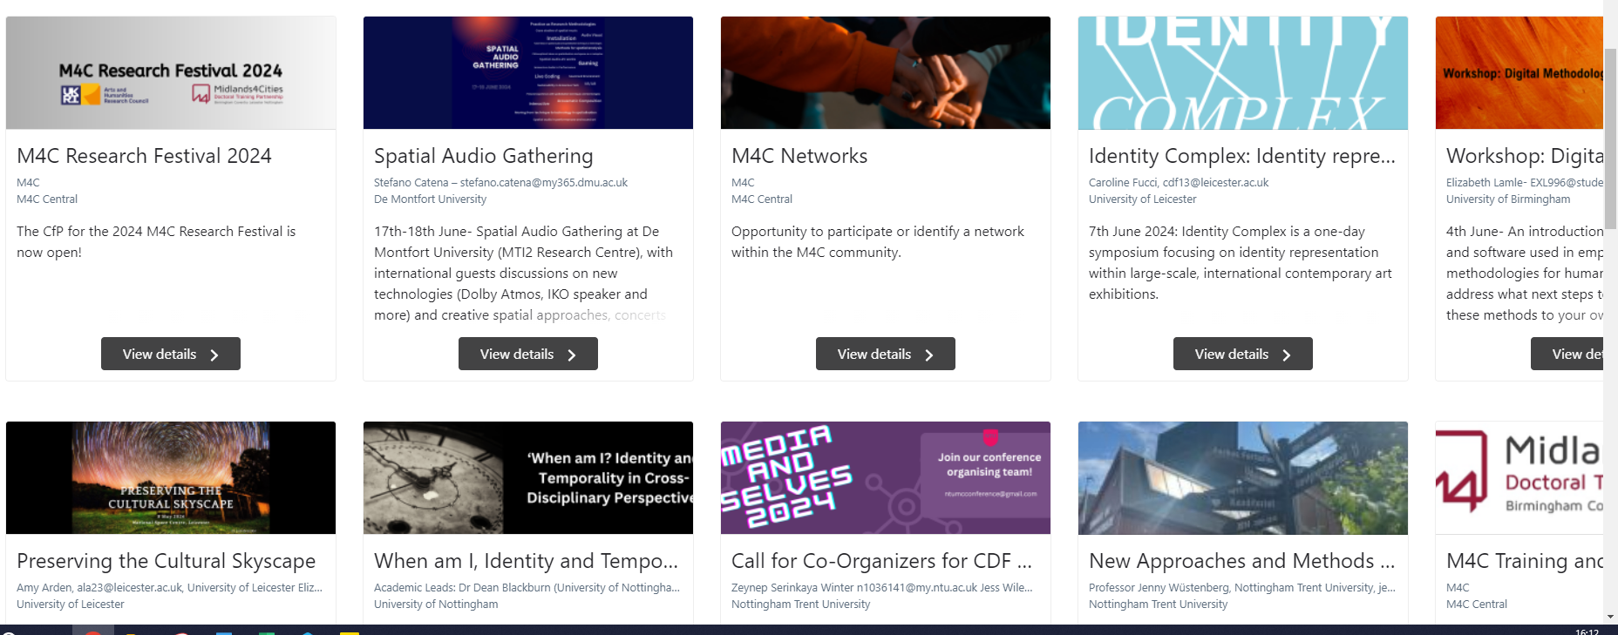
Some Current Cohort Development Fund activities?
https://uniofnottm.sharepoint.com/sites/M4CVPP/SitePages/CDFExplorer.aspx
Notes:
New examples

Slide 17
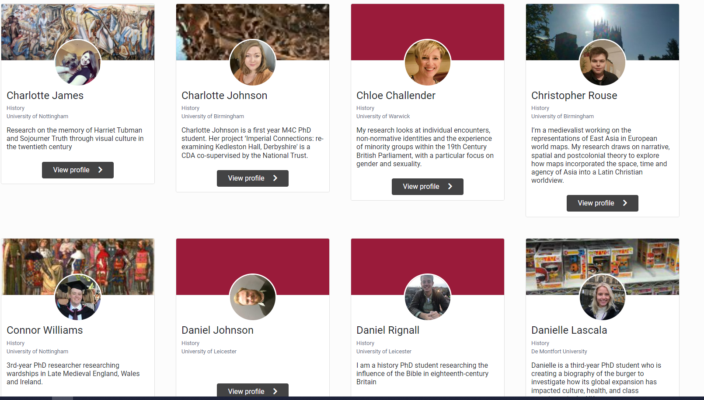
Student profiles sit on both the VPP and the M4C webpages
Notes:
New examples

Slide 18
Access to student profiles
While M4C likes to have up-to-date student profiles on the website and encourage students to create and update their profile, we acknowledge that there may be good reason why a student may not wish to be discoverable. These include politically sensitive or otherwise controversial projects, or issues of safeguarding.​
Students can choose not to have their VPP profile drawn through to the website. A VPP profile is only accessible to current students and supervisors.​
Students may also request through M4C that their project titles not be publicly available through Je-S and its replacement system.​
We advise all students that if they are contacted by a journalist or by a member of the public, they should discuss their response with their supervisory team and if necessary, with their institutional external relations team.​
Notes:
New examples

Slide 19
M4C supervisor expectations
1. We expect all supervisors to engage with the VPP, and to do so promptly after the student starts. If first registration does not occur within 30 days, the supervisor will be deregistered and unable to use the VPP. This is an IT protocol.
2. We expect all forms to be completed online as far as possible on the VPP. Please don’t use previously downloaded forms, as they are regularly updated on the VPP.
3. Please engage with the supervisor CPD that your institution offers, particularly around EDI support, student welfare and best practice. M4C offers some additional briefings for CDA supervisors.
4. Please encourage your students to participate in M4C activities and help us build our cohorts and research community. All opportunities are advertised on the VPP.

Slide 20
Trouble-shooting
M4C is bound by UKRI and AHRC regulation as well as by institutional regulation.
Students who need additional support, whether that be sick leave, Disabled Students' Allowance, maternity and other parental leave, need to apply through university processes, to enable us to confirm support.
Changes to modes of study, supervisory teams, project outline, should be discussed with Site Directors or with M4C Central before any commitments are made to students.
This is particularly important for international students, to ensure that recommendations do not contravene their visas.
If anything occurs not covered by university regulation, please discuss the matter with Site Directors.

Slide 21

Supervisor support and development
Midlands4Cities is participating where it can in the RSVP project around supervision(https://www.rsvp.ac.uk/) as are several M4C institutions.
  We will share outcomes, including supervisory tools, from this project through Site Directors.
Please let your SDs know if you think there is focused support or even training that M4C might scope out for supervisors.

Slide 22
Other Ways to Get Involved
1. Dialogue Days
  Events proposed and organised by academic staff to address particular methodologies or research questions. The 2025 call will be circulated in November 2024.
2. Recruitment panels
  Panellists score shortlisted applications for the annual recruitment round. 2025 will be final application round for M4C.
3. EDI Advisory Group
  Now in its third year, this group has been set up to challenge M4C to embed EDI best practice in all activities and support innovative developments.
4. Research Festival
  All M4C students are expected to attend the Research Festival and present at least once. Supervisors are welcome to attend, particularly online presentations.

Slide 23
The future of M4C
The 2025 cohort will be the last recruited to M4C.
However, M4C will continue to exist until at least 2029, and in some form until 2033.
The central team will remain in place, with an increased focus on student support, development and training.
The additional research funding will remain in place for the duration of the DTP.
The relationship between the current DTPs, and the Focal Awards and the Landscape Awards has not yet been fixed, but in any discussions, M4C’s priority is student support and opportunity.

Slide 24
Thank you for attending!
There will be further, online refresher, briefings on CDA supervision, Mid-Year Review, and Placements during the year. You will receive calendar invitations for these.
All supervisors should receive the monthly newsletter with details of upcoming training and research events.
Any questions, please contact Lisa Millard or the M4C Central team:
  m4c@warwick.ac.uk
  enquiries@midlands4cities.ac.uk

