Slide 1

Placement Information Session – M4C
Thursday 8th May 2025

Slide 2
Key Placement Contacts
m4c@warwick.ac.uk
Lisa Millard – Doctoral Training Manager
Emily Hardy – Doctoral Training Programmes Co-ordinator
Prof David Lambert – M4C Site Director
Dr Ross Forman – M4C Site Director
placements@midlands4cities.ac.uk
Dr Jade Jenkinson – Placements Manager at M4C Nottingham
M4C Site placements - Placement
VPP - M4C Placement Guidance

Slide 3
Schedule
11.00 – 11.45 | Why opt for a Placement? Finding a Placement How to fit this in with your project Administrative process Funding Extensions
11.45 – 12.00 | PGR Reflections on experience of being on placement (Laura Staccoli)
12.00 – 12.10 | General Q&A
12.10 – 1.30 | Lunch/Sign Up Slots/General Questions

Slide 4
Why to choose to do a Placement?
Create connections
Learn new skills
Experience of non-academic working environment
Real world understanding and impact of research
Variety to the PhD Journey

Slide 5
Examples of Warwick M4C PGR Placements
Newgen Publishing UK
Nottingham Playhouse
Twentieth Century Society
Oxford University Museum of Natural History
School of Sexuality Education
Magyarorszagi Terre des Hommes (Hungary)
Zoo Digital Group - remotely
District Six Museum (Cape Town)
City University of New York, US
V&A
Instituto de Estudios Canarios (IECan) [Institute for Canarian Studies]
Herefordshire Records and Archives
British Museum

Slide 6
Finding your Placement

Slide 7
What kind of placement can I do?
As part of your studentship, you can apply to undertake an employability skills focused placement.
These placements allow you to spend up to 3 months with a host organisation.
You can also undertake a research placement of up to 6 months if the placement will have a direct impact on your PhD thesis.
The organisation is of your choice providing the opportunity to try out a potential future career, expanding your network of contacts and developing new skills.
This can be with one of our partners, an opportunity advertised on the VPP, or you can create your own placement in collaboration with any organisation where you will help them respond to a genuine business or research need.

Slide 8
What kind of placement can I do?
Placements can be done in a single block of time (full-time) or spread over a longer period for a few days a week (part-time) or flexibly - whatever works best for you and your host
You cannot undertake a placement until you have passed your first mid-year review (beginning of April). You cannot start a placement in the final six-months of your funded period (you may include the additional time extension provided by the placement funding extension if you are so entitled).

Slide 9
International Students Consideration
International students, studying on a visa, are subject to visa rules which impact on placements.
From an immigration perspective, all students who require immigration sponsorship from their university [a visa] to study in the UK are limited to only undertake placements which are assessed and integral to the course/research. Placements which do not contribute directly to the PhD research as an integral part of the PhD study (i.e. those that are supplementary) cannot be supported under the UK immigration rules.
From a Warwick perspective, if your placement is integral to the PhD (which most are) then you will not need to submit a TWD, but you will need to ensure you have completed the Change of Study Location Process (COSL) if your placement is overseas. This is on the understanding that attendance monitoring (as normal) continues.

Slide 10
How to find your placement
Apply via the M4C advertised placements
Find your own!

Slide 11
How to find your placement
Advertised Placements
Live on the VPP
Finding your own placement
Bespoke to the needs of the student and the project
Communicated in the M4C Newsletter
Agreed placement opportunities with M4C approved providers therefore slightly less additional paperwork
Provider will be expecting students to want to apply
create your own placement in collaboration with any organisation where you will help them respond to a genuine business need.

Slide 12
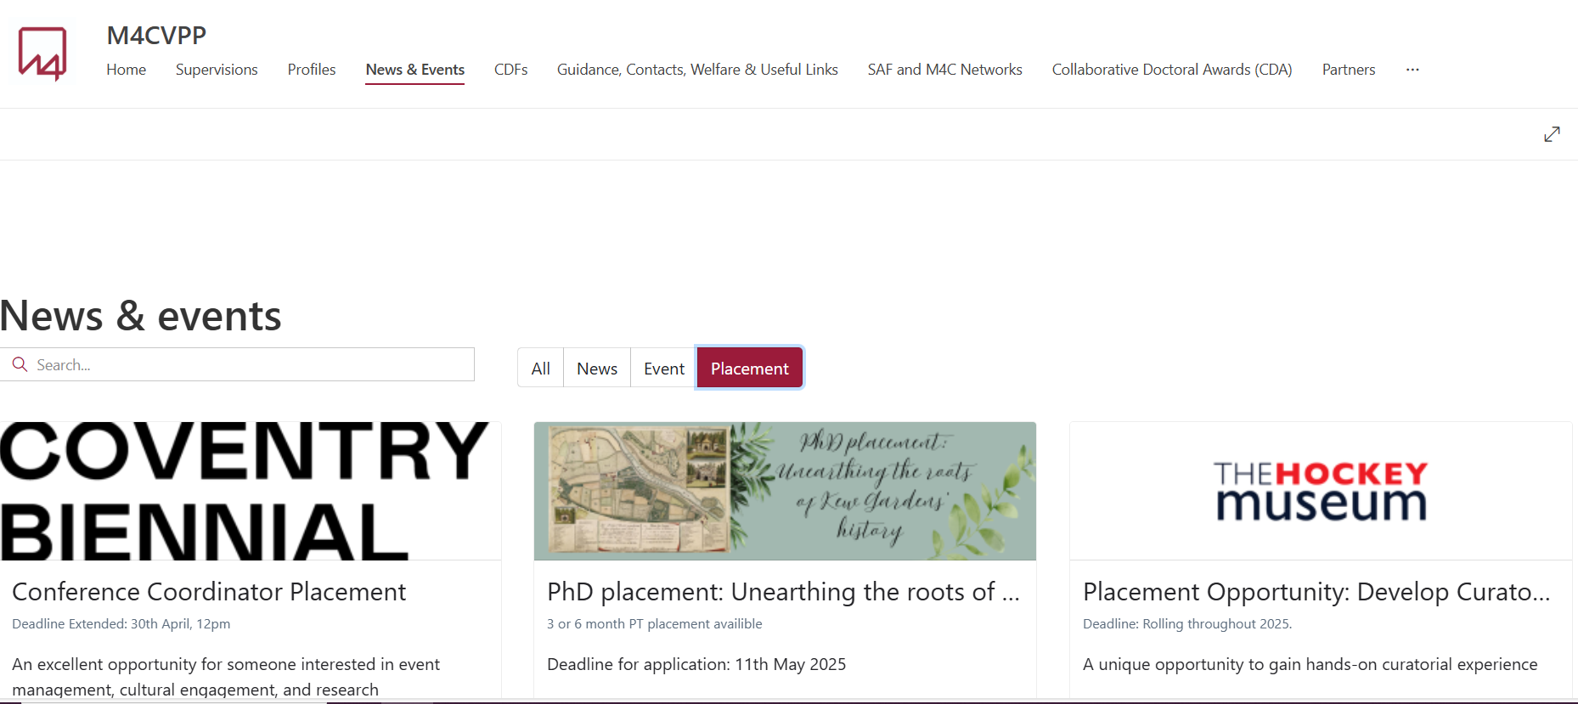
How to find your placement – advertised placement

Slide 13
M4C Advertised Placement
Find an advertised placement you are interested in
Follow the application details on the advert
Contact placements manager at M4C and m4c@warwick.ac.uk to let us know you are applying.
If the provider would like to move forward with the placement, Jade and M4C Warwick team will advise on the paperwork to be completed and next steps.

Slide 14
Finding your Own Placement
You could approach an M4C partner and contact them directly to understand where there may be need for placement or pre-existing partnerships, or you can approach another external organisation.
Talk to your department, talk to supervisors, talk to other PGRs – seek advise on potential providers.
It is advisable to send a scoping email to partners you might be interested in working with to discern need and interest (see next slide)
You need to have a clear rationale of what the organisation can do for you, what you can do for the organisation and talk with them to determine whether the placement could work.
If conducting a research placement, you also need to be clear on how this works with your PhD and will enhance the PhD.
Once you have established an interest you will need to develop a project and fill in the M4C Part 1 Project Brief, which will then need to be approved.
Put the organisation and yourself in contact with Jade and Lisa.
Jade will then advise on further paperwork to be put in place.

Slide 15
The Scoping Email
Briefly introduce yourself and your area of expertise.
Could highlight that you are an (AHRC) M4C funded student and therefore don't require payment as you will continue to be paid your stipend.
For our partner organisations I would also note that they have hosted M4C students in the past and it would be great to continue collaborating.
Give a brief outline of what you are interested in researching/any project ideas and enquire whether they have the required works/expertise to host you.
Arrange a call so you can scope their engagement and talk through project ideas with the end goal of collaboratively filling in the Part 1 placement brief form.

Slide 16

Funding your Placement
You are able to apply to extend your funded period for the duration of the placement (Funding Extension).
If you are already hold a 48-month award (e.g. CDAS, extensions) then you cannot request a funding extension due to placement.
You can also apply for up to £1680 to support travel and/or accommodation expenses.
You will continue to receive your stipend as normal during the period of a placement and, for eligible students, a successful application will result in the length of your funding being extended by the length of time spent on placement. Please note that this does not extend your submission date.
Should you submit your thesis within your funded period, including the extension to funding awarded as a result of a placement, you will receive no further stipend payments. Do not submit your thesis while on placement.
All funding extensions need to be applied for via the Part 2 Placement Funding Application form and full budgeting and evidence must be provided.

Slide 17
Placement and the PhD

Slide 18
Top Tips
Adding a placement to your PhD journey requires excellent organisation and planning skills to ensure your project progresses whilst you are on placement.
Be prepared for timings to be affected and plan accordingly.
Ensure your supervisor is aware of what you are doing, how your research is going – be honest.
Flexibility on how you work so you can accommodate the needs of your placement and the needs of your project.
Don't forgot to keep your downtime, don't overwork, and if it's becoming difficult to handle, seek advise – a placement should be a positive addition to the PhD and not an additional cause for stress.

Slide 19
Administrative Process

Slide 20
Placements – Step 1
Step 1 - Contacting a potential host
Student makes contact with host, explaining who you are, what you’re interested in doing and clarify you’re a funded M4C student to see if they are interested in hosting you. If this a partner M4C organisation, then the placement team at Nottingham will direct correct contacts on to you.
Meet the contact at the organisation, talk about dates, scope for the placement and start to complete the Part 1 - Placement Application and Project Brief Form (M4C).

Slide 21
Placements – Step 2
Step 2 - Completing Part 1 Placement Application and Project Brief form
Detail what you will be doing, when you will be doing it and where you will doing the placement. The Form acts as a proposal that you then submit to the M4C DTP Placements Manager (at M4C). The placement manager has to approve before any further paperwork sent.
M4C DTP Placements Manager (at M4C) will be in touch and they will direct you to the M4C Site Placement page, providing you with the appropriate paperwork by following the ‘UoW Student Placement Process Checklist’.
After Part 1 is approved you will be sent UoW documents (see next slide). You need to work with your placement provider to get the forms completed.
In the meantime, M4C Warwick will draft the Placement Agreement to be signed between the provider, UoW and the student.
Once submitted to M4C Placements Manager, we will work to review the documentation.
Move onto Step 3.

Slide 22
UoW Placements Paperwork
Document | Who completes it?
Student Placement Health and Safety Agreement | Placement Provider
Working in an Office Risk Assessment | Placement Provider
Working from Home Risk Assessment (if applicable) | You
Student Placement Process Checklist | You
Placement Roles and Responsibilities Guide | For all to read
HEI Approval Checklist | Lisa Millard
Placement Agreement | Lisa Millard (signatures required by student, placement provider, UoW department)

Slide 23
Placements – Step 3
Step 3 - Completing Part 2 Placement Funding Application form to extend your funded period for the duration of the placement
Complete this form ensuring you have appropriate budgeting information (in line with UoW financial rules and regs) to enable Site Directors to review the extension.
Submit to Site Directors for their approval.
Once approved, we will send this onto the finance manager at M4C.
M4C Warwick and M4C Nottingham will work together to bring all the pieces of the puzzle together and confirm approval of your placement.
Enjoy!
Ensure you keep tabs on any comms coming from M4C Nottingham of what you need to evidence whilst on placement (activity tracker, H&S etc).

Slide 24
Placements – Step 4
Step 4 - After your placement: Completing placement feedback forms
Complete the feedback forms (one for you, one for your host) along with your activity tracker.
Spread the word and reflect!
For more information, visit the CADRE M4C Placements page: https://warwick.ac.uk/fac/arts/cadre/m4c/placement/
VPP for latest guidance and M4C processes.

Slide 25
PGR Reflection of a Placement – Laura Staccoli

Slide 26
Q&A

