Slide 1
Dead men tell no tales?
Tim Lockley
University of Warwick

Slide 2
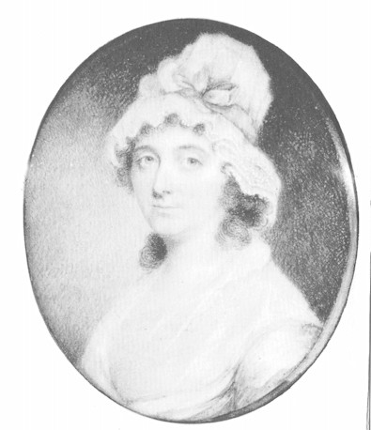
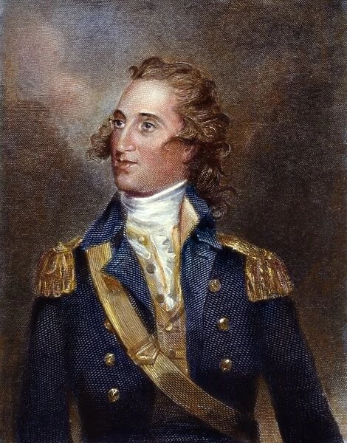
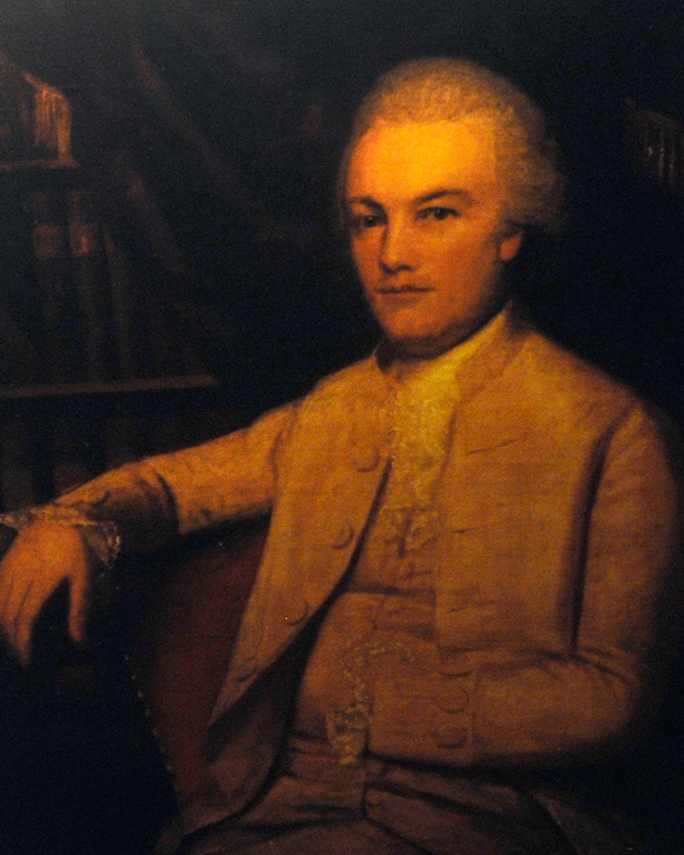
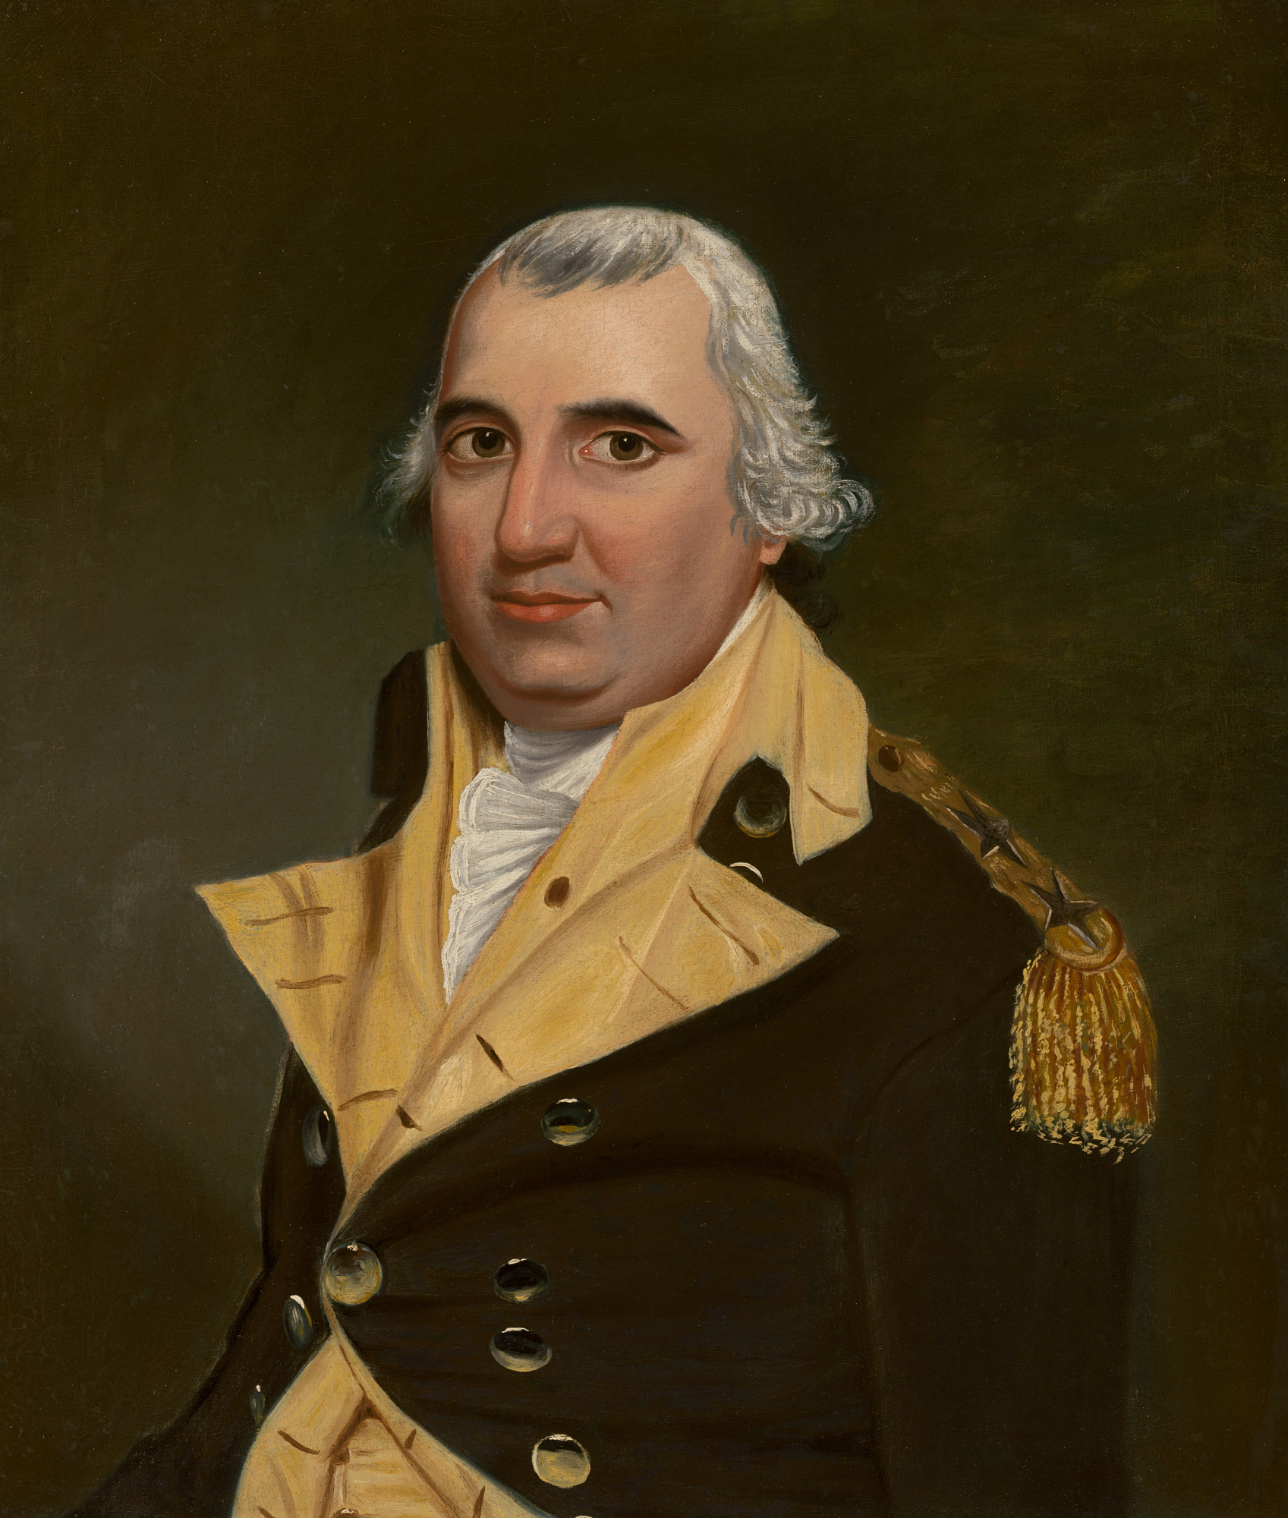

Slide 3
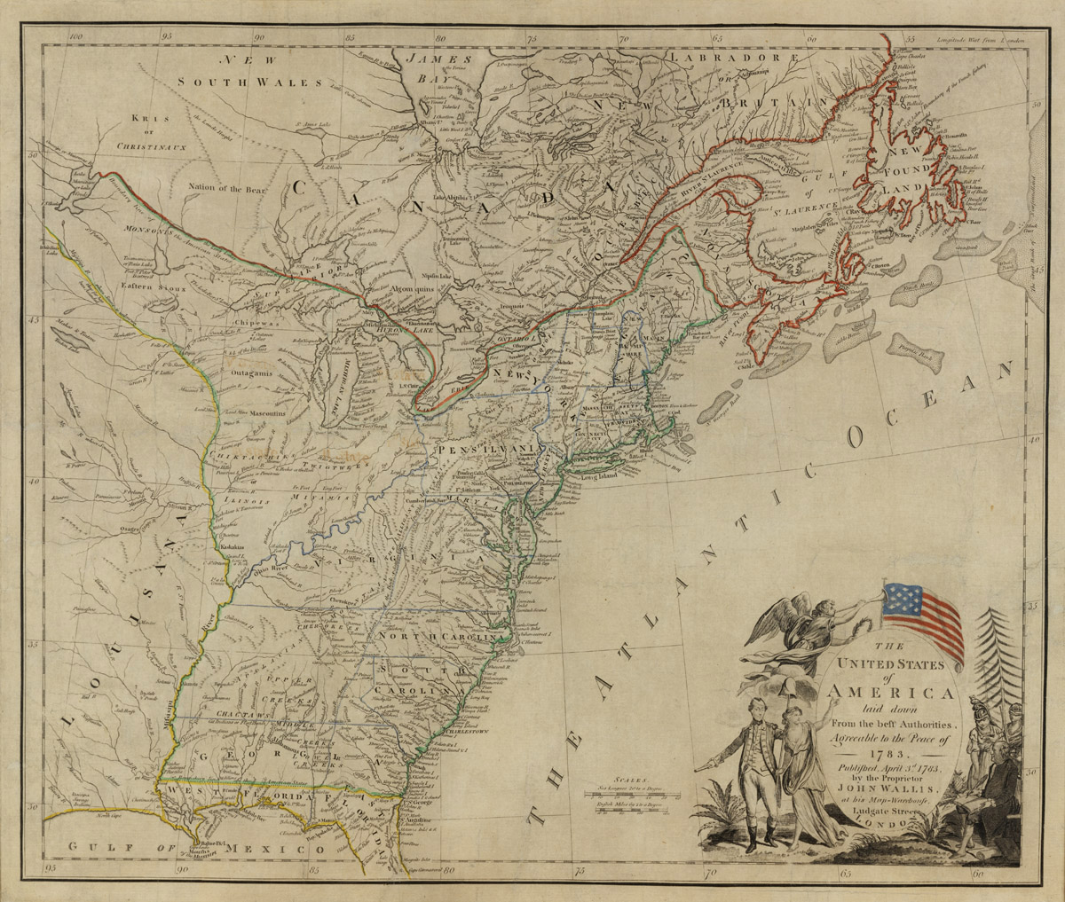

Slide 4
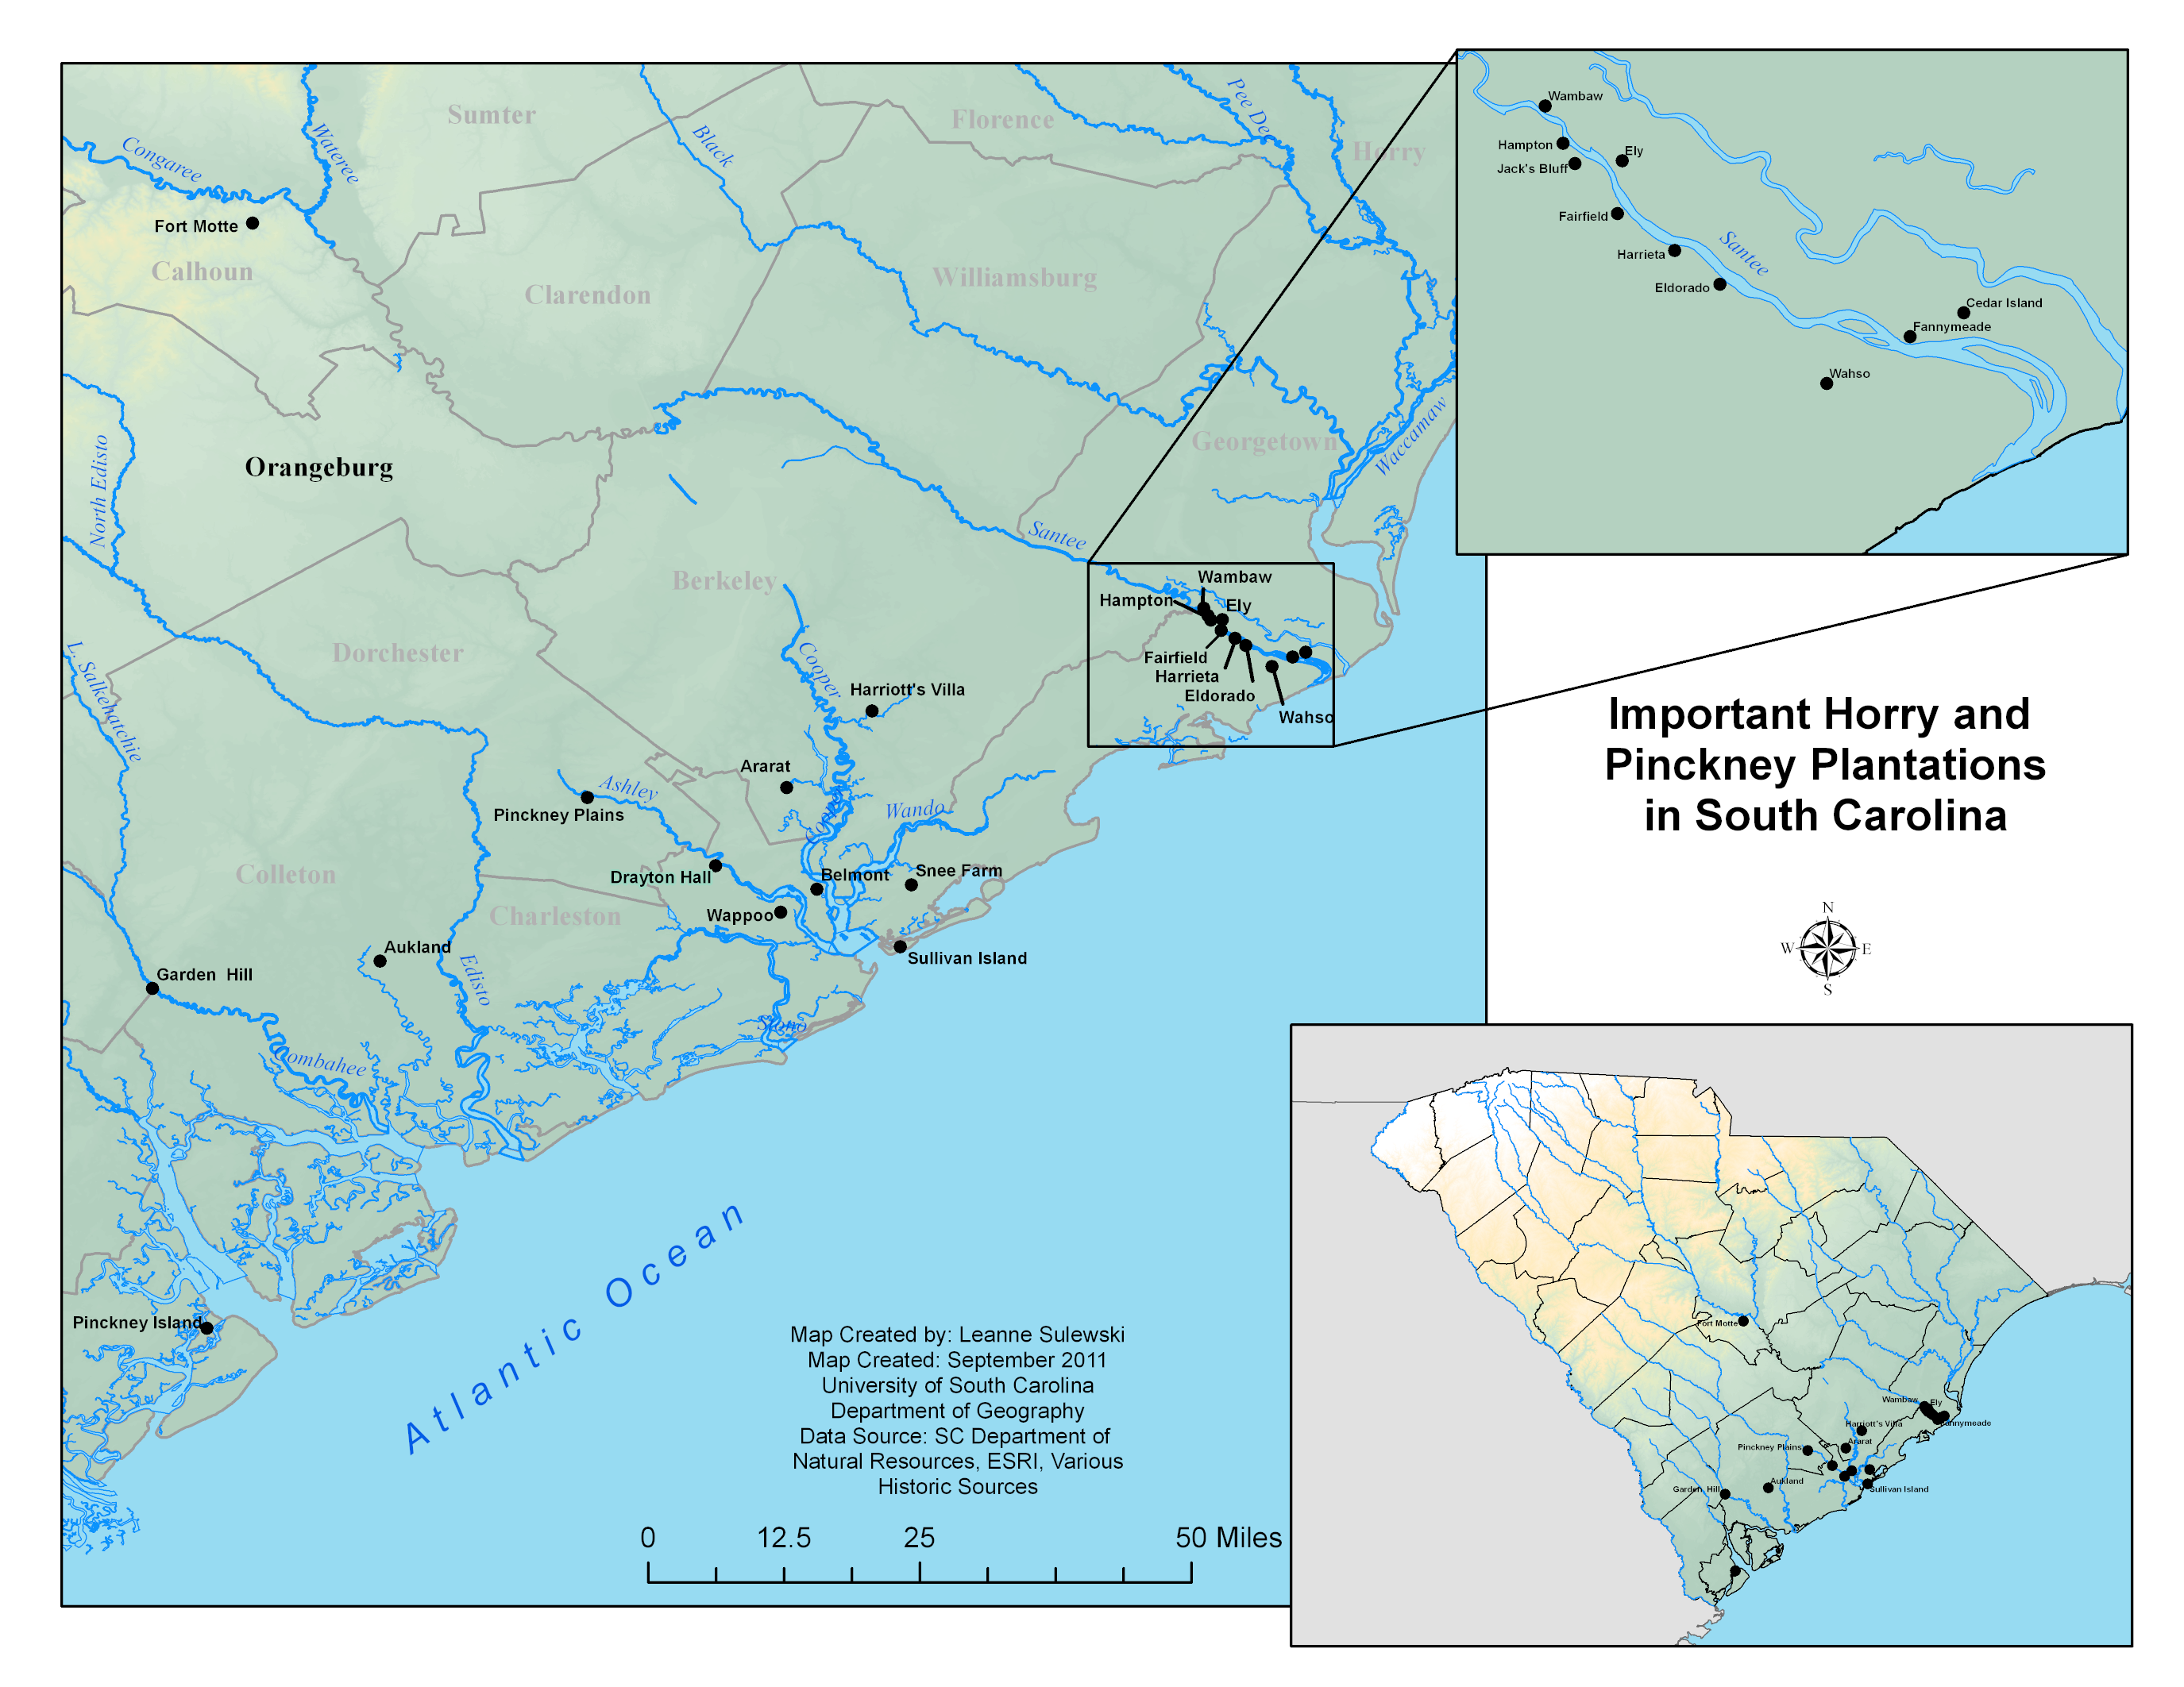

Slide 5
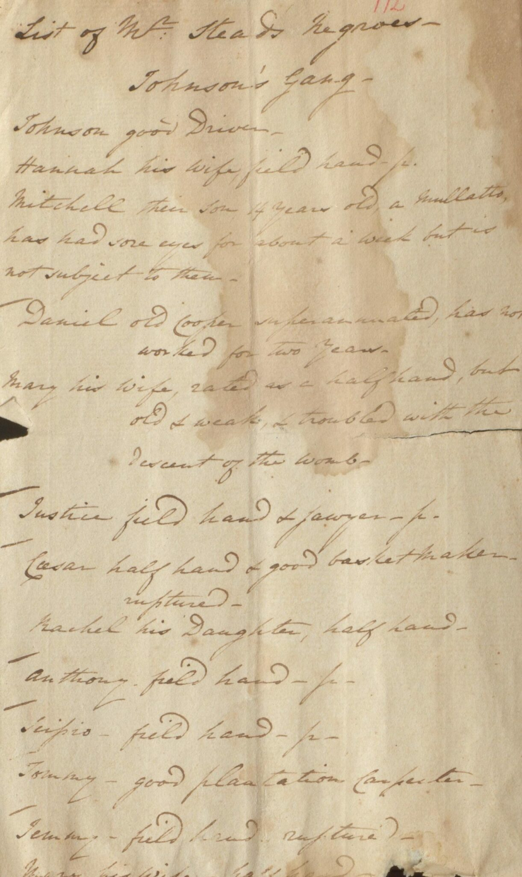
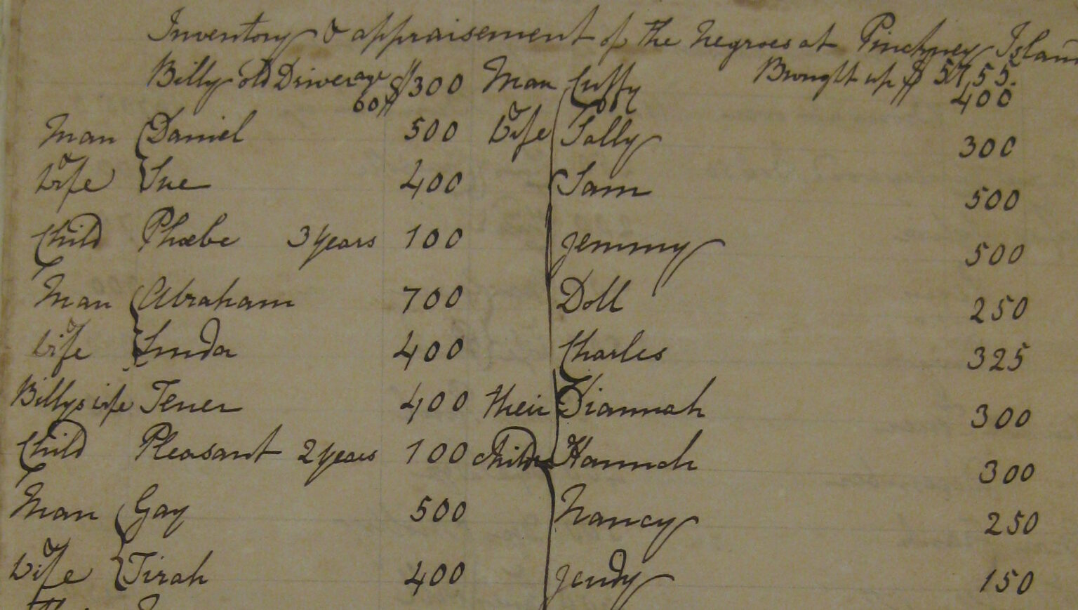

Slide 6
Remedies
For the tooth achs
Take a jugg of water, and put a few red hott coals into it and wash the mouth often with it.
For an Intermiting Fever
Infuse two Ounces of Sampson Snake root in a quart of Madeira Wine, in the sun or by the fire twenty four Hours. Take a glass three times a day in the intermission.
For a guinea Worm
Put a Oz^{e}. of Garlick, 2 Oz^{e}. Brimstone and 2 Oz^{e}. Black Pepper into a quart of Rum and drink a Glass every morning
For, even, afar-gone Consumption
Take a pint, or a quart a day of Coffee, made with milk instead of water, and take it at pleasure like other Coffee; Suprising changes have been wrought in a fortnight, says M^{r}. Hill, by this humble recipe.

Slide 7
Recipies
Yam Puding
Take a pound of Yams boil’d dry, beat it fine in a Mortar with a pound Butter till it Puffs, take ten Eggs half the white, beat them with a pound of Sugar, add half a pint of wine with Spice, the Juice of a Lemon with a little of the rine, and some slices of Citron laid on the Top.
CocoaNut Torts
Take a Coco Nutt and dry it well before the fire, then grate it and add to it four spoonfuls of sugar powder’d, and 2 of rose Water. divide this equally and to one half put the Yolks of three Eggs well Beat and to the other half three whites.

Slide 8
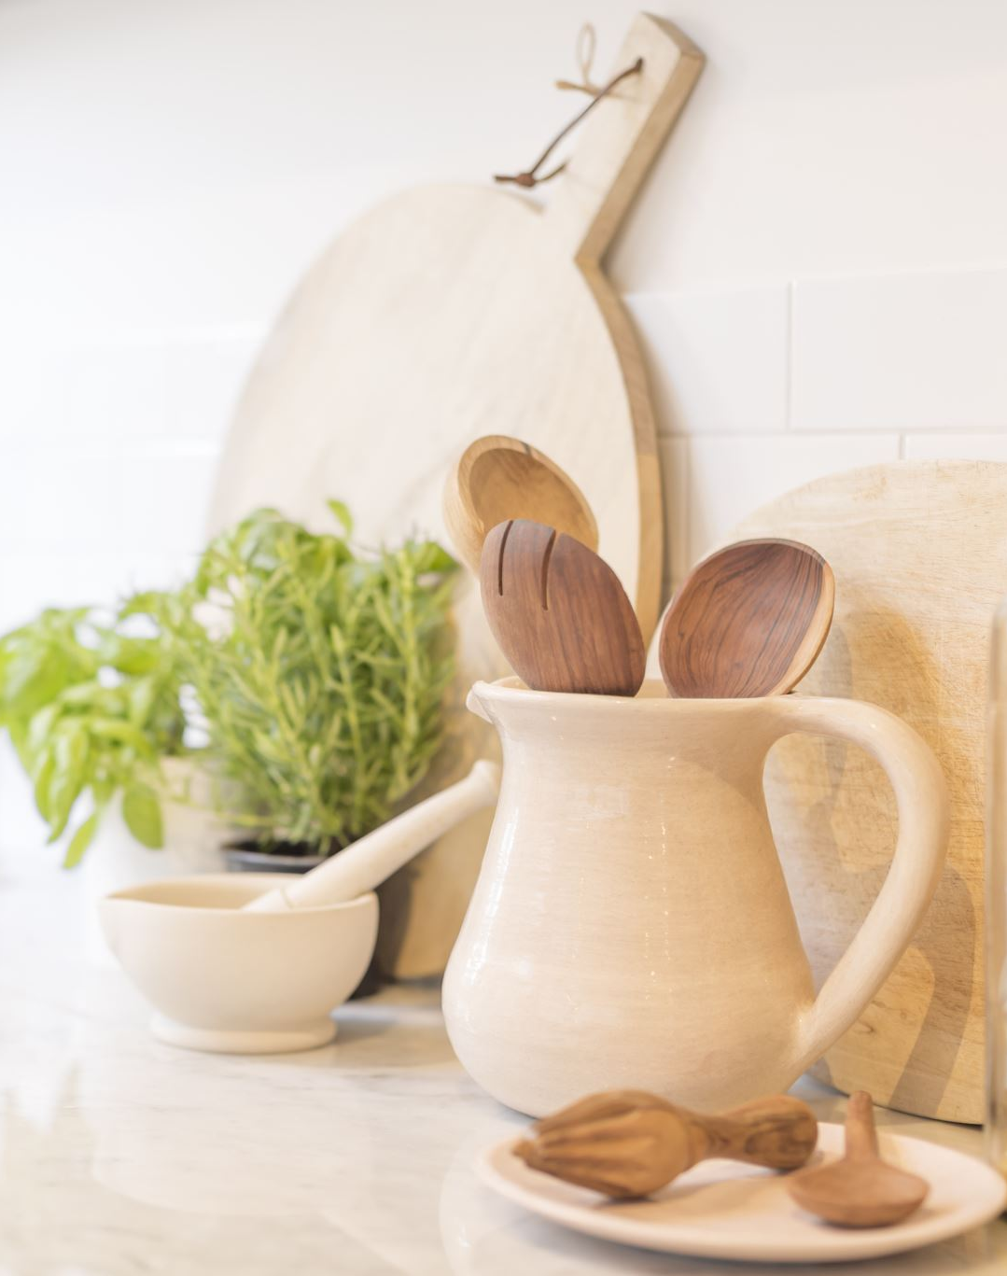
To make raisin Wine
In the Spring of the year when fruit is generally new, take three hundred w^{t}. of Smyrna raisins & about 5 gallons of the Softest water put them into a Tub to soak about 18 or 20 days stirring the fruit twice a Day, then draw off the Liquor & squeeze the raisins in a Cyder press or otherwise & add the Liquor thus press’d out so that which was drawn off and fill a Hogshead therewith. What remains will serve to keep your Hogshead filld up what remains which must time to time be carefully observed, as a great deal will evaporate. Let it remain in the cask six months, at first covering the Bung-hole with a flat tile for some days while the liquor ferments much & afterwards put in the bung and loose the vent Pig as you see occasion. Then <...>k it about into another cask and at the end of three months fine it & bottle off. In about a twelvemonth twill be fitt to drink.

