Slide 1
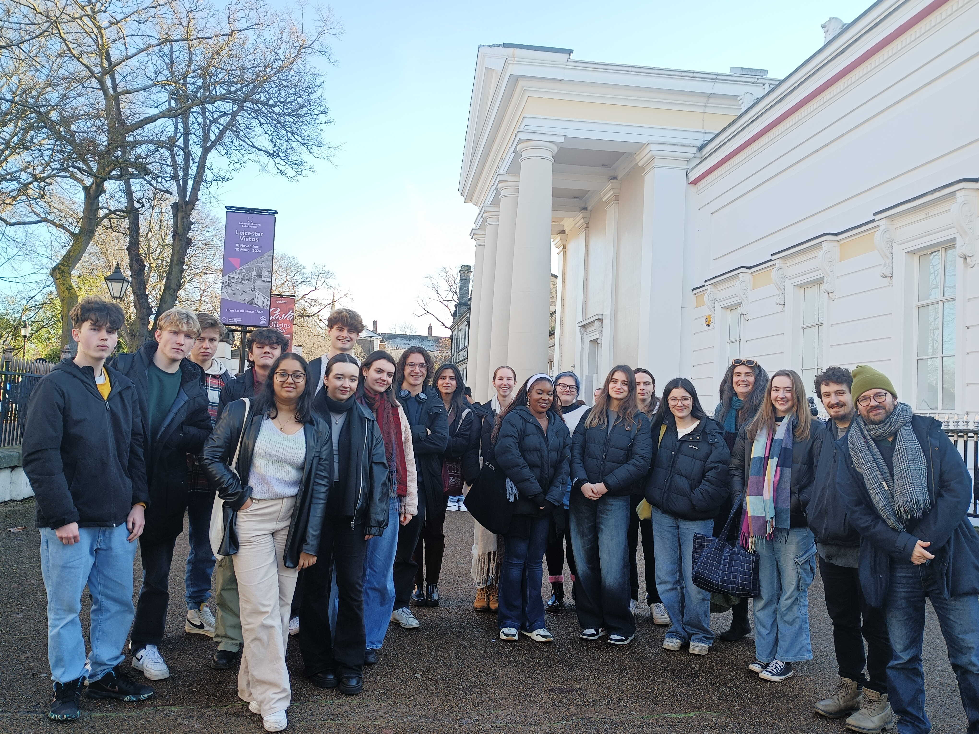
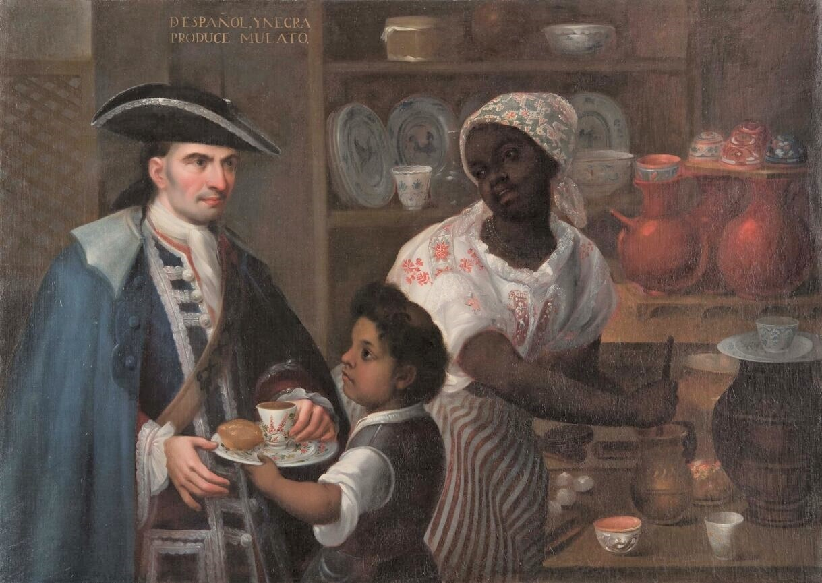
Casta: The Origins of Caste
Leicester Museum and Gallery
29 November 2023

Slide 2
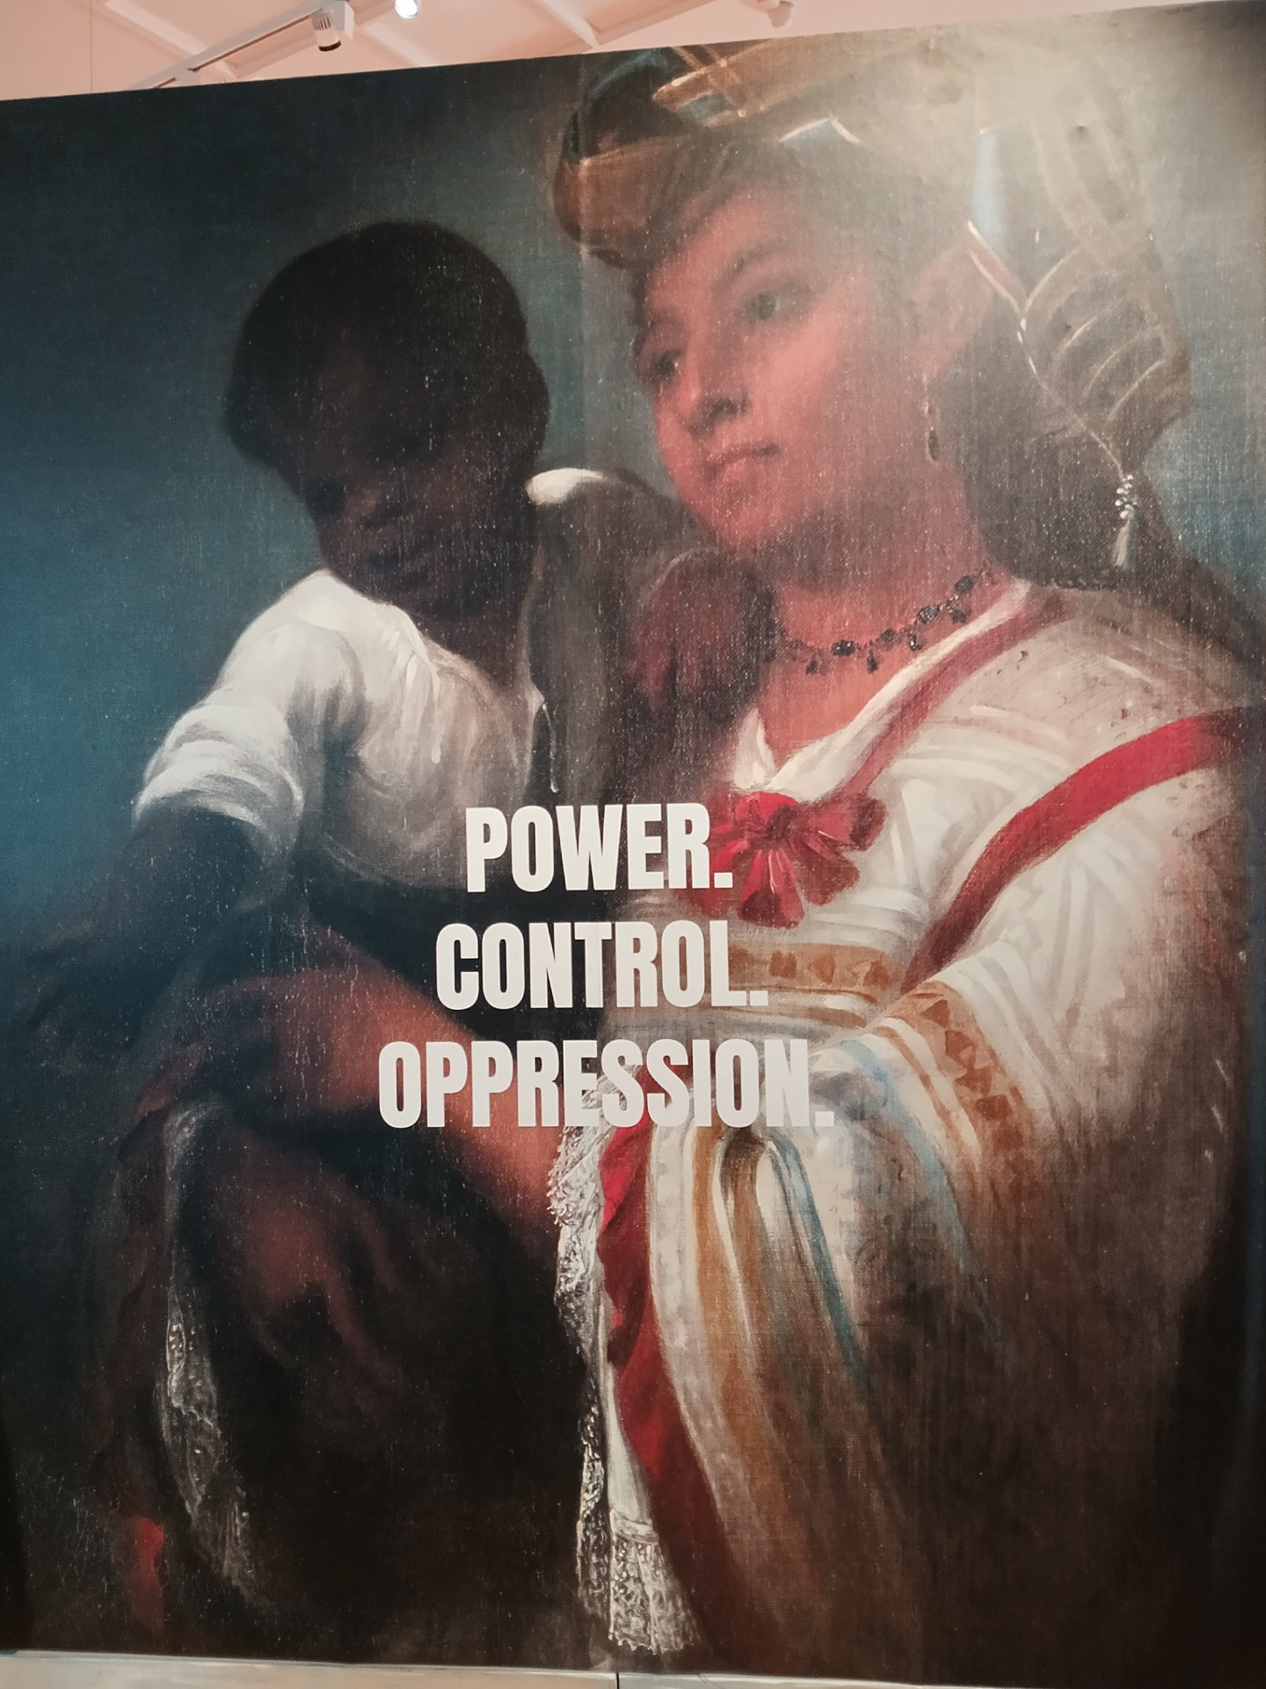
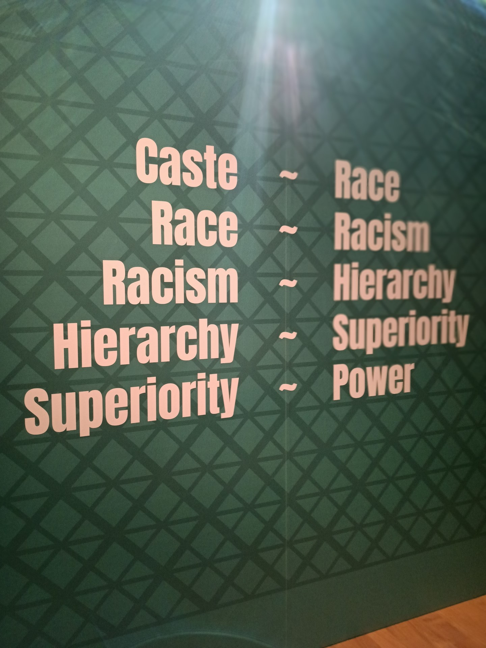

Slide 3
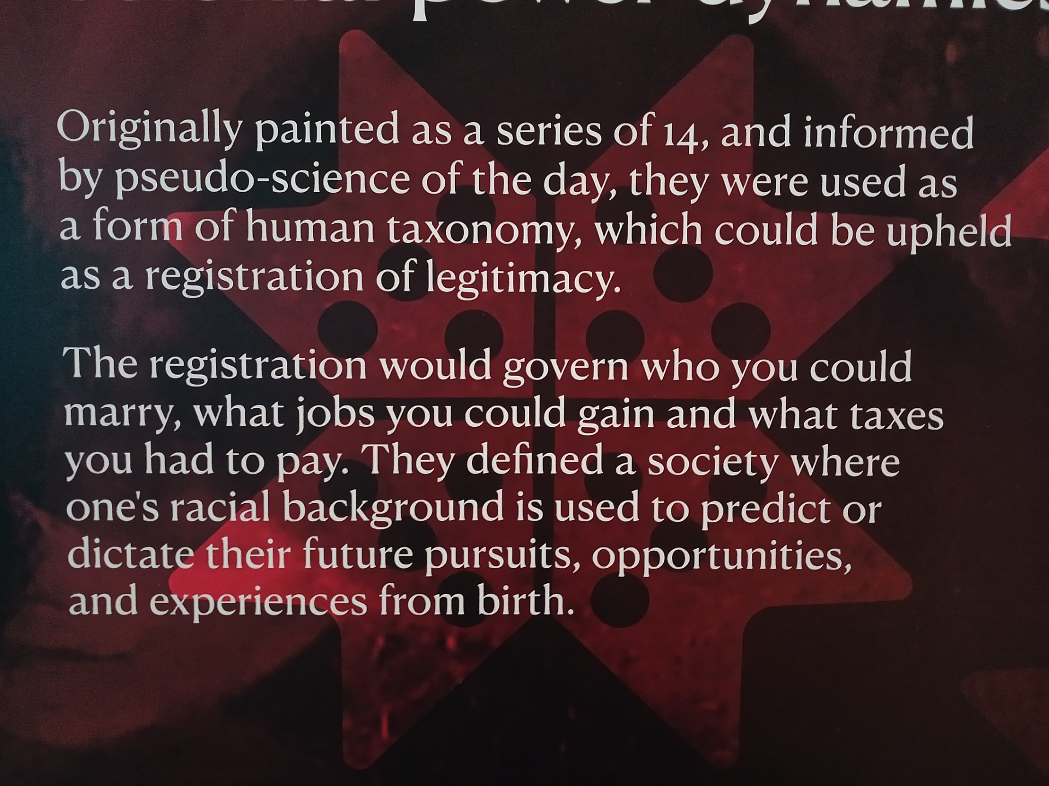

Slide 4
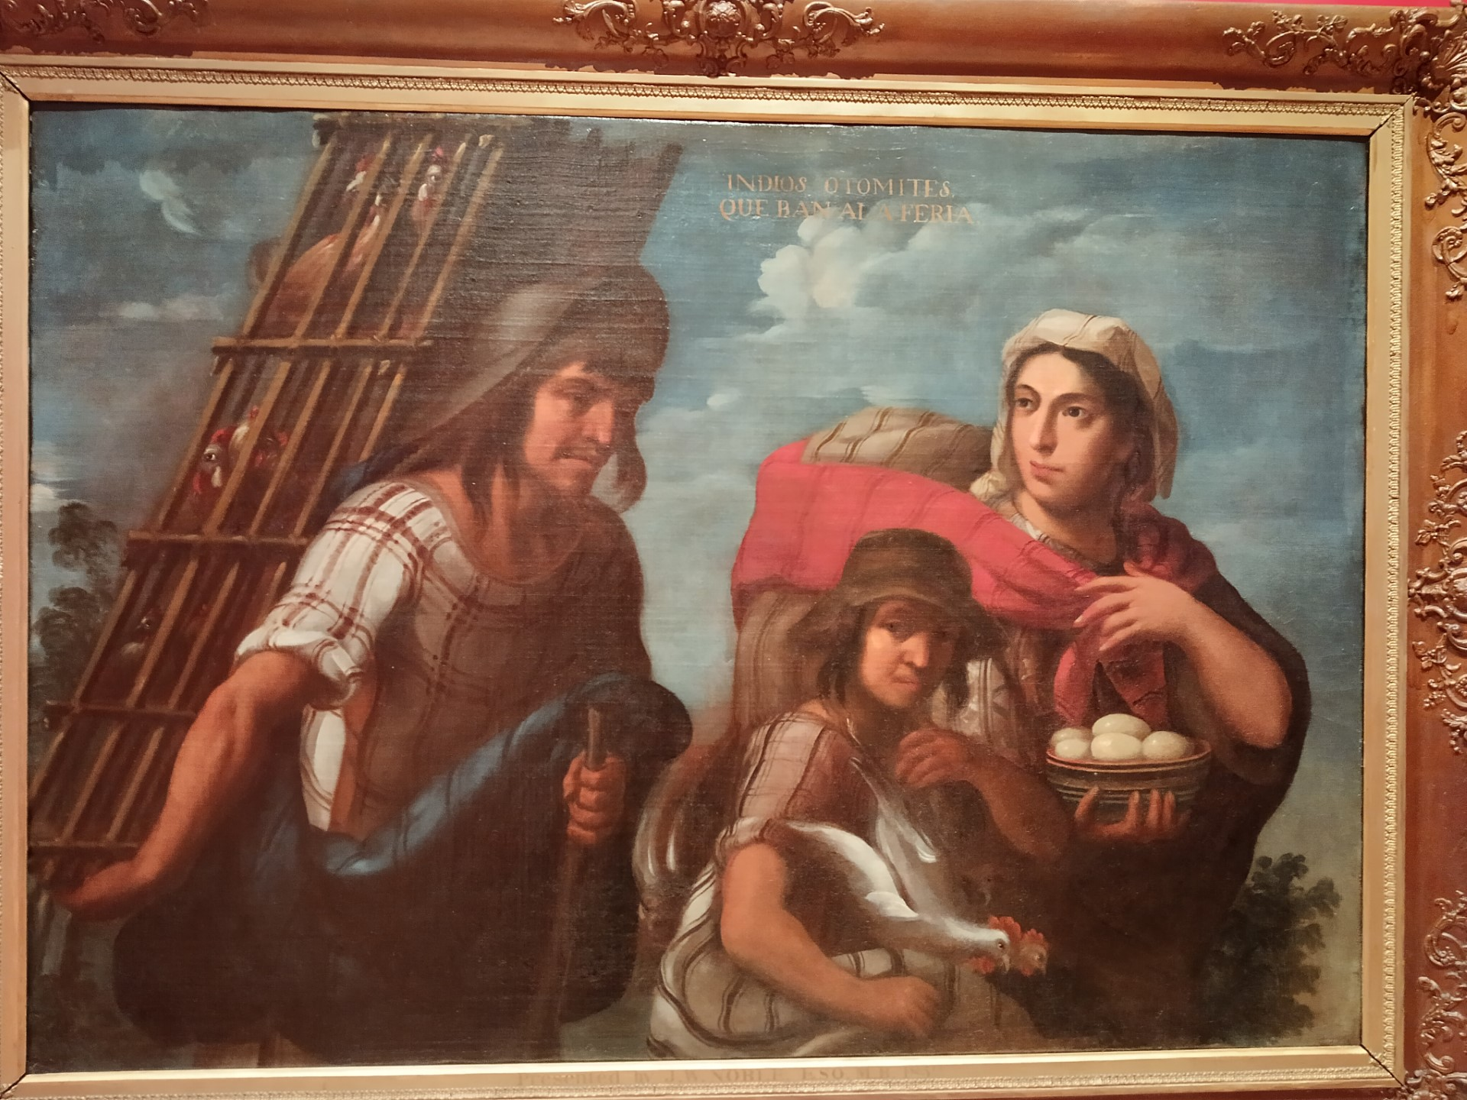
Indios Otomies que ban a la feria. (Otomi Indians going to the fair). 1715, Circle of Juan Rodríguez Juárez

Slide 5
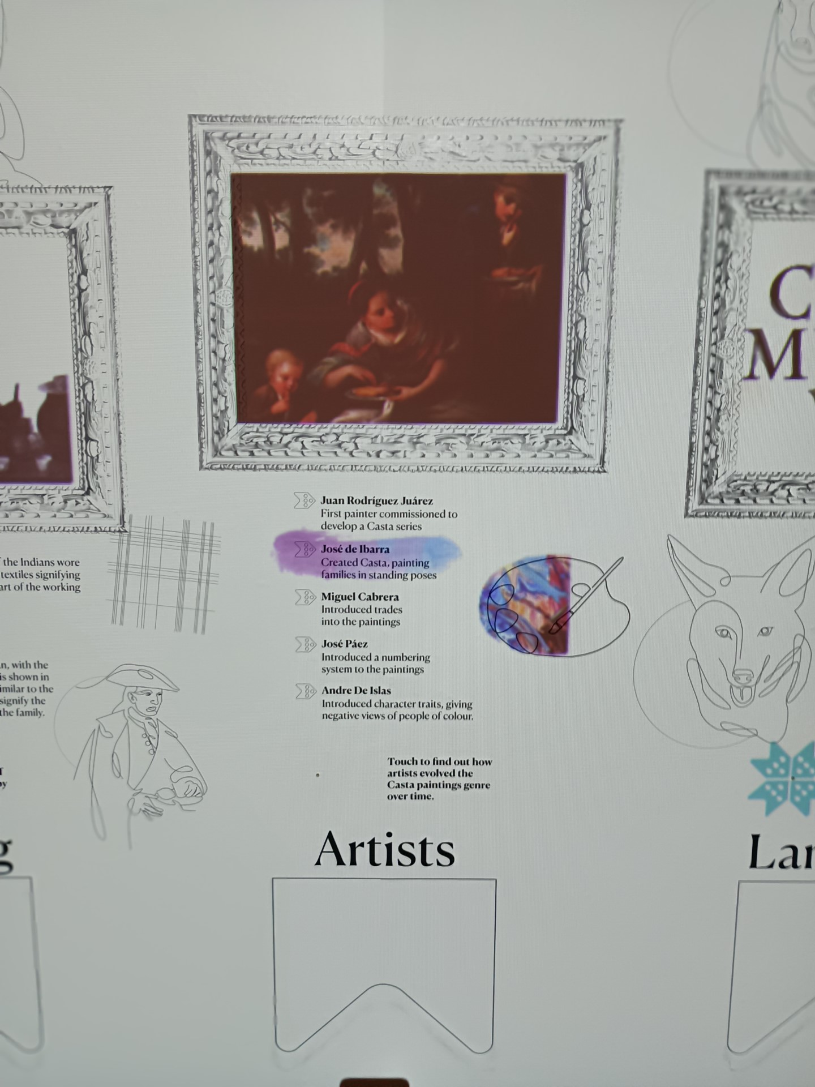
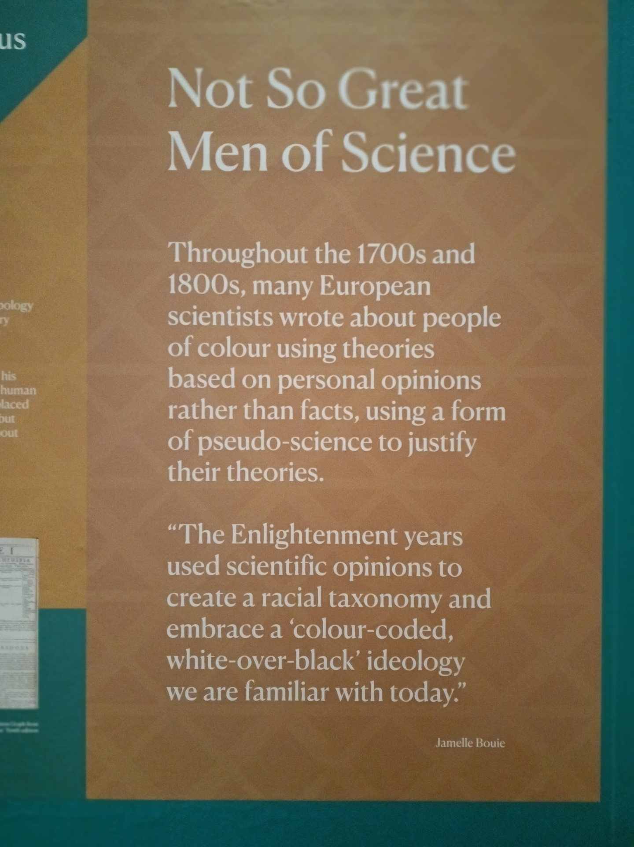

Slide 6
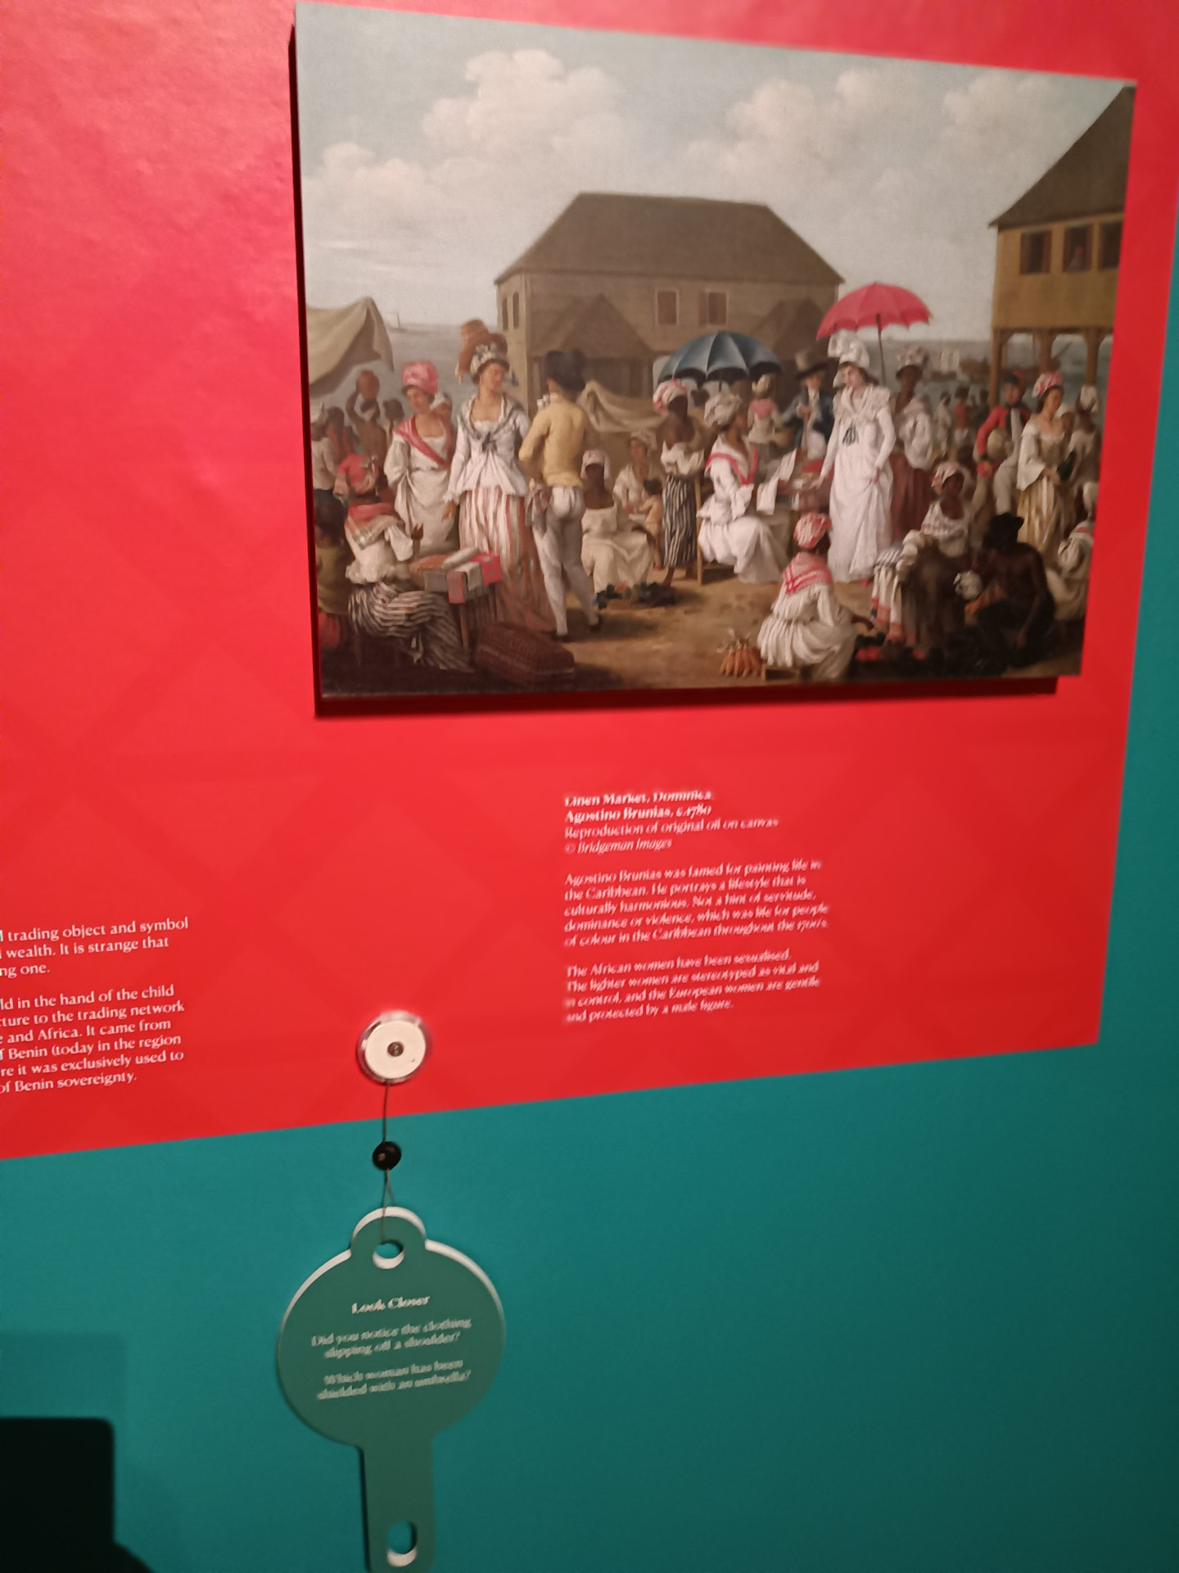
British art from a similar period
Interactive display

Slide 7
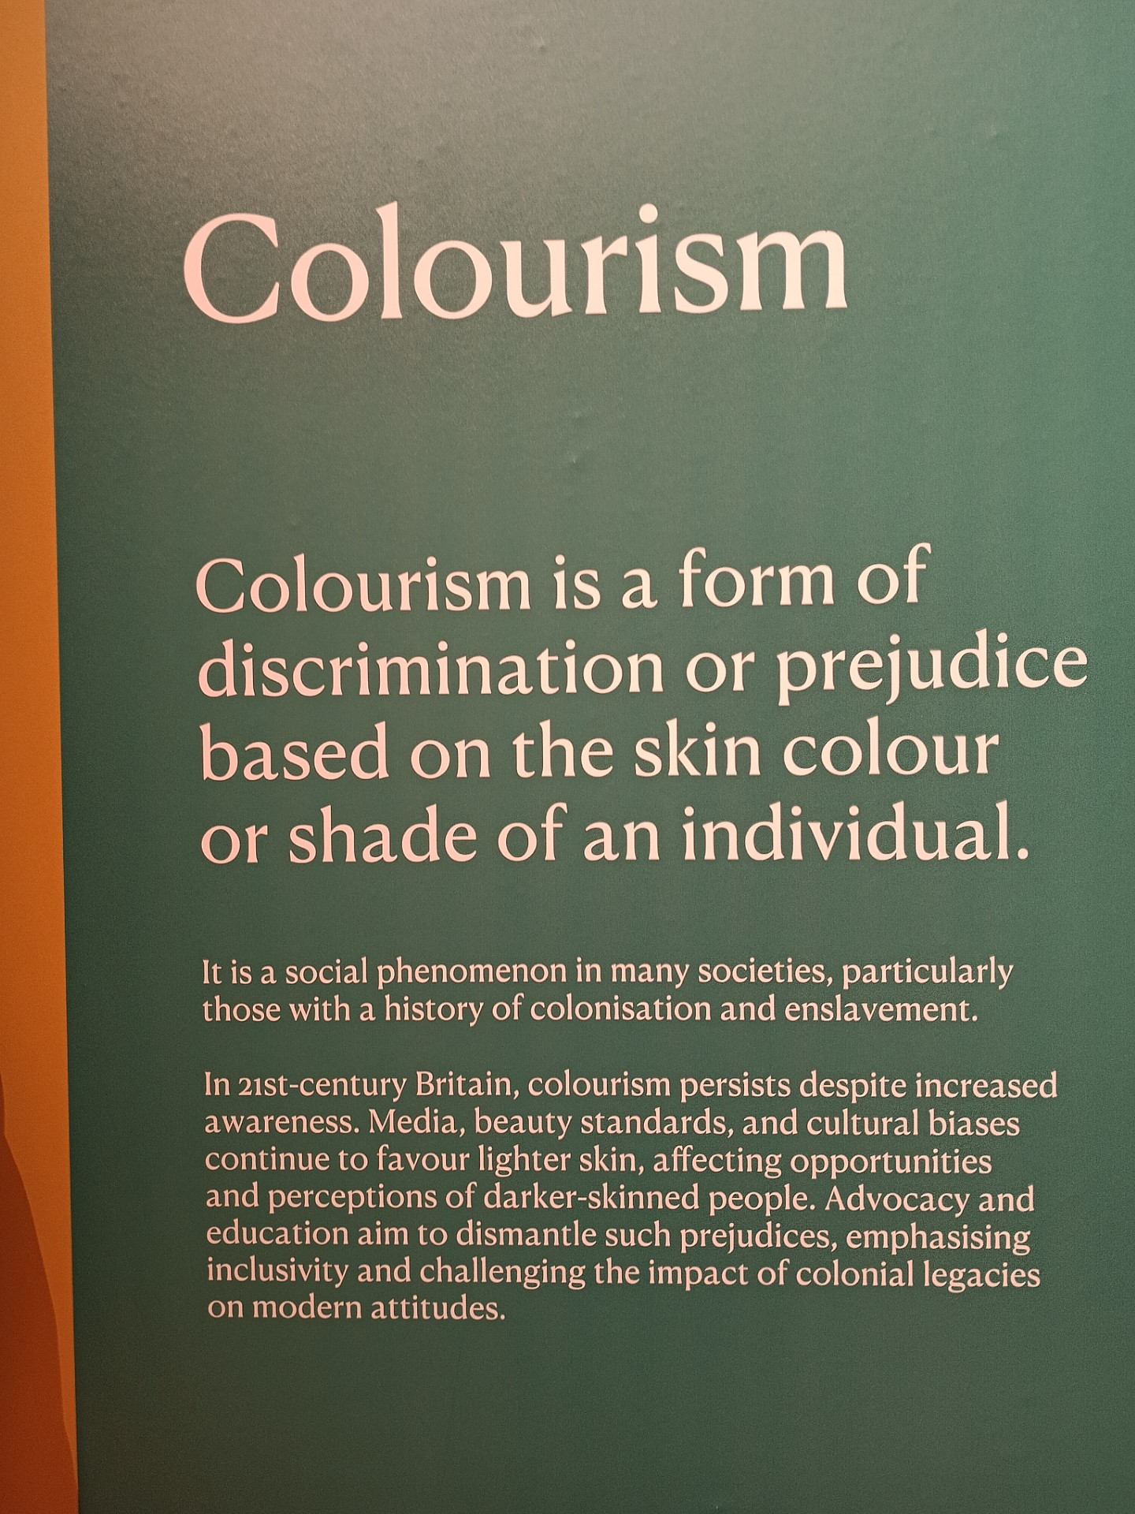

Slide 8
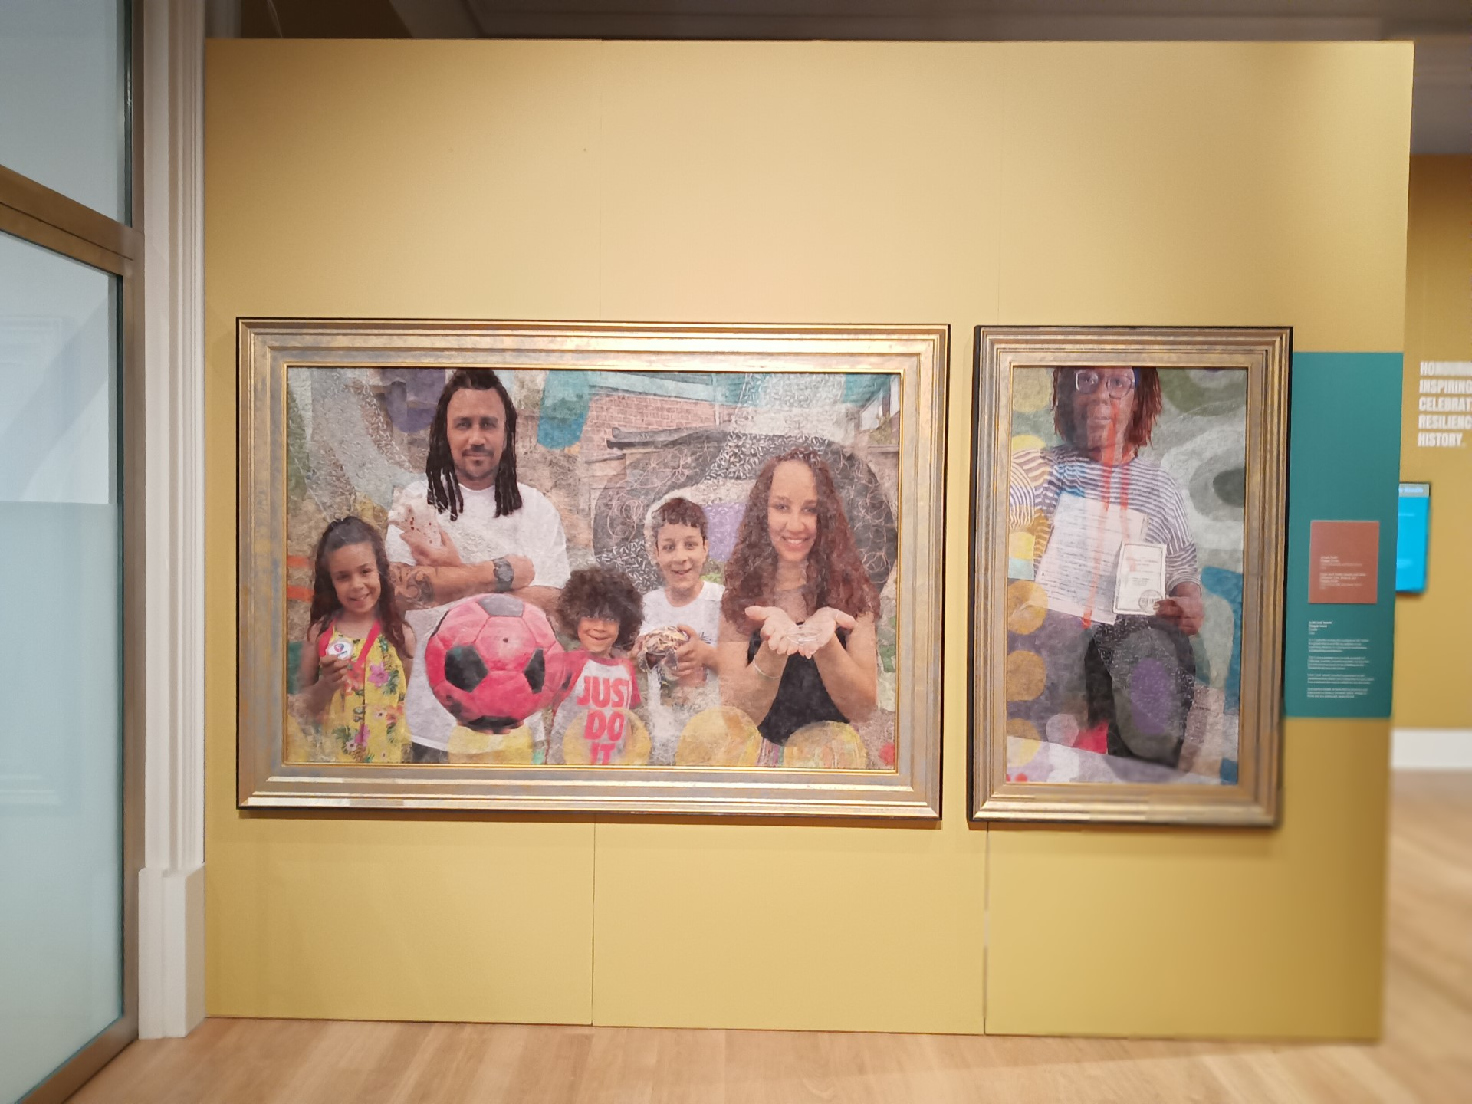

Slide 9
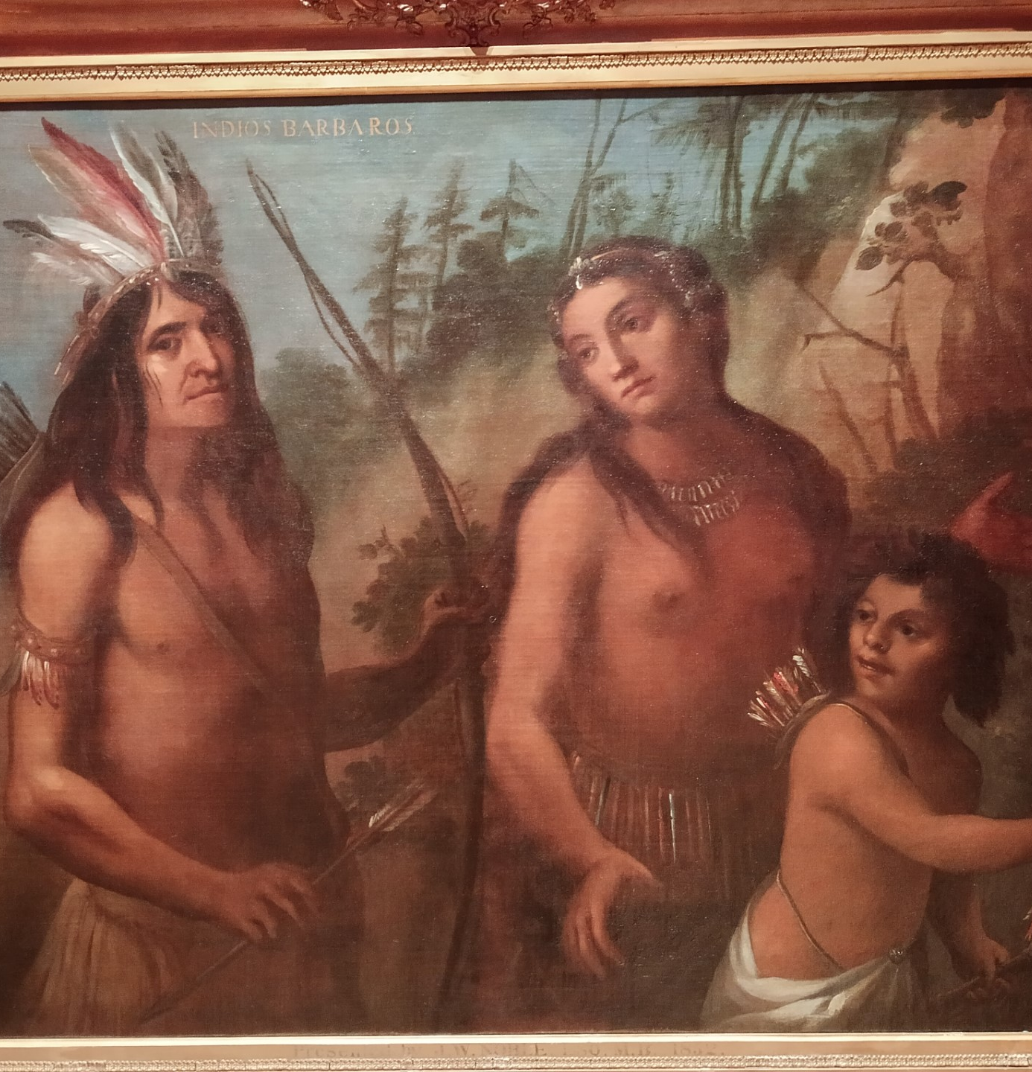
Curating an exhibition
What did you like about the way the Leicester Museum and Gallery, Casta: The Origin of Caste was curated?
What might you do differently?
https://www.leicestermuseums.org/CastaOriginsOfCaste

