Slide 1
AM101: Latin American Themes and Problems
Week 4: The Conquest of the Mainland

Slide 2
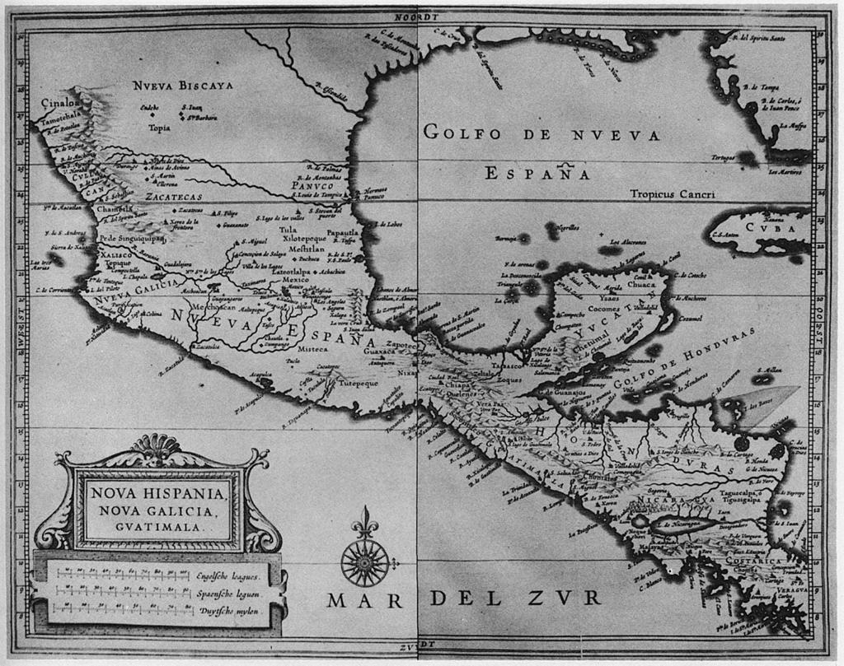

Slide 3
HernAn Cortés and the Conquest of the Aztec Empire

Slide 4
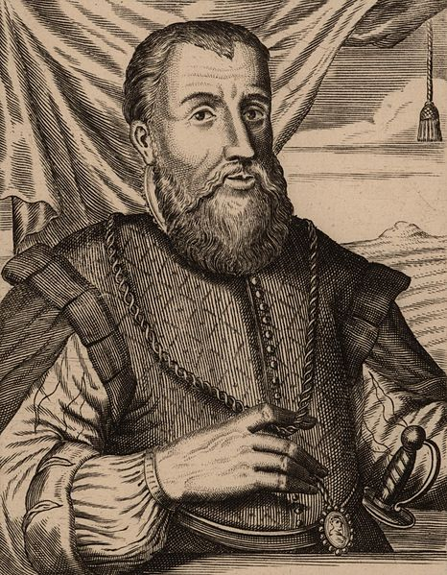
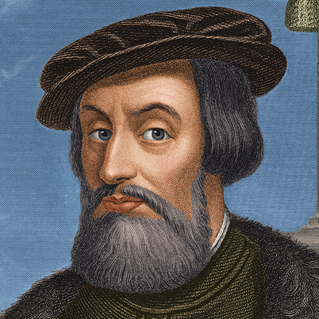
Hernán Cortés
Governor Diego Velázquez

Slide 5
1518 Velazquez agrees to send a third expedition to the mainland, led by Hernãn Cortés to initiate trade relations with coastal tribes
Early 1519 Velazquez suspects that Cortés will use expedition in order to conquer mainland. Orders alternative leader to replace Cortés.
Eventually lets him go, with an expedition which comprised 630 men (including around 200 Africans and Cuban Arawak Indians)

Slide 7
First stop: Yucatán
Here he captures a key to the Conquest, a Toltec or Tabascan noblewoman called “Malintzin” or La Malinche
He also meets Gerónimo de Aguilar, a Spaniard living in Yucatan after a previous expedition.
This gives Cortes an enormous advantage – translation.

Slide 8
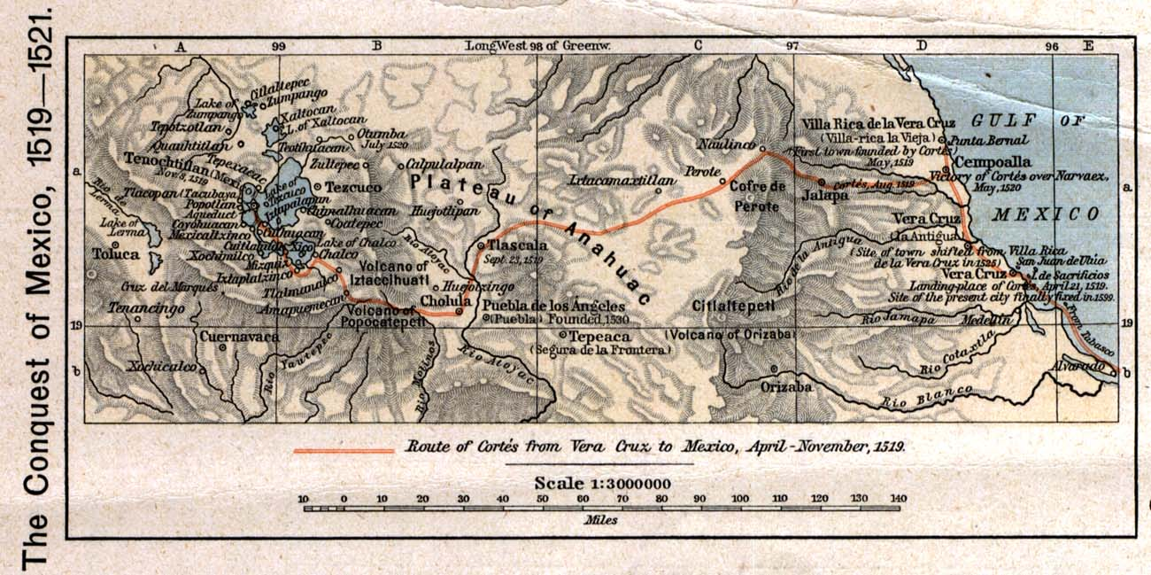
Cortés’s route through Mexico

Slide 9
Second stop: Veracruz
Persuades the Totonac chief, Chicomecoatl to rebel against the Aztecs. This is the first of many opposition groups that would ally with Cortés
Founds a Spanish town called La Villa Rica de la Vera Cruz. His men vote him in as “adelantado”, which effectively frees him from Velasquez’s control

Slide 10
Third stop: Tlaxcala
Here he is welcomed by large indigenous group, the Tlaxcalans, who are keen to ally with the Spaniards against the Aztecs (due to cost of over a century of Flower Wars and threat of conquest)
Fourth stop: Cholula
Massacre of Cholula. Moctezuma, Aztec leader planned to murder Spanish soldiers and their allies in Cholula. La Malinche discovers plot and instead Spanish murder Cholula nobles.

Slide 11
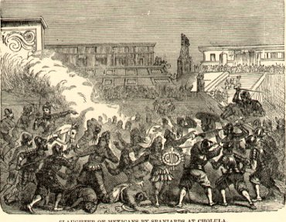
The Massacre of Cholula

Slide 12
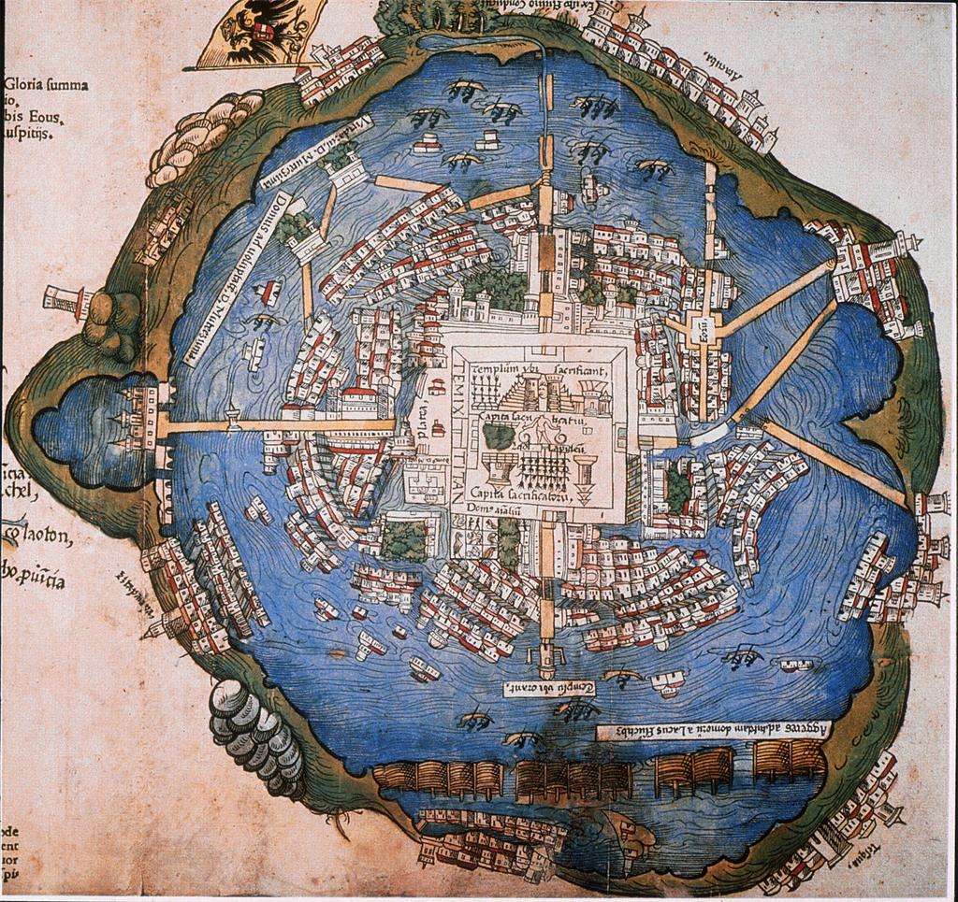
Map of Tenochtitlán in 1519

Slide 13
Fifth stop: Tenochtitlan
Cortes is welcomed by Moctezuma
Cortes takes Moctezuma prisoner
Cortes returns to Veracruz and defeats Pánfilo de Narváez
Cortes returns to Tenochtitlan to find that tensions are high.
(His second in command had murdered many Aztec nobles)
Cortes again hears of imminent attack and preempts this by
murdering Aztec warriors in Main Temple. Moctezuma is killed
during the skirmishes
Cortes and Spanish retreat, losing treasure, allies and horses (La Noche triste)

Slide 14
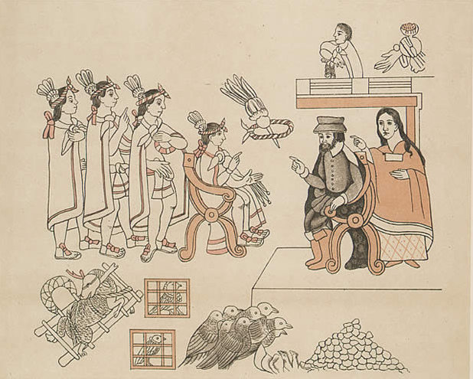
Hernán Cortés meets Moctezuma. Source: Lienzo de Tlaxcala

Slide 15
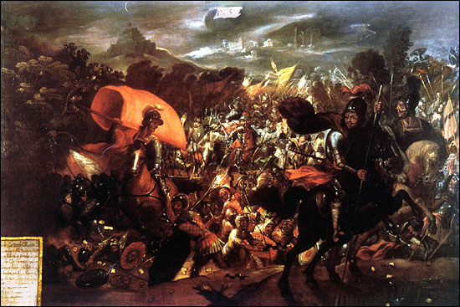
La Noche Triste

Slide 16
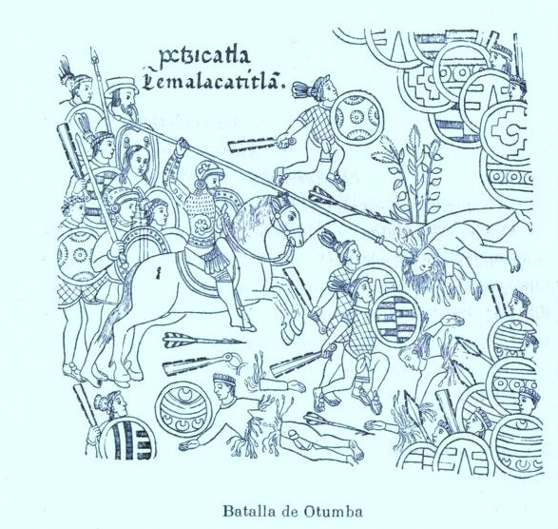
Refuge in Tlaxcala

Slide 17
Conquest of Tenochtitlan
Tlaxcalans and Spanish team up to conquer Aztec capital
Build brigantines
Cut off supplies from mainland
Smallpox starts to affect city, killing Moctezuma’s successor, Cuitláhuac
13 August 1521, Aztecs and Tlaxcalans conquer Tenochtitlan

Slide 18
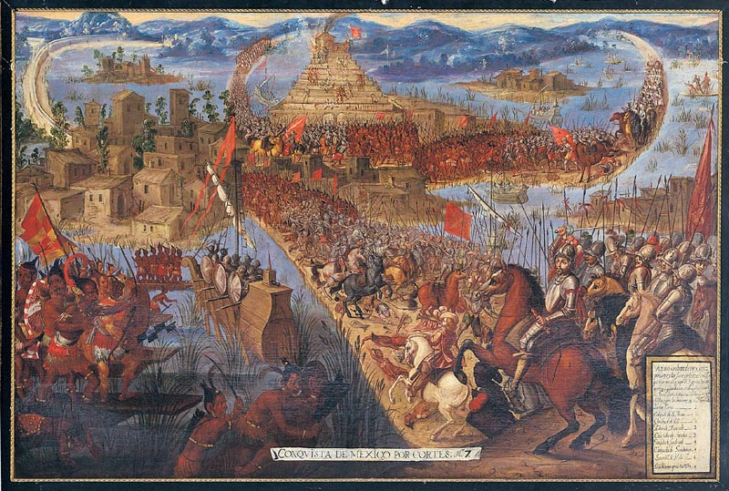

Slide 19
Francisco Pizarro and the Conquest of the Inca Empire

Slide 20
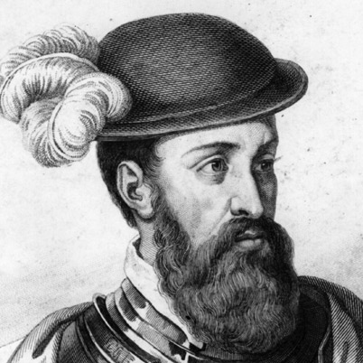
Francisco Pizarro

Slide 21
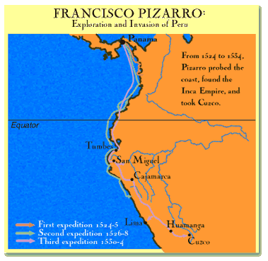

Slide 22
1526-29 Pizarro makes first contact with Inca Empire
1528 Inca Emperor, Huayna Capac dies of smallpox
Inca Empire splits between two rival kings, Huáscar and Atahualpa.
1531 Pizarro returns with permission to conquer Inca empire. He has 106 infantry
and 62 cavalry
November 1532 meets Atahualpa at Cajamarca. Kills 2000 of Atahualpa’s followers
and captures Atahualpa.
1532-33 Ransoms Atahualpa for gold.
1533-1572 Incas rebel under Manco Inca and then Tupac Amaru. To punish the
Incas Spanish destroy all Cusco and build Spanish city over remains.

Slide 23
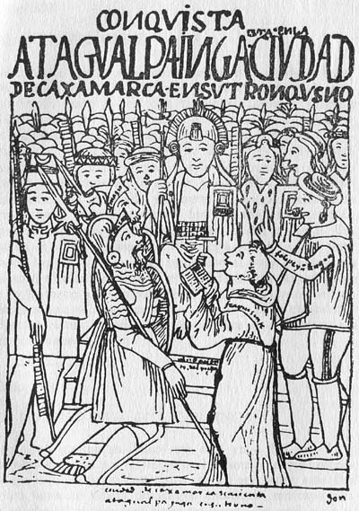
Atahualpa. Last Emperor of the Inca

Slide 24
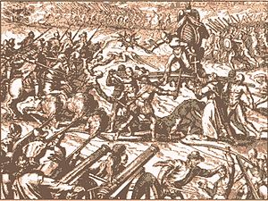

Slide 25
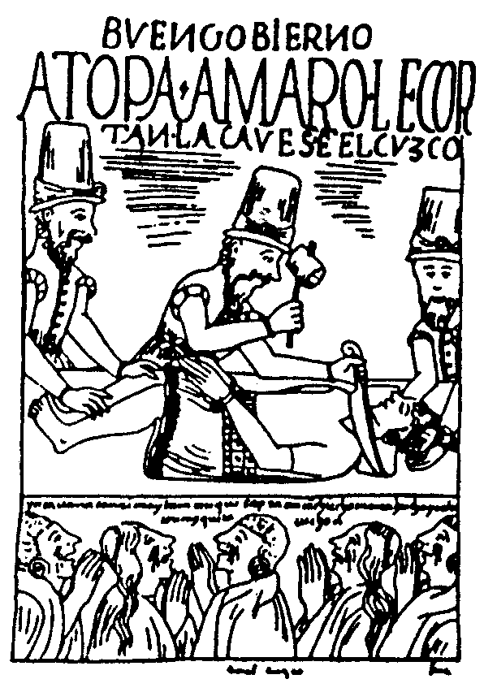
Death of Tupac Amaru

Slide 26
The conquest of the Mainland: Five explanations
‘How was it that a motley bunch of Spanish adventurers, never numbering much more than four hundred or so, was able to defeat an Amerindian military power on its home ground in the space of two years? What was it about Spaniards, or about Indians, that made so awesomely implausible a victory possible?’
(Inga Clendinnen, ‘“Fierce and
Unnatural Cruelty”’, 1991, p. 65)

Slide 27
Fortune, Myth and Religious Belief

Slide 28
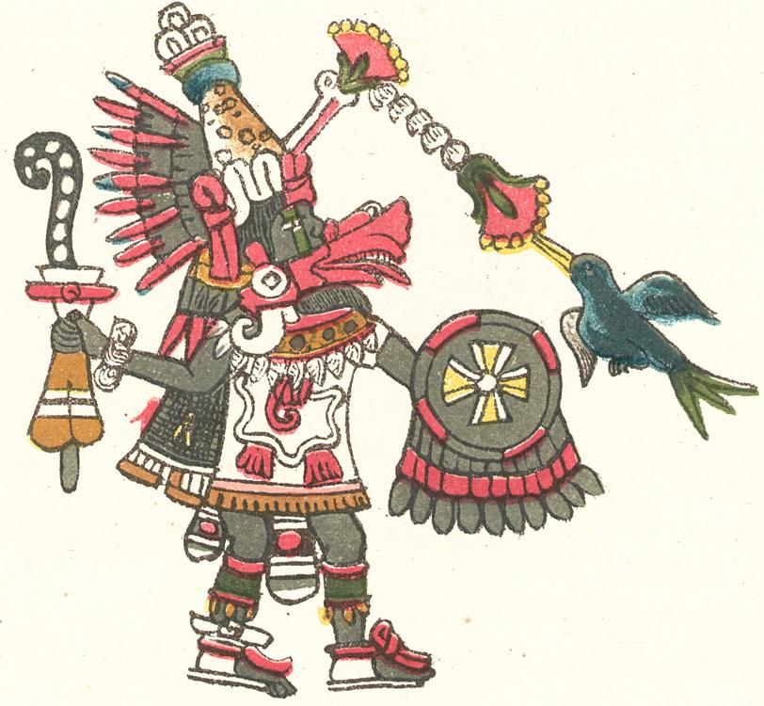
Quetzalcoatl – The Feathered Serpent

Slide 29
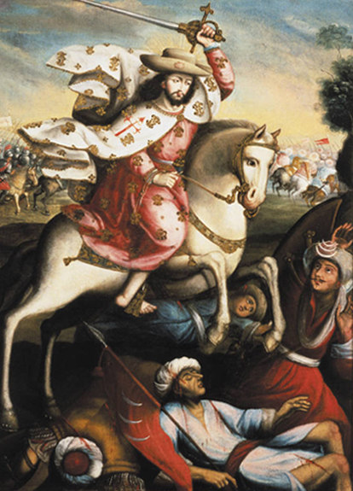
Santiago Matamoros – St James the Moor Slayer. Patron Saint of Spain

Slide 30
Military Technology

Slide 31
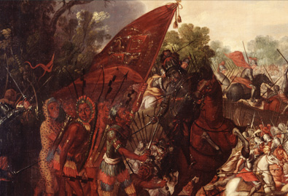
Use of horses in conquest of Tenochtitlán. Source: Library of Congress

Slide 32
Centralised Government

Slide 33
Social structure of Aztec empire

Slide 34
Internal resistance and Divisions

Slide 35
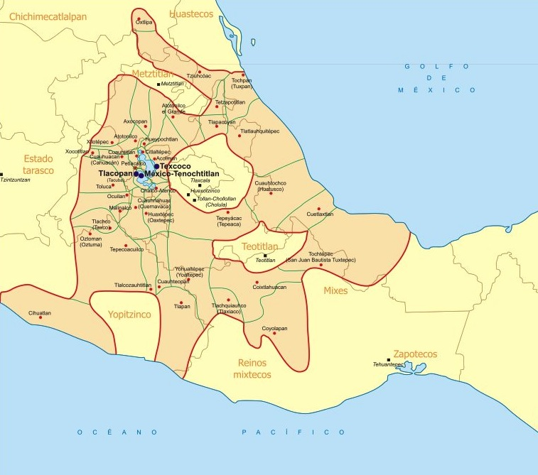
Atepetl (city-states) of the Aztec Empire

Slide 36
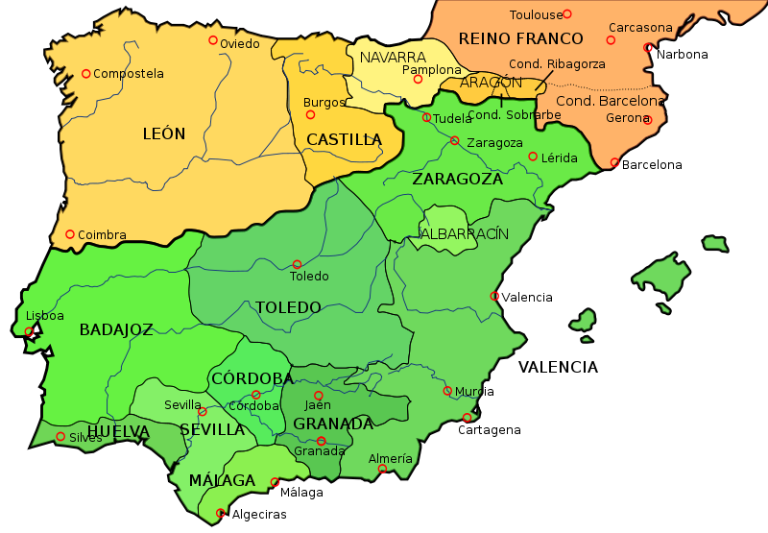
Spanish political divisions under Al-Andalus

Slide 37
Disease

Slide 38
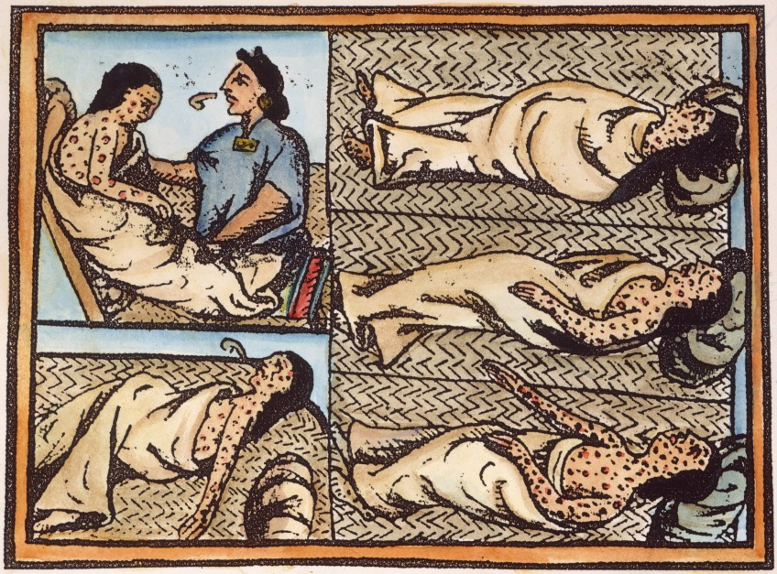
American victims of small pox. Source: Florentine Codex

